Slide 1

Reporting Outputs
London UK – Riyadh KSA - Basel Switzerland

Slide 2
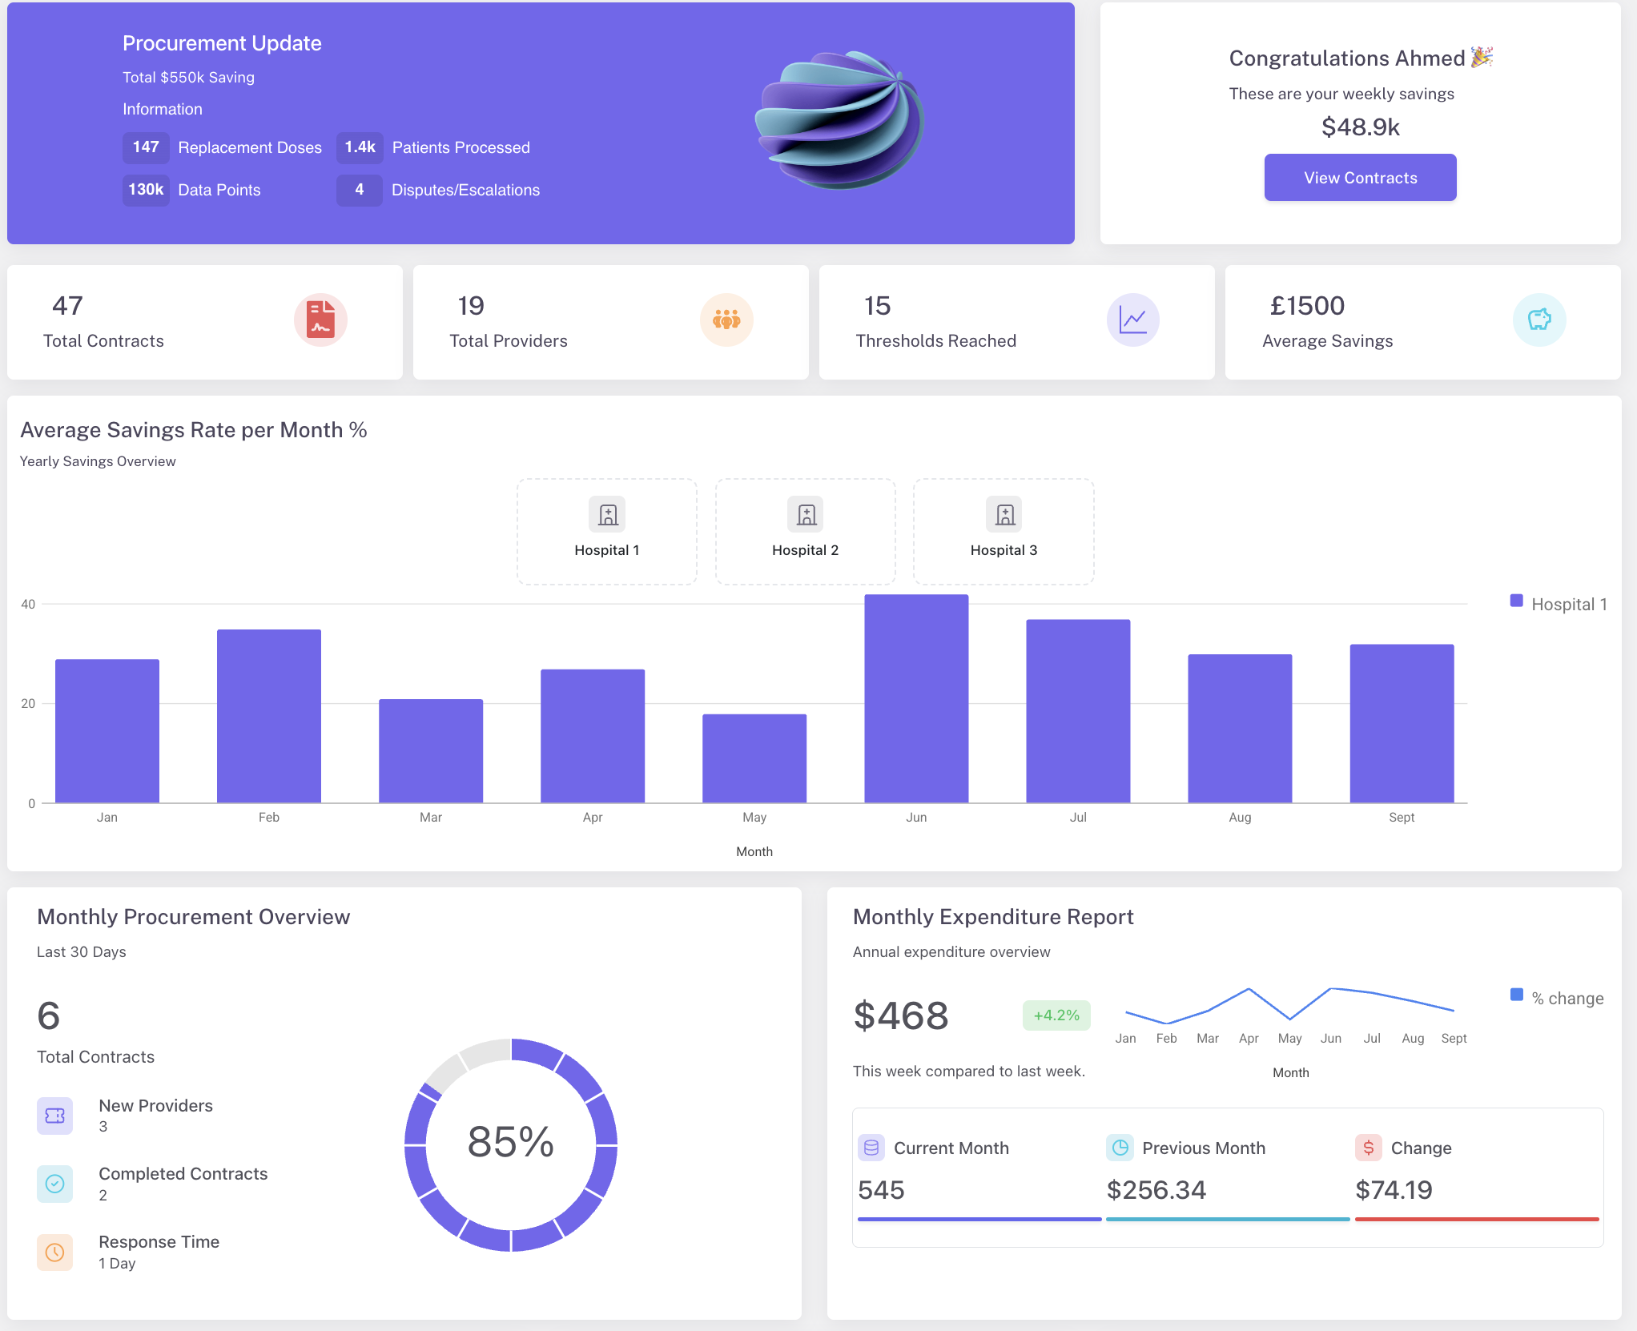
VBP Dashboard

Slide 3
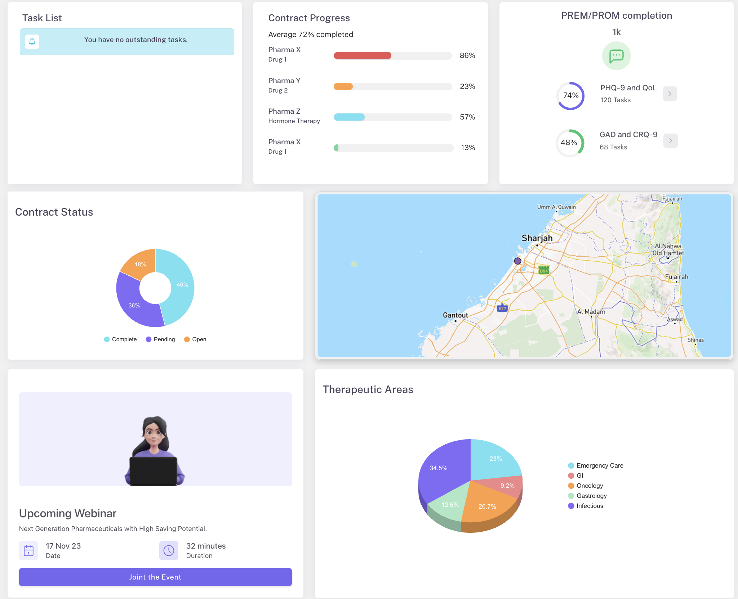
VBP Dashboard 2

Slide 4
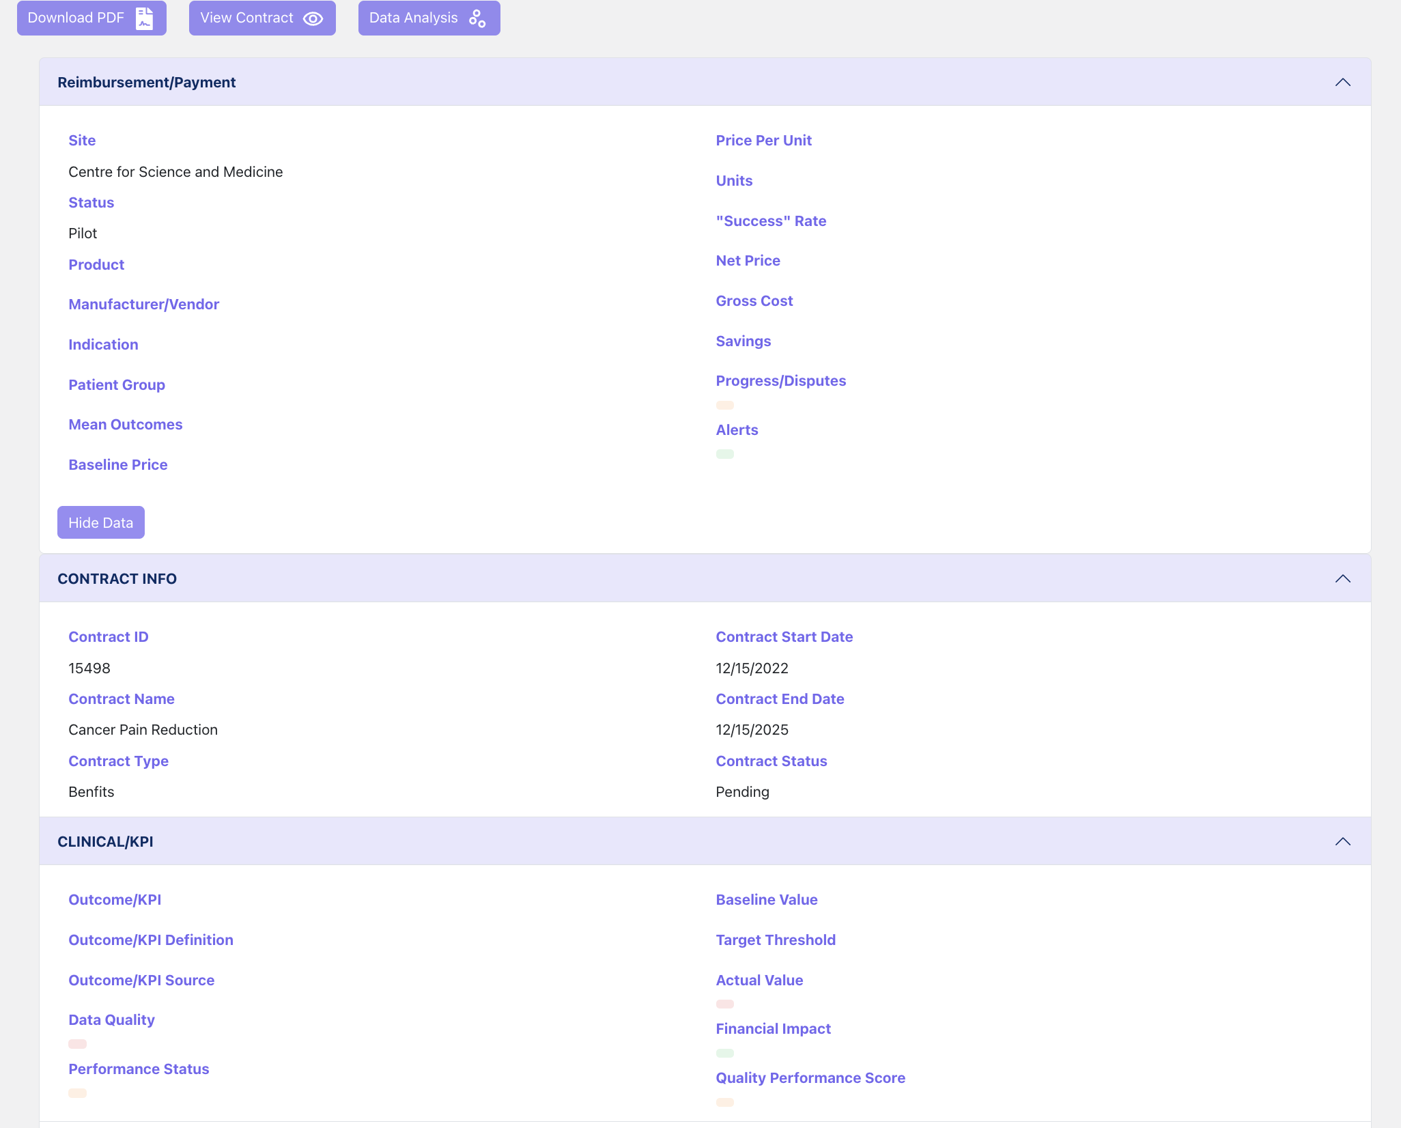
Contract Output

Slide 5
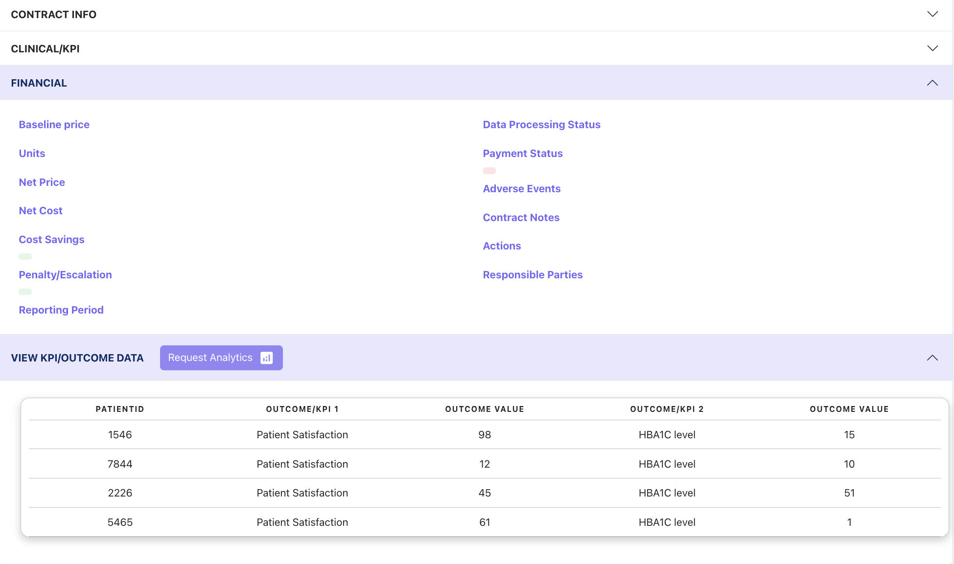
Contract Output 2

Slide 6
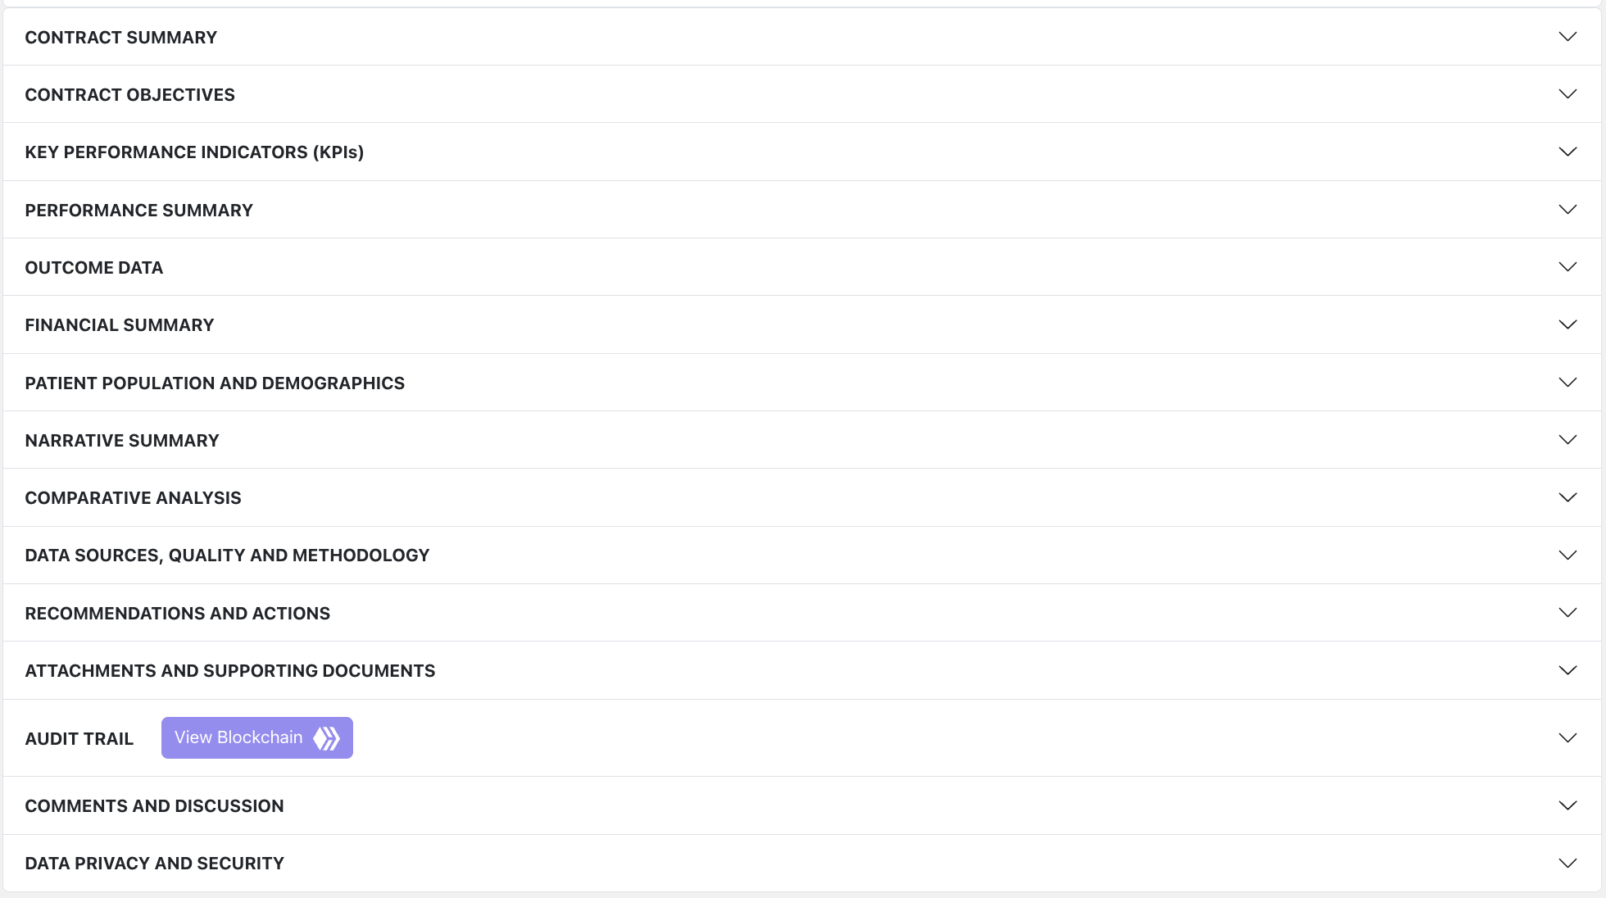
VBP Reporting

Slide 7
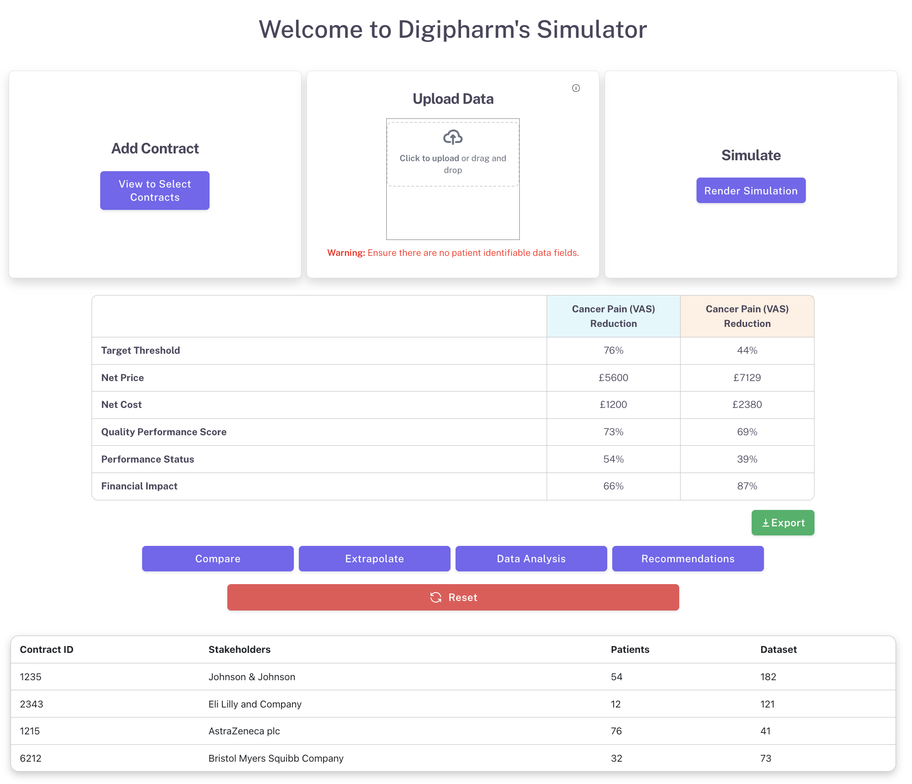
Contract Simulator

Slide 8
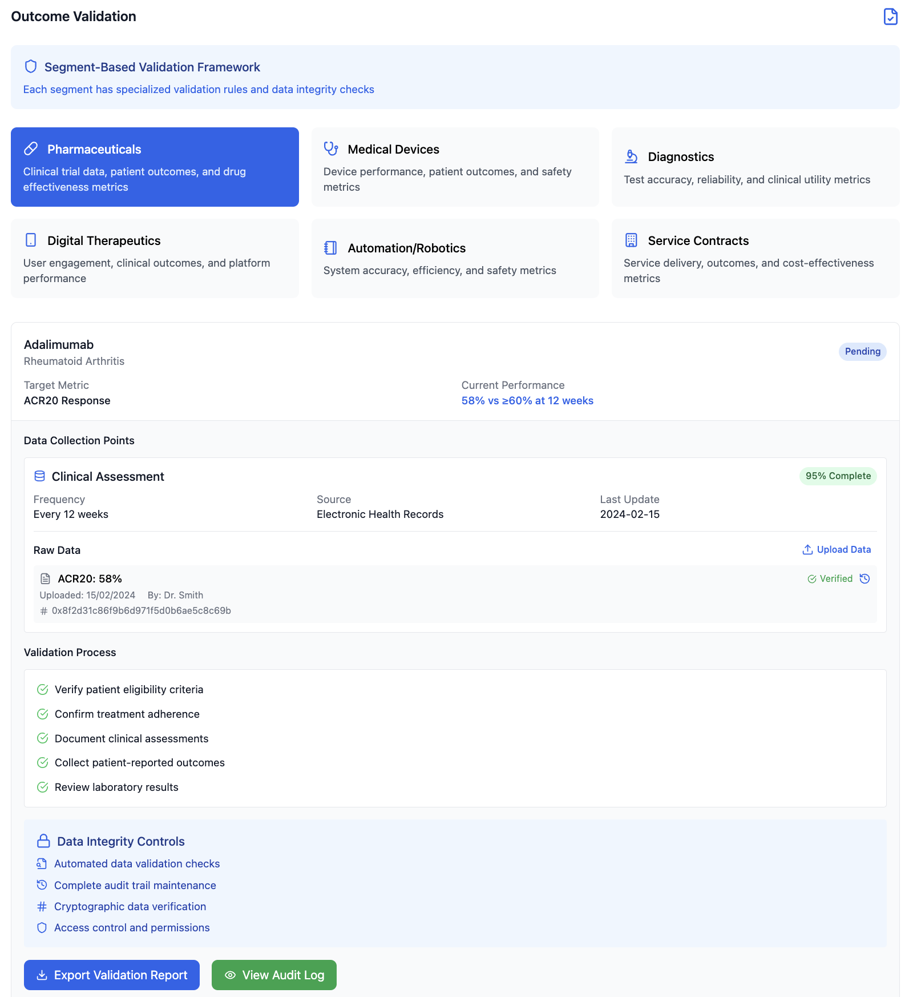
Outcome Validation

Slide 9
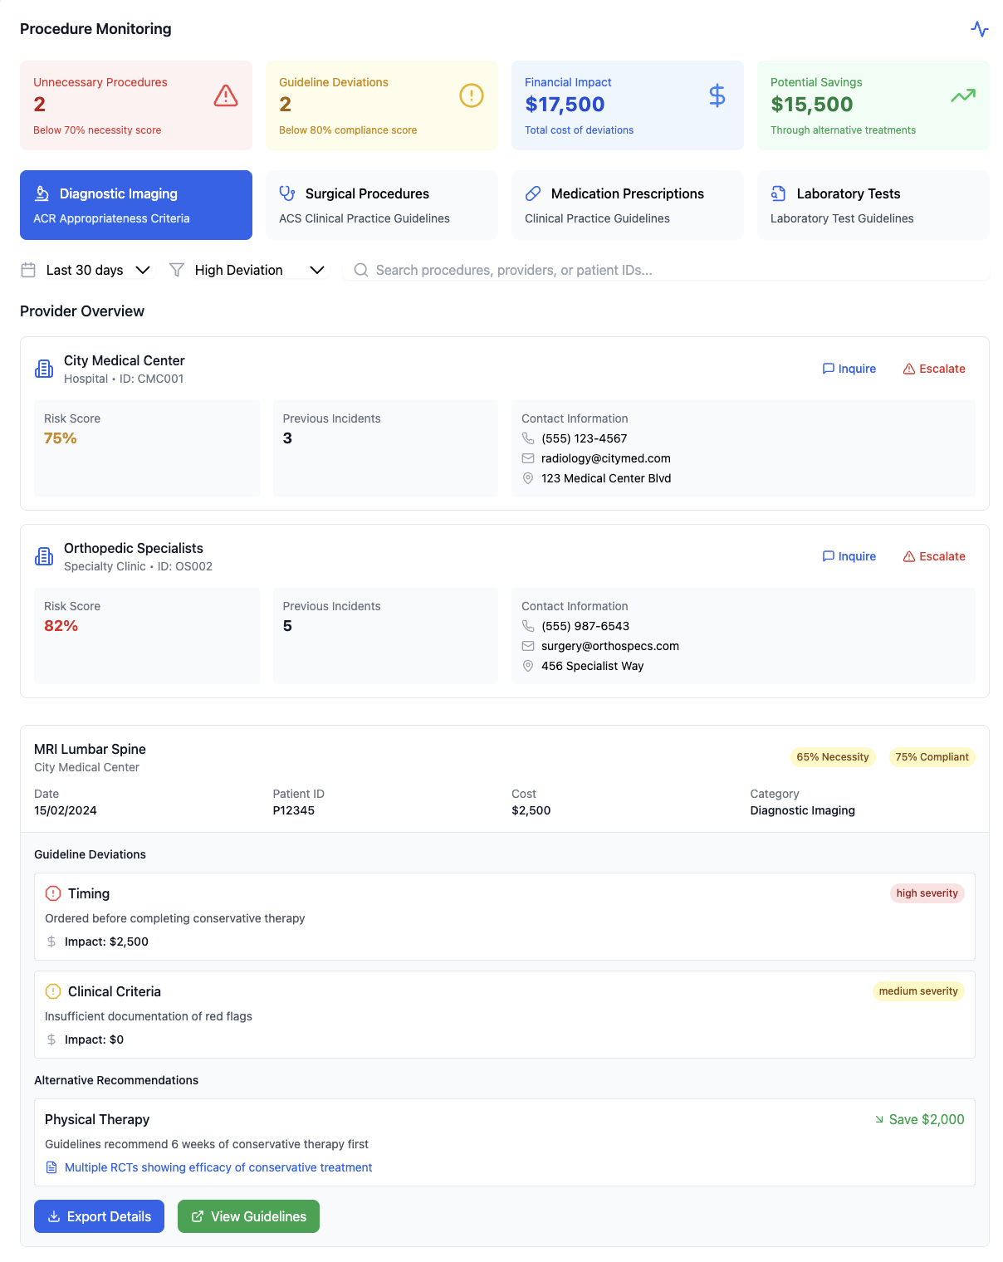
Procedure Monitoring

Slide 10
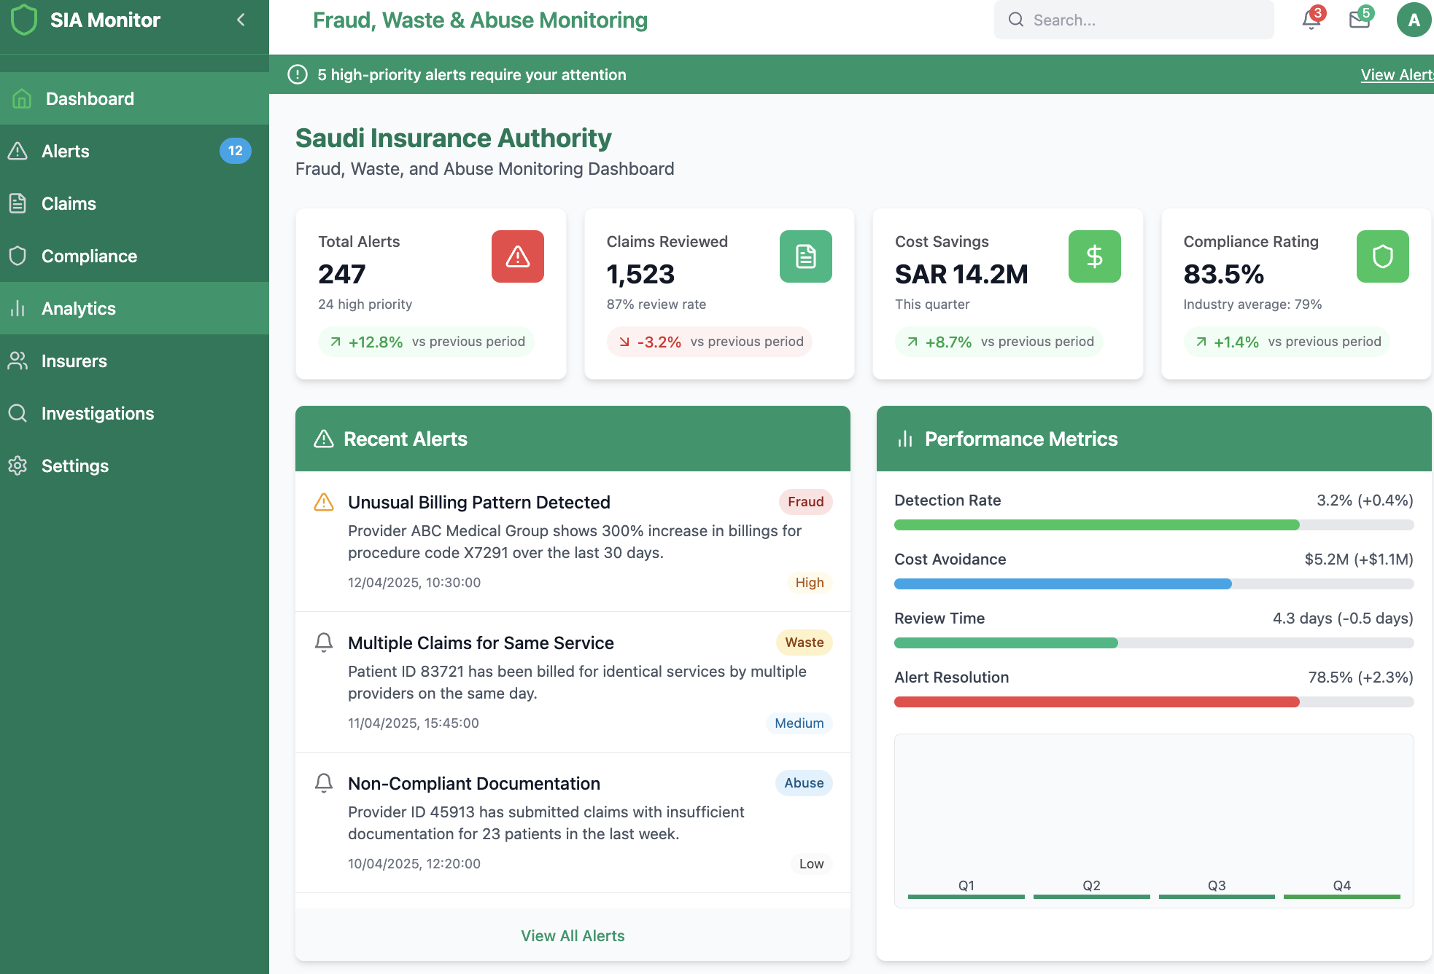
FWA Reporting Dashboard

Slide 11
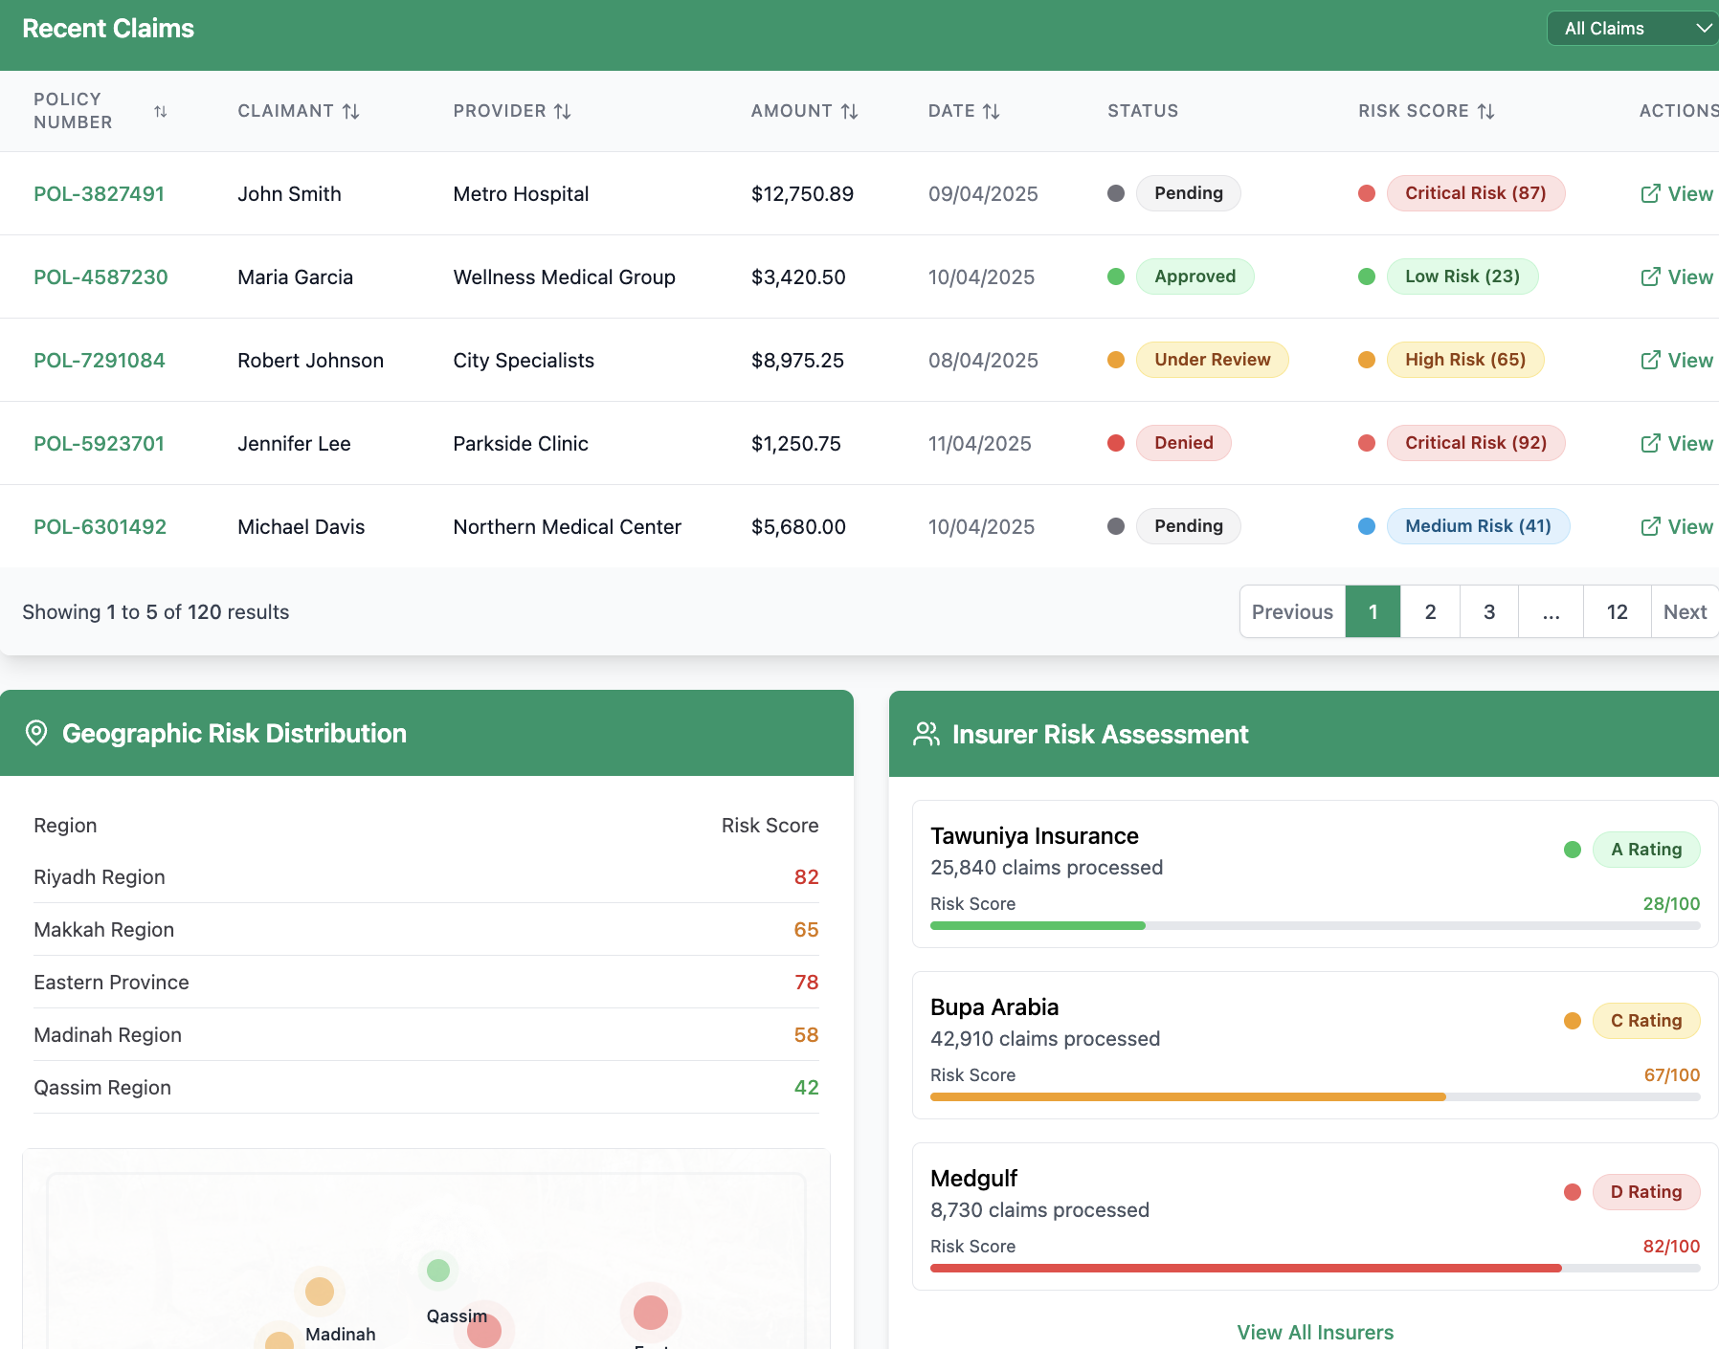
FWA Reporting Dashboard 2

Slide 12
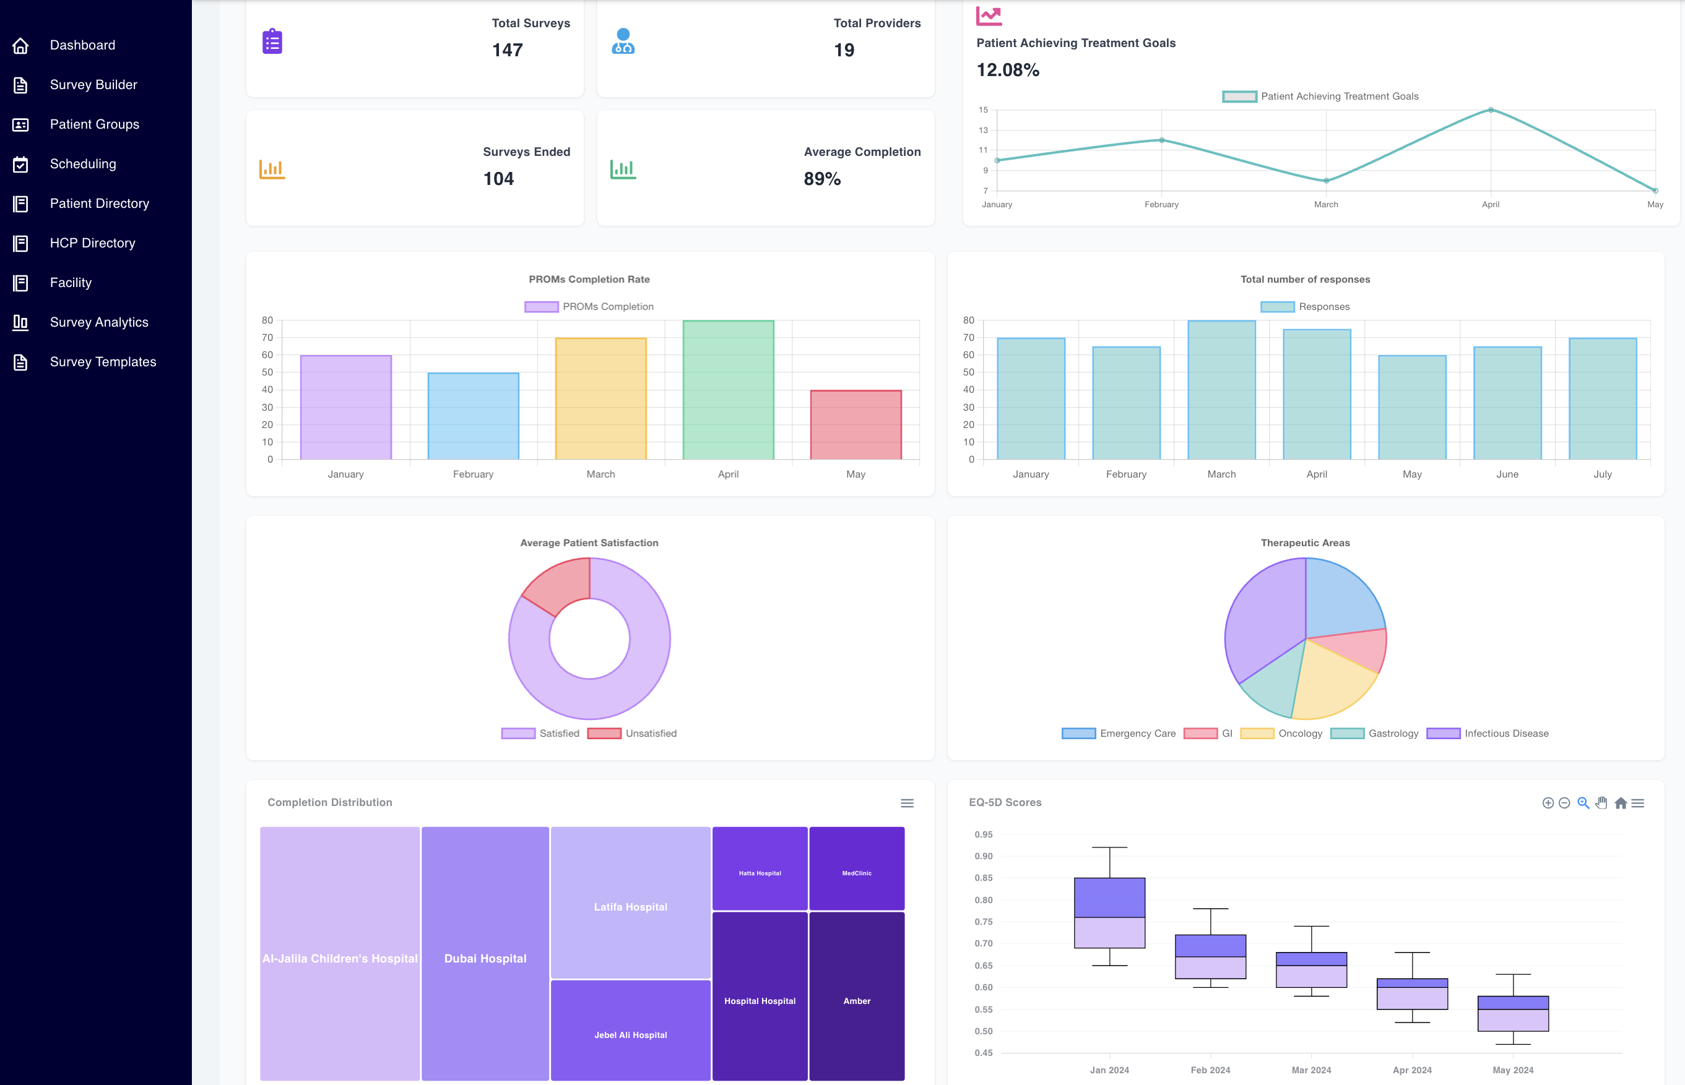
PROMs Dashboard

Slide 13
DISCLAIMER
The information in this document has been prepared solely for informational purposes and does not constitute an offer to sell or the solicitation of an offer to purchase any securities from any entities described herein. No representation or warranty can be given with respect to the accuracy or completeness of the information herein, or with respect to the terms of any future offer of securities conforming to the terms hereof.
This document is confidential and is intended solely for the information of the person to whom it has been delivered. It may not be reproduced or distributed, in whole or in part, by any means (including electronically), without the prior written consent of DigiPharm (the “Company”).
Nothing contained herein should be construed as tax, accounting or legal advice. Neither the Company nor any of its officers, directors, affiliates or representatives accept any responsibility for the tax treatment of any investment in the securities of the Company. You should consult your own legal, accounting, and tax advisers to determine the consequences of an investment in the Company and to make an independent evaluation of such investment. The information contained herein contains forward-looking statements. These forward-looking statements are based on the Company’s current expectations, beliefs, projections, future plans and strategies, anticipated events or trends and similar expressions concerning matters that are not historical facts, as well as a number of assumptions concerning future events. These statements are subject to risks, uncertainties, assumptions and other important factors, many of which are outside the Company’s control, which could cause actual results to differ materially from the results discussed in the forward-looking statements. Actual results may vary materially from those expressed or implied, and there can be no assurance that estimated returns or projections will be realized or that actual returns will not be materially different than estimated herein. Accordingly, you are cautioned not to place undue reliance on such forward-looking statements or projections. You should conduct your own analysis, using such assumptions as you deem appropriate, and should fully consider other available information, including the information described in the Safe and in the Company’s business plan, in making a decision to invest. Past performance is not necessarily indicative of future results, and there is no assurance that the historic returns described herein will actually be achieved. Performance is dependent upon future events and may be significantly affected by changes in economic and other circumstances. This presentation also contains estimates made by independent parties and by us relating to market size and growth and other industry data. These estimates involve a number of assumptions and limitations and you are cautioned not to give undue weight to such estimates. All forward-looking statements are based on information available to the Company as of the date hereof and the Company assumes no obligation to, and expressly disclaims any obligation to, update or revise any forward-looking statements, whether as a result of new information, future events or otherwise.

