Slide 1


AI-Based Mental Health Assistant
An AI-based mental healthcare and assistance providing application for people facing mental health issues who seek help in the comfort of their homes by providing information, resources, and support.
The Quantum Tech-Mystifiers
Sagnik Chakraborty - 22101106020
Souhardya Banerjee - 22101105062
Gouranga Biswas - 22101106044

Slide 2
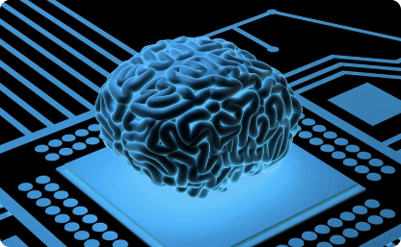
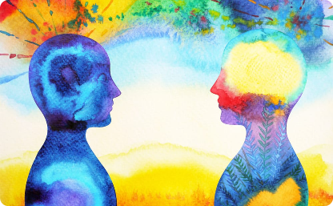

Accessibility
Artificial Intelligence-assisted therapy
Personalized Solutions
Challenges to mental health treatment access can be addressed via AI-enabled teletherapy and other platforms that offer remote consultations with practitioners.
AI systems can monitor a person's mental and emotional states and offer art-based therapies that help address specific problems and issues with cognition and mood.
AI-powered algorithms allow healthcare providers to offer personalized treatment methods, particularly for stress-triggered conditions like anxiety, depression, and PTSD.
The Importance of AI in Mental Health

Slide 3
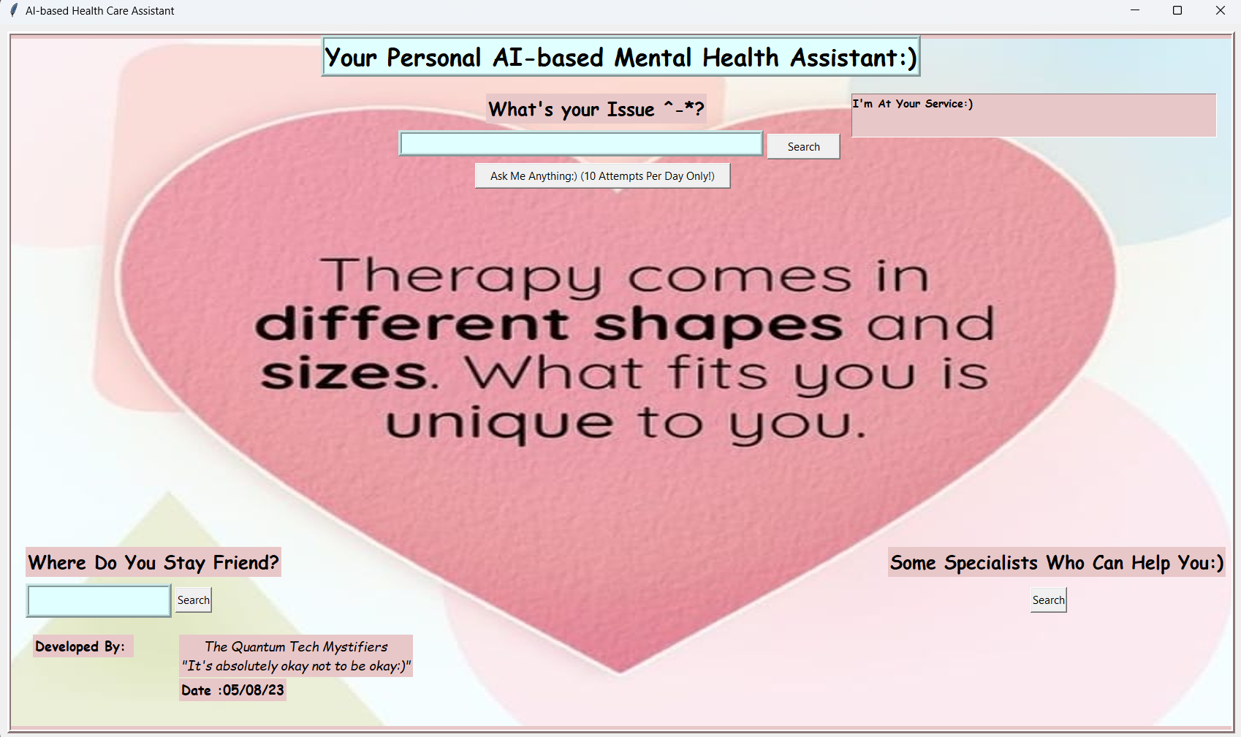
The app starts off with a GUI-based window created using the Tkinter library.
The window is designed to look aesthetically pleasing and inviting for the user, and the colour used in the picture as well as in the background, which is known as "Blush"(Hex: #E8C7C8) is scientifically proven to be soothing to the brain
The window consists of a heading, two text boxes for the user to input their queries, four buttons to search for help and a label which displays the output

Slide 4
What is the AI-Based Mental Health Assistant?
Functionality
It's an app that uses AI and machine learning to provide mental health services to patients in a convenient and efficient manner
The project is written in Python and is powered by OpenAI’s GPT-3.5 Turbo and Google’s TTS engine
The code is written in Python and uses various modules such as tkinter, gtts, time, pillow, and web-oriented modules
The code also uses the Onedrive API to provide direct download links for the background image from my MS Onedrive account
We start by defining a function which takes a OneDrive link as its parameter. The base64 module is used to encode the link into a data-bytes string. We then construct a URL using that string which is then used to retrieve the file from OneDrive. Once the file is retrieved, we finally use the urllib.request module to save the file locally as temp.jpg
Benefits

Slide 5
The AI-based Health Assistant has 4 Components:
Component I
Component II
Component III
A text entry box at the top which asks the user to enter the issue they are facing
The "Ask Me Anything:) (10 Attempts Per Day Only!)" button is used to ask OpenAI’s GPT-3.5 Turbo to generate an answer to the user’s query. The AI-based engine accesses an OpenAI API from RapidAPI which provides natural language processing capabilities to generate responses to the user's input, and has a usage rate limit of 10 requests per day
The output is then displayed on the label and
Is also played as an audio file using Google’s Text-to-Speech engine
The assistant also provides the user with a button "Search" beside the issue entry box which searches 3 websites, namely "HelpGuide.org", "NIMH.nih.gov", and "Mind.uk.org" which provide more information and resources related to the issue that the user has entered
A text entry box [at the lower left corner] asks for the user's location or any location of their choice, and the search button beside it uses the Google Maps API to search for Mental Hospitals and Trauma Care Centres in and around the location
Component IV
It also has a search button for mental health professionals. When clicked, it triggers the ‘Professionals’ function which opens up a webpage named "goodtherapy.org" with a list of professionals across different countries who specialise in therapy
All the website search results are displayed in separate windows using the webview module for the user to browse through and choose the best option for their needs.

Slide 6
Some Significant Drawbacks of Our App and Areas of Development
Limited Accuracy: The app relies on AI and natural language processing, which may not always produce accurate or appropriate responses…The answers provided by the AI may be generic and not tailored to the individual's specific needs
Lack of Human Interaction: The app cannot replace the benefits of human interaction, empathy, and understanding that mental health professionals can provide. In some cases, users may need personalised support that an AI cannot offer…The area of development in this case may be providing consultancy services by doctors through the app
Reliability on External APIs: The app relies on external APIs like OpenAI and Google's TTS engine. Since it is free, it does have a very limited usage rate(the GPT part)…If these APIs experience downtime or changes in their terms of service, it could affect the functionality of the app
Language Limitations: The app's effectiveness may be limited for users who don't speak or understand the language used by the AI. It may not be available in all languages, making it less accessible to some individuals
Dependency on the Internet: The app requires an internet connection to access the AI engine and external resources, which could be an issue for users in areas with poor internet connectivity
Ethical Concerns: The use of AI in mental health care raises ethical questions, such as ensuring the AI's responses are ethical, unbiased, and sensitive to users' needs
Misinterpretation of User Intent: The AI may misinterpret the user's query, leading to inappropriate or irrelevant responses, potentially causing confusion or distress

Slide 7

AI Vs. Human Therapists
1
Emotional comfort
2
Accuracy
Human therapists offer emotional comfort and rapport to their clients, something machines cannot do.
AI algorithms can assist and enhance diagnostics and provide clinical feedback with a high level of accuracy, leading to better outcomes.
3
24/7 Availability
AI machines are readily available, whereas humans are limited by their regular working hours. Moreover, an AI assistant can attend to several patients simultaneously.

Slide 8
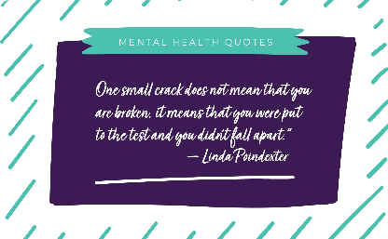
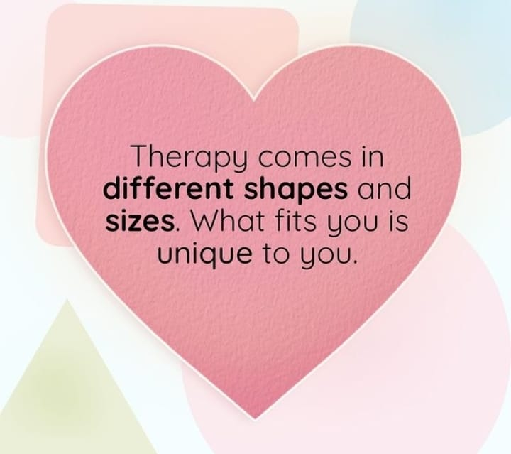
Conclusion
By providing a personal AI-based mental health assistant, we hope to make mental health care more accessible to those who need it and encourage people to take better care of their mental health. No one should ever feel alone in their struggles and our code aims to provide a platform where people can get support and help. At the same time, we hope to encourage people to take better care of their mental health and to seek help whenever they need it.
Mental health is just as important as physical health and everyone should be aware of the resources available to them.
The scalability of the AI-based Mental Health Assistant can help bridge gaps in mental health services, making a significant difference in patients' lives.

