Slide 1
</>
React.js · Node.js · Express.js · MongoDB Atlas · JWT
Student Management System
Technical Project Presentation — MERN Stack
SUBMITTED_BY
Theechana R
REPOSITORY
github.com/theechana54/Azure-VM-Website-Hosting
LIVE_URL
azure-vm-website-hosting-nine.vercel.app
CONTACT
theechana54@gmail.com

Slide 2
01 // OBJECTIVE
Project Objective
Develop a full-stack web application that enables educational institutions to efficiently manage student information — with hands-on implementation of REST APIs, authentication, database design, and cloud deployment on the MERN stack.
Build
A complete MERN stack CRUD application
Secure
JWT authentication & role-based access
Deploy
Cloud hosting on Vercel + Render
const objective = {
stack: ['React', 'Node', 'Express', 'MongoDB'],
auth: 'JWT',
deployment: ['Vercel', 'Render'],
};
STUDENT-MANAGEMENT-SYSTEM // MERN STACK
02

Slide 3
02 // OVERVIEW
What the System Does
1
2
3
4
Authentication
Access Control
CRUD Records
Responsive UI
Register & login secured with JWT tokens
Role-based permissions — Admin vs User
Add, update, delete, search student data
Optimized for desktop and mobile devices
A web application that allows administrators and users to digitally manage student records with a fully responsive, production-deployed interface.
STUDENT-MANAGEMENT-SYSTEM // MERN STACK
03

Slide 4
03 // STACK
Technology Stack
Frontend
Backend
Database
React.js · Vite · Tailwind CSS
Node.js · Express.js
MongoDB Atlas (Cloud)
Auth
Hosting
Tooling
JWT (JSON Web Token)
Vercel (FE) · Render (BE)
Git · GitHub · Postman
STUDENT-MANAGEMENT-SYSTEM // MERN STACK
04

Slide 5
04 // FEATURES
Key Features
User Registration & Login
JWT-based Authentication
Role-Based Access (Admin/User)
Add / Update / Delete Students
Search & Filter Students
Form Validation
Dashboard with Statistics
Responsive UI (Desktop & Mobile)
Export Records to Excel
RESTful API Integration
MongoDB Database Integration
Secure Password Hashing
STUDENT-MANAGEMENT-SYSTEM // MERN STACK
05

Slide 6
05 // DATA MODEL
Database Schema
MongoDB collections used by the application
users
students
name
String
Full name
name
String
Student name
email
String
Unique login
rollNo
String
Unique ID
password
String
bcrypt hash
department
String
Dept name
role
String
admin / user
year
Number
Academic yr
email/phone
String
Contact
STUDENT-MANAGEMENT-SYSTEM // MERN STACK
06

Slide 7
06 // REST API
API Endpoints
POST
/api/auth/register
Register a new user
POST
/api/auth/login
Login & receive JWT
GET
/api/students
List / search / filter students
POST
/api/students
Add a new student
PUT
/api/students/:id
Update a student
DELETE
/api/students/:id
Delete a student
GET
/api/students/export
Export to Excel
STUDENT-MANAGEMENT-SYSTEM // MERN STACK
07

Slide 8
07 // CODEBASE
Project Structure
Azure-VM-Website-Hosting/
|-- client/ React frontend (Vite)
| |-- src/pages/ Register, Login, Dashboard
| |-- src/components/ Reusable UI components
| `-- src/context/ AuthContext (JWT state)
|-- server/ Node.js + Express backend
| |-- controllers/ Route logic
| |-- models/ Mongoose schemas
| |-- routes/ API route definitions
| |-- middleware/ JWT verification
| `-- server.js App entry point
`-- README.md
MVC-style backend
Models define schema
Controllers hold logic
Routes map HTTP verbs
Middleware guards auth
STUDENT-MANAGEMENT-SYSTEM // MERN STACK
08

Slide 9
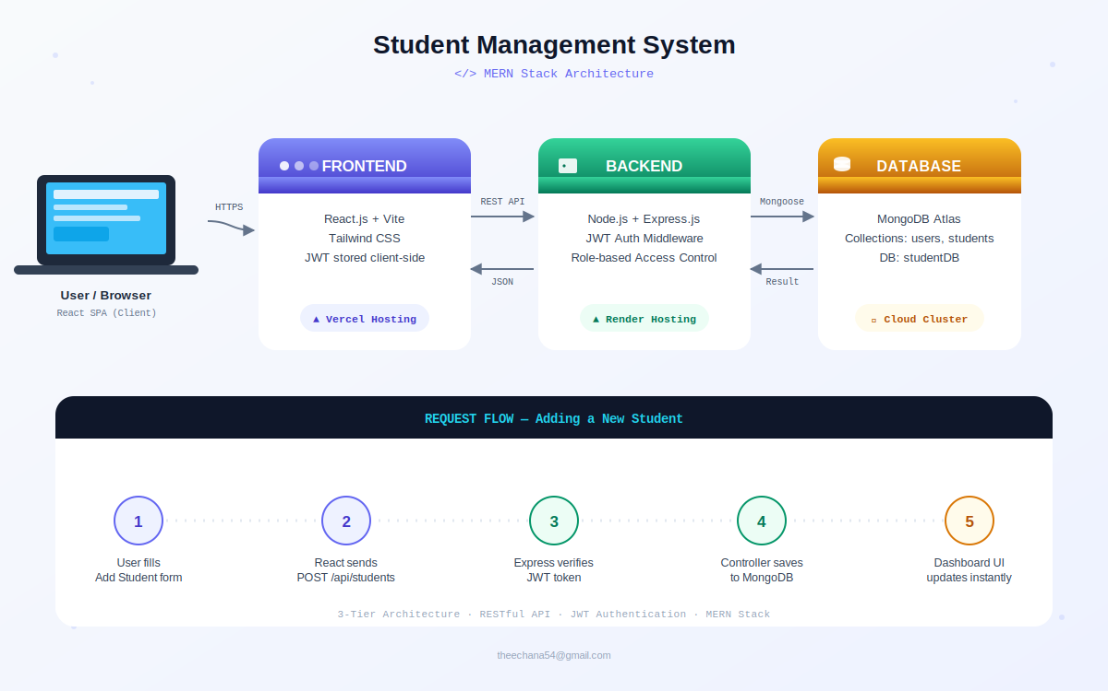
08 // ARCHITECTURE
System Architecture
STUDENT-MANAGEMENT-SYSTEM // MERN STACK
09

Slide 10
09 // SEQUENCE
Request Flow — Login
Client Server Database
|-- POST /api/auth/login -------->| |
| |-- verify credentials -->|
| |<-- user document ---------|
|<-- 200 OK + JWT token ----------| |
|-- GET /api/students (Bearer JWT)->| |
| |-- verifyToken() middleware
| |-- find({}) -------------->|
|<-- 200 OK + JSON array ---------|<-- documents ----------|
1
Client submits credentials to /api/auth/login
2
Server verifies against MongoDB & signs a JWT
3
Subsequent requests carry the JWT as a Bearer token
STUDENT-MANAGEMENT-SYSTEM // MERN STACK
10

Slide 11
10 // DEPLOYMENT
Deployment Pipeline
Vercel
Render
MongoDB Atlas
Frontend
Backend
Database
Root dir: client
Env: VITE_API_URL
Auto-deploy on push
Root dir: server
Env: MONGO_URI, JWT_SECRET
Node.js Web Service
Cloud cluster
DB: studentDB
Network access whitelisted
STUDENT-MANAGEMENT-SYSTEM // MERN STACK
11

Slide 12
11 // OUTCOMES
Learning Outcomes
✓
Built a complete MERN Stack application from scratch
✓
Designed and consumed RESTful APIs
✓
Implemented CRUD operations end-to-end
✓
Implemented JWT authentication & role-based authorization
✓
Connected a React frontend to a Node/Express backend
✓
Managed a cloud-hosted MongoDB database
✓
Deployed a full-stack app using Render & Vercel
✓
Debugged real deployment issues (CORS, env vars, build config)
STUDENT-MANAGEMENT-SYSTEM // MERN STACK
12

Slide 13
12 // ROADMAP
Future Enhancements
1
2
3
Pagination
Profile Pictures
Email Notifications
Handle large student datasets efficiently
Upload photos for each student
Notify users on account creation
4
5
6
Attendance Tracking
Data Visualization
Password Reset
New module to track attendance
Charts & graphs on the dashboard
Reset password via email
STUDENT-MANAGEMENT-SYSTEM // MERN STACK
13

Slide 14
</>
Thank You
Questions & Live Demo
LIVE_URL azure-vm-website-hosting-nine.vercel.app
REPOSITORY github.com/theechana54/Azure-VM-Website-Hosting
CONTACT theechana54@gmail.com

