Slide 1

TEAM : 03
CUSTOMER
TREND
ANALYSIS
BY
FOOD
BRAND

Slide 2

TEAM MEMBERS
THEENUL FAREEHA M
SUBHASHINI R
GODDAM VIVEKA VARDHAN
SAHELI BHATTACHARJEE
UNDER THE GUIDANCE OF MENTOR
PAVITHRA KANNAN

Slide 3
OVERVIEW
> Product-level performance dashboards implemented with detailed category insights
> Category-level comparisons across key dimensions: taste, price, packaging
> Cross-filtering functionality enables drill-down and interactive exploration
> Correlation analysis between sales and sentiment provides actionable insights

Slide 4

INTRODUCTION
> This dashboard provides a visual and interactive view of product performance
> It allows comparison of product categories based on average ratings and customer feedback
> Key attributes such as taste, price, and packaging are analyzed for better understanding
> Interactive features like cross-filtering help explore relationships between categories and dimensions
> It also includes correlation analysis between sales and feedback, enabling data-driven decisions.

Slide 5
MILESTONE - 3
The focus was on building product-level dashboards with category-level comparisons. Products were evaluated not only on sales but also on key attributes such as taste, price, and packaging, creating a balanced view of performance
Sentiment analysis was integrated with customer ratings to provide deeper insights. Positive, neutral, and negative feedback distributions were highlighted, while cross-filtering allowed users to drill down into category-specific performance
Correlation analysis was conducted to link sales performance with customer feedback. This provided evidence of how attributes and sentiment influence outcomes, enabling data-driven decision making

Slide 6
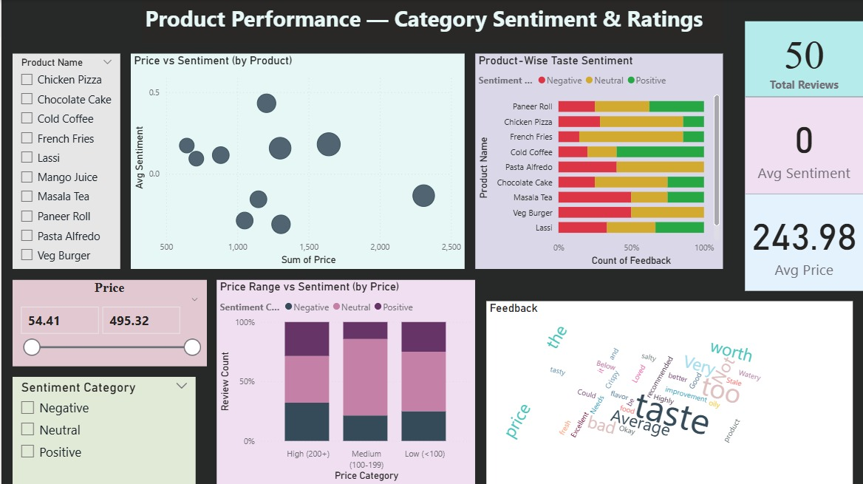

Slide 7
KEY INSIGHTS & OBSERVATIONS
Category Leaders: Paneer Roll and French Fries show consistently higher positive sentiment and favorable ratings
Improvement Areas: Masala Tea and Lassi reflect low average sentiment and higher negative feedback trends
Price–Sentiment Dynamics: Mid-priced products drive balanced sentiment, while some high-priced items underperform on perception
Taste & Packaging Signals: Feedback cloud highlights recurring concerns around taste quality and packaging issues
Overall Review Mix: Significant proportion of neutral and negative sentiment indicates scope to enhance customer satisfaction

Slide 8
FUTURE ENHANCEMENTS
ENHANCE UNDERPERFORMING CATEGORIES: Improve taste profile and packaging for Masala Tea and Lassi
SUSTAIN HIGH PERFORMERS: Maintain quality and customer experience for Paneer Roll and French Fries.
RE-ALIGN PRICING STRATEGY: Review premium products where price perception is misaligned with sentiment
CUSTOMER EXPERIENCE FOCUS: Address recurring feedback themes (e.g., taste, freshness, packaging) through targeted initiatives.
CONTINUOUS MONITORING: Utilize dashboards for real-time tracking of sentiment, ratings, and sales correlation

Slide 9
THANK YOU
- TEAM 03

