Slide 1
OpticPS: An Open-Source Framework for Probabilistic Shaping in Optical Communications
• Research collaboration between researchers at Manchester and Southampton
• Uniform, Fixed and Adaptive Shaped PAM4 for IM/DD: technical discussion deck
• SIMULATION RESULTS ONLY — NO SOUTHAMPTON MEASUREMENTS HAVE BEEN IMPORTED.

Slide 2
Problem statement
• Does shaping improve an unamplified IM/DD link, and under which constraint?
• Baud rate, entropy, net rate and optical power are separate quantities
• A fair comparison must control them explicitly
• Lower BER at equal baud is not more throughput

Slide 3
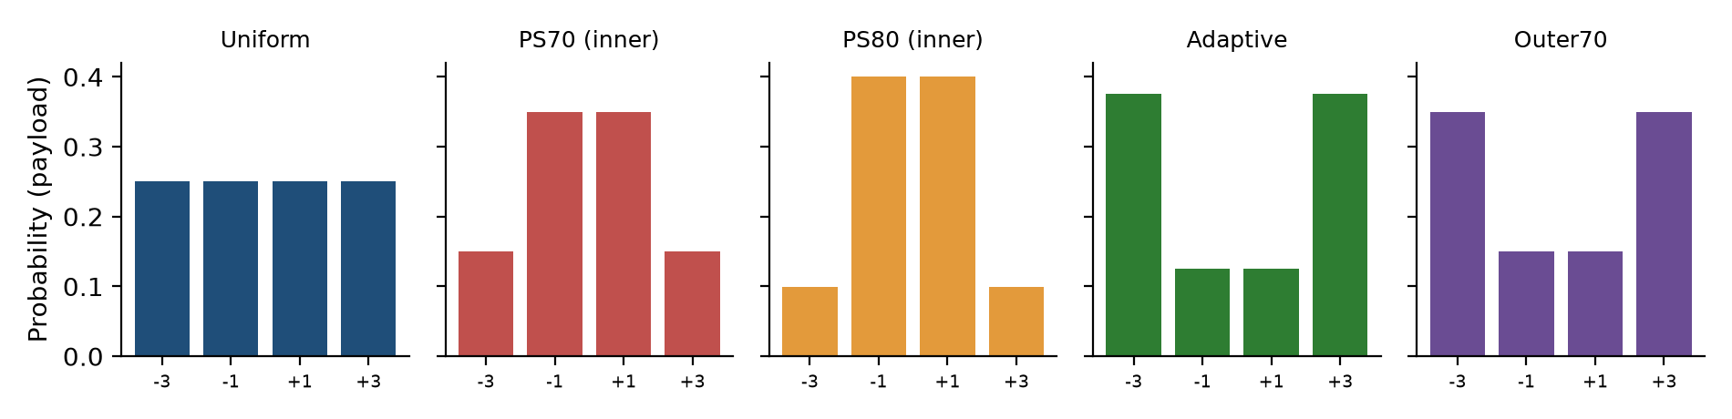
PAM4 fundamentals
• Levels -3, -1, +1, +3 with Gray labels 00, 01, 11, 10
• Uniform carries 2 bit/symbol
• Fixed drive swing fixes level spacing, so noise margin stays the same
• Electrical energy is not optical power
SIMULATION ONLY: no Southampton measurements imported

Slide 4
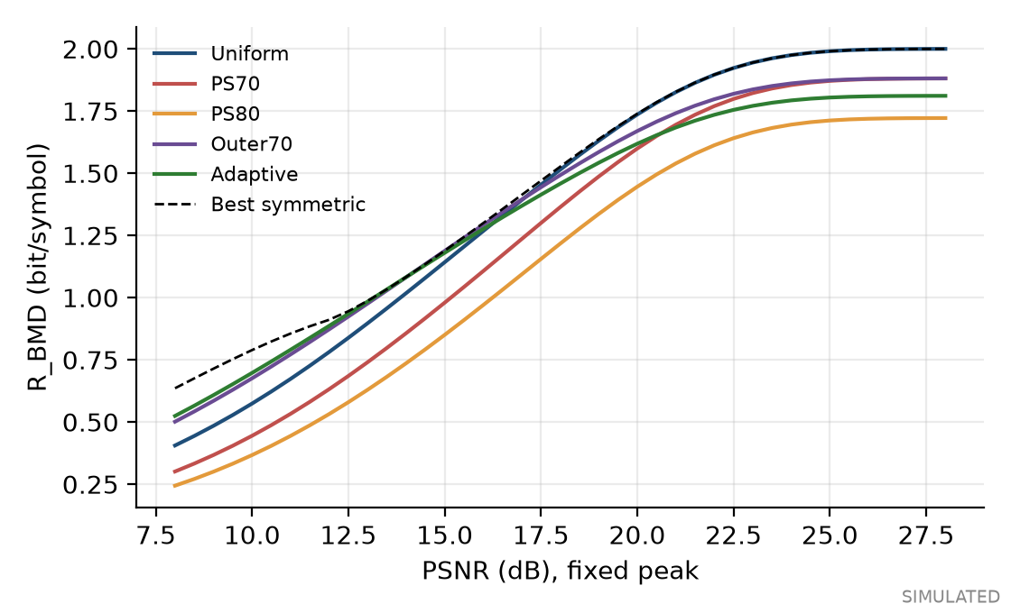
Probabilistic shaping and the peak constraint
• Under an average-power limit, inner-heavy input helps
• A modulator's extinction ratio imposes a peak limit
• Then optimal input is outer-heavy (Wiegart et al., 2021)
• 14 dB, SMD: Uniform 1.035, PS70 0.869, PS80 0.745, Outer70 1.101
SIMULATION ONLY: no Southampton measurements imported

Slide 5
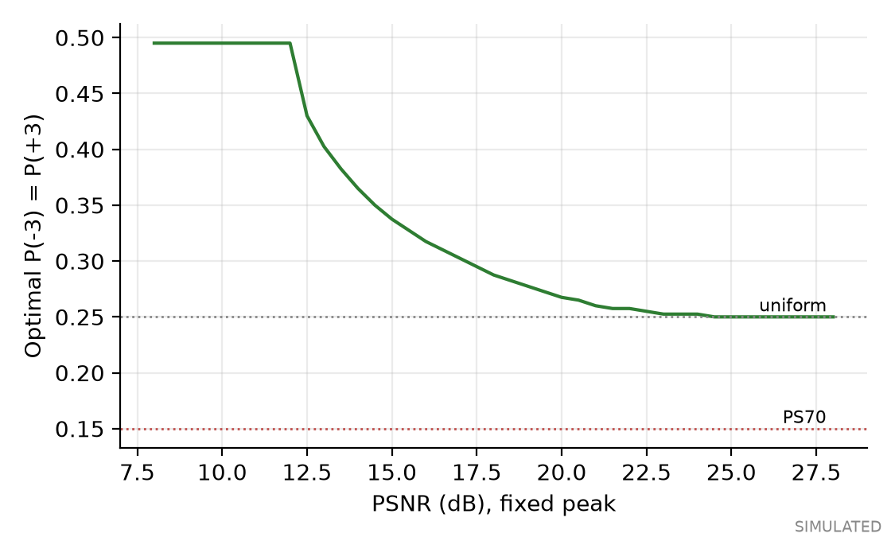
Maxwell-Boltzmann family
• P(x) = exp(-λx²) / Z
• λ = 0 uniform; λ > 0 inner-heavy; λ < 0 outer-heavy
• PS70 and PS80 have λ > 0
• Optimum moves to uniform as PSNR rises
SIMULATION ONLY: no Southampton measurements imported

Slide 6
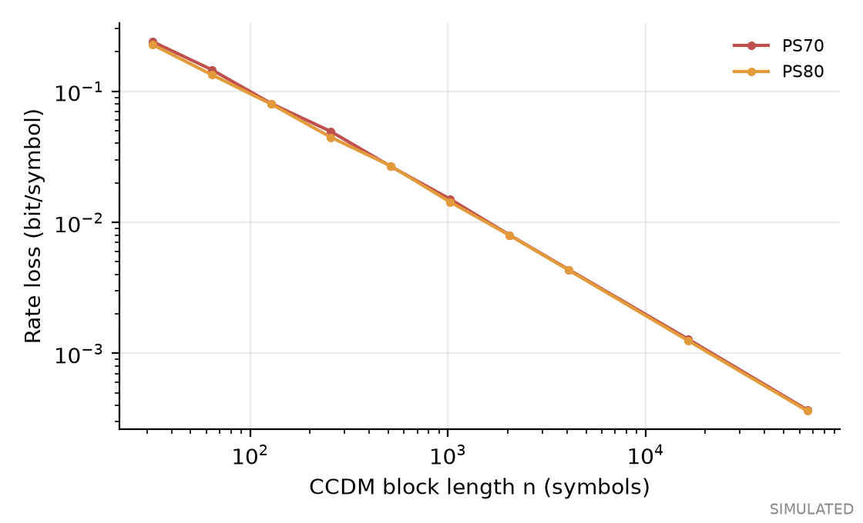
CCDM architecture
• Exact enumerative implementation, 1024-symbol blocks
• Rate loss: 0.015 bit/symbol for PS70
• One symbol error destroys a block
• No FEC, so this is not PAS
SIMULATION ONLY: no Southampton measurements imported

Slide 7
System architecture
• Bits → CCDM → Gray levels → frame → NRZ or RRC → M8199B CSV
• Link simulation or a real capture
• Sync → calibrate → FFE → MD or MAP → metrics
• Fitting uses preamble and training only

Slide 8
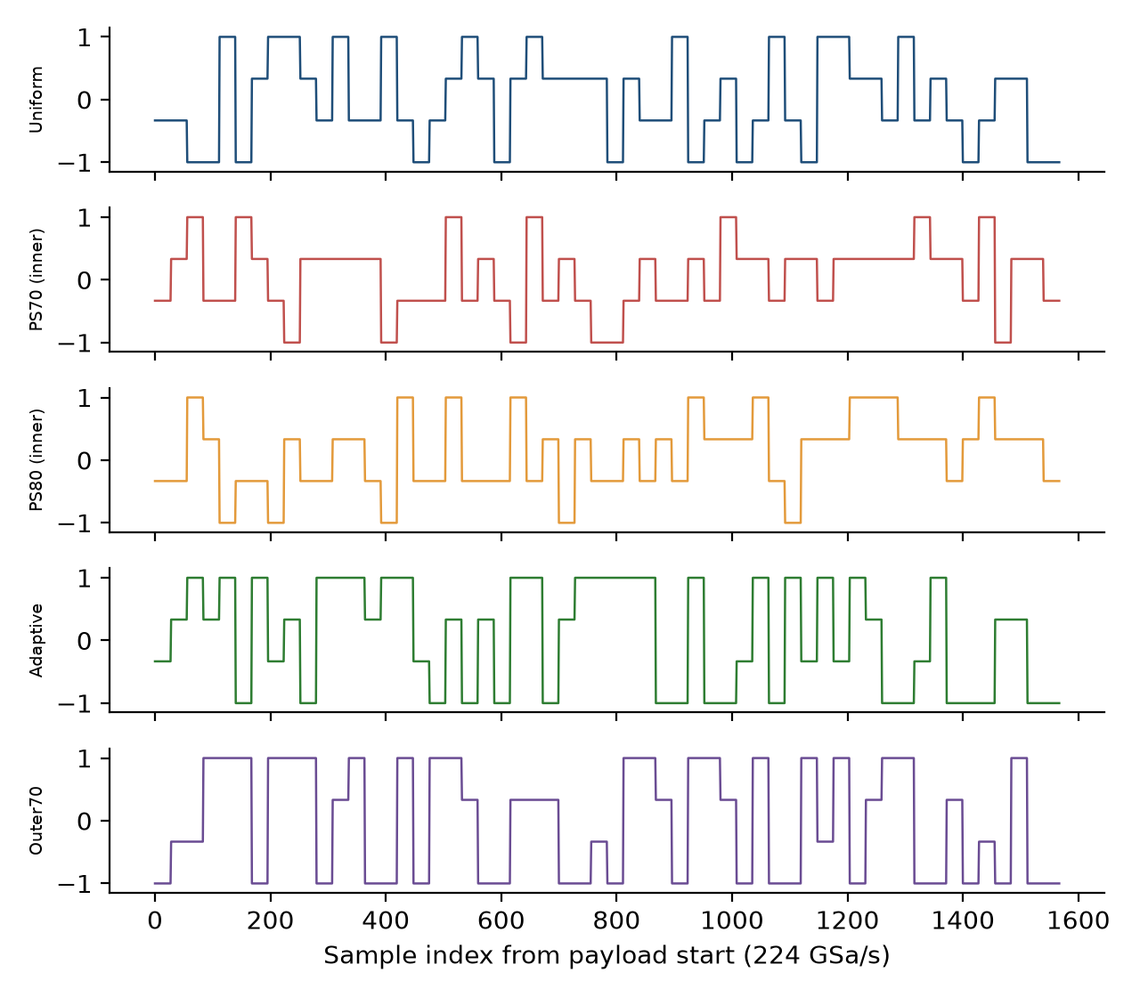
Keysight M8199B waveform package
• Profile A: 224 GSa/s, 8 GBaud, 28 sps, 917,504 samples
• Profile B: 224 GSa/s, 56 GBaud, 4 sps, 262,144 samples
• Header DataOut1, within ±1, multiples of 512
• CSV rules from owner's notes; playback unverified
SIMULATION ONLY: no Southampton measurements imported

Slide 9
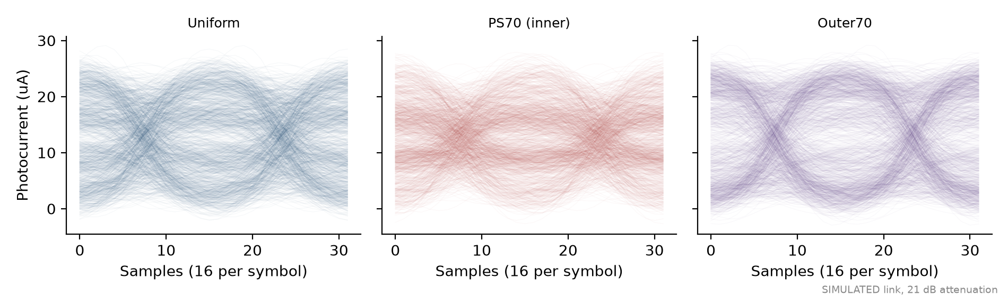
Receiver DSP
• Software sync with polarity and phase search
• 15-tap FFE trained on known symbols
• MAP: argmax p(y|x) P(x), with likelihoods from training
• Metrics: SER, label BER, R_SMD, R_BMD
SIMULATION ONLY: no Southampton measurements imported

Slide 10
Experimental fairness
• Protocol A: equal baud, equal drive swing
• Protocol B: equal net rate, with any baud change reported
• Vpp, RMS, launch, received power, OMA, ER recorded separately
• Paired runs; bootstrap over runs, not samples

Slide 11
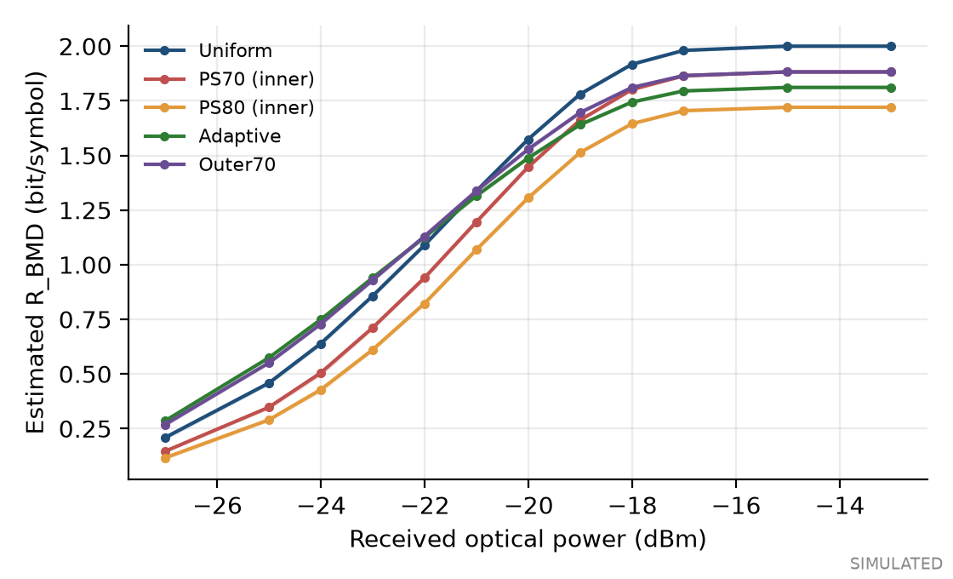
Baseline comparison, Profile A near -22.0 dBm
• PS70 (inner) vs Uniform: lower: -0.150 b/sym (95% CI -0.151 to -0.147)
• PS80 (inner) vs Uniform: lower: -0.267 b/sym (95% CI -0.270 to -0.264)
• Adaptive vs Uniform: higher by +0.036 b/sym (95% CI +0.033 to +0.039)
• Outer70 vs Uniform: higher by +0.041 b/sym (95% CI +0.037 to +0.045)
SIMULATION ONLY: no Southampton measurements imported

Slide 12
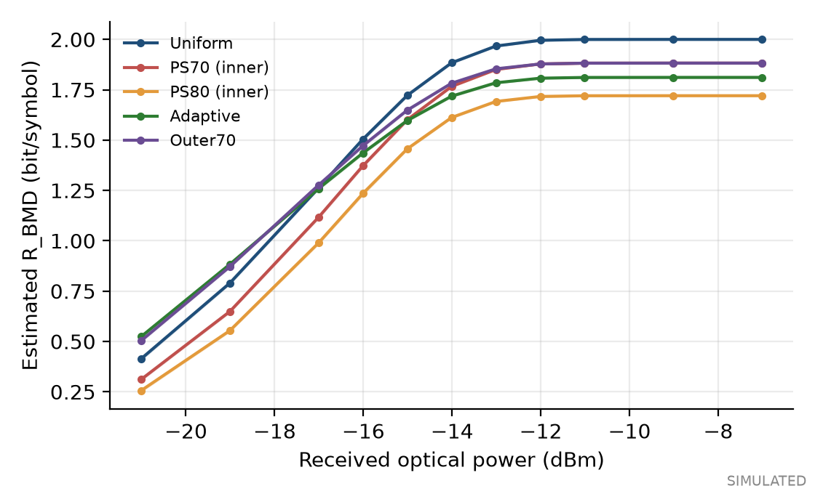
Profile B near -19.0 dBm
• PS70 (inner) vs Uniform: lower: -0.141 b/sym (95% CI -0.143 to -0.139)
• PS80 (inner) vs Uniform: lower: -0.236 b/sym (95% CI -0.238 to -0.234)
• Adaptive vs Uniform: higher by +0.093 b/sym (95% CI +0.090 to +0.097)
• Outer70 vs Uniform: higher by +0.081 b/sym (95% CI +0.078 to +0.084)
SIMULATION ONLY: no Southampton measurements imported

Slide 13
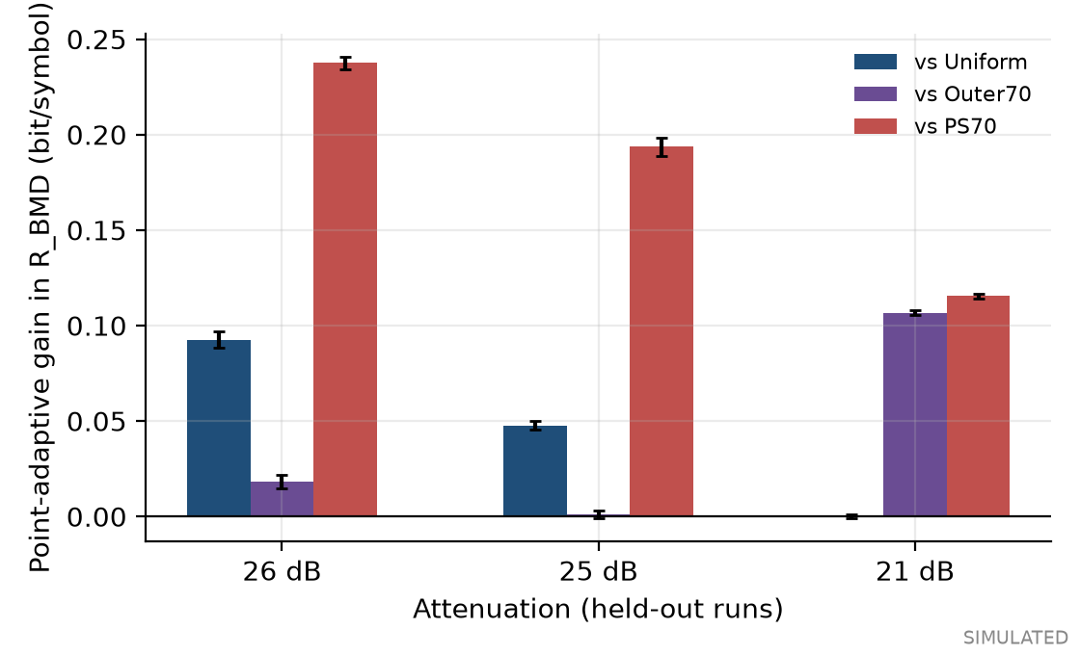
Adaptive shaping on held-out runs
• Exported file: P(±3) = 0.375, simulation-optimized
• 26 dB: chose P(±3) = 0.43; vs Outer70 higher by +0.018 b/sym (95% CI +0.015 to +0.022)
• 25 dB: chose P(±3) = 0.34; vs Outer70 not resolved: +0.001 b/sym (95% CI -0.001 to +0.003)
• 21 dB: chose P(±3) = 0.25; vs Outer70 higher by +0.107 b/sym (95% CI +0.105 to +0.108)
SIMULATION ONLY: no Southampton measurements imported

Slide 14
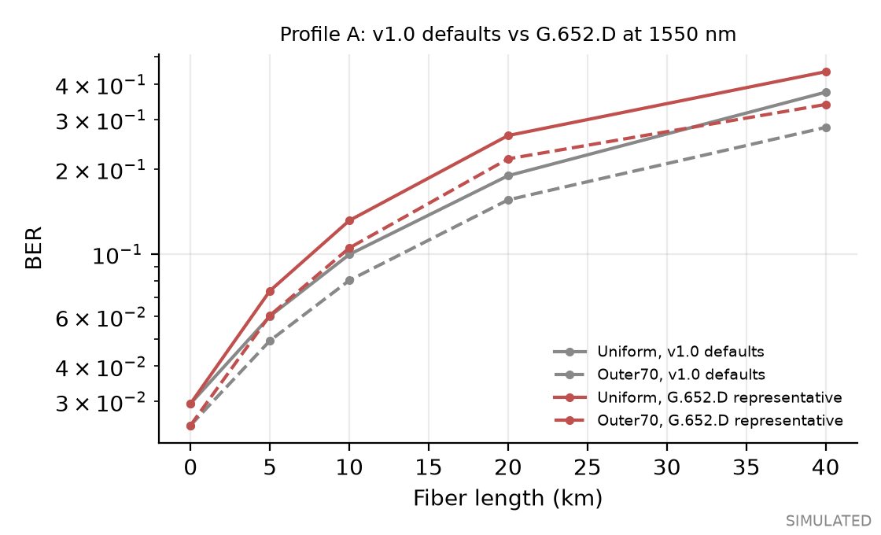
Fiber model: ITU-T G.652.D presets
• Selectable fiber: none (v1.0), G.652.D representative, bounds low and high, custom
• Values carry provenance: limit, typical link value, data sheet or measured
• Re-run of the v1.0 fiber sweep: 25 of 25 Profile A points identical
• Dispersion null: simulation within 3e-08 of theory
• Attenuation 0.275 vs 0.2 dB/km drives the change; slope is negligible
• Analytical and simulated only; Southampton fiber type and length unconfirmed
SIMULATION ONLY: no Southampton measurements imported

Slide 15
Key findings and limitations
• PS70 and PS80 are expected to lose at fixed swing
• Outer-heavy is the candidate to measure
• No FEC: rates are achievable bounds
• Model parameters are generic; compression and AC effects need measurement
SIMULATION ONLY: no Southampton measurements imported

Slide 16
Southampton next steps
• Confirm receiver model and modulator limits
• Verify CSV import on the M8199B
• First run: Profile A, Uniform and Outer70, back-to-back
• Separate training and held-out captures, 5+ repeats
• Then regenerate this analysis from measurements

