Slide 1

UNIVERSITY OF GHANA
COLLEGE OF BASIC AND APPLIED SCIENCES
CSCD 612 INTELLIGENT SYSTEMS 2025/2026
END OF SEMESTER PROJECT
CONFLICT-FREE AIRPORT TAXI TRAJECTORY PLANNING
Reproducing SPPTW-MTTC: Shortest Path with Time Windows and a Maximum Traversal Time Constraint
Ernest Agyemang - 22424512
Victoria Dowana - 22425077
Joseph Harry Mills Jnr - 22425759

Slide 2
Introduction
The problem
Think of an airport; Planes don't just fly.. before takeoff, they have to “drive” (taxi) from their gate to the runway, and same after landing back to the gate. That driving happens on a maze of paved paths called taxiways guided by air traffic controllers who tell each plane where to go and when.
The challenge is to plan routes and timings, so planes do not collide or block each other while moving safely.
The paper's approach
Zhang, Ding, and Zuo (2018) built on earlier time-window reservation approaches (Ravizza et al., 2014; Zhang, Ding, Wang, et al., 2016), which already guaranteed a conflict-free way to taxi by searching for the fastest route for each aircraft.
What this project does
A from-scratch reproduction of the paper's actual algorithm and not just the general family of technique it improves upon, built and independently checked in Python.

Slide 3
Objectives
Implement Zhang, Ding, and Zuo's (2018) real SPPTW-MTTC algorithm from scratch
Build, and independently check, a system that schedules aircraft taxiing with no conflicts, while obeying a maximum-wait rule
Show Intelligent Systems ideas at work in a real system: smart (heuristic) search, how we represent knowledge about the airport, handling time-based rules, and coordinating several aircraft at once
Find and fix real bugs in the code by testing it, not just by reading it
Present clear, reproducible evidence of the paper's real-world payoff : planes wait at the gate instead of stopping and starting mid-way on the taxiway

Slide 4
The Paper's Actual Contributions
Maximum Waiting Time Limit
Every part of the taxiway network has a maximum time a plane may spend there. Waiting longer than that is simply not allowed.
Tracking a Range of Arrival Times
Instead of tracking only the earliest possible arrival time at each spot, the system tracks a whole range of times - so the maximum-wait rule never accidentally throws away a good route.
Cost That Also Counts Driving Time
The cost of a plan is the finishing time so far, plus the actual driving time so far (waiting is never counted as driving). Between two plans that finish at the same time, the one that drove less is preferred - so gaps in the schedule get filled with waiting, not extra driving.
Working Backwards to Delay Pushback
Once a route is chosen, the system decides where any needed waiting should go, and always pushes it as early as possible - ideally one wait at the gate instead of several short stops along the way.

Slide 5
Two Different Jobs, Easy to Mix Up
The total time for any trip = driving time (fixed once you pick a route) + waiting time (however much the schedule needs).
Cost that counts driving time = CHOOSING THE ROUTE
Because waiting is never counted as driving time, between two routes that finish at the same time, the system always prefers the one that drove less - it would rather fill a gap in the schedule with waiting than with an unnecessary detour.
Working backwards = DECIDING WHERE TO WAIT
Once the route is chosen, and we know some waiting can't be avoided, this step decides where that waiting goes - pushing it as early as possible, ideally as one wait at the gate instead of several stops along the way.
Put together: no wasted distance (choosing the route) + no wasted stopping and starting (deciding where to wait) = wait at the gate, then drive straight through.

Slide 6
The Search Formula: f(n) = g(n) + h(n)
f(n) = g(n) + h(n) f is the total score for a plan - the lower it is, the sooner the plan gets explored.
g(n) - The real cost paid so far: finishing time so far + driving time so far. This isn't a guess - it's the paper's key idea (earlier work only counted finishing time).
h(n) - A guess at what's left: the fastest possible remaining time, assuming a completely empty, traffic-free taxiway. Worked out ahead of time using Dijkstra's algorithm, starting at the goal and working backward.
Why this guess is safe - This guess must never be too high. Since real traffic is never faster than an empty taxiway, the guess is always safe to use - and that's what guarantees the search finds the best possible route, not just a good one.

Slide 7
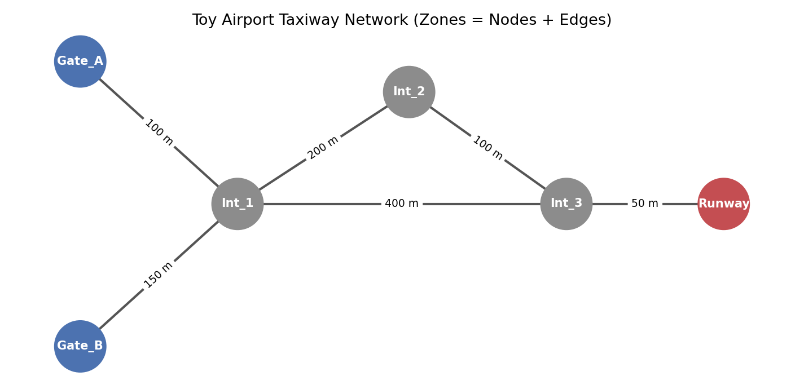
How We Modeled the Airport: Zones as Nodes and Edges
Figure 1: The toy airport network used for testing. Both taxiway segments
and junctions are treated as separate zones, each with its own time limit.

Slide 8
Results: Delayed Pushback in Action
Flight | Ready | Pushback | Completion | Taxi Time
Flight_101 | 0 s | 0 s | 60 s | 60 s
Flight_202 | 5 s | 15 s | 85 s | 70 s
Flight_303 | 8 s | 45 s | 105 s | 60 s
Flight_303 doesn't push back at T=8s - it waits at the gate until T=45s,
then drives the whole route (60s) without a single stop:
the system put all the necessary waiting into one hold at the gate instead of scattering it along the way.

Slide 9
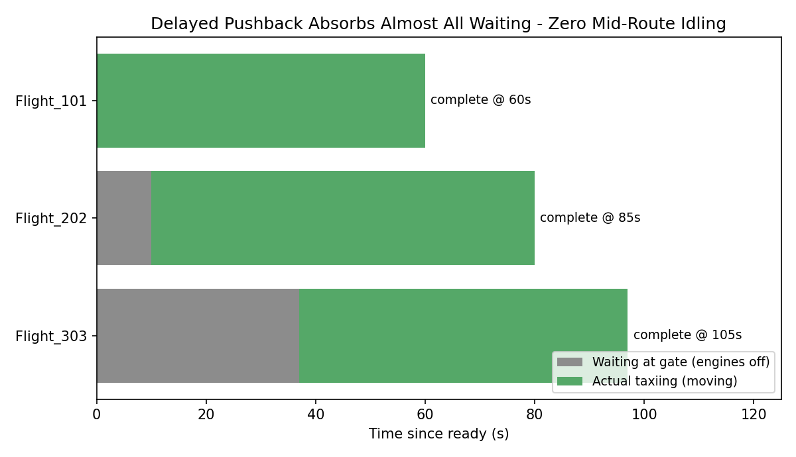
Waiting Absorbed at the Gate, Not Mid-Route
Figure 2: Almost all the necessary waiting happens at the gate, with engines off,
instead of on the taxiway with engines on, for every plane that needed to wait.

Slide 10
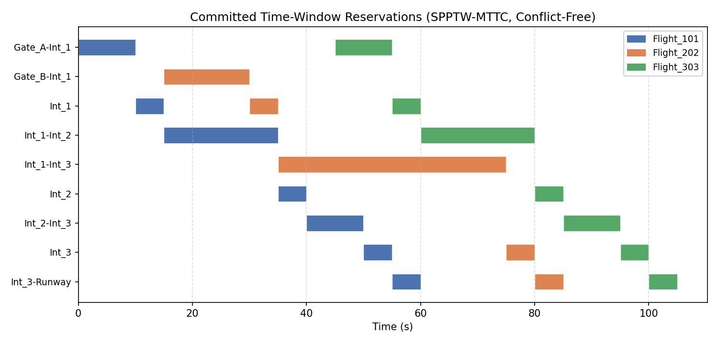
The Committed Conflict-Free Schedule
Figure 3: The final, locked-in time slots for every zone. No two
different planes ever use the same zone at the same time, once you include the required safety gap.
Zero safety-gap violations anywhere.
We independently double-checked every pair of locked-in time slots against the minimum safety gap.
All three planes' routes pass everywhere.

Slide 11
Conclusion
Rebuilt the paper's real contributions: the maximum-wait limit, the cost that also counts driving time, tracking a range of arrival times, and the step that decides where waiting should go
Found and fixed two real bugs through hands-on testing, not just by reading the code
The results directly show the paper's real-world payoff: no wasted distance (choosing the route) plus no wasted stopping and starting (deciding where to wait) = wait at the gate with engines off, then drive straight through
The final system was independently checked and is fully conflict-free

Slide 12
References
Chen, Y., Quan, L., & Yu, J. Z. (2024). Aircraft taxi path optimization considering environmental impacts based on a bilevel spatial–temporal optimization model. Energies, 17(11), Article 2692. https://doi.org/10.3390/en17112692
Tian, W., Yang, M., Zhou, X., Yin, J., & Shi, X. (2025). Airport field path optimization method based on conflict hotspot avoidance mechanism. Applied Sciences, 15(15), Article 8204. https://doi.org/10.3390/app15158204
Von der Burg, M., Kamphof, J., Soomers, J., & Sharpanskykh, A. (2024). Towards autonomous airport surface movement operations using hierarchical multi-agent planning. SSRN Electronic Journal. https://doi.org/10.2139/ssrn.4916874
Zhang, T., Ding, M., & Zuo, H. (2018). Improved approach for time-based taxi trajectory planning towards conflict-free, efficient and fluent airport ground movement. IET Intelligent Transport Systems, 12(10), 1360–1368. https://doi.org/10.1049/iet-its.2018.5193
Ravizza, S., Atkin, J. A., & Burke, E. K. (2014). A more realistic approach for airport ground movement optimisation with stand holding. Journal of Scheduling, 17(5), 507–520.

