Slide 1
The error list
-MElvin R
-Mohith kalekar
-Pugal Ramyaa
-

Slide 2
PRoblem Statement
To design an AAF system that can provide consent based financial data to 3rd party systems.
The existing front-end financial systems do not have a safe, legal and reliable way to properly assess the income and credit history of person. These systems work on the traditional Web2.0 systems.

Slide 3
Our solution- credSecure
CredSecure is a web 3.0 based finance system.
Our solution makes use of all the advantages a blockchain-based file transfer system can offer.
Enhanced security. Your data is sensitive and crucial, and blockchain can significantly change how your critical information is viewed.
Greater transparency.
Instant traceability. ...
Increased efficiency and speed. ...
Automation.

Slide 4
Why use Credsecure?
Given the advantages of Web3.0, we have also included a ChatBot that will make the process of securing a loan easier.
With this, we aim to make the process safer, more accessible and reliable.

Slide 5
How does it work?
CredSecure takes your data related to your income and credit history and converts it into a blockchain.
We use IPFS Protocol to convert the data into an encrypted form which can only be accessed by the authorized personnel.

Slide 6
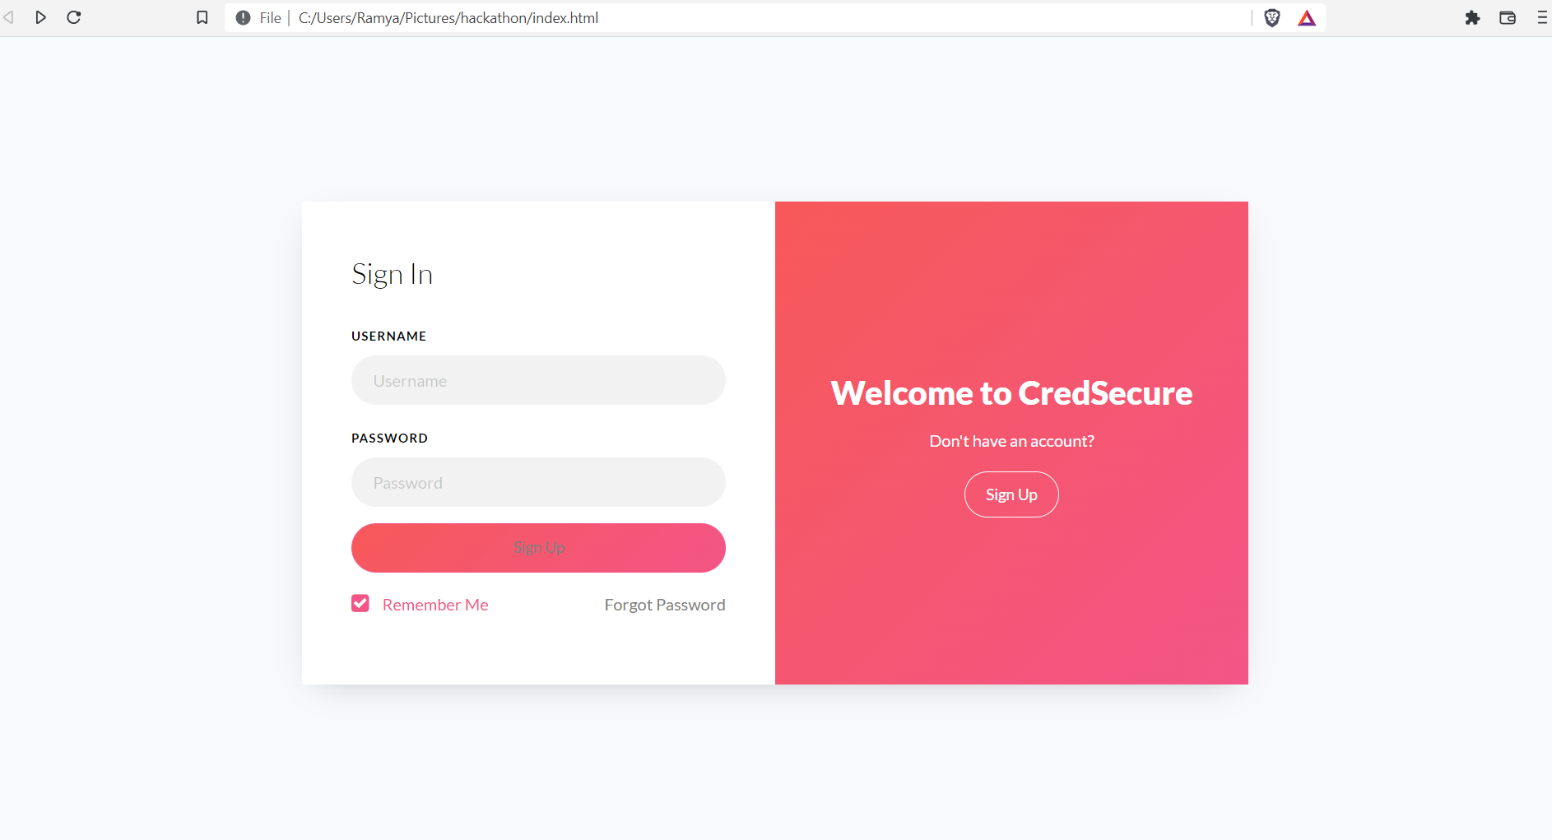
Our progress
Webpage-

Slide 7
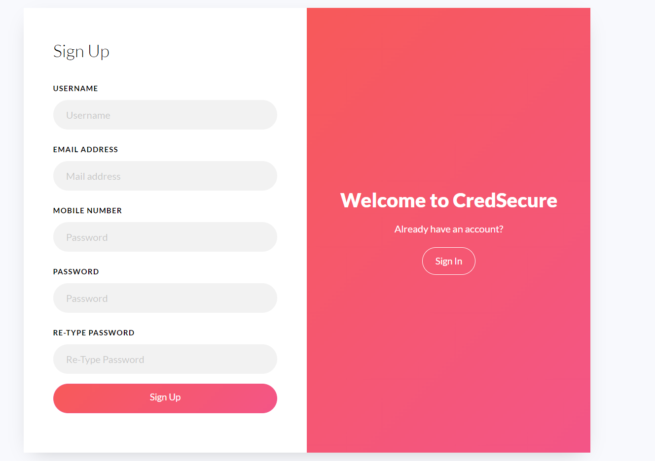

Slide 8
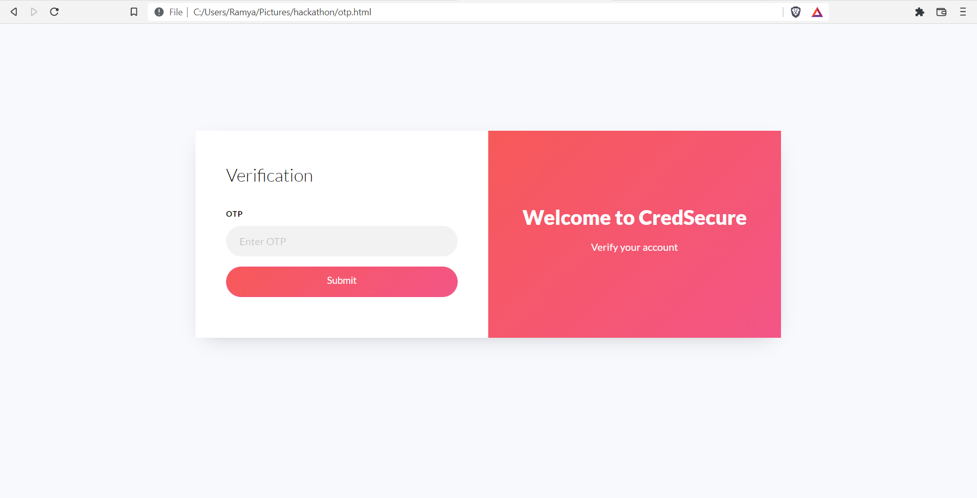

Slide 9
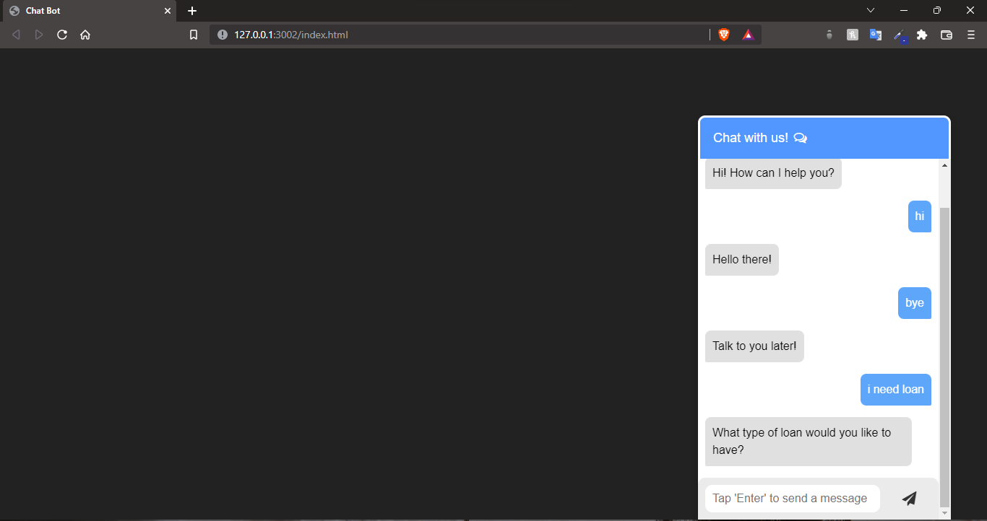
Chat bot (IN PROGRESS)

Slide 10
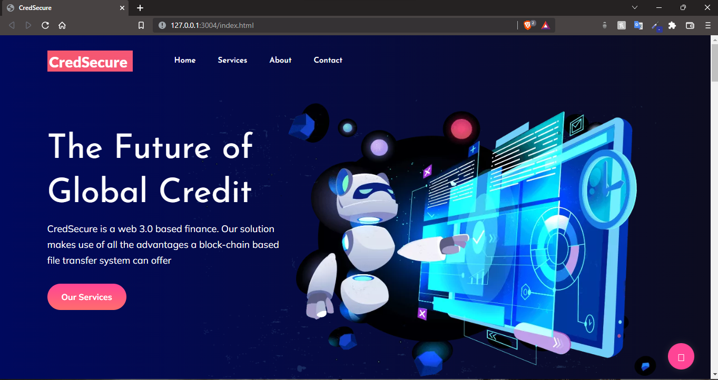

Slide 11
