Slide 1

Cutie Cube
Embedded Systems (CPE-311) Project
Thai-Nichi Institute of Technology

Slide 2



Members
Primsara Pathranarakul 1811310133
Kewalee Boonin 1811310208
Sahassawas Tongneam 1811310299
Anupat Chunhawiriyakun 1811310372
Theetawat Buakaew 1811310562
1

Slide 3
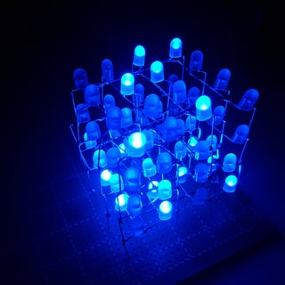
Overview
LED Cube 4x4x4
Decorative led lights provide various lighting functions
Project budget: 500 Bath
2
Notes:
ระบบเราต้องการทำอะไร ทำไมถึงทำโปรเจคนี้

Slide 4
Overview
Requirement
Self-study on these following topics
Real time clock
Pseudo-Random
Shift register
3

Slide 5
01.
Specification
System information
Function
Project planning
4

Slide 6
System information
MCU : STM32L152RB
Component : 5mm Blue LED x 64
5V 10A regulated switching power supply
74HC595 shift registers x 5
Software : Keil µVision
Language : C
5

Slide 7
Function
Rain
setVoxel
shift
6

Slide 8
Project planning
Task | January |  |  |  | February
 | Week 1 | Week 2 | Week 3 | Week 4 | Week 1 | Week 2 | Week 3
Design
Hardware
Coding
Testing
7

Slide 9
02.
Architectural Design
Block diagram
Hardware detail selection
STM32 Pin allocation
8

Slide 10
Block diagram
STM32
L152RB
PA4, PA5, PA11
Shift Register
PB8
Button
PB5, PB7
LED
9

Slide 11
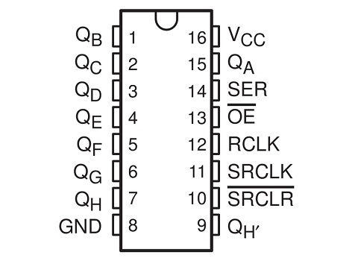
Hardware detail selection
74HC595 Shift Register
10
Notes:
อธิบายว่ามันส่งข้อมูลเป็นชุด

Slide 12
STM32 Pin allocation
Port/Pin | 1 | 2 | 3 | 4 | 5 | 6 | 7 | 8 | 9 | 10 | 11 | 12 | 13 | 14 | 15
A |  |  |  | ⬛ | ⬛ |  |  |  |  |  | ⬛
B |  |  |  |  | ✩ |  | ✩ | ◉
✩ LED
◉ Button
⬛ Shift Register
11
Notes:
อ้างอิงตาม LED_CUBE/CUBE-SCHEMATIC.pdf at master · itsharryle/LED_CUBE (github.com)

Slide 13
03.
Detailed Design
Top-Down Design
Flowchart
Gantt chart
12

Slide 14
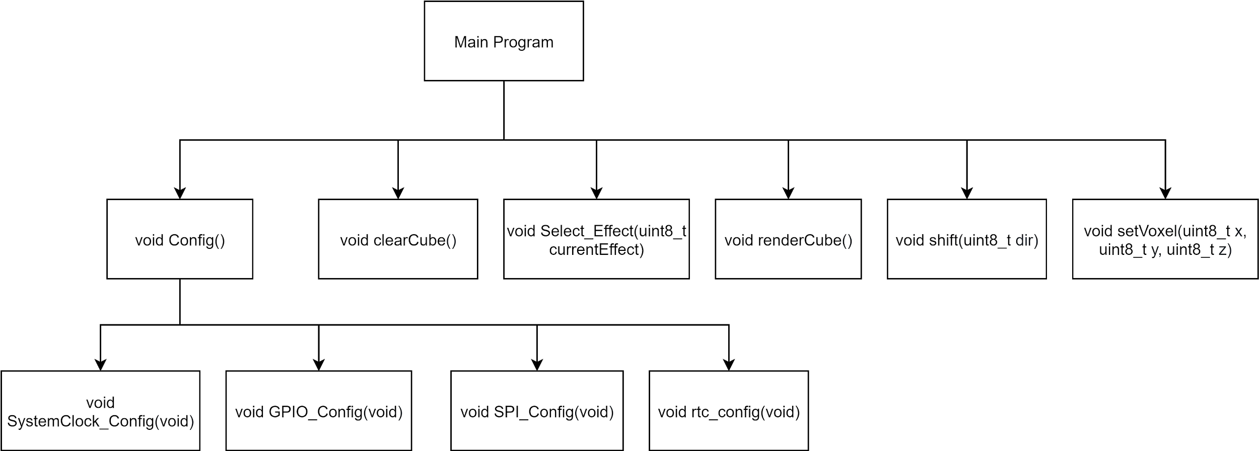
Top-Down Design
13
Notes:
https://drive.google.com/file/d/1652IqpJT9UDqoZZdnppu2cdPJOdPoNXS/view?usp=sharing
แก้ให้มันเห็นชัดเจน ภาพโครงสร้างตัวโค้ด
หน้าสอง
Top-Down Design - Google Search

Slide 15
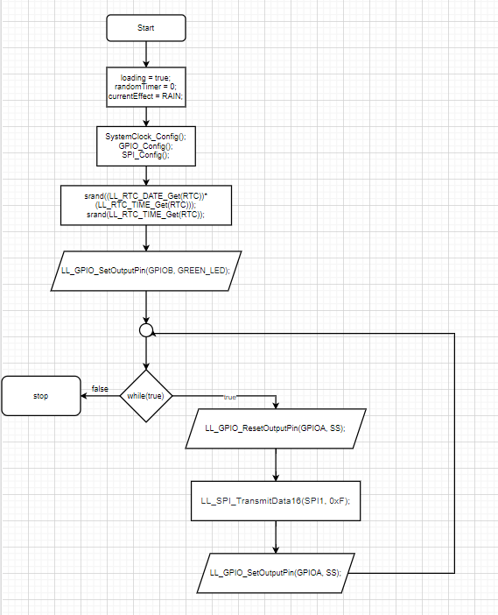
Flowchart
14
Notes:
https://drive.google.com/file/d/1652IqpJT9UDqoZZdnppu2cdPJOdPoNXS/view?usp=sharing
Flow chart แต่ละฟังชั่น

Slide 16
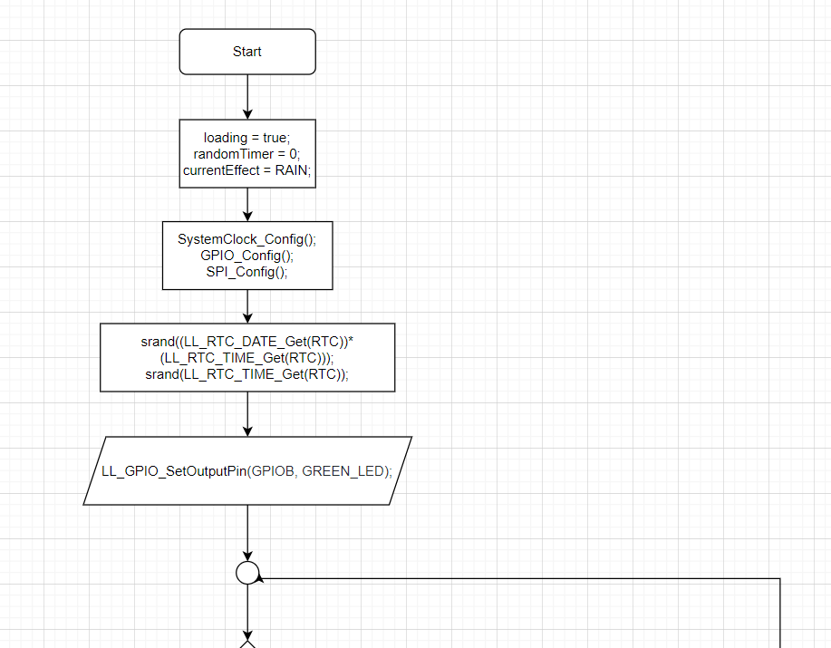
Flowchart
15
Notes:
https://drive.google.com/file/d/1652IqpJT9UDqoZZdnppu2cdPJOdPoNXS/view?usp=sharing
Flow chart แต่ละฟังชั่น

Slide 17
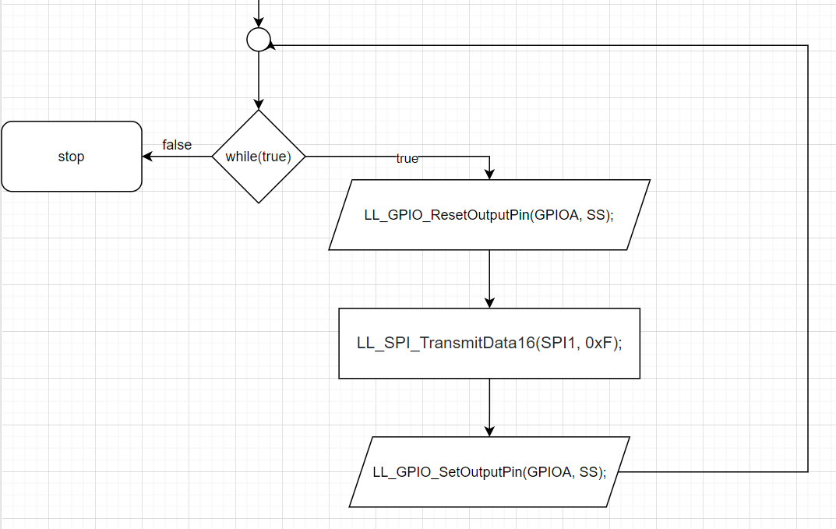
Flowchart
16
Notes:
https://drive.google.com/file/d/1652IqpJT9UDqoZZdnppu2cdPJOdPoNXS/view?usp=sharing
Flow chart แต่ละฟังชั่น

Slide 18
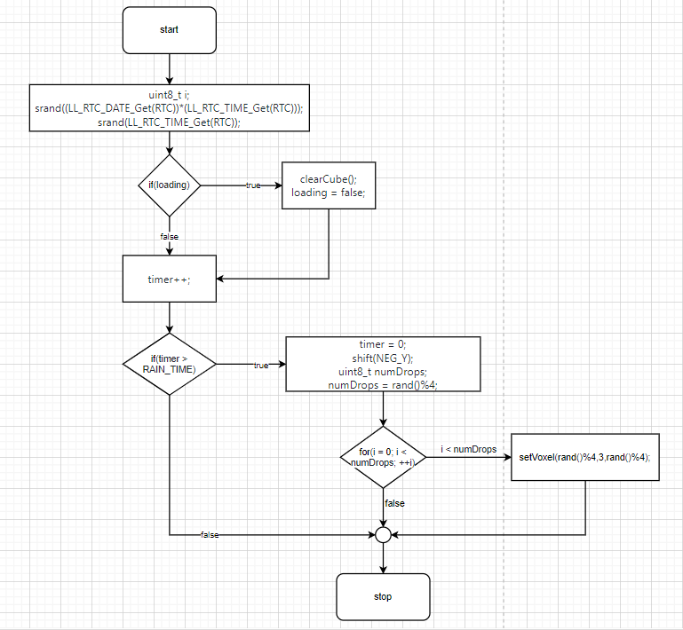
Flowchart (Rain)
17

Slide 19
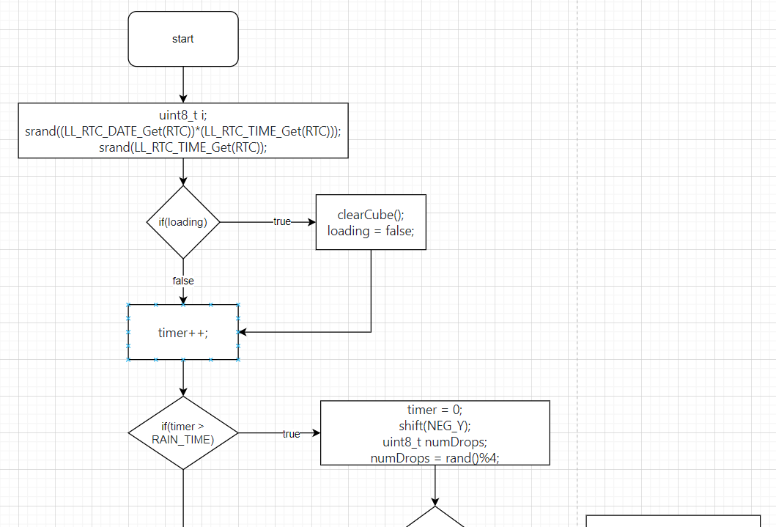
Flowchart (Rain)
18

Slide 20
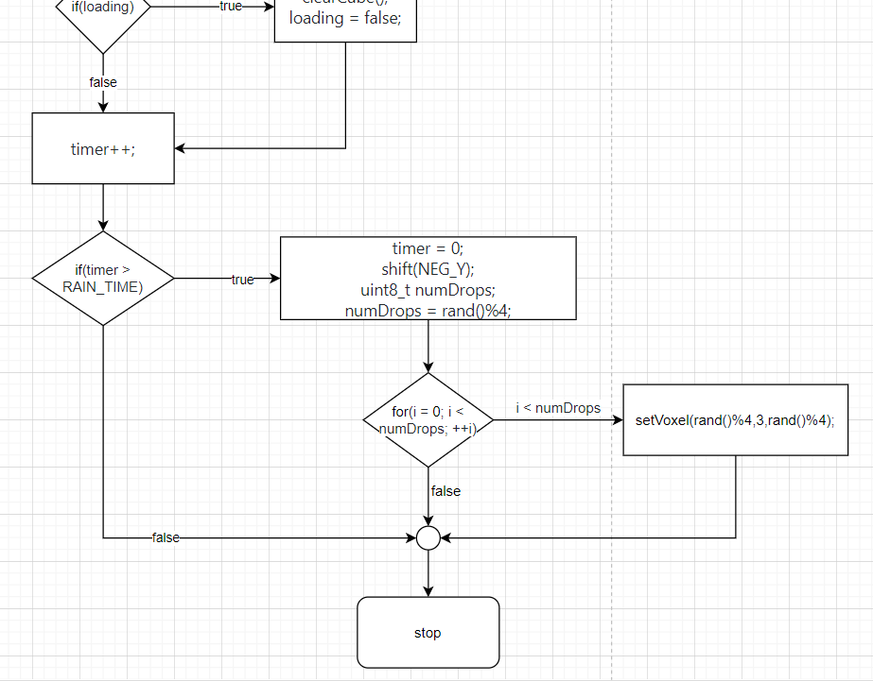
Flowchart (Rain)
19

Slide 21
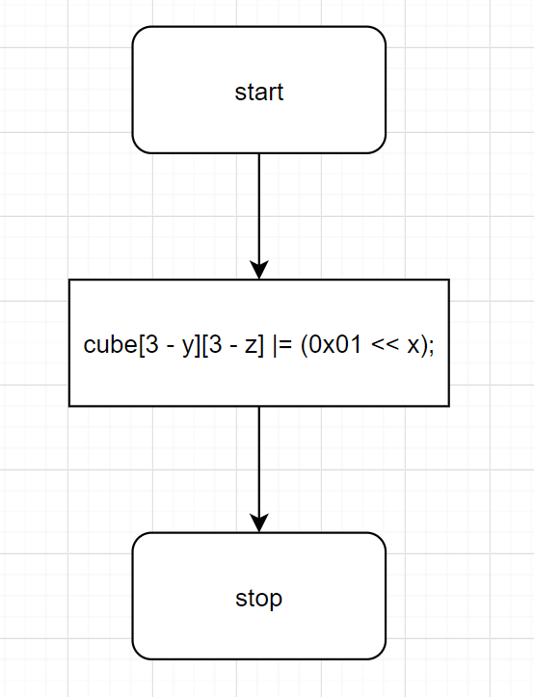
Flowchart (setVoxel)
20

Slide 22
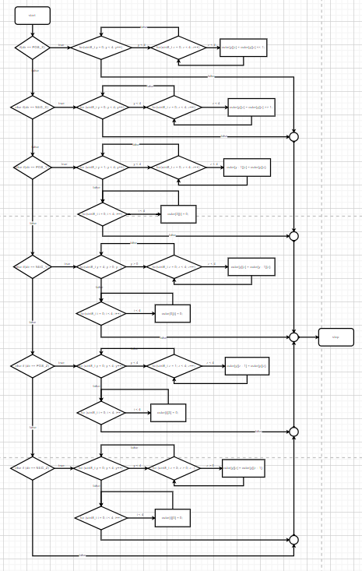
Flowchart (shift)
21

Slide 23
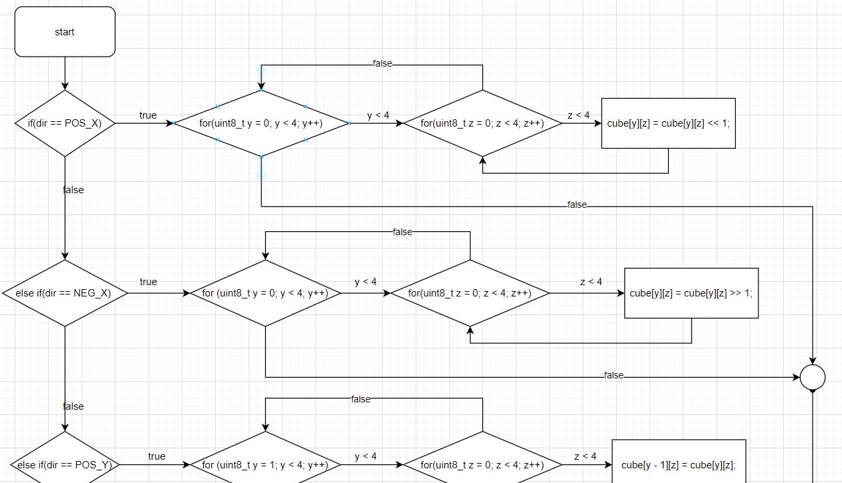
Flowchart (shift)
22

Slide 24
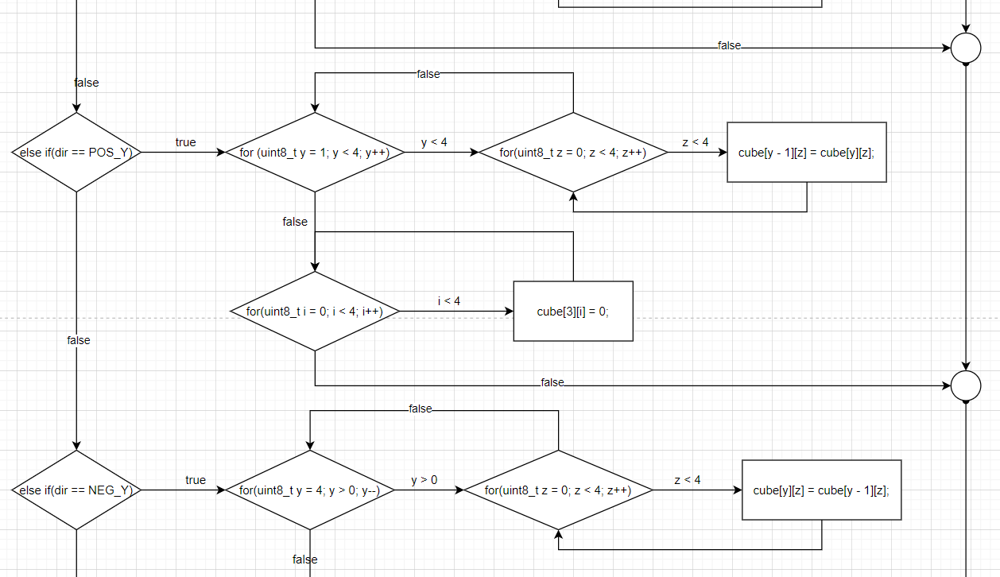
Flowchart (shift)
23

Slide 25
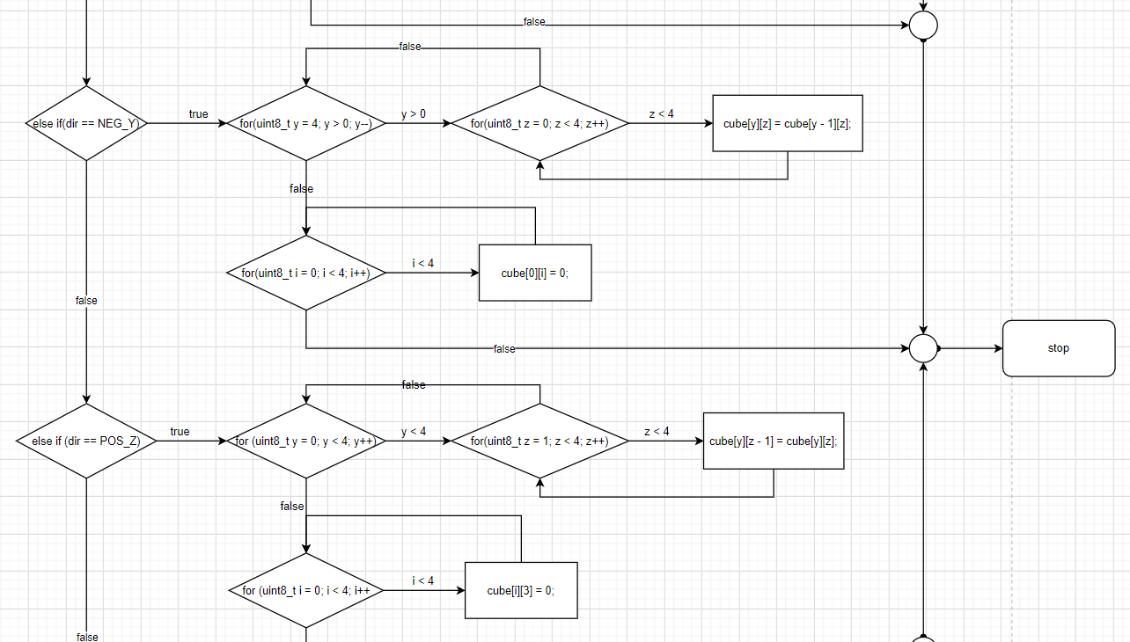
Flowchart (shift)
24

Slide 26
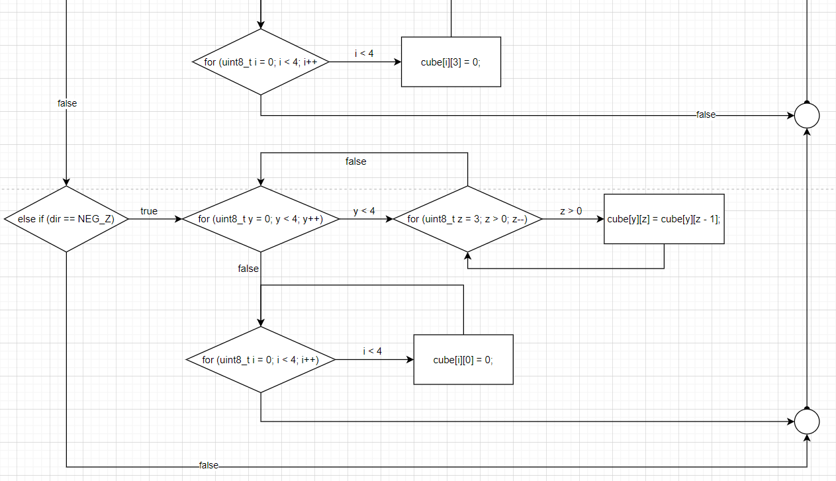
Flowchart (shift)
25

Slide 27
Gantt Chart
 | Responsibility | January |  |  |  | February
Task |  | Week 1 | Week 2 | Week 3 | Week 4 | Week 1 | Week 2 | Week 3
Search Interest Project | All
Discuss with teacher | All
Planning How to make it | All
Hardware | Kewalee, Anupat
Coding, Assembly | Anupat
Testing and Repair | Primsara, Sahasswas, Theetawat
Presentation | All
26

Slide 28
04.
Demo Video/Picture
27

Slide 29
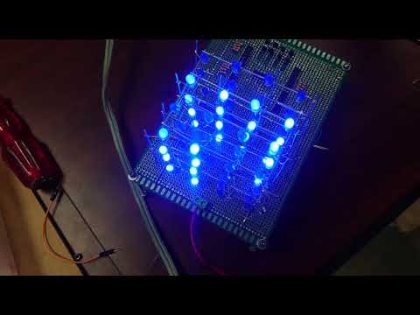
Let’s see
28

Slide 30
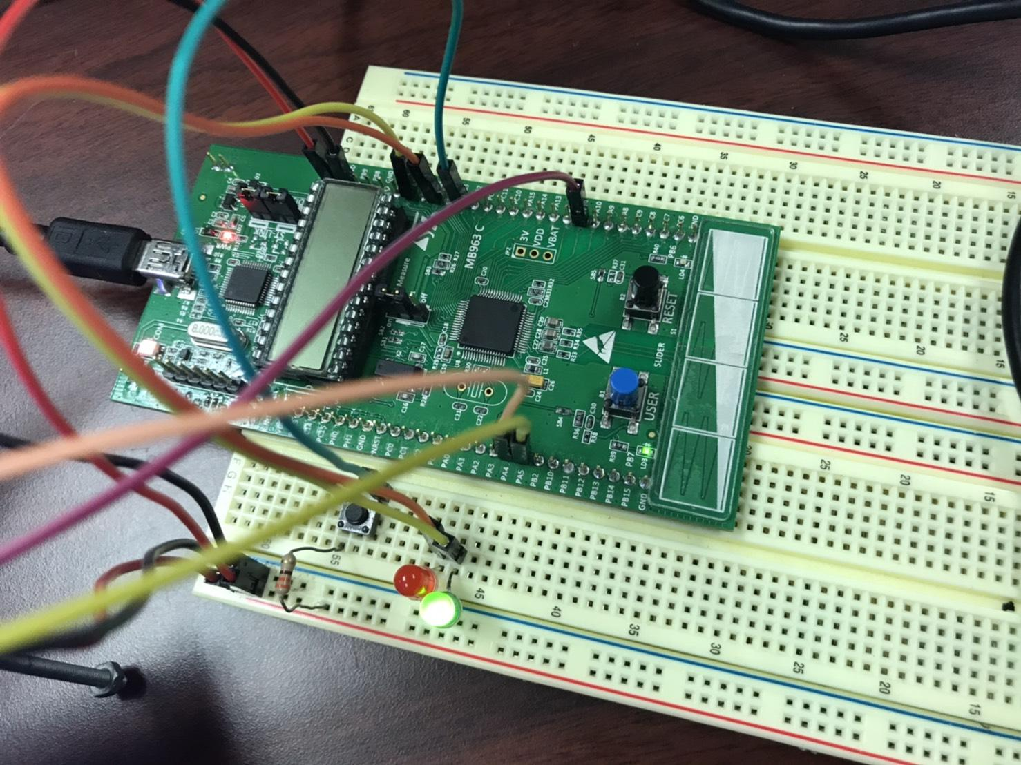
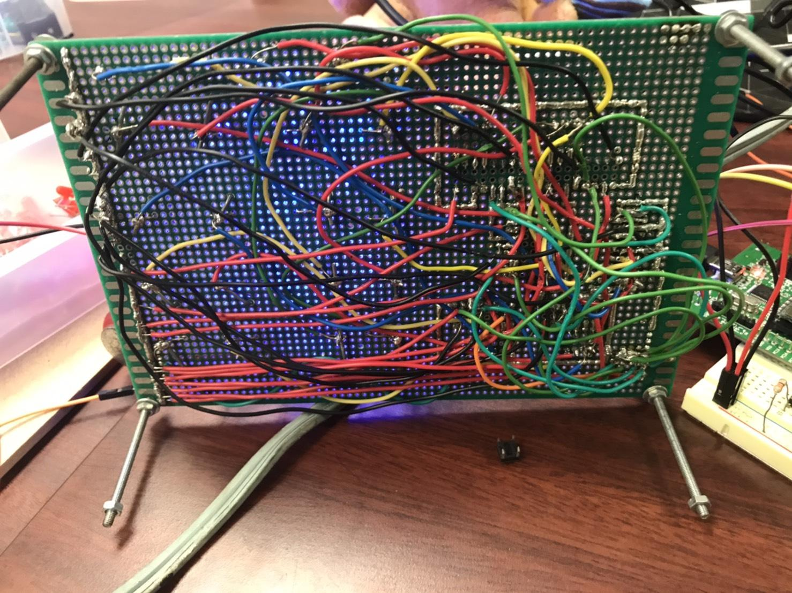
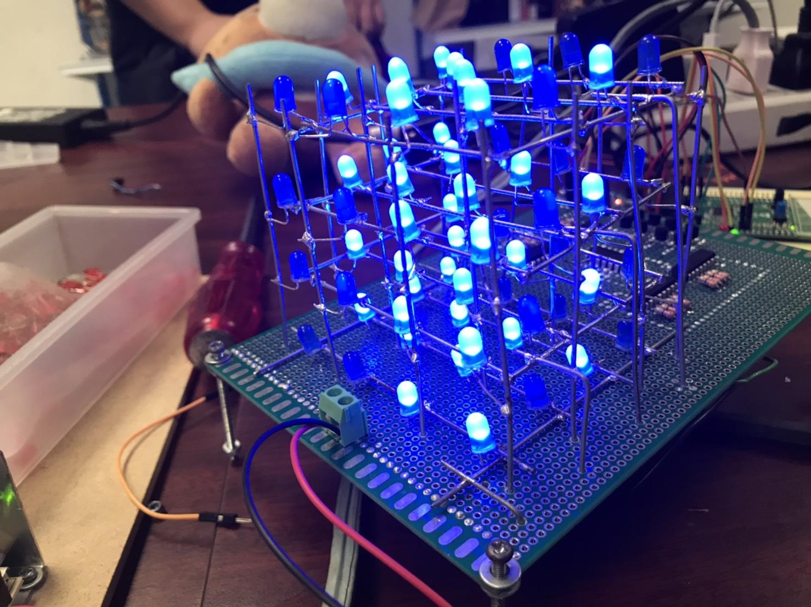
Pictures
29

Slide 31
05.
Problem and Solution
30

Slide 32
Problem and Solution
Problem with LEDs during the test because of circuit soldering
LEDs didn’t work as wish and can’t identified that the problem happened because of source code or hardware
31

Slide 33
Problem and Solution
1.Problem with LEDs during the test
Fixed the circuit soldering and re-arranged wires to make the circuit looks easier to analyze
32

Slide 34
Problem and Solution
2.LEDs didn’t work as wish and can’t identified
Move some wires, try the program with easier circuit and try to change some pins on the microcontroller to search for some errors
33

Slide 35
06.
Conclusion
34

Slide 36
Conclusion
We have made a light toy which consists 64 LEDs and it’s called “Cutie Cube”
During the work, we have met many problems eg. the circuit, the program, unknown device or even on LEDs but finally, our team can passed through these problems and can make “Cutie Cube” successfully
35

Slide 37
THANK YOU FOR YOUR ATTENTION
Any questions?
36

