Slide 1

Simple Calculator
Project done by Yeoh Kean Hooi - 2 Casmir

Slide 2
Objective
Gain Python Experience
ASK + Math
To make calculating more easier and efficient

Slide 3
Targeted Users
Children
Teenager
Young Adult
Adult
Middle-Age
Senior Citizen

Slide 4
Hardware & Software Requirement
Python 3.8 and later
Windows 7, Windows 8.1 and Windows 10 (tested on Build 1803 & Build 1909)
Mac OS X 10.11 Mavericks and later (tested on macOS 10.14 Mojave and macOS 10.15 Catalina)
7MB RAM only
Single Core CPU and higher (Intel & AMD)
x64 & x86 CPU

Slide 5
Hardware and software we use and test
Python 3.8 32-Bit (Windows)
Python 3.9 64-Bit (macOS)
Windows
Mac (Apple)

Slide 6
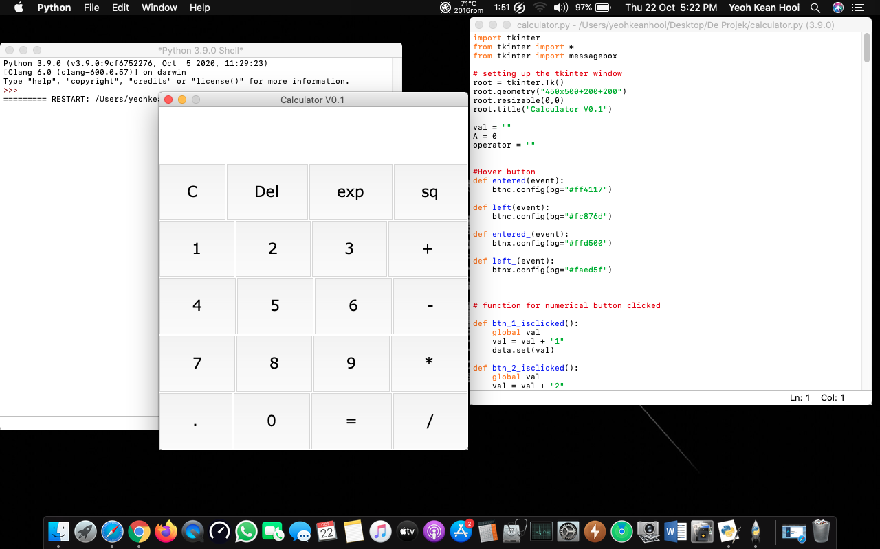
Simple Calculator running on macOS Catalina 10.15
Same Python file, no changes between Windows and Mac
*Windows will be shown later for demo

Slide 7
Demo

Slide 8
Improvement to add in the future
Sound effect that will play when you press the button
Extend the limit of number
Dark mode for macOS

Slide 9
Conclusion

Slide 10
Thank you!

