Slide 1



Project INSA - SII Auto-learning of Chatbot from manuals

Slide 2
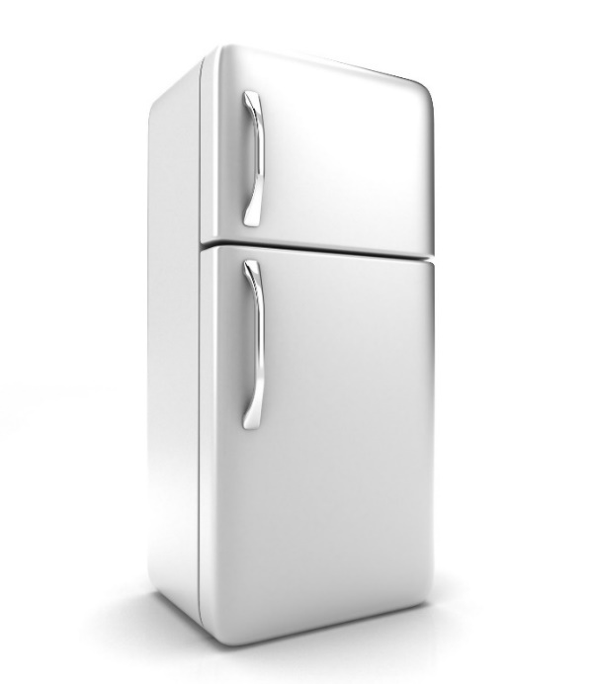
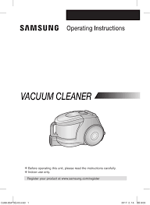
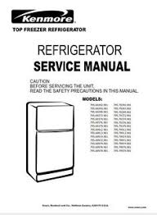
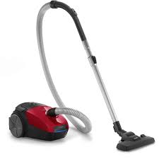
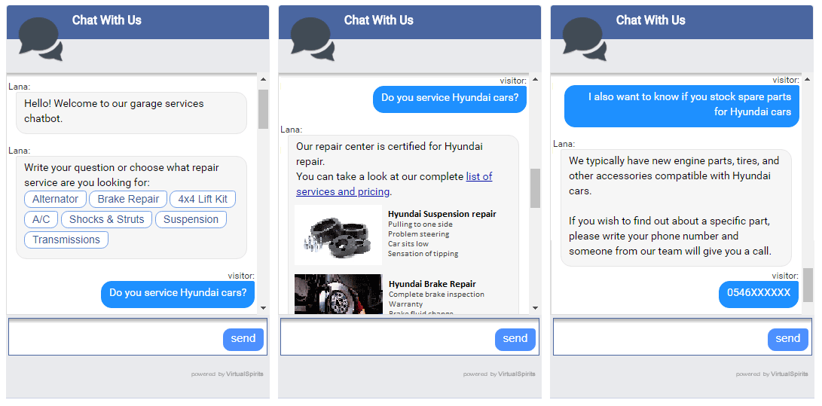
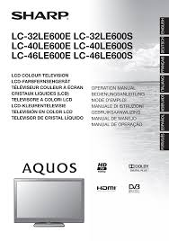
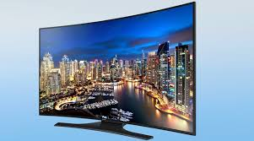
Manuals are available in every field: household appliants, client services, etc..

Slide 3
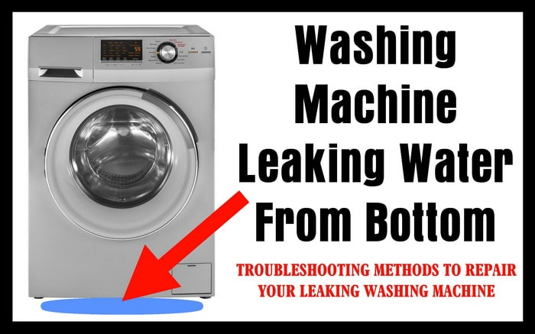
We consider washing machines’ manuals

Slide 4
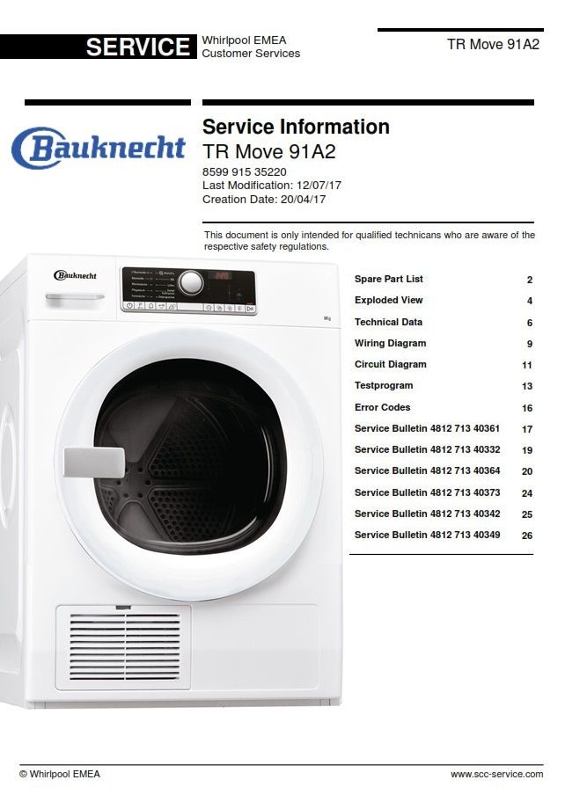

Slide 5
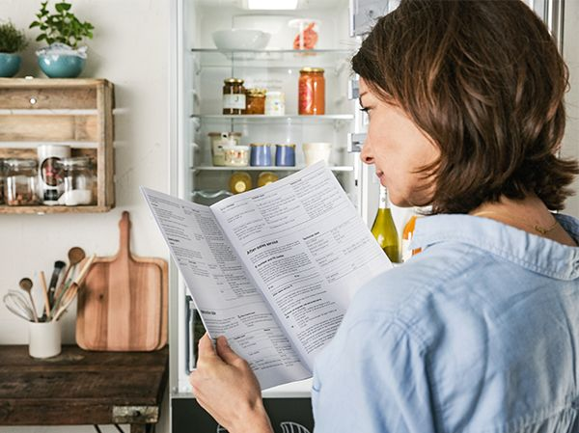
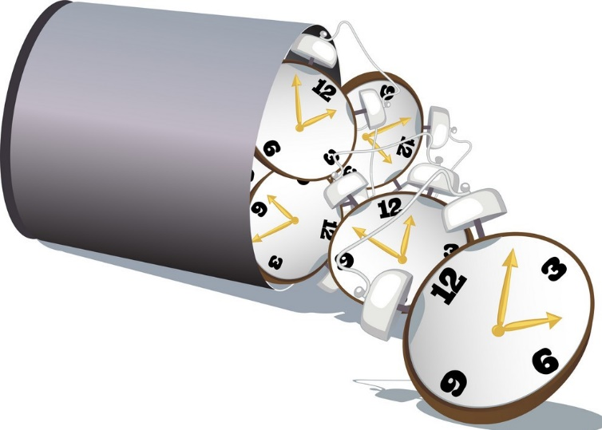
???
Wasting time!!!

Slide 6
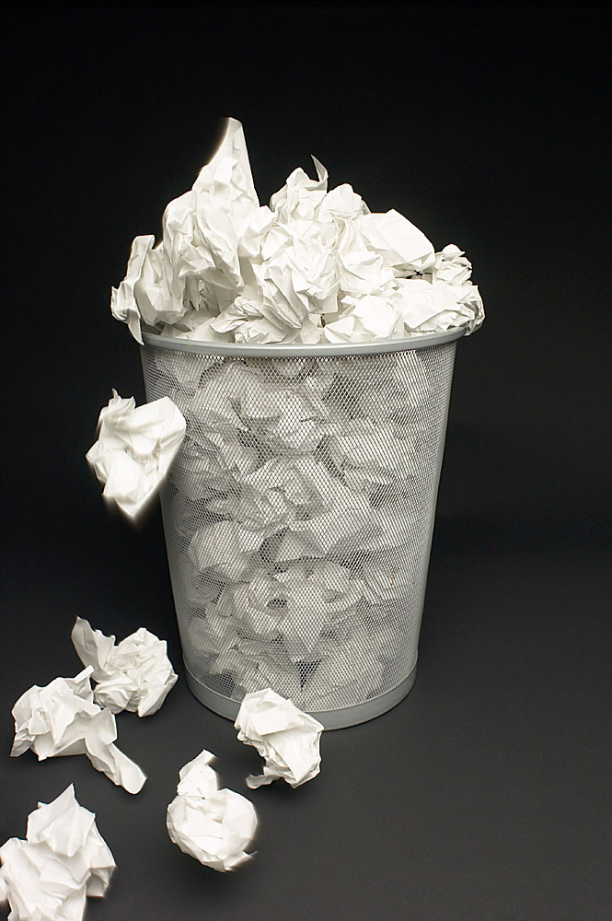
Resource wasting!!!

Slide 7

Inovative solution: Chatbot

Slide 8


Slide 9
Manuals
Data restruction
We can manually execute this procedure.
Paraphrasing
How can it become automatically done?
Creation of RASA files
Chatbot RASA

Slide 10
Demo

