Slide 1
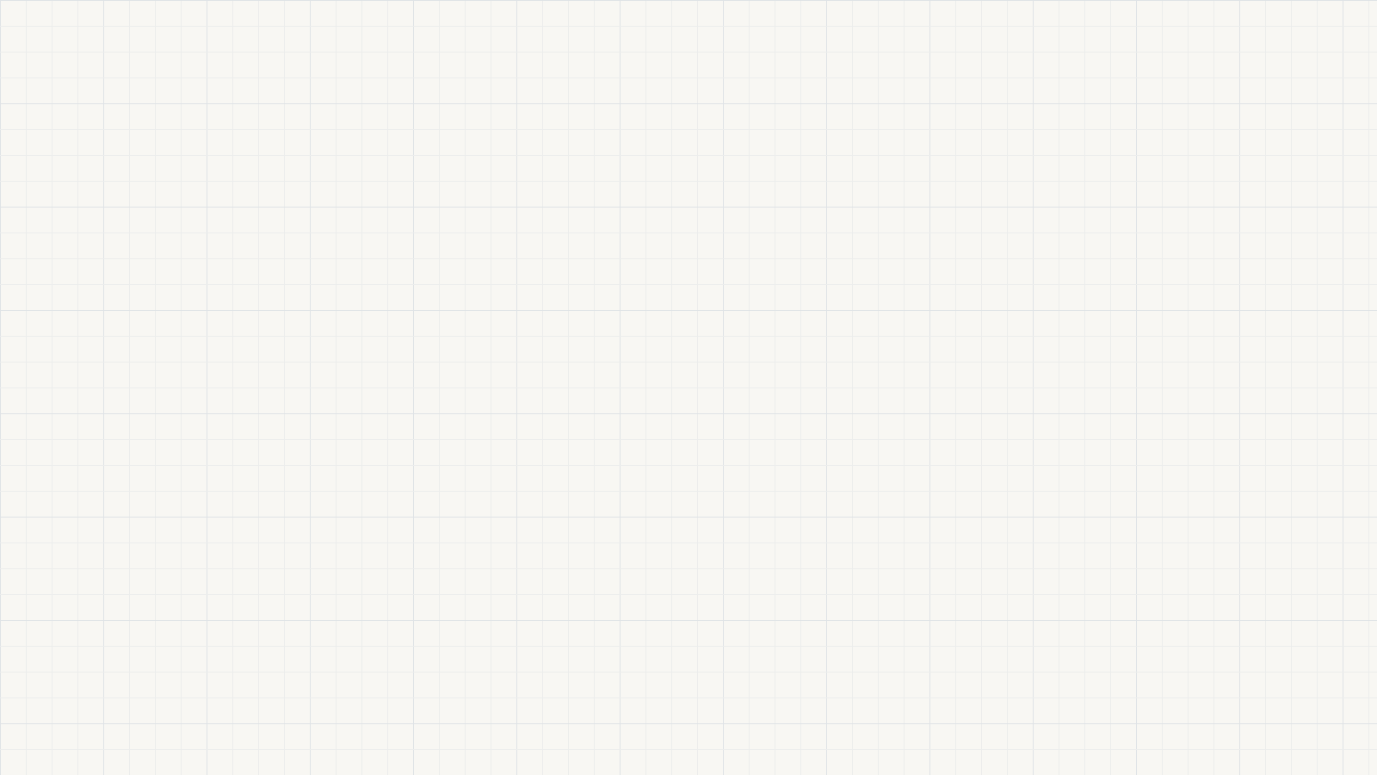
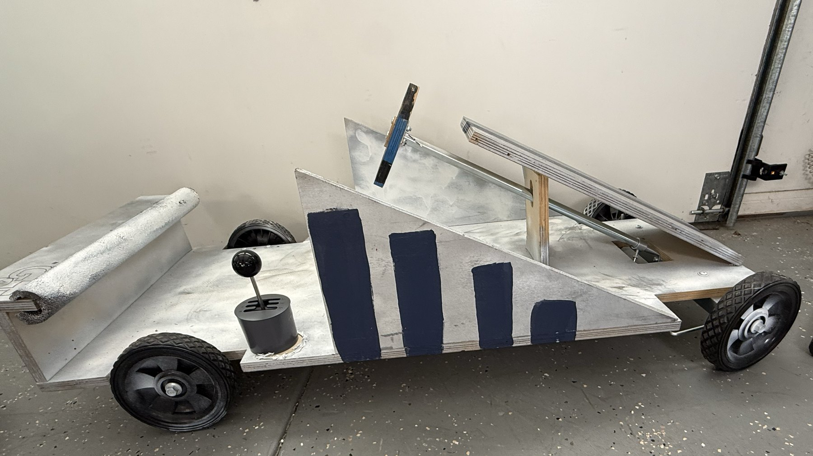
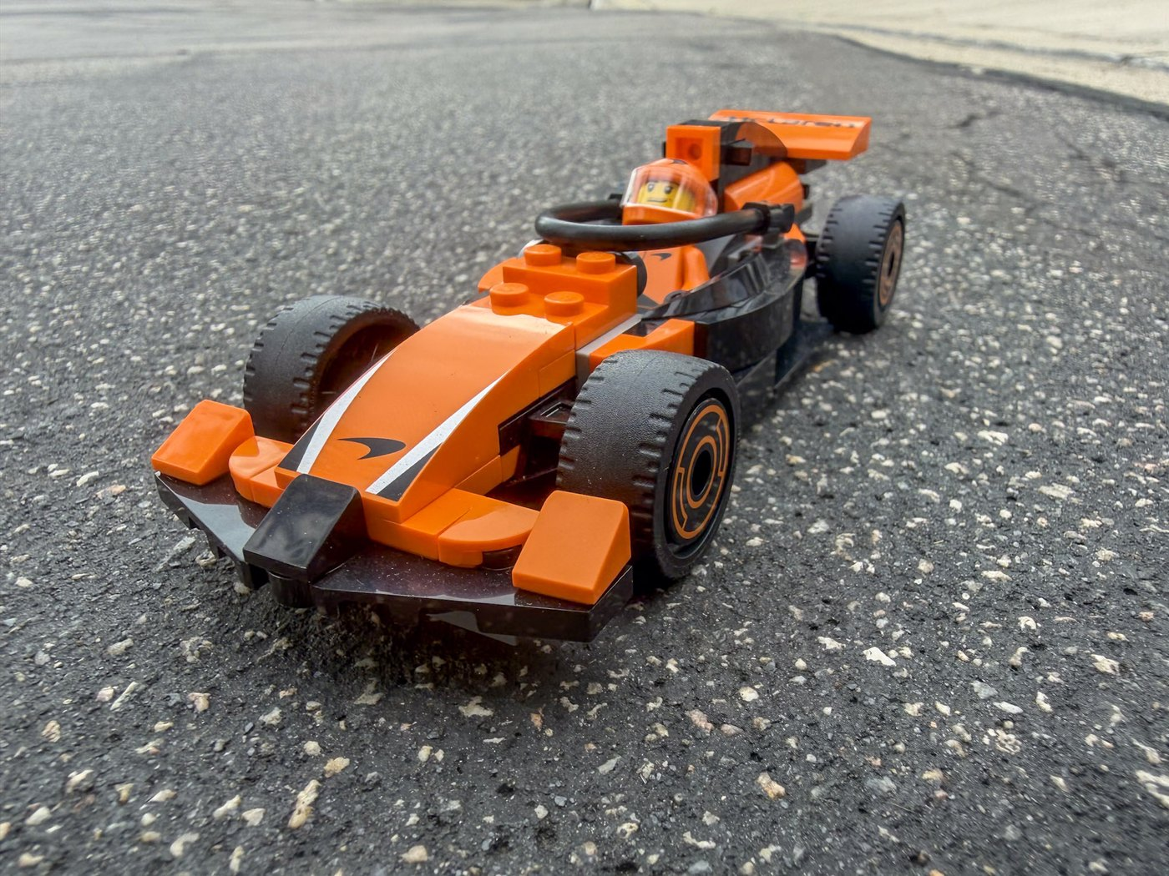
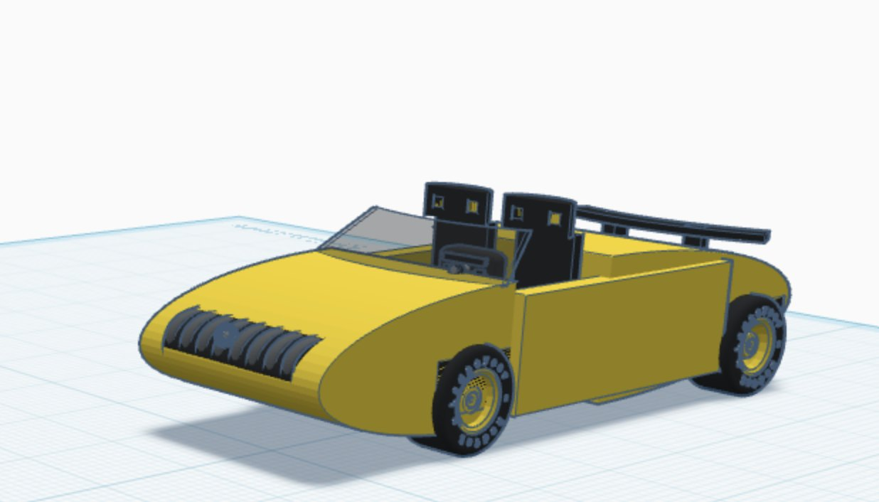
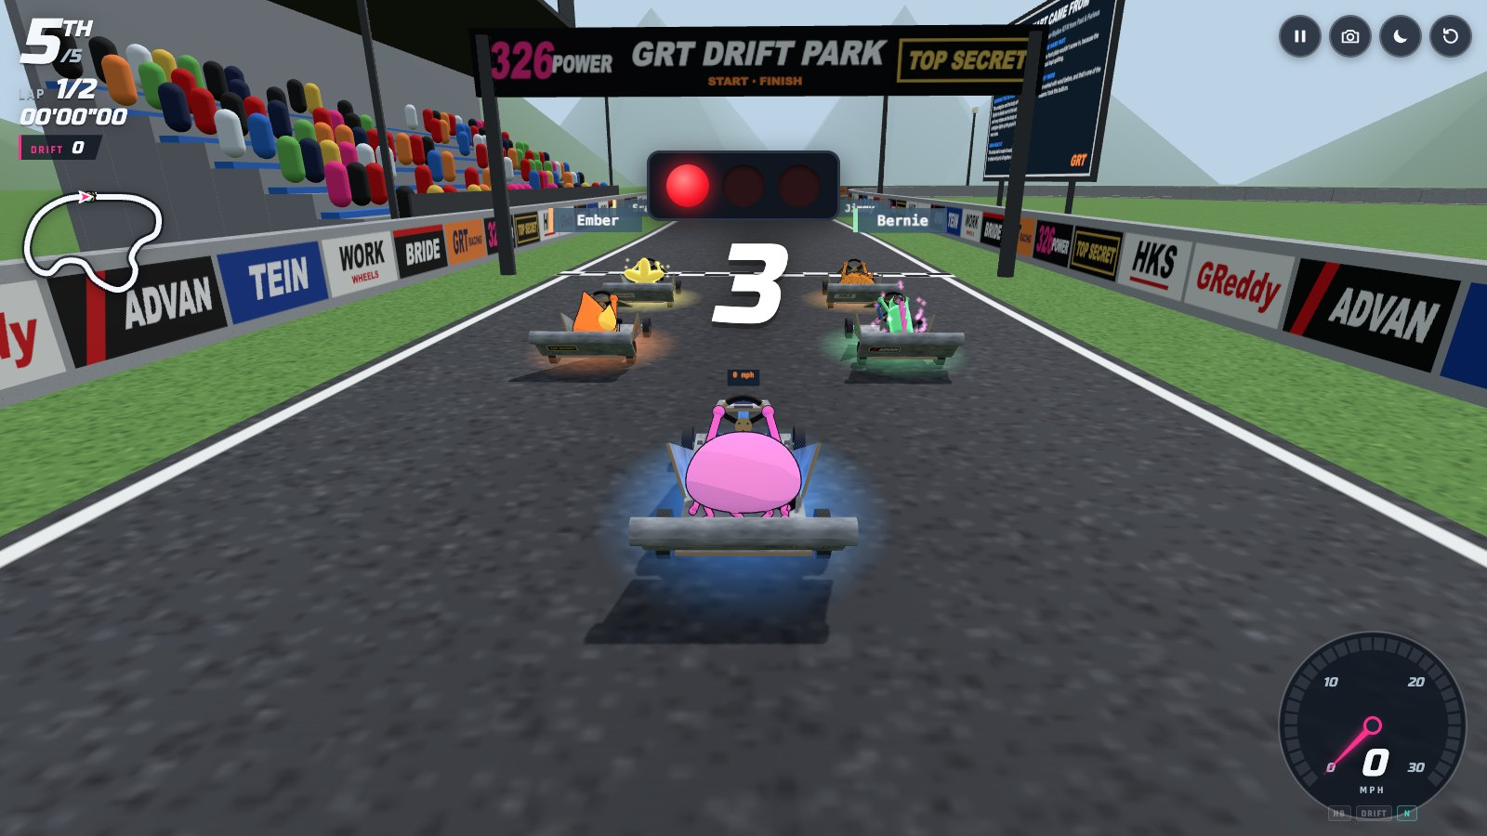
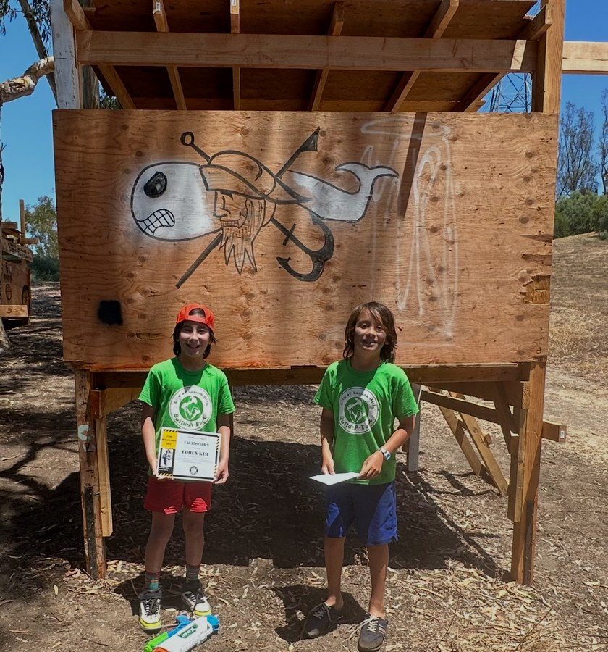
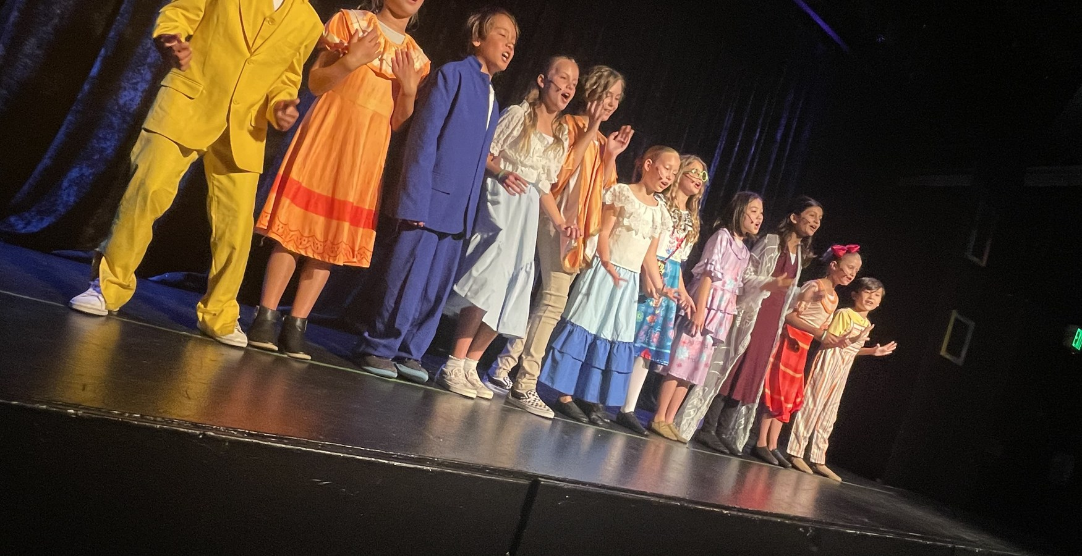

OCSA · PRODUCTION & DESIGN CONSERVATORY
ALEXANDER
KIM
PORTFOLIO
stuff I build, code, draw and design
02 Hearth (app)
05 Go-Kart Build
06 Meet the Crew
07 Go-Kart World
08 LEGO Virtual Portfolio
09 Wheelie Ride
10 The Lobby
11 Mercedes SL63
12 Poppin' Matcha Booth
13 Poppin' Matcha Ads
14 Alex & Mr. Fishy
16 The Fort
17 Birdhouse & Glider
18 Music Production
19 Encanto

Slide 2
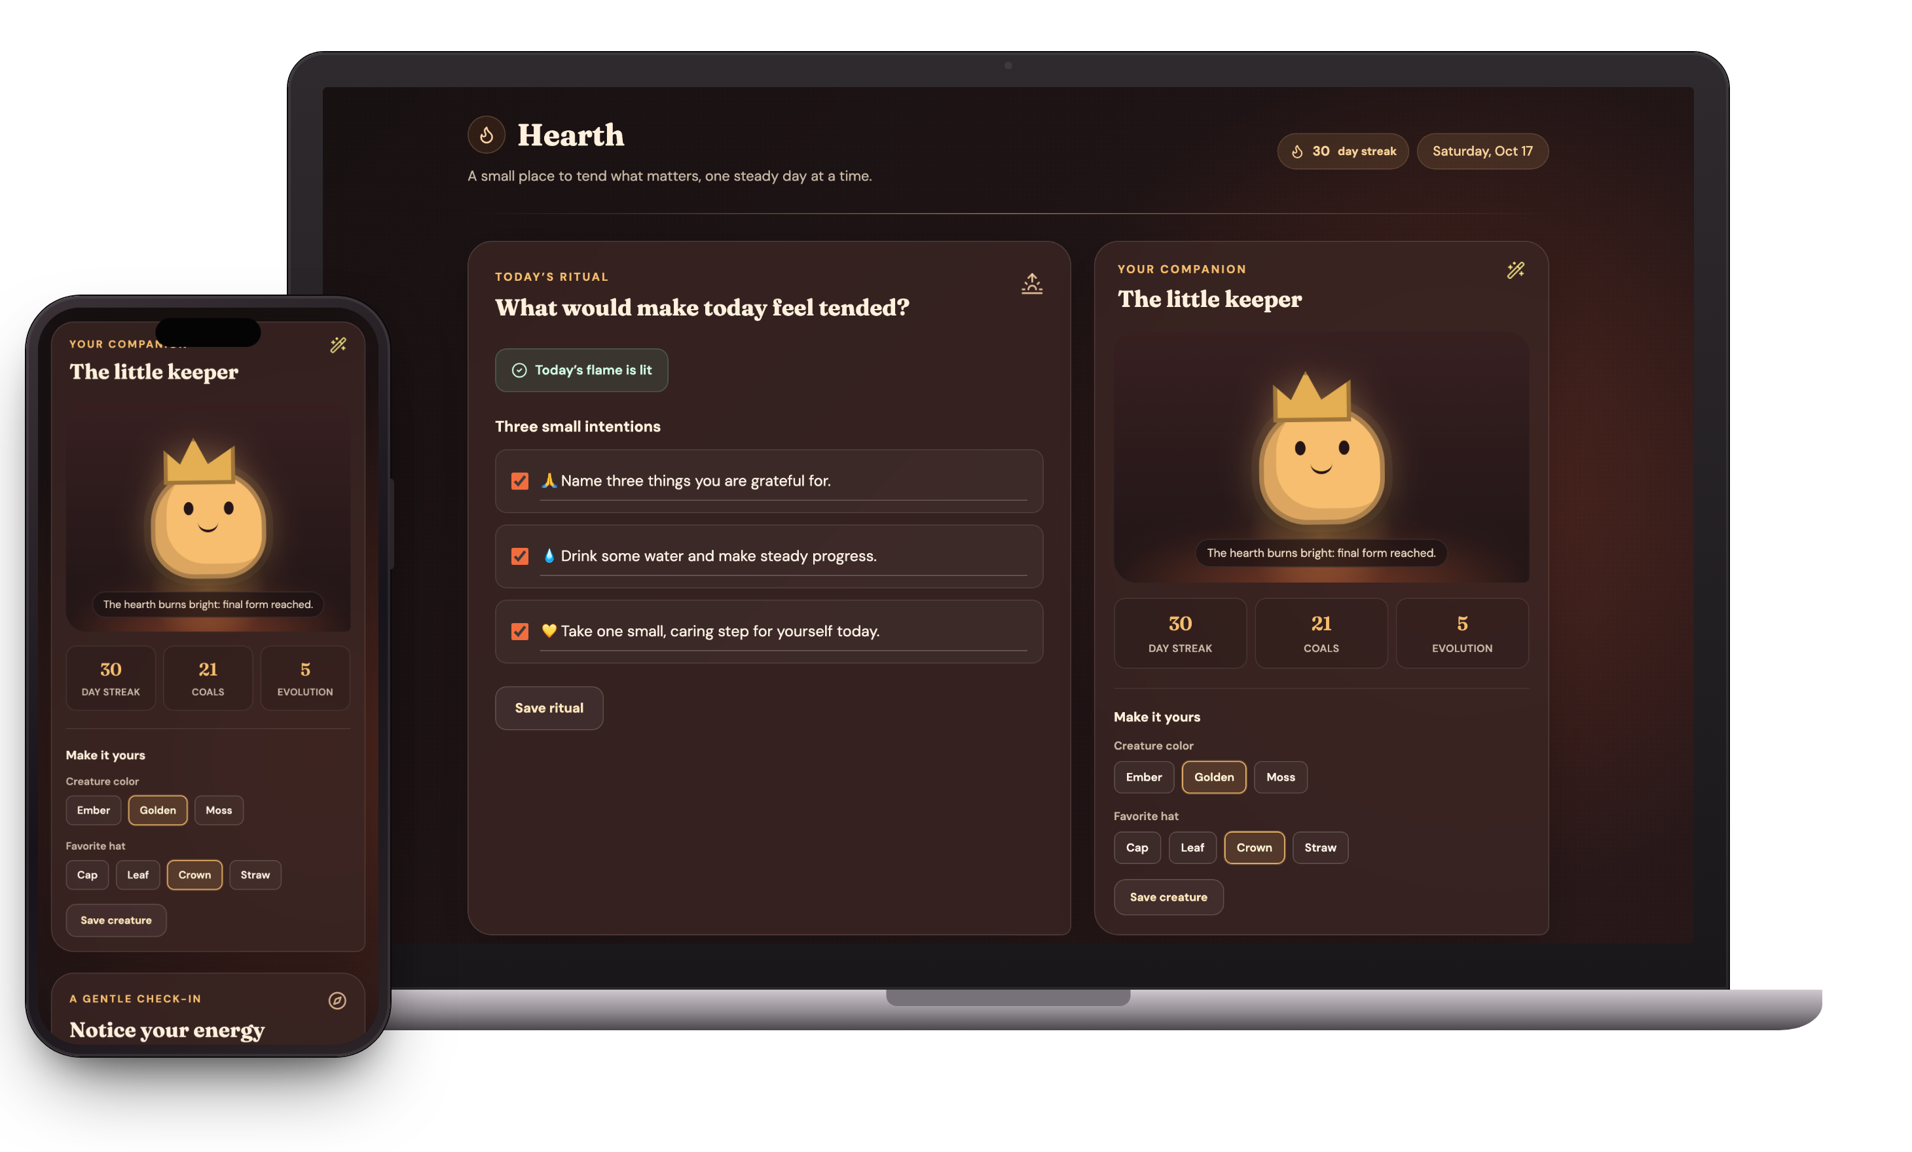
02
DESIGN & TECHNOLOGY · APP DESIGN
HEARTH
a wellness app that grows with you
■ WHAT IT IS
Hearth is a wellness app built around a daily ritual: each morning it asks “What would make today feel tended?” and you set three small intentions. A quick check-in on your mood, energy and stress shapes kinder goals, an “I’m feeling” page suggests ways to cope, and you get a companion that grows with your streak.
■ MY ROLE
I was the designer and coder: I came up with the idea, designed every screen and feature, and coded it by directing an Agent coding tool for the OC Student AI Network.
■ WHY I INCLUDED IT
Like a lot of students, I juggle assignments, deadlines and social pressure, and I wanted a calm way to take each day one step at a time. I noticed a lot of people make games, so I wanted to make something that stood out and could actually help.
no ads, no tracking!
3
28
0
INTENTIONS A DAY
DAYS TO THE FINAL FORM
DATA COLLECTED
ALEXANDER KIM
PORTFOLIO · 02 / 19

Slide 3
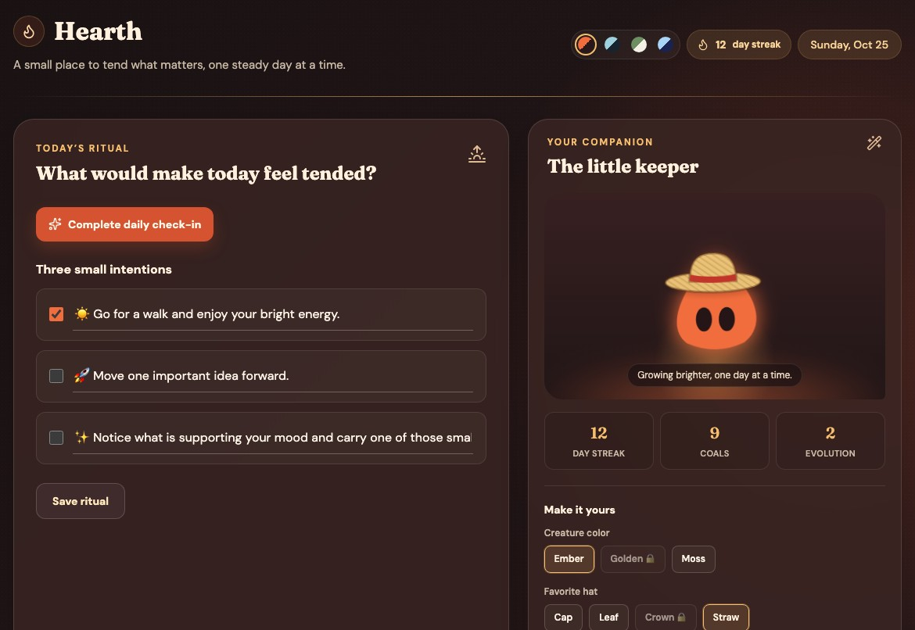
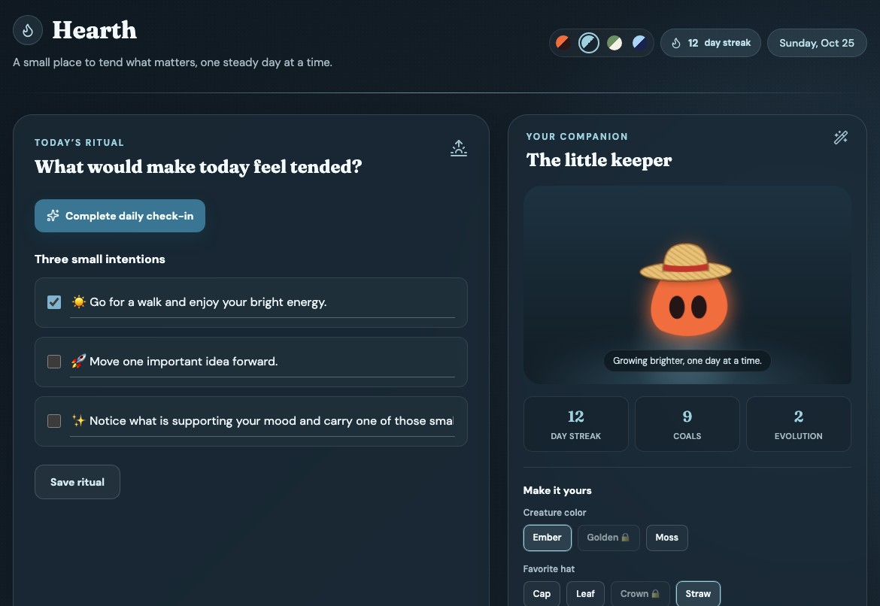
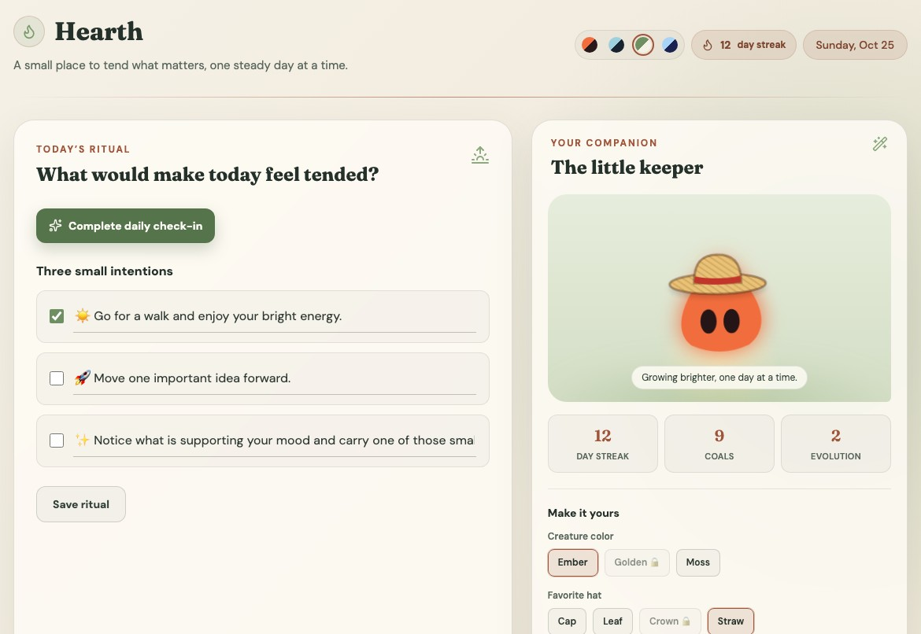
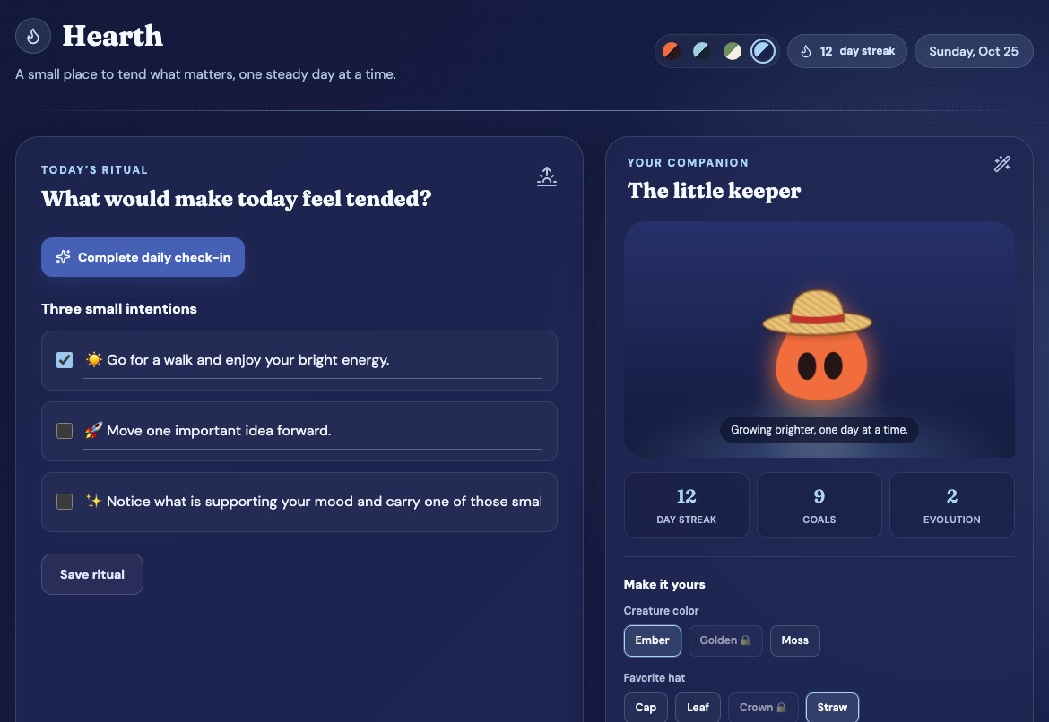
03
HEARTH · COLOR & MOOD
COLORS THAT MATCH YOUR MOOD
Colors change how people feel, so I designed four calm themes you can switch between depending on your mood. Each one comes from a place or memory that makes me feel calm.
EMBER
TIDEPOOL
MORNING MEADOW
MARSHY
cozy + comforting
serene + connected
fresh + hopeful
soft + safe
From camping trips with my mom, where the campfire is one of the most comforting feelings I know.
From exploring tide pools as a kid, where every animal was relaxed and the ecosystem worked as one.
From mornings lying in the grass under a blue sky, with nowhere to be and a whole new day ahead.
From Marshy, my sequined midnight-blue sheep, who kept me company on the darkest nights.
ALEXANDER KIM
PORTFOLIO · 03 / 19

Slide 4
04
HEARTH · MY PROCESS
TURNING PROBLEMS INTO SOLUTIONS
1
2
3
4
THINK
OUTLINE
BUILD
TEST & FIX
I sat down and asked myself what tool could make the world better and isn’t out there enough.
I wrote the main outline: a daily check-in, three goals, and a creature that grows.
I built it by prompting an Agent coding tool, one feature at a time.
I tested each part, and when something broke I found another way.
■ WHAT DIDN’T WORK, AND WHAT I DID ABOUT IT
The app wouldn’t load
The Agent got stuck on goals
The shop locks free hats
My first version wouldn’t run at all.
It kept misreading the goals feature and handing back the same broken answer, no matter how I prompted it.
The Agent decided you have to buy the free hats for your creature.
Fix: I loaded it on a personal account, and it worked.
Fix: I turned the problem into the solution: a goal tracker you set up yourself with short surveys.
Fix: Still working on it, and it’s next on my list.
FIXED
FIXED
IN PROGRESS
ALEXANDER KIM
PORTFOLIO · 04 / 19

Slide 5
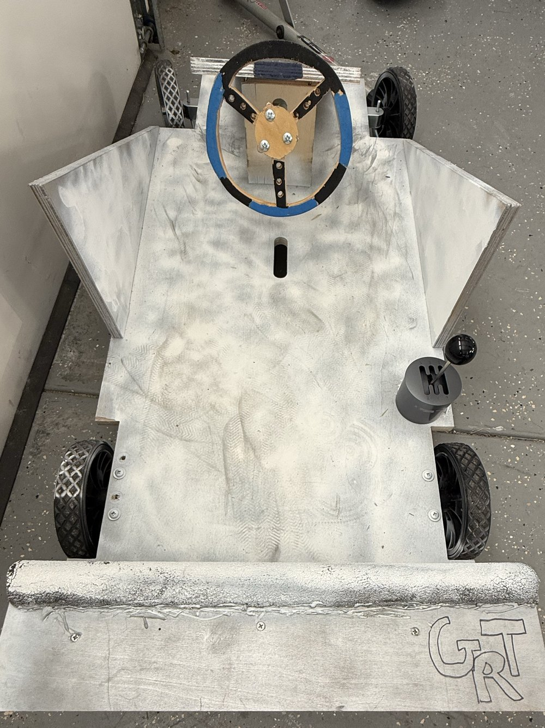
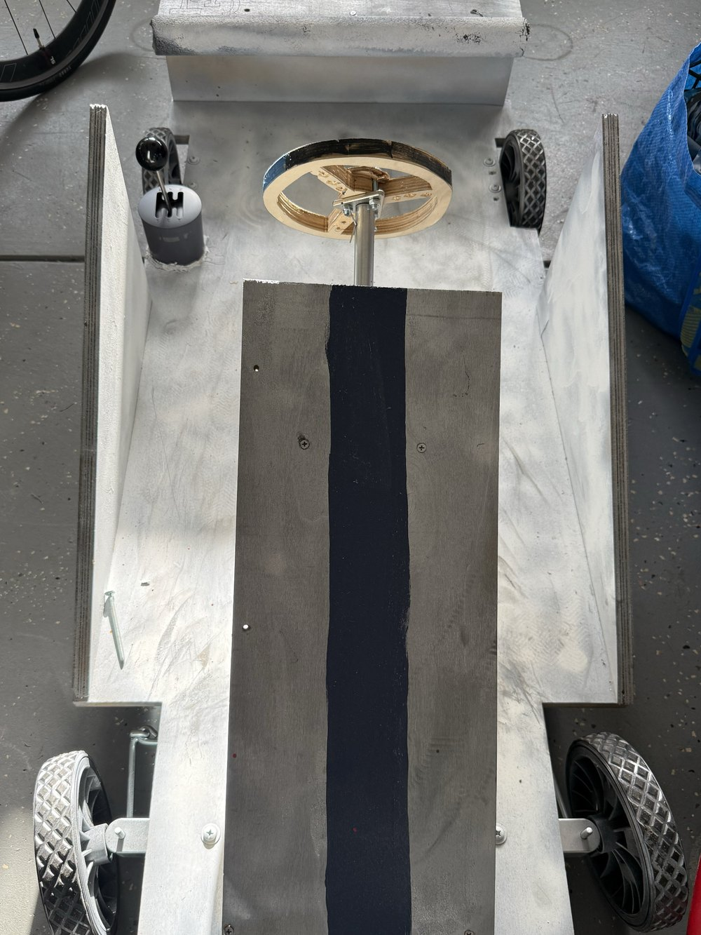
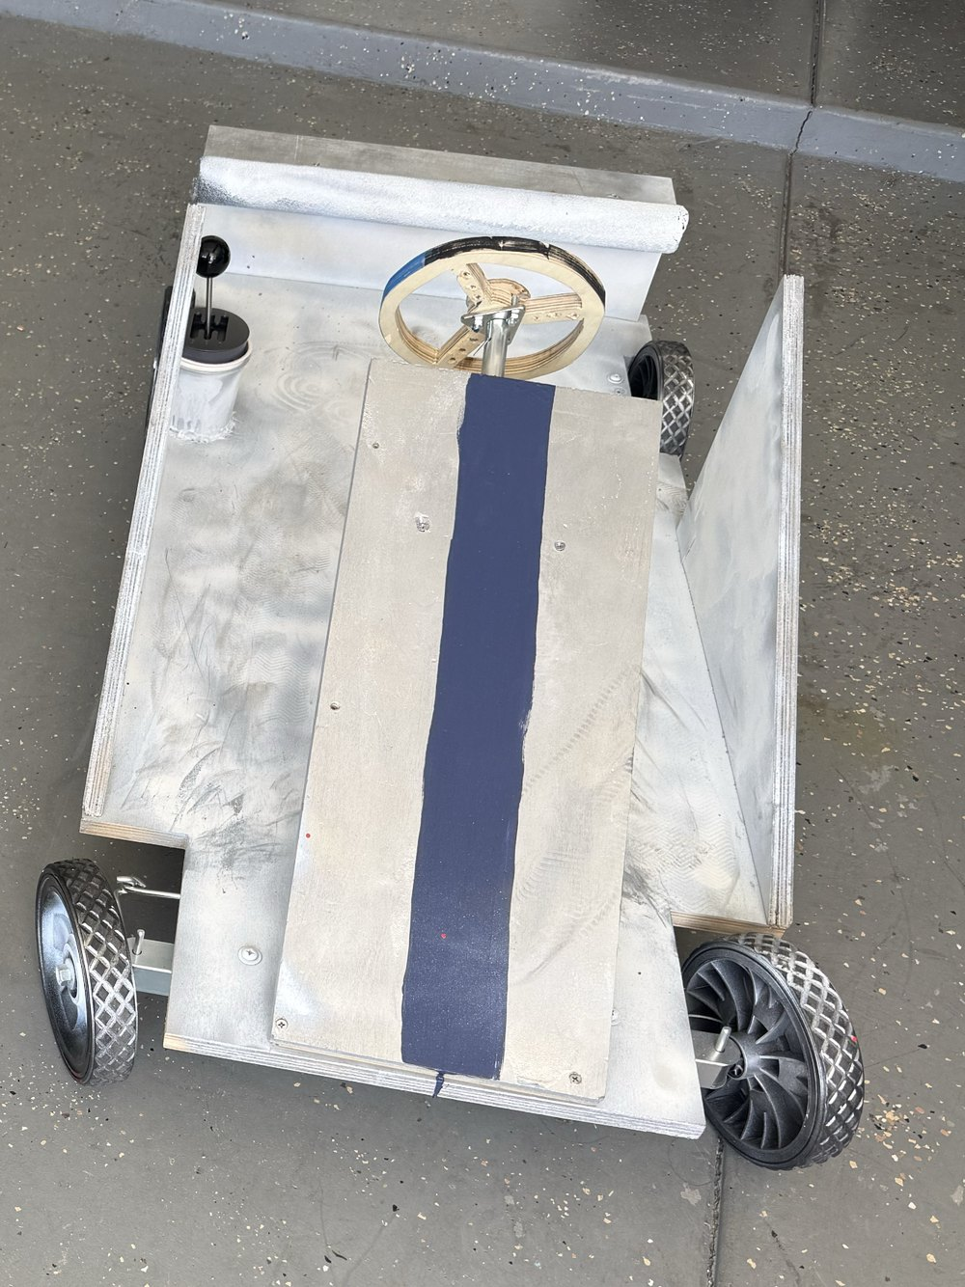
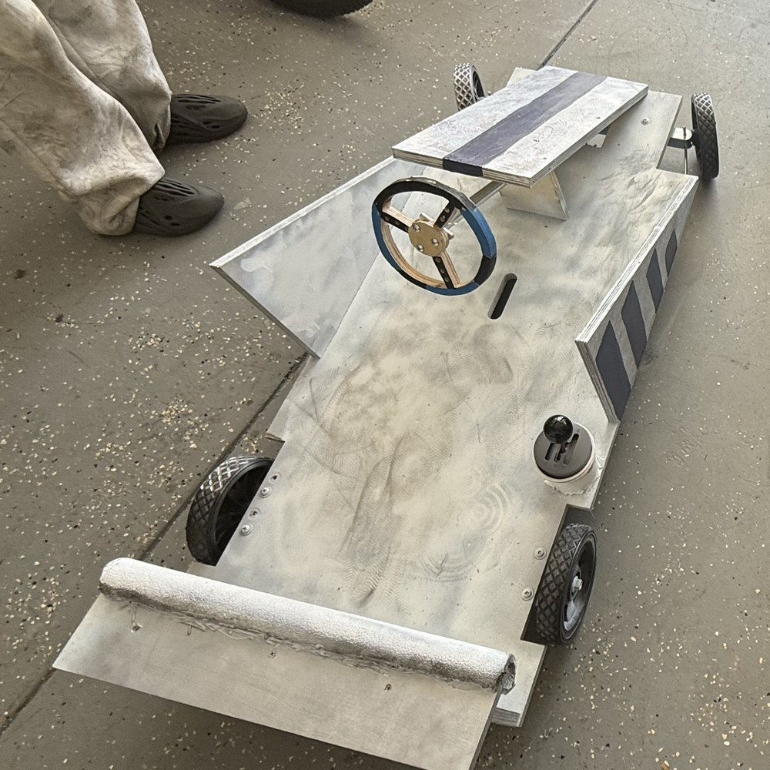
05
BUILDING & MAKING · ENGINEERING
4
GO-KART BUILD
■ WHAT IT IS
This summer I went to a go-kart camp and built my own kart.
■ MY ROLE
I built the frame, added a stick shifter, and painted it. My favorite car is the Nissan Skyline, so I based the look on Brian’s Skyline from Fast & Furious: silver with blue stripes, plus blue underglow lights to make it more realistic.
■ WHY I INCLUDED IT
It’s the first real vehicle I’ve built, and it’s what inspired my racing game.
4 GTR = the car name
1
3
2
■ THE SKYLINE LOOK
Silver body
Navy stripes
Blue underglow
1 the frame
3 paint + stripes
2 stick shifter!
ALEXANDER KIM
PORTFOLIO · 05 / 19

Slide 6
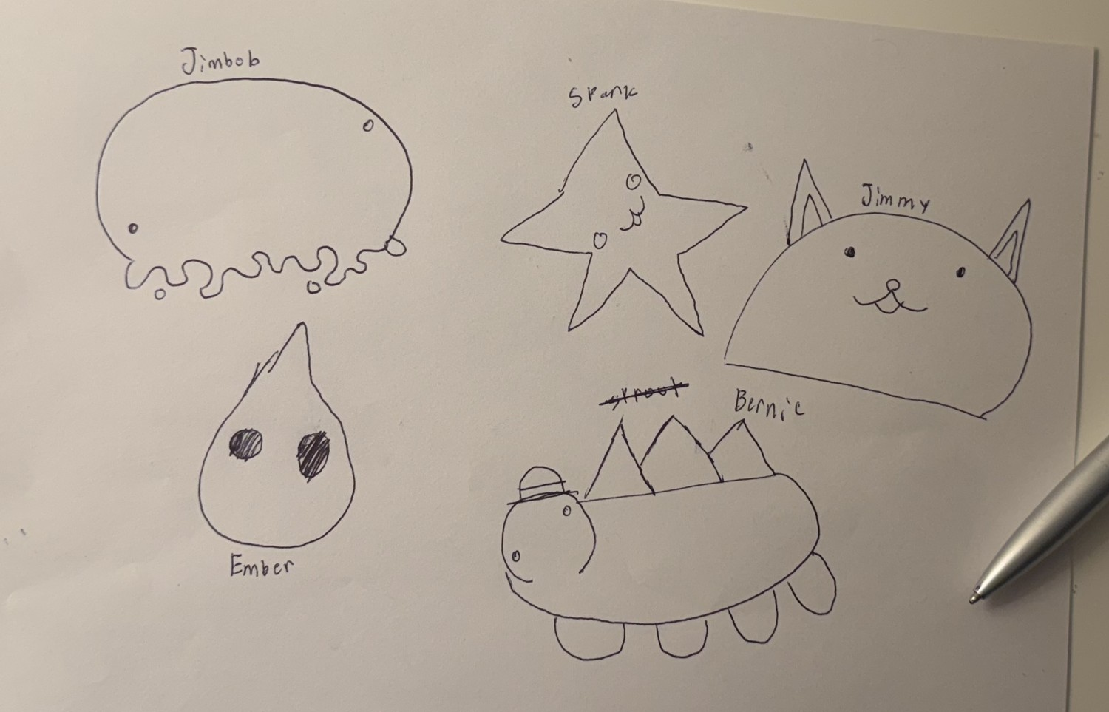
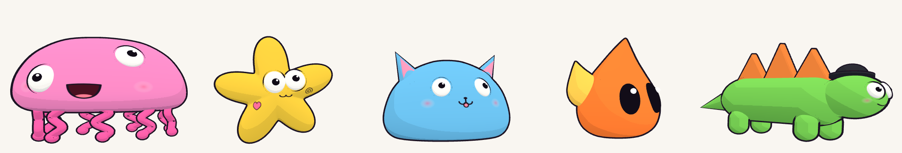
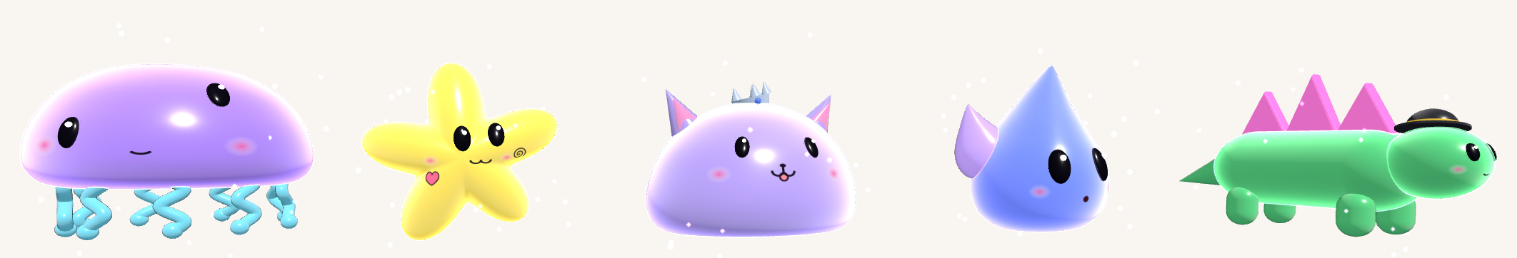
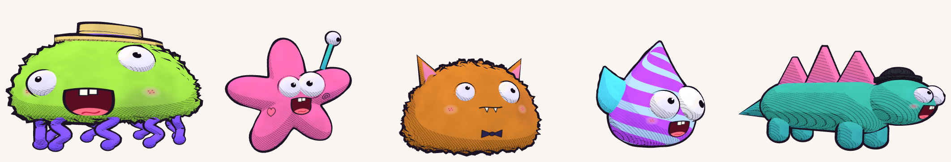
06
CHARACTER DESIGN · SKETCH TO 3D
MEET THE CREW
Jimbob, Srank, Jimmy, Ember and Bernie are five characters I invented and first drew in pen on paper. I turned each sketch into a 3D character, then tried every one in three looks inspired by cartoons and games I studied. I included them to show my process: how a quick doodle grows into a finished character without losing what made the drawing special. They’re the racers in my go-kart game.
■ 1 SKETCH ON PAPER
■ 2 BRING THEM TO LIFE IN 3D, IN THREE LOOKS
JIMBOB
SRANK
JIMMY
EMBER
BERNIE
TOON
flat + bold
GALAXY
shiny glow
PAINTED
Bernie was almost named Sprout. It’s still crossed out!
fuzzy + wobbly
ALEXANDER KIM
PORTFOLIO · 06 / 19

Slide 7

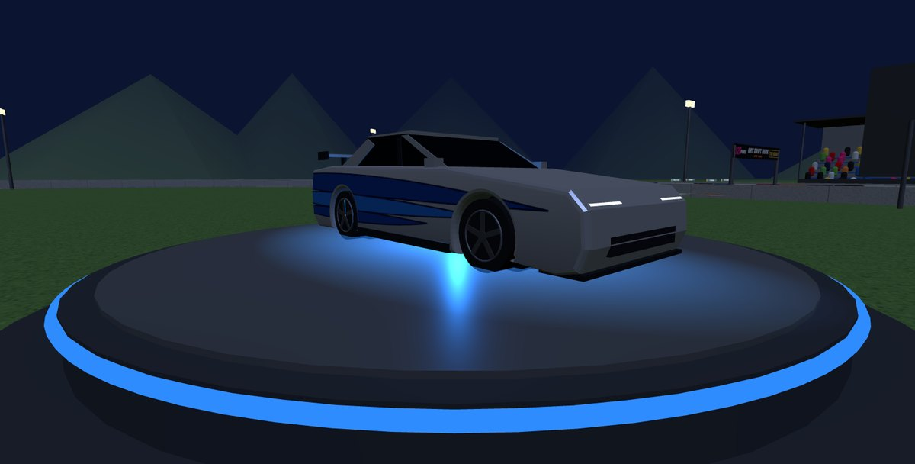
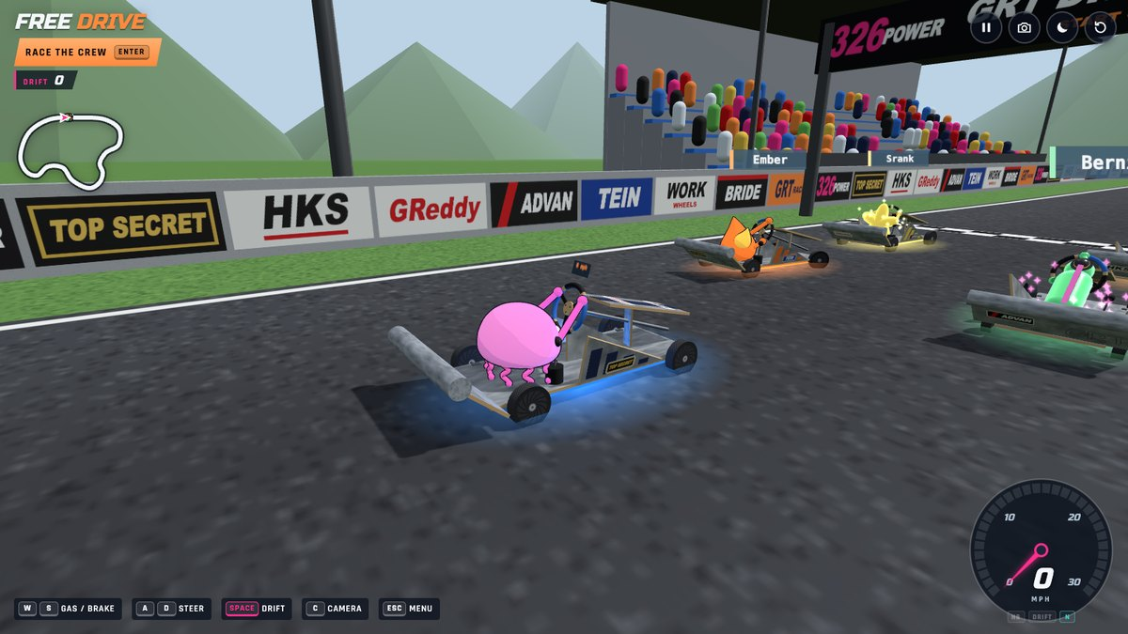
07
CODING · GAME DESIGN
GO-KART WORLD
■ WHAT IT IS
I’m really into racing games, so I made a 3D racing game inspired by the go-kart I built and the Crazy Cart I’m customizing.
■ MY ROLE
I drew the characters by hand, then built the game in Visual Studio Code using an agent orchestration harness with the Opus 5.5 model. I added different modes, a drift track and details like sponsor banners inspired by real racing brands, plus Brian’s Skyline turning on a stand in the middle.
■ WHY I INCLUDED IT
It shows how I turn something I built in real life into something people can play.
racing brands on the walls
my crew, drawn by hand
Brian’s Skyline
drifting past the crew
■ MODES + FEATURES
RACE THE CREW
FREE DRIVE
DRIFT POINTS
NIGHT
4 CAMERAS
VR
RACE HUD
ALEXANDER KIM
PORTFOLIO · 07 / 19

Slide 8
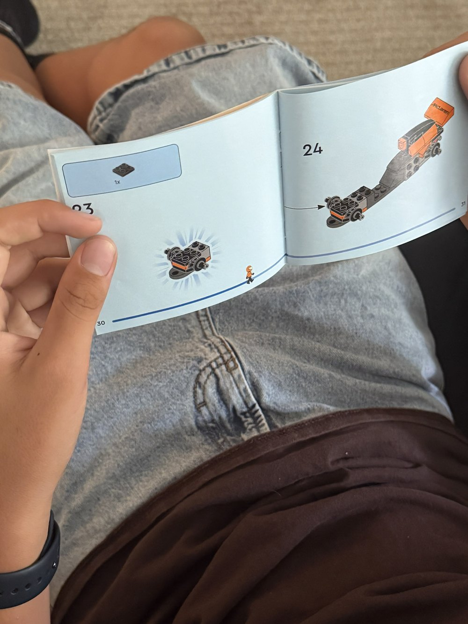
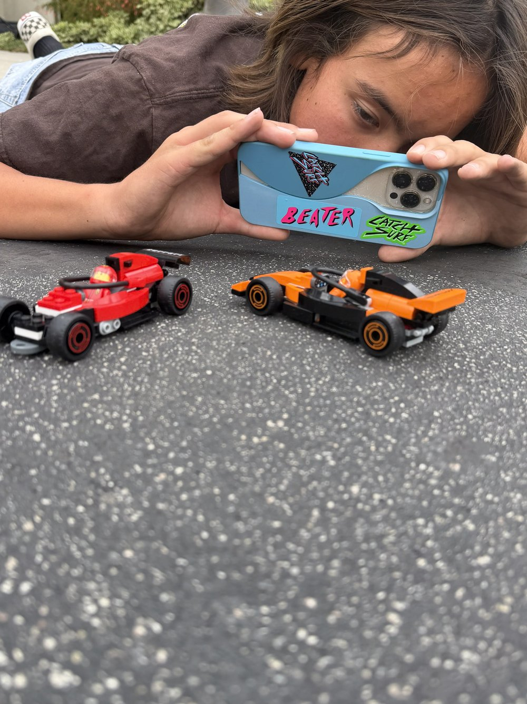
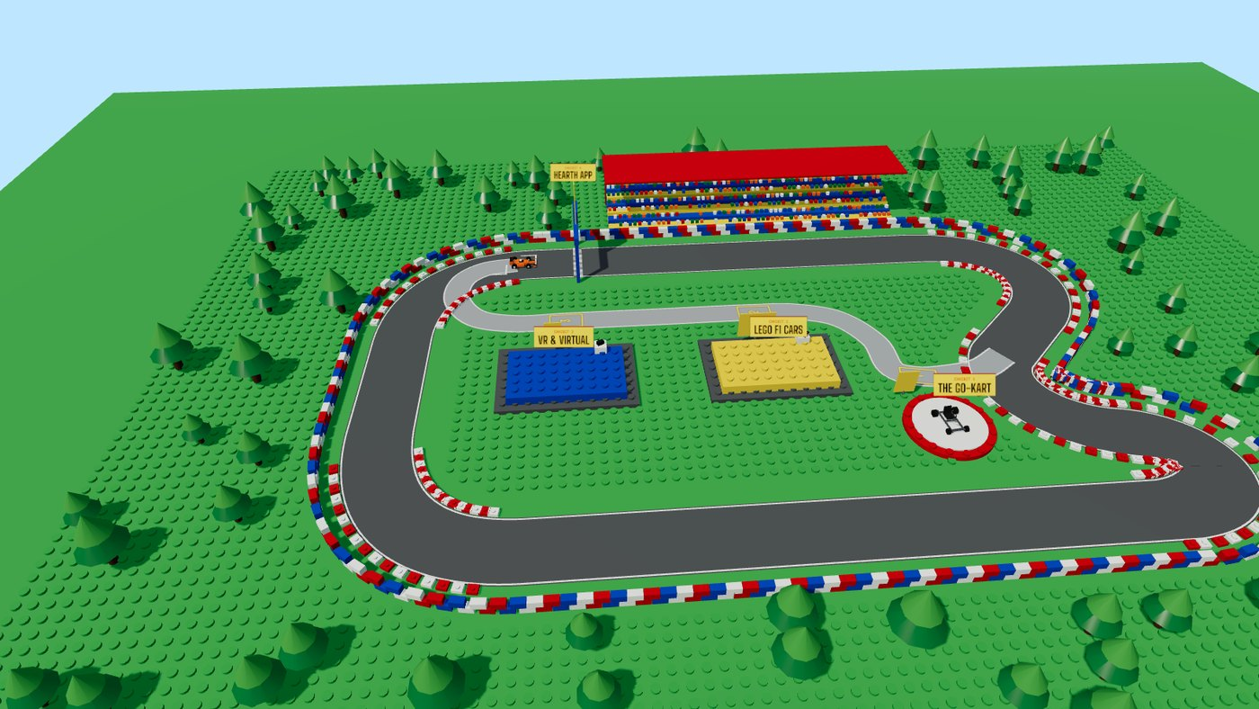
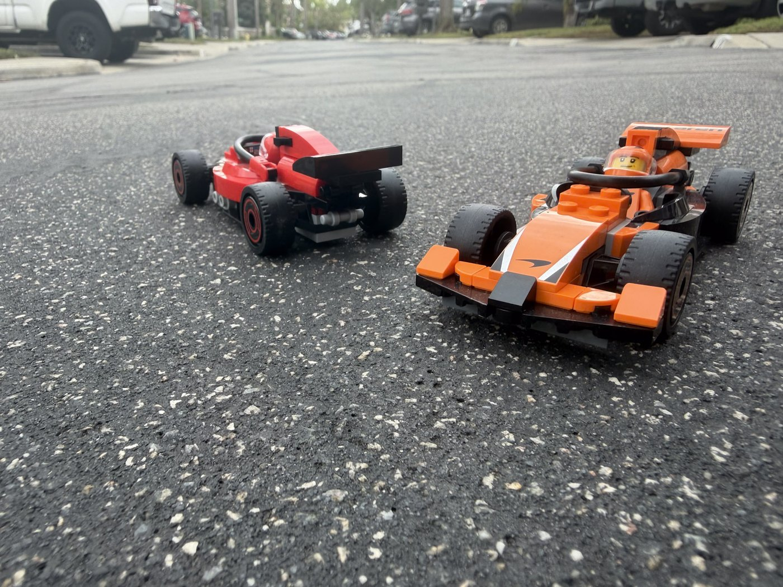
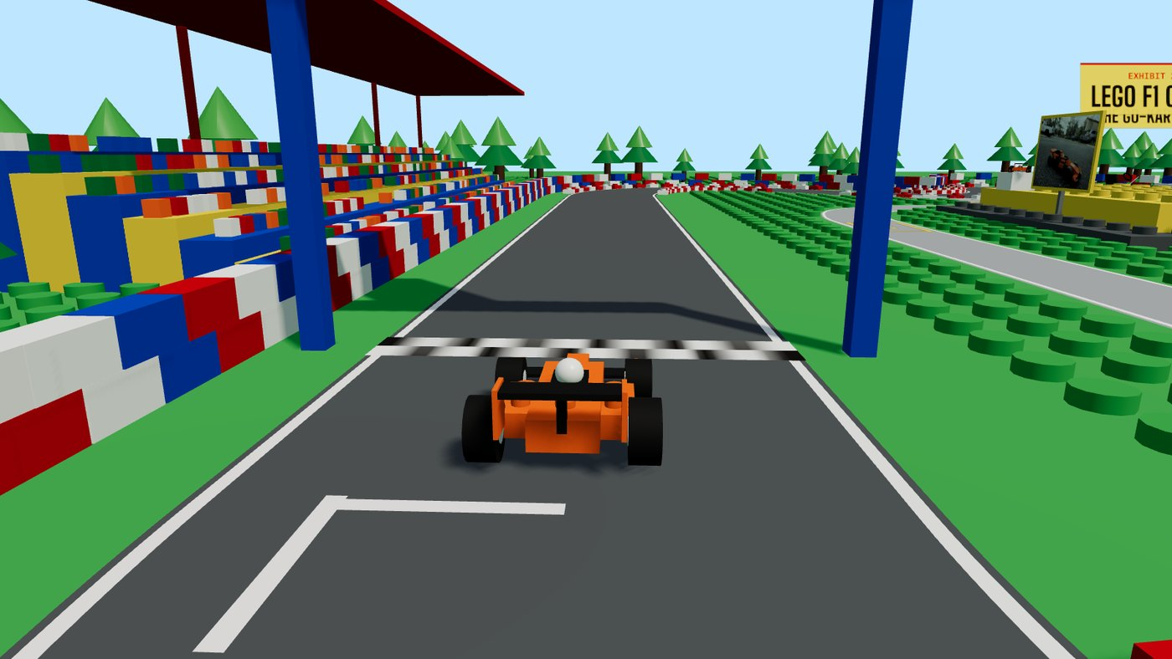
08
BUILDING & MAKING → 3D CONCEPT
LEGO VIRTUAL PORTFOLIO
■ REAL BRICKS
■ VIRTUAL CIRCUIT (BRICK BUILT)
I shot them at street level so they look real
same orange car, now you drive it
■ WHAT IT IS
I built two LEGO F1 cars and photographed them outside at street level, so they look like real race cars.
■ MY ROLE
Then I used them to design a virtual portfolio: a LEGO-scale 3D race track where you drive my orange car and pull in to see each project.
■ WHY I INCLUDED IT
It shows how something I built with my hands became the idea for a bigger digital world.
ALEXANDER KIM
PORTFOLIO · 08 / 19

Slide 9
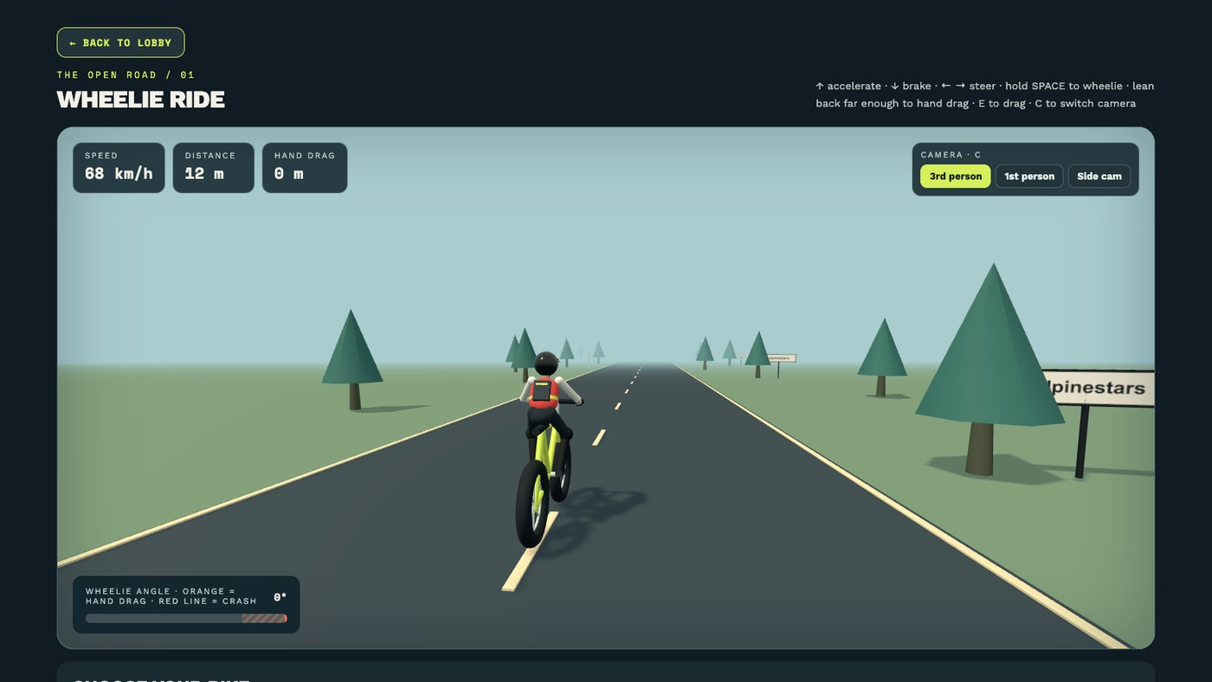
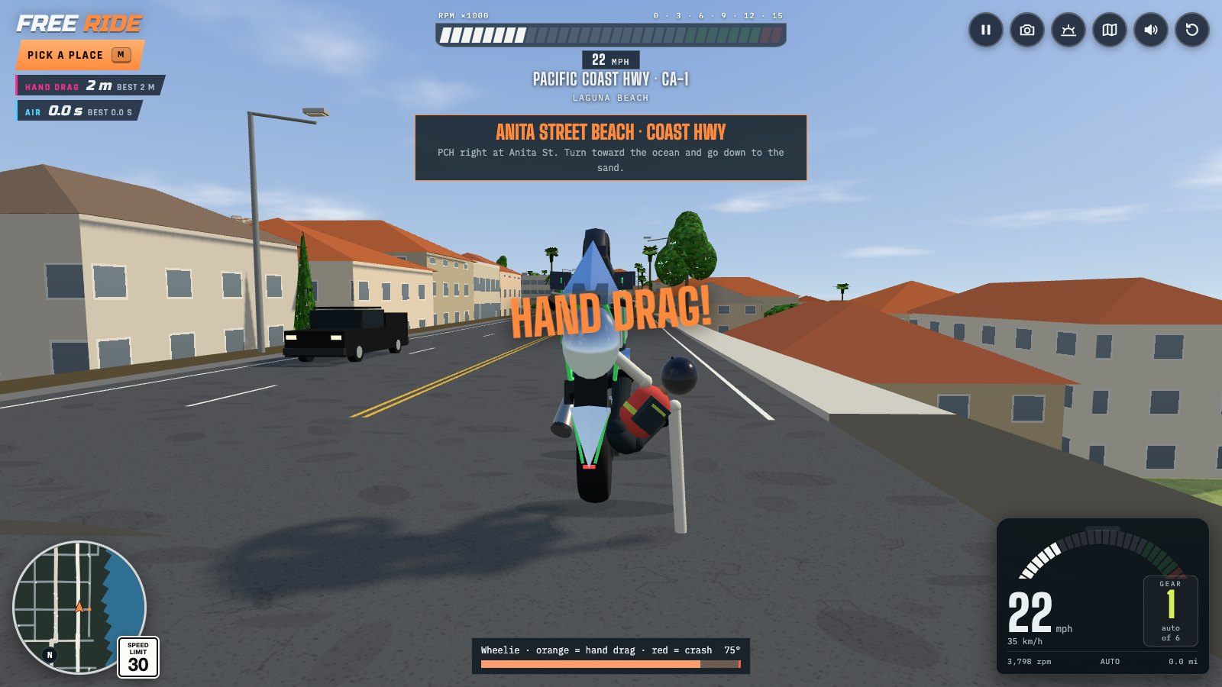
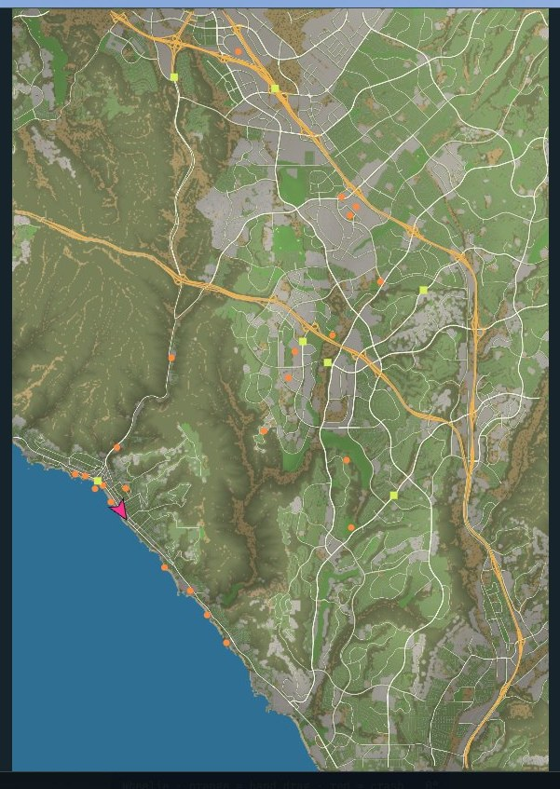
09
CODING · GAME + REAL MAP DATA
■ VERSION 1 · ONE STRAIGHT ROAD
15,900
REAL ROADS
WHEELIE RIDE
104,600
REAL BUILDINGS
■ WHAT IT IS
A 3D game where you pick a bike and hold a wheelie as long as you can without looping out. Version 1 was one straight road, so for Version 2 I rebuilt it in my own Orange County neighborhood with real map data.
■ MY ROLE
I designed and built both versions, and I wrote down every problem and fix in a release log.
■ WHY I INCLUDED IT
It shows how I keep improving my projects after version 1.
15 × 21 km
OF MY REAL MAP
■ VERSION 2 · MY NEIGHBORHOOD IN ORANGE COUNTY
■ WHAT I LEARNED (FROM MY RELEASE LOG)
1 Test your data, not just your code. The ocean came out as dry land because the elevation data said the sea was 0 m high, same as a beach.
2 Faking movement is easy until you want to go somewhere. A real position and heading made maps, traffic and landmarks possible.
3 Always test the extremes. I only found a camera bug by testing the fastest bike.
REAL GEARS
JUMPS
CRASH PHYSICS
LIVE SOUND
click a road to ride there
ALEXANDER KIM
PORTFOLIO · 09 / 19

Slide 10
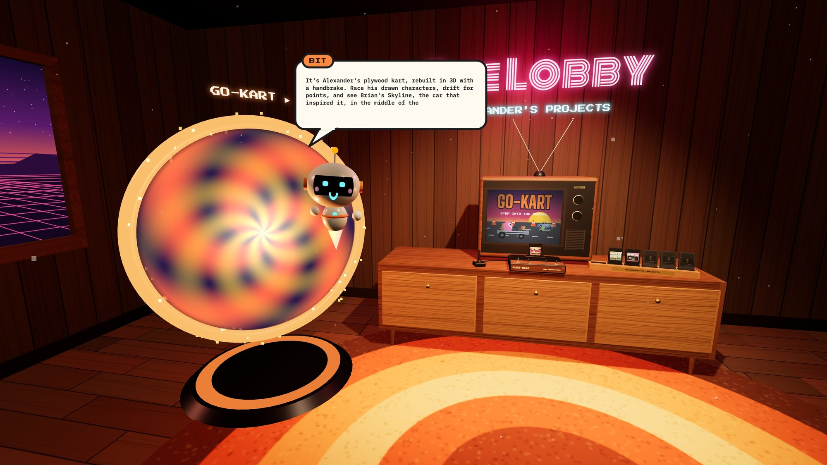
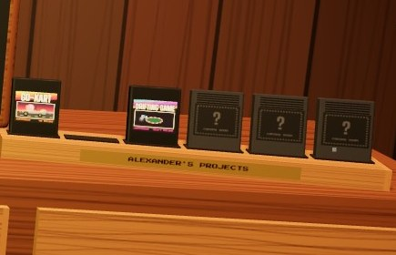
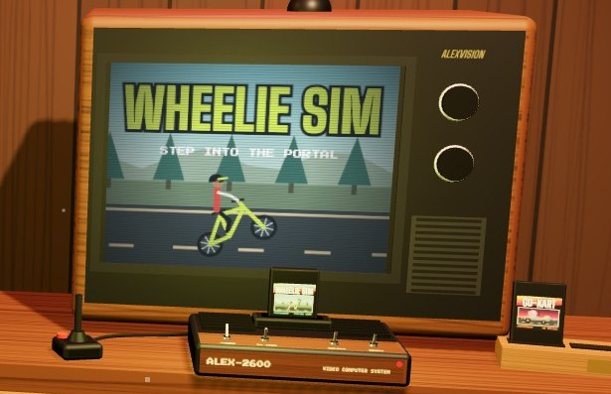
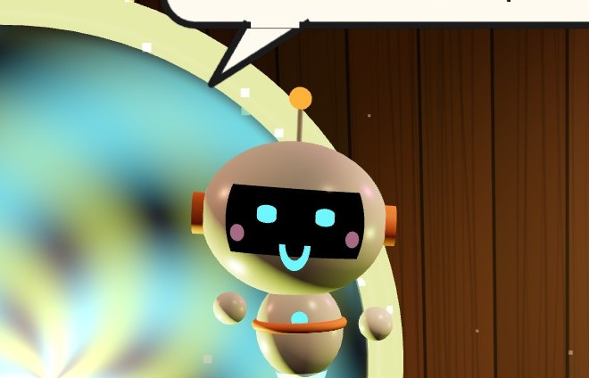
10
CODING · 3D / VR CONCEPT
THE LOBBY
■ WHAT IT IS
A 3D game room for all my projects. Each project is a game cartridge you plug into my ALEX-2600 console, then you step through a portal into the game. Bit, a little robot, shows you around.
■ MY ROLE
I sketched this concept to showcase my work, then turned it into a 3D experience you can explore in a browser or a VR headset.
■ WHY I INCLUDED IT
I love the idea of a gaming system that plays the games I’m building, with a virtual robot as your guide.
my projects, as game cartridges
■ HOW IT WORKS
1
PICK A CARTRIDGE
2
PLUG IT IN
3
STEP THROUGH
Every project is a cartridge on the rack. The “?” slots are for games I haven’t made yet.
The ALEX-2600 console plays the game’s title screen on the TV.
Bit tells you about the game, then a portal opens straight into it.
ALEXANDER KIM
PORTFOLIO · 10 / 19

Slide 11

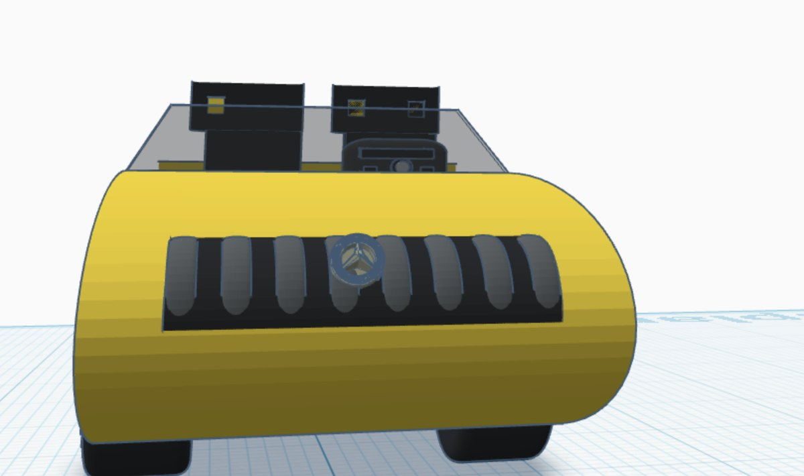
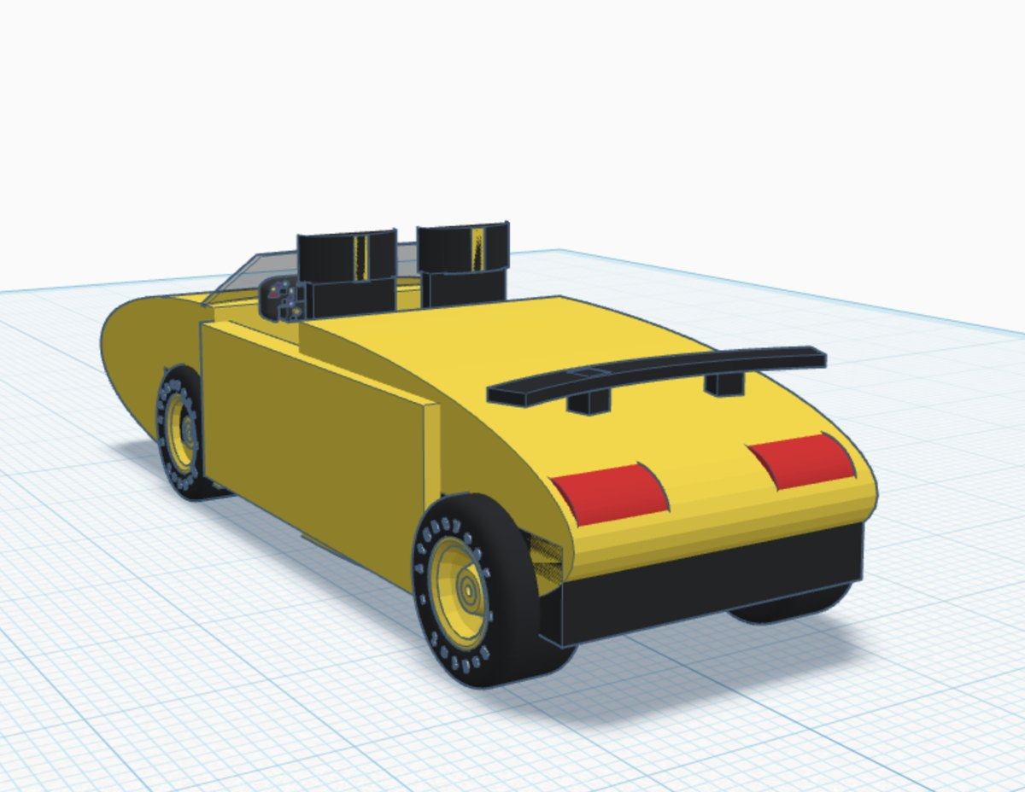
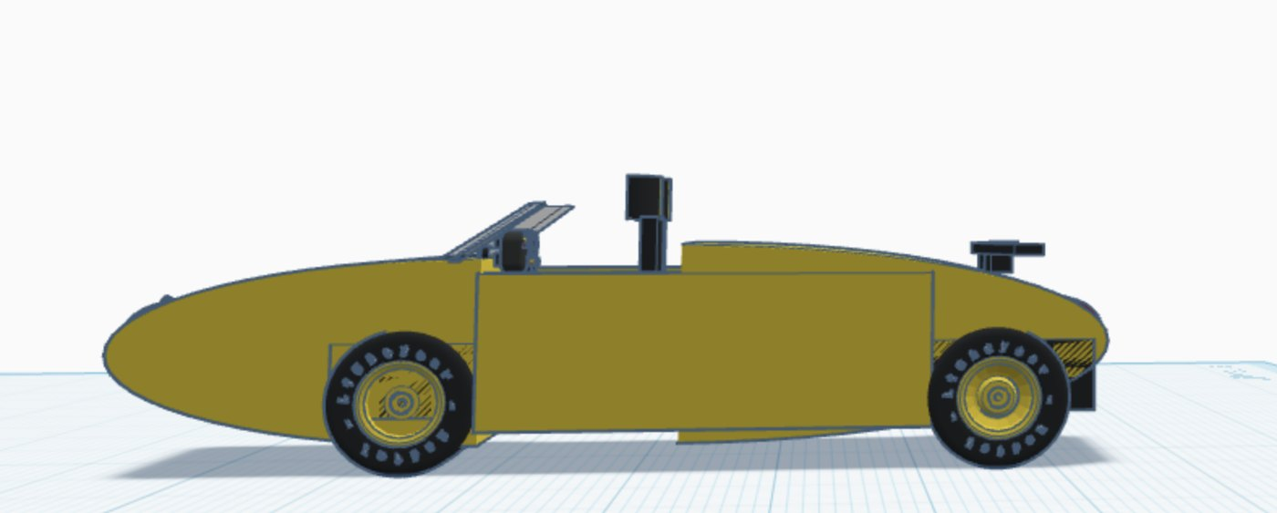
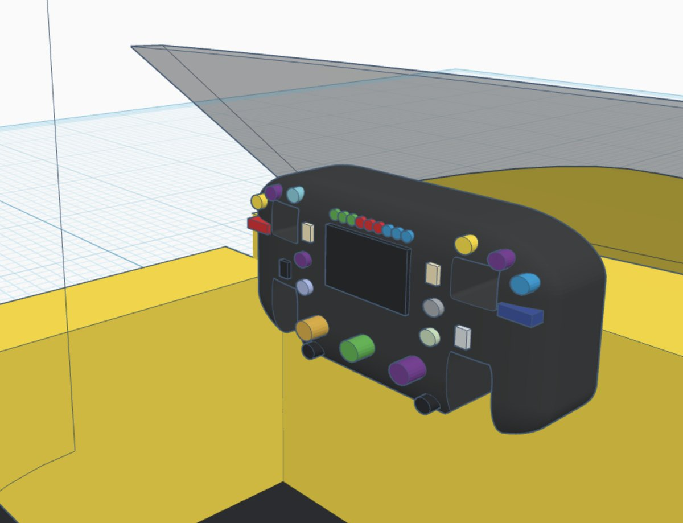
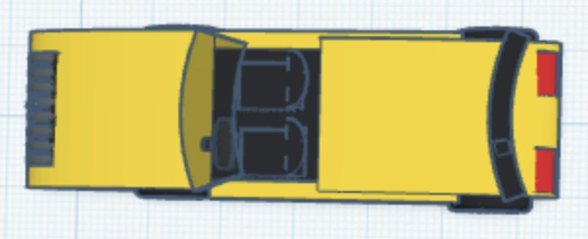
11
CAD · 3D MODELING
VIEW 1 · THREE-QUARTER
VIEW 2 · FRONT
MERCEDES SL63
■ WHAT IT IS
This is my 3D model of the Mercedes-AMG SL63, a famous roadster, made in Tinkercad.
■ MY ROLE
I’m a big fan of cars and I like designing in Tinkercad, so I made this as practice and as a 3D model for a game I’m making. I built it from simple shapes, down to the seats, the grille, the wheels and a steering wheel full of buttons.
■ WHY I INCLUDED IT
It shows my sense of scale and design, how I assemble a model from parts, and how I’m learning spatial awareness.
VIEW 3 · REAR
VIEW 4 · SIDE
DETAIL A · STEERING WHEEL
even the wheel has buttons!
VIEW 5 · TOP
MODEL
TOOL
Mercedes-AMG SL63
Tinkercad
DRAWN BY
FOR
Alexander Kim
my racing game
ALEXANDER KIM
PORTFOLIO · 11 / 19

Slide 12
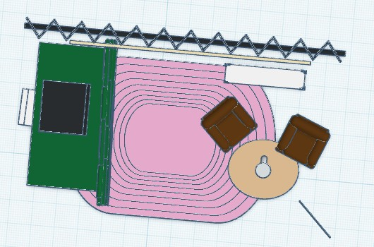
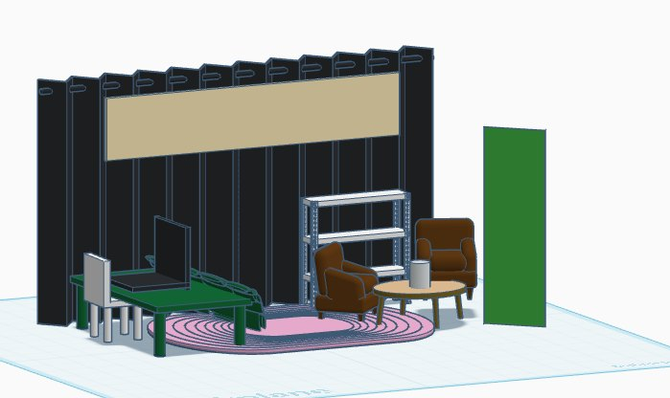
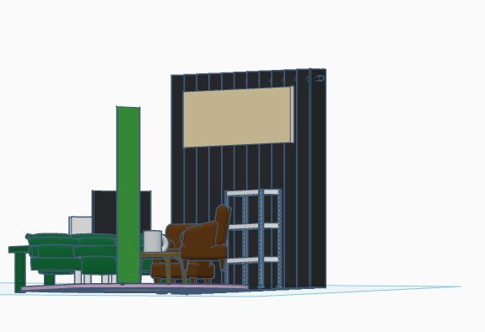
12
DESIGN & TECHNOLOGY · CAD · REAL-WORLD SPACES
POPPIN’ MATCHA BOOTH
■ PLAN · FROM ABOVE
■ FRONT
■ WHAT IT IS
This is a booth I designed in CAD for Poppin’ Matcha, the company my 7th and 8th grade class ran for Virtual Enterprises Junior Ventures.
■ MY ROLE
I was a Senior Manager in Marketing, responsible for ads and promotions.
■ WHY I INCLUDED IT
It shows how I design real-world environments in CAD, from the back wall and shelves to the lounge chairs and rug.
back wall
lounge chairs
■ SIDE
counter + screen
table
rug
MY TEAM ROLE
SENIOR MANAGER,
MARKETING
ALEXANDER KIM
PORTFOLIO · 12 / 19

Slide 13

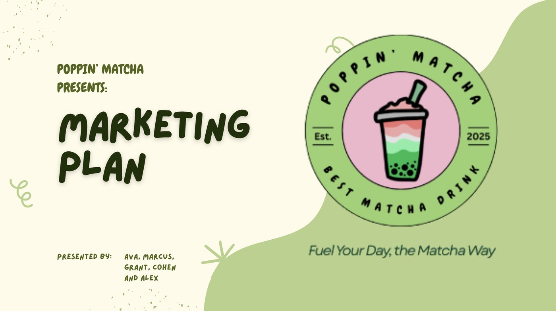
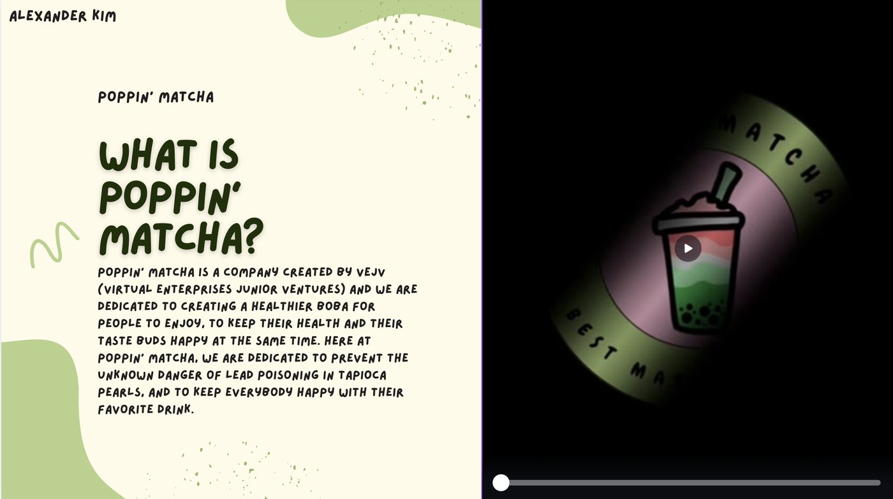
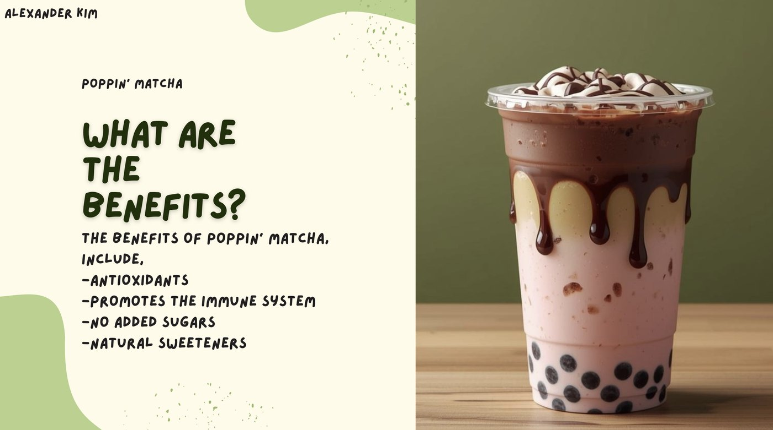
13
VISUAL ART · GRAPHIC DESIGN IN CANVA
POPPIN’ MATCHA ADS
web banner
■ WHAT IT IS
These are ads and promotions for Poppin’ Matcha: a web banner, a vertical video ad and slides from our marketing plan.
■ MY ROLE
My role was helping create ideas for them. I used Canva, starting with templates and then customizing them for our brand.
■ WHY I INCLUDED IT
It shows graphic design for a brand our class built together as a team.
■ OUR BRAND MISSION
slides from our marketing plan
vertical video ad
a boba with healthy benefits that still keeps its flavor
ALEXANDER KIM
PORTFOLIO · 13 / 19

Slide 14
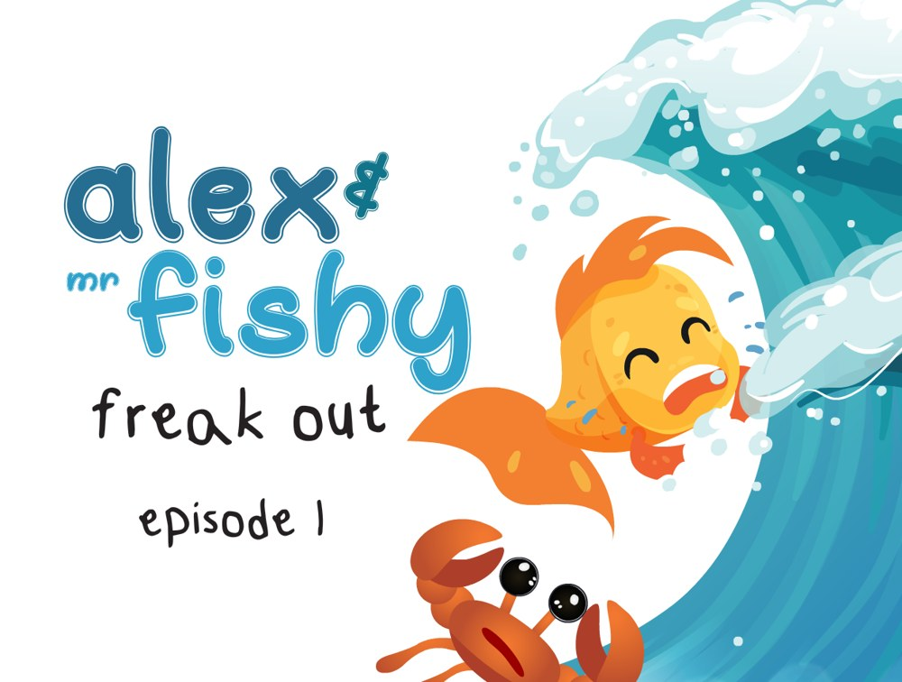
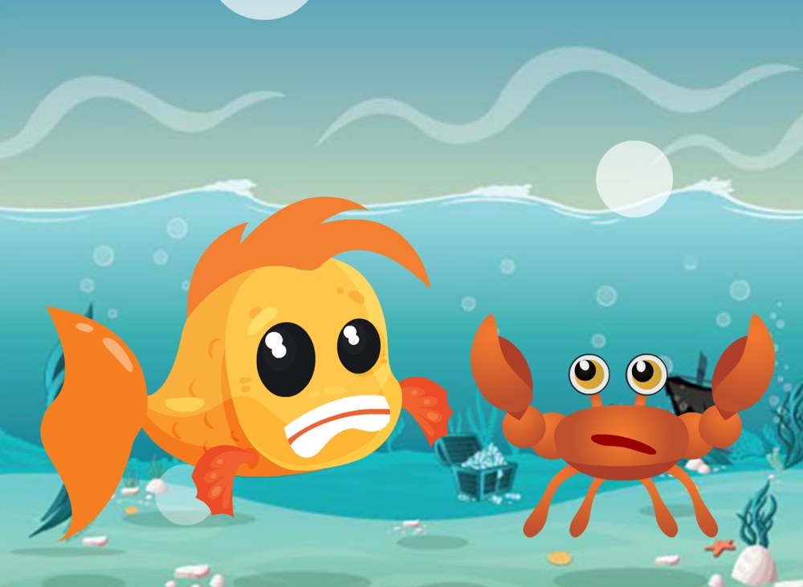

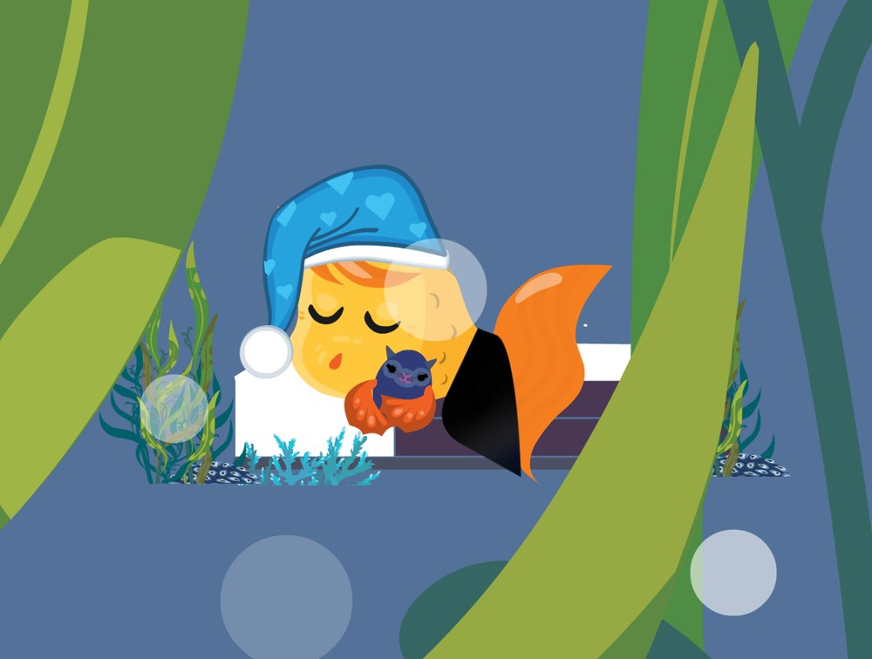
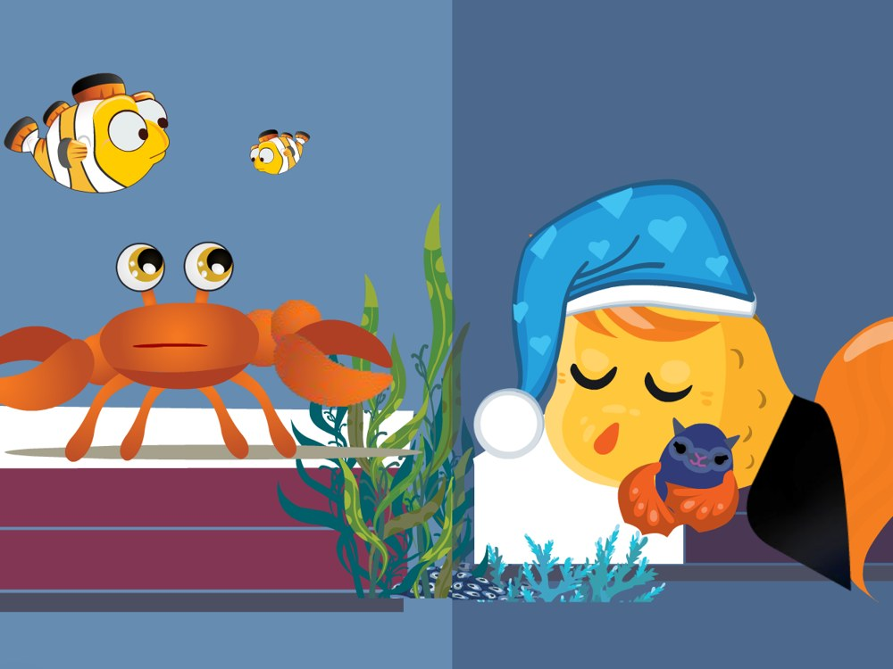
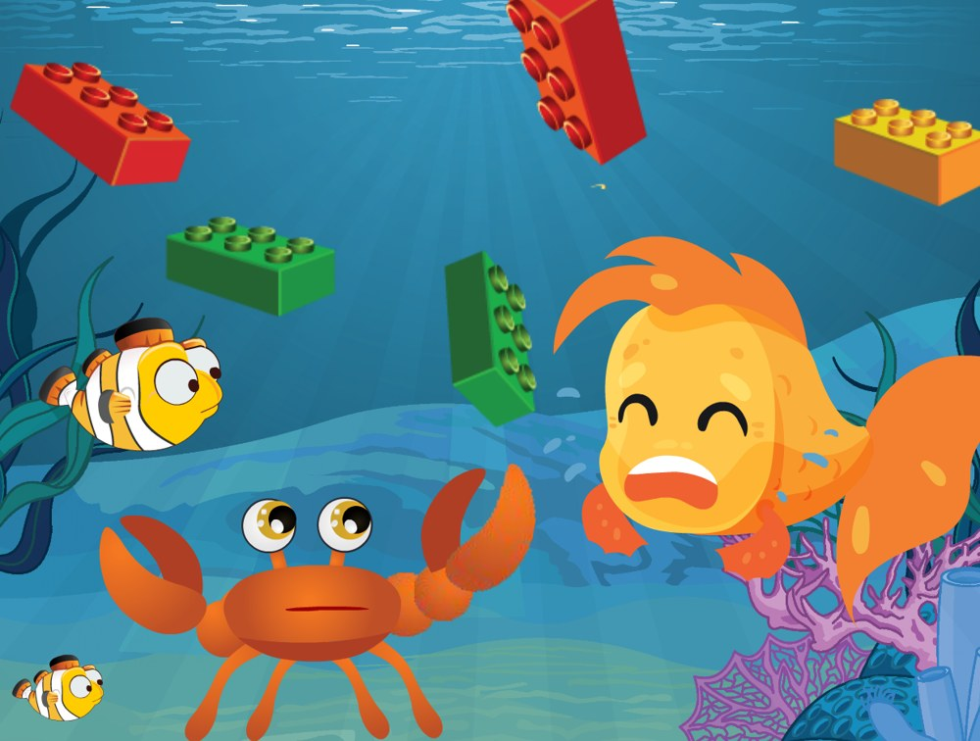

14
ANIMATION · CARTOON SERIES · STORYBOARDS
Alex & Mr. Fishy is my cartoon series. In every episode, Mr. Fishy gets into a mess and learns something with help from his friend Alex. I picked frames from each cartoon and laid them out as storyboards.
ALEX & MR. FISHY
1.1
1.2
1.3
■ EPISODE 1
FREAK OUT
everything will be OK!
A storm is coming and Mr. Fishy is scared. His friend Alex comes along and helps him discover he can trust that everything will be OK, and he can ride the waves.
Title card: a giant wave is coming!
Mr. Fishy freaks out about the storm.
With Alex’s help, he rides the waves.
2.1
2.2
2.3
2.4
■ EPISODE 2
WAKE UP
Mr. Fishy and Alex help a school of fish rebuild their home after they made a mess “messing around.” Brick by brick, they build it back up together.
Mr. Fishy is fast asleep.
His friends need him to wake up.
The fish’s home is a mess of bricks.
Brick by brick, they build it back up together.
ALEXANDER KIM
PORTFOLIO · 14 / 19

Slide 15









15
ALEX & MR. FISHY · EPISODES 3 + 4
Rocky Bal Beta was our real pet betta fish
THE BIG RACE
3.1
3.2
3.3
3.4
■ EPISODE 3
RACE
Mr. Fishy is sure he’s the best and can win his race without training. He goes up against Rocky Bal Beta, who was our pet betta fish in real life. He loses, and learns that he needs to put the work in and practice humility.
Mr. Fishy, the “lean mean swimming machine.”
His rival: Rocky Bal Beta.
Race day: he falls way behind.
Time to put the work in.
4.1
4.2
4.3
4.4
■ EPISODE 4
STRONGER
Mr. Fishy worked hard with Alex to get ready for the race, and he gets a rematch, with a lot of chaos.
The rematch!
Breaking news: “Banana Pants” interrupts the Tour de Fish.
A virus makes the computer sick.
And the chaos keeps coming.
ALEXANDER KIM
PORTFOLIO · 15 / 19

Slide 16



16
BUILDING & MAKING · WOODWORKING
THE FORT
■ WHAT IT IS
At a camp I went to with my brother, we built a fort out of wood.
■ MY ROLE
We used posts for the frame, built the first floor above the ground using nails, built the walls, added a roof, and then decorated it. My role was assembling the fort.
■ WHY I INCLUDED IT
It’s where I got my experience building with wood.
me + my brother
■ HOW WE BUILT IT
1
2
3
4
5
posts hold the floor off the ground
POSTS
FLOOR
WALLS
ROOF
DECORATE
for the frame
nailed together, above the ground
built and nailed on
added on top
made it ours
we decorated it!
ALEXANDER KIM
PORTFOLIO · 16 / 19

Slide 17





17
BUILDING & MAKING · EARLY BUILDS
BIRDHOUSE & GLIDER
■ BIRDHOUSE: FROM BARE WOOD TO FINISHED
■ BALSA-WOOD GLIDER
1
2
3
4
piece by piece
■ WHAT IT IS
Building has always been one of my favorite things to do. These photos show me painting a wooden birdhouse and putting together a balsa-wood glider.
■ MY ROLE
I painted my own design on the birdhouse and assembled the glider piece by piece.
■ WHY I INCLUDED IT
These early projects are where my love of making things started, and they led to bigger builds like my fort and my go-kart.
ALEXANDER KIM
PORTFOLIO · 17 / 19

Slide 18






18
MUSIC · DJ MIXING + PRODUCTION
MUSIC PRODUCTION
■ WHAT IT IS
I love playing music. I make and mix music with my MIDI keyboard, my laptop and my DJ controller.
■ MY ROLE
I’ve created my own mixes, performed DJ mixing in my school talent show, and played at parties for my neighborhood.
■ WHY I INCLUDED IT
I like it when people are happy, dancing and enjoying music together.
my home studio
mixing live
the best part is when everyone starts dancing
■ WHERE I’VE PLAYED
TALENT SHOW 2026
NEIGHBORHOOD PARTIES
HOME STUDIO
my act was on the program!
ALEXANDER KIM
PORTFOLIO · 18 / 19

Slide 19





19
THEATRE EXPERIENCE · PERFORMANCE
ENCANTO
■ WHAT IT IS
Encanto was a youth musical theatre production I performed in, with a big cast, bright costumes and a painted set.
■ MY ROLE
I was part of the cast, singing and acting on stage alongside everyone else to bring the story to life.
■ WHY I INCLUDED IT
Being on stage showed me how much the set, costumes and lighting shape a story, and that’s the side of theatre I want to learn next.
next: designing the set!
ALEXANDER KIM
PORTFOLIO · 19 / 19

