Slide 1
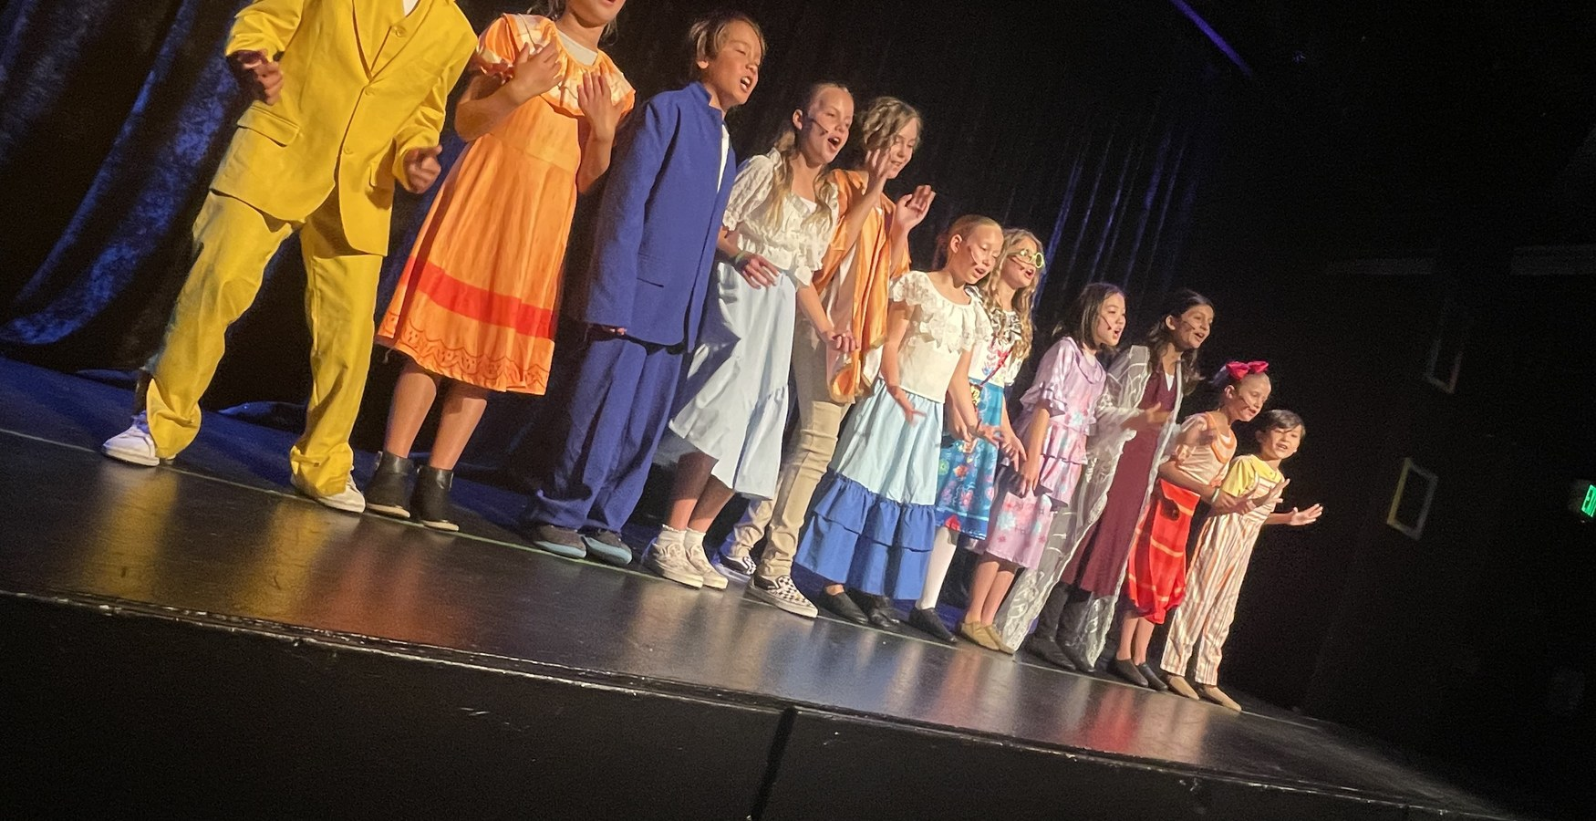
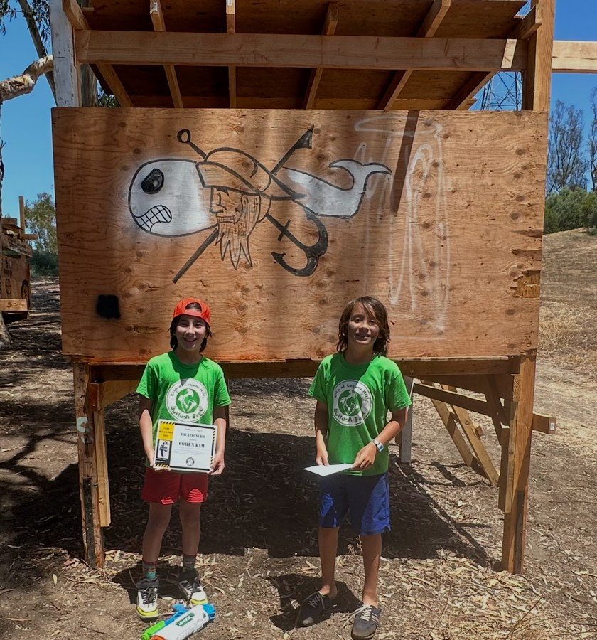
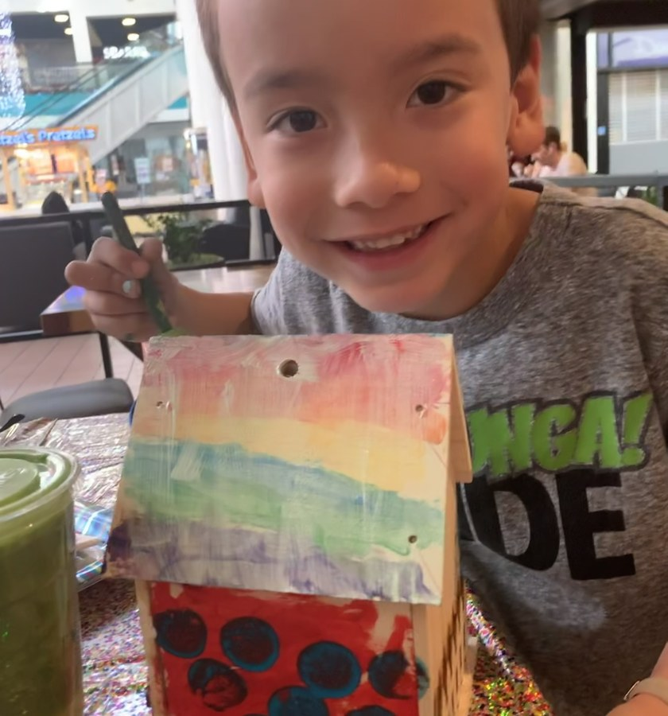
OCSA · PRODUCTION & DESIGN CONSERVATORY
Alex Kim’s Portfolio
Apps, characters, building and theatre: the things I make and why.
INSIDE
Hearth a wellness app I designed and coded
Meet the crew characters from sketch to 3D
Building & Making birdhouse, glider and a fort
Encanto performing in a musical

Slide 2
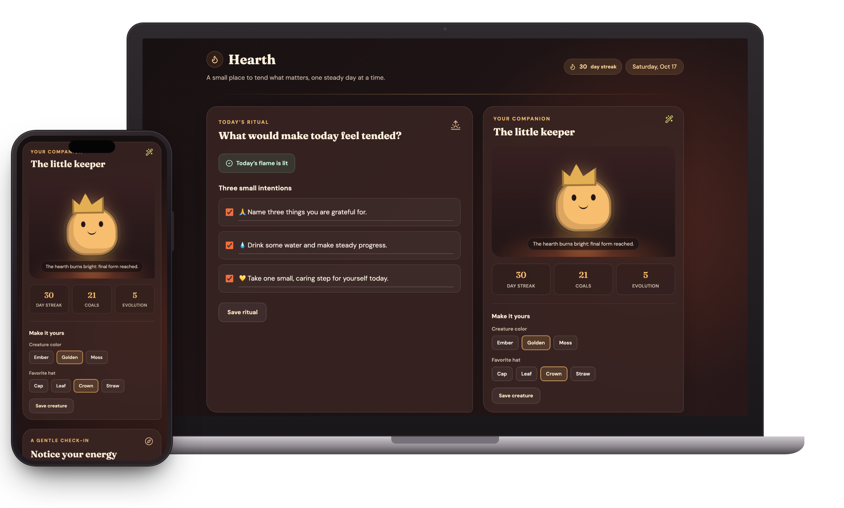
DESIGN & TECHNOLOGY · APP DESIGN
Hearth
A wellness app that grows with you
WHAT IT IS
Hearth is a wellness app built around a daily ritual: each morning it asks “What would make today feel tended?” and you set three small intentions. A quick check-in on your mood, energy and stress shapes kinder goals, an “I’m feeling” page suggests ways to cope, and you get a companion that grows with your streak.
MY ROLE
I was the designer and coder: I came up with the idea, designed every screen and feature, and coded it by directing an Agent coding tool for the OC Student AI Network.
3
28
0
WHY I INCLUDED IT
Like a lot of students, I juggle assignments, deadlines and social pressure, and I wanted a calm way to take each day one step at a time. I noticed a lot of people make games, so I wanted to make something that stood out and could actually help.
intentions a day
days to the final form
data collected

Slide 3
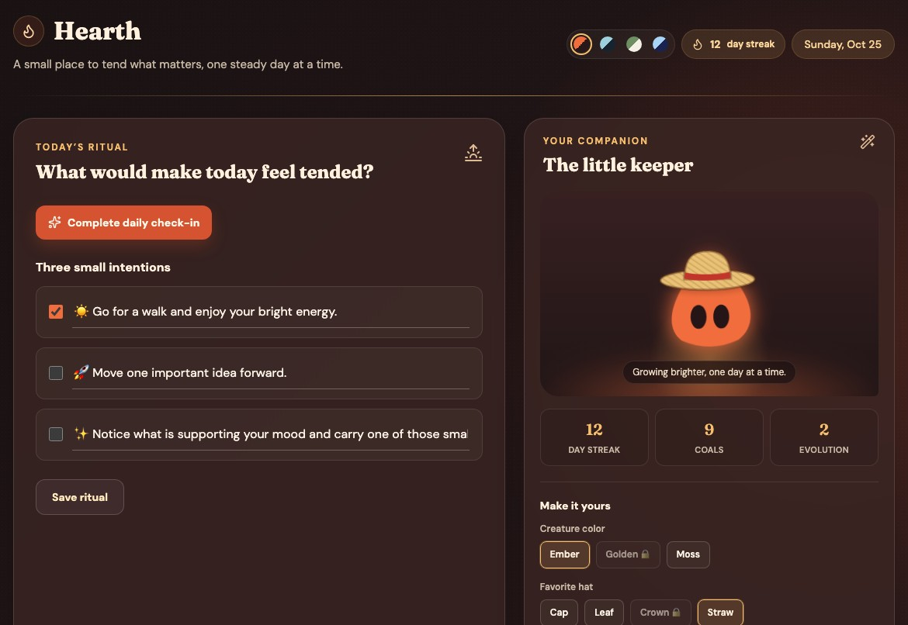
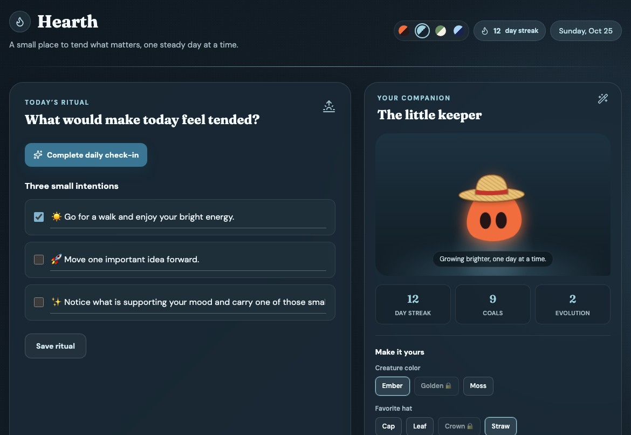
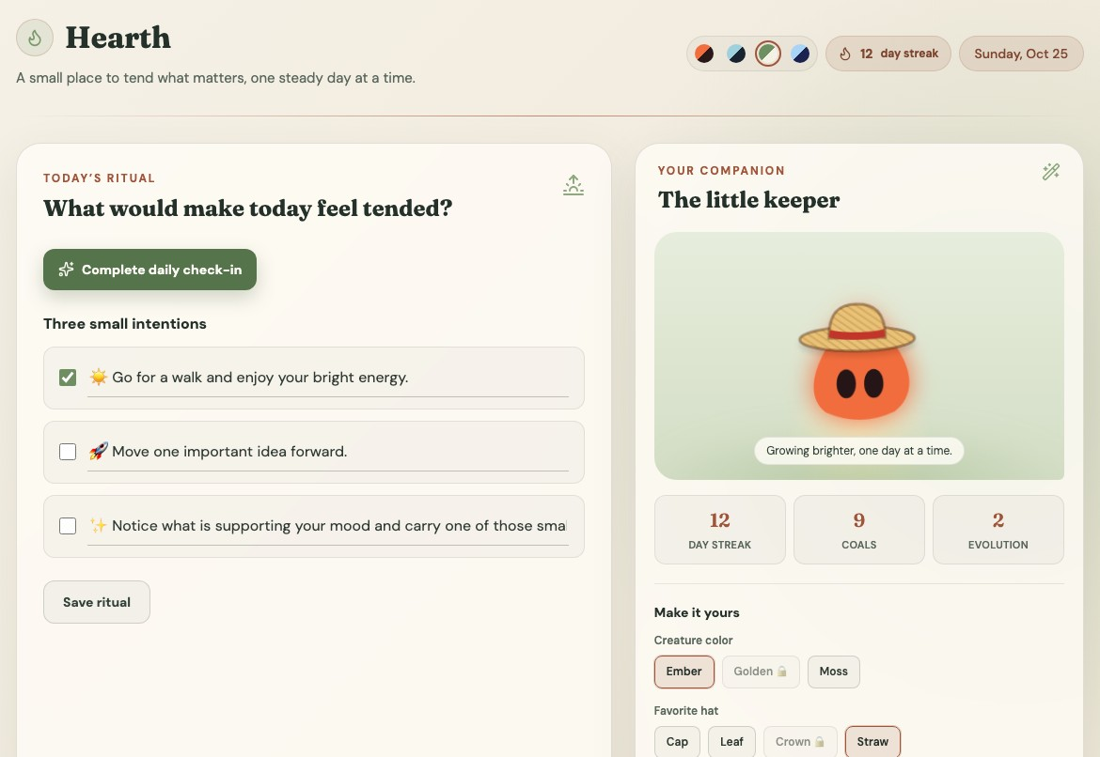
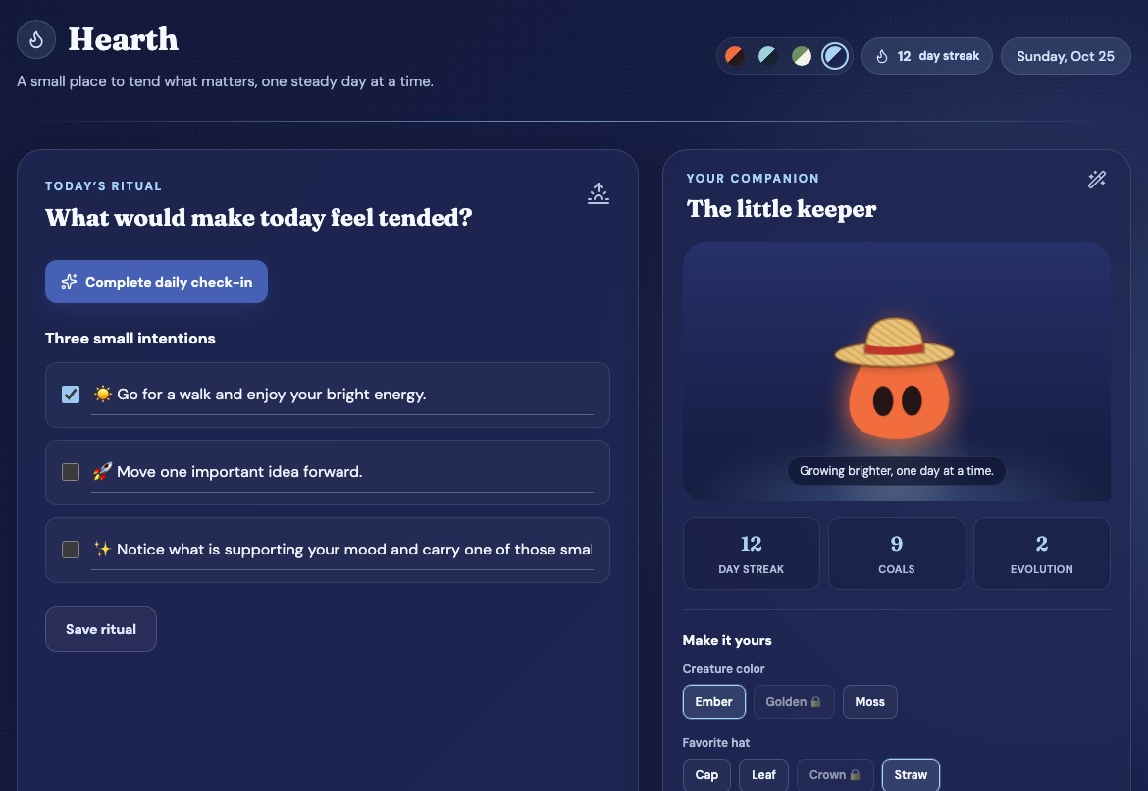
HEARTH · COLOR & MOOD
Colors that match your mood
Colors change how people feel, so I designed four calm themes you can switch between depending on your mood. Each one comes from a place or memory that makes me feel calm.
Ember
Tidepool
Morning Meadow
Marshy
Cozy and comforting
Serene and connected
Fresh and hopeful
Soft and safe
From camping trips with my mom, where the campfire is one of the most comforting feelings I know.
From exploring tide pools as a kid, where every animal was relaxed and the ecosystem worked as one.
From mornings lying in the grass under a blue sky, with nowhere to be and a whole new day ahead.
From Marshy, my sequined midnight-blue sheep, who kept me company on the darkest nights.

Slide 4
HEARTH · MY PROCESS
Turning problems into solutions
1
Think
2
Outline
3
Build
4
Test & fix
I sat down and asked myself what tool could make the world better and isn’t out there enough.
I wrote the main outline: a daily check-in, three goals, and a creature that grows.
I built it by prompting an Agent coding tool, one feature at a time.
I tested each part, and when something broke I found another way.
WHAT DIDN’T WORK, AND WHAT I DID ABOUT IT
The app wouldn’t load
FIXED
The Agent got stuck on goals
FIXED
The shop locks free hats
IN PROGRESS
My first version wouldn’t run at all.
It kept misreading the goals feature and handing back the same broken answer, no matter how I prompted it.
The Agent decided you have to buy the free hats for your creature.
Fix: I loaded it on a personal account, and it worked.
Fix: I turned the problem into the solution: a goal tracker you set up yourself with short surveys.
Fix: Still working on it, and it’s next on my list.

Slide 5
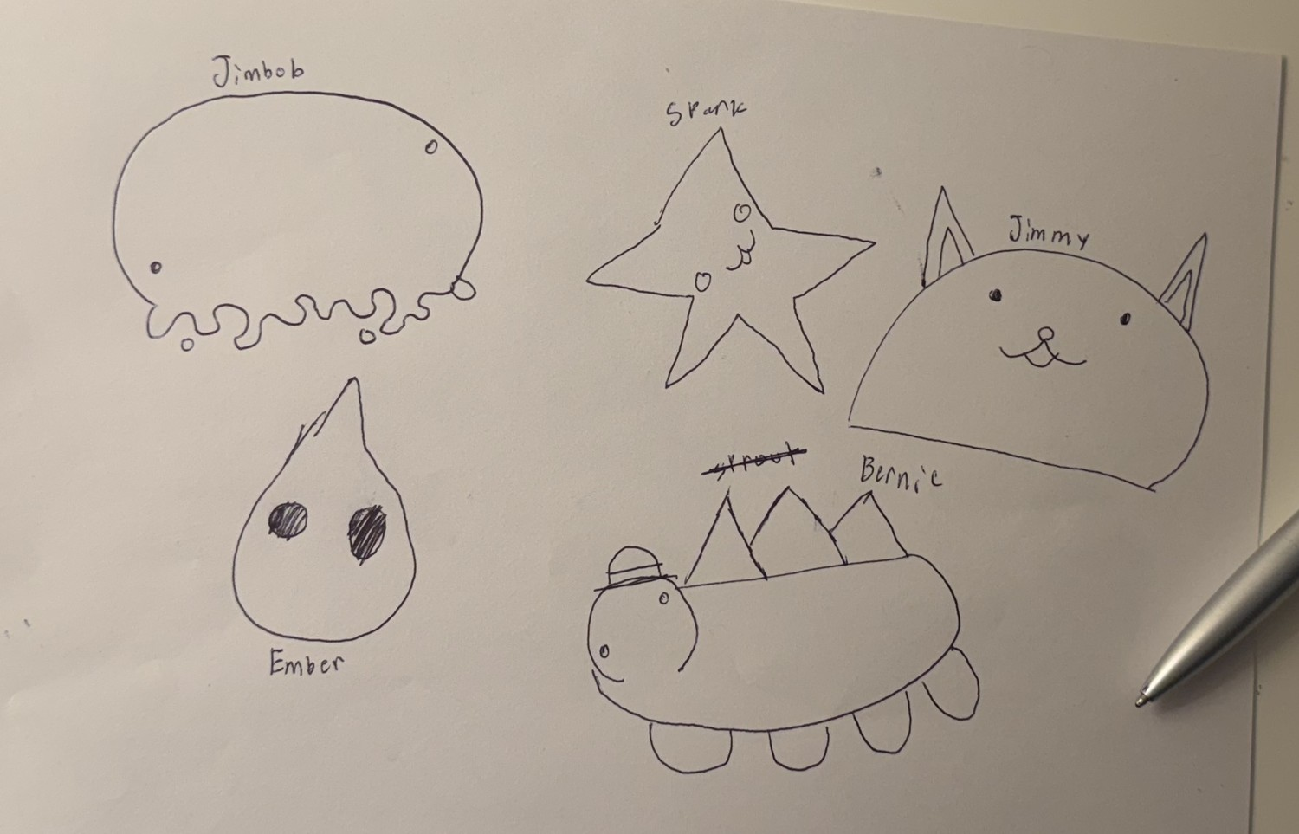
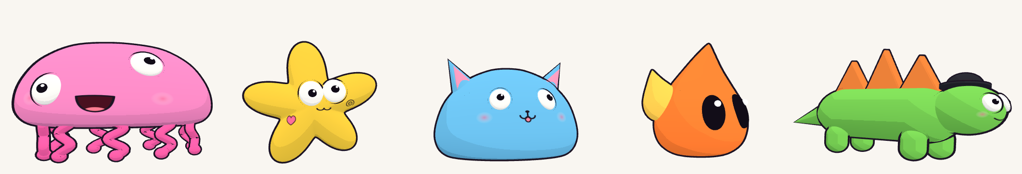
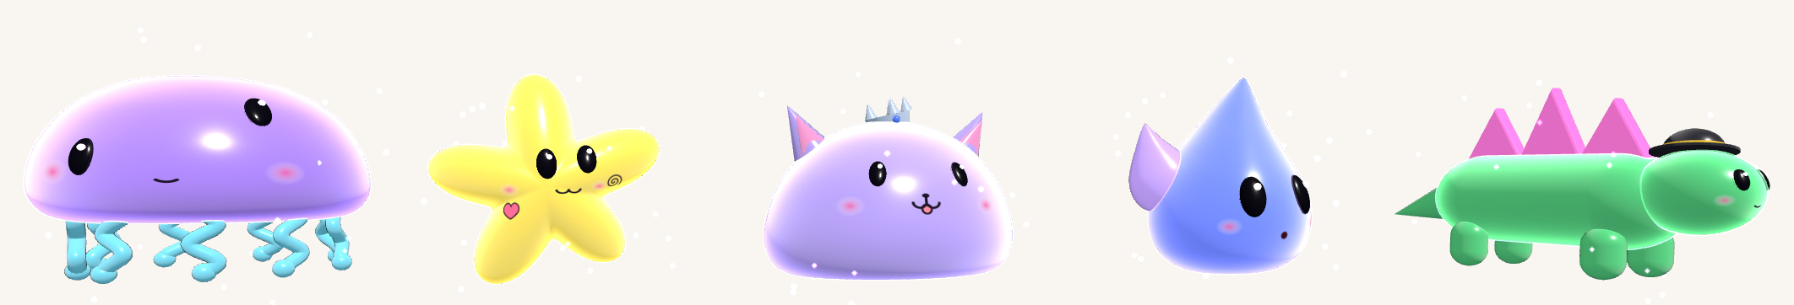
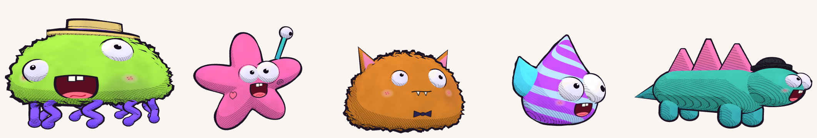
CHARACTER DESIGN · SKETCH TO 3D
Meet the crew
Jimbob, Srank, Jimmy, Ember and Bernie are five characters I invented and first drew in pen on paper. I turned each sketch into a 3D character, then tried every one in three looks inspired by cartoons and games I studied. I included them to show my process: how a quick doodle grows into a finished character without losing what made the drawing special.
1
Sketch on paper
2
Bring them to life in 3D, in three looks
Jimbob
Srank
Jimmy
Ember
Bernie
Toon
flat & bold
Galaxy
shiny glow
Painted
fuzzy & wobbly
Bernie was almost named Sprout. The old name is still crossed out on the page.

Slide 6
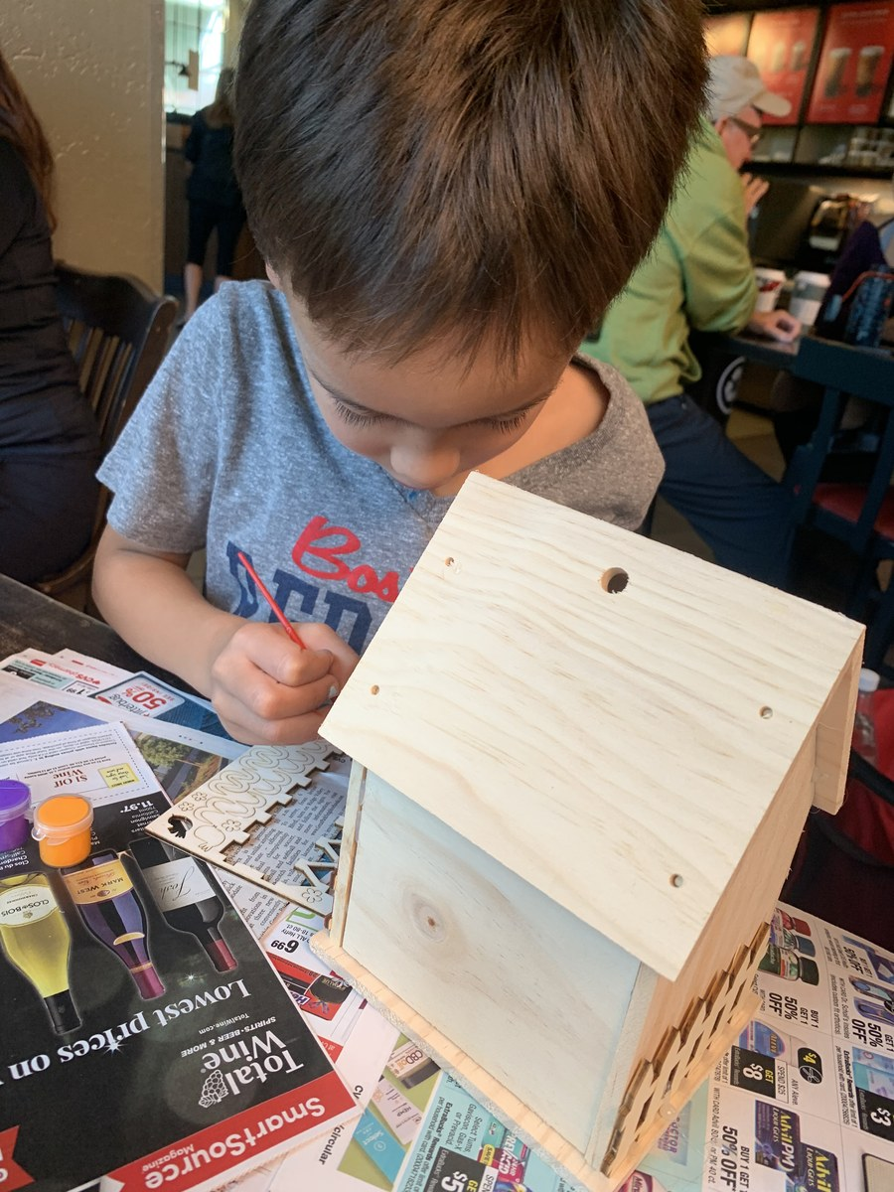
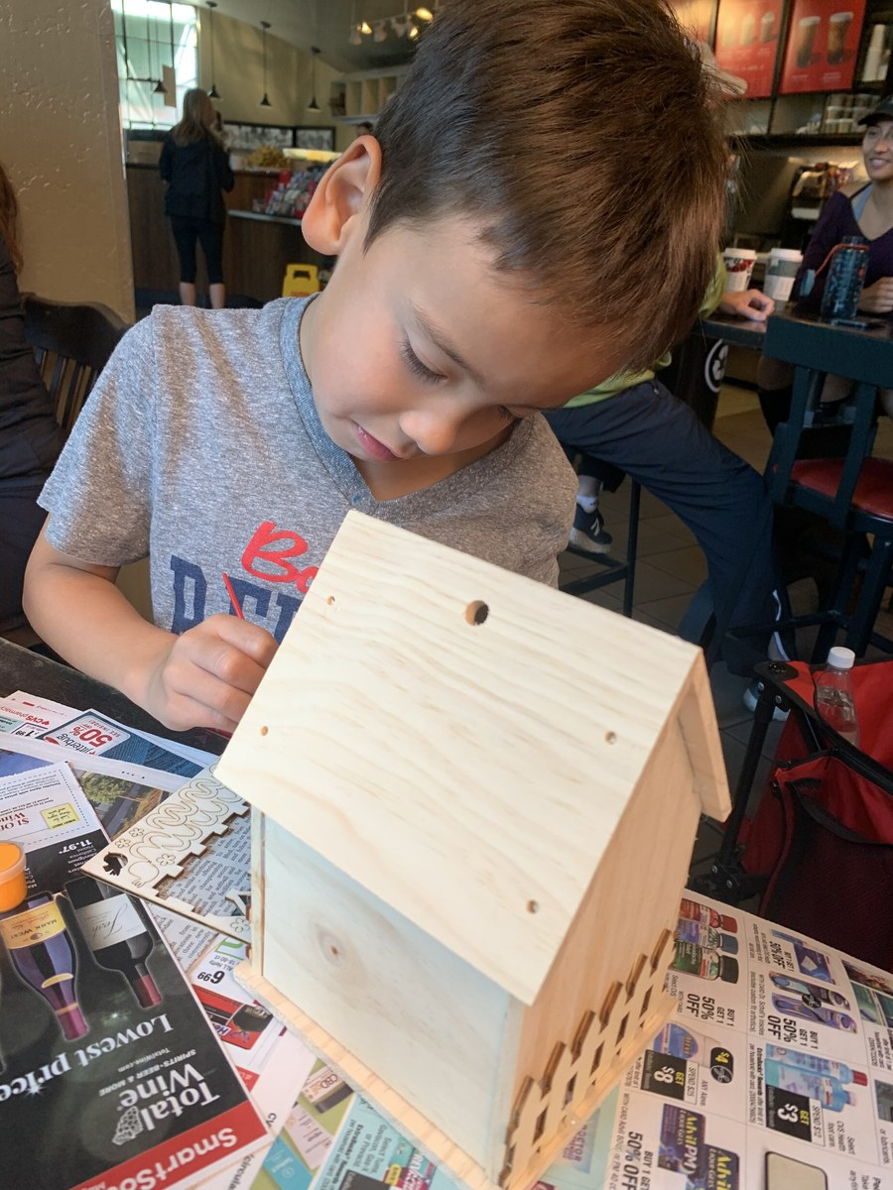
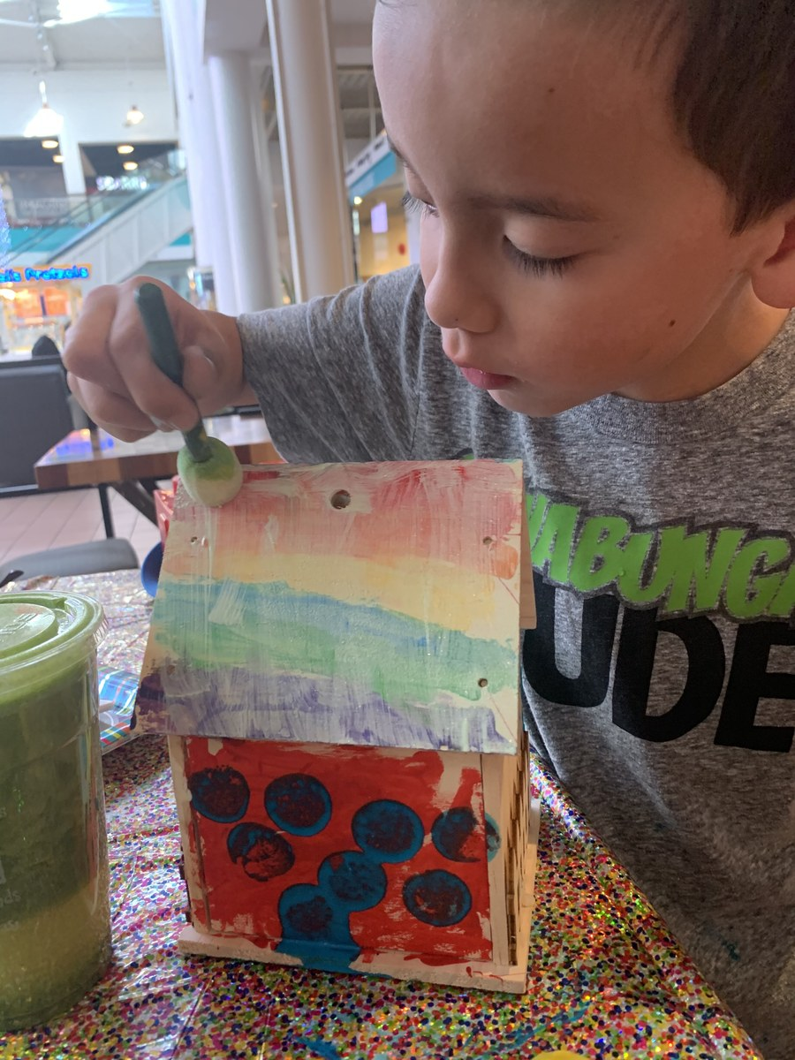
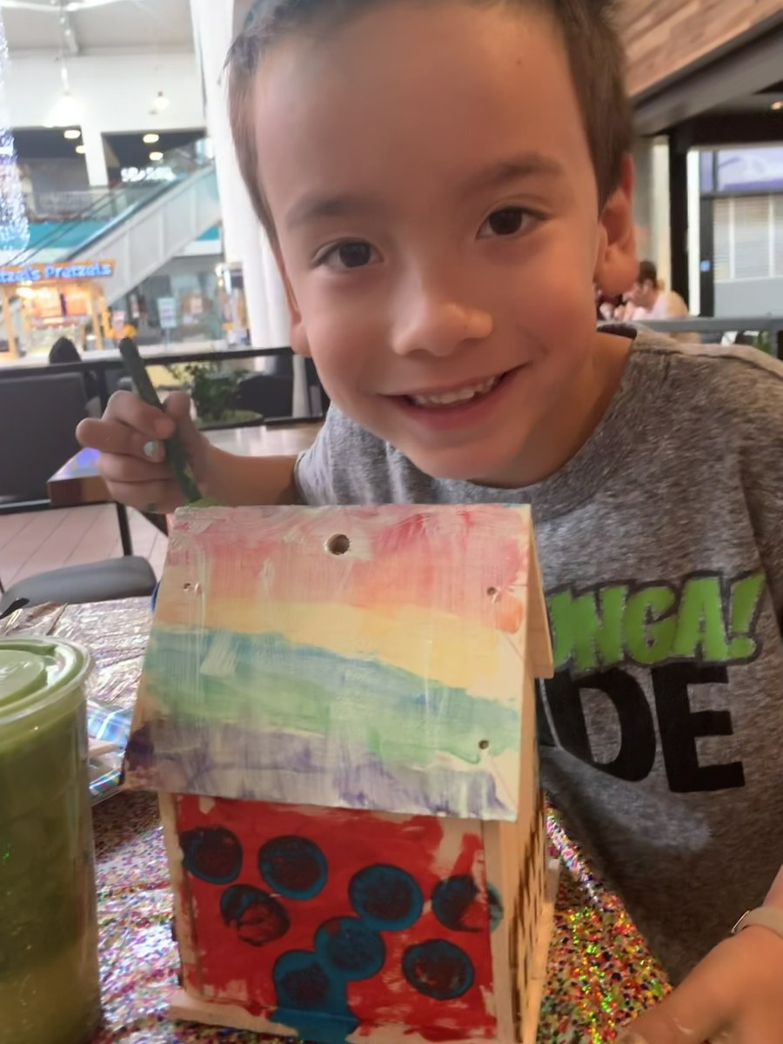
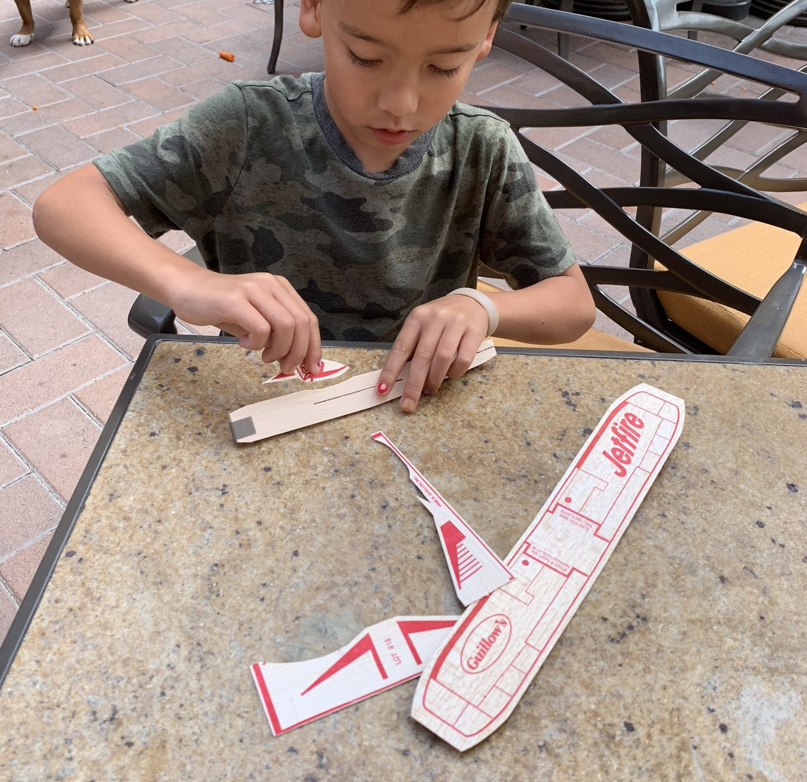
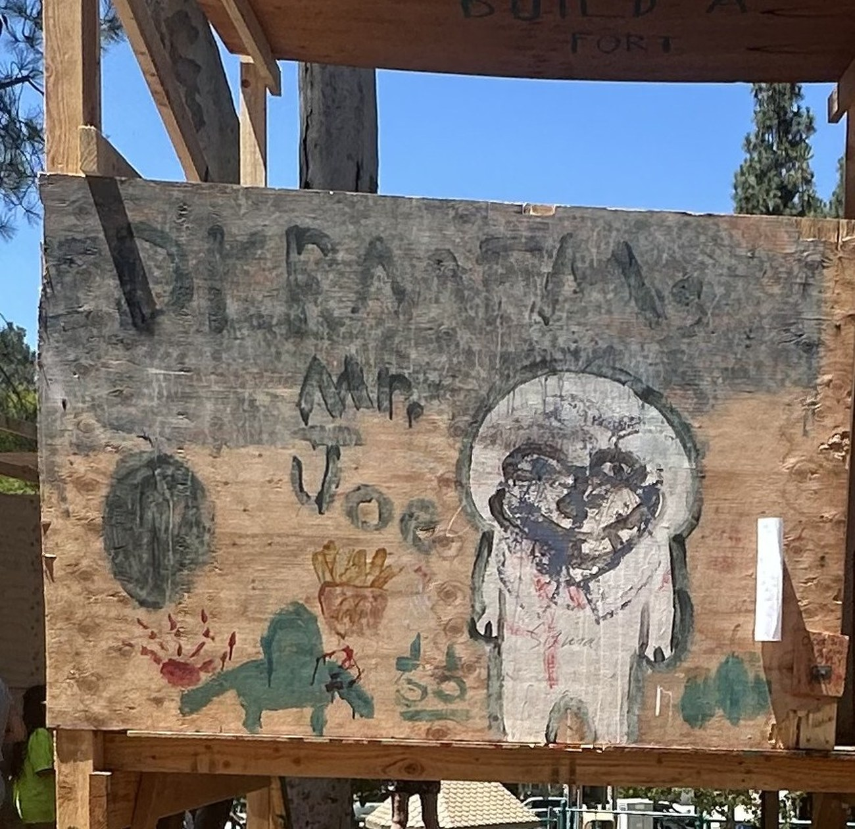
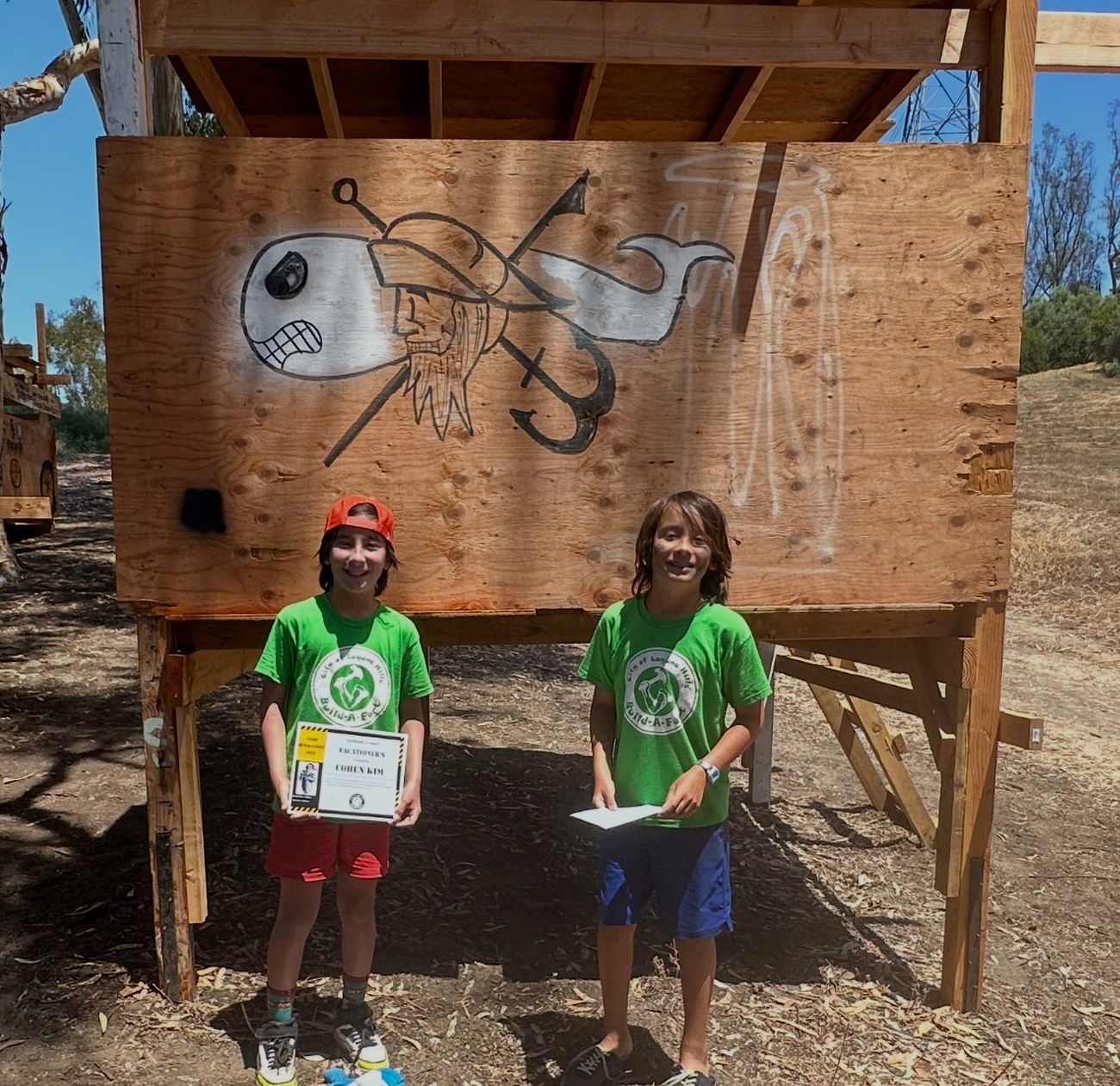
BUILDING & MAKING · WOODWORKING & DIY
Building & Making
WHAT IT IS
Building has always been one of my favorite things to do. These photos show me painting a wooden birdhouse, putting together a balsa-wood glider, and building a big fort with a friend.
MY ROLE
I painted my own design on the birdhouse, assembled the glider piece by piece, and helped build and decorate the fort.
Birdhouse: from bare wood to finished
WHY I INCLUDED IT
These early projects are where my love of making things started, and it led to bigger builds like my go-kart.
Balsa-wood glider
The fort in progress
Finished fort

Slide 7
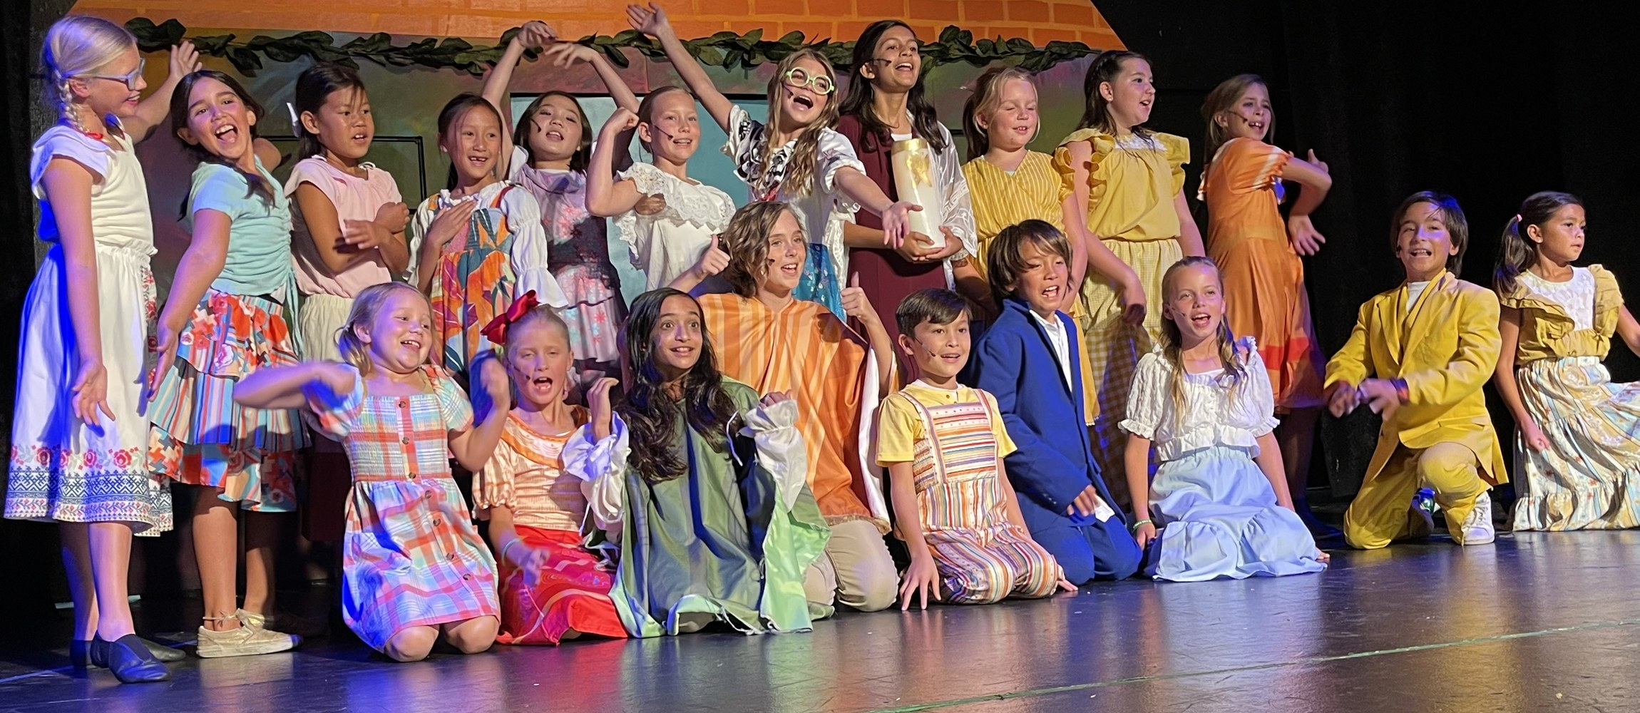
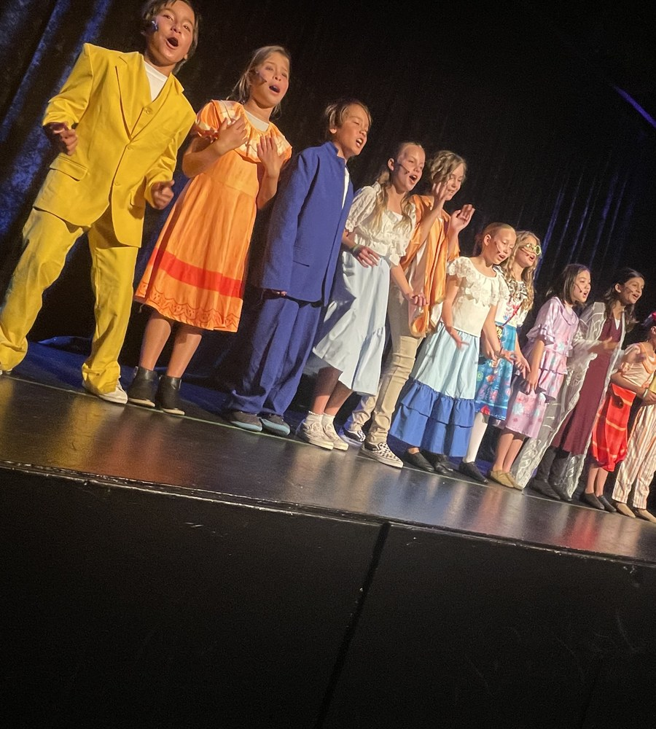
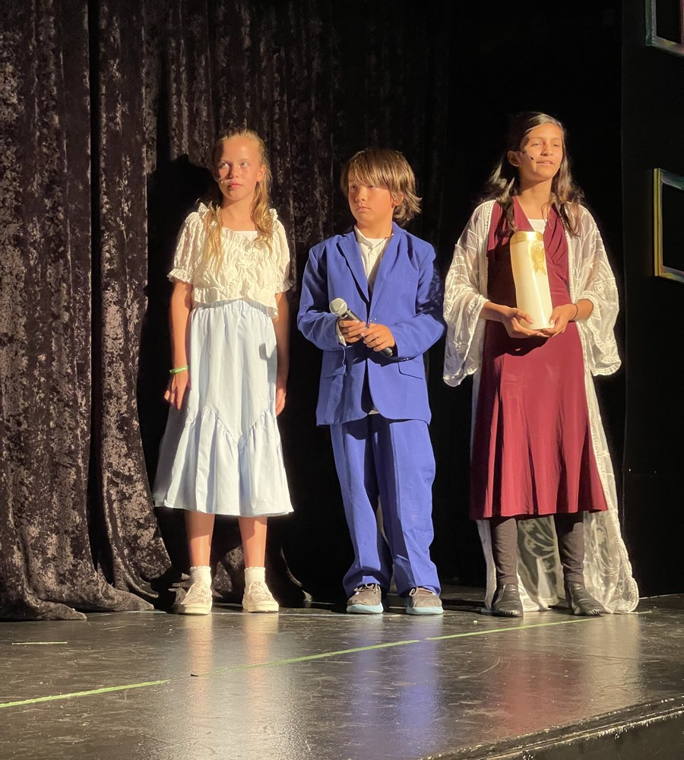
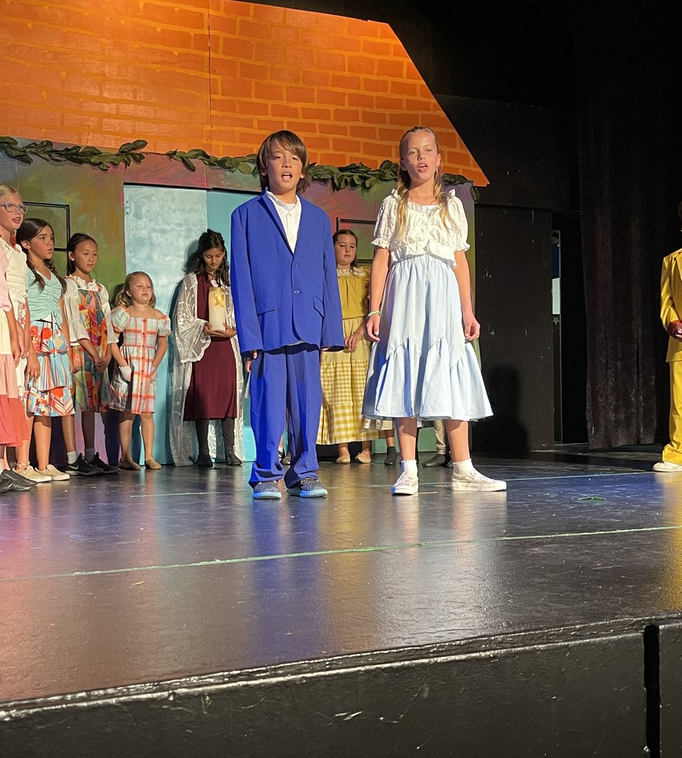
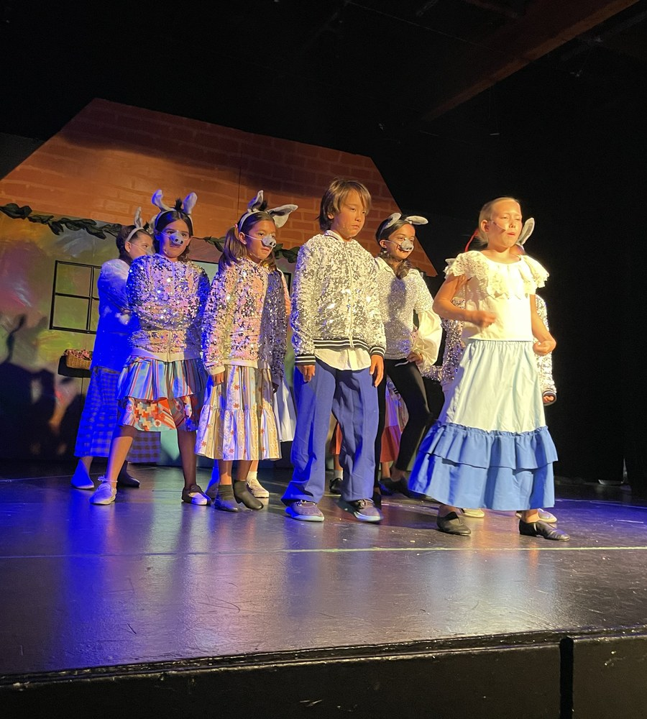
THEATRE EXPERIENCE · PERFORMANCE
Encanto
WHAT IT IS
Encanto was a youth musical theatre production I performed in, with a big cast, bright costumes and a painted set.
MY ROLE
I was part of the cast, singing and acting on stage alongside everyone else to bring the story to life.
WHY I INCLUDED IT
Being on stage showed me how much the set, costumes and lighting shape a story, and that’s the side of theatre I want to learn next.

