Slide 1
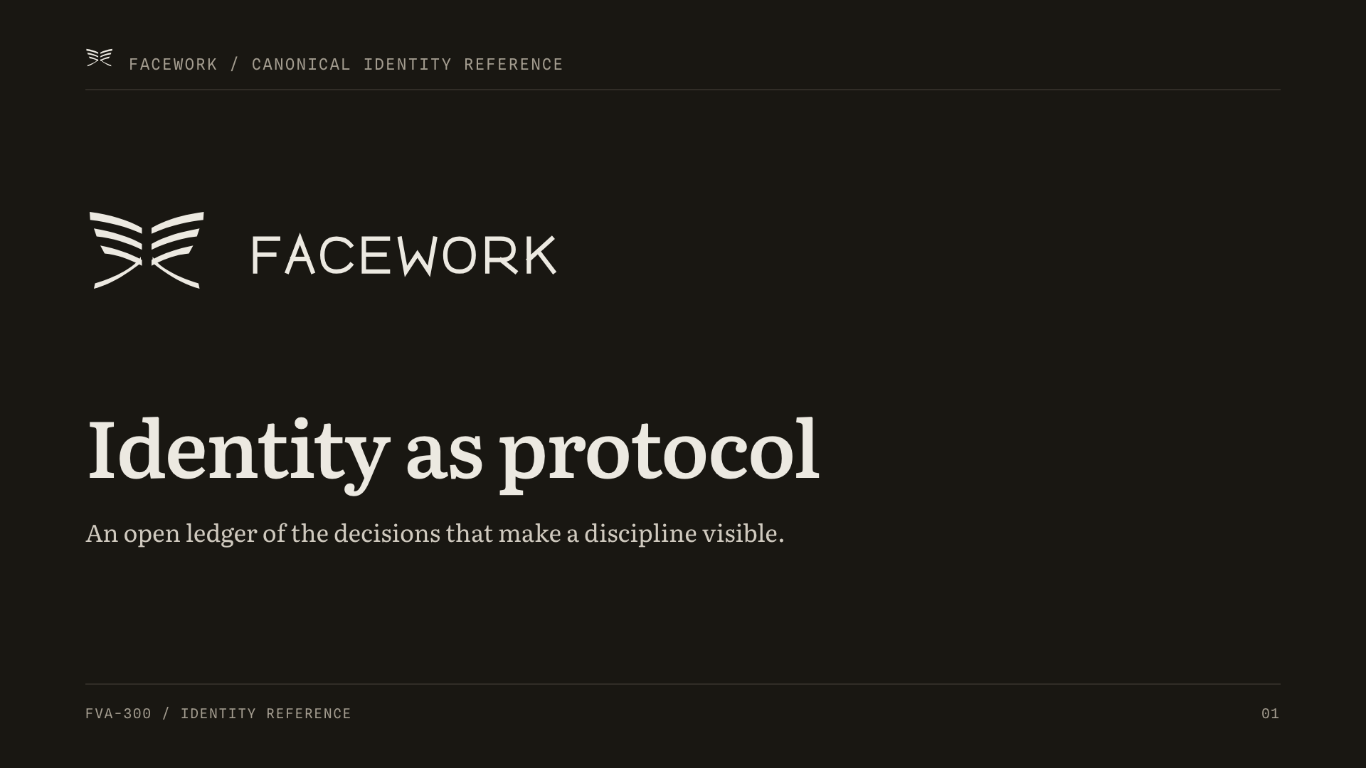
Notes:
Source: FVA-000 identity program; FVI-001 Coherence Mark; FVI-100 Register. Spoken bridge: "This is not a brand guide. It is an open ledger — every identity decision is recorded so a discipline can be seen, questioned, and carried forward. The identity program has open gates; nothing here claims to be finished."

Slide 2
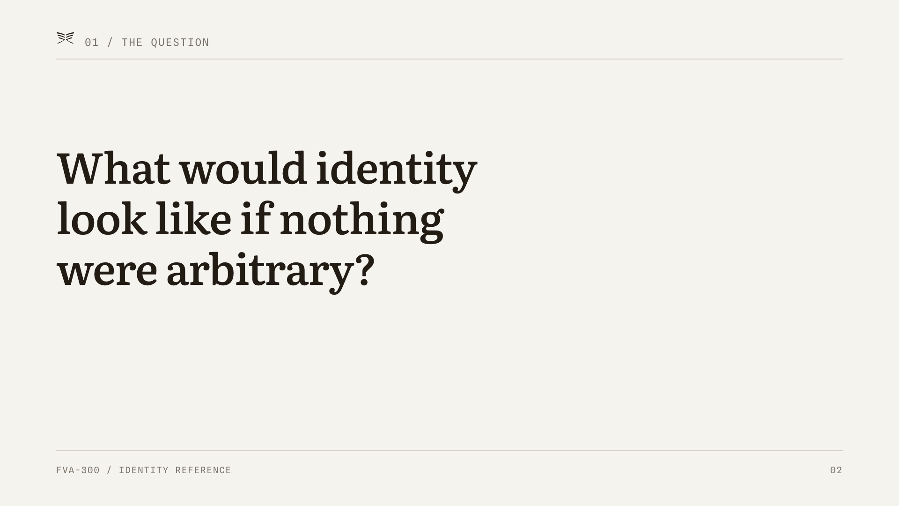
Notes:
Source: FVA-000 program premise; Constitution Art. I (coherence over decoration). Spoken bridge: "Every mark, every letterform, every interval had to answer one question before it earned its place."

Slide 3
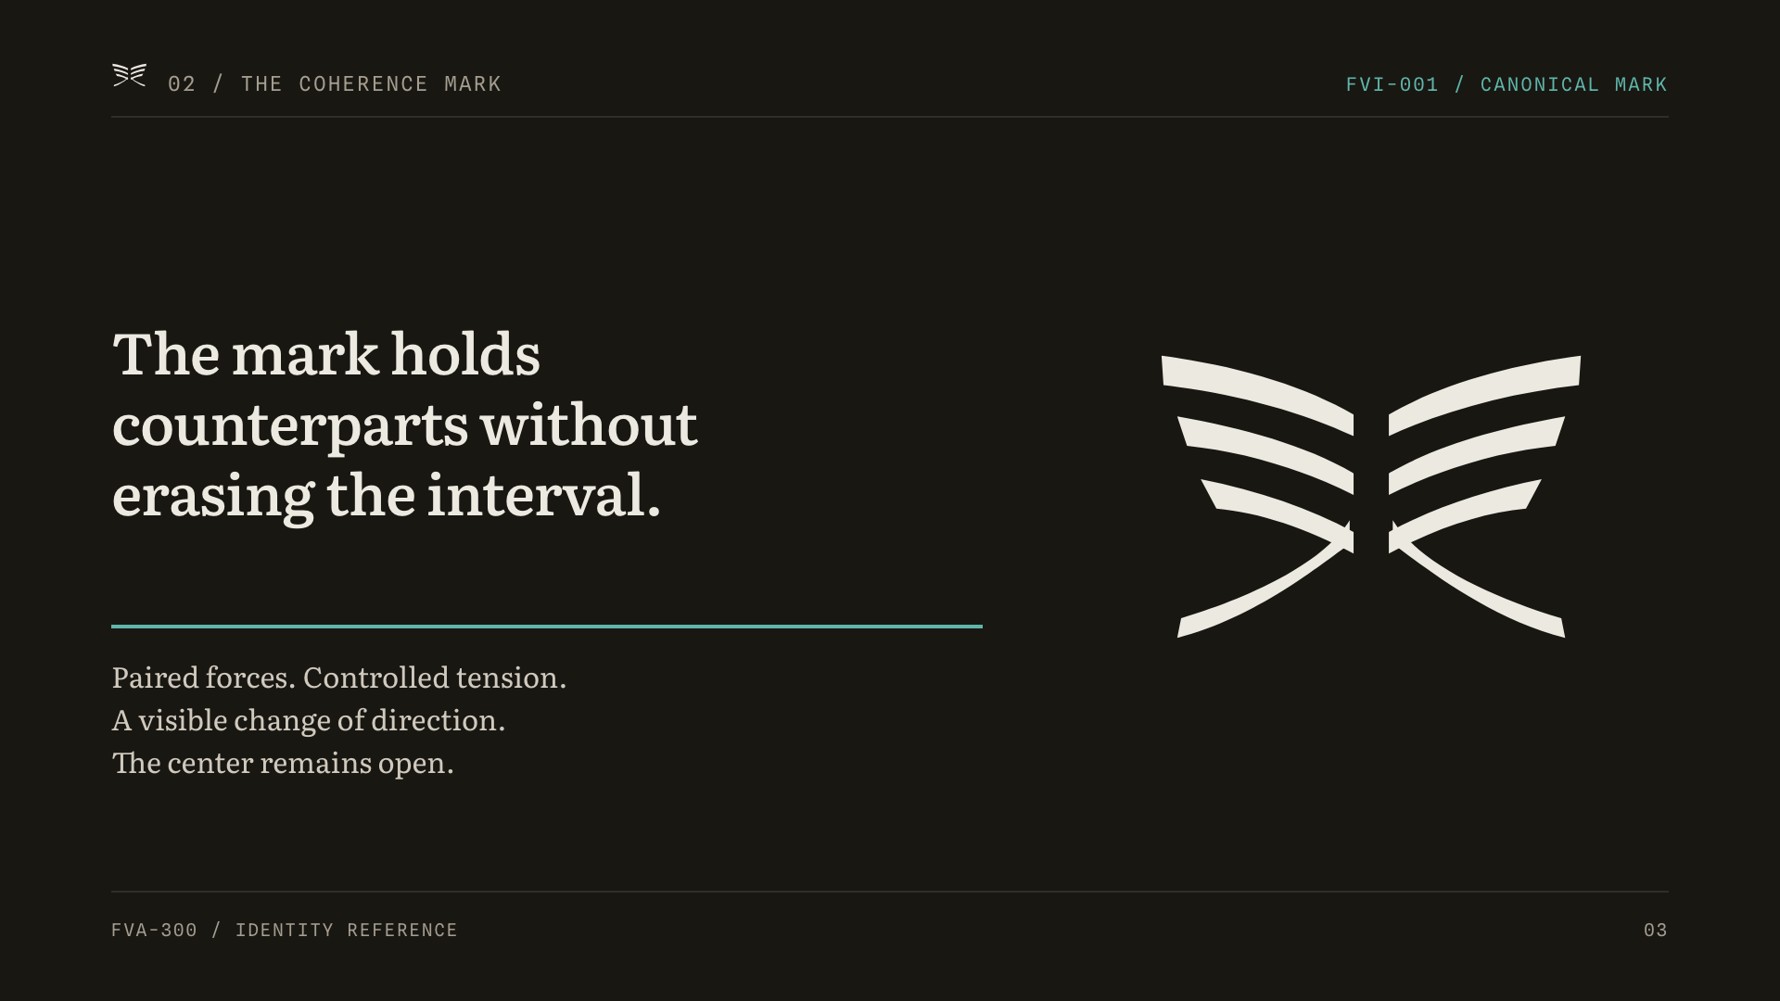
Notes:
Source: FVI-001 Coherence Mark derivation. Renamed from the working title "Axis Exchange" to "The Coherence Mark". Spoken bridge: "Two wings meet and turn without touching. The center is never closed — the interval is the point."

Slide 4
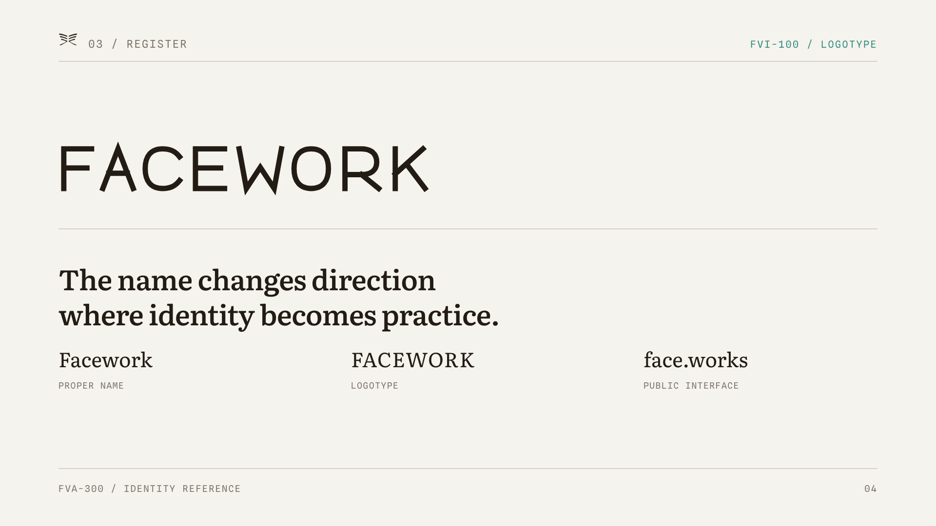
Notes:
Source: FVI-100 Facework logotype. Spoken bridge: "The wordmark turns at the same point the name turns — where an idea becomes a practice. One name, three registers."

Slide 5
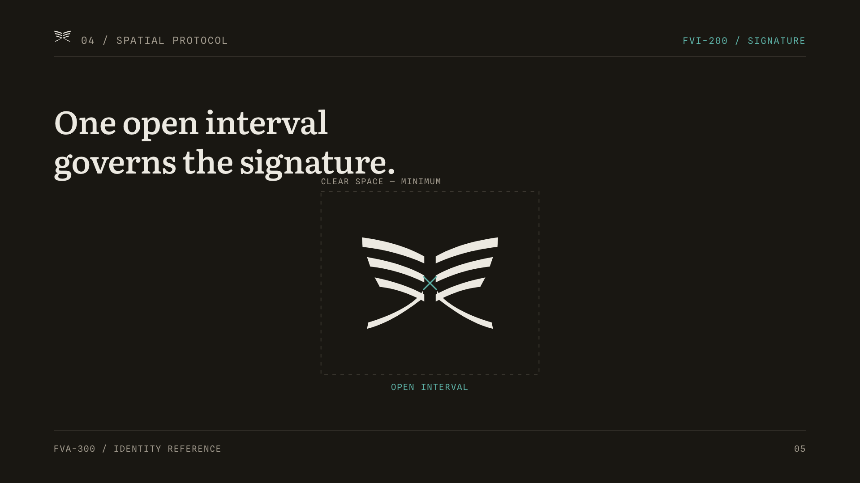
Notes:
Source: FVI-200 lockups & spatial protocol. Spoken bridge: "One interval — the open center — sets the clear space and governs every lockup. Protect the interval and the signature holds at any size."

Slide 6
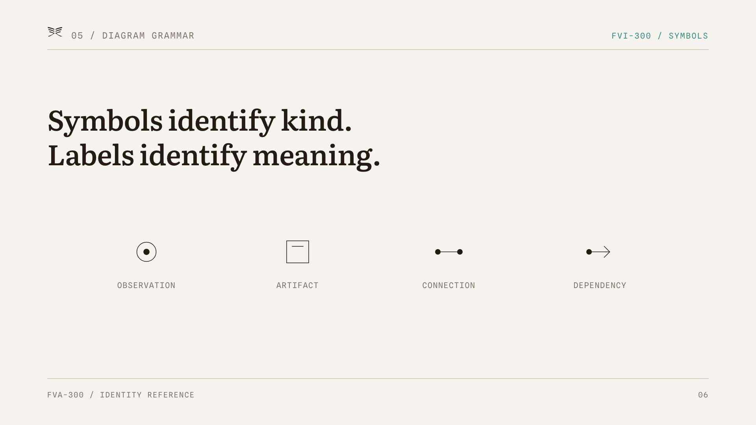
Notes:
Source: FVI-300 symbol & diagram grammar (canonical symbol library). Spoken bridge: "The system separates kind from meaning. The glyph tells you what type of thing this is; the label tells you which one. Shape is never decorative."

Slide 7
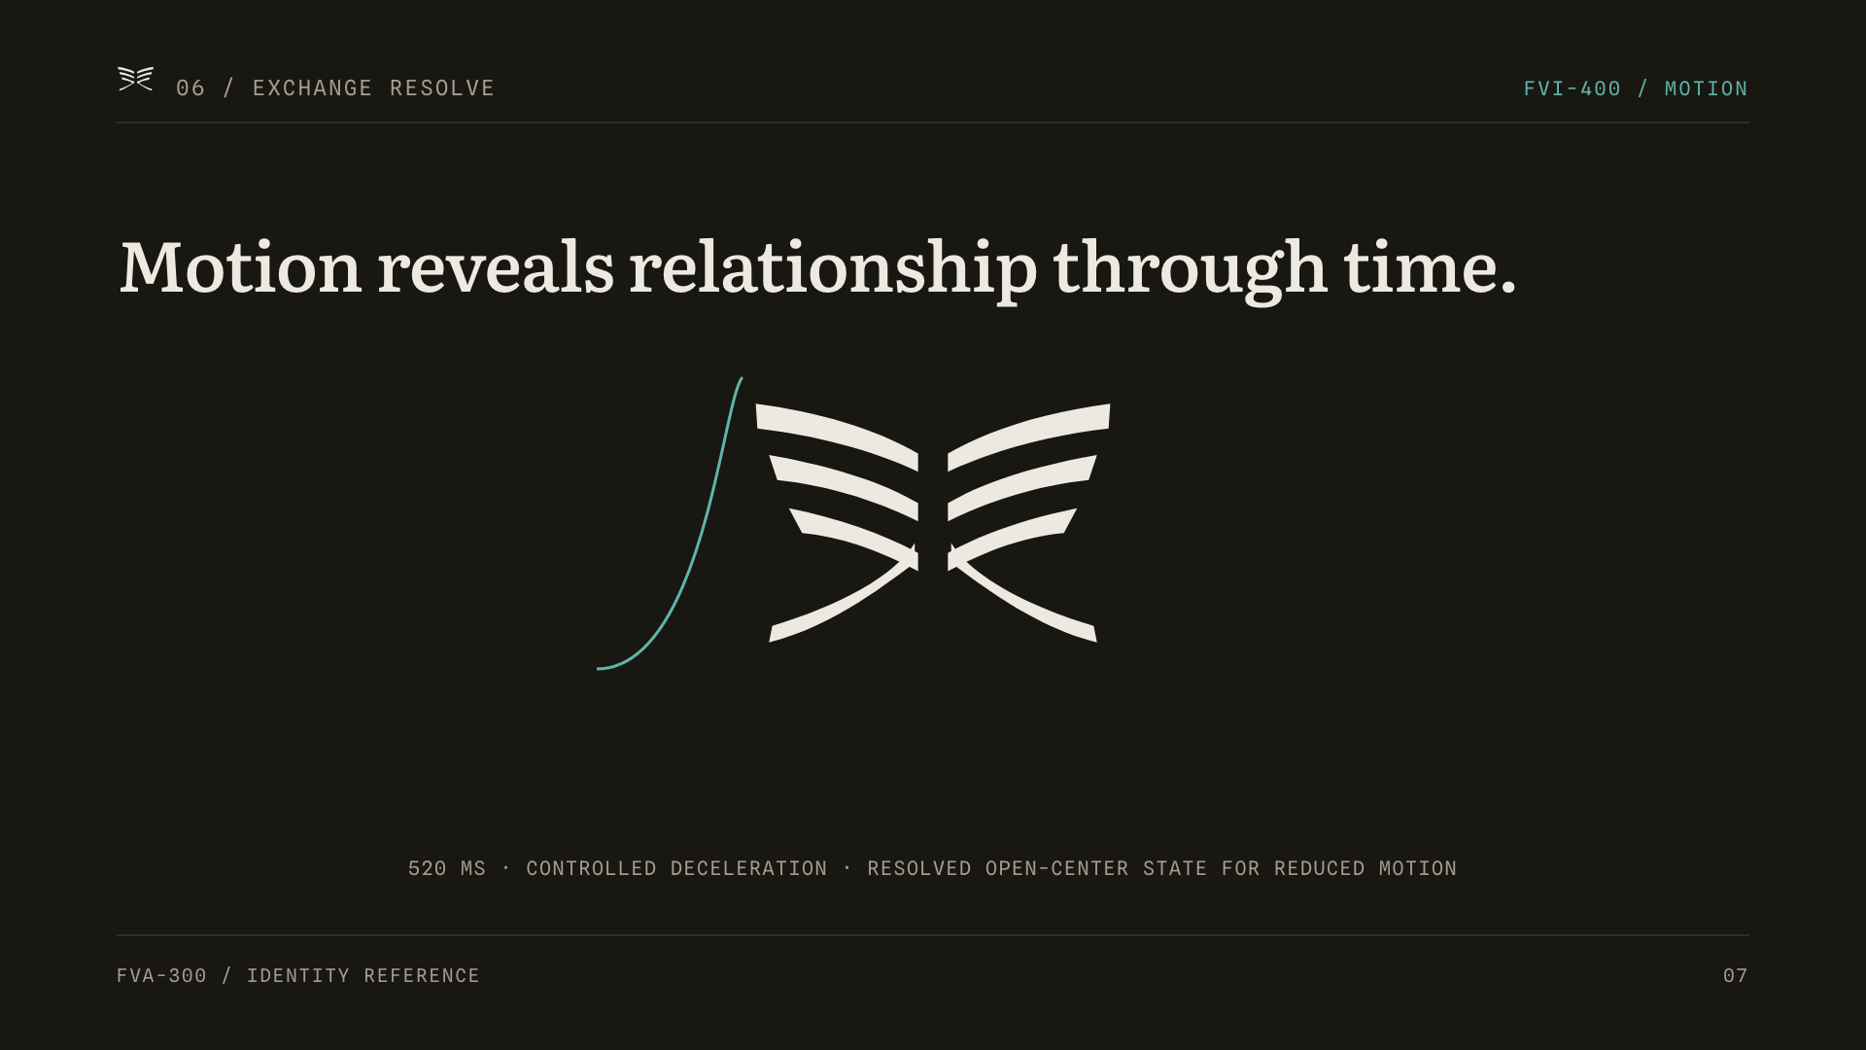
Notes:
Source: FVI-400 Exchange Resolve motion signature. Spoken bridge: "The one sanctioned motion is a controlled deceleration that resolves to the open-center resting mark — and reduced-motion users see that resolved state directly."

Slide 8
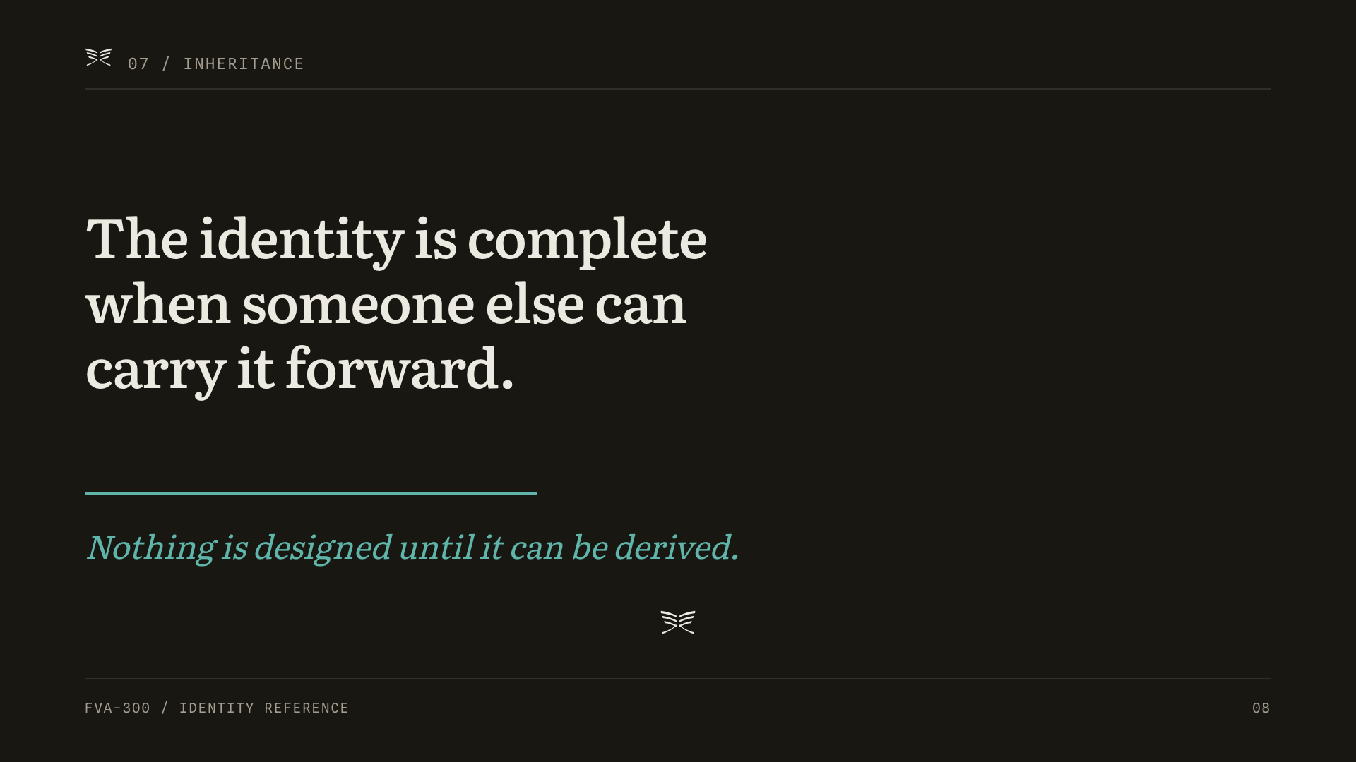
Notes:
Source: FVA-000 program close; Constitution (derivability standard). Spoken bridge: "The test of this identity is not whether it looks finished, but whether someone else can reconstruct every decision from the record. Nothing is designed until it can be derived."

