Slide 1


SMART INDIA HACKATHON 2026
TITLE PAGE
• Problem Statement ID – 26151
• Problem Statement Title- INTELTRACE — Dark Web Threat Actor De-Anonymization
• Theme- Blockchain & Cybersecurity
• PS Category- Software/Hardware
• Team ID-
• Team Name (Registered on portal) RUN TIME ERRORS

Slide 2



RUNTIME ERRORS
Proposed Solution
A consent-aware intelligence pipeline that turns scattered online footprints into explainable linkage leads — correlating identifiers, behaviour, and stylometry into scored, analyst-reviewable attribution chains.
Collect
Correlate
Attribute
Authorized observations, identifiers & source metadata
PGP / wallet / email + behaviour + stylometry signals
Scored links with confidence levels & analyst review queue
What Makes It Stand Out
Design Principles
Explainable weights with reason codes on every linkage decision
Human-in-the-loop review — no silent overwrites
Multiple output formats: Dashboard, Network graph, CSV/JSON, PDF
Probabilistic leads, not proof — responsible by design
Legal-basis gate enforced before any collection step
Modular pipeline allows incremental capability addition
4-level confidence scoring for analyst prioritization
2

Slide 3


RUNTIME ERRORS
Technical Approach
01
Source
Authorized feeds only — legal-basis gate enforced at ingestion
02
Extract
PGP fingerprints • crypto wallet addresses • email • XMPP handles
03
Normalize
Canonical identifier resolution across heterogeneous sources
04
Analyze
Stylometry models + temporal & behavioural pattern analysis
05
Resolve → Graph → Report
Link scoring • entity–relationship graph • Dashboard + exports
Stack: Python • Streamlit • SQLAlchemy • NetworkX • Pandas • ReportLab
3

Slide 4

RUNTIME ERRORS
Why It Works
INTELTRACE is built on four architectural pillars that distinguish it from ad-hoc OSINT tooling — combining rigor, safety, and operational utility in a single pipeline.
Explainable
Human-in-the-Loop
Every linkage decision carries human-readable reason codes — analysts understand exactly which signals drove a connection, enabling defensible reporting and courtroom-ready documentation.
Analyst review is a mandatory gate before any attribution is finalized. No automated overwrites. Every confidence update is logged with the reviewer identity and timestamp.
Safe & Auditable
Scalable & Modular
Demo mode for safe testing • legal-basis gate before collection • 4-level confidence scoring (Confirmed / Probable / Possible / Speculative) • full immutable audit logs.
Plugin-style module architecture allows new extractors to be added without touching core logic. Blocking and canopy steps enable scale-up to large entity sets without quadratic comparison cost.
Dashboard
Network Graph
CSV / JSON
Interactive Streamlit UI
Visual entity–relationship map
Machine-readable exports
PDF Report
STIX Export
Formatted analyst summary
Threat intel sharing format
4

Slide 5
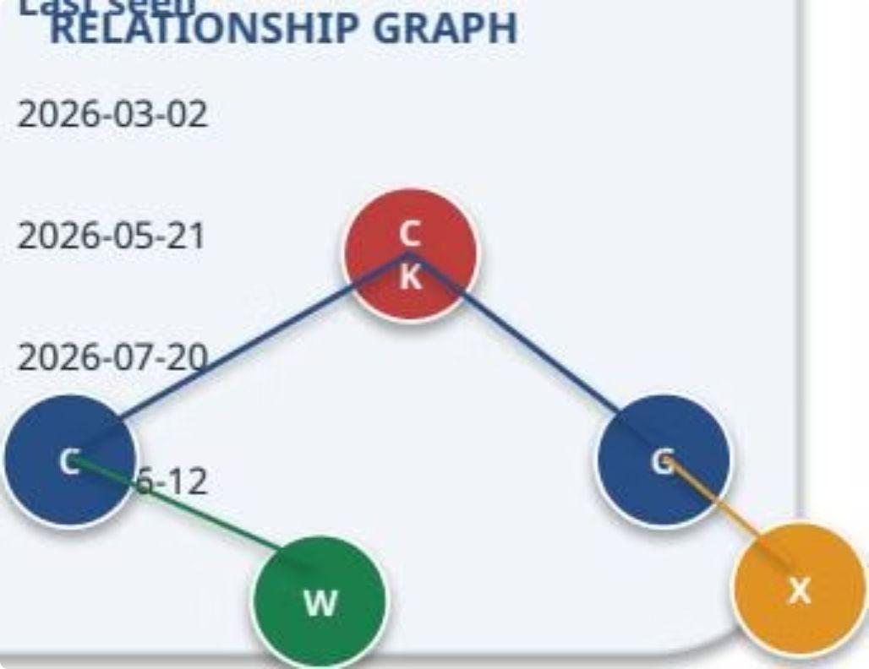

RUNTIME ERRORS
Impact & Feasibility
Demo Metrics
Operational Benefits
Roadmap & Phases
→
Faster Triage
Phase 1 — Now
Scored leads surface high-confidence links first, reducing analyst workload.
Synthetic demo with curated test data; full pipeline validated end-to-end
→
Persona Migration Detection
Phase 2
Authorized collector integrations; real-world identifier extraction at scale
Tracks when threat actors rebrand across platforms using behavioural continuity signals.
12
Tracked
7
Relationship
Entities
Links
Phase 3
Actors in demo dataset
Cross-platform identities
Blocking + canopy for large graphs; enriched stylometry models
→
Exportable Evidence
10
Observations
4
Confidence
Searchable timeline and STIX-compatible exports feed directly into downstream SIEM/TIP systems.
Phase 4
Levels
Continuous analyst workflow; agency SIEM/TIP integration
Ingested data points
Confirmed to Speculative
Responsible Use:
INTELTRACE produces probabilistic leads only — not proof. All real-world collection must remain fully authorized and legally compliant.
5

Slide 6
RUNTIME ERRORS
Research & References
INTELTRACE is grounded in established threat intelligence methodology and built against a formally specified government problem statement. All components are original implementations referencing peer-validated techniques.
Reference | Details
SIH 2026 Problem Statement 26151 | Issued by NTRO — mandating dark web threat actor de-anonymization tooling for national cybersecurity operations
Project Codebase | Python microservices, synthetic demo dataset, Streamlit dashboard — fully functional end-to-end prototype submitted with hackathon entry
Identifier Extraction Methodology | PGP fingerprint parsing • cryptocurrency address regex • email/XMPP handle normalization — canonical resolution across heterogeneous dark web sources
Entity Resolution & Link Scoring | Probabilistic record linkage with explainable reason codes; 4-level confidence taxonomy (Confirmed / Probable / Possible / Speculative)
Stylometry & Behaviour Analysis | Authorship attribution via writing-style fingerprinting; temporal activity pattern modelling for cross-platform persona linkage
Graph Intelligence Layer | NetworkX-based entity–relationship graph; blocking/canopy steps for scalable pairwise comparison; visual network export
Reporting & Export Layer | ReportLab PDF reports • CSV & JSON machine-readable exports • STIX-like structured threat intelligence output for SIEM/TIP integration
Team
Problem ID
RUN TIME ERRORS
SIH 2026 — #26151
Theme
Sponsor
Blockchain & Cybersecurity
NTRO
6

