Slide 1
A comparative analysis of standard path planning algorithms
Varun Madhavan 18CH30031
Arnesh Issar 18CH3FP07
Motiar Rehaman 18CH3FP26

Slide 2
What we are going to do?

Slide 3
Index:
Shortest Path Problem
What is path finding?
Applications of path finding
Naive Approach
Greedy Best First Search
Dijkstra Algorithm
A* Algorithm
RRT Algorithm
RRT* Algorithm
Visualizations

Slide 4
What is path finding?
Pathfinding algorithms address the problem of finding a path from a source to a destination avoiding obstacles and minimizing the costs (time, distance, risks, fuel, price, etc.).
Very common programming challenge. Mainly known from navigation and games
We will find that the core algorithms apply to a huge range of problems.

Slide 5
Applications of Path Finding Algorithms
Google maps
Video Games
Autonomous Vehicles
Robotics

Slide 6
Shortest Paths Problem

Slide 7
0.
A Naive Approach

Slide 8
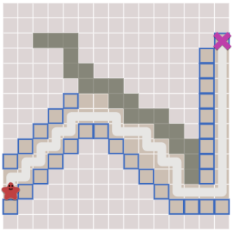
Greedy Best-First-Search
Consider a path finder that works on the following simple approach -
At each step, consider the possible movements allowed (look only one step ahead)
Move in the direction that brings you closest to the goal
Such a pathfinder would detect no obstacles in the immediate vicinity and would move in the direction that gets it closest to the goal.
However, during the path it would detect an obstacle and would change direction accordingly to go around it.
In doing so, it would end up covering a much larger distance than strictly required.
Hence the Greedy Best-First-Search algorithm is not guaranteed to find the shortest path

Slide 9
1.
Dijkstra Algorithm

Slide 10
High Level Idea:
Dijkstra’s Algorithm (also called Uniform Cost Search)
Lets us prioritize which paths to explore.
It favors lower cost paths, instead of exploring all possible paths equally.
We can assign lower costs to encourage moving on roads, higher costs to avoid forests, higher costs to discourage going near enemies, and more.
When movement costs vary, we use this instead of Breadth First Search.
Data Structures used:
Priority Queue

Slide 11
Pseudo Code
The graph is stored as adjacency lists so that adj[a] contains a pair(b,w) always when there is an edge from node a to node b with weight w.
Priority Queue contains the nodes, ordered by their distance
Using the Priority Queue the next node to be processed is retrieved in logarithmic time

Slide 12
for (int i = 1; i <= n; i++)
distance[i] = INF;
distance[x] = 0;
q.push({0,x});
while (!q.empty())
{ int a = q.top().second;
q.pop();
if (processed[a]) continue;
processed[a] = true;
for (auto u : adj[a])
{ int b = u.first, w = u.second;
if (distance[a]+w < distance[b])
{ distance[b] = distance[a]+w;
q.push({-distance[b],b}); } } }
Time Complexity: O(n+ mlogm)
The algorithm goes through all nodes of the graph and adds for each edge at most one distance to the priority queue.

Slide 13
‹#›
Drawbacks of Dijkstra Algorithm
The efficiency of Dijkstra’s algorithm is based on the fact that the graph does not contain negative edges.
If there is a negative edge, the algorithm may give incorrect results. As an example, consider the following graph:
2
The shortest path from node 1 to node 4:
1 → 3 → 4 length i= 1
Dijkstra’s algorithm finds the path:
1 → 2 → 4 length i= 5
2
3
1
4
6
-5
3

Slide 14
Dijkstra’s Algorithm works well to find the shortest path, but it wastes time exploring in directions that aren’t promising. Hence reducing the speed.
Greedy Best First Search explores in promising directions but it may not find the shortest path.
The A* algorithm uses both the actual distance from the start and the estimated distance to the goal.

Slide 15
A* Algorithm

Slide 16
A* Algorithm
Dijkstra’s Algorithm is guaranteed to find the shortest path
However, it explores all directions even if they aren’t promising.
Greedy Best First Search explores only the most promising directions but it may not find the shortest path.
The A* algorithm uses both the actual distance from the start and the estimated distance to the goal.
Data Structures used:
Map
Priority Queue

Slide 17
Pseudo Code
The graph is stored as adjacency lists so that adj[a] contains a pair(b,w) always when there is an edge from node a to node b with weight w.
Priority Queue contains the nodes, ordered by a heuristic.
Using the PQ the next node to be processed is retrieved in logarithmic time.

Slide 18
Pseudo Code
frontier = PriorityQueue()
frontier.put(start, 0)
came_from = dict()
cost_so_far = dict()
came_from[start] = None
cost_so_far[start] = 0
while not frontier.empty():
current = frontier.get()
if current == goal:
break
for next in graph.neighbors(current):
new_cost = cost_so_far[current] + graph.cost(current, next)
if next not in cost_so_far or new_cost < cost_so_far[next]:
cost_so_far[next] = new_cost
priority = new_cost + heuristic(goal, next)
frontier.put(next, priority)
came_from[next] = current
Time Complexity: Heuristic Dependent (same as Dijkstra for O(1) heuristic)

Slide 19
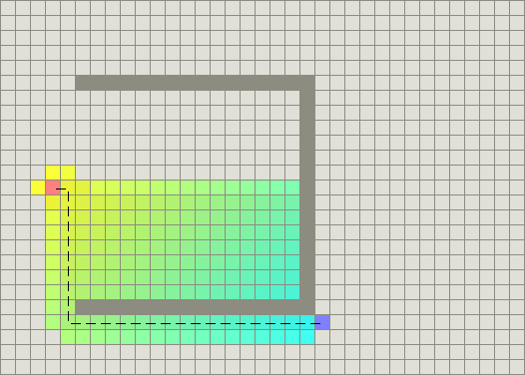
Drawbacks of A*
Due to the heuristic, A* follows a somewhat greedy approach when searching for new nodes. So we don’t necessarily find the shortest paths
Due to this nature it gets easily stuck on concave objects & wastes computation time on the same.
Although the cost of the path doesn’t suffer since the path gets updated.

Slide 20
3.
RRT Algorithm

Slide 21
Rapidly-exploring Random Trees (RRT)
A Rapidly-exploring Random Tree (RRT) is a pathfinding algorithm that works by building a space-filling tree that avoids the given obstacles.
The tree is constructed incrementally from samples drawn randomly from the search space and is inherently biased to grow towards large unsearched areas of the problem (exploration bias parameter).
They easily handle problems with obstacles and have been widely used in autonomous robotic motion planning.

Slide 22
RRT Algorithm Overview
Till we reach the destination, or for a fixed number of iterations, do -
Pick a point in the grid at random and find the node (in the graph) closest to it (X_nearest)
Create a new node (X_new) a certain distance (“jump distance”) away from X_nearest in the direction of the random sampled node
Each time a node is created, a check must be made that the vertex lies outside of an obstacle.
While chaining the node to its closest neighbor we must also avoid obstacles.
The algorithm ends when a node is generated within the goal region, or a limit is hit. This path will not necessarily be optimal.
The benefit of the algorithm is its speed and implementation. Compared to other path planning algorithms, RRT is very fast. The costliest part of the algorithm is finding its closest neighbor as this process grows depending on the number of vertices that have been generated.

Slide 23
Pseudocode
// Initialization
dest // region that identifies success
counter = 0 // keeps track of iterations
iter_limit = n //number of iterations algorithm should run for
G(Vertices, Edges) // graph containing edges and vertices, initialized as empty
// find path
while counter < iter_limit:
X_new = sample_node() // sample new node at random
if inside_obstacle(X_new) == True: // if new node is inside an obstacle, try again
continue
X_nearest = find_nearest(G, X_new) // find nearest vertex
G.app(X_nearest) // add the new node to the graph
if Xnew is inside dest:
Return G
Return G

Slide 24
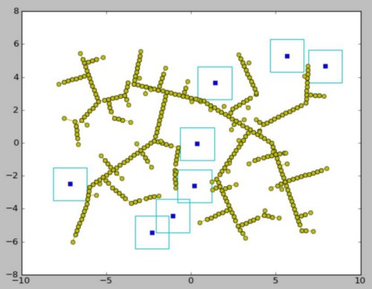
Drawbacks of RRT Algorithm
‹#›
Since nodes are attached to their nearest neighbor, RRT has a tendency to produce very cubic graphs. The structural nature of these graphs hinders the probability of finding an optimal path. Instead of taking the hypotenuse between two points, the two legs of a triangle are navigated across. This is evidently a longer distance. The cubic nature and irregular paths generated by RRT are addressed by RRT*.

Slide 25
3.
RRT* Algorithm

Slide 26
RRT* Algorithm
RRT* is an optimized version of RRT. When the number of nodes approaches infinity, the RRT* algorithm is guaranteed to find the shortest path.
The basic principle of RRT* is the same as RRT, but two key additions to the algorithm result in significantly different results.
cost of a node = distance of a node from the it’s parent node. After the closest node is found in the graph, a neighborhood of vertices in a fixed radius from the new node are examined. If a node with a cheaper cost() than the proximal node is found, the cheaper node replaces the proximal node. This helps to eliminate cubic structure of RRT.
rewiring -> After a vertex has been connected to the cheapest neighbor, the neighbors are again examined. Neighbors are checked if being rewired to the newly added vertex will make their cost decrease. If the cost does indeed decrease, the neighbor is rewired to the newly added vertex. This feature makes the path more smooth.

Slide 27
RRT* Algorithm
RRT* creates incredibly straight paths. Additionally, its graphs are characteristically different from those of RRT. For finding an optimal path, especially in a dense field of obstacles, the structure of RRT* is incredibly useful. The graph vines around objects, finding shorter paths in comparison to RRT. If the destination were to change, the original graph can still be used as it represents the quickest path to most locations in the region.
However, this comes at the cost of the speed of the algorithm which is significantly larger than for standard RRT.
This increase is mainly due to the obstacle avoidance check. Obstacle avoidance must be checked when a node is placed, when a node is connected to its neighbor, and for each node that is to be rewired. This is a considerable number of checks to make.

Slide 28
Pseudocode
// find path
while counter < iter_limit:
X_new = sample_node() // sample new node at random
if inside_obstacle(X_new) == True: // if new node is inside an obstacle, try again
continue
X_nearest = find_nearest(G, X_new) // find nearest node in the tree
cost(X_new) = distance(X_new, X_nearest)
X_neighbors = get_neighbours(G, X_new, radius)
Link = Chain(X_new, X_nearest)
// rewire
For x’ in X_neighbors
If cost(X_new) + distance(X_new, x’) < cost(x’)
cost(x’) = cost(X_new) + distance(X_new, x’)
parent(x’) = X_new
G += {X_new, x’}
G += Link
Return G
// Initialization
dest // region that identifies success
counter = 0 // keeps track of iterations
iter_limit = n //number of iterations algorithm should run for
radius
G(Vertices, Edges) // graph containing edges and vertices, initialized as empty

Slide 29
Thanks!

