Slide 1
Welcome
Fish 559; Day1: 09h00-09h30
Notes:
a

Slide 2
Chasco – something along these lines. Likelihoods are a reoccurring them.
This workshop is centered around three principles of modeling
  Formulation
    Building models from first principles using biologically meaningful parameters
    Likelihoods
  Implementation
    Fitting your model to data using ADMB – the bulk of the workshop and perhaps the most difficult for ecologists.
    Likelihoods
  Evaluation
    Likelihoods
    Residual diagnostics
    Management risk

Slide 3
What Does ADMB Do?
Parameters are hypotheses describing nature.
ADMB finds the hypotheses that best describe your system.
It can find the value of the parameter vector that minimizes a (complex) non-linear function of many variables.
It can compute measures of uncertainty by:
  estimating asymptotic variance-covariance matrices;
  computing likelihood profiles for parameters and model outputs - relatively how much better is one hypothesis over another; and
  sampling parameter vectors from Bayesian posteriors using the Markov Chain Monte Carlo (MCMC) algorithm.

Slide 4
Why Use ADMB?
It is fast because the minimization algorithm uses analytical derivatives and a quasi-Newton algorithm.
There is no need to supply the derivatives of the function to be minimized with respect to the parameters; these are computed automatically using Reverse Mode Autodifferentiation.
ADMB code is essentially C++ but includes:
  commands to specify the function to be minimized; and
  support for additional data structures (in particular it can deal with matrices).

Slide 5
Aims of this Workshop
Introduce students to ADMB.
Conduct several in-class examples.
Motivate projects for later in the class.

Slide 6
Statistical
Background
Fish 559; Day1: 09h30-10h30
Notes:
a

Slide 7
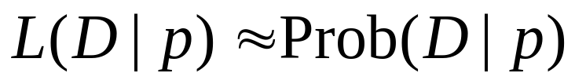
Maximum Likelihood
Given a set of data, and a probability model, maximum
likelihood chooses the values for the parameters that make
the data “most likely”.
The likelihood of the data D given the parameter(s) p is the
probability of the data given the parameter(s).
Note:
Probability: knowing parameters -> predicting data.
Likelihood: knowing data -> parameter estimation.

Slide 8
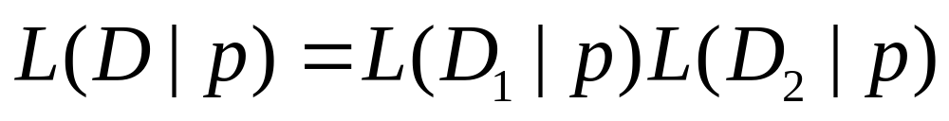
Basics of Likelihood
If the data consists of two parts D₁ and D₂, the likelihood
of the data D=D₁+D₂ is the product of the likelihoods
of each of D₁ and D₂:
Data point 1
Data point 2

Slide 9
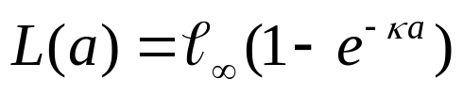
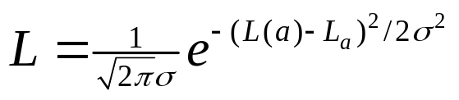
Further Likelihood Considerations
To compute the likelihood for a given set of
parameters we need:
The deterministic (model) relationship between the input
variables (covariates) and the (expected) data:
How the data pertain to the model prediction – the
“sampling” distribution (in this case normal), i.e.:
Model prediction
Data

Slide 10
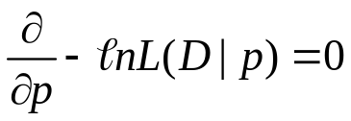
Maximum Likelihood
Given a likelihood function, we find the maximum likelihood
values for the parameters of the model, by maximizing the
log-likelihood, or minimizing the negative log-likelihood, i.e.:
Naturally, it is seldom the case that one can solve this
equation but it is possible (such as a linear regression).

Slide 11
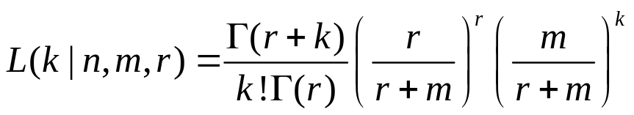
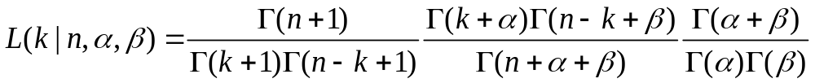
Thoughts on likelihoods
It is traditional to assume that count data are Poisson
distributed and yes-no data are binomial, but actual data are usually overdispersed. If these cases one should assume:
Negative binomial likelihood:
Beta-binomial likelihood:

Slide 12




Likelihood Profile-I
Likelihood profile is a way to estimate a confidence interval for
the estimate of a model parameter when the model is fitted
using maximum likelihood.
The problem. We have a model based on a vector of
parameters . One of these parameters is “p” and we want
a x% confidence interval for it. The negative log-likelihood
function for this problem is or (separating out p),
. Note: .

Slide 13





Likelihood Profile-II
The steps in computing a likelihood profile:
  Fit the model to find the maximum likelihood
  estimates for the parameters and also the lowest
  negative log-likelihood .
  Select a wide range of values for p.
  For each value of p=A, find the values for the
  parameters such that is
  minimized. Record the negative log-likelihood for
  each value of p,
  Plot against p.

Slide 14
Likelihood Profile-I
Negative log-likelihood, fixing the
parameter to each value in turn
(minimize on the rest of the parameters)
-log
likelihood
MLE
•
•
•
•
•
•
•
Parameter of Interest
Alternative
values for the
parameter

Slide 15


Model Selection-I
Given N models which are all fitted to the same data set
(denoted D), we can identify the best approximating model
by calculating the AIC, BIC, etc.
where p_{i} is the number of parameters in model i and n is
the number of data points

Slide 16
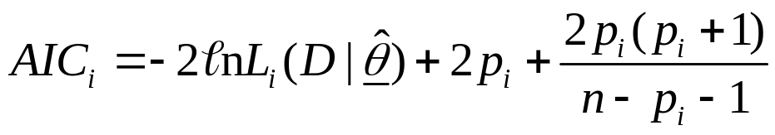
Model Selection-II
All things equal, BIC will select less complex models
than AIC. AIC_{c} takes small sample size effects into account:
I always use AIC_{c} but its effect is small for n >> p_{i}

Slide 17
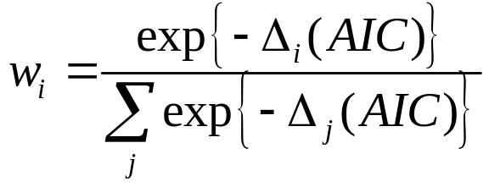

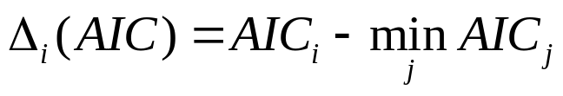
Model Selection-III
Models can be weighted with AIC and BIC, e.g.:
where is:

Slide 18
Review I
This workshop is centered around three principles of modeling
  Formulation
    The model -
    Likelihoods -
  Implementation
    Fitting your model to data in ADMB – the bulk of the workshop and perhaps the most difficult for ecologists.
    Likelihoods
  Evaluation
    Likelihoods
    Residual diagnostics
    Management risk

Slide 19
Review II
This workshop is centered around three principles of modeling
  Formulation
    The model -
    Likelihoods -
  Implementation
    Fitting your model to data in ADMB – the bulk of the workshop and perhaps the most difficult for ecologists.
    Likelihoods
  Evaluation
    Likelihoods
    Residual diagnostics
    Management risk
Data point 1
Data point 2

Slide 20
Review III
This workshop is centered around three principles of modeling
  Formulation
    The model -
    Likelihoods -
  Implementation
    ADMB will find the set of parameter that best fit the data by minimizing the negative log of the likelihood. We will demonstrate.
  Evaluation
    Likelihoods
    Residual diagnostics
    Management risk

Slide 21
Review IV
This workshop is centered around three principles of modeling
  Formulation
    The model -
    Likelihoods -
  Implementation
    ADMB will find the set of parameter that best fit the data by minimizing the negative log of the likelihood. We will demonstrate.
  Evaluation
    Likelihood profiles
    AIC

Slide 22
References
Wagenmakers, E-J and S. Farrell. 2004. AIC model selection using Akaike weights. Psyschonomic Bulletin & Review 11: 192-196.

