Slide 1
Introduction to ADMB
Fish 559; Day1: 11h30-12h30
Notes:
a

Slide 2
Very simply – you are going to:
Give your computer a set of instructions, specifically find the hypothesis that best explain your data based on your likelihood rules.
Your instructions are written in ADMB format.
Because your computer doesn’t know ADMB speak, you use ADMB libraries/dictionaries to translate your instructions in to computer language.
Then the computer will use your translated instructions and the ADMB dictionaries to get the answer you want/need/hope for.
The library that your computer translator uses to change ADMB instructions into computer instructions is not smart, so you have to be precise in your programming.
ADMB is now used by thousands people in dozens of fields. Learning it will make you very marketable in the workplace.

Slide 3
Specifying the Problem
ADMB programs are written using a template (a file with a .TPL extension).
The TPL file specifies:
  the function to be minimized ;
  the parameters that are to be varied to minimize the function;
  any variables that depend on the parameters but are not parameters themselves; and
  the data (constants) that are part of the function.

Slide 4
The ADMB “Approach”
Create a .TPL file. This file provides the specifications to:
  read in the data;
  identify the parameters and any derived variables;
  define the model; and
  define the objective function to be minimized.
Convert the TPL file to a C++ file (a CPP file) using tpl2cpp.exe.
Compile and link the resultant C++ program as you would any other C++ program.
The ADMB documentation is very terse but can be helpful – consult it!

Slide 5
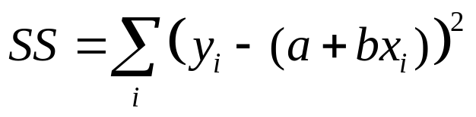
The First Example - I
We start with a least-squares problem:
  Find a and b by minimizing:
Program: LECTA.TPL
Data File: LECTA.DAT
To compile: ADMB -s LECTA
To run: LECTA
Have a look at the various output files

Slide 6
The First Example - II
(Linear Regression)
Sections:
DATA – the input data (read from
LECTA.DAT)
PARAMETER – the model parameters, any
functions of the parameters, and the
objective function.
PROCEDURE – where the calculations are
done
There are other SECTIONS which will come
later.
DATA_SECTION
init_int NData;
init_vector x(1,NData);
init_vector y(1,NData);
PARAMETER_SECTION
init_number a;
init_number b;
vector ypred(1,NData);
objective_function_value obj_fun;
PROCEDURE_SECTION
ypred = a + b*x;
obj_fun = norm2(y-ypred);

Slide 7
The First Example - III
(Linear Regression)
Reserved words:
To specify storage types (in blue)
To specify built-in functions (in green)
DATA_SECTION
init_int NData;
init_vector x(1,NData);
init_vector y(1,NData);
PARAMETER_SECTION
init_number a;
init_number b;
vector ypred(1,NData);
objective_function_value obj_fun;
PROCEDURE_SECTION
ypred = a + b*x;
obj_fun = norm2(y-ypred);
// This is a comment
catch is a reserved word!!
Some notes:
You can add comments (lines starting
with //) – use them!
ADMB works with vectors – see how
the predicted values are computed.
The “objective_function_value” is the
variable being minimized.

Slide 8
Our First Example - IV
(Adding output)
DATA_SECTION
init_int NData;
init_vector x(1,NData);
init_vector y(1,NData);
PARAMETER_SECTION
init_number a;
init_number b;
vector ypred(1,NData);
objective_function_value obj_fun;
PROCEDURE_SECTION
ypred = a + b*x;
cout << ypred << endl;
obj_fun = norm2(y-ypred);
// This is a comment
REPORT_SECTION
report << ypred << endl;
report << y << endl;
Use:
  “cout” to output the values for variables to the screen; and
  “report” to output results to the .REP file (only after the minimization is complete)

Slide 9
The First Example - V
(Output Files of Interest)
LECTA.PAR – lists the parameter estimates, the final objective function, and the gradient – the latter should be close to zero!
LECTA.STD – lists the parameter estimates and the (asymptotic) standard errors.
LECTA.COR – lists the parameter estimates, their (asymptotic) standard errors, and their (asymptotic) correlation matrix.
LECTA.REP – lists any variables specified in the REPORT_SECTION.

Slide 10
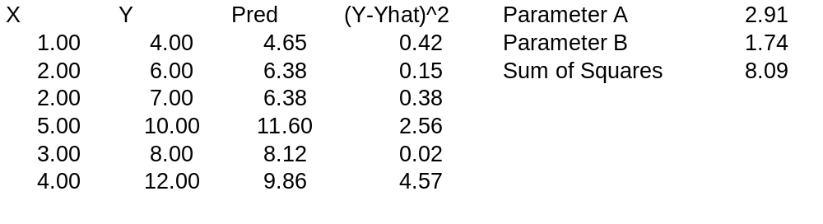
This Problem Could Have Been Done in EXCEL using SOLVER!
Note: I had to run SOLVER twice
to get the real solution

Slide 11
Dissecting The Program
(arithmetic)
ypred = a + b*x;
obj_fun = norm2(y-ypred);
The first line is a vector operation - it defines a vector, each element of which, ypred(i), is a+b*x(i).
The second line sums the squares of the differences between the observed (y) and predicted (ypred) values – this is also a vector operation.

Slide 12
Something About Arithmetic
The following are the ADMB arithmetic expressions:
  Z=a+b – addition (note Z+=b)
  Z=a-b – subtraction
  Z=a*b – multiplication
  Z=a/b – division
ADMB implements all the standard functions (and more):
  Z=log(a)
  Z=mfexp(a)
  Z=pow(a,b) – exponentiation
  Z=square(a)
  Z=norm2(vec1,vec2)

Slide 13
Declaring Variables
Before a variable is used, it has to be declared.
Key distinction among variables:
  Fixed throughout the program (data to be read in, values for fixed parameters, e.g. Survival) – declare in the DATA_SECTION.
  The parameters to be estimated and any variables that are functions of these parameters – declare in the PARAMETER_SECTION.
Declarations are of the form:
“Data type” “variable name”;
Notes:
Not at the local level
CITES listings

Slide 14
Data Types
ADMB needs to know what dimensions and format your data/variables/parameters will be in!
The most-basic types:
  int (e.g. int Count) – integer.
  number (e.g. number Biomass) – real number.
  vector (e.g. vector me(1,10)) – set of real numbers indexed by 1,2,..,10.
  ivector – as for vector, except that the contents are integers.
  matrix – two dimensional array of real;
  imatrix – two dimensional array of integer;
  3darray – three dimensional array of real; and
  4darray – four dimensional array of real
All variables MUST be declared before they are used – no exemptions!

Slide 15
Variable Names-I
Variable names:
  Must start with an alphabetic character.
  Don’t use any reserved words (if, else, etc.)
  Choose descriptive but not overly long variable names (e.g. biomass, MSY).
  ADMB (and C) is case-sensitive, i.e. the variables biomass and Biomass are NOT the same variable.

Slide 16
Variable Names - II
Other rules / hints:
  Use underscores to split names within a variable name (e.g. my_biomass).
  Avoid re-using the same variable for different purposes.
  Don’t forget those semi-colons!

Slide 17
Review I
This workshop is centered around three principles of modeling
  Formulation
    The model -
    Likelihoods -
  Implementation
    You learned what a template file is
    Your template contains specific instructions about data, parameters, variables, and the objective function
    You learned that ADMB code gets translated to machine code
  Evaluation
    Likelihoods
    Residual diagnostics
    Management risk

