Slide 1
Sections
Fish 559; Day2: 09h15-10h30
Notes:
a

Slide 2
Very simply – you are going to:
Define your model of nature
Define the error structure between your model and the observations
Implement your model and likelihood in ADMB by creating an ADMB template
Change your ADMB template into machine language
Tell the computer to run your template
Look at the best parameters and the fit to the data.

Slide 3
All the Sections
DATA_SECTION
INITIALIZATION_SECTION
PARAMETER_SECTION
PRELIMINARY_CALCS_SECTION
PROCEDURE_SECTION
FUNCTION
REPORT_SECTION
RUNTIME_SECTION
TOP_OF_MAIN_SECTION
GLOBALS_SECTION
These sections are required
Optional sections control ADMB and improve readability

Slide 4
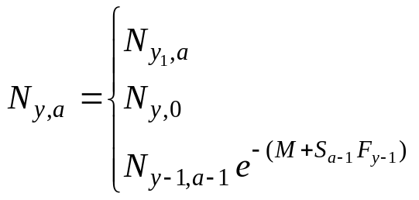
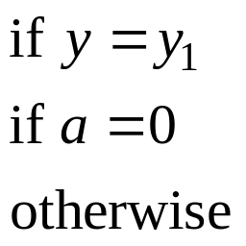
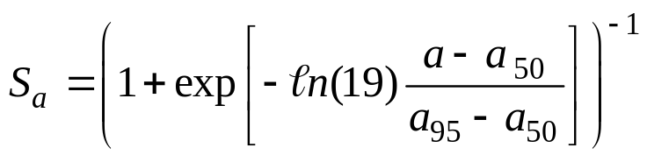
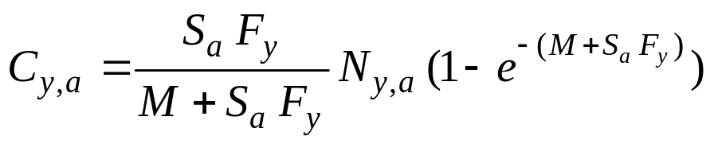
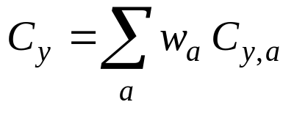
Example-I
(An Age-structured Model)
Fit the following simple age-structured population dynamics
model to CPUE, catch and catch-at-age data.

Slide 5
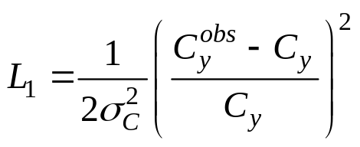
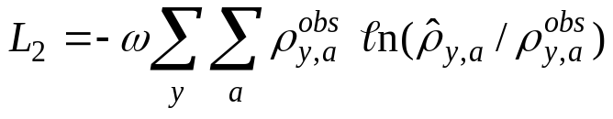
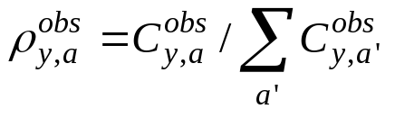
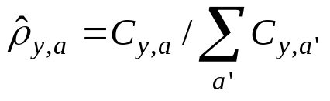
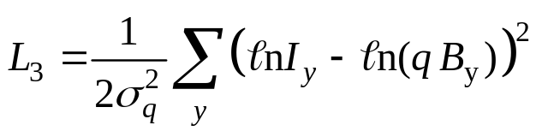
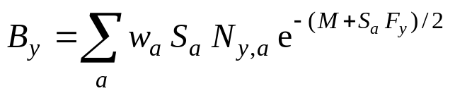
Example-II
(The Likelihood function)
The negative of the logarithm of the likelihood function
includes three contributions: the catch data, the catch-at-age data, and the CPUE data. Likelihoods: normal with constant CV for the first, multinomial for the second, and log-normal for the third.

Slide 6
Example-II
(Parameters and Data)
Numbers in the first year and for age 0 (estimated).
Fully-selected fishing mortality by year (estimated).
Ages-at-50%- and at-95%-selectivity (estimated).
Natural mortality (pre-specified).
Weight-at-age (pre-specified).
Catchability (estimated).
Weights to apply to the catch, CPUE and catch-at-age data (pre-specified).
Catch, CPUE and observed catch proportion-at-age data (pre-specified).

Slide 7
The DATA_SECTION-I
This section declares the data to be read in from the DAT file, and any static variables:
  Use the “init_” prefix to indicate that a variable is to be read in.
Read from a file
A static variable
init_int Count; // Counter
init_vector X(1,Count); // Data vector
vector ZZ(1,10) // Storage
Limits of vectors can be variables
or pre-specified values

Slide 8
The DATA_SECTION-II
The default data file is “PROGRAM.DAT”.
  To change this default at runtime, type the command “PROGRAM –ind ALT.DAT”.
  To change the data file in the DATA_SECTION, add the line:
  !!ad_comm::change_datafile_name(“new name”).

Slide 9
Exercise
(The DATA Section)
DATA_SECTION
init_int Nyear;
init_int Nage;
init_number Mval;
init_vector Wght(0,Nage);
init_number SigCatch;
init_number SigCPUE;
init_number Omega;
init_matrix CatchCpue(1,Nyear,0,2);
init_matrix Propn(1,Nyear,-1,Nage);
vector Catch(1,Nyear);
vector CPUE(1,Nyear);
!! Catch = column(CatchCpue,1);
!! CPUE = column(CatchCpue,2);
Variables in which to store
the catch and CPUE data
Use the “column” function
to extract the catch and
CPUE data

Slide 10
The PARAMETER_SECTION-I
Specifying the parameters of the model:
  Add a prefix (“init_”), i.e. “init_number a” in the PARAMETER_SECTION indicates that a is an estimated parameter (what would it mean if this statement was in the DATA_SECTION?)
  You can limit the range of an estimated parameter by adding “bounded”, e.g. “init_bounded_number a(1,5)” estimates “a” and forces its estimate to lie between 1 and 5 – why do we need this feature?
  You can “stage” your minimization by using “phases” (e.g. init_number a(2) – means that “a” will be treated as “free” in “phase 2”). What does phase “-1” mean?
  The estimated parameters MUST be real numbers!

Slide 11
The PARAMETER_SECTION-II
Other aspects of the PARAMETER_SECTION.
  There MUST be a line that lists the variable that will be minimized:
    Objective_function_value ZZZZ
  Include any temporary variables in this section (without the “init_” prefix and without phases / bounded).
  Sometimes you want the sum of a vector of parameters to be 0 – use the “dev” option (e.g. init_dev_vector ZZ(1,10))

Slide 12
The PARAMETER_SECTION-III
To set phases and bounds for a matrix or vector use:
  init_bounded_number_vector
  init_bounded_number_matrix
This is a new feature of ADMB and programs which use this construct cannot be compiled using an old version of the compiler.

Slide 13
The PARAMETER_SECTION-IV
The PIN File:
  A file of initial parameter values (the order of the variables in the PIN file must be the same as that of the variables in the TPL file).
  Hint-1: run ADMB without a PIN file and use the resultant PAR file as a proforma.
  Hint-2: You can change the default PIN file by running with the –ainp option (i.e. PROGRAM –ainp MY.PIN).
INITIALIZATION_SECTION
  Statements like “a 10” (no punctuation) can be included in this section to override the default value assigned to a parameter.
  This is NOT very flexible.

Slide 14
The PARAMETER_SECTION-V
To execute some code (such as projections) only in a given phase add the following code:
if (current_phase() == 2)
{ Code; }
Or
if (last_phase())
{ Code; }

Slide 15
Exercise
(The PARAMETER Section)
PARAMETER_SECTION
init_vector logN(1,Nyear+Nage,1)
init_bounded_number Sel50(0,Nage,1)
init_bounded_number Sel95(0,Nage,1)
init_vector logFish(1,Nyear,1)
init_number logq(1)
matrix N(1,Nyear+1,0,Nage)
vector S(0,Nage)
matrix F(1,Nyear,0,Nage)
matrix Z(1,Nyear,0,Nage)
vector CPred(1,Nyear);
vector CPUEPred(1,Nyear);
matrix PropnPred(1,Nyear,0,Nage);
vector Bio(1,Nyear);
number Like1;
number Like2;
number Like3;
objective_function_value objn;
The estimable parameters
The variables that are
functions of the
estimable parameters
The quantity minimized

Slide 16
The PRELIMINARY_CALCS_SECTION-I
Comes after the PARAMETER_SECTION
Only executed once (not part of the function to be minimized)
Used to do “housekeeping” of the input data, e.g.:
  Convert from tonnes to kgs.
  Convert data from one format to another, e.g. if the data was read in as a matrix but you want it in the form of vectors, use:
        “vec =column(data,colno)”

Slide 17
The PRELIMINARY_CALCS_SECTION-II
Alternatives to a PCS:
  Add lines to the DATA and PARAMETER SECTIONS preceded by !! (e.g.
  !! Vec = column(data,5);
  Include a LOCAL_CALCS Section in the middle of the DATA_SECTION.

Slide 18
The REPORT_SECTION
Formatted output:
report << setw(15) << setfixed() << setprecision(10) << Initial_F << endl;
This outputs “Initial_F” over 15 characters, 10 of which are after the decimal place.
Output from cout can also be formatted.
Output to an alternative file:
ofstream f1("Param.Est");
f1 << SigmaR << endl;
f1 << Steep << endl;
Note: “<<“ concatenates and “endl” moves to a new line.

Slide 19
The RUNTIME_SECTION
Some programs just need a little more help. Tricky models and data can cause problems
Allows you to control some aspects of how ADMB operates:
maximum_function_evaluations phase 1, phase 2, phase 3
convergence_criteria phase 1, phase 2, phase 3
E.g.
maximum_function_evaluations 3100,150,300,4000
convergence_criteria 01,.0001,1e-7

Slide 20
The TOP_OF_MAIN_SECTION
TOP_OF_MAIN_SECTION
gradient_structure::set_MAX_NVAR_OFFSET(1000);
gradient_structure::set_NUM_DEPENDENT_VARIABLES(800);
gradient_structure::set_GRADSTACK_BUFFER_SIZE(100000);
gradient_structure::set_CMPDIF_BUFFER_SIZE(1000000);
arrmblsize=900000;
This is all very geeky stuff. If you really want to know about this stuff, read the AutoDiff manual! However, you may find that you get an error message from ADMB indicating you don’t have enough storage – this is when you need a TOP_OF_MAIN_SECTION and may need to increase the values in parenthesis!

Slide 21
The GLOBALS_SECTION
Sometimes there are things that no one else has thought of, or perhaps needs
Have some C code that you really want to use – this is the place for it.
GLOBALS_SECTION
// some C++ compilers don't supply this!
int mymax(int x,int y)
{
if (x>y)
return x;
else
return y;
}

Slide 22
Some Command Line Options
-ainp NAME: Change the PIN file
-est: Only do the estimation – saves time when you are developing models.
-maxph N: Change the maximum number of phases to N.
-nox: don’t show parameter and gradient values.
-? / -help: list of available options.

