Slide 1
Variance Estimation
Fish 559; Day2: 13h30-15h30
Notes:
a

Slide 2
Very simply – you are going to:
Understand the difference between parameter/hypotheses and derived variables.
Learn to estimate and describe uncertainty. Almost every ecologist with be confronted with what you know and how certain are you.
Learn how to estimate the uncertainty of parameters and derived variables.

Slide 3
Variance Estimation
There are a variety of ways to compute standard errors and confidence intervals for model parameters and model outputs. This lecture considers two of these:
  asymptotic methods; and
  likelihood profile.

Slide 4
Asymptotic Methods

Slide 5
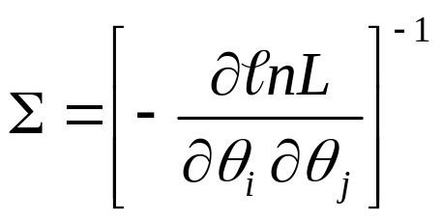
Asymptotic Standard Errors and Correlations-I
ADMB automatically calculates asymptotic standard errors and parameter correlations:
Note that the second derivatives are computed numerically (rather than analytically).
The results appear in the .STD and .COR files.

Slide 6
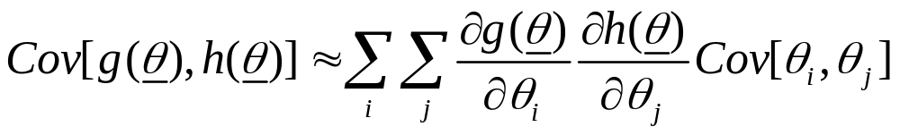
Asymptotic Standard Errors and Correlations-II
The default asymptotic variance-covariance calculations relate to the parameters of the model. However, we often want uncertainty estimates for derived quantities.
The way to do this is via the delta method:

Slide 7
Asymptotic Standard Errors and Correlations-III
To obtain asymptotic variances for derived parameters include
  sdreport_number xx;
  sdreport_vector yy;
  sdreport_matrix zz;
in the PARAMETER_SECTION.
Note: the results from asymptotic theory are approximations and may be bad approximations.

Slide 8
Asymptotic Standard Errors and Correlations-IV
Hints to speed things up:
  Only calculate the derived variables when they are needed:
  if (sd_phase())
  { code; }
  Look at the correlation matrix. If you see large (>0.80) correlations among the parameters, it may be time to consider reparameterizing the model!

Slide 9
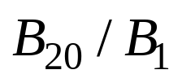
Exercise-I
Use the age-structured model from the last lecture and the dataset LECTD.DAT (a dataset with error) and compute:
  the variance-covariance matrix for the parameters;
  the standard error for the ratio:

Slide 10
Exercise-II
The correlation matrix:
The standard error of :
0.038787
“Large” values
in bold
33 Sel50 1.0000
34 Sel95 0.9663 1.0000
35 logFish 0.6845 0.6354 1.0000
36 logFish 0.7331 0.6794 0.7865 1.0000
37 logFish 0.7521 0.6950 0.7468 0.8133 1.0000
38 logFish 0.7597 0.6992 0.7034 0.7712 0.8081 1.0000
39 logFish 0.7597 0.6949 0.6708 0.7372 0.7792 0.8175 1.0000
40 logFish 0.7643 0.6962 0.6444 0.7057 0.7470 0.7887 0.8250 1.0000

Slide 11
Likelihood profile

Slide 12
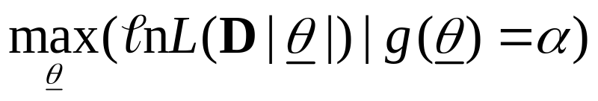
Likelihood profile-I
(What it might be)
What a likelihood profile might / should be:
  Fit the model to find the ML parameter estimates and find the corresponding negative log-likelihood.
  Select a set of fixed values for the quantity of interest.
  Minimize the negative log-likelihood fixing the quantity to each value in turn.
  Plot the difference between the negative log-likelihood from step 1 and those from step 3

Slide 13


Likelihood profile-II
(Confidence intervals)
An 100-x% confidence interval for p parameters is determined by finding the values for the parameter(s) for which:
is the negative log-likelihood corresponding to the maximum likelihood estimates.

Slide 14
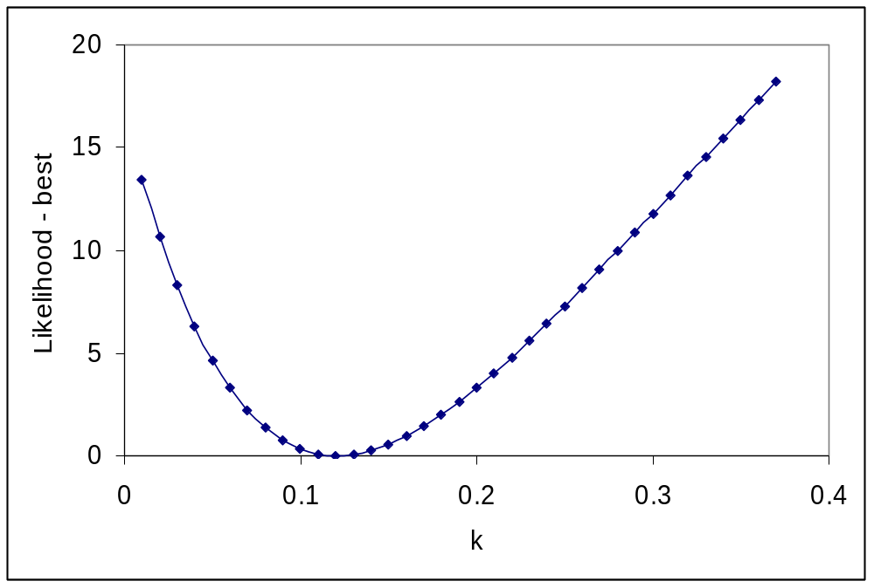
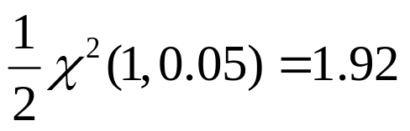
Likelihood profile-III
We can compute confidence intervals from likelihood profiles
Approximate 95% CI

Slide 15

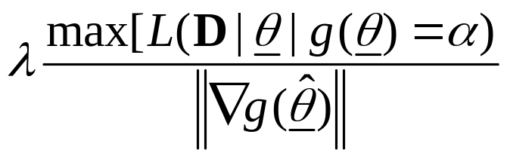
Likelihood profile – IV
(What it actually is in ADMB)
The ADMB Likelihood profile is actually an approximation to a Bayesian posterior!! It uses a profile for to approximate a posterior for .
What ADMB produces in its .PLT files is:

Slide 16
Likelihood Profile-V
(How to create one)
To obtain a likelihood profile for any quantity:
  add the following line to the PARAMETER_SECTION:
  Likeprof_number xx
  Run the program with the “-lprof” or “-lprof -prsave” options. The latter option produces the list of parameter values for each minimization involving a fixed value for the quantity of interest in the .pvl file. The results in this file provide alternative starting values (e.g. for MCMC runs).
  The results will appear in the files xx.plt, diags, dgs2, and xx.pvl.

Slide 17
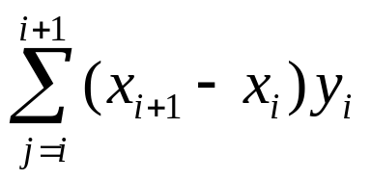
Likelihood Profile-VI
(Understanding the output files)
The xx.plt file:
  Each line of this file is a point (x, y) where x is the value of the quantity and y is a density.
  This file contains an approximation to the Bayesian posterior based on the likelihood profile and a normal approximation.
  To interpret the points (x_{i},y_{i}); (x_{i+1},y_{i+1}), compute the sum:
  This is an approximation to the probability that x lies between x_{i} and x_{i+1}.

Slide 18
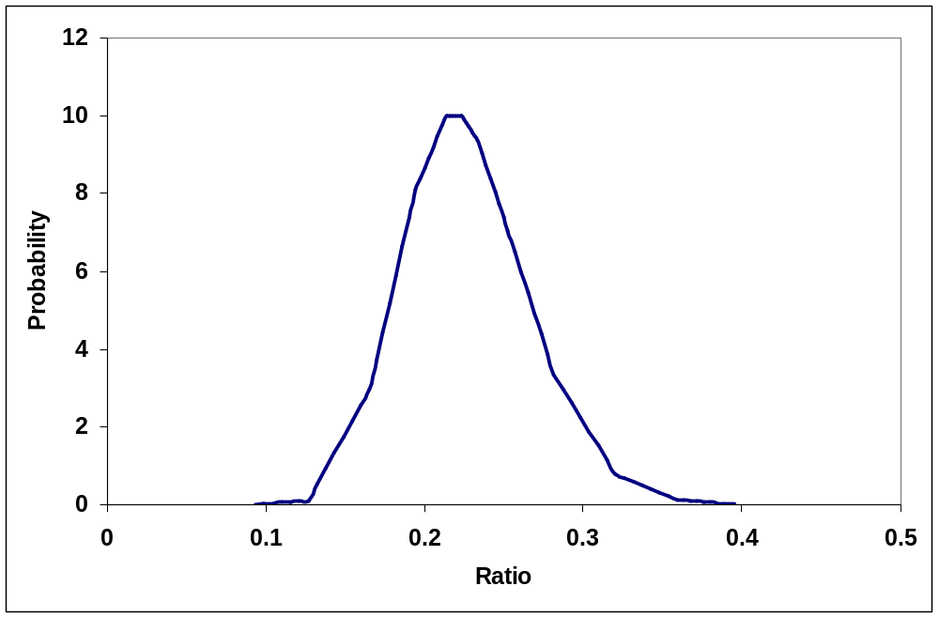
A “Likelihood Profile”
This is the likelihood profile for B₂₀/B₁

Slide 19
Likelihood Profile-VII
(Tricks and traps)
To change the number of steps, and the width of each step when conducting a likelihood profile, add the following lines to the PRELIMINARY_CALCS_SECTION:
  xx.set_stepnumber(zz);
  xx.set_stepsize(zz);
The default number of steps is 17 (-8 to 8) setting it to zz will lead to 2*zz+1 steps.
The default step size is 0.5 (in units of standard deviation).
Don’t be surprised if this doesn’t work!

Slide 20
Likelihood Profile-VI
(Constructing real likelihood profiles)
Add code that involves the computing the square of the difference between the quantity and a (read-in) target value.
Run the program for many different target values.
Construct a likelihood profile manually.

