Slide 1
ADMB and MCMC
Fish 559; Day3: 11h00-12h30

Slide 2
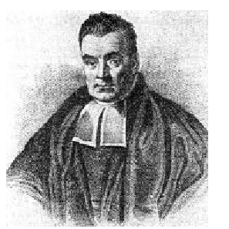
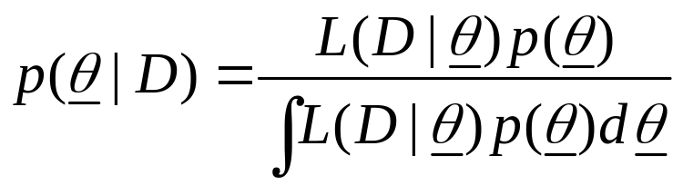

Basics of a Bayesian Assessment
Bayes Theorem:
We need to specify the prior distribution,
, in order to apply Bayes theorem.
The objective is to represent the posterior by means of a (large) number of vectors of parameters.

Slide 3
Objectives for MCMC
MCMC is a way to construct a (joint) Bayesian posterior for the parameters of a population dynamics model.
The basic idea is to set up a (long) “chain” which starts at a pre-specified vector and that then traverses the posterior distribution.
The sample from the posterior distribution is then every n’th element in the chain (ignoring the first “few” elements of the chain).

Slide 4
Overview of the MCMC algorithm
Select an “initial” parameter vector (often the mode of the posterior) and compute its posterior density (the product of the likelihood and the prior).
Generate a “new” parameter vector based on the current one (using a “jump” function) and compute its posterior density.
Replace the current parameter vector by the new parameter vector with probability equal to the ratio of the new to the current posterior density.
Output the current parameter vector.
Repeat steps 2)- 4) many times!
Steps 2-4 are referred to as a cycle.

Slide 5
A Little More Detail
A) Set i to 0.
B) Set y to xi.
C) Apply the “jump function” to y to generate a new vector z (may only differ in one element from y) and compute f(z).
D) If f(z) > f(y), set i=i+1, xi=z, go to B).
E) Generate w~U[0,1]. If w < f(z)/f(y) , set i=i+1, xi=z, go to B).
F) Set i=i+1, xi=y and go to B).

Slide 6
The Jump Function
The “jump” function should be chosen to optimize performance (but is usually selected for computational convenience).
It should be possible to reach all possible parameter vectors “eventually” by applying the “jump” function long enough.
The ADMB “jump” function is a multivariate normal distribution centred at the current parameter vector. The variance-covariance matrix is a rescaled version of that which is generated by ADMB.

Slide 7
Example-I
Compute posterior distributions for the parameters of a logistic regression.
  Formulate the problem as maximum likelihood estimation.
  Select prior distributions.
  Choose a jump function.

Slide 8
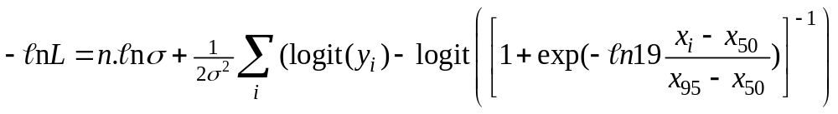
Example-II
The likelihood formulation of the problem.
The prior: uniform on the logarithms of x₅₀, x₉₅ and σ.
The jump function: multivariate normal with mean zero and variance-covariance matrix from the ADMB cor file.
Hint: You will need the mvtnorm library to run the mcmc function.

Slide 9
Example-III
(R Implementation)
f1 <- function(x)
{
A50 <- exp(x[1])
A95 <- exp(x[2])
Sigma <- exp(x[3])
pred <- MakePred(co$Length,A50,A95)
pred <- log(pred/(1-pred))
SS <- (pred-co$Prob2)^2
SS <- sum(SS)
LogLike <- length(pred)*log(Sigma) + sum(SS)/(2.0*Sigma^2)
return(LogLike)
}
Calculate the
likelihood function
MakePred<-function(Length,A50,A95)
{
pred <- 1/(1+exp(-1*log(19)*(Length-A50)/(A95-A50)))
return(pred)
}
Vector of
predicted values

Slide 10
Example-IV
(R Implementation)
Xcurr <- Xinit
Fcurr <- -1*f1(Xcurr)
Outs <- matrix(0,nrow=(Nsim-Nburn),ncol=(Ndim+1))
Ipnt <- 0; Icnt <- 0
for (Isim in 1:Nsim)
{
Xnext <- rmvnorm(1, Xcurr, cov=cor, sd, rho, Ndim)
Fnext <- -1*f1(Xnext)
Rand1 <- log(runif(1,0,1))
if (Fnext > Fcurr+Rand1)
{Fcurr <- Fnext; Xcurr <- Xnext }
if (Isim %% Nthin == 0)
{
Ipnt <- Ipnt + 1
if (Ipnt > Nburn)
{ Icnt <- Icnt + 1; Outs[Icnt,] <- c(Xcurr,Fcurr); }
}
}
}
DoMCMC<-function(Xinit,Ndim,sd,cor,Nsim=1000,
Nburn=0,Nthin=1)
{
FileN <- "lect18.txt"
TheData<-scan(file=FileN, what=list(Length=0,Prob=0))
co <- NULL
co$Length <- TheData$Length
co$Prob1 <- TheData$Prob
co$Prob2 <- log(TheData$Prob/(1-TheData$Prob))
environment (f1) =environment()

Slide 11
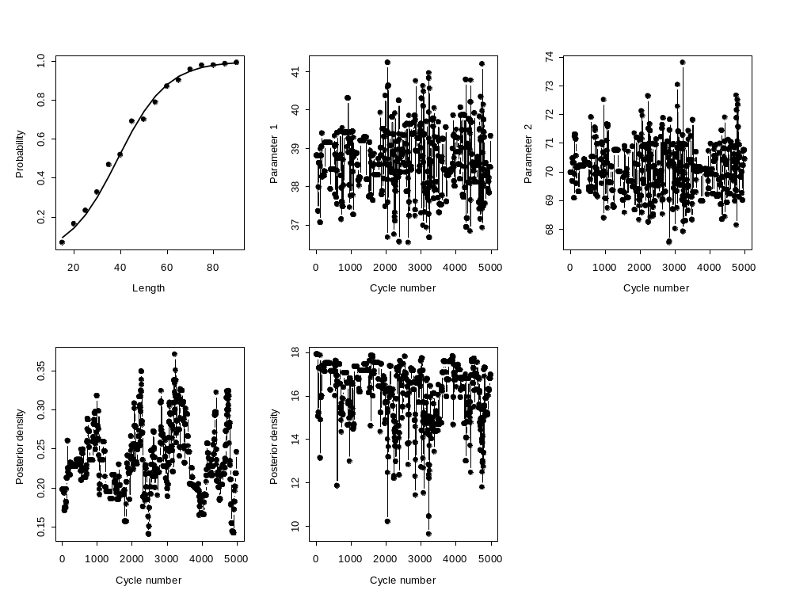
Example-V
(Results-silly jump function)
sd <- c(0.1,0.1,0.1); cor <- matrix(c(1,0,0,0,1,0,0,0,1), ncol=3,nrow=3)

Slide 12
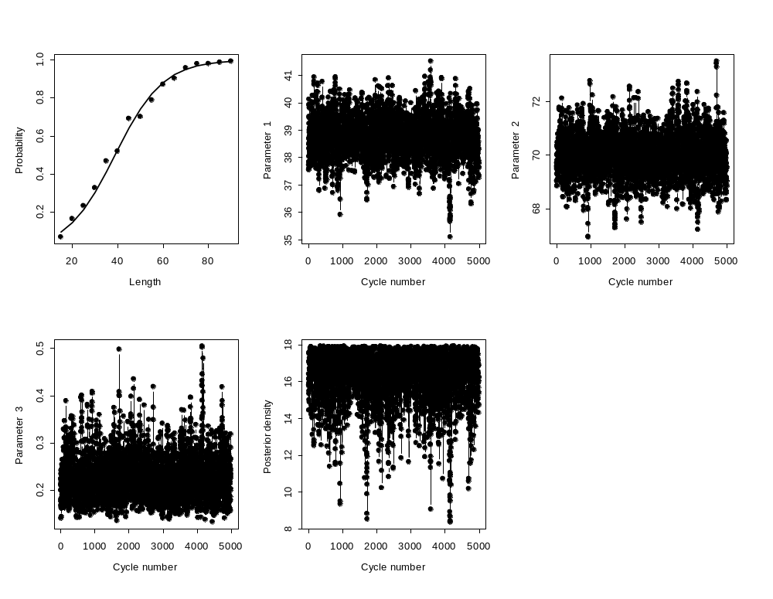
Example-VI
(Results-ADMB jump function)
sd <- c(0.015702,0.0093949,0.17678);
cor <- matrix(c(1,0.3769,0,0.3769,1,0,0,0,1),ncol=3,nrow=3)

Slide 13
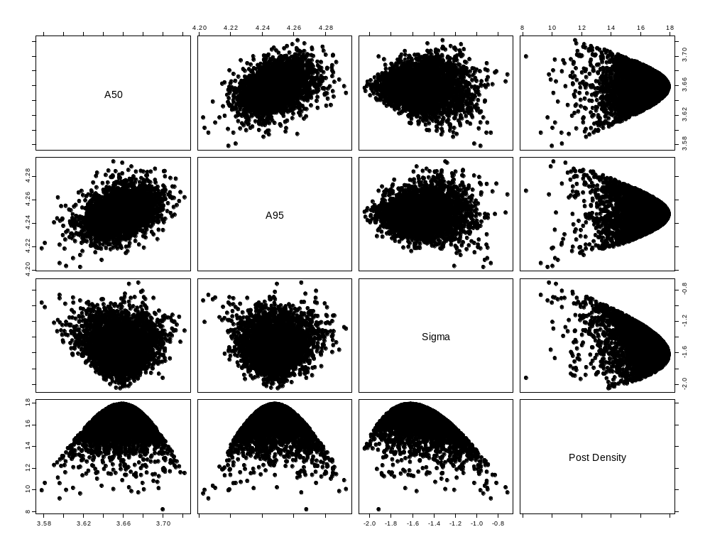
Example-VII
(Results-Posterior correlations)

Slide 14
Running MCMC using ADMB
Run ADMB with the “-mcmc N -mcsave M” option. N is the number of MCMC cycles and M is the frequency with which parameter vectors are saved.
ADMB will produce a .HST file which contains various diagnostic statistics along with marginal posteriors for any variables declared as sdreport or likeprof_number. However, this file is not very helpful and should probably be ignored.

Slide 15
ADMB Options - I
-mcscale: dynamically scales the variance-covariance matrix (to turn this off use –mcnoscale).
-mcmult N: scale the initial variance-covariance matrix if some of the values are “large”.
-mcr: restart the calculations (this doesn’t always work).
-mcgrope N: use a “jump” function with a fatter tail. N is amount of fat-tailedness (try N=0.05→0.10).
-mcdiag: Replace the Hessian-based correlation matrix by an identity matrix.
-mcrb N: Reduce the extent of correlation (1-9: lower-higher)

Slide 16
ADMB Options - II
-mcpin fn: Start the chain with the parameter vector stored in the file “fn”.
Hint: One could construct alternative starting values by running a likelihood profile and assembling alternative PIN files from the .PVL files.

Slide 17
ADMB Options - III
-mceval: Reads in all the saved parameter vectors and calls the function for each parameter vector. To perform calculations for each parameter vector during this process (only), add code along the following lines:
  if (mceval_phase())
  { code; }
This can be used to output results of interest for each parameter vector. You might wish to save the output to a file!

Slide 18
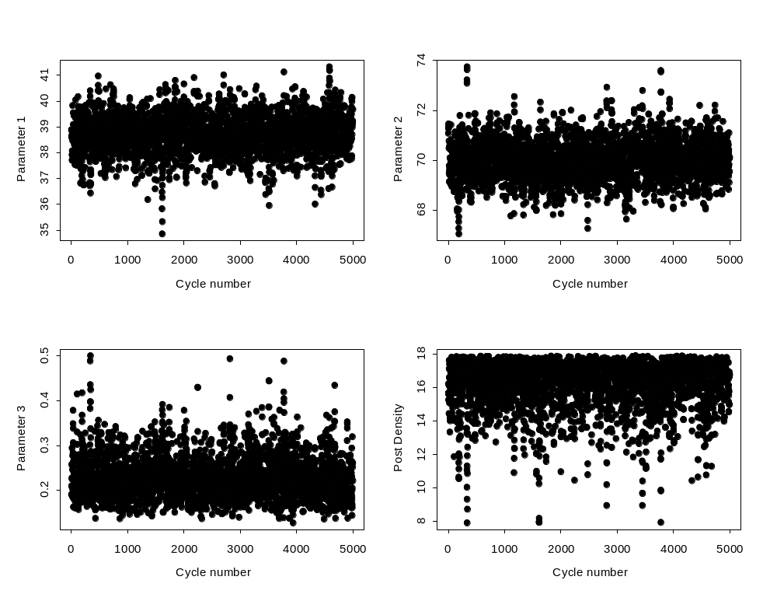
Example
(ADMB version-I)
LectH –mcmc 10000 –mcsave 2

Slide 19
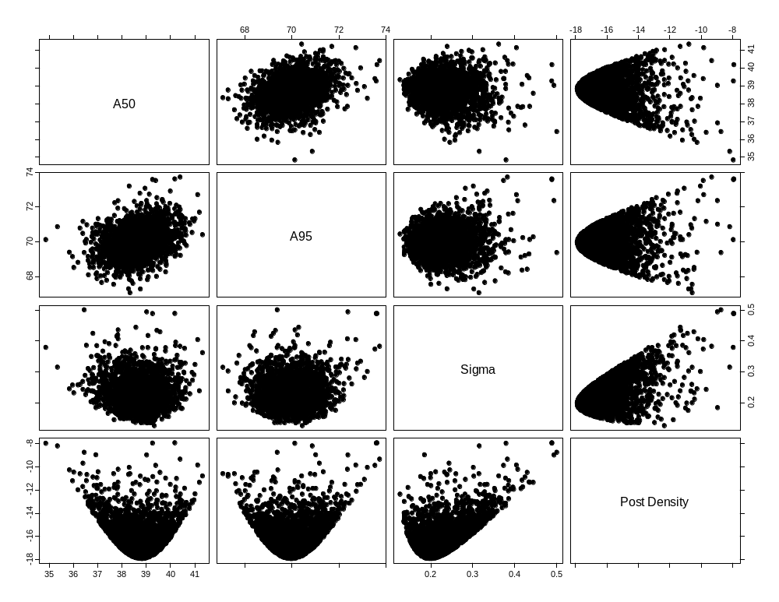
Example
(ADMB version-II)
This plot was produced using the “pairs” function

Slide 20
“Burn in” and “thinning”
The impact of the initial parameter vector and the Markov nature of the algorithm are reduced by having a “burn in” period and by “thinning” the chain.
To get x samples from the posterior:
  Allow for a “burn-in” period (5-50% of the total chain length) to allow the algorithm to “set itself up”. The results of this period are discarded.
  “Thin” the chain by taking every n’th value in the chain.

Slide 21
Tricks of the (MCMC) trade - I
The performance of MCMC deteriorates as the number of parameters increases. Therefore, integrate out any nuisance parameters analytically.
  Examples (Walters and Ludwig, 1994).
    The catchability coefficients;
    The observation error standard deviations.
Walters, C.J. and D. Ludwig. Can. J. Fish. Aquat Sci. 51: 713-722

Slide 22
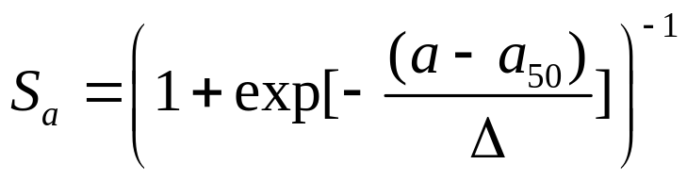
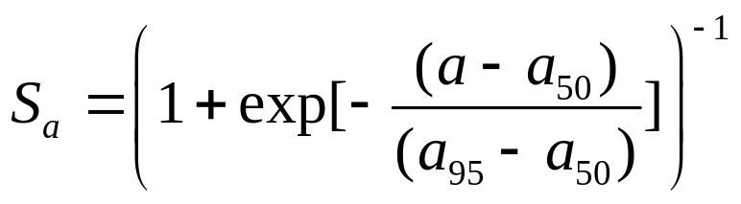
Tricks of the (MCMC) trade - II
The performance of MCMC deteriorates if the parameters are highly correlated (often true for age-structured models).
Use the .COR file to identify highly-correlated parameters (ρ ≥ 0.8).
Re-parameterize the model to reduce correlations:
Use
and not

