Slide 1
Introduction to ADMB-RE
Fish 559; Day3: 16h00-17h30
Notes:
a

Slide 2
What is ADMB-RE?
ADMB with random effects (the parameters in “normal” ADMB are fixed effects).
The random effects are integrated out using the Laplace approximation and the marginal likelihood is maximized for fixed effects and variance parameters.
Unlike nlme, ADMB-RE can deal with arbitrary non-linear random effects models (e.g. non-normal random effects distributions and non-normal error models).

Slide 3
What is ADMB-RE?
ADMB-RE programs differ from standard ADMB programs
because some of the parameters are random effects.
ADMB-RE programs include a statement of the form:
random_effects_vector x(1,nobs)
ADMB-RE programs are compiled using the call:
admb –r program_name

Slide 4
Why Random Effects?
To include “latent variables” (or “random effects”) in models such as:
  Generalized linear mixed models (GLMM)
  Hierarchical models
  State-space models
  Spatial models
  GAMS
Often the variance of the latent variable is of interest (e.g. between-species variation in recruitment).

Slide 5
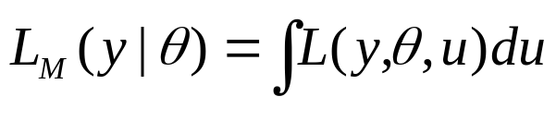

Technical Details-I
The likelihood function for a mixed model is:
where y is the data,
θ is the vector of fixed effects,
u is the vector of random effects, and
is the full likelihood.
The likelihood is the marginal likelihood obtaining by
integrating out the unobserved random variables

Slide 6






Technical Details-II
Let :
Now:
where
We can show that:
The Laplace maximization steps:
With the current value of θ optimize the joint likelihood to
find and .
use and to approximate
continue optimization.
Following Nielsen and Magnusson

Slide 7
Features of a random effects model
All random effects models include two main components:
1. The likelihood of the data given the fixed and random effects:
f -= -nobs*log(sigma_Y) - 0.5*norm2((pred_Y-Y)/sigma_Y);
2. Probability model for the random effects:
-nobs*log(sigma_x) - 0.5*norm2((x-mu)/sigma_x);
G = -0.5*norm2(u);
for (I =1;I <=n; I++)
x(I) = lambda*gamma_deviate(u(I),a);
normal
gamma

Slide 8
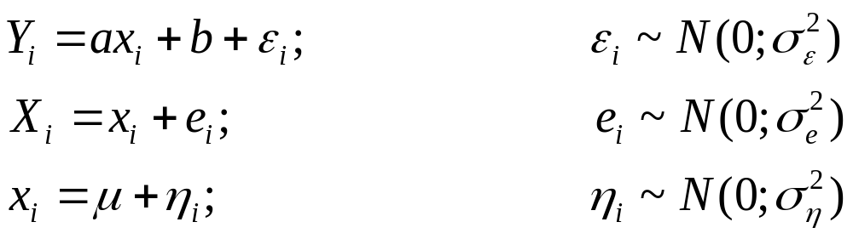

A First Example-I
Consider a model in which y is related to x, but x is
measured with error
We will assume that is known to be 0.5.
Example taken from the ADMB-RE manual

Slide 9
A First Example-II
DATA_SECTION
init_int nobs
init_vector Y(1,nobs)
init_vector X(1,nobs)
PARAMETER_SECTION
init_number a
init_number b
init_number mu
vector pred_Y(1,nobs)
init_bounded_number sigma_Y(0.000001,10) // standard deviation of Y
init_bounded_number sigma_x(0.000001,10)
random_effects_vector x(1,nobs)
objective_function_value f
How to define x as a
random effect

Slide 10
A First Example-III
PROCEDURE_SECTION
f = 0;
pred_Y=a*x+b;
f -= -nobs*log(sigma_Y) - 0.5*norm2((pred_Y-Y)/sigma_Y);
f -= -0.5*norm2((X-x)/0.5);
f -= -nobs*log(sigma_x) - 0.5*norm2((x-mu)/sigma_x);
Normal log-
likelihood function
Measurement error
Ensure the Xs are
random effects

Slide 11
A First Example-IV
To compile and run:
admb –r [-s] simple
simple
This produces the normal ADMB output files:
simple.par
simple.std
simple.cor
The output includes the estimates of the fixed effects
and the random effects.

Slide 12
A First Example-V
index name value std dev
1 a 1.9687e+00 1.6268e-01
2 b 3.8694e+00 7.2563e-01
3 mu 3.5000e+00 9.0830e-01
4 sigma_Y 1.0269e+00 4.4062e-01
5 sigma_x 2.8284e+00 6.5222e-01
6 x -1.0477e+00 4.1727e-01
.
.
14 x 7.3147e+00 4.3272e-01
15 x 7.5403e+00 4.5006e-01

Slide 13
So What Did We Just Do?
The hyper-parameters (a, b, μ, σ_{ε}, and σ_{η}) were estimated using maximum likelihood.
The marginal likelihood was evaluated using the Laplace approximation.
The values for the random effects are estimated conditional on the values for the fixed effects.
Does anyone know why we fixed σ_{e}?

Slide 14
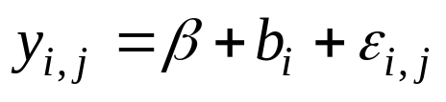
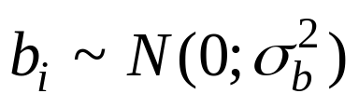
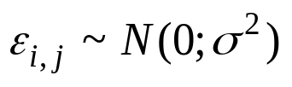
Back to Streams-I
We constructed a random effects model for the streams data set as follows:
β is the mean density across the population.
b_{i} is a random variable representing the deviation from the population mean:
ε_{i,j} is a random variable representing the deviation for observation j from mean density for stream i, i.e.

Slide 15
Back to Streams-II
DATA_SECTION
init_int nstream
init_int nobs
init_matrix Y(1,nobs,1,nstream)
PARAMETER_SECTION
init_number beta
init_bounded_number sigma_Y(0.000001,50)
init_bounded_number sigma_b(0.000001,50)
random_effects_vector b(1,nstream)
objective_function_value f
PROCEDURE_SECTION
int i,j;
f =0;
for (i=1;i<=nstream;i++)
{ f -= -log(sigma_b) -0.5*square(b(i)/sigma_b);
for (j=1;j<=nobs;j++)
f -= -log(sigma_Y) -0.5*square((Y(j,i)-(beta+b(i)))/sigma_Y); }

Slide 16
Back to Streams-III
The results from “streams.tpl” are identical to those from a call to:
lm3 <- lme(fixed = Density ~ 1,data=Streams,
random = ~ 1 | Stream,method="ML")
Note that this is maximum likelihood not restricted maximum likelihood.

Slide 17
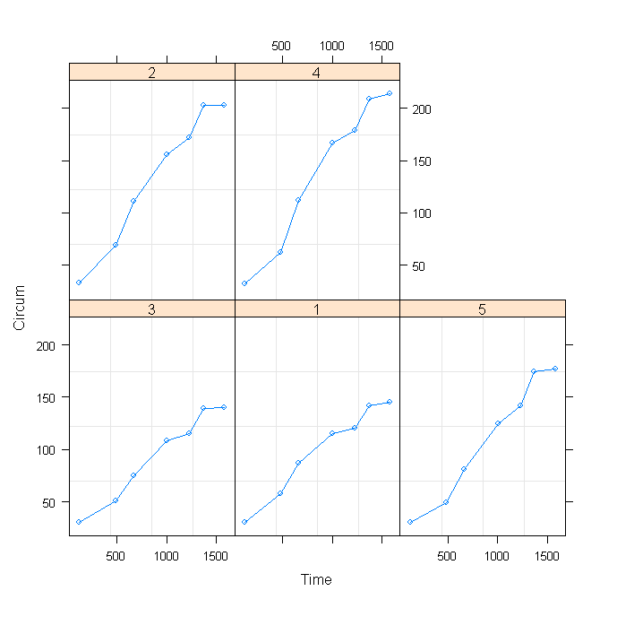
Non-linear Regression-I
Seven measurements are taken of the circumferences of five
trees. We fit these data using a logistic model.
(ADMB-RE manual, Sec 3.2; Pinheiro and Bates, Ch. 8.2)

Slide 18
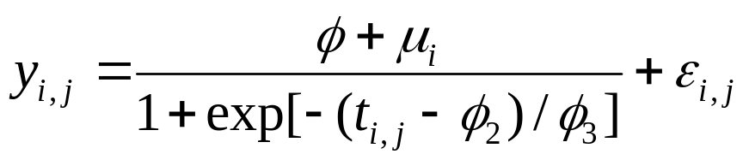
Non-linear Regression-II
The model we fit to these data is:
fm2 <- nlme(Circum ~ Asym/(1+exp(-1*(Time-xmid)/scal)),
data = Orange,
fixed = Asym + xmid + scal ~ 1,
random = Asym ~ 1,
start = c(Asym = 192, xmid = 1000, scal = 200))

Slide 19
Non-linear Regression-III
DATA_SECTION
init_int n
init_vector y(1,n)
init_vector t(1,n)
init_int M
init_vector ngroup(1,M)
PARAMETER_SECTION
init_bounded_vector beta(1,3,-50,2000,1)
init_bounded_number log_sigma(-6.0,5.0,1)
init_bounded_number log_sigma_u(-10,5,2)
random_effects_vector u(1,M,2)
objective_function_value g
number sigma_u;
number sigma;

Slide 20
Non-linear Regression-IV
PROCEDURE_SECTION
int i,j,ii;
dvariable Pred;
g = 0.0; ii = 0;
sigma = mfexp(log_sigma);
sigma_u = mfexp(log_sigma_u);
for(i=1;i<=M;i++)
{ g -= -log(sigma_u) -0.5*square(u(i)/sigma_u);
for (j=1;j<=n/M;j++)
{ ii++;
Pred = (beta(1)+u(i))/(1+exp(-1*(t(ii)-beta(2))/beta(3)));
g -= -log(sigma) -0.5*square((y(ii)-Pred)/sigma);
}
}

Slide 21
SEPARABLE FUNCTIONS
You can use SEPARABLE_FUNCTIONS to speed up the calculations.
This involves reducing the problem so a set of subproblems which use only a few random effects.
Note that the function header must be one line!
SEPARABLE FUNCTION void test (const dvariable& lam1, int i)
nll += 0.5*square(lam1-y(i));

Slide 22
Final Hints-I
You can transform the distribution for the random effects to speed up the calculations.
You can run the model with the random effects treated as fixed effects (and the standard deviation of the random effects pre-specified) to check the model is correct.
REML estimates of variance parameters can be obtained by ignoring the distribution for the random effects

Slide 23
Final Hints-II
The Laplace approximation can be inaccurate. It is possible to use Importance sampling to approximate the integrals but this can be very slow.

Slide 24
References
Random effects in AD Model Builder ADMB-RE user guides:
  http://otter-rsch.com/admbre/admbre.pdf
  admb-project.googlecode.com/files/admb-re.pdf .

