Slide 1
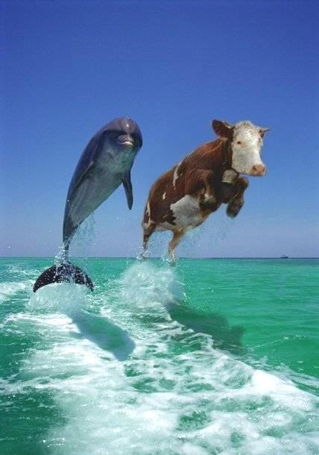
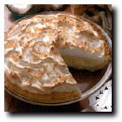

Notes:
It’s all about the tradeoffs

Slide 2
The Triad of Drivers
Exploitation
Fisheries Production
Trophodynamics
Biophysical
Notes:
2

Slide 3
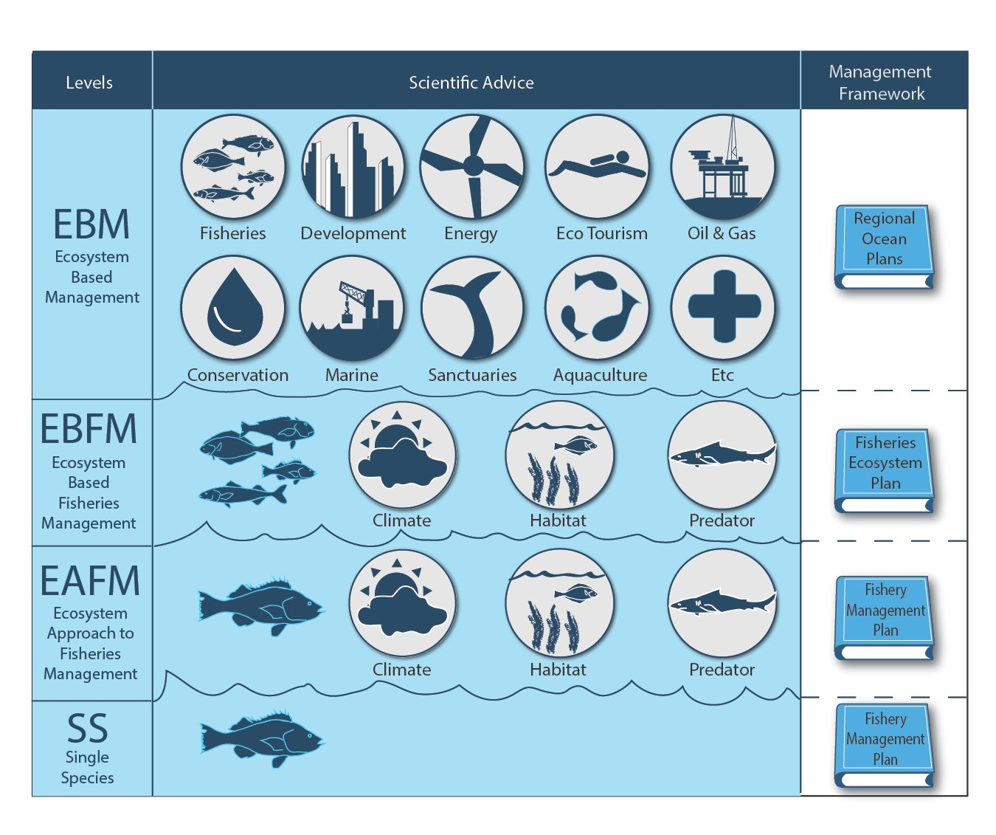
Notes:
Different levels of EBM for different emphases and different kinds of inclusion.

Slide 4
Considerations for EBFM Case Studies
Background
The species involved
The geographic extent/location
The fisheries context
The ecosystem (environmental, ecological) context
The mandates for those species/locales
The management jurisdiction
Why EBFM
What is the problem/issue, especially wrt tradeoffs?
How did we get into this situation?
EBFM elements
Why will ignoring the ecosystem facets will lead to further trouble?
How did/does considering ecosystem facets improve the situation?
What is/was the solution?
  Scientific aspects
  Management aspects
What are next steps, especially wrt how widely applicable this could be?
What are major lessons learned?

Slide 5
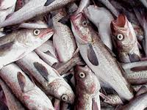
What is the most productive fishery in the US?
Why?

Slide 6
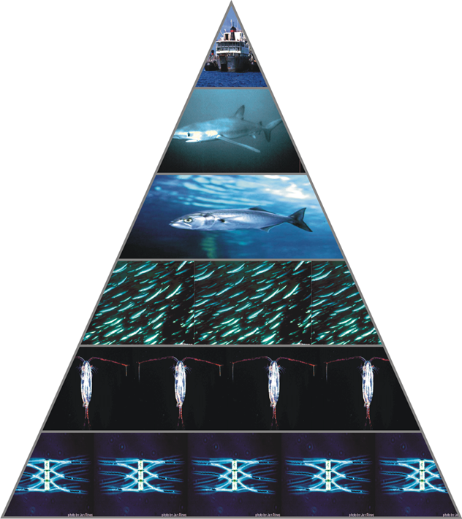
Understanding System Production Limits Is Critical
There are limits to how much fish any ecosystem can produce
Notes:
• Turning to System production constraints, one example is … the eastern Bering Sea, which has had major shifts in what critters are produced over time
• As reminder, there is a base of the food web called plankton, which are eaten by small fish, which are in turn eaten by bigger fish and other “Charismatic megafauna” like whales or seals or seabirds
• This forms a food pyramid
• Over time the overall output of the base of the food pyramid has remained mostly stable, but the groups of organisms at the top of the pyramid have shown major fluctuations, as seen in many examples, like the Bering Sea
• How material and energy from the base flows to one group of organisms versus another over time has huge ramifications
• This would be like telling a farmer that they had only so much area of land and feed to grow cattle, but with no idea of what feed the cows would prefer
• … nor how many goats, sheep, deer, and buffalo were also on the land,
• … plus the amount of land (i.e. habitat) to grow the cattle was changing every year due to other factors off the farm
• The reason this is important is … because we often estimate yield of fishes in isolation, yet when we estimate yield from a system it is much different, usually lower, as we can see from the Bering Sea example
Data from Gaichas et al.

Slide 7
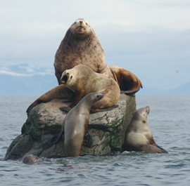
Stellar Sea Lions & Walleye Pollock
Alaskan US
  Rookeries of sea lions
  Closed off for fishing
  A suite of models
  A precautionary setting
  Enough food for pinnipeds
  Predation on and competition with pollock
  NEPA, Lawsuits
Similar examples in S. Africa, elsewhere
  e.g. Yodzis 2001

Slide 8
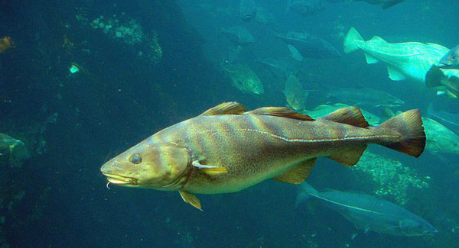
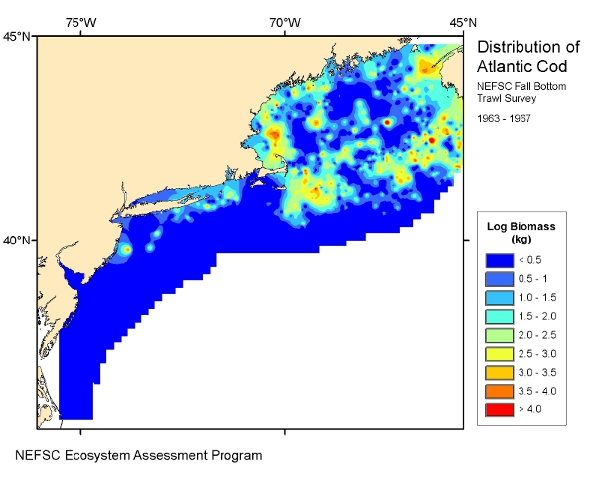
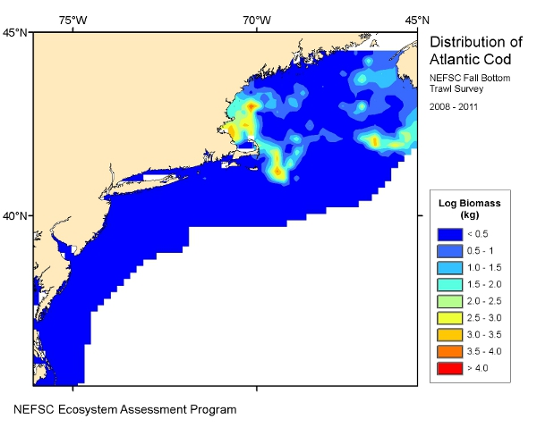
Where’s Waldo?
The problem with
shifting and shrinking
Notes:
• First, let’s talk Climate Change effects
• One example among many is changes to the habitats for key species -- such as Atlantic Cod
• These habitats have shifted and shrunk
• So, what’s the problem with shifting and shrinking?
• It would be like taking the population of Boston and shifting everyone to Falmouth
• That’s bad for Falmouth ... just kidding … because …. Shifting and shrinking habitats mean … the most suitable places to live for many important marine critters is becoming less and less available
Graphs from Nye et al., EcoAP

Slide 9
Shift
Contraction
Expansion
Parallel Shift
A
Stock Boundary
B
Stock Boundary
C
Stock Boundary
D
Stock Boundary
Area occupied by Stock
Actual Stock Size
Time
Time
Time
Time
Apparent Stock Size
Link et al. 2011

Slide 10
What is a BRP?
= Biological Reference Point
Based off of estimates of biomass or abundance, and fishing
Numerous examples, but most common in N. America are those associated with or proxied for B_{MSY} or F_{MSY}
Used to determine status of a stock (overfished, rebuilt, overfishing, etc.)
Typically uses estimates of B and Catch to derive
Mgt decisions derived from these estimates
r/2
B_{20% B-virgin}
B_{MAX}
B_{MSST}
F_{20%MSP}
Strongly suspected that for forage fish, should incorporate predation accordingly
F_{MSY}
K/2
50%YPR
B_{90% Surv.}
F_{max}
F_{0.1}
F=M

Slide 11

Precision important
but Accuracy even more so

Slide 12
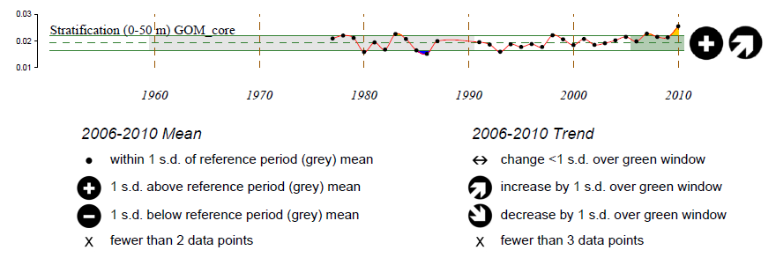
Evaluating short term climate change
Degree | Duration | Trend | Spatial Scale
1. Low: recent years mean within 1 s.d. of baseline mean | 1. Low: change present <33% of recent years | 1. Low: no trend or current trend returning toward baseline | 1. Low: change affects <33% of the area
2. Moderate: recent years mean exceeds 1 s.d. of baseline mean | 2. Moderate: change present 33-66% of recent years | 2. Moderate: Non-significant recent trend away from baseline | 2. Moderate: change affects 33-66% of the area
3. High: recent years mean exceeds 2 s.d. of baseline mean | 3. High: change present >66% of recent years | 3. High: Significant recent trend away from baseline | 3. High: change affects >66% of the area
Notes:
Our first step was develop a consistent method to analyze ecosystem indicators of climate change that are measured at the regional scale. We first compared conditions as measured by each indicator in the most recent 5 year period (dark green shading) relative to a 1960-1990 baseline (light green shading). We then used consistent criteria to rate the degree of change, the duration of the change, the trend, and spatial scale of the change in the indicator. We present the results of recent status and trend relative to the baseline for the Mid Atlantic Bight and the Gulf of Maine in the next two slides.

Slide 13
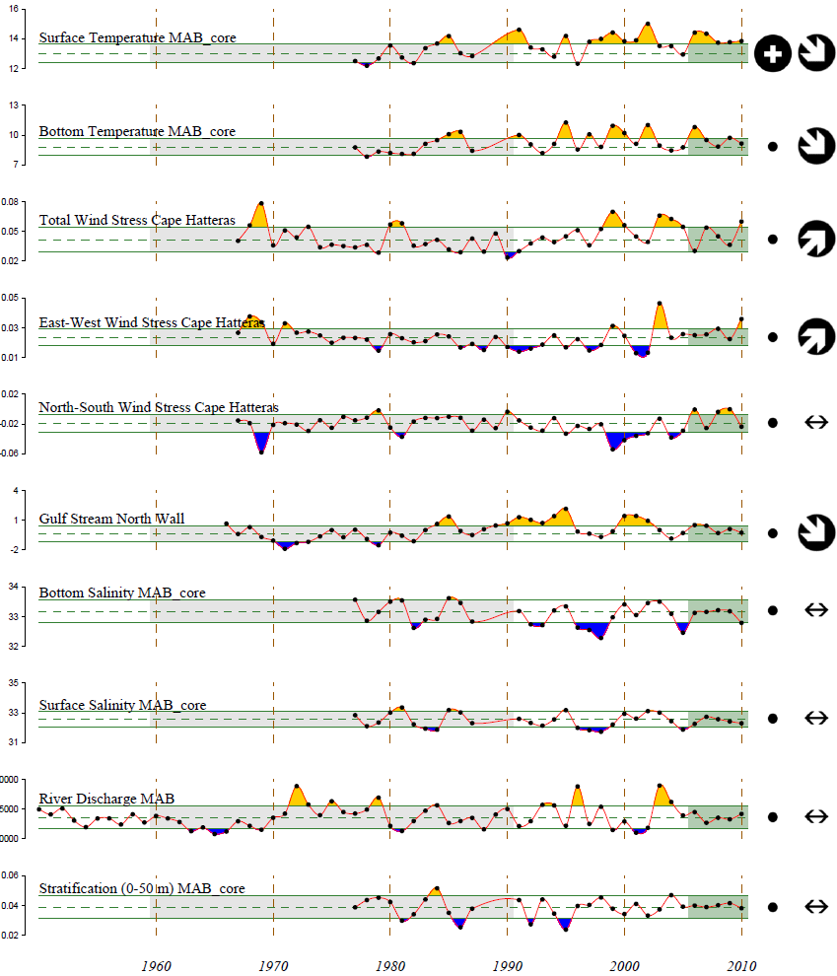
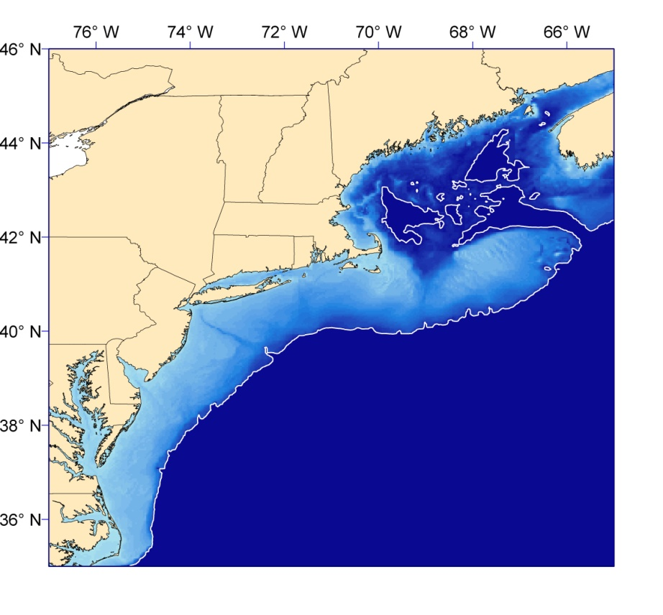
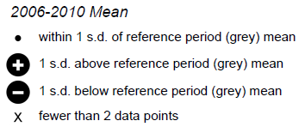
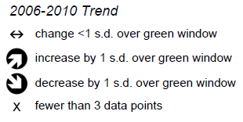
Middle Atlantic Bight
Notes:
The Mid Atlantic Bight is a highly variable system, but even against this high natural variability we see recent changes in status and trends of major physical and climate indicators. Surface temperatures have been higher here during the past 5 years (although the recent trend was back towards the baseline for both surface and bottom temperatures). There are also significant trends in wind stress and major boundary currents in this region during the past 5 years relative to the baseline.

Slide 14
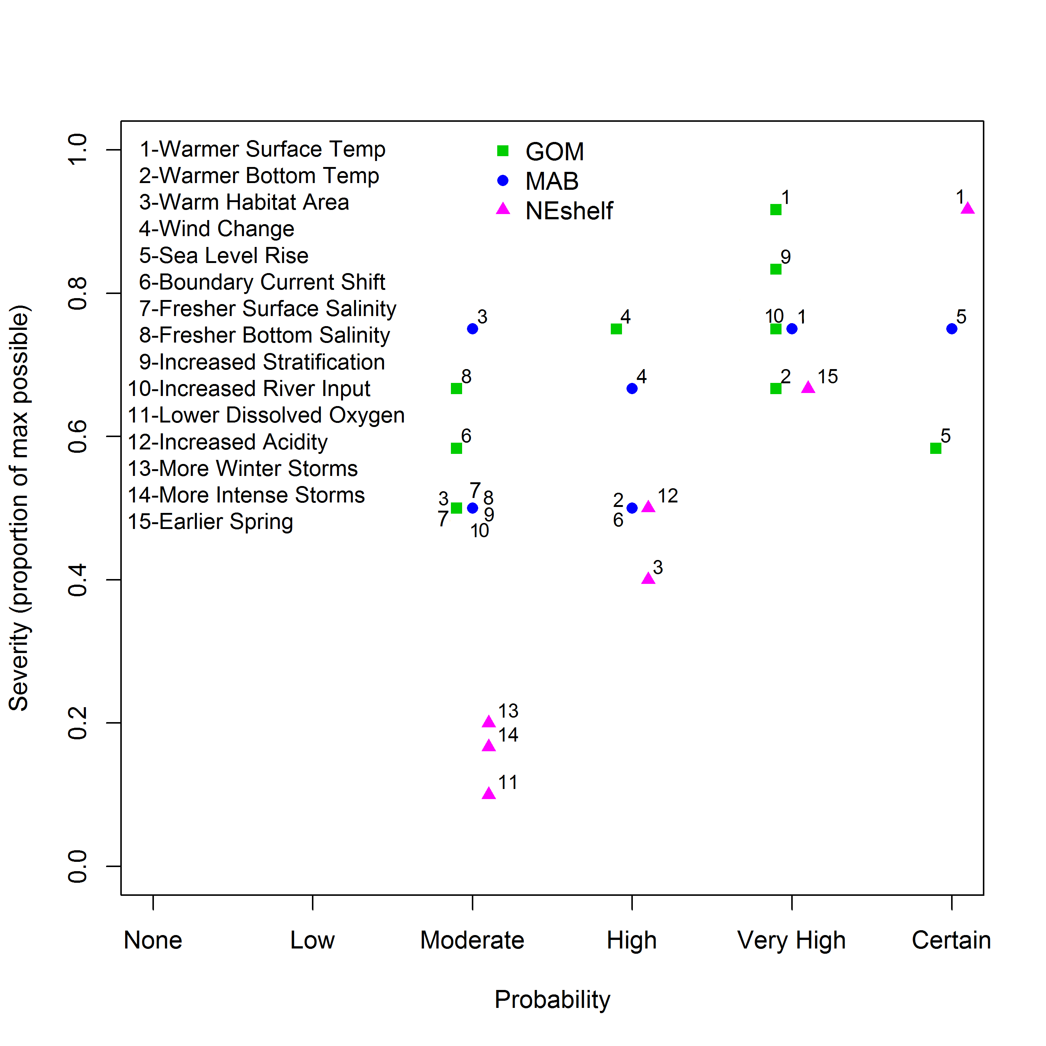
Ranking short term regional climate risks
Notes:
We rated these physical indicators using our scoring system and combined scores into an overall severity for each. Here we compare the severity with the probability that each change would happen in the near future based both on modeling and observations in the system. In this way we can see which specific climate attributes are likely to have the highest impact in each region of the NE US LME. Increased surface temperature has the highest severity and probability across the whole region, while increased stratification and river input are potentially important in the GOM and sea level rise is potentially important in the MAB. This prioritization may allow us to focus analytical resources on different drivers of fishery population dynamics in each region.

Slide 15
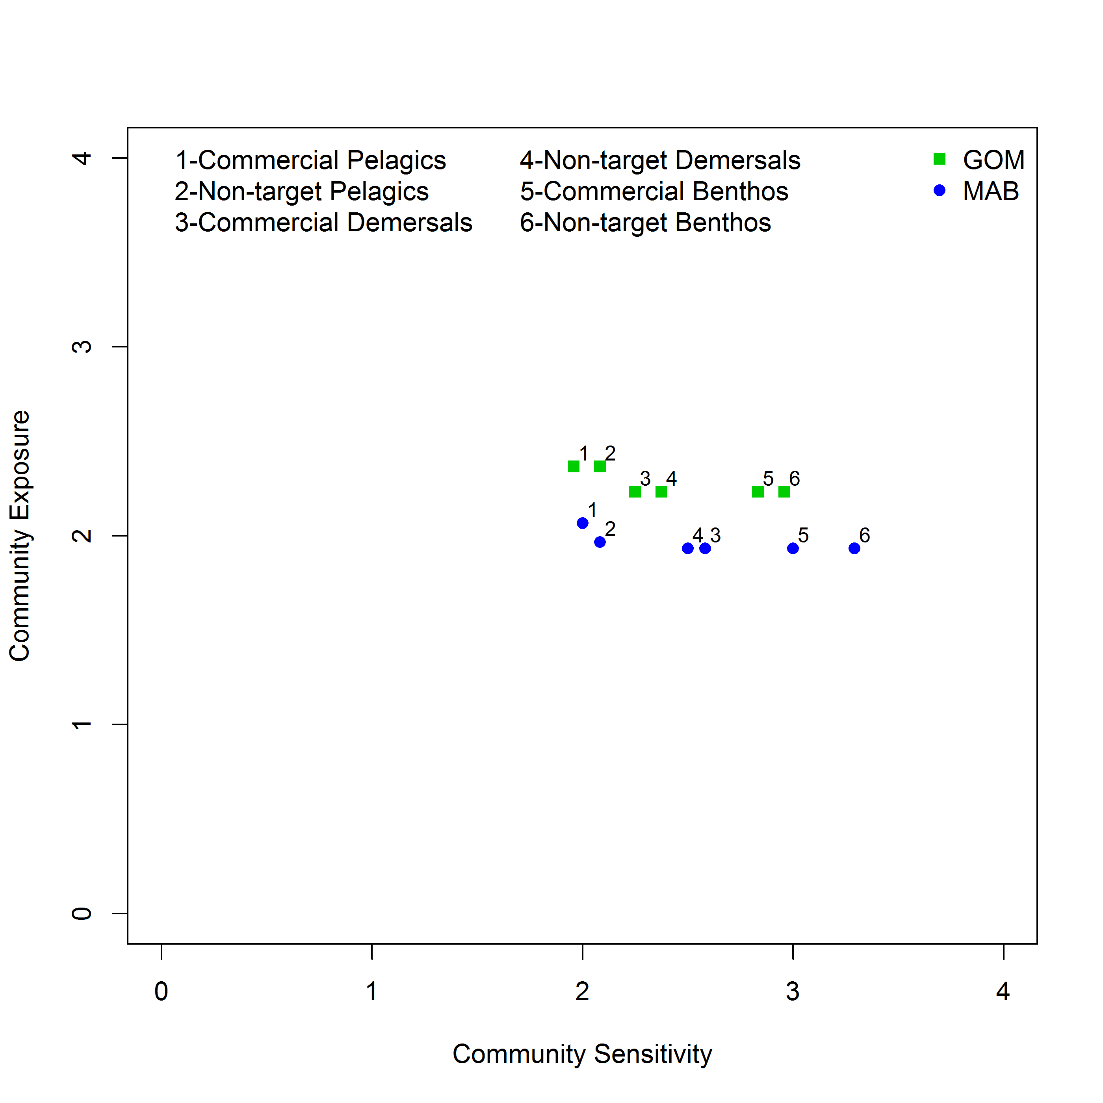
Putting it all together: 5-10 year risk
Sensitivity evaluation has been done for each managed species in the NE Shelf
Notes:
This is the final result of the risk analysis, combining the community exposure scores with the community sensitivity scores. Overall, we found GOM communities to have higher exposure than MAB communities, while MAB communities were more sensitive. Overall, benthic communities were found to be most sensitive to climate impacts. In these systems, lobster and bivalve fisheries bring in most of the economic benefit, so including climate effects within assessments for these species may be important to sustaining the human economies dependent on these resources. Demersal communities, including Gadiods, have a similar level of exposure to climate impacts as invertebrates, but may be slightly less sensitive. Nevertheless, the high exposure, particularly in the GOM, suggests that climate risks to gadoid populations may be greater than previously suspected.

Slide 16
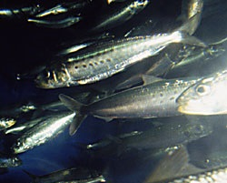

System Impacts of Ecosystem Changes
Jellyfish outbreaks
Brodeur et al. in press
Notes:
• One example is the explosion of jellyfish in many US marine ecosystems, an example we don’t often think about
• The reason we care is that whenever there is an outbreak of jellyfish, it has usually been a bad sign, like a canary in the coal mine, for marine ecosystems;
• Jellyfish respond to changes in ocean habitat, and are likely an indicator of climate change;
• Jellyfish eat baby fish (larvae)
• … and out-eat (compete) the food of these baby fish; It is a lot like always having to share your dessert with your spouse, and kids, and cousins, and…
• and this shift in how energy flows through an ecosystem may make ultimately it difficult for some stocks to persist, recover, or thrive. The example for the North Pacific shows than when Jellyfish are abundant, forage fish are not
• US fisheries is worth many billions of dollars, not including all the regional economic multipliers
• Since we know from US examples and from other places that these jellyfish can impede fish production, the potential loss of fish yield, and related socio-economic benefits, has been estimated to be quite large
• We need to account for this possibility
Data from Brodeur et al.

Slide 17
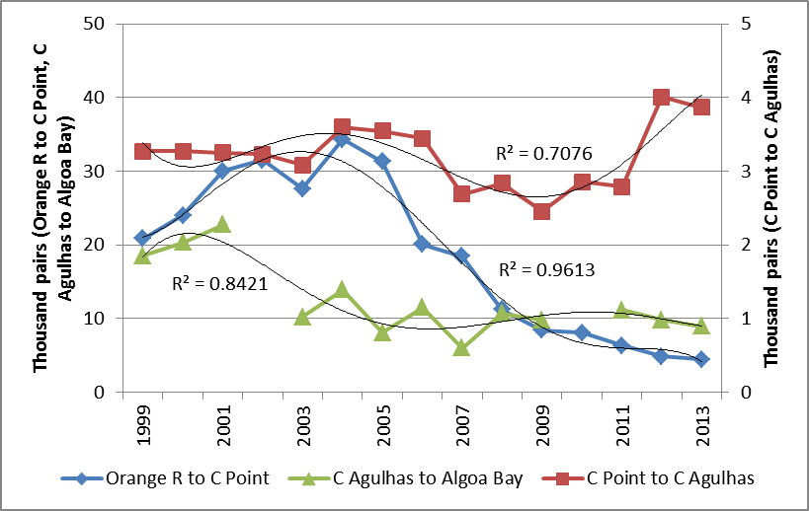
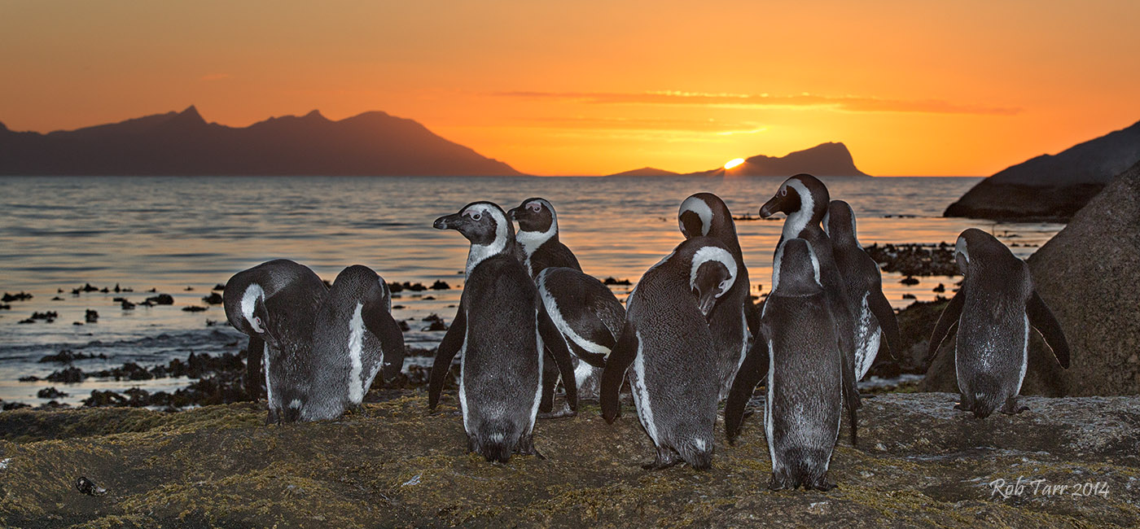
African
Penguins
CONCERN:
That fishing around penguin breeding
islands is a major contributor to
declining penguin populations

Slide 18
Island Closures
Objectives (2010 Panel report): “with the objective to maximize the probability of
determining whether pelagic fishing near colonies has an impact on penguins”

Slide 19
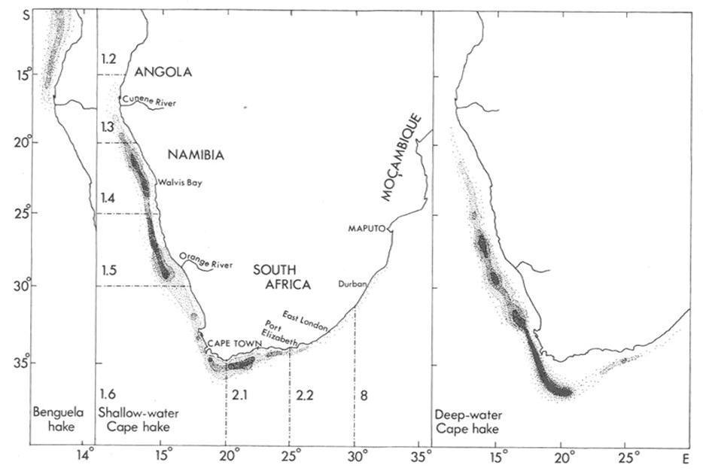
Hake
There is no obvious break in distribution at national boundaries.

Slide 20
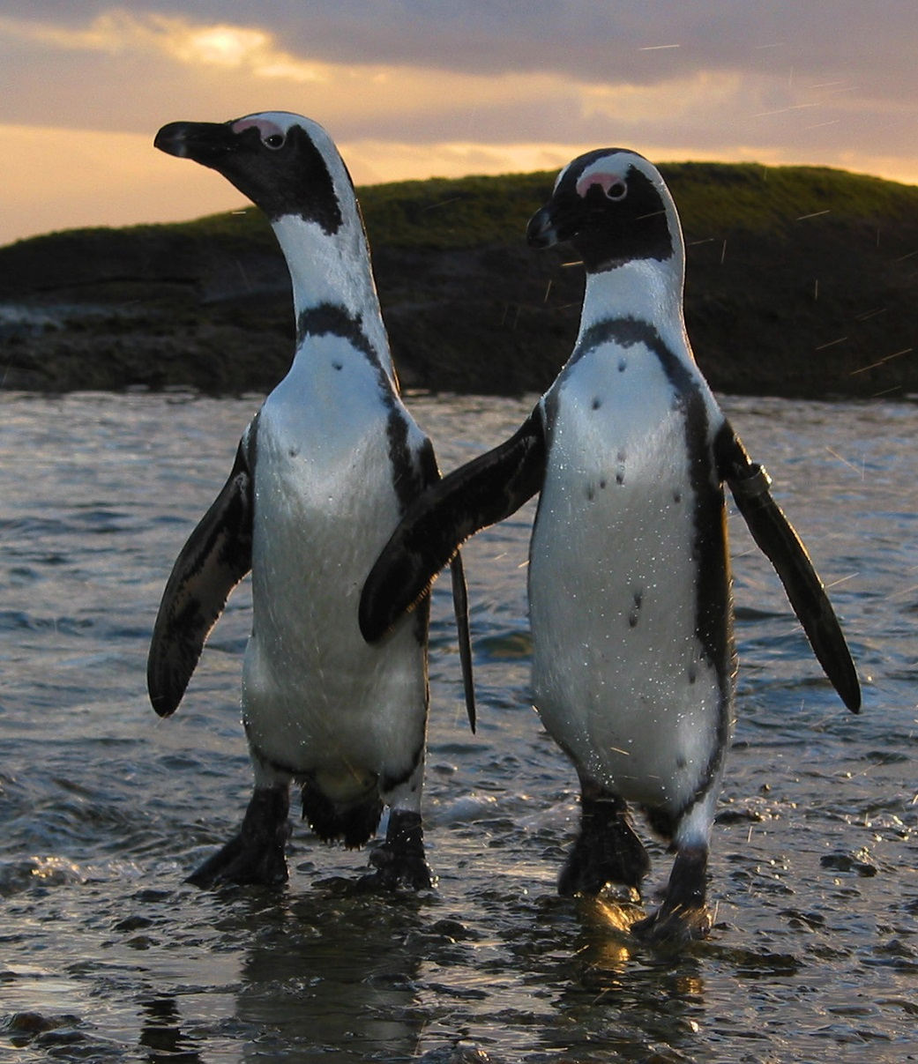
Penguin Feasibility Study Objectives
Provide a stronger basis for designing an experiment to evaluate the impact of fishing near islands on penguins.
Draw conclusions on the impact of catches near islands on penguins
Draw conclusions on the impact of island closures on penguins.
Notes:
Lots of interest
Not solvable by purely SA methods

Slide 21
Panel Conclusions
Can the Island Closure Feasibility Study tell us whether an experimental closure programme could yield definitive conclusions regarding the impact of fishing close to penguin breeding islands on penguin populations?
Yes, the Feasibility Study has completed its objectives
Notes:
And that was it…

Slide 22
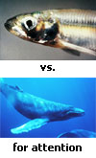

IWC-Fish
Several meetings globally
  Highly charged emotionally, politically, etc.
  Pits whales vs. fisheries
  Competition for forage fish that are prey of whales and TS of fisheries

Slide 23
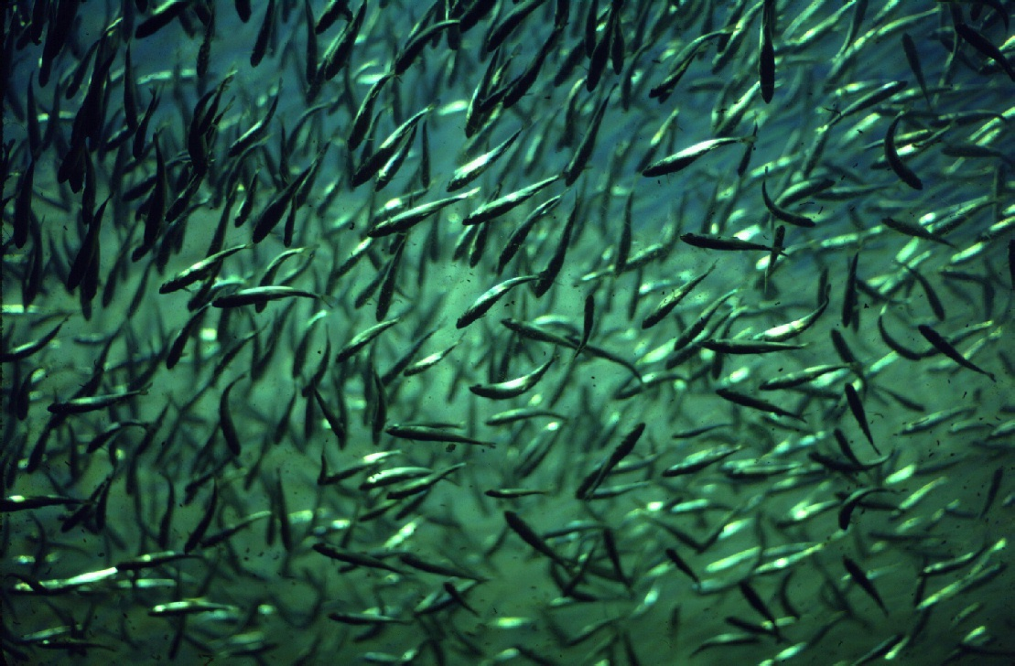
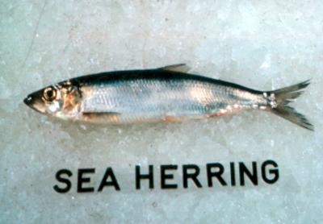
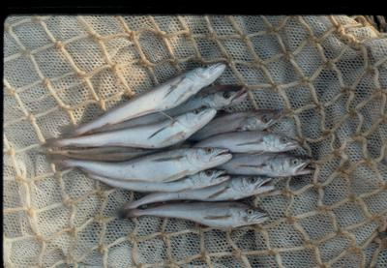
Forage Fish Issues
F + M2 = ↑Z
Adequate food for other trust spp
Competition among fleets and predators
Competition with larvae of commercial spp
Predation on larvae of commercial spp
Notes:
Is the stock a “forage” fish ? Forage is defined as a species that:
is small to moderate in size (average length of ~5-25 cm) throughout its lifespan, especially including adult stages;
is subject to extensive predation by other fishes, marine mammals, and birds throughout its lifespan;
comprises a considerable portion of the diet of other predators in the ecosystem in which it resides throughout its lifespan (usually >5% diet composition for >5 yrs);
has or is strongly suspected to have mortality with a major element due to consumptive removals;
is typically a lower to mid trophic level (TL) species; itself consumes food usually no higher than TL 2-2.5;
has a high number of trophic linkages as predator and prey; serves as an important, major (as measurable by several methods) conduit of energy/biomass flow from lower TL to upper TL;
often exhibits notable (pelagic) schooling behavior;
often exhibits high variation in inter-annual recruitments; and
relative to primary production and primary producers, has a ratio of production and biomass, respectively, to those producers no smaller than on the order of 10⁻³ to 10⁻⁴.

Slide 24
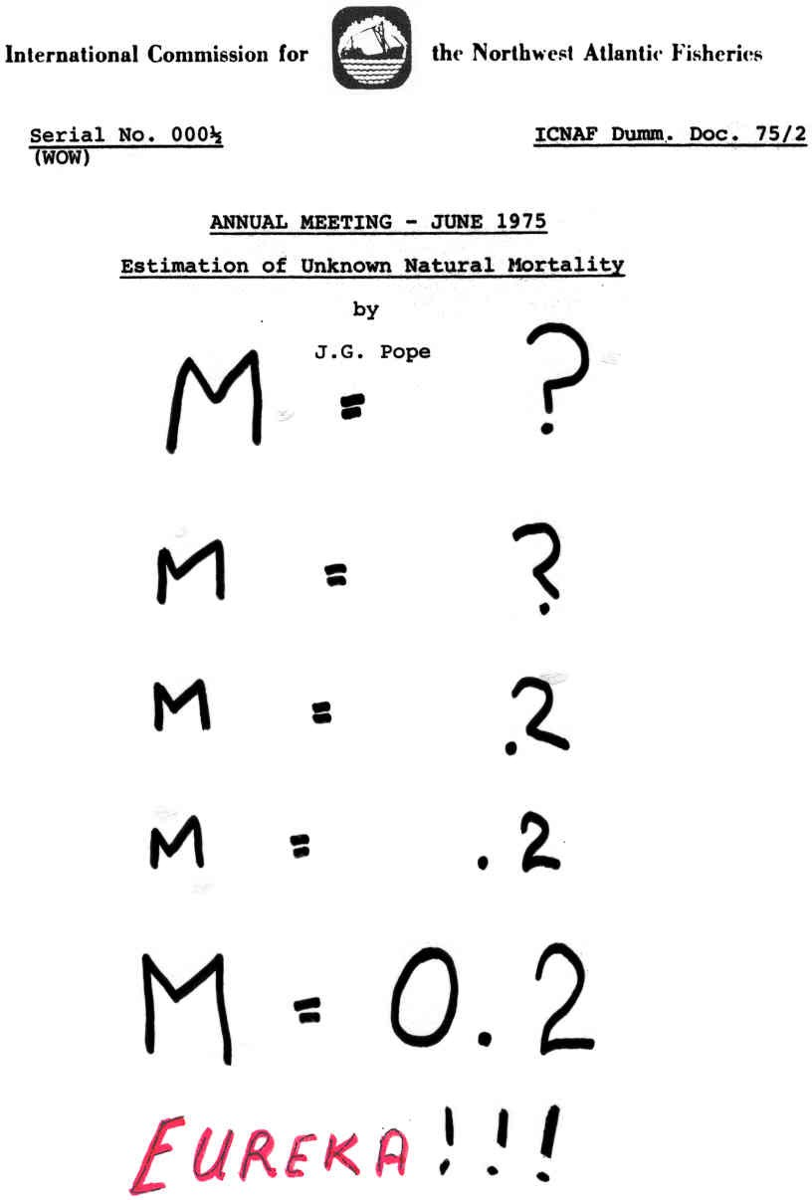

Slide 25
Common Observations
More recently predators removed ~3X the fishery
Removals of Atlantic herring
Overholtz & Link. 2007. ICES J. Mar. Sci. 64:83-96.

Slide 26
Common Observations
More recently predators removed ~3-5X the fishery
NEFSC 2011. 51st SAW Report NEFSC CRD 11-01
Relative removals of red hake

Slide 27
Common Observations
Predators removed ~3-5X the fishery
Removals of Loligo squid
Moustahfid et al. 2008. N. Am. J. Fish. Manag. 29:1555-1566.

Slide 28
Common Observations
Catch 5-20x lower than very minimal estimates of Predation
NEFSC 2011. 51st SAW Report NEFSC CRD 11-01
Relative removals of silver hake

Slide 29
Common Observations
M2’s are Time Variant
Rates are Prey, Predator, and Fishery Dependent
Recently M2 2-4X F
Overholtz & Link. 2007. ICES J. Mar. Sci. 64:83-96.
Mortality rates (M2 & F) for Atlantic herring

Slide 30
Common Observations
M2’s are Time Variant
Rates are Prey, Predator, and Fishery Dependent
M2 usually 3-5X F
Mortality rates (M2 & F) for Loligo squid
Moustahfid et al. 2008. N. Am. J. Fish. Manag. 29:1555-1566.

Slide 31
Common Observations
M2’s are Time & Age Variant
M2 modeled is > 0.2 assumed
Temporal variability in predation mortality on young age classes of Atlantic mackerel
Tyrrell et al. 2008. ICES J. Mar. Sci. 65:1689-1700

Slide 32
Common Observations
Most predation focused on younger ages, dampens after 2+
M2’s are Age and Time Variant
M2 modeled is NE 0.2 assumed
Mortality rates (M2 & F) for Menhaden at ages 0, 1 and 2
Garrison et al. 2008. ICES J. Mar. Sci. 67: 856-870

Slide 33
Observations about Predation on Forage Stocks
Consumption to Catch (Landings; C/L) ratios for these stocks often >> 1
  C/L ratio of ~1 implies that for total Z, F~M
    Rule of thumb: worth considering at this level
  Most C/L ratios 3-5X
Similarly, it follows that M2 for these stocks is often >> than F
  Most 2-4X higher

Slide 34
Observations about Predation on Forage Stocks
M2 is not:
  0.2,
  age invariant,
  nor time invariant
M2 often focuses on younger age classes, but not always
  Can influence recruitment successes
  Some stocks vulnerable throughout life histories

Slide 35
So what difference does it make?
Pandalid Biomass
Empirical estimates of B consumed by predators higher than existing modeled B; higher Ms suggested
Link & Idoine 2009. N. Am. J. Fish. Manag. 29:1567-1583.

Slide 36
So what difference does it make?
B/B_{MSY}
No Pred W/ Pred
Longfin squid
If predators not considered, may actually be unknowingly below BRP
Moustahfid et al. 2008. N. Am. J. Fish. Manag. 29:1555-1566.

Slide 37
So what difference does it make?
If M2 increases, less fishery SP would be available & optimal Fs lower
Mackerel
Moustahfid et al. 2009. ICES J. Mar. Sci. 66: 445-454
Notes:
Projections of available surplus for the fishery at different levels of predation mortality showed that the surplus for the fishery
would decrease if predation mortality increased over the next few decades. Clearly, increased predatory demands
will result in lower surplus yields for the fishery.
37

Slide 38
So what difference does it make?
From a global meta analysis
Tyrrell et al. 2011 Fish. Res. 108:1-8

Slide 39
So what difference does it make?
From a global meta analysis
Conundrum:
MSY estimated w/pred included 1.5-4x higher
But, …
total Z higher, and allocating across “fleets” means:
M2 higher and F lower
Thus, lower B available for fishery harvest
Tyrrell et al. 2011 Fish. Res. 108:1-8

Slide 40
EBM and the issue of Predation on Forage Stocks– Predatory Demand
Estimating M2 does not fully consider other elements of the ecosystem
What are the predatory demands for forage?
Notes:
Talked about examples before

Slide 41
Marine Mammal Consumption
Estimating marine mammal consumption on NEUS shelf
  Consumption roughly equal to commercial catch
  Marine mammals out-competing fisheries for resources?
  Catches inhibiting marine mammal rebuilding?
Col 2011

Slide 42
Forage Fishery Harvesting Scenarios in MS-PROD
Forage fishery: range of harvest increases on forage fish
Biomass reductions start with forage fish and odontocetes
  After 20 years all guilds impacted through trophic interactions
Increasing forage fish harvest 2x leaves all guilds above biomass
targets except forage fish slightly lower
5 Years
20 Years

Slide 43

Suggested tools for handling the forage issue
Multiple ways to address:
  Address in assessments directly
  Uncertainty buffers to OFL/OY
  Spatial mgt of foraging areas (of preds), spawning areas (of forage), etc.
  Biomass thresholds
  Total set asides of forage for non- or minimal harvest

