Slide 1
quantfishwoRkshop
Introduction to R & Rstudio
Nov 13, 2018
Gavin Fay, gfay@umassd.edu
Twitter: @gavin_fay

Slide 2
Schedule
11/13: Introduction R / R Studio (G. Fay)
11/20: Data basics/explore (R. Wildermuth)
11/27: Data wrangling (M. Winton)
….. who knows? (featuring YOU)

Slide 3
Format
Live coding sessions
Tutorial
Chance to work with your own data
Sticky notes
Community support
“Try stuff and see what happens”

Slide 4
Why R?
Reproducible Science!
Full data science workflow
Language & environment for statistical computing and graphics
Open source
Free
Rstudio provides support for using R
We are learning R together with RStudio and its many supporting features
NB: R is not the only solution out there

Slide 5
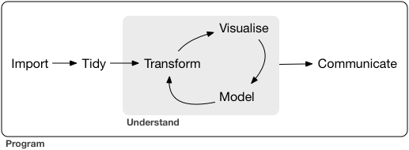
“R: what is it good for?”
(fortunately, not absolutely nothing)
Wickham + Grolemund (2017)

Slide 6
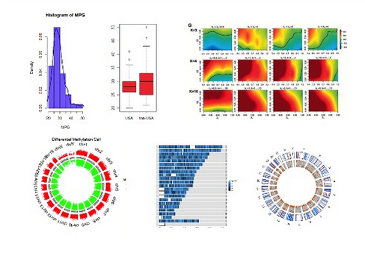
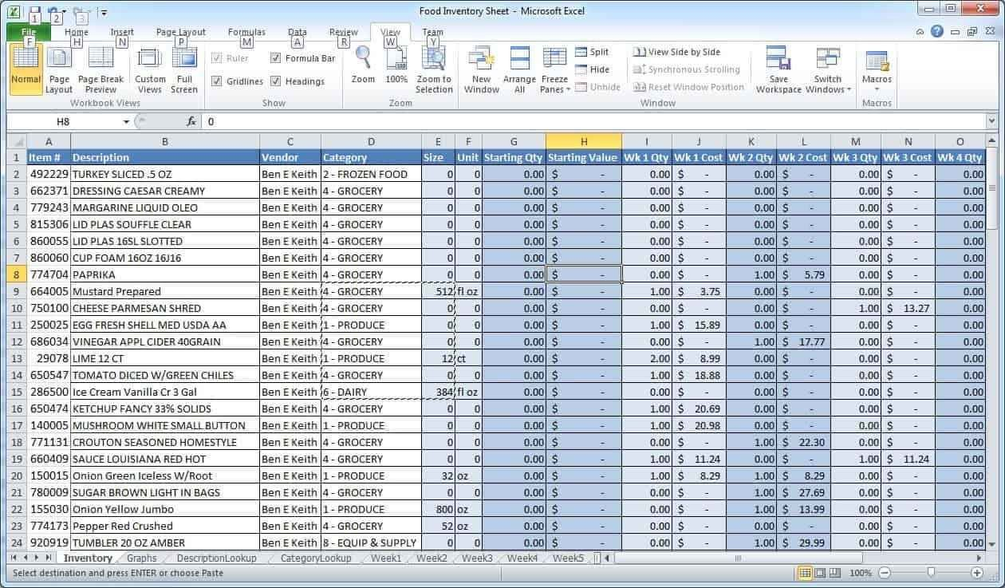
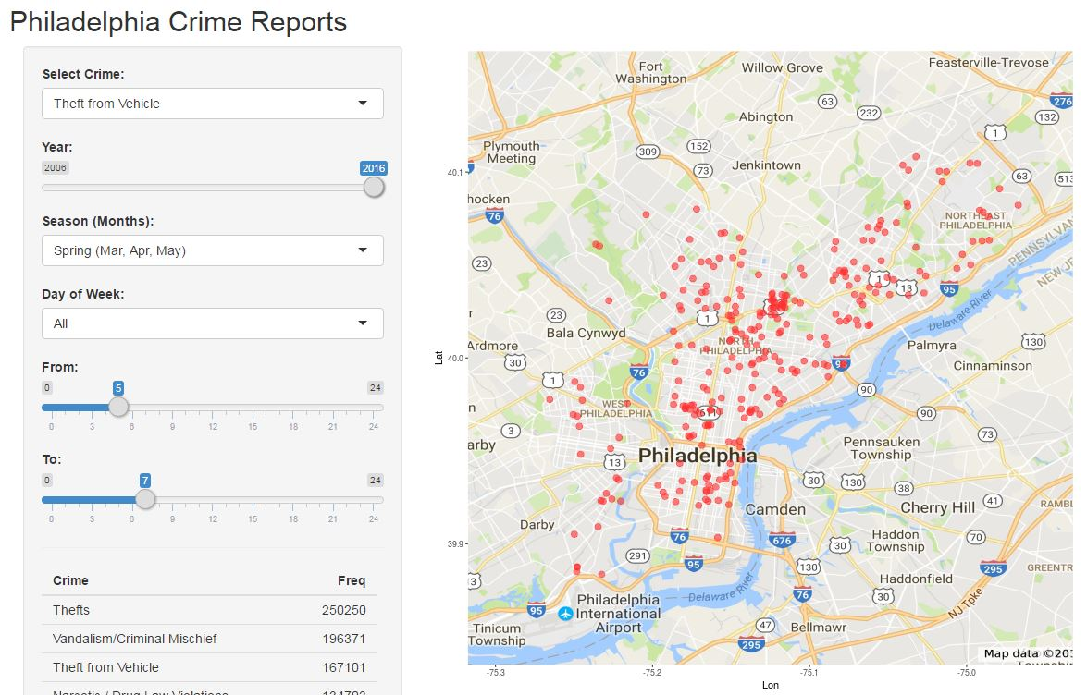
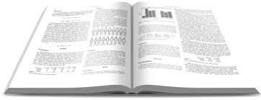
“R: what is it good for?”
(fortunately, not absolutely nothing)
Wickham + Grolemund (2017)

Slide 7
Using R today: Rstudio Cloud
Rstudio Cloud (web browser interface)
https://rstudio.cloud/project/134344
Installing R and R Studio
R (https://r-project.org)
R Studio (https://rstudio.com)

Slide 8
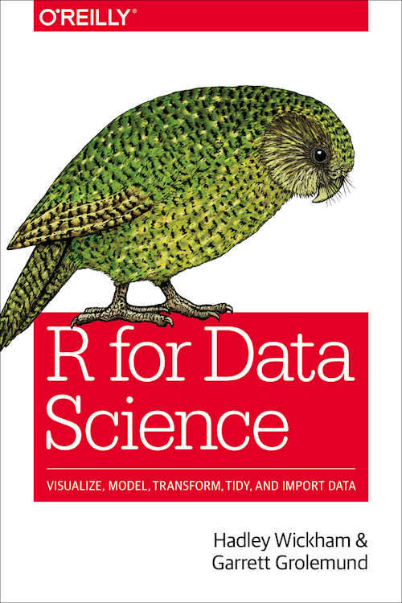
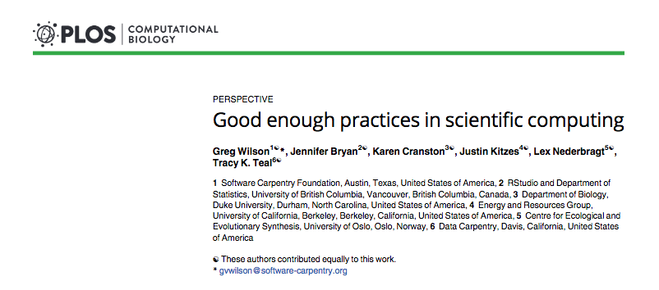
Reading
R for data science (Wickham & Grolemund)
https://r4ds.had.co.nz
Wilson et al. 2017
https://doi.org/10.1371/journal.pcbi.1005510

Slide 9
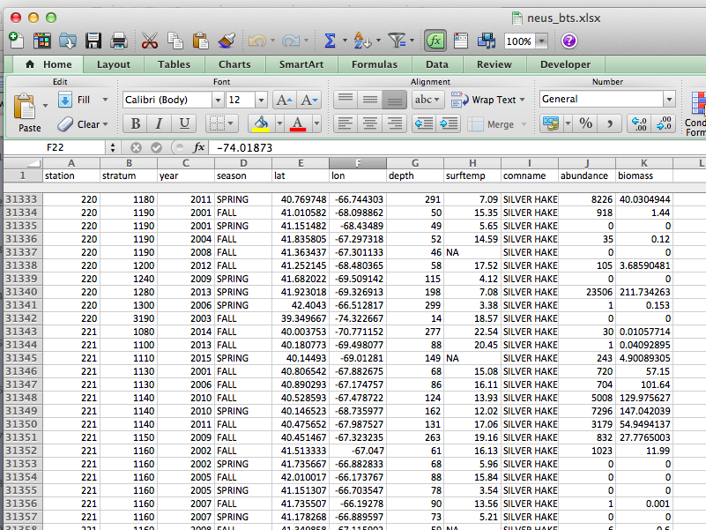
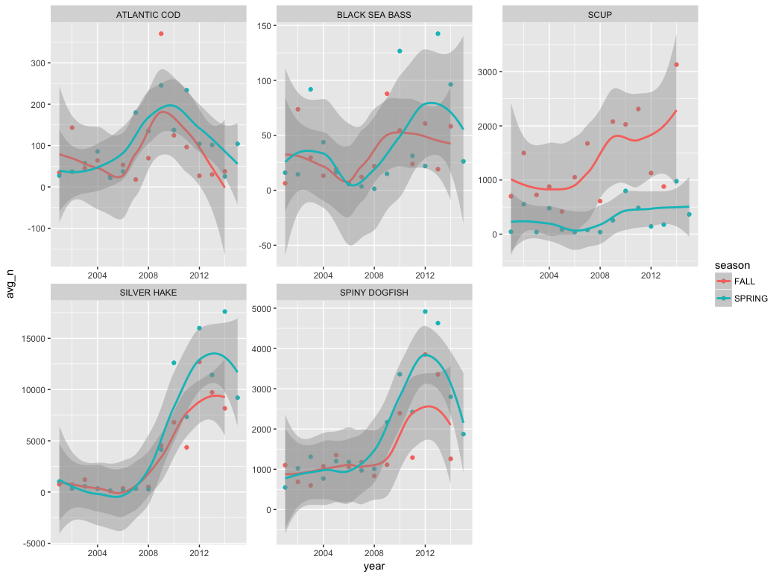
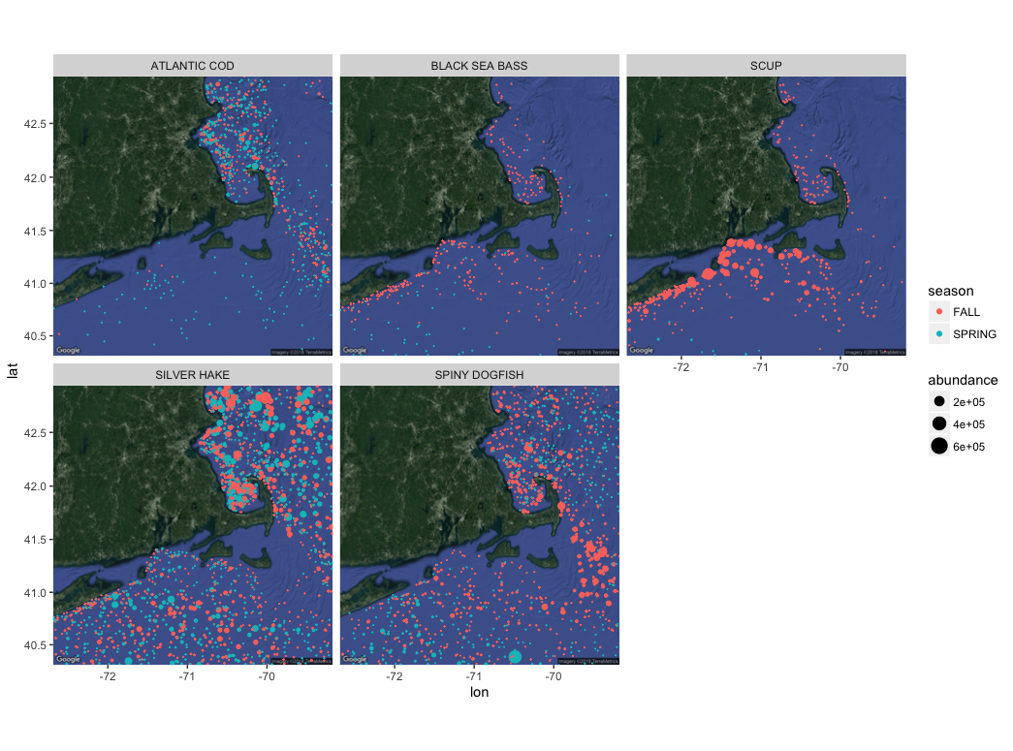
Intro to R: Objectives
Introduction to R and Rstudio
Analysis of Northeast US trawl survey data
(from http://oceanadapt.rutgers.edu/)

Slide 10
Finding information for today
Updated continuously at:
https://github.com/thefaylab/quantfishR_01_introR

Slide 11
Let’s go!
Switch to R

Slide 12
Packages today
install.packages(‘tidyverse’)
install.packages(‘ggmap’)
install.packages(‘readxl’)

