Slide 1
CMP-6035B Computer Vision: Image Categorisation II
100263854 – Theofanis Chatzidimitriou

Slide 2
Contents
SIFT Extraction
Bag of Words
Steps
Results
Classifiers
Spatial Pyramid
Steps
Results
Additional Scene Recognition Method (Fisher Vector)

Slide 3
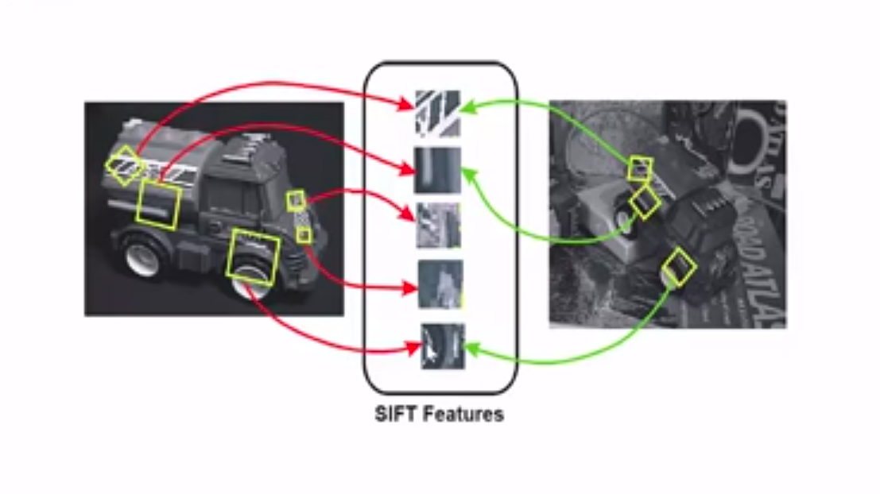
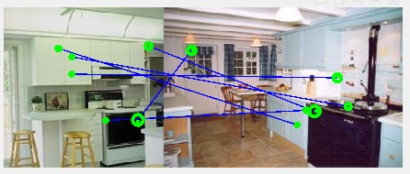
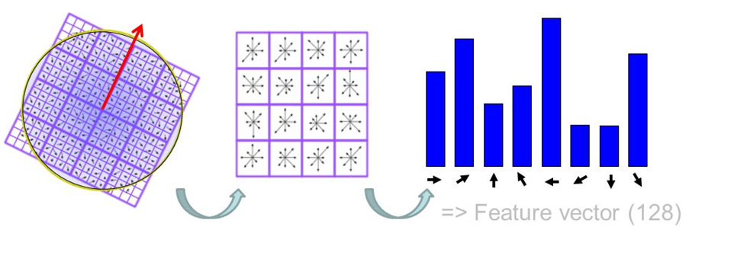
SIFT features (Scale-invariant feature transform)
Invariant to transformation
Features based on images’ gradients
They were used for the Bag Of Sift and Spatial Pyramid
feature extraction
https://medium.com/data-breach/introduction-to-sift-scale-invariant-feature-transform-65d7f3a72d40
>Dictionary of visual words
> size 128xN
N: size of dictionary
>Each word is a histogram of sift descriptors
(kitchen, store etc.)
SIFT features between 2 images with the same scene

Slide 4
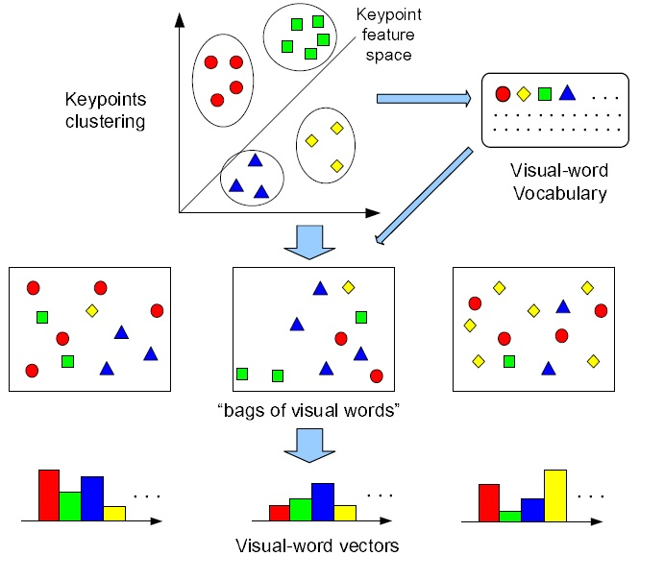
Create Vocabulary for SIFT
Steps
For all images:
Extract features
SIFT or PHOW
Cluster features
Parameters:
Different sizes of vocabularies were tested
50,100,1000
Different steps sizes were tested
10,100,200
the smaller the denser sampling
Bin size of 6 was used
Color spaces:
RGB
GRAYSCALE
K-mean clustering
Picks random centroids
Assign each data point to the closest centroid
Move the centroid to the center of the assigned points
Repeat above steps until there is no changes
Bag of Visual Words from extracted patch-based visual features

Slide 5
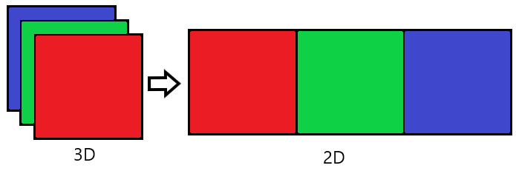
Colour spaces
Colour spaces with more than 1 channel:
Concatenate the color channels into a 2D matrix
Use vl_phow
Dense SIFT features
Extract SIFTs from all channels separately
> Not much improvement with this method

Slide 6
kNN (k-Nearest Neighbor)
Supervised algorithm
No-training
Non-parametric
Parameters:
k
Distance metric
Steps:
Determine parameter k
Calculate the distance between each data
Sort the distance and determine the nearest neighbors based on k-th minimum distance
Classify data by using a majority vote.

Slide 7
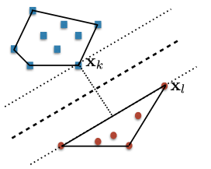
SVM (Support Vector Machine)
Linear SVM used
Supervised algorithm
Lambda(λ) value used as regularize value
1 vs all(15)
In comparison with kNN:
Gave much better results
Faster
Classes are indicated with 1 or -1
> 1 being the current class that is tested
> -1 are the rest of the classes
All results have -+1% error
Reference:CMP-6035B Lecture 4: Classifiers

Slide 8
Bag Of Sift Results
K-Nearest Neighbours
vl_disft
Colour space: RGB
Vocab size: 400
Feature Step size: 5
Step size:5
Max accuracy: 0.553 => k =10
Colour space: GRAYSCALE
Vocab size: 200
Feature Step size: 5
Step size:5
Max accuracy: 0.532 => k =15

Slide 9
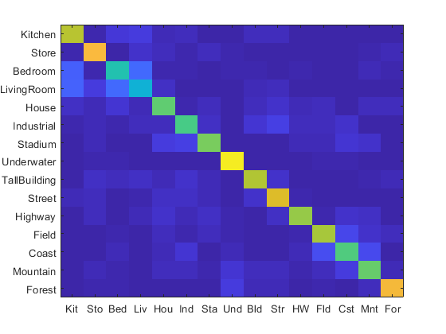

Bag Of Sift Results
Support Vector Machine
vl_disft
Colour space: RGB
Vocab size: 1000
Feature Step size: 5
Step size:200
Max accuracy: 0.698 => λ =10
Colour space: GRAYSCALE
Vocab size: 1000
Feature Step size: 5
Step size:10
Max accuracy: 0.67 => λ =1
HTML
HTML

Slide 10

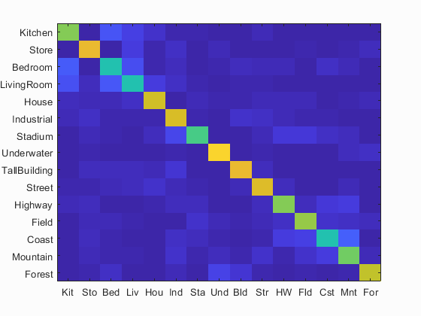
Bag Of Sift Results
K-Nearest Neighbours
Support Vector Machine
vl_phow
Colour space: RGB
Vocab size: 1000
Feature Step size: 5
Step size:10
Max accuracy: 0.540 => k =8
Colour space: RGB
Vocab size: 1000
Feature Step size: 5
Step size:10
Max accuracy: 0.694 => λ = 10
HTML
HTML

Slide 11
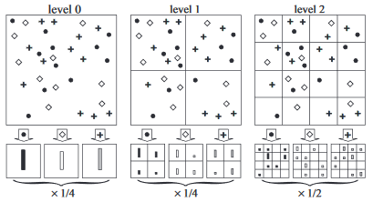
Spatial Pyramid
Collection of orderless feature histograms
Each level consists of a grid with histograms
Histograms are created by the local SIFT descriptors on each quadrant
For each level a weight is applied
Lazebnik, Svetlana & Schmid, Cordelia & Ponce, J.. (2006).

Slide 12
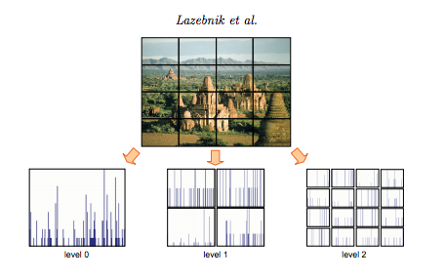
Spatial Pyramid
For all the images
extract sift features of the image
find the minimum distance of the extracted features
construct a histogram with those values.
It will be the histogram with SIFT features for Level 0 of the pyramid.
Create a matrix with the total levels of the pyramid
Each level will have a number of quadrants
Each quadrant will be represented with a histogram of its SIFT features.
Then each level will have those histograms concentrated into a row, for the pyramid.
It will result into a bigger histogram
Apply the appropriate weight to each level
Parameters:
Maximum level
Vocabulary size
Feature Step Size : 5
Color space

Slide 13
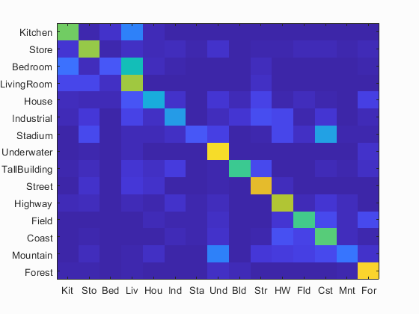
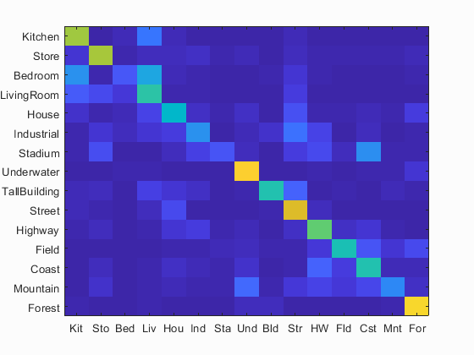
Spatial Pyramid Results
K-Nearest Neighbours
vl_dsift
Colour space: RGB
Vocab size: 400
Feature Step size: 5
Step size: 10
Level: 2
Max accuracy: 0.565 => k =10
Colour space: GRAYSCALE
Vocab size: 200
Feature Step size: 5
Step size: 200
Level: 2
Max accuracy: 0.539 => k =9
HTML
HTML

Slide 14
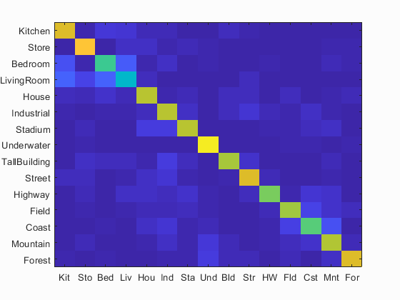
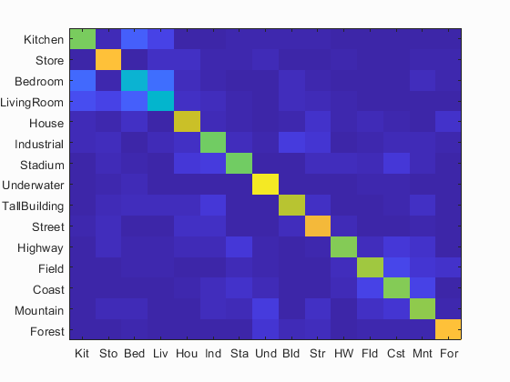
Spatial Pyramid Results
Support Vector Machine
vl_dsift
Colour space: RGB
Vocab size: 1000
Feature Step size: 5
Step size: 10
Level: 2
Max accuracy: 0.724 => λ =1
Colour space: GRAYSCALE
Vocab size: 1000
Feature Step size: 5
Step size: 10
Level: 3
Max accuracy: 0.702 => λ =0.001
HTML
HTML

Slide 15
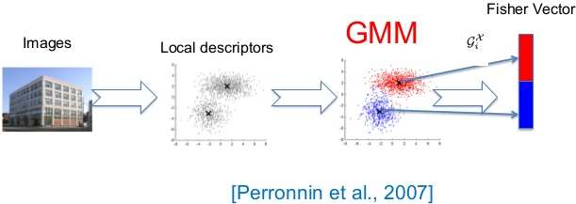
Additional scene recognition method: Fisher Encoding
Introduced in Image Classification with the Fisher Vector: Theory and Practice (Perronnin et al. 2007)
> Build upon the Bag Of Visual Words method
Fisher Vocabulary:
Extract SIFT descriptors from each image.
Apply Gaussian Mixture Model (GMM) to the obtained features.
Instead of clustering
returns the means, covariances, priors that are used as a vocabulary
Fisher Vector:
Extract SIFT descriptors
Compute the fisher vector of each image by using their SIFT features and the already computed vocabulary
Each vector represent an image
Comparison with BoS:
Advantages:
It can be computed with much
smaller vocabularies
Disadvantages:
Takes more storage
(2*D+1)*N –1
Parameters:
Step Size (Vocabulary)
Feature Step Size (Sift extraction/Fisher Vector)

Slide 16
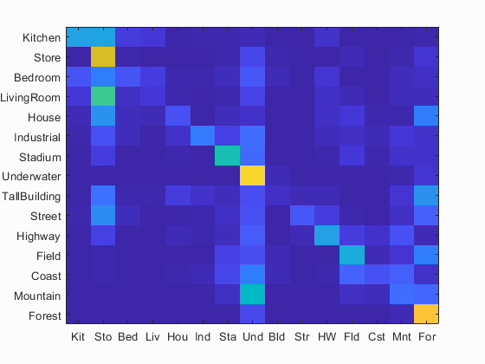
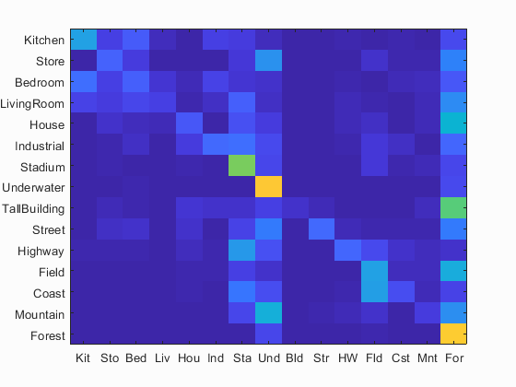
Fisher Encoding Results
K-Nearest Neighbours
vl_dsift
Vl_fisher
Colour space: RGB
Vocab size: 100
Feature Step size: 5
Step size: 75
Max accuracy: 0.358 => k = 1
Colour space: GRAYSCALE
Vocab size: 100
Feature Step size: 5
Step size: 75
Max accuracy: 0.31 => k = 2
HTML
HTML

Slide 17
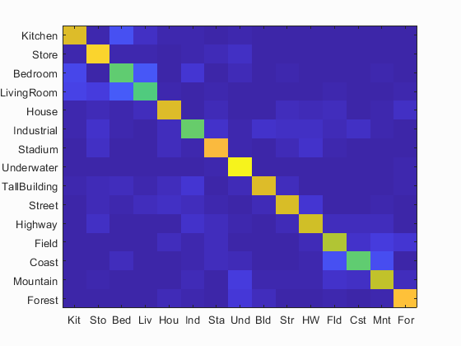

Fisher Encoding Results
Support Vector Machine
vl_dsift
Vl_fisher
Colour space: RGB
Vocab size: 100
Feature Step size: 5
Step size: 75
Max accuracy: 0.766667 => λ = 0.00001
Colour space: GRAYSCALE
Vocab size: 100
Feature Step size: 5
Step size: 75
Max accuracy: 0.725333 => λ = 0.01
HTML
HTML

Slide 18
Conclusion
The less the step size the slower and more memory Matlab was using
Spatial Pyramid gave good results till level 2 with RGB color space
After level 2, not really better results, much more computational power
Feature Step Size of 5 seemed to worked fine with all methods
Fisher Vector method worked better with smaller vocabulary
kNN classifier was really slow in comparison with SVM
Too much data

Slide 19
Contribution
Theofanis Chatzidmitriou

