Slide 1

Artificial Intelligence and Machine Learning
TEXTBOOKS/LEARNING RESOURCES:
a) T. M. Mitchell, Machine Learning (1st ed.), McGraw Hill, 2017. ISBN 978-1259096952.
b) E. Alpaydin, Introduction to Machine Learning (4th ed.), Phi, 2020. ISBN 978-8120350786
REFERENCE BOOKS/LEARNING RESOURCES:
a) Oswald Campesato, Artificial Intelligence, Machine Learning, and Deep Learning (1st ed.), Mercury Learning & Information, 2020. ISBN 9781683924665.

Slide 2
Lecture - 2
Machine Learning Life Cycle
Artificial Intelligence (AI) vs. Machine Learning
Data and Types of Data

Slide 3
Machine Learning Life Cycle
1
2
3
ML Life Cycle involves seven major steps:
Gathering Data
Data preparation
Data Wrangling
4
5
6
7
Analyse Data
Train the model
Test the model
Deployment

Slide 4
Machine Learning Life Cycle
Machine learning
Life cycle
The most important thing is to understand the problem and to know the purpose of the problem.
To solve a problem, we create a machine learning system called "model", and this model is created by providing "training data".
Therefore, the life cycle starts by collecting data.

Slide 5
Machine Learning Life Cycle
Data Gathering is the first step of the machine learning life cycle. The goal of this step is to identify and obtain all data-related problems.
In this step, we need to identify the different data sources, as data can be collected from various sources such as files, database, internet, or mobile devices.
It is one of the most important steps of the life cycle. The quantity and quality of the collected data will determine the efficiency of the output. The more will be the data, the more accurate will be the prediction.
1
Gathering Data
Identify various data sources
Collect data
Integrate the data from different sources

Slide 6
Machine Learning Life Cycle
After collecting the data, we need to prepare it for further steps. Data preparation is a step where we put our data into a suitable place and prepare it to use in our machine learning training.
This step can be further divided into two processes:
Data exploration: It is used to understand the nature of data that we have to work with. We need to understand the characteristics, format, and quality of data. A better understanding of data leads to an effective outcome. In this, we find Correlations, general trends, and outliers.
Data pre-processing: Now the next step is pre-processing of data for its analysis.
2
Data preparation
Data Conversion
Data Scaling

Slide 7
Machine Learning Life Cycle
In real-world applications, collected data may have various issues, including:
Missing Values
Duplicate data
Invalid data
Noise
So, we use various filtering techniques to clean the data. It is mandatory to detect and remove the above issues because it can negatively affect the quality of the outcome.
3
Data Wrangling

Slide 8
Machine Learning Life Cycle
Now the cleaned and prepared data is passed on to the analysis step. This step involves:
Selection of analytical techniques
Building models
Review the result
The aim of this step is to build a machine learning model to analyze the data using various analytical techniques and review the outcome.
It starts with the determination of the type of the problems, where we select the machine learning techniques such as Classification, Regression, Cluster analysis, Association, etc. then build the model using prepared data, and evaluate the model.
4
Analyse Data

Slide 9
Machine Learning Life Cycle
We use datasets to train the model using various machine learning algorithms. Training a model is required so that it can understand the various patterns, rules, and, features.
Once the model has been trained, then we test the model. In this step, we check for the accuracy of our model by providing a test dataset to it and calculate the percentage accuracy of the model as per the requirement of project or problem.
5
6
Train and Test the model

Slide 10
Machine Learning Life Cycle
The last step of machine learning life cycle is deployment, where we deploy the model in the real-world system.
If the above-prepared model is producing an accurate result as per our requirement with acceptable speed, then we deploy the model in the real system.
But before deploying the project, we will check whether it is improving its performance using available data or not. The deployment phase is similar to making the final report for a project.
7
Deployment

Slide 11
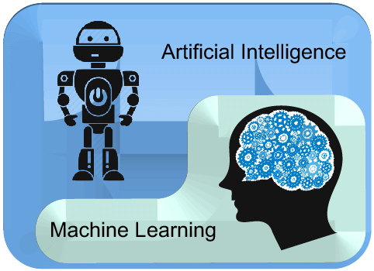
Artificial Intelligence (AI) vs. Machine Learning
ML is the subset of AI.
AI is a bigger concept to create intelligent machines that can simulate human thinking capability and behaviour.
Machine Learning is an application or subset of AI that allows machines to learn from data without being programmed explicitly.

Slide 12

Artificial Intelligence (AI) vs. Machine Learning

Slide 13
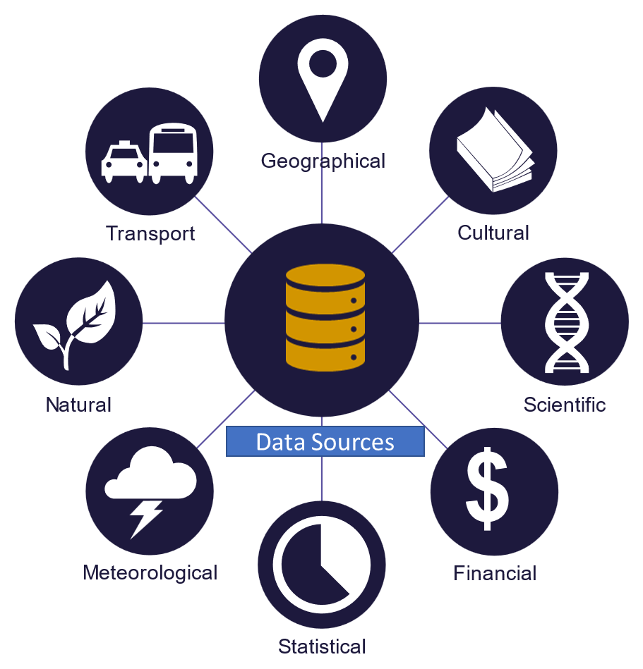
Data and Types of Data

Slide 14
Data and Types of Data
Types of Data
Numerical
Categorical
Time series
Text
Exp.: 1,2,3 or 2.45, 3.687
Exp.: Cold, Hot, Humid, Raining, Low
Exp.: 9AM-$300; 10AM-&200; 11AM-$400
Exp.: Dog, Cow, Horse

Slide 15
Numerical Data
Numerical data is any data where data points are exact numbers. Statisticians also might call numerical data, quantitative data. Numerical data can be characterized by continuous or discrete data. Continuous data can assume any value within a range whereas discrete data has distinct values.

Slide 16
Categorical data
In the context of super classification, categorical data would be the class label. This would also be something like if a person is a man or woman, or property is residential or commercial.
Categorical data represents characteristics, such as a hockey player’s position, team, hometown. Categorical data can take numerical values. For example, maybe we would use 1 for the color red and 2 for blue. But these numbers don’t have a mathematical meaning. That is, we can’t add them together or take the average.

Slide 17
Time series data
For example, we might measure the average number of home sales for many years. The difference of time series data and numerical data is that rather than having a bunch of numerical values that don’t have any time ordering, time-series data does have some implied ordering. There is a first data point collected and the last data point collected.
Time series data is a sequence of numbers collected at regular intervals over some period of time.
Time series data has a temporal value attached to it, so this would be something like a date or a timestamp that you can look for trends in time

Slide 18
Textual Data
Text data is basically just words. A lot of the time the first thing that you do with text is you turn it into numbers using some interesting functions like the bag of words formulation.

Slide 19
Data and Types of Data
Numerical data is any data where data points are exact numbers. Statisticians also might call numerical data, quantitative data. Numerical data can be characterized by continuous or discrete data. Continuous data can assume any value within a range whereas discrete data has distinct values.
Categorical data represents characteristics, such as a hockey player’s position, team, hometown. Categorical data can take numerical values. For example, maybe we would use 1 for the color red and 2 for blue. But these numbers don’t have a mathematical meaning. That is, we can’t add them together or take the average. In the context of supervised classification, categorical data would be the class label. This would also be something like if a person is a man or woman, or property is residential or commercial.
Time series data is a sequence of numbers collected at regular intervals over some period of time. Time series data has a temporal value attached to it, so this would be something like a date or a timestamp that you can look for trends in time. For example, we might measure the average number of home sales for many years. The difference of time series data and numerical data is that rather than having a bunch of numerical values that don’t have any time ordering, time-series data does have some implied ordering. There is a first data point collected and the last data point collected.
Text data is basically just words. A lot of the time the first thing that you do with text is you turn it into numbers using some interesting functions like the bag of words formulation.

Slide 20


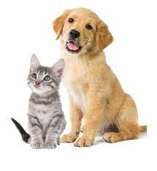
Feature Variable
Feature Variable
Red Color, Round Shape, some texture patterns
Red Color, Round Shape, Plain texture patterns
Height, color, patterns, ears, face

Slide 21
Feature Variable
Need of Feature Variable
Features are the basic building blocks of datasets. The quality of the features in your dataset has a major impact on the quality of the insights you will gain when you use that dataset for machine learning.
Additionally, different business problems within the same industry do not necessarily require the same features, which is why it is important to have a strong understanding of the business goals of your data science project.
You can improve the quality of your dataset’s features with processes like feature selection and feature engineering. If these techniques are done well, the resulting optimal dataset will contain all of the essential features that might have bearing on your specific business problem, leading to the best possible model outcomes and the most beneficial insights.

Slide 22
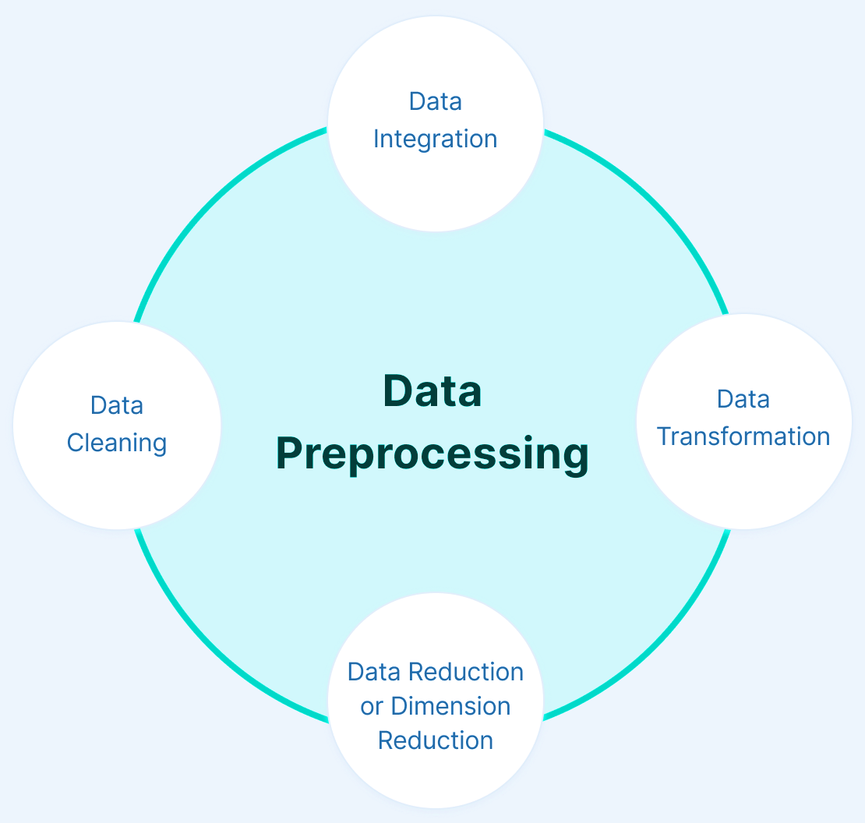
Data Pre-processing
Data Pre-processing
Data pre-processing is a process of preparing the raw data and making it suitable for a machine learning model.

Slide 23

Data Pre-processing
Overview
of
Operators In Python

Slide 24

Data Pre-processing
Overview
of
Arrays In Python

Slide 25
Data Pre-processing
Data Pre-processing
1. Prerequisite
Download the latest version for Python (3.10.7) https://www.python.org/downloads/
Download and install Spyder (IDE) https://www.spyder-ide.org/
2. Importing Libraries
Numpy: It is used for including any type of mathematical operation in the code. It is the fundamental package for scientific calculation in Python. It also supports to add large, multidimensional arrays and matrices.
Matplotlib: It is a Python 2D plotting library, and with this library, we need to import a sub-library pyplot. This library is used to plot any type of charts in Python for the code.
Pandas: It is an open-source data manipulation and analysis library used for importing and managing the datasets.

Slide 26
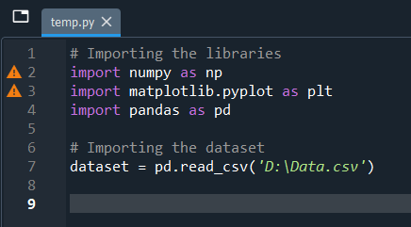
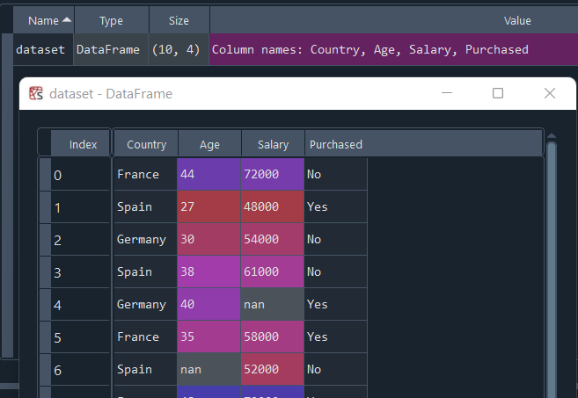
Data Pre-processing
Data Pre-processing
3. Loding Dataset
>> data_set= pd.read_csv('DatasetName.csv')

Slide 27
Data Pre-processing
Handling Missing
To handle missing values, we will use Scikit-learn library in our code, which contains various libraries for building machine learning models. Here we will use Imputer class of sklearn.preprocessing library. Below is the code for it:
By deleting the particular row: The first way is used to commonly deal with null values. In this way, we just delete the specific row or column which consists of null values. But this way is not so efficient and removing data may lead to loss of information which will not give the accurate output.
By calculating the mean: In this way, we will calculate the mean of that column or row which contains any missing value and will put it on the place of missing value. This strategy is useful for the features which have numeric data such as age, salary, year, etc. Here, we will use this approach

Slide 28
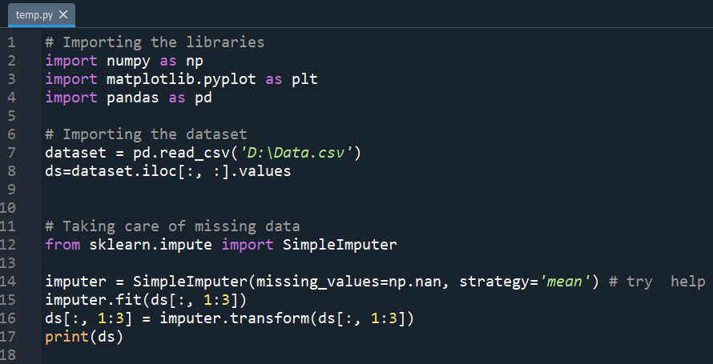
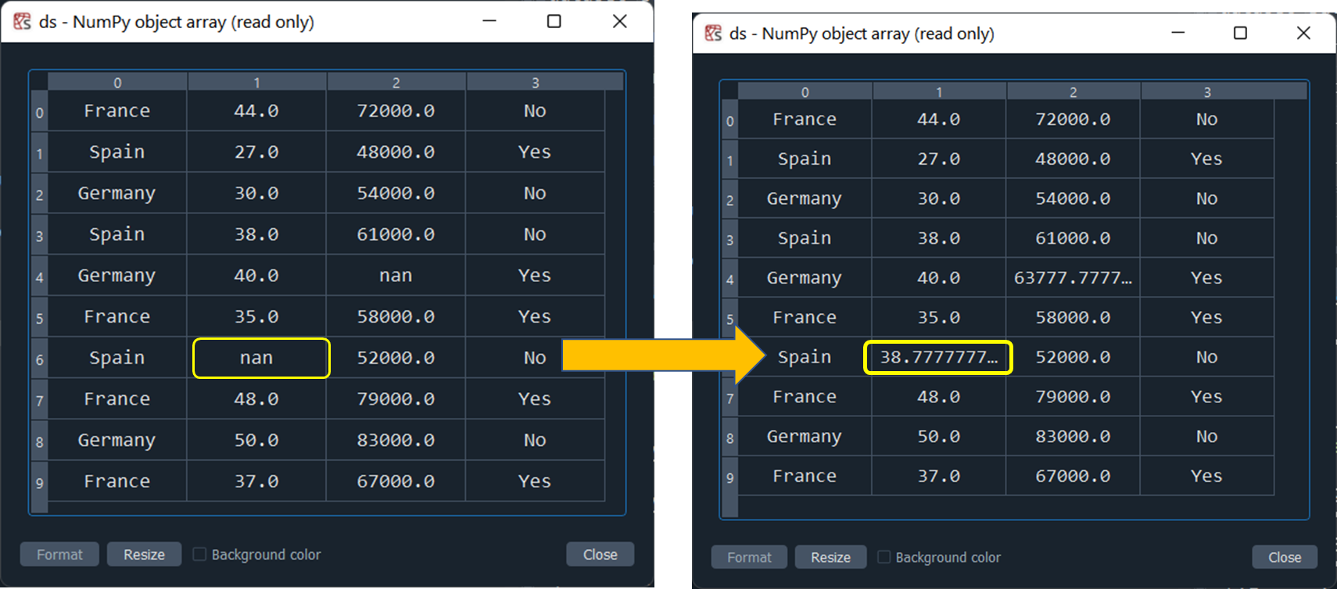
Data Pre-processing
Handling Missing

Slide 29
Data Pre-processing
Encoding Categorical Data
Categorical data is data which has some categories such as : Cow, Dog, Cat, Success, Fail, etc.
Since machine learning model completely works on mathematics and numbers, but if our dataset would have a categorical variable, then it may create trouble while building the model. So it is necessary to encode these categorical variables into numbers.
To encode categorical data we will use LabelEncoder() class from preprocessing library.

Slide 30
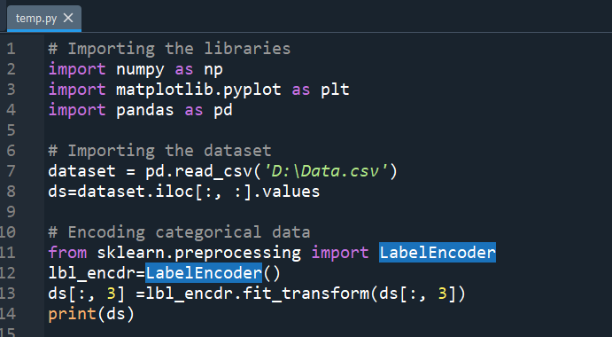
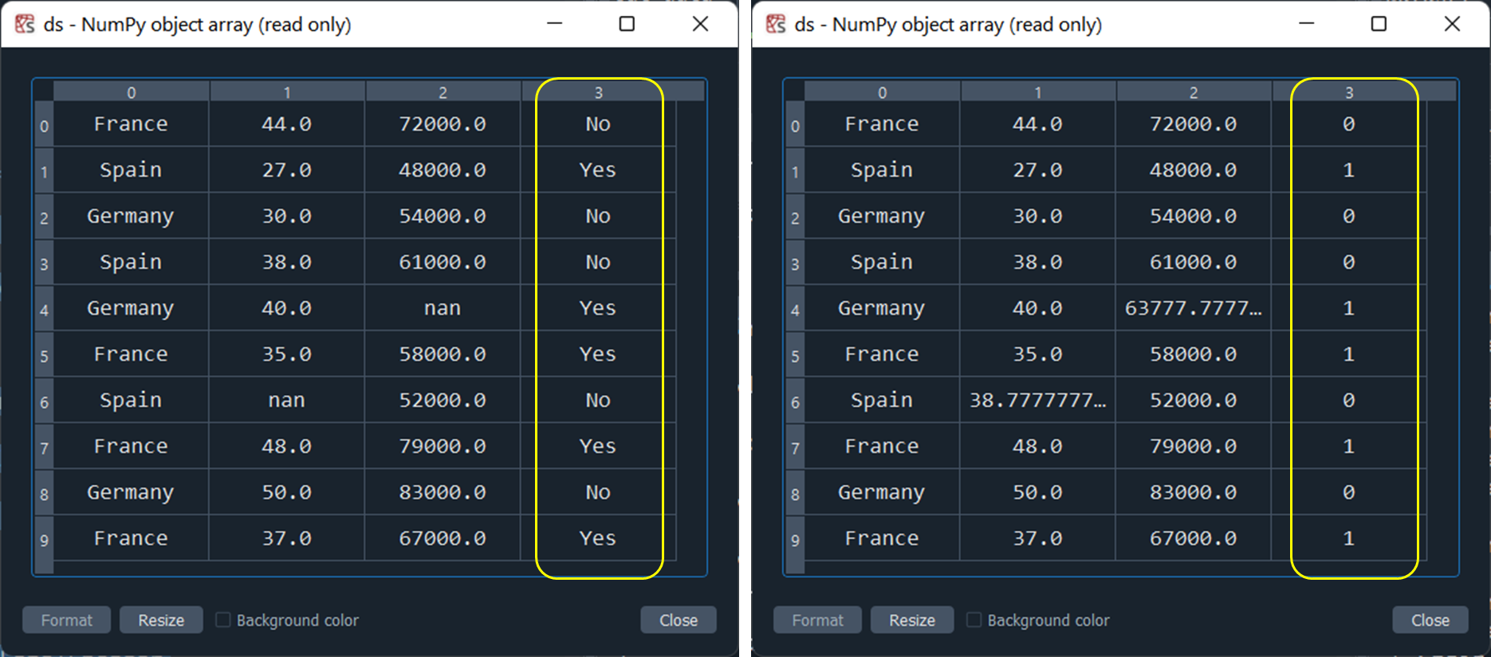
Data Pre-processing
Encoding Categorical Data

Slide 31
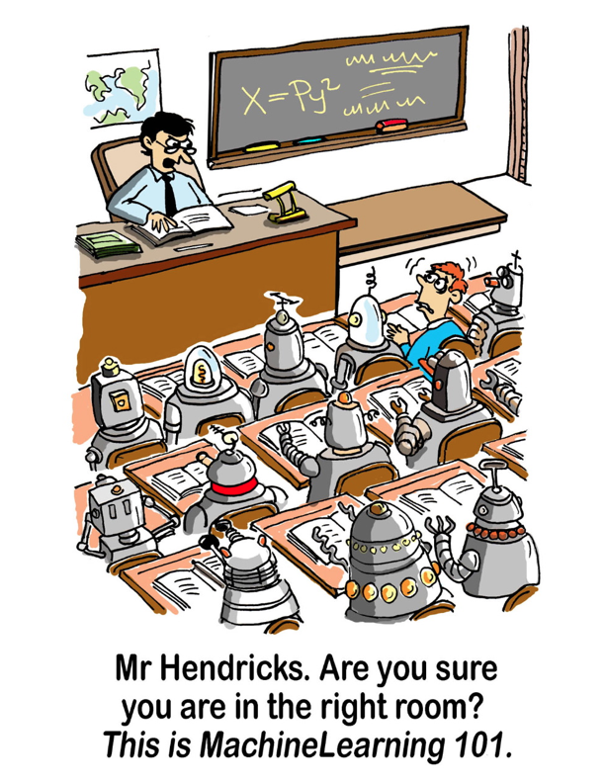

Slide 32
Data Pre-processing
In machine learning data preprocessing, we divide our dataset into a training set and test set. This is one of the crucial steps of data preprocessing as by doing this, we can enhance the performance of our machine learning model.
Training Set: A subset of dataset to train the machine learning model, and we already know the output.
Test set: A subset of dataset to test the machine learning model, and by using the test set, model predicts the output.
So we always try to make a machine learning model which performs well with the training set and also with the test dataset. Here, we can define these datasets as:
Splitting Dataset
In
Train & Test set

Slide 33
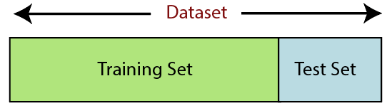
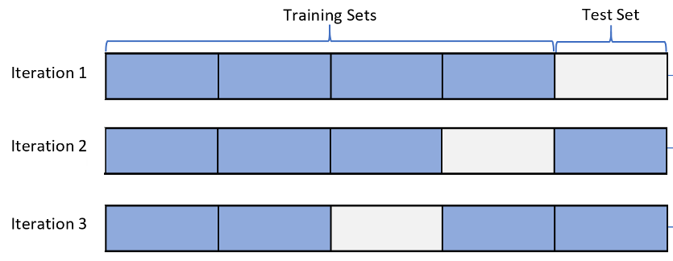
Data Pre-processing
Splitting Dataset
In
Train & Test set

Slide 34
Data Pre-processing
Splitting Dataset
In
Train & Test set
train_test_split(*arrays, test_size=None, train_size=None, random_state=None, shuffle=True)
Parameters:
*arrays: inputs such as lists, arrays, data frames, or matrices
test_size: this is a float value whose value ranges between 0.0 and 1.0. it represents the proportion of our test size. its default value is none.
train_size: this is a float value whose value ranges between 0.0 and 1.0. it represents the proportion of our train size. its default value is none.
random_state: this parameter is used to control the shuffling applied to the data before applying the split. it acts as a seed.
shuffle: This parameter is used to shuffle the data before splitting. Its default value is true.

Slide 35
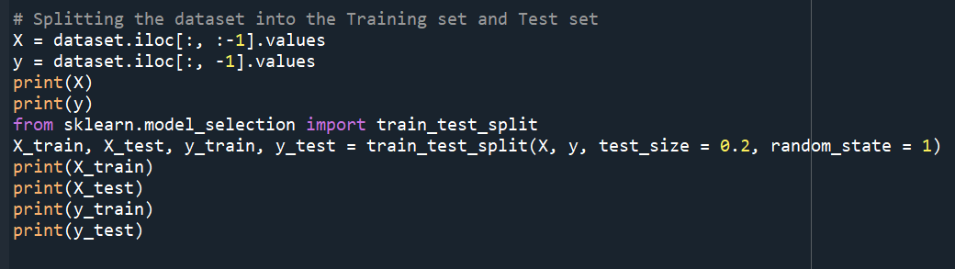
Data Pre-processing
Splitting Dataset
In
Train & Test set

Slide 36
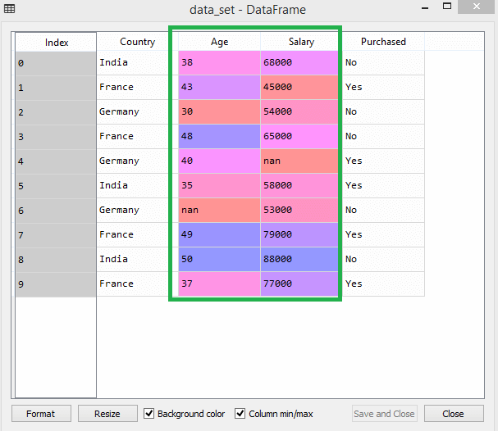
Data Pre-processing
Feature scaling is the final step of data preprocessing in machine learning. It is a technique to standardize the independent variables of the dataset in a specific range.
In feature scaling, we put our variables in the same range and in the same scale so that no any variable dominate the other variable.
In the following example: salary values will dominate the age values, and it will produce an incorrect result.
Feature Scaling
Or
Normalization

Slide 37
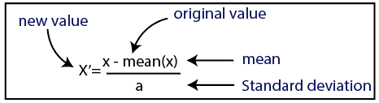
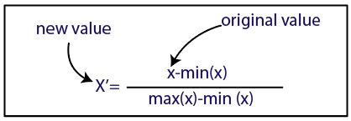
Data Pre-processing
Feature Scaling
Or
Normalization
There are two ways to perform feature scaling in machine learning:
Standardization
Normalization (min-max)

Slide 38
Data pre-processing Python Code
# Importing the libraries
import numpy as np
import matplotlib.pyplot as plt
import pandas as pd
# Importing the dataset
dataset = pd.read_csv('D:\Data.csv')
ds=dataset.iloc[:, :].values
# Taking care of missing data
from sklearn.impute import SimpleImputer
imputer = SimpleImputer(missing_values=np.nan, strategy='mean') # try help
imputer.fit(ds[:, 1:3])
ds[:, 1:3] = imputer.transform(ds[:, 1:3])
print(ds)
# Encoding categorical data; Encoding the Dependent Variable
from sklearn.preprocessing import LabelEncoder
lbl_encdr=LabelEncoder()
ds[:, 3]=lbl_encdr.fit_transform(ds[:, 3])
print(ds)
# Splitting the dataset into the Training set and Test set
# X = dataset.iloc[:, :-1].values
# y = dataset.iloc[:, -1].values
X=ds2[:, :-1]
Y=ds2[:, -1]
print(X)
print(Y)
from sklearn.model_selection import train_test_split
X_train, X_test, y_train, y_test = train_test_split(X, Y, test_size = 0.2, random_state = 1)
print(X_train)
print(X_test)
print(y_train)
print(y_test)
# Feature Scaling
from sklearn import preprocessing
min_max_scaler = preprocessing.MinMaxScaler(feature_range =(0, 1))
X_train[:, 3:] = min_max_scaler.fit_transform(X_train[:, 3:])
Standardisation = preprocessing.StandardScaler()
X_test[:, 3:] = Standardisation.fit_transform(X_test[:, 3:])
print(X_train)
print(X_test)

Slide 39
Further Readings:
Machine Learning A-Z, https://www.superdatascience.com/pages/machine-learning
Operators In Python, https://www.youtube.com/watch?v=Pm9FOpOwhlA
Arrays In Python, https://www.youtube.com/watch?v=phRshQSU-xA&t=201s
Google Collab, https://colab.research.google.com
How and Where to Apply Feature Scaling in Python?, https://www.turing.com/kb/how-and-where-to-apply-feature-scaling-in-python

