Slide 1
Statistical Machine Learning
TEXTBOOKS/LEARNING RESOURCES:
a) Masashi Sugiyama, Introduction to Statistical Machine Learning (1st ed.), Morgan Kaufmann, 2017. ISBN 978-0128021217.
b) T. M. Mitchell, Machine Learning (1st ed.), McGraw Hill, 2017. ISBN 978-1259096952.
REFERENCE BOOKS/LEARNING RESOURCES:
a) Richard Golden, Statistical Machine Learning A Unified Framework (1st ed.), unknown, 2020.

Slide 2
Lecture - 3
What Is the Least Squares Method?
Line Of Best Fit
Steps to Compute the Line Of Best Fit
The least-squares regression method with an example
A python program to implement Least Squares method

Slide 3
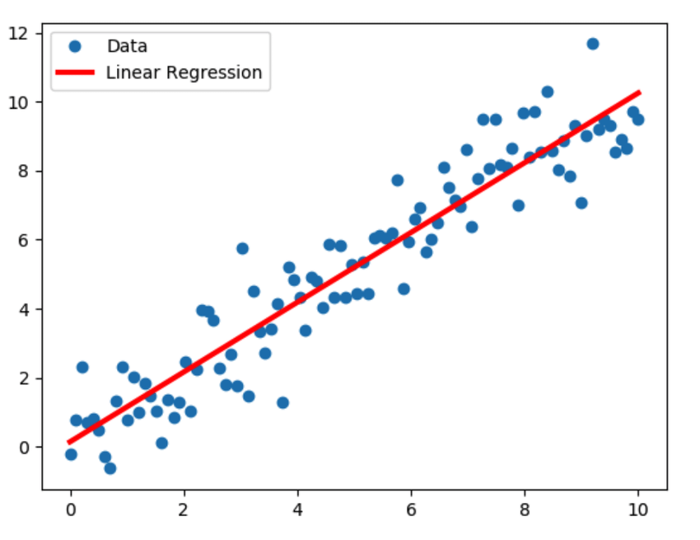
Least Square Regression Method
What is the Least Squares Method
The least-squares regression method is a technique commonly used in Regression Analysis.
It is a mathematical method used to find the best fit line that represents the relationship between an independent and dependent variable.

Slide 4
Least Square Regression Method
Why LSM is Used ?
The least-squares method is a statistical method used to find the line of best fit of the form of an equation such as y = mx + c to the given data.
The curve of the equation is called the regression line. Our main objective in this method is to reduce the sum of the squares of errors as much as possible.
This method is often used in data fitting where the best fit result is assumed to reduce the sum of squared errors that is considered to be the difference between the observed values and corresponding fitted value.
The sum of squared errors helps in finding the variation in observed data.
Line of best fit is drawn to represent the relationship between 2 or more variables (shown in scatter plot of data points).
It is based on the idea that the square of the errors obtained must be minimized to the most possible extent and hence the name least squares method.

Slide 5
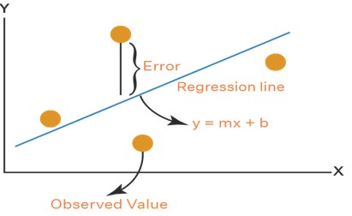
Least Square Regression Method
What is the Line Of Best Fit?
Let us assume that the given points of data are (x1, y1), (x2, y2), (x3, y3), …, (xn, yn) in which all x’s are independent variables, while all y’s are dependent ones.
This method is used to find a linear line of the form y = mx + c, where y and x are variables, m is the slope, and c is the y-intercept.

Slide 6

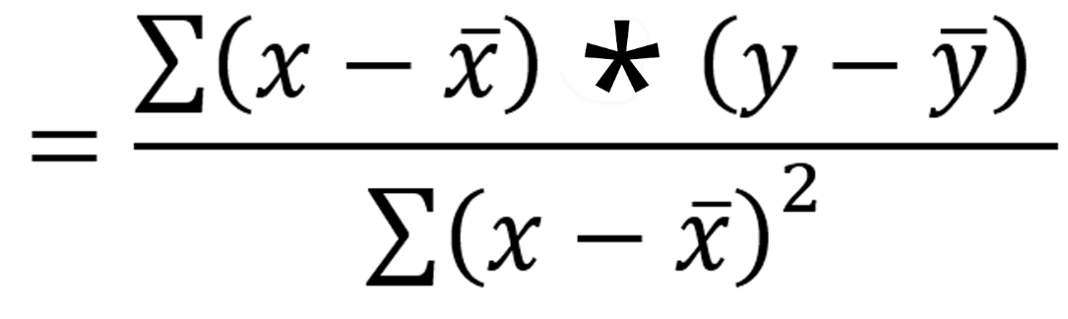


Least Square Regression Method
Steps to Find
Line Of Best Fit?
As an assumption, let’s consider that there are ‘n’ data points.
Step 1: Calculate the slope ‘m’ by using the following formula:
Step 2: Compute the y-intercept (the value of y at the point where the line crosses the y-axis):
Step 3: Substitute the values in the final equation:
Now let’s look at an example and see how you can use the least-squares regression method to compute the line of best fit.
Means, C = (∑y – m ∑x) / n

Slide 7
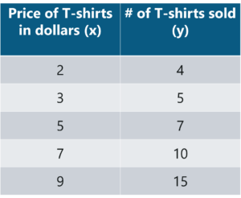
Least Square Regression Method
Tom who is the owner of a retail shop, found the price of different T-shirts vs the number of T-shirts sold at his shop over a period of one week. He tabulated this like shown below
Let us use the concept of least squares regression to find the line of best fit for the given data.
Example

Slide 8
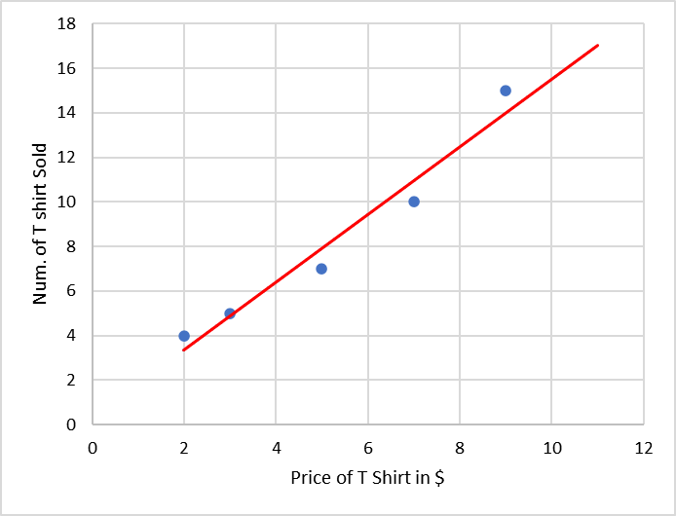
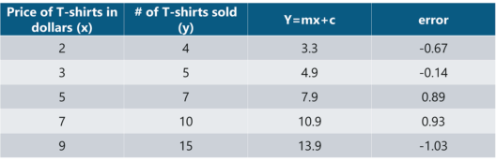
Least Square Regression Method
Example
Now one can use the above equation (y=mx + c) to estimate how many T-shirts of price $8 can he sell at the retail shop.
y = (1.518)(8) + 0.305 = 12.45 T-shirts
This comes down to 13 T-shirts! That’s how simple it is to make predictions using Linear Regression.

Slide 9
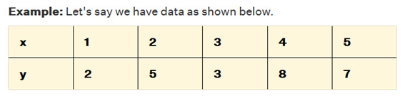
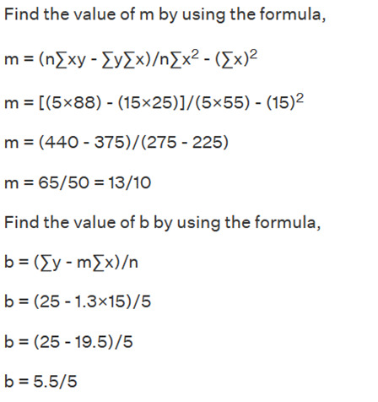
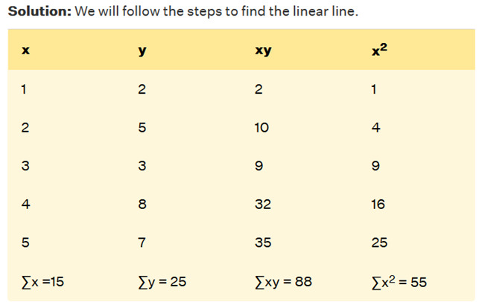
Least Square Regression Method
So, the required equation of least squares is
y = mx + b = 13/10x + 5.5/5.

Slide 10
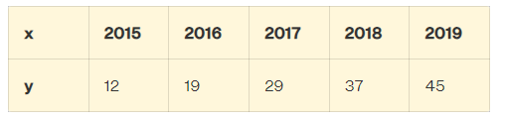
Least Square Regression Method
Practice Example
Q1. Consider the set of points: (-1, 0), (0, 2), (1, 4), and (k, 5). The values of slope and y-intercept in the equation of least squares are 1.7 and 1.9 respectively. Determine the value of k.
Q2. The following data shows the sales (in million dollars) of a company. Make the data easily manageable and Estimate the sales in the year 2020 using the regression line?

Slide 11

Least Square Regression Method
Implementation
Logic: To implement Least Squares method in order to build a model that studies the relationship between an independent and dependent variable.
The model will be evaluated by using least square regression method where RMSE and R-squared will be the model evaluation parameters.
Step 1: Import the required libraries
Step 2: Import the data set
Step 3: Assigning ‘X’ as independent variable and ‘Y’ as dependent variable
Step 4: Calculate the values of the slope and y-intercept
Step 5: Plotting the line of best fit
Step 6: Model Evaluation

Slide 12
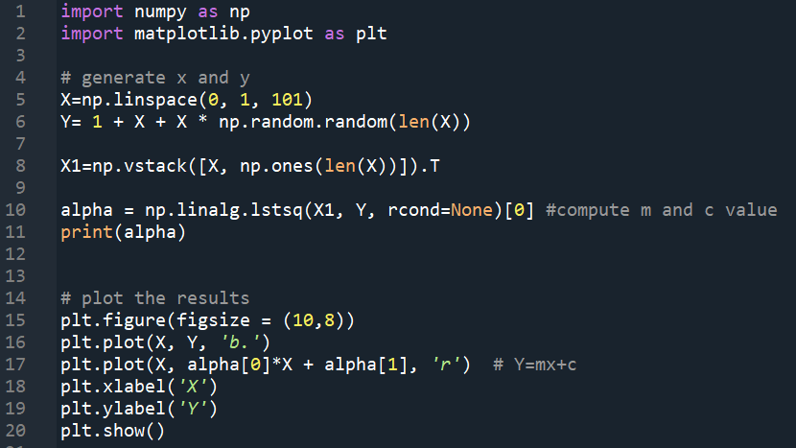
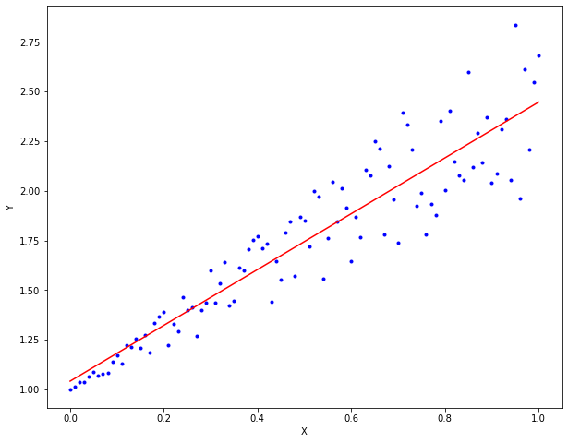
Least Square Regression Method
https://numpy.org/doc/stable/reference/generated/numpy.linalg.lstsq.html

