Slide 1
Artificial Intelligence & Machine Learning
TEXTBOOKS/LEARNING RESOURCES:
a) Masashi Sugiyama, Introduction to Statistical Machine Learning (1st ed.), Morgan Kaufmann, 2017. ISBN 978-0128021217.
b) T. M. Mitchell, Machine Learning (1st ed.), McGraw Hill, 2017. ISBN 978-1259096952.
REFERENCE BOOKS/LEARNING RESOURCES:
a) Richard Golden, Statistical Machine Learning A Unified Framework (1st ed.), unknown, 2020.

Slide 2
Lecture
What Is the Logistic Regression?
Sigmoid Function
Types of LR
Applications of LR in different field
Linear regression Vs Logistic Regression
Python program to implement Logistic regression(Lab)

Slide 3
Logistic Regression
It is used for predicting the categorical dependent variable using a given set of independent variables.
Instead of giving the exact value as 0 and 1, it gives the probabilistic values which lie between 0 and 1. it has ability to provide probabilities and classify new data using continuous and discrete datasets.
Outcome must be a categorical or discrete value. It can be either Yes or No, 0 or 1, true or False, etc.
Classify the observations using different types of data and can easily determine the most effective variables used for the classification.

Slide 4
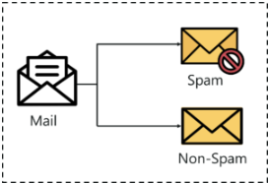
Logistic Regression
Example
Logistic regression analysis is valuable for predicting the likelihood of an event.
It helps determine the probabilities between any two classes.

Slide 5
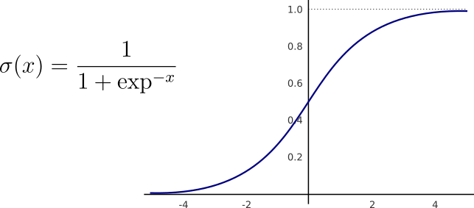
Mathematical function used to map the predicted values to probabilities. It maps any real value into another value within a range of 0 and 1.
The value of the logistic regression must be between 0 and 1, which cannot go beyond this limit, so it forms a curve like the "S" form. The S-form curve is called the Sigmoid function or the logistic function.
Use the concept of the threshold value, which defines the probability of either 0 or 1.
Sigmoid / Logistic function
Where, x is the linear combination of the input features and their corresponding coefficients in the logistic regression model.
e is the base of the natural logarithm (approximately equal to 2.71828).

Slide 6
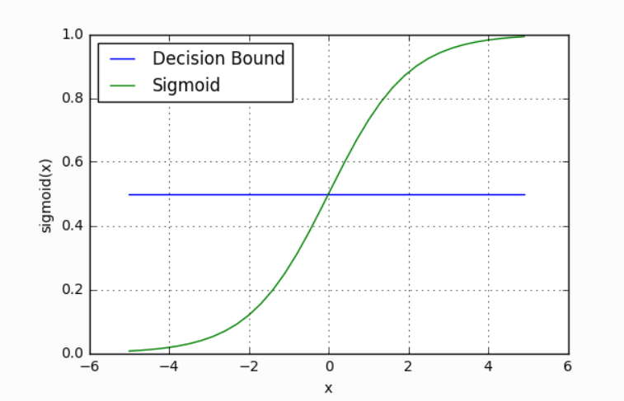
Decision boundary in Logistic Regression
The sigmoid function returns a probability value between 0 and this probability value is then mapped to a discrete class which is either “0” or “1”.
In order to map this probability value to a discrete class, we select a threshold value. This threshold value is called Decision boundary.
Above this threshold value, we will map the probability values into class 1 and below which we will map values into class 0.
Mathematically, it can be expressed as follows:-
p ≥ 0.5 => class = 1
p < 0.5 => class = 0

Slide 7
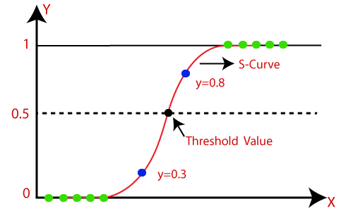
The ‘S’ curve
Instead of fitting a regression line, we fit an "S" shaped logistic function, which predicts two maximum values (0 or 1).
The curve from the logistic function indicates the likelihood of something such as whether the cells are cancerous or not, a mouse is obese or not based on its weight, etc.

Slide 8


How it works
Logistic Regression Equation
The Logistic regression equation can be obtained from the Linear Regression equation. The mathematical steps to get Logistic Regression equations are given below:
We know the equation of the straight line can be written as:
In Logistic Regression, y can be between 0 and 1 only, so for this let's divide the above equation by (1-y):
But we need range between -[infinity] to +[infinity], then take logarithm of the equation it will become:

Slide 10


Assumptions in Logistic Regression
The relationship between the independent variables and the log-odds of the outcome follows a straight line in the logit space. Mathematically, this relationship can be represented as:
p is the probability of the binary outcome (0 ≤ p ≤ 1)
β₀, β₁, β₂, ..., βᵣ are the coefficients for the intercept and each predictor variable (x₁, x₂, ..., xᵣ) respectively.
And p(x)/(1-p(x)) is termed odds.
The left-hand side is called the logit or log-odds function.
The odds are the ratio of the chances of success to the chances of failure.
As a result, in Logistic Regression, a linear combination of inputs is translated to log(odds), with an output of 1.

Slide 11
Assumptions in Logistic Regression
Other considerable Assumptions
Independence of errors: The observations are assumed to be independent of each other.
Little or no multicollinearity: The predictor variables are not highly correlated with each other.
Large sample size: Logistic regression performs well with a sufficient number of observations.

Slide 12
Logistic Regression
Types of Logistic R
 | Binomial LR | Multinomial LR | Ordinal logistic regression
No of categories for response variable | 2 | 3 or more | 3 or more
Does order of categories matter? | NO | NO | YES
Example | If a person is likely to get a positive COVID-19 result or not. | If a person has COVID-19, an allergy, a cold, or the flu. | Sorting the severity of a COVID-19 infection into mild, moderate, or severe.

Slide 13
Binomial and multinomial LR example
Whether or not to lend to a bank customer (outcomes are yes or no).
Assessing cancer risk (outcomes are high or low).
Will a team win tomorrow’s game (outcomes are yes or no).
Classifying texts into what language they come from.
Predicting whether a student will go to college, trade school or into the workforce.
Does your cat prefer wet food, dry food or human food?
Binomial LR
Multinomial LR

Slide 14
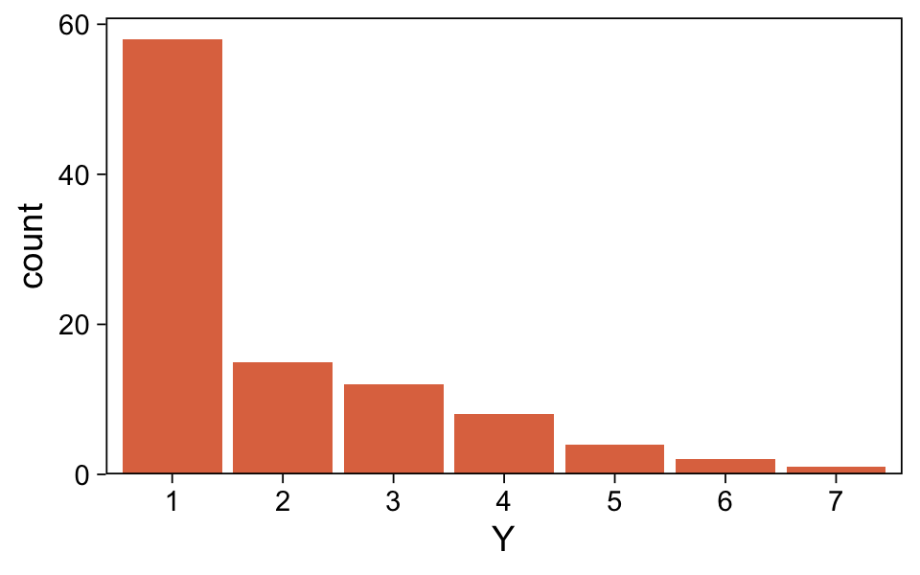
Logistic Regression
Ordinal Regression
Ranking restaurants on a scale of 0 to 5 stars.
Predicting the podium results of an Olympic event.
Assessing a choice of candidates, specifically in places that institute ranked-choice voting.
Ranking students marks on a scale of poor, average, best

Slide 15
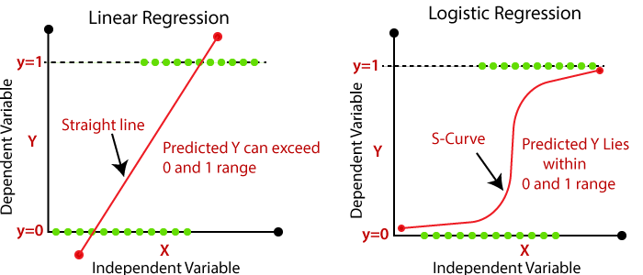
Linear regression vs Logistic Regression

Slide 16
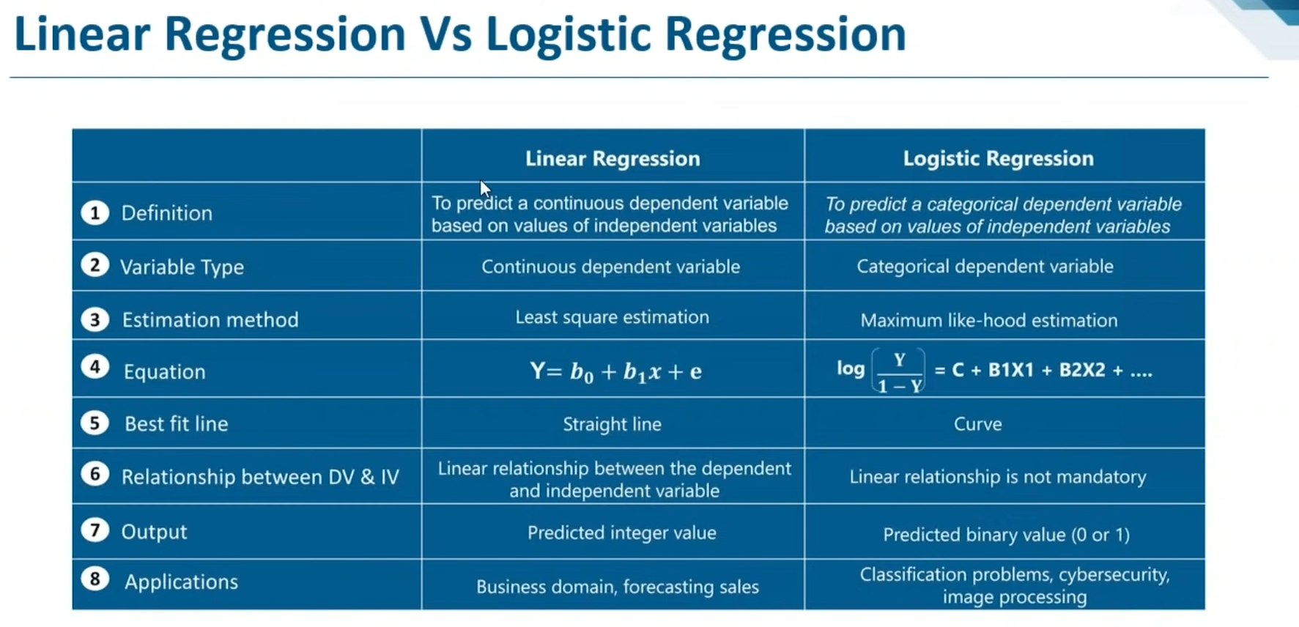

Slide 18

Application of LR
Medicine
Credit scoring
Hotel Booking
Text editing

Slide 19
Application of LR in blockchain
Fraud Detection: Blockchain-based systems often deal with transactions and financial activities. Logistic regression can be used for fraud detection, identifying suspicious transactions, or determining the likelihood of fraudulent behavior based on historical data.
User Authentication: Blockchain networks may implement user access controls. Logistic regression could be employed to assess the probability of a user being genuine or to detect potential unauthorized access based on user behavior patterns.
Market Analysis: For blockchain-based marketplaces or token sales, logistic regression could be used to predict the probability of success for certain projects based on various factors such as team experience, project specifications, market conditions, etc.
Risk Assessment: In blockchain-based lending platforms or insurance systems, logistic regression might be used to assess the risk associated with a particular loan or insurance application.
Sentiment Analysis: Logistic regression can be utilized in sentiment analysis of blockchain-related news, social media posts, or community discussions to gauge the sentiment towards specific projects or tokens.

Slide 20
Application of LR in Fullstack
User Behavior Analysis:.
can be applied to analyze user behavior, such as predicting whether a user will churn or not, whether they will click on a specific element, or whether they will make a purchase.
A/B Testing: Full-stack developers often conduct A/B tests to compare different versions of a website or application.
It can be used to assess the significance of the results and determine which version performs better in terms of user engagement or conversion rate.
Spam Detection: can be used in spam detection systems to classify incoming emails as either spam or non-spam.
Sentiment Analysis: If your full-stack application deals with user-generated content like reviews or comments, sentiment analysis can be performed to determine whether the sentiment expressed is positive or negative.
Recommendation Systems: building recommendation systems by predicting whether a user will like or dislike a particular item based on their previous behavior and preferenc.es
User Authentication: Used in combination with other algorithms for user authentication based on behavior patterns or other characteristics.

Slide 21
Application of LR in DevOps
Anomaly Detection: 1. DevOps teams often deal with large volumes of data from various systems and processes.
2. To build anomaly detection models that help identify unusual behavior or outliers in system logs, performance metrics, or user activities.
1
Quality Assurance and Testing: In software development,
1. It can be employed to create predictive models for software quality assurance and testing.
2. It can help determine whether a software component is likely to pass or fail certain tests based on historical data.
2
Incident Management:
1. It predict the severity of incidents or issues in a system based on certain parameters
2. Allocate resources accordingly.
3
Resource Optimization:
1. Predict resource usage patterns, such as CPU, memory, or network bandwidth.
2. By understanding resource demands, . DevOps teams can optimize infrastructure provisioning and scaling strategies.
4
Continuous Integration and Deployment (CI/CD):
1. Evaluate the success or failure of continuous integration and deployment pipelines based on various factors such as code quality, test coverage, or build times.
5

Slide 22
Further Readings:
1. Logistic regression introduction: https://www.youtube.com/watch?v=wmznPOlEk2k
2. Logistic regression explained: https://www.analyticsvidhya.com/blog/2021/08/conceptual-understanding-of-logistic-regression-for-data-science-beginners/
3. Logistic Regression — Detailed Overview: https://towardsdatascience.com/logistic-regression-detailed-overview-46c4da4303bc
4. Python library requirement: Pythohttps://scikit-learn.org/stable/modules/generated/sklearn.linear_model.LogisticRegression.html
4. StatQuest: Logistic Regression: https://www.youtube.com/watch?v=yIYKR4sgzI8
5. Linear Regression Vs. Logistic Regression: https://www.youtube.com/watch?v=OCwZyYH14uw
6. Linear Regression Vs. Logistic Regression: https://shorturl.at/rsMP9

