Slide 1

Optimization
The process where we train the model iteratively that results in a maximum and minimum function evaluation.
We compare the results in every iteration by changing the hyper parameters in each step until we reach the optimum results.
We create an accurate model with less error rate.
There are different ways using which we can optimize a model. Gradient Descent and Stochastic Gradient Descent Algorithms

Slide 2
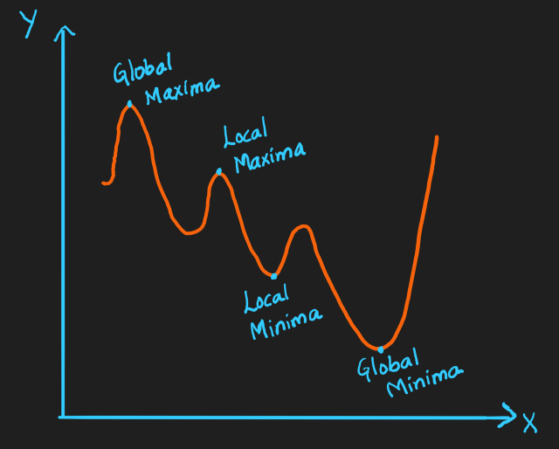
MAXIMA AND MINIMA
Maxima is the largest and Minima is the smallest value of a function within a given range. We represent them as below:
Global Maxima and Minima: It is the maximum value and minimum value respectively on the entire domain of the function
Local Maxima and Minima: It is the maximum value and minimum value respectively of the function within a given range.
There can be only one global minima and maxima but there can be more than one local minima and maxima.

Slide 3
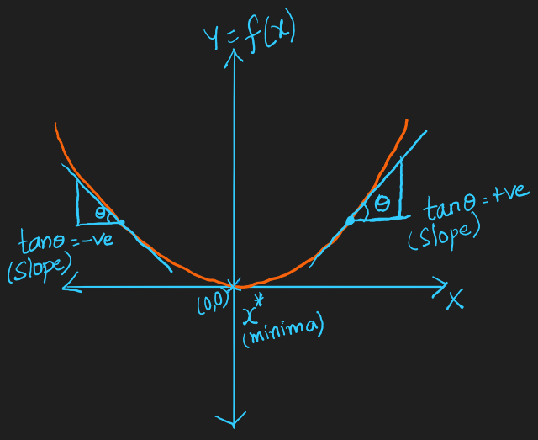
GRADIENT DESCENT
Gradient Descent is an optimization algorithm and it finds out the local minima of a differentiable function. It is a minimization algorithm that minimizes a given function.
Let’s see the geometric intuition of Gradient Descent:

Slide 4
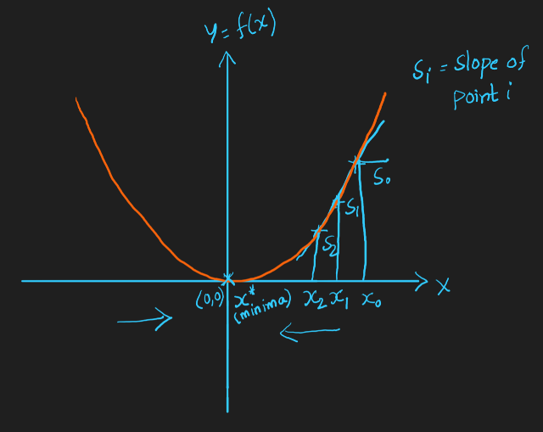
Example
Let’s take an example graph of a parabola, Y=X²
Here, the minima is the origin(0, 0). The slope here is Tanθ.
So the slope on the right side is positive as 0<θ<90 and its Tanθ is a positive value.
The slope on the left side is negative as 90<θ<180 and its Tanθ is a negative value.

Slide 5
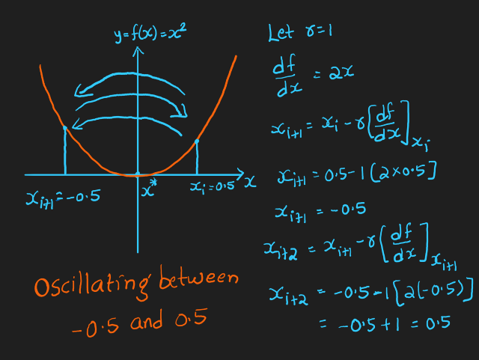
LEARNING RATE
Hyper parameter or tuning parameter that determines the step size at each iteration while moving towards minima in the function.
For example, if r = 0.1 in the initial step, it can be taken as r=0.01 in the next step.
Likewise it can be reduced exponentially as we iterate further. It is used more effectively in deep learning.

Slide 6

What happens if we keep r value as constant:
In the above example, we took r=1. As we calculate the points Xᵢ, Xᵢ+₁, Xᵢ+₂,….to find the local minima, X*, we can see that it is oscillating between X = -0.5 and X = 0.5.
When we keep r as constant, we end up with an oscillation problem. So, we have to reduce the “r” value with each iteration. Reduce the r value as the iteration step increases.

Slide 7
Hyper parameters
Hyper parameters decide the bias-variance tradeoff. When r value is low, it could overfit the model and cause high variance. When r value is high, it could underfit the model and cause high bias.
We can find the correct r value with Cross Validation technique. Plot a graph with different learning rates and check for the training loss with each value and choose the one with minimum loss.

Slide 8
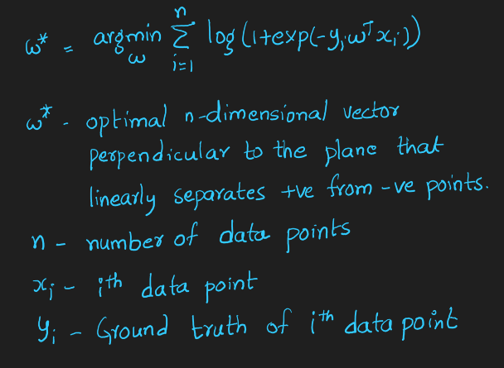
GRADIENT DESCENT IN LOGISTIC REGRESSION
The formula for the optimal plane in logistic regression after applying sigmoid function is:

Slide 9
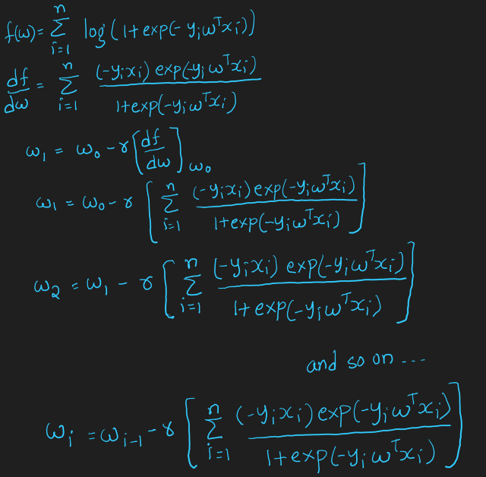
Apply Gradient Descent Algorithm on Logistic Regression:

Slide 10
Disadvantage of Gradient Descent:
We’ll calculate W₀, W₁, W₂, …., Wᵢ-₁, Wᵢ to find W*. When (Wᵢ-₁ — Wᵢ) is small i.e., when Wᵢ-₁, Wᵢ converge, we declare W* = Wᵢ
When n(number of data points) is large, the time it takes for k iterations to calculate the optimum vector becomes very large.
Time Complexity: O(kn²)
This problem is solved with Stochastic Gradient Descent and is discussed in the next section.

