Slide 1
Artificial Intelligence & Machine Learning
TEXTBOOKS/LEARNING RESOURCES:
a) Masashi Sugiyama, Introduction to Statistical Machine Learning (1st ed.), Morgan Kaufmann, 2017. ISBN 978-0128021217.
b) T. M. Mitchell, Machine Learning (1st ed.), McGraw Hill, 2017. ISBN 978-1259096952.
REFERENCE BOOKS/LEARNING RESOURCES:
a) Richard Golden, Statistical Machine Learning A Unified Framework (1st ed.), unknown, 2020.

Slide 2
UNIT - 3
Overfitting Problem
Regularization (Ridge, Lasso, Elastic)
Dropout and Early Stopping

Slide 3
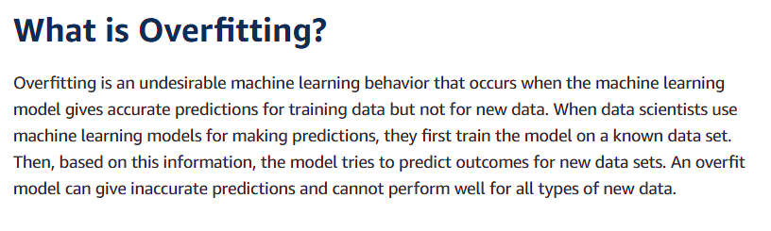



Overfitting Problem
Why does overfitting occur?
The training data size is too small and does not contain enough data samples to accurately represent all possible input data values.
The training data contains large amounts of irrelevant information, called noisy data.
The model trains for too long on a single sample set of data.
The model complexity is high, so it learns the noise within the training data.

Slide 4















Overfitting Problem
Overfitting Examples Consider a use case where a machine learning model has to analyze photos and identify the ones that contain dogs in them. If the machine learning model was trained on a data set that contained majority photos showing dogs outside in parks , it may may learn to use grass as a feature for classification and may not recognize a dog inside a room.

Slide 5
Overfitting Problem
How to prevent overfitting?
You can prevent overfitting by diversifying and scaling your training data set or using some strategies like:
Early stopping
Early stopping pauses the training phase before the machine learning model learns the noise in the data. However, getting the timing right is important; else the model will still not give accurate results.
Pruning
You might identify several features or parameters that impact the final prediction when you build a model. Feature selection—or pruning—identifies the most important features within the training set and eliminates irrelevant ones. For example, to predict if an image is an animal or human, you can look at various input parameters like face shape, ear position, body structure, etc. You may prioritize face shape and ignore the shape of the eyes.

Slide 6
Overfitting Problem
How to prevent overfitting?
You can prevent overfitting by diversifying and scaling your training data set or using some strategies like:
Regularization (Ridge/Lasso/Elastic/Dropout)
Regularization is a collection of training/optimization techniques that seek to reduce overfitting. These methods try to eliminate those factors that do not impact the prediction outcomes by grading features based on importance. For example, mathematical calculations apply a penalty value to features with minimal impact.
Ensembling
Ensembling combines predictions from several separate machine learning algorithms. Some models are called weak learners because their results are often inaccurate. Ensemble methods combine all the weak learners to get more accurate results. The two main ensemble methods are bagging and boosting. Boosting trains different machine learning models one after another to get the final result, while bagging trains them in parallel.

Slide 7

Overfitting Problem
How to prevent overfitting?
You can prevent overfitting by diversifying and scaling your training data set or using some strategies like:
Lasso Regularization/ L1 regularization
It stands for Least Absolute and Selection Operator.
It added the penalty term contains only the “absolute weights” .
Since it takes absolute values, hence, it can shrink the slope to 0, whereas Ridge Regression can only shrink it near to 0.
So, our L1 regularization technique would assign the less signification feature with a zero weight, if it doesn’t have a significant effect on the prediction of our target column.

Slide 8


Overfitting Problem
How to prevent overfitting?
You can prevent overfitting by diversifying and scaling your training data set or using some strategies like:
Ridge Regularization/L2 regularization
A Ridge regressor is basically a regularized version of a Linear Regressor. i.e to the original cost function of linear regressor, we add a regularized term that forces the learning algorithm to fit the data and helps to keep the weights lower as possible.
Adds “squared magnitude)” of coefficient (square of weights) as penalty term to the loss function. Here the highlighted outline part represents L2 regularization element.
If lambda is zero, then it get back to OLS (ordinary linear regression).
If lambda is very large, then it will add too much weight and it will lead to under-fitting.
“It’s important how lambda is chosen. This technique works very well to avoid over-fitting issue”.

Slide 9
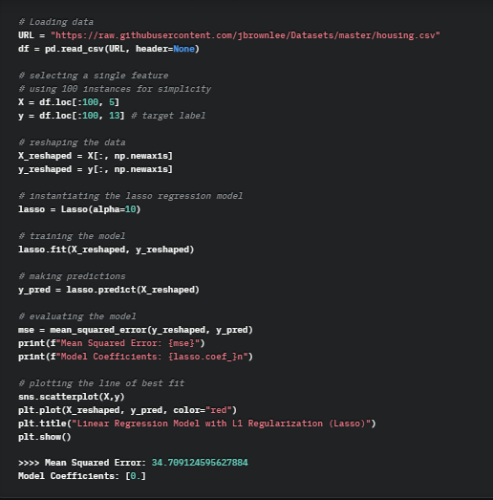
L1 Regularisation

Slide 10
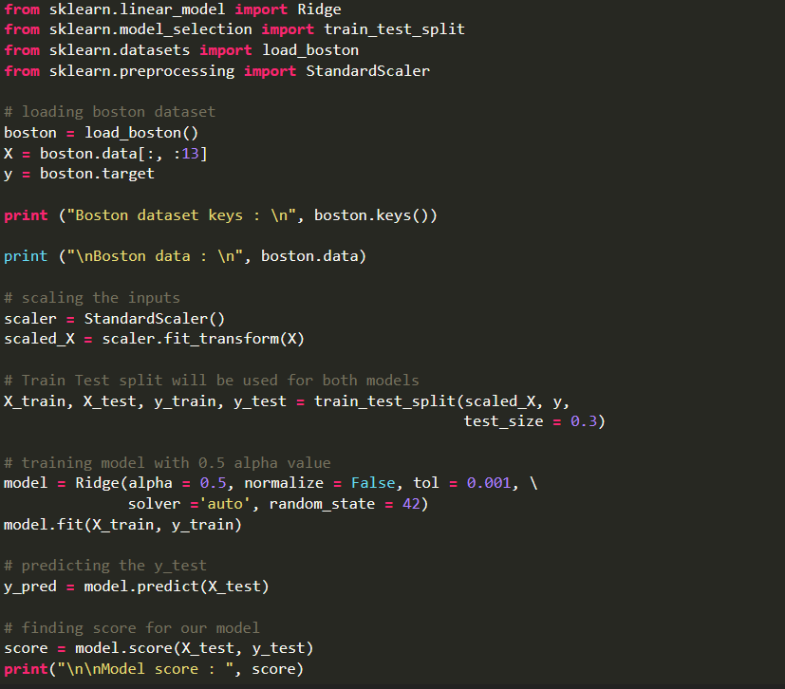
L2 Regularisation

Slide 11
Out of the Box Question
L1 and L2 Regularization. Why are they named so?
The names "L1" and "L2" come from the norm used to calculate the regularization term.
In L1 regularization, the norm used is the L1 norm, which is the sum of the absolute values of the elements.
In L2 regularization, the norm used is the L2 norm, which is the square root of the sum of the squared values of the elements.
These norms are commonly used in mathematics, and they determine the type of regularization applied to the model.

Slide 12
Overfitting Problem
How to prevent overfitting?
You can prevent overfitting by diversifying and scaling your training data set or using some strategies like:
Elastic Regularization (Combination of both Ridge and Lasso)
Elastic regularization is a combination of both L1 (Lasso) and L2 (Ridge) regularization techniques.
Elastic adds both L1 and L2 penalty terms alpha (α) and lambda (λ) to the loss function during training, allowing for a more flexible and balanced approach to regularization.
It address some of the limitations of each individual regularization method.
Elastic Net is particularly useful when dealing with high-dimensional datasets or datasets where many features may be correlated.

Slide 13
How the penalty is calculated in any cost function
In L1 and L2 regularization, the penalty term (often denoted as α or λ, depending on notation) is a hyperparameter need to specify before training the model. It controls the strength of regularization.
The larger the value of α or λ, the stronger the regularization effect.
We can typically choose and calculate the penalty term for L1 and L2 regularization:
L1 Regularization (Lasso):
In L1 regularization, it aims to minimize the defined cost function:
Cost(L1) = Cost(Original) + λ * Σ|θ_i|
λ is the regularization parameter for L1 regularization.
You need to choose an appropriate value for λ through techniques like cross-validation or grid search.
Common values to try for λ include a range of positive values, often in a logarithmic scale (e.g., 0.001, 0.01, 0.1, 1, 10).

Slide 14
How the penalty is calculated in any cost function
L2 Regularization (Ridge):
In L2 regularization, it aims to minimize the following cost function:
Cost(L2) = Cost(Original) + λ * Σ(θ_i^2)
λ is the regularization parameter for L2 regularization.
We need to choose an appropriate value for λ through techniques like cross-validation or grid search.
Common values for λ in L2 regularization also include a range of positive values, often in a logarithmic scale.
Selection of γ:
The choice of λ depends on your specific problem and dataset.
You typically start with a broad search over a range of λ values, and you can use techniques like k-fold cross-validation to evaluate how well your model performs for each value of λ.
The value of λ that results in the best model performance (e.g., lowest validation error) is typically chosen.
Keep in mind that the appropriate value of γ can vary from one problem to another, so it's essential to experiment with different values to find the one that balances model complexity (number and magnitude of coefficients) and model accuracy effectively.

Slide 15
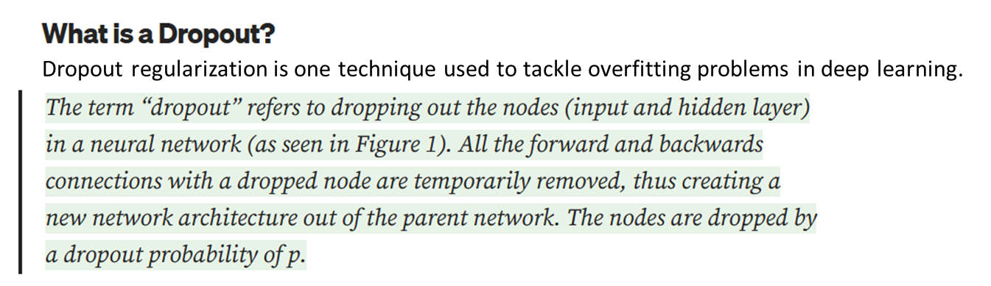
Overfitting Problem
How to prevent overfitting?
You can prevent overfitting by diversifying and scaling your training data set or using some strategies like:

Slide 16
NOTES : Regularisation Techniques
Regularization is a set of techniques used in machine learning and statistical modeling to prevent overfitting and improve the generalization performance of a model.
Regularization methods introduce a penalty term into the model's objective function, encouraging it to have simpler and more stable patterns that generalize better to new data.
There are several common types of regularization techniques used in machine learning, including:
L1 Regularization (Lasso): L1 regularization adds a penalty term to the model's objective function that is proportional to the absolute values of the model's coefficients. It encourages the model to have sparse feature weights, effectively selecting a subset of the most important features while setting others to zero. L1 regularization is useful for feature selection.
L2 Regularization (Ridge): L2 regularization adds a penalty term to the objective function that is proportional to the squared values of the model's coefficients. It encourages the model to have small, evenly distributed feature weights. L2 regularization helps prevent large coefficients that might lead to overfitting.
Elastic Net Regularization: Elastic Net is a combination of L1 and L2 regularization. It adds both L1 and L2 penalty terms to the objective function, allowing for feature selection and coefficient shrinkage. Elastic Net is useful when there are many features, and some of them are highly correlated.

Slide 17
NOTES : Regularisation Techniques
Data Augmentation: Data augmentation is a regularization technique used primarily in computer vision. It involves generating new training examples by applying various transformations (e.g., rotation, translation, cropping) to the existing data. This helps the model generalize better by exposing it to more diverse variations of the data.
Pruning (for Decision Trees): Pruning is a regularization technique for decision trees. It involves removing branches or nodes from a decision tree that do not significantly improve the model's performance. Pruning prevents the tree from becoming too deep and complex.
The choice of regularization technique and the strength of regularization (controlled by hyperparameters like regularization strength or dropout rate) depend on the specific problem and the characteristics of the data.
Regularization is a crucial tool for achieving better model performance and preventing overfitting in various machine learning algorithms.
Dropout (for Neural Networks): Dropout is a regularization technique specifically used in neural networks. During training, dropout randomly deactivates a fraction of neurons (units) in a neural network, effectively preventing the network from relying too heavily on any one neuron or feature. This encourages the network to learn more robust and generalizable representations.
Early Stopping: Early stopping is a regularization technique that stops the training process when the model's performance on a validation dataset starts to degrade. It prevents the model from continuing to learn the noise in the training data.

Slide 18
References:
https://www.edureka.co/blog/regularization-in-machine-learning/
https://www.dataquest.io/blog/regularization-in-machine-learning/
https://www.mygreatlearning.com/blog/what-is-ridge-regression/
https://neptune.ai/blog/fighting-overfitting-with-l1-or-l2-regularization

