Slide 1
Artificial Intelligence & Machine Learning
TEXTBOOKS/LEARNING RESOURCES:
a) Masashi Sugiyama, Introduction to Statistical Machine Learning (1st ed.), Morgan Kaufmann, 2017. ISBN 978-0128021217.
b) T. M. Mitchell, Machine Learning (1st ed.), McGraw Hill, 2017. ISBN 978-1259096952.
REFERENCE BOOKS/LEARNING RESOURCES:
a) Richard Golden, Statistical Machine Learning A Unified Framework (1st ed.), unknown, 2020.

Slide 2
Optimization
Gradient Descent
Stochastic Gradient Descent

Slide 3

Optimization
The process where we train the model iteratively that results in a maximum and minimum function evaluation.
We compare the results in every iteration by changing the hyper parameters in each step until we reach the optimum results.
We create an accurate model with less error rate.
There are different ways using which we can optimize a model. Gradient Descent and Stochastic Gradient Descent Algorithms

Slide 4
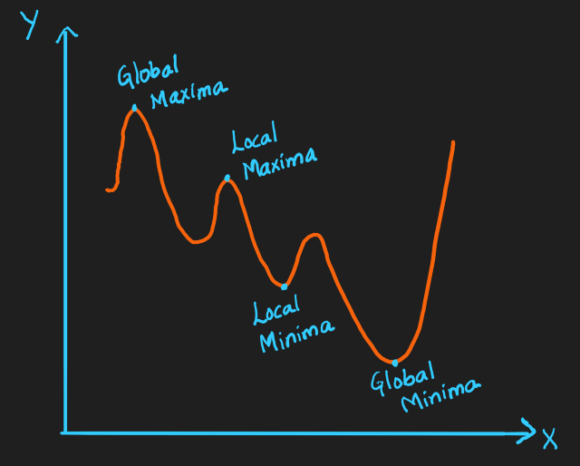
MAXIMA AND MINIMA
Maxima is the largest and Minima is the smallest value of a function within a given range. We represent them as below:
Global Maxima and Minima: It is the maximum value and minimum value respectively on the entire domain of the function
Local Maxima and Minima: It is the maximum value and minimum value respectively of the function within a given range.
There can be only one global minima and maxima but there can be more than one local minima and maxima.

Slide 5
Loss functions
Loss functions (also known as cost/error functions) help us evaluate how well a model performs when it comes to predictions.
Optimization helps us to systematically and iteratively minimize the loss and obtain a model that can generalize well on the data and therefore predict accurately.
Two of the most common optimization algorithms used to minimize the loss function in a machine learning or deep learning model are:
Gradient descent
Stochastic gradient descent

Slide 6
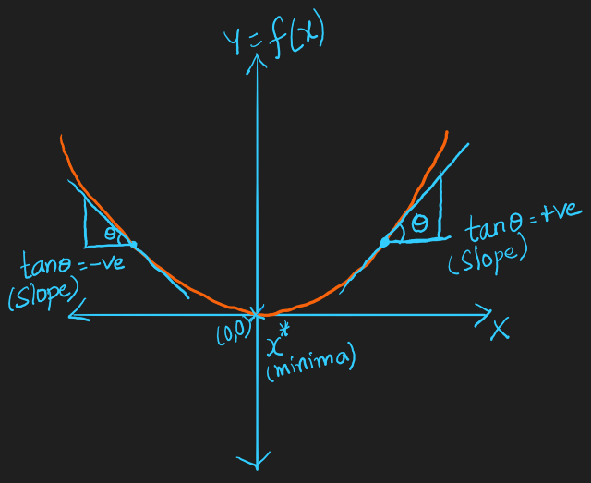
GRADIENT DESCENT
Gradient Descent is an optimization algorithm and it finds out the local minima of a differentiable function. It is a minimization algorithm that minimizes a given function.
Let’s see the geometric intuition of Gradient Descent:

Slide 7
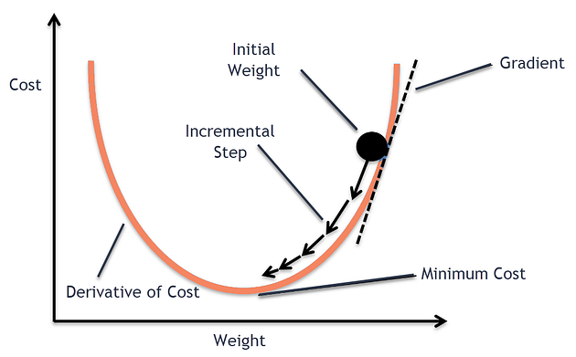
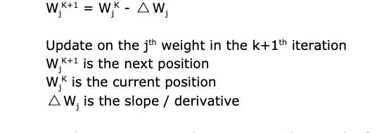
What is gradient descent?
Gradient descent is an algorithm to find the minimum of a function.
In machine learning, the difference between the predicted and the actual value is called error.
All error, across all datapoints, when added together is known as the cost.
Naturally, we would want to minimize the function that represents this cost — Cost Function.
When the cost function cannot be differentiated easily Gradient Descent does the job for us.

Slide 8
Why Gradient Descent??
It is easy to find the value of slope and intercept using a closed-form solution
But when you work in Multidimensional data then the technique is so costly and takes a lot of time Thus it fails here.
So, the new technique came as Gradient Descent which finds the minimum very fast.
Its not only up to linear regression but it is an algorithm that can be applied on any machine learning part including logistic regression, and it is the complete backbone of deep learning.

Slide 9
Where in Machine Learning does Gradient Descent figure out?
Gradient descent figures in the training phase of any machine learning algorithm.
It is a very popular method to tune the parameters of a machine learning model — so as to attain the minimum error state.
"A gradient measures how much the output of a function
changes if you change the inputs a little bit."
In machine learning, a gradient is a derivative of a function that has more than one input variable. Known as the slope of a function in mathematical terms, the gradient simply measures the change in all weights with regard to the change in error.

Slide 10

Where in Machine Learning does Gradient Descent figure out?
Gradient descent figures in the training phase of any machine learning algorithm.
It is a very popular method to tune the parameters of a machine learning model — so as to attain the minimum error state.
"A gradient measures how much the output of a function
changes if you change the inputs a little bit."
In machine learning, a gradient is a derivative of a function that has more than one input variable. Known as the slope of a function in mathematical terms, the gradient simply measures the change in all weights with regard to the change in error.

Slide 11
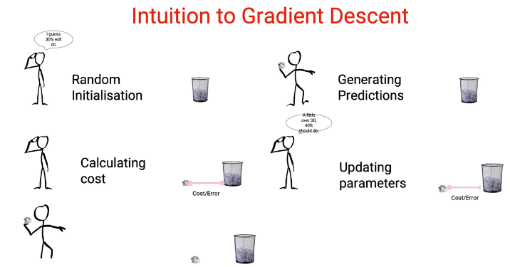
GRADIENT DESCENT

Slide 12
“Tuning the parameters until the cost function is at its minimum”

Slide 13
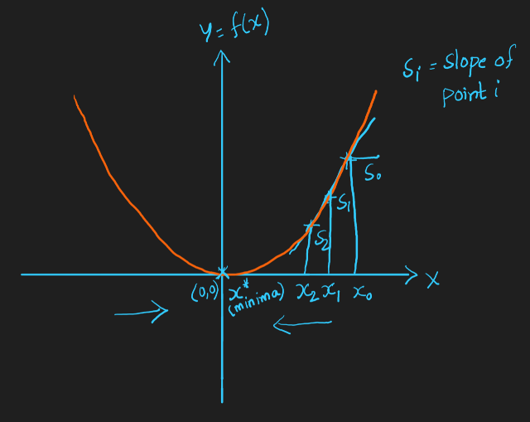
Example
Let’s take an example graph of a parabola, Y=X²
Here, the minima is the origin(0, 0). The slope here is Tanθ.
So the slope on the right side is positive as 0<θ<90 and its Tanθ is a positive value.
The slope on the left side is negative as 90<θ<180 and its Tanθ is a negative value.

Slide 14
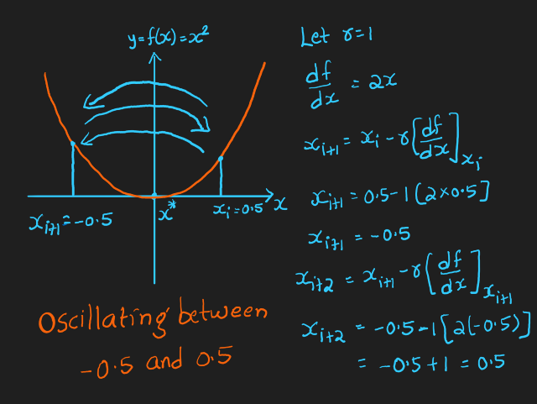
LEARNING RATE
Hyper parameter or tuning parameter that determines the step size at each iteration while moving towards minima in the function.
For example, if r = 0.1 in the initial step, it can be taken as r=0.01 in the next step.
Likewise it can be reduced exponentially as we iterate further. It is used more effectively in deep learning.

Slide 15

Steps of the algorithm
Find the slope of the objective function with respect to each parameter/feature. In other words, compute the gradient of the function.
Pick a random initial value for the parameters. (To clarify, in the parabola example, differentiate “y” with respect to “x”. If we had more features like x1, x2 etc., we take the partial derivative of “y” with respect to each of the features.)
Update the gradient function by plugging in the parameter values.
Calculate the step sizes for each feature as : step size = gradient * learning rate.
Calculate the new parameters as : new params = old params -step size
Repeat steps 3 to 5 until gradient is almost 0.

Slide 16

What happens if we keep r value as constant:
In the above example, we took r=1. As we calculate the points Xᵢ, Xᵢ+₁, Xᵢ+₂,….to find the local minima, X*, we can see that it is oscillating between X = -0.5 and X = 0.5.
When we keep r as constant, we end up with an oscillation problem. So, we have to reduce the “r” value with each iteration. Reduce the r value as the iteration step increases.

Slide 17
Hyper parameters
Hyper parameters decide the bias-variance tradeoff. When r value is low, it could overfit the model and cause high variance. When r value is high, it could underfit the model and cause high bias.
We can find the correct r value with Cross Validation technique. Plot a graph with different learning rates and check for the training loss with each value and choose the one with minimum loss.

Slide 18
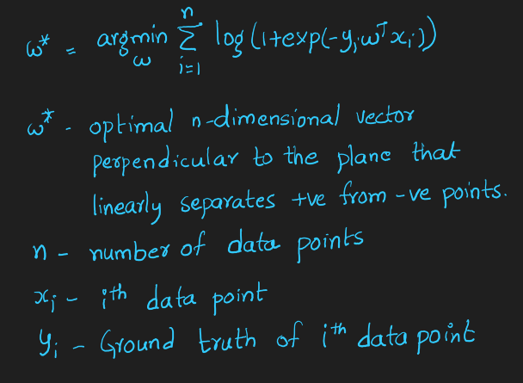
GRADIENT DESCENT IN LOGISTIC REGRESSION
The formula for the optimal plane in logistic regression after applying sigmoid function is:

Slide 19
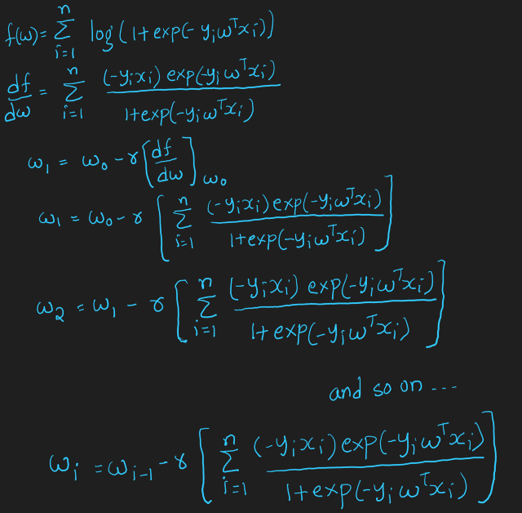
Apply Gradient Descent Algorithm on Logistic Regression:

Slide 20
Disadvantage of Gradient Descent:
We’ll calculate W₀, W₁, W₂, …., Wᵢ-₁, Wᵢ to find W*. When (Wᵢ-₁ — Wᵢ) is small i.e., when Wᵢ-₁, Wᵢ converge, we declare W* = Wᵢ
When n(number of data points) is large, the time it takes for k iterations to calculate the optimum vector becomes very large.
Time Complexity: O(kn²)
This problem is solved with Stochastic Gradient Descent and is discussed in the next section.

Slide 21

Stochastic Gradient Descent “Stochastic”, in plain terms means “random”.
One training sample (example) is passed through the neural network at a time and the parameters (weights) of each layer are updated with the computed gradient.
So, at a time a single training sample is passed through the network and its corresponding loss is computed.
The parameters of all the layers of the network are updated after every training sample.
For example, if the training set contains 100 samples, then the parameters are updated 100 times that is one time after every individual example is passed through the network. Following is the gradient descent equation and for stochastic gradient descent it is iterated over ’n’ times for ’n’ training samples in the training set.
Here,
(Theta(j)) corresponds to the parameter
(alpha) is the learning rate that is the step size multiplied by the derivative of the function by which to move on the loss function curve toward the minima.

Slide 22
Advantages of Stochastic Gradient Descent
It is easier to fit into memory due to a single training sample being processed by the network.
It is computationally fast as only one sample is processed at a time
For larger datasets it can converge faster as it causes updates to the parameters more frequently.
Due to frequent updates the steps taken towards the minima of the loss function have oscillations which can help getting out of local minimums of the loss function (in case the computed position turns out to be the local minimum)

Slide 23
Disadvantages of Stochastic Gradient Descent
Due to frequent updates the steps taken towards the minima are very noisy. This can often lead the gradient descent into other directions.
Also, due to noisy steps it may take longer to achieve convergence to the minima of the loss function
Frequent updates are computationally expensive due to using all resources for processing one training sample at a time
It loses the advantage of vectorized operations as it deals with only a single example at a time

Slide 24
Further Readings:
Thank You.

