Slide 1
Artificial Intelligence & Machine Learning
TEXTBOOKS/LEARNING RESOURCES:
a) Masashi Sugiyama, Introduction to Statistical Machine Learning (1st ed.), Morgan Kaufmann, 2017. ISBN 978-0128021217.
b) T. M. Mitchell, Machine Learning (1st ed.), McGraw Hill, 2017. ISBN 978-1259096952.
REFERENCE BOOKS/LEARNING RESOURCES:
a) Richard Golden, Statistical Machine Learning A Unified Framework (1st ed.), unknown, 2020.

Slide 2
Decision Tree Classifier

Slide 3
Decision Tree Classifier
Supervisor Agree
Supervised classification technique.
It builds tree like structure where
Node : test on attributes
Branch : Tests outcome
Leaf Node : Class Labels
Decision tree are created using
“Tree Induction Algorithms”
Yes No
Search Other Problem
Dataset Available
Yes No
Can we Collect Dataset?
Select Problem
Yes No
Select Problem
Search Other Problem
Fig. Decision tree for selecting research problem

Slide 4

Decision Tree Classifier
Tree Induction Algorithm
Step1 : Discretize the continuous valued attributes.
For example age can be discretized as:
A - Under 18
B - 18 - 40
C - 41 - 65
D - above 65
Step2 : Split the node by selecting best attribute
Step3 : Stop
a) If all the instance belongs to same class.
b) If there is no remaining attribute to divide further
How we select the Best Attribute ?

Slide 5
Decision Tree Classifier
Finding Best Split Attributes
Assigned some “goodness value” to attributes
Rank attributes based on its goodness value.
Select attributes with highest rank first
Finding Goodness value:
Split Algorithm Based on Information Theory
Split Algorithm Based on Gini Index

Slide 6
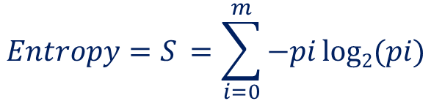
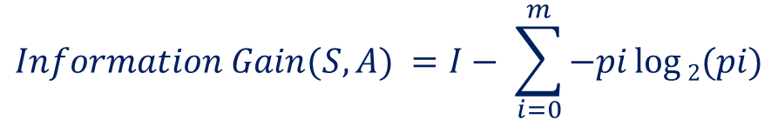
Decision Tree Classifier
Split Algorithm Based on Information Theory [8]
This method is based on the calculation of entropy.
Entropy is minimum - when all values of the target attribute are the same.
Entropy is maximum - when there is an equal chance of all values for the target attribute
$${Entropy=S}_{ }=\sum_{i=0}^{m}{−pi log2⁡(pi})$$
where
p_{i} = Probability of occurrence of attribute value
i = 1, 2, 3, . . . . m (no. of classes)
$${Information Gain(S,A)}_{ }=I− \sum_{i=0}^{m}{−pi log⁡2(pi})$$
where
I = Information before split
A = Attribute

Slide 7
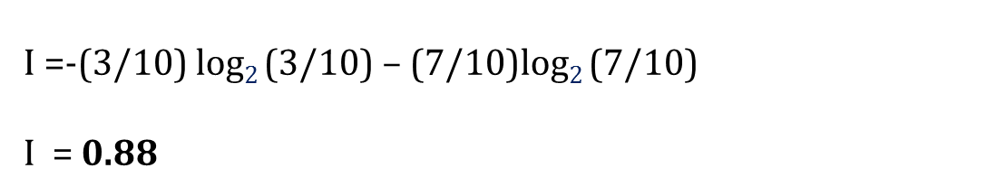
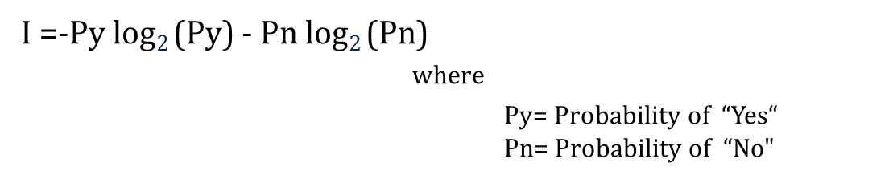
Decision Tree Classifier
Split Algorithm Based on Information Theory
Table: Training sample [7]
Step1: Calculate the information before split
Sample space = 10
Classes
Yes = 3
No = 7
I =-Py log$2$(Py) - Pn log$2$(Pn)
where
Py= Probability of “Yes“
Pn= Probability of “No"
I =-(3/10) log$2$(3/10) – (7/10)log$2$(7/10)
I = 0.88
Information before split

Slide 8


Decision Tree Classifier
Split Algorithm Based on Information Theory
Table: Training sample [7]
Step2: Calculate the information for “Refund”
Refund
Yes = 3
No =7
Yes = 0
No =3
Yes =3
No =4
I(yes) =-(0/3) log$2$(0/3) – (3/3)log$2$(3/3)
I (yes) = 0
I(no) =-(3/7) log$2$(3/7) – (4/7)log$2$(4/7)
I (no) = 0.985
Information (Refund) = (3/10)*(0) + (7/10)*( 0.985)
= 0.69

Slide 9
Decision Tree Classifier
Split Algorithm Based on Information Theory
Table: Training sample [7]
Step3: Calculate the information for “Marital Status”
Marital Status
Single= 4
Married=4
Divorced=2
Yes = 2
No =2
Yes =0
No =4
Yes =1
No =1
I(single) =-(2/4) log$2$(2/4) – (2/4)log$2$(2/4) =1
I(married) =-(0/4) log$2$(0/4) – (4/4)log$2$(4/4) =0
I(divorced) =-(1/2) log$2$(1/2) – (1/2)log$2$(1/2) =1
Information (marital status) = (4/10)*(1) + (4/10)*(0) + (2/10)*(1)
= 0.60

Slide 10
Decision Tree Classifier
Split Algorithm Based on Information Theory
Table: Training sample [7]
Step4: Rank the attributes
Attributes | Information (Before Split) | Information (After Split) | Information Gain
Refund | 0.8812 | 0.69 | 0.1912
Marital Status | 0.8812 | 0.60 | 0.2812
Since marital status has the highest information it will be selected for splitting

Slide 11
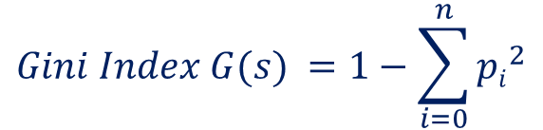
Decision Tree Classifier
Split Algorithm Based on Gini Index [8]
Gini Index is the measure of resource inequality. It varies from 0 to 1.
0 - no uncertainty
1 - maximum uncertainty
$${Gini Index G(s)}_{ }=1−\sum_{i=0}^{n}{{pi}^{2}}$$
where
p_{i} = Relative frequency of class i in data sample
$${Information Gain(S,A)}_{ }=I−G(s)$$
where
I = Information before split

Slide 12
Decision Tree Classifier
Split Algorithm Based on Gini Index
Table: Training sample [7]
Step1: Calculate the information before split
Sample space = 10
Classes
Yes = 3
No = 7
I = 1- (Py)² - (Pn) ²
where
Py= Probability of “Yes“
Pn= Probability of “No"
I =1- (3/10) ² – (7/10)²
I = 0.49
Information before split

Slide 13
Decision Tree Classifier
Split Algorithm Based on Gini Index
Table: Training sample [7]
Step2: Calculate the information for “Refund”
Refund
Yes = 3
No =7
Yes = 0
No =3
Yes =3
No =4
I(yes) =1-(0/3)² – (3/3)²
I (yes) =0
I(no) =1-(3/7)² – (4/7)²
I (no) =0.489
Information (Refund) = (3/10)*(0) + (7/10)*(0.489) = 0.3423

Slide 14
Decision Tree Classifier
Split Algorithm Based on Gini Index
Table: Training sample [7]
Step3: Calculate the information for “Marital Status”
Marital Status
Single= 4
Married=4
Divorced=2
Yes = 2
No =2
Yes =0
No =4
Yes =1
No =1
I(single) =1-(2/4) ² – (2/4) ² = 0.5
I(married) =1-(0/4) ² – (4/4) ² =0
I(divorced) =1-(1/2) ² – (1/2) ² =1
Information (marital status) = (4/10)*(0.5) + (4/10)*(0) + (2/10)*(1) = 0.4

Slide 15
Decision Tree Classifier
Split Algorithm Based on Gini Index
Table: Training sample [7]
Step4: Rank the attributes
Attributes | Gini Index (Before Split) | Gini Index (After Split) | Information Gain
Refund | 0.49 | 0.3423 | 0.1477
Marital Status | 0.49 | 0.4 | 0.09
Since Refund has the highest information it will be selected for splitting

Slide 16
Decision Tree Classifier
Advantages
Easy to understand
Easy to generate rules
Disadvantages
Problem in handling numeric data
Large data generates Complex tree
Need expensive training

Slide 17
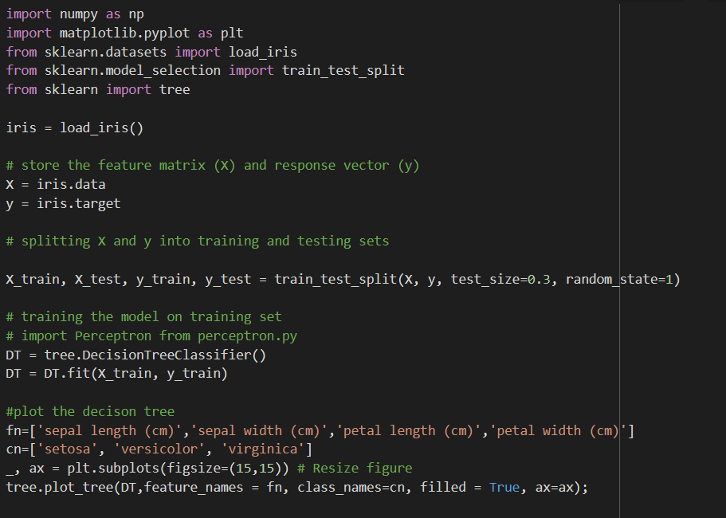
Decision Tree Classifier
fig
We ca save the image file by fig.savefig('imagename.png')

Slide 18
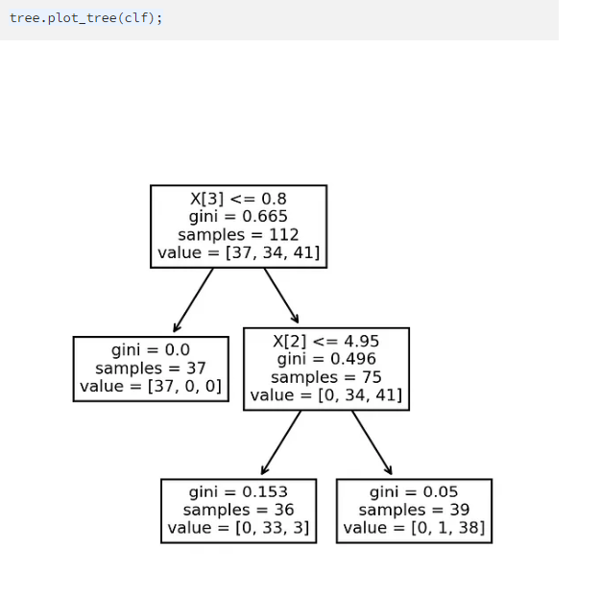
Decision Tree Classifier

Slide 19
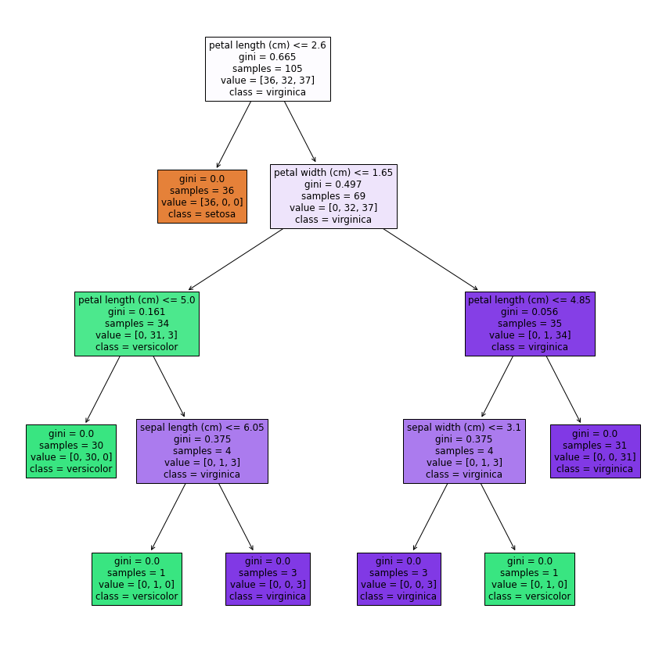
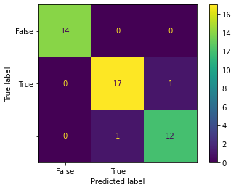
Decision Tree Classifier

Slide 20
Issues in Decision Tree Classifier
Overfitting
Instability
Bias towards dominant features
Lack of smoothness
Limited expressiveness
Difficulty handling irrelevant features
Imbalanced datasets
High variance
Greedy nature
Difficulty with continuous variables

Slide 21
Thank You.

