Slide 1
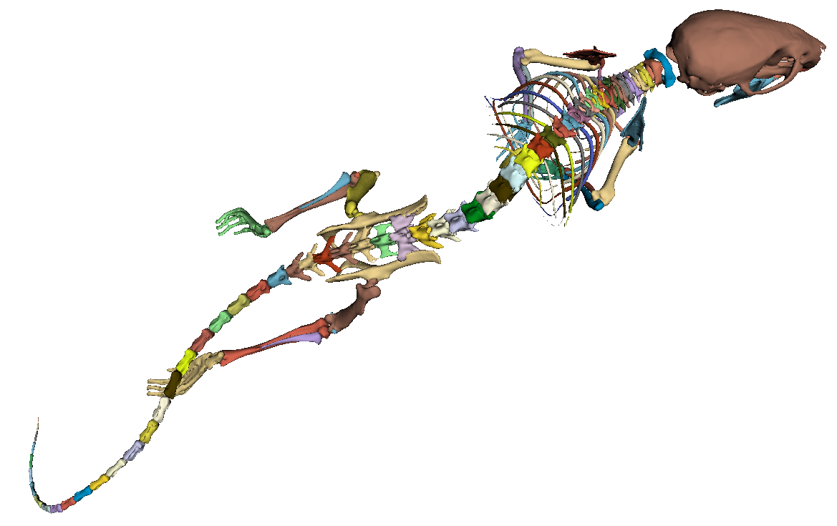
Development and evaluation
of a bone anatomy segmentation guide
for micro-CT in mice
Stefan Rohrbacher, BSc^{1,2}
Supervisor: Dipl.-Ing. Michael Rauter¹
¹ University of Applied Sciences Wiener Neustadt, Master’s programme MedTech - Functional Imaging, Conventional and Ion Radiotherapy ² Diagnostikum Graz Süd West GmbH, Graz
Introduction
Results
Anatomical segmentation is a common task in microscopic computed tomography (micro-CT) studies. Segmentation quality and accuracy strongly depend on the tools chosen and operator experience [1]. Therefore, it is important to educate newcomers to the field in the basics of micro-CT segmentation.
Fig. 1: Fully segmented mouse skeleton [2]
Fig. 3: Average segmentation improvement over all testers calculated via the Dice similarity coefficient [2]
Materials and Methods
The aim of this study was to explore potential segmentation workflows, as well as the creation of a guide for performing these segmentations and explaining the process to less experienced operators.
The goal was to answer the research question:
“Does the usage of a segmentation guide improve segmentation quality when used by inexperienced operators?”
Nine micro-CT datasets of mice were segmented by the author and a gold standard segmentation was established.
A guide was created, outlining workflows for bone segmentation.
This guide was handed out to test candidates and they were tasked to use the guide to segment a specific part of a scan volume.
The candidates were asked to perform segmentations first prior to reading the guide and second after reading the guide.
From the results, their accuracy was computed by comparing the results of each test candidate with the gold standard.
Dice similarity coefficient and Hausdorff distance were chosen as a similarity scores.
Fig. 4: Average segmentation improvement over all testers calculated via the Hausdorff distance [2]
Discussion and Limitations
Increased segmentation accuracy was observed if the testers retained information given to them in the guide.
Limitations
No statistical significance due to small sample size (n=7)
No double blind A/B test setup [3]
No standard HU-range for threshold operations was defined [4]
The study has several limitations. Only a small number of testers volunteered to perform the segmentations and return their results. Therefore the study can not claim to provide statistical significance.
Segmentation
Guide creation
unaided segmentation by testers
aided segmentation by testers
Evaluation
Study Flowchart
Conclusion and Outlook
Fig. 2: Study workflow chart [2]
The limited sample size did not allow for a statistically significant demonstration of improvement in the segmentations. However, the results suggest that a larger number of testers would likely show more notable enhancements in segmentation accuracy.
As this master’s thesis could not demonstrate statistically significant results, further research should address the limitations of this study. Such as a having a large sample size of testers, a double blind A/B testing setup and constraining testers to fixed HU ranges.
References
[1] T. Perciano, D. Ushizima, H. Krishnan, D. Parkinson, N. Larson, D. M. Pelt, W. Bethel, F. Zok, and J. Sethian, “Insight into 3D micro-CT data: Exploring segmentation algorithms through performance metrics,” Journal of Synchrotron Radiation, vol. 24, no. 5, pp. 1065–1077, Sep. 1, 2017, issn: 1600-5775. doi:10.1107/S1600577517010955.
[2] Created by the Author, 2024
[3] K. C. Brata and A. H. Brata, “User experience improvement of japanese language mobile learning application through mental model and A/B testing,” International Journal of Electrical and Computer Engineering (IJECE), vol. 10, no. 3, p. 2659, Jun. 1, 2020, issn: 2088-8708, 2088-8708. doi: 10.11591/ijece.v10i3.pp2659-2667.
[4] M. B. Chavez, E. Y. Chu, V. Kram, L. F. De Castro, M. J. Somerman, and B. L. Foster, “Guidelines for Micro–Computed Tomography Analysis of Rodent Dentoalveolar Tissues,” JBMR Plus, vol. 5, no. 3, e10474, Mar. 2021, issn: 2473-4039. doi: 10.1002/jbm4.10474.

