Slide 1
Power Converters
Ubai
20/463263/TK/51255
Power Electronics (TKE215204)
Final Exam Odd Semester 2024
Instructor: Dr.-Ing. Ir. Yohan Fajar Sidik, S.T., M.Eng.

Slide 2
General Instructions :
The simulation is carried out using LTSpice
The outputs of this task are a power point slide, simulation files, and a repository in Github.
Task 1 - DC-DC Step-down Buck Converter
Task 2 - Grid-connected PV Inverter

Slide 3
Task 1: Buck Converter
You have a task to design a buck converter to step down voltage. The detail instructions for your task as follows:
Determine by yourself the specifications of the buck converter. The minimal specifications are the input voltage, the desired output voltage, the switching frequency, the output power, the current ripple, and the voltage ripple.
Determine the inductor value L and the capacitor value C.
Design an open loop control of the buck converter.
Design a closed loop control of the buck converter.
Plot the inductor current and show that the current ripple is in accordance with the design specifications.
Plot the output voltage and show that the voltage ripple is in accordance with the design specifications.

Slide 4
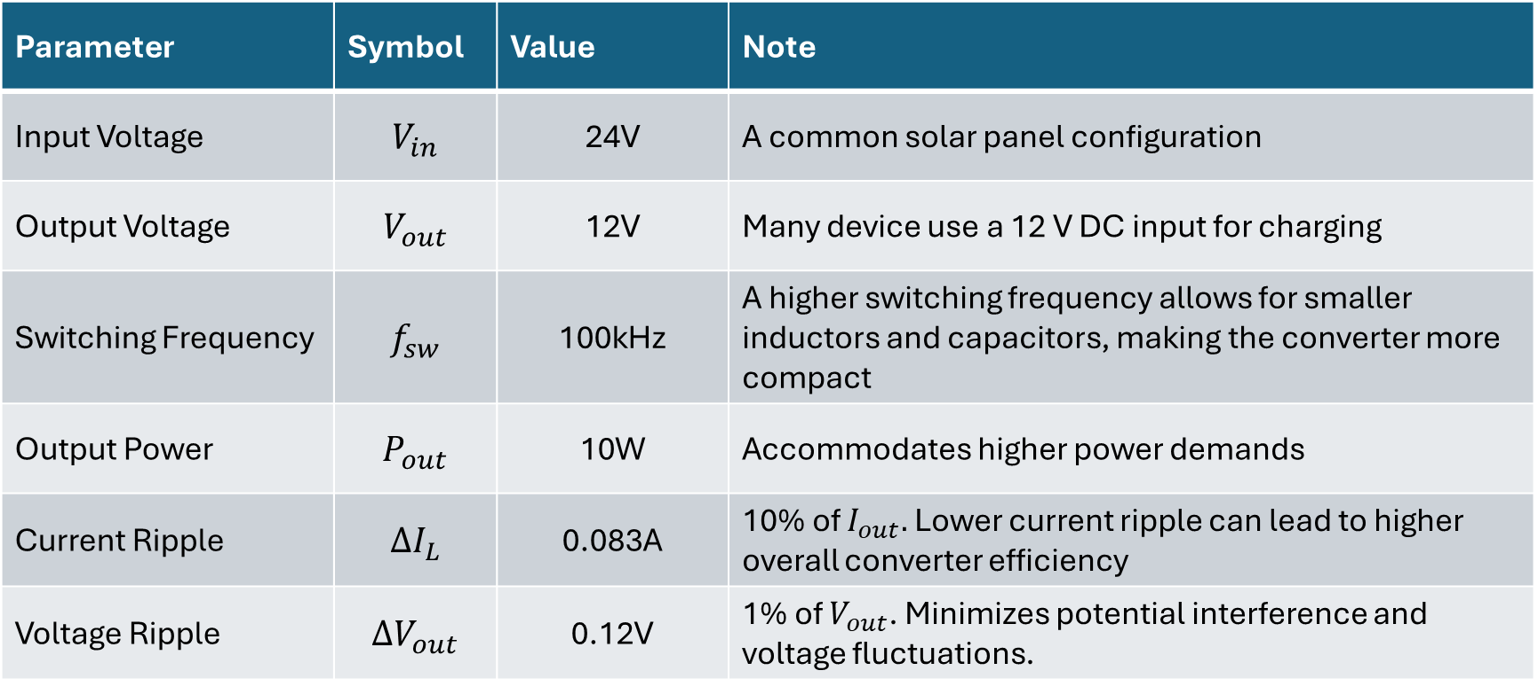
Specifications
Parameter | Symbol | Value | Note
Input Voltage | $$V_{in}$$ | 24V | A common solar panel configuration
Output Voltage | $$V_{out}$$ | 12V | Many device use a 12 V DC input for charging
Switching Frequency | $$f_{sw}$$ | 100kHz | A higher switching frequency allows for smaller inductors and capacitors, making the converter more compact
Output Power | $$P_{out}$$ | 10W | Accommodates higher power demands
Current Ripple | $$∆I_{L}$$ | 0.083A | 10% of $I_{out}.$Lower current ripple can lead to higher overall converter efficiency
Voltage Ripple | $$∆V_{out}$$ | 0.12V | 1% of $V_{out}$. Minimizes potential interference and voltage fluctuations.

Slide 5

Inductor value and the capacitor value
Duty Cycle
$$D=\frac{V_{out}}{V_{in}}≈0.5$$
Output Current
$I_{out}=$ $\frac{P_{out}}{V_{out}}≈0.83\text{A}$
Inductor value
$L=\frac{\left(V_{in}−V_{out}\right)×D }{∆I_{L}×f_{sw}}$ $≈$ $\text{72.29}\text{mH}$
Capacitor value
$C=\frac{I_{out}×D }{∆V_{out}×f_{sw}}$ $≈$ $\text{3}\text{4.58}\text{uF}$

Slide 6

Switch Timing
Period
$$T=\frac{1}{f_{sw}}=\text{10}μ\text{s}$$
Switch on duration
$$T_{ON}=D×T≈\text{5}\text{μs}$$
Switch off duration
$$T_{OFF}=T−T_{ON}≈\text{5}\text{μs}$$

Slide 7
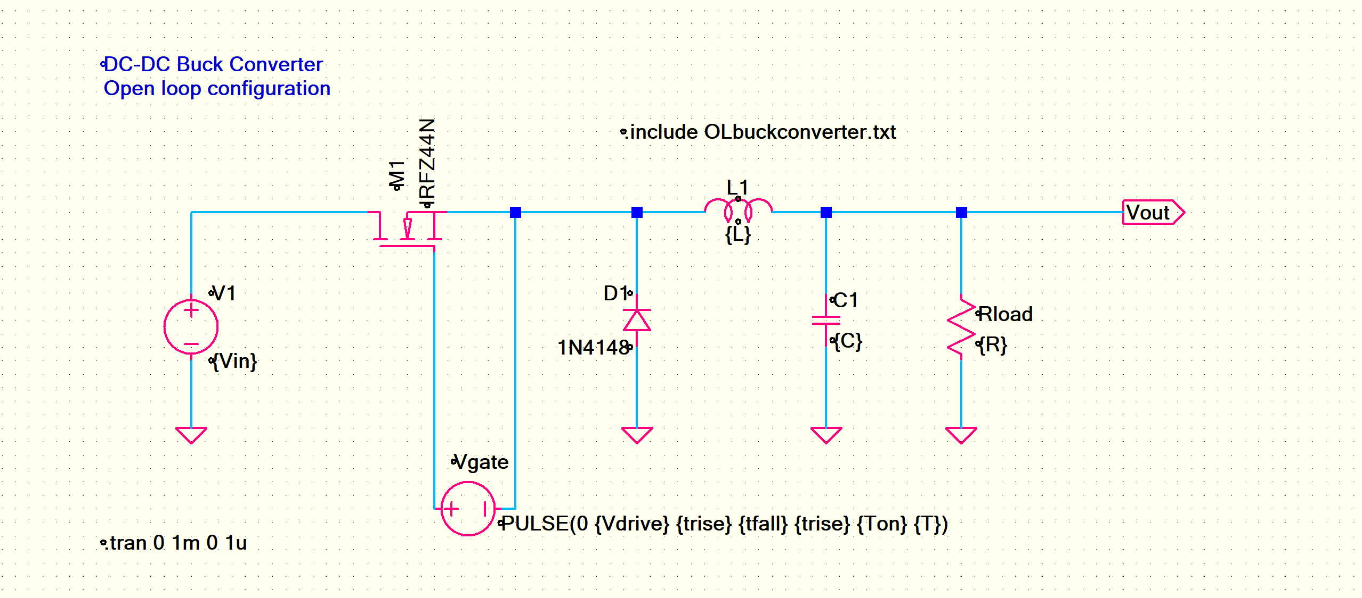
Open Loop Schematic

Slide 8
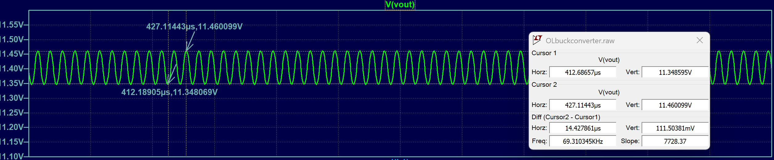
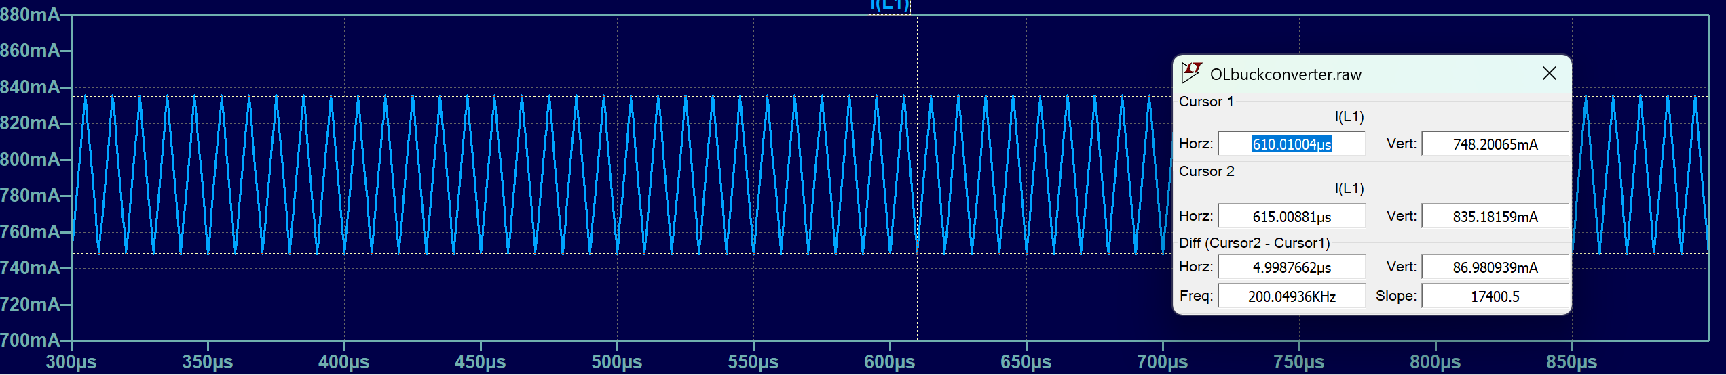
Current Ripple and Voltage Ripple

Slide 9
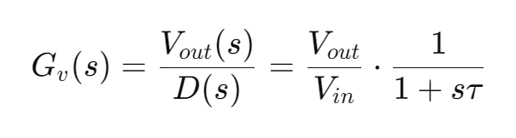

Control System
Time Constant
$$τ≈\frac{L}{R}≈\frac{L×I_{out}}{V_{out}}≈\text{5.02}\text{ms}$$
Gain
$$K=\frac{V_{out}}{V_{in}}=0.5$$

Slide 10
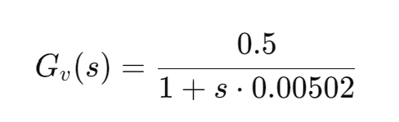
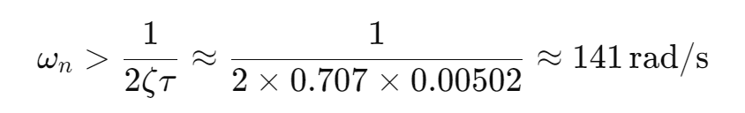
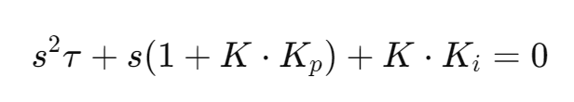
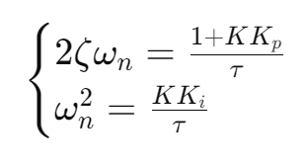
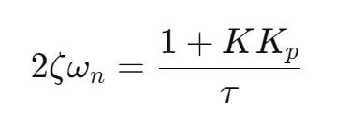
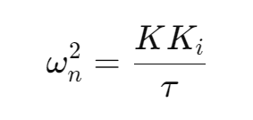
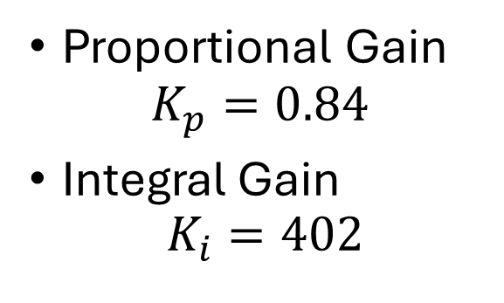
Control System
ωn=200 for a balance between speed and stability.
Proportional Gain
$$K_{p}=0.84$$
Integral Gain
$$K_{i}=402$$

Slide 11
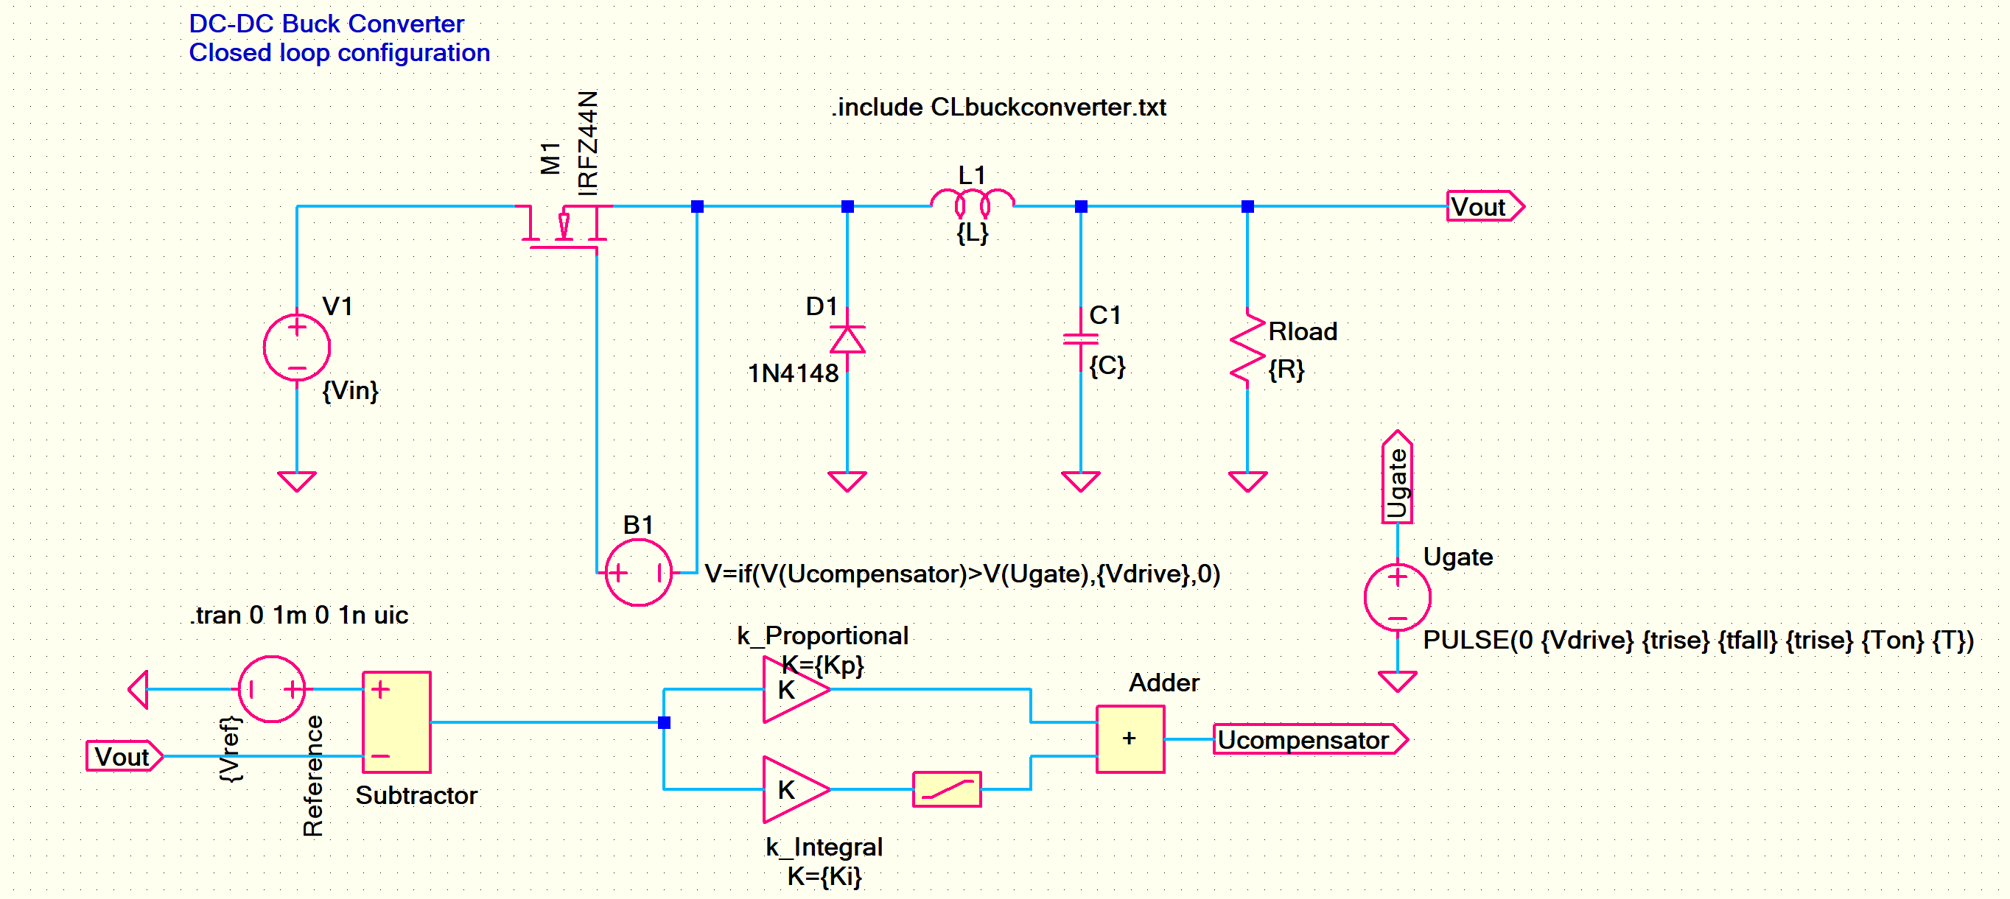
Closed Loop Schematic

Slide 12
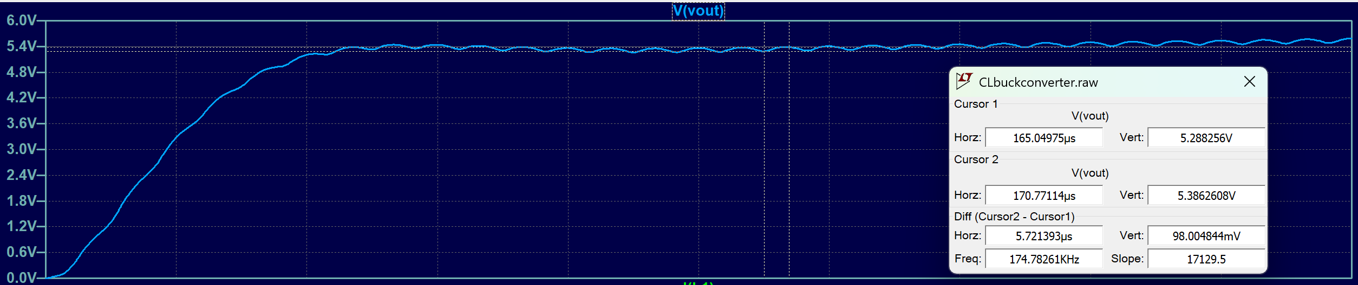
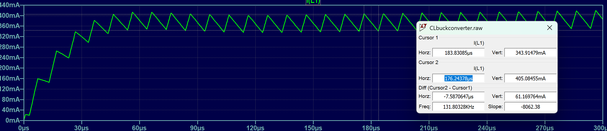
Current Ripple and Voltage Ripple

Slide 13
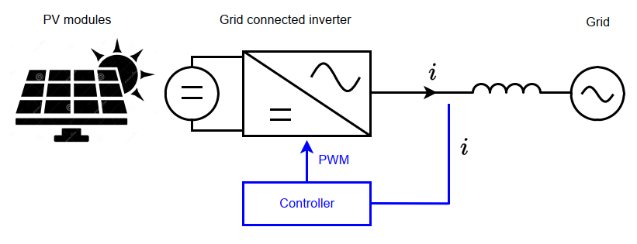
Task 2: grid-connected PV Inverter
You have a task to design a PV grid connected inverter system as shown in Figure 1. The task involves determining inverter specifications, PV module configuration, and designing a control system that can controls the active and reactive power injected to the grid. The detail instructions for your task as follows: Determine by yourself the specifications of the buck converter. The minimal specifications are the input voltage, the desired output voltage, the switching frequency, the output power, the current ripple, and the voltage ripple.
Determine the PV module configuration and its rating such as voltage and current.
Determine the specifications of the inverter. The minimal specifications are dc link voltage, acvoltage, power capacity, semiconductor devices, and modulation technique. Give the reasons to support your specifications.
Determine the inductor value L connecting the inverter and the grid. Support your answer by providing a graph of a vector analysis of the system.
Design a control system that can controls the active and reactive power injected to the grid. Draw your control system design using control block diagrams. Provide as well the method to compute controller gain parameters such as Kp and Ki.
Plot currents in dq-domain and show that the currents can be controlled. You need to compare the reference currents and the measured currents.
Plot the phase and the line voltage of the inverter in time and frequency domain. For frequency domain analysis, you need to perform Fast Fourier Transform (FFT) to the signal in the time domain.
Provide the case when your system experiences the overmodulated. What is the effect of the overmodulation of the controller? support your answer by your simulation result..

Slide 14
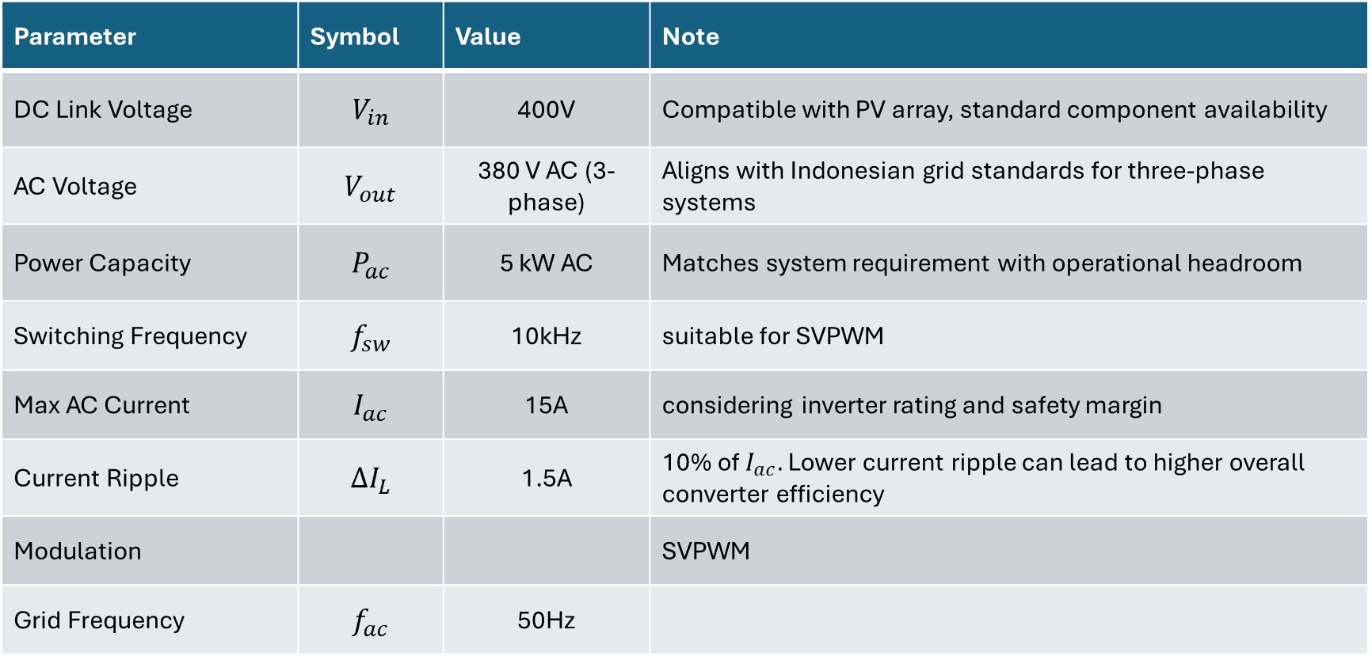
Inverter Specification
Parameter | Symbol | Value | Note
DC Link Voltage | $$V_{in}$$ | 400V | Compatible with PV array, standard component availability
AC Voltage | $$V_{out}$$ | 380 V AC (3-phase) | Aligns with Indonesian grid standards for three-phase systems
Power Capacity | $$P_{ac}$$ | 5 kW AC | Matches system requirement with operational headroom
Switching Frequency | $$f_{sw}$$ | 10kHz | suitable for SVPWM
Max AC Current | $$I_{ac}$$ | 15A | considering inverter rating and safety margin
Current Ripple | $$∆I_{L}$$ | 1.5A | 10% of $I_{ac}.$Lower current ripple can lead to higher overall converter efficiency
Modulation |  |  | SVPWM
Grid Frequency | $$f_{ac}$$ | 50Hz

Slide 15
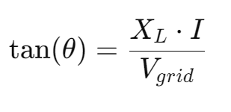

Inductor Filter value
$L=\frac{V_{dc}}{∆I_{L}×f_{sw}}≈27mH$
Inductor reactance
Grid voltage Represented as a horizontal phasor (reference axis) at 380 V AC.
θ = 0°: Active power injection (unity power factor).
θ > 0°: Reactive power absorption (inductive).
θ < 0°: Reactive power injection (capacitive).

Slide 16
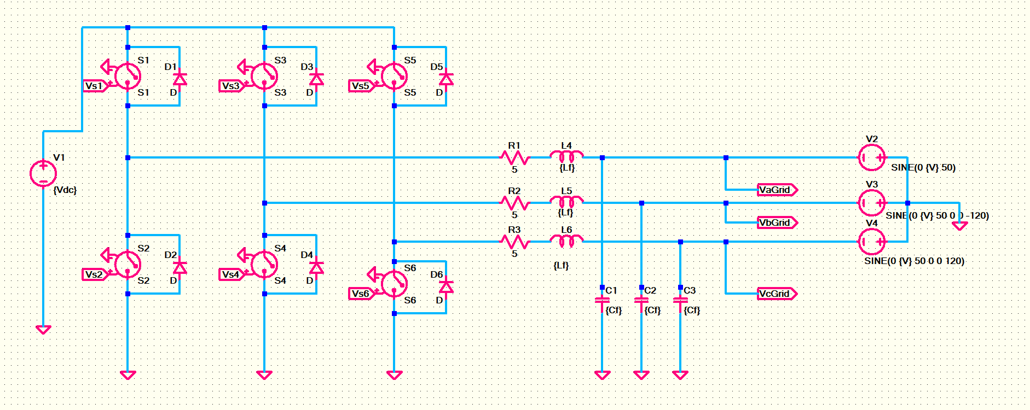
Schematic

Slide 17
Project repository
https://github.com/ubaia/powerelectronics-converter

