Slide 1




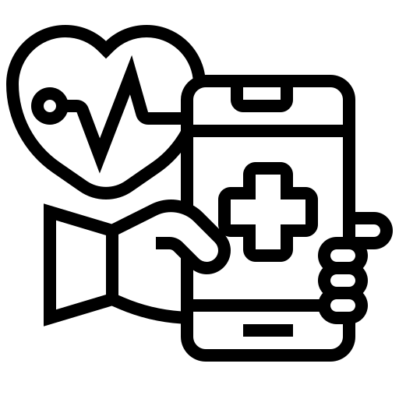
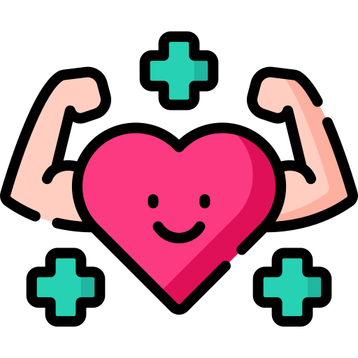
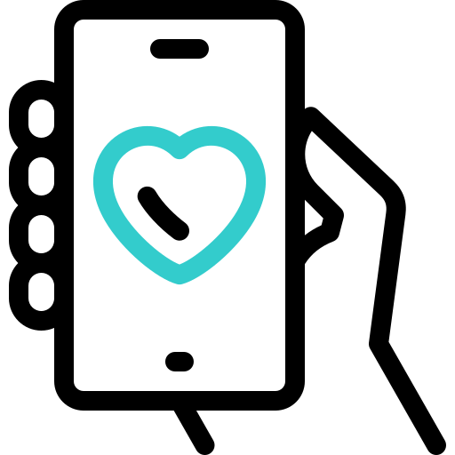

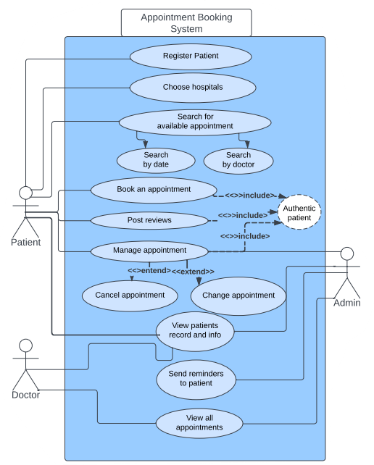
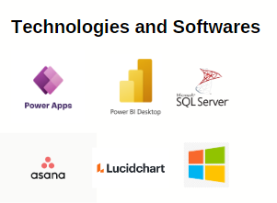
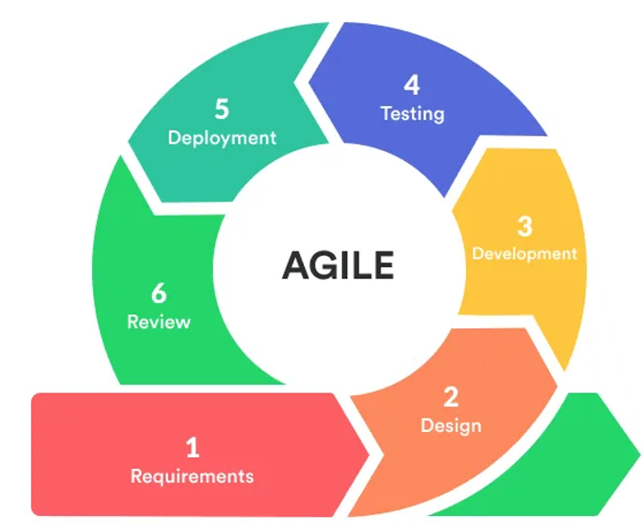
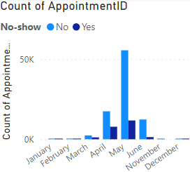






Developing a GP Mobile App with Enhanced Analytics for Croydon GP Practice.
Project scope and objective
Your health, Your appointments, Simplified.
App Design
The primary project deliverable is a fully functional GP Mobile App that is compatible with both iOS and Android platforms. The app will provide patients with a user-friendly interface to manage their appointments, reschedule or cancel them as needed, and receive automated reminders to reduce instances of missed appointments.
Project Research & Analysis
The design framework for the app is a culmination of extensive research on UX design accessibility challenges and evolving functional needs. Due to PowerApps’ limitations some features have been compromised. Complemented by consistent key colour schemes, this design approach, as showcased in the accompanying use case diagram, ensures a visually unified experience, fostering intuitive navigation and user familiarity.
During the research and analysis phase quantitative surveys will be conducted to capture user perspectives comprehensively. These findings will steer feature development, ensuring the app addresses user needs while adhering to healthcare standards succinctly.
Key Research Findings
User Preferences: patients prefer a simple, intuitive interface for appointment booking and accessing test results.
Appointment Behavior: 30% of missed appointments are due to poor reminder systems, need effective appointment reminders.
Feedback on Messaging: User’s desire for a secure messaging system to communicate with GPs for non-emergency queries.
Service Usage Patterns: Peak appointment times, enabling better scheduling and resource allocation for improved service delivery.
Constraints and limitations
Navigating time constraints, inexperience in this development realm, and licensing limitations may impact feature depth and testing thoroughness. Embracing these constraints guides a focused approach, prioritizing key functionalities within the project's scope and resources.
Power Apps: front-end implementation
Power BI: Analysis and Visualization of data
Sql Server: back-end implementation
Asana: Project management
Analytics
Progress/Continuation
The initial phase of data collection and visualization for analyzing no-show appointments has commenced, laying the groundwork for comprehensive
Progress
The initial project phases, encompassing planning, research compilation, and the start of documentation, have concluded.
Methodology
Employing Agile methodology enables adaptive development despite constraints. Iterative sprints and user feedback steer the app's evolution efficiently.
analytics within the app's framework.
Continuation
Keep working on creating the database and the app's front design.
Incorporate user feedback to refine app features and enhance usability.
45% Completed
23/09/23
27/11/23
04/02/24
23/02/23
19/03/24
19/03/24
Stage 01
Stage 02
Stage 03
Stage 04
Stage 05
Stage 06
Planning
Research & Analysis
Design & Development
User Feedback & Final Testing
Documentation
Submit & ExpoTees

Slide 2
Issues & Considerations
Social | Considering how the app can help everyone equally, making sure it's easy for everyone to use, no matter their background or where they live. This means making it fair and simple for everyone, even if they're not used to using technology a lot. These simple words aim to convey the essence of social considerations—ensuring fairness, inclusivity, and simplicity for all users, regardless of their circumstances or familiarity with technology.
Ethical | Ethical concerns center on privacy, data security, and responsible data usage. Upholding ethical standards involves stringent measures to protect sensitive patient information, compliance with data protection laws, and ensuring the ethical use of collected data for the users' benefit.
EDI(Equity, Diversity, and Inclusion) | EDI considerations focus on creating an inclusive app design that respects diverse cultural backgrounds and varying levels of health literacy. The app should prioritize usability for all users, irrespective of socio-economic status, language, or cultural differences, fostering an inclusive healthcare environment.
Legal compliance | Compliance with legal standards involves adherence to healthcare regulations, data protection laws, and privacy standards. The app's design and functionalities must align with legal requirements, ensuring full compliance to mitigate legal risks.
Security Measures | Security measures encompass robust safeguards against data breaches and unauthorized access to sensitive patient information. Implementing encryption protocols, access controls, and regular security audits ensures the app's resilience against potential security threats.
Professional Standards | Meeting professional standards entails designing the app in line with healthcare industry norms and best practices. Adhering to professional standards ensures the app's functionality aligns with accepted healthcare practices and ethical guidelines.
Project Risks | Mitigating project risks involves identifying potential challenges such as technical limitations, resource constraints, or unforeseen regulatory changes. Addressing these risks proactively allows for contingency plans, ensuring smoother project progress and successful delivery.
Professional Skills | Professional Skills
App Development | Proficient in full-stack app development, leveraging various technologies and frameworks to create intuitive and functional applications. Skilled in translating user requirements into efficient and user-friendly app interfaces. Previously been part of similar projects and got hand-on working in industry.
Power Apps | Currently developing skills in Power Apps, demonstrating a foundational understanding and having created basic projects using the platform. Actively learning and expanding expertise to elevate app development skills to meet industry standards for the forthcoming project.
Power BI | Proficient in leveraging Power BI for data visualization and analytics, good at creating interactive dashboards and reports to derive meaningful insights. Skilled in transforming complex data into actionable visualizations for informed decision-making.
Project Management | Experienced in project planning, execution, and delivery within set timelines. Proficient in task delegation, resource management, and risk mitigation strategies to ensure project success while meeting stakeholders' expectations.
Working in Agile Environment | Skilled in Agile methodologies, adept at working in iterative sprints, fostering collaboration, and adaptability within cross-functional teams. Capable of embracing changing requirements and delivering incremental value in a fast-paced, Agile-driven environment.
References (Including Logos)
CLEANPRO (no date) Teesside University Logo. Available at: https://www.cleanpng.com/png-teesside-university-university-of-sunderland-acade-3324946/ (Accessed on: 27/11/2023)
Better Health(no date) Flat Icon. Available at: https://www.flaticon.com/free-icon/better-health_10605926?term=health&page=1&position=15&origin=search&related_id=10605926 (Accessed on: 28/11/2023)
Medical Team (no date) Flat Icon. Available at: https://www.flaticon.com/free-icon/medical-team_4807695?term=health&page=1&position=20&origin=search&related_id=4807695 (Accessed on: 28/11/2023)
Healthcare (no date) Flat Icon. Available at: https://www.flaticon.com/free-icon/healthcare_3195289?term=health+app&page=1&position=3&origin=search&related_id=3195289 (Accessed on: 28/11/2023)
Serena Gray (29/07/2020) What is the Agile Methodology in Software Development? Available at: https://serenagray2451.medium.com/what-is-the-agile-methodology-in-software-development-c93023a7eb85 (Accessed on: 29/11/2023)
Xie and Kalun (09/2023) Consumers’ Preferences for Purchasing mHealth Apps. Available at: https://www.ncbi.nlm.nih.gov/pmc/articles/PMC10510454/#:~:text=A%20total%20of%207%20health,mobile%20data%20consumption%2C%20and%20cost. (Accessed on: 29/11/2023)
Sionnadh (2016) Patient prefer Adherence. https://www.ncbi.nlm.nih.gov/pmc/articles/PMC4831598/ (Accessed on: 29/11/23)
Ingentive (no date) Poerpoint png Availabe at: https://8333564.fs1.hubspotusercontent-na1.net/hubfs/8333564/powerapps.png (Accessed on: 03/12/23)
DataCamp (no date) What is Power BI? Available at: https://www.datacamp.com/blog/all-about-power-bi (Accessed on: 03/12/23)
SQL Server (no date) Flaticon. Available at: https://cdn-icons-png.flaticon.com/512/5968/5968364.png (Accessed on: 03/12/23)
Asana Logo (no date) Logowik. Available at: https://logowik.com/content/uploads/images/asana1963.jpg (Accessed on: 03/12/23)
Lucidchart Logo png (no date) Wikipidea. Available at: https://upload.wikimedia.org/wikipedia/en/thumb/f/f2/Lucidchart_logo_%28September_2021%29.svg/1280px-Lucidchart_logo_%28September_2021%29.svg.png (Accessed on: 03/12/23)
Windows Logo (no date) Wikimedia Commons. Available at: https://upload.wikimedia.org/wikipedia/commons/thumb/3/34/Windows_logo_-_2012_derivative.svg/2048px-Windows_logo_-_2012_derivative.svg.png (Accessed on: 03/12/23)
NHS England (02/01/2019) Missed GP appointments costing NHS millions. Available at: https://www.england.nhs.uk/2019/01/missed-gp-appointments-costing-nhs-millions/ (Accessed on: 02/12/23)

