Slide 1
F1 Kafka Simulation
Pon Rahul M
Information Systems

Slide 2

What is ?
Distributed event streaming platform
Simpler definition:
  Message bus++
    Storage
    Stream processing – Message queue
    Scalable

Slide 3
Simulation
Scenario: Car race
Simulates real-time data streaming from the OBD of the car to the audience/pit crew
Two teams:
  Red Bull Racing
  Mercedes-AMG PETRONAS
You, play as:
  Max Verstappen (Red Bull)
  Lewis Hamilton (Mercedes)
You team has access to a pit crew

Slide 4
Pub/Sub
Producers
Merc Car
RB Car
Kafka Message Bus
Audience dashboard
Merc Pit Crew
RB Pit Crew
Consumers

Slide 5
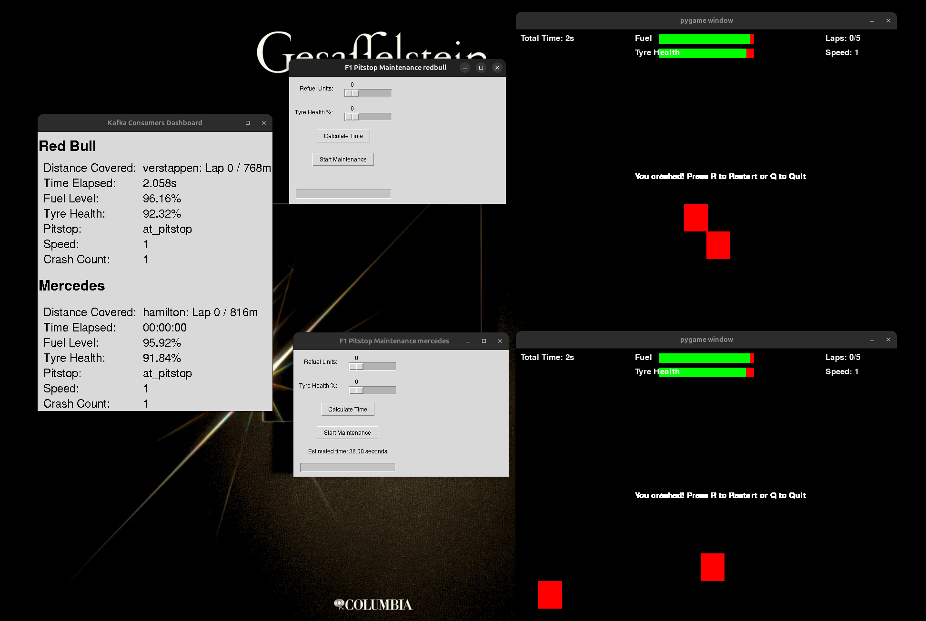
Layout

Slide 6
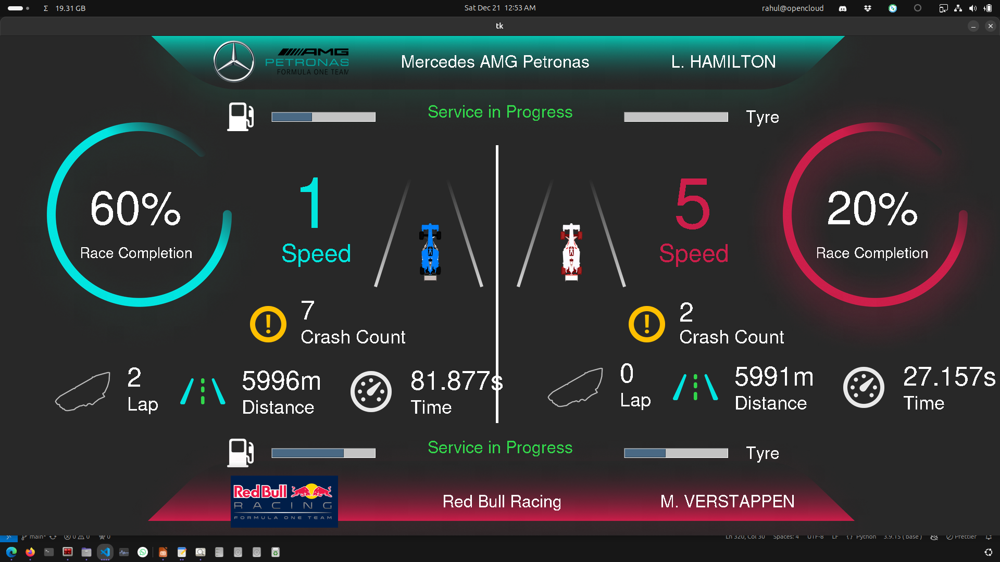
Dashboard

Slide 7
Kafka Setup
Dockerized
Vanilla Kafka implementation from apache/kafka
Start the Kafka cluster with docker compose
  docker compose up -d
Create the necessary topics
  docker compose exec --workdir /opt/kafka/bin/ -it broker sh
  ./kafka-topics.sh --bootstrap-server localhost:9092 --create --topic redbull_distance

Slide 8
Player Setup
4 individuals, access to one of the windows:
  Red Bull: 1 driver + 1 pit crew member
  Mercedes: 1 driver + 1 pit crew member
Clone the Git repository:
  git clone https://github.com/theflyingrahul/kafka_f1
Install requirements
  pip install -r requirements.txt
Run program:
  python game_merc.py
  python pitstop_redbull.py

Slide 9
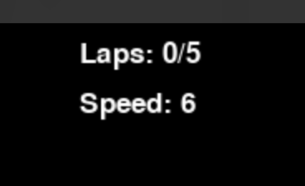
Instructions
It is a car game!
L/R arrow keys allow horizontal steering
Up arrow increases speed
Down arrow reduces speed
Starts at speed 1
Max speed is 6
5 laps: 6 km per lap
Green line on the game screen indicates end of a lap

Slide 10
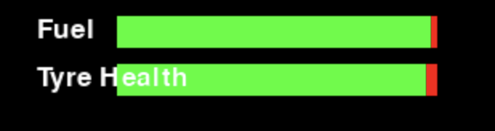
Instructions
Your car runs on fuel: 5% burn for every 200m
Your car has tyres: 5% wear for every 100m
Game console has gauges for the same
Maintenance needed to refuel and condition tyres – you have access to a pit
If tyre health depletes, max speed is limited to 1
If fuel depletes, GAME OVER!

Slide 11
Instructions
Driver may request a pitstop by pressing F1 during anytime of the gameplay
Pit crew is situated at the start of the track / lap
You may access your pit only at the end of the current lap
Maintenance takes time:
  10% refuel takes 3 seconds
  10% tyre health takes 2 seconds
  Plan accordingly

Slide 12
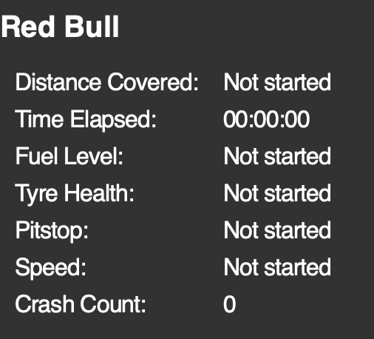
Instructions
Pit crew:
Maintenance can be done only if the driver has requested for a pitstop AND when the car is at the pitstop
Be prepared! Look at the status on the dashboard!

Slide 13

Instructions
Crash as many times as you want
Resume game by pressing r
Penalty of 5 seconds for every crash
Team with the lowest overall time wins
Game on!

