Slide 1
Introduction to Kafka
Pon Rahul M
Information Systems

Slide 2

What is ?
Distributed event streaming platform
Simpler definition:
  Message bus++
    Storage
    Stream processing – Message queue
    Scalable

Slide 3
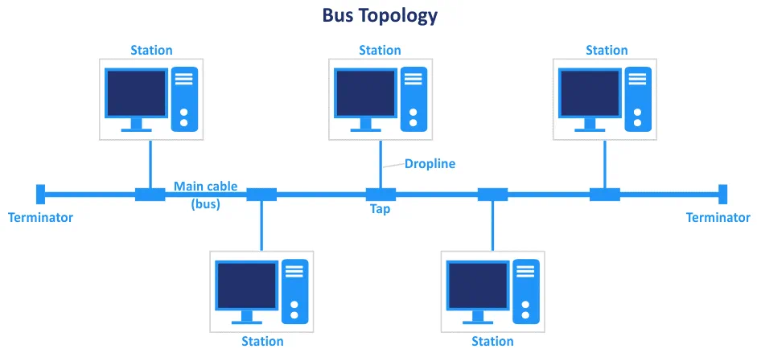
Bus
https://www.nakivo.com/blog/types-of-network-topology-explained/

Slide 4
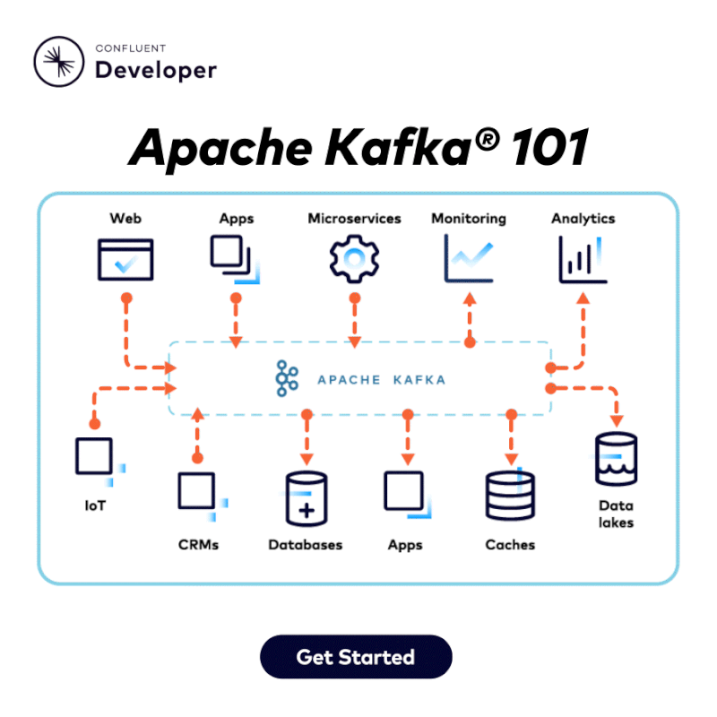
Kafka Bus
Source: Confluent

Slide 5
Keywords
Broker
Message
Producer
Consumer
Topic
Partition

Slide 6
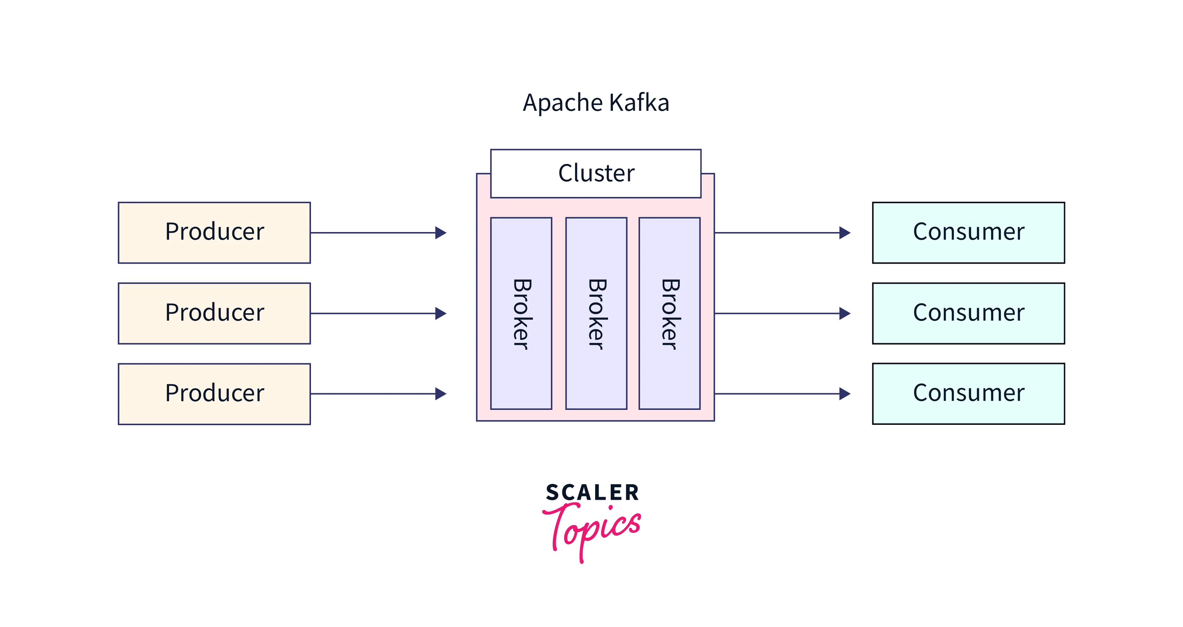
Broker
Kafka is a distributed system
Each Kafka server instance is called a broker
Arranges transactions between communicating entities
Handles requests from clients to write and read messages
Kafka cluster: a collection of one or more Kafka brokers

Slide 7
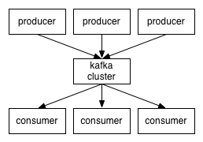
Pub-sub
Message: sequence of bits
  Event
Messaging pattern: how are messages transmitted between senders and receivers
  Broadcast, request-response, etc.
Publishers: send messages to multiple subscribers
  Producers
Subscribers: receive messages from multiple publishers
  Consumers
https://kafka.apache.org/081/documentation.html

Slide 8
Topics
Lots of events can occur in a single application
  Order tracking, delivery personnel location, offer notifications, click-stream, etc.
Topics are a way to organize events
A user-defined category or feed name where data is stored and published
  Log of similar events

Slide 9
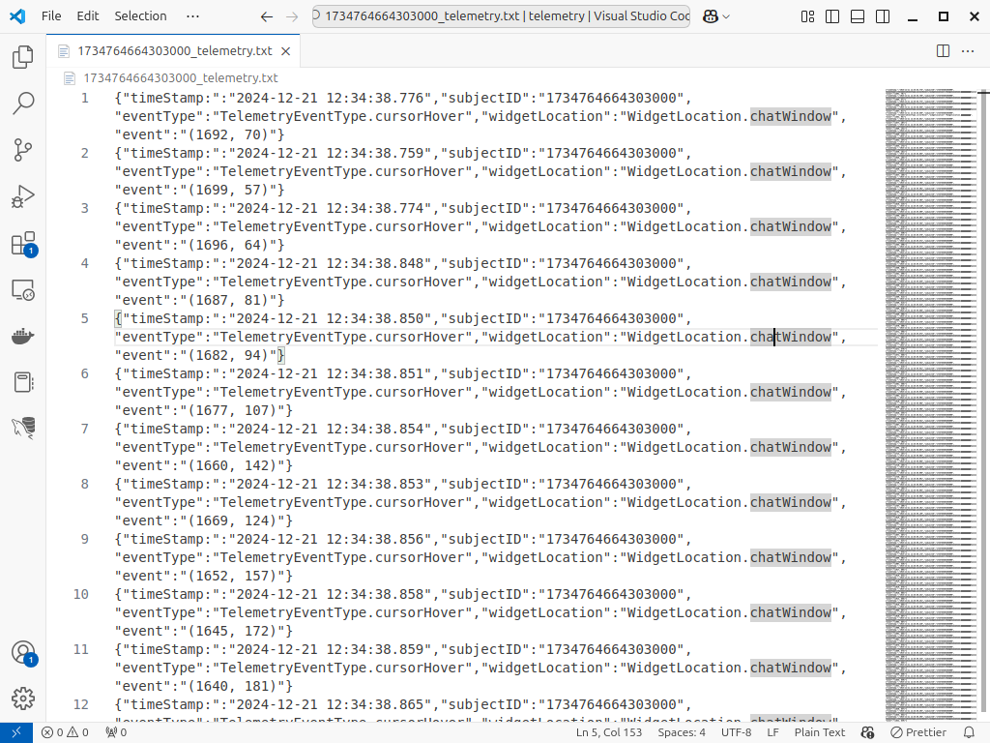
Clickstream Data

Slide 10
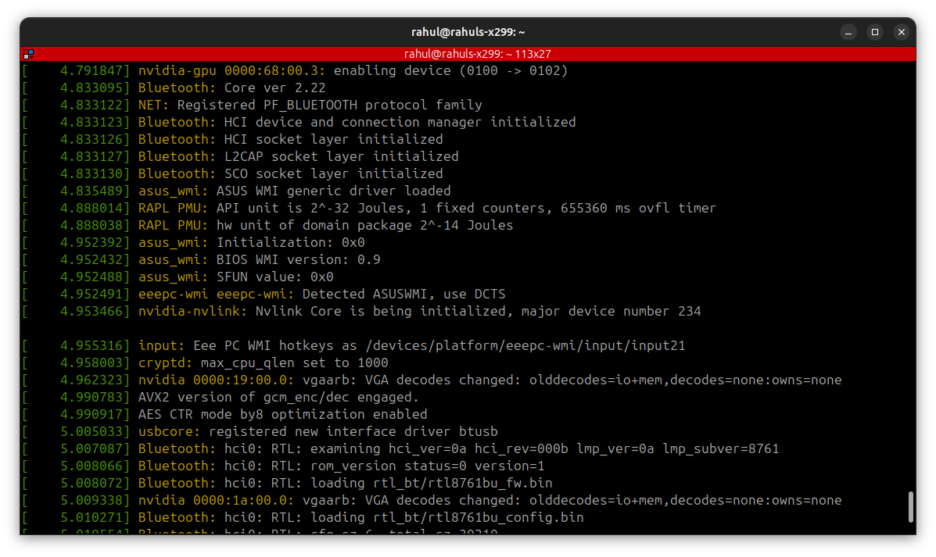
System Logs

Slide 11
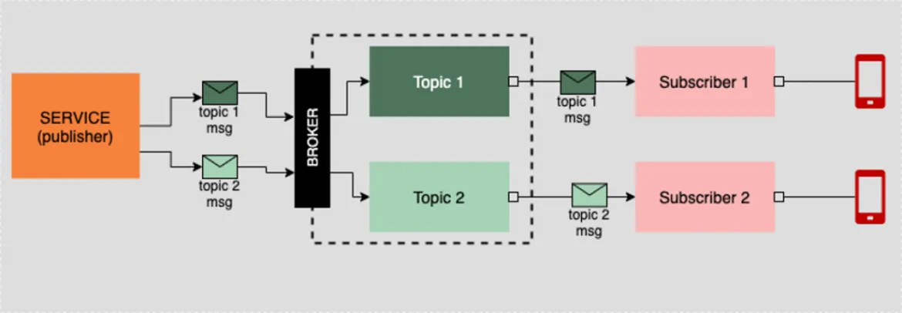
https://www.redhat.com/en/blog/apache-kafka-10-essential-terms-and-concepts-explained

Slide 12
Good Practices
A producer writes to one topic
  Multiple producers may write to the same topic
  Avoid using a producer to write to multiple topics
A consumers listens to one topic
  Avoid subscribing a consumer to multiple topics
producer.send(new ProducerRecord<String, String>("my-topic", Integer.toString(i)));
consumer.subscribe(Arrays.asList(topic1,topic2))

Slide 13
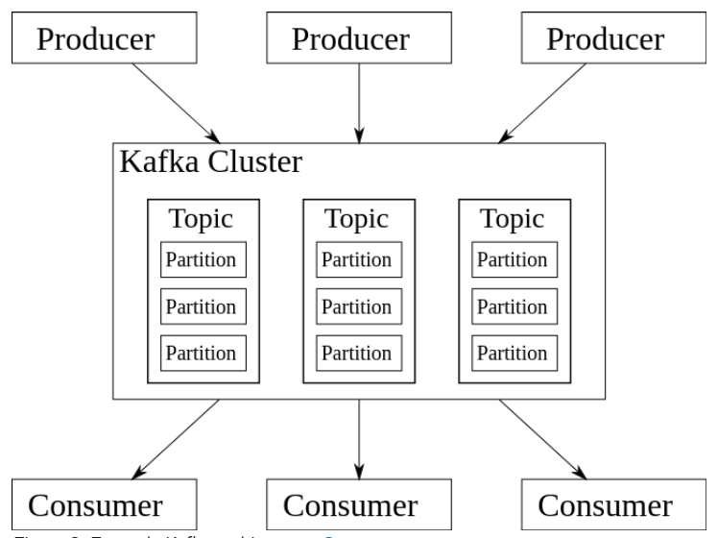
Partitions
A topic is broken into multiple partitions
  A partition is a block of the topic / log file
Partitions are replicated across brokers, essentially replicating topics
Allows scalability: clients can publish and subscribe to multiple brokers simultaneously
High availability, fault-tolerance, automatic load balancing

Slide 14

Event Write Sequence
Consider a topic with three partitions
Where is a new event written to?
No keys?
  Round-robin
Use keys?
  Hash the key
  Map the hash to a partition
synchronous_produce_message('redbull_fuel', 'main-tank', '54.33%')

Slide 15
Thank you!

