Slide 1

The Foreman
Lukáš Zapletal, Red Hat
Notes:
Talk slower

Slide 2
@lzap

Slide 3
Agenda
Introduction
  Provisioning
  Configuration
  Monitoring
History and Technology
Architecture and Installation
Automating with CLI + API
Plugins
Demo
Notes:
Introductory talk – first half basic introduction,
second half – customizing to fit your own needs in your data center
How many people use Foreman today?
Puppet?
Chef?
Salt?
Anyone using non-puppet in foreman?
TALK SLOWER

Slide 4
Introduction

Slide 5
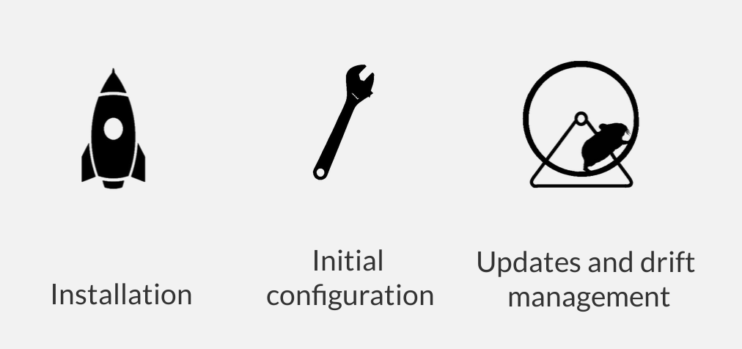
Foreman's Realm
Notes:
Talk slower

Slide 6

Foreman
Notes:
Talk slower

Slide 7
Provisioning
Bare-metal
Virtualization
Cloud
Containers
Notes:
Talk slower

Slide 8
Provisioning on virtualization
Libvirt
Xen
RHEV / oVirt
VMWare
Notes:
Talk slower

Slide 9
Provisioning on cloud
OpenStack
EC2
Rackspace
Digital Ocean
Azure
Notes:
Talk slower

Slide 10
Provisioning in our community
“1st tier” plugins (team github, docs)
100 of other community plugins
THANK YOU
Notes:
Talk slower

Slide 11
Provisioning
BOOTP/PXE (bare-metal, virtualization)
Image-based (bare*, cloud, virt, containers)
* (well bare-metal is still WIP)
Notes:
Talk slower

Slide 12
Configuration
Puppet
Ansible
Chef
Salt
Automatic registration & setup of clients, including autosigning certs/keys
Defining:
  Classes / states
  Parameters / pillars
Inventory data:
  Facts / Grains
  Reports
Notes:
Talk slower

Slide 13
Reporting
Generic Report API with graphs/trends:
  System Inventories
  Reports from runs
Generic reports: ABRT, OpenSCAP
Notes:
Talk slower

Slide 14
Reporting
Context sensitive search:
  Keyword completion
  Works across whole application
Notes:
Talk slower

Slide 15
Distributed Architecture
Remote sites support via Smart-Proxy
Large organizations and/or multi-tenancy:
  Organizations (Divisions)
  Locations
Strong RBAC model
  Users / Groups
  Permissions / Filters
LDAP / MS-AD integration
Notes:
Install a basic foreman – smart-proxy runs on the localhost with foreman

Slide 16
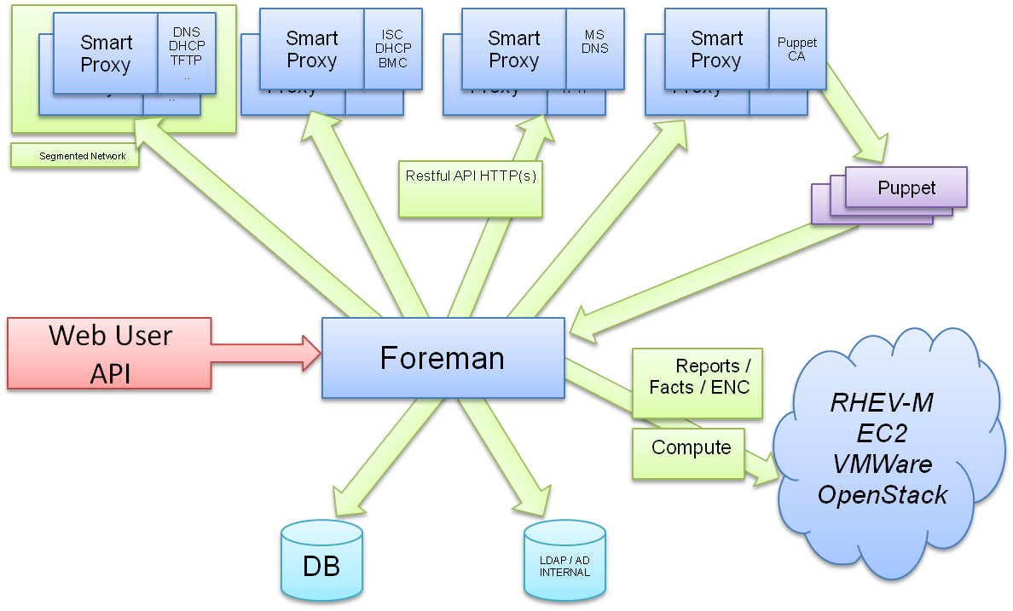
Notes:
Talk slower

Slide 17
History
Project started in July 2009
Initial set of features: Puppet + PXE provisioning
300 unique contributors (fall 2017)
Core team sponsored by Red Hat (GMT +10 -8)
Translated to 15 languages
Large, healthy and friendly community
Reported usage: Red Hat, CERN, EMC, Citrix, DHL, BBC, Digg, Good Data, Mozilla, eBay/Paypal (100,000 nodes)
Notes:
Install a basic foreman – smart-proxy runs on the localhost with foreman

Slide 18
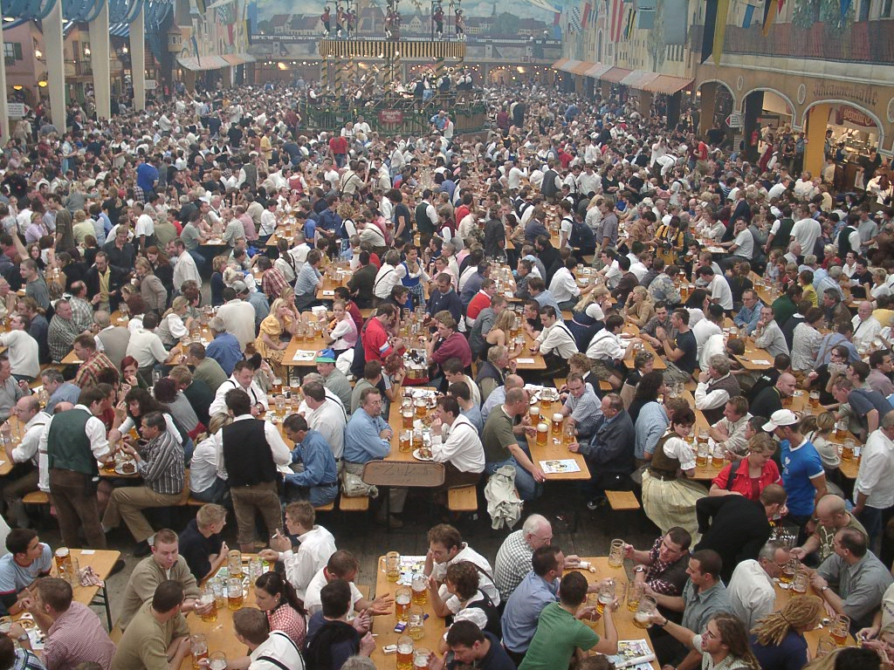
Professional support
Red Hat Satellite 6
Netways, Germany
ATIX, Germany
Credativ, Germany
Individuals
Notes:
Install a basic foreman – smart-proxy runs on the localhost with foreman

Slide 19
Technology
Foreman UI, API, orchestrator
  Ruby on Rails application
  Targeted on UNIX platforms
  Steep learning curve (git clone, bundle install)
Smart Proxy
  Ruby / Sinatra application
  Minimum dependencies
  Quick start (git clone, bundle install)
  On all Ruby 1.8+ platforms (incl. MS Windows)
Notes:
Install a basic foreman – smart-proxy runs on the localhost with foreman

Slide 20
Installation
Repositories for RHEL/Fedora, Debian/Ubuntu
Puppet-based installer
Sane defaults for POC deployments
Able to install, configure and manage:
  Foreman app
  Smart-proxies
  Services: DNS, DHCP, TFTP, Puppet
  Selected plugins
  # foreman-installer -h | wc -l
  439
Notes:
Install a basic foreman – smart-proxy runs on the localhost with foreman

Slide 21

Customization
Notes:
Talk slower

Slide 22
Customization
Multiple provisioning workflows
Enable or disable authorization and authentization
Global configuration options
Smart proxy configuration values (features)
Automation with API + CLI
Foreman Plugins
Smart Proxy Plugins
Foreman Hooks Plugin
Notes:
Talk slower

Slide 23
API & CLI
Full UI coverage
All of our API is documented
Docs DSL w/ dynamic Ruby bindings
Full RESTful API
  Docs at /apidoc on your Foreman server
  Also available at http://www.theforeman.org/api/1.9/index.html
Notes:
Talk slower

Slide 24
Working from command line
REST HTTPS JSON API
On par with UI
Username/Password authentication
Session support
Easy to use, great for working in shell
hammer salt-key list --smart-proxy=smartproxy.example.com
Notes:
Talk slower

Slide 25
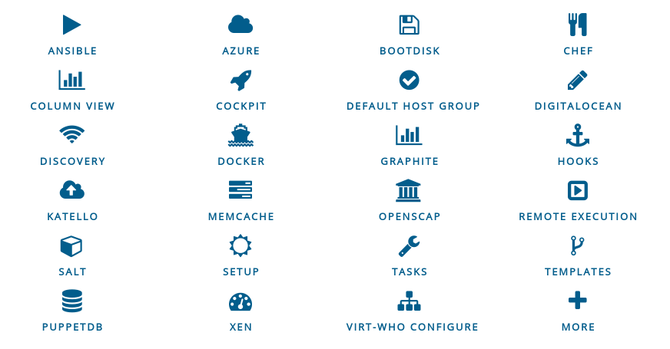
Plugins
Rich ecosystem of existing plugins
More Info: http://projects.theforeman.org/projects/foreman/wiki/List_of_Plugins
Notes:
Talk slower

Slide 26





Katello plugin
Content Lifecycle Management
  http://www.katello.org/
Sync RPM, Docker, and Puppet content
Notes:
Talk slower

Slide 27
Katello plugin
Manage through a lifecycle environments
  Dev → QA → Production
Assign hosts to Content Views
Filter out/in errata or individual packages
Patch Management
  Fast incremental patching (fast-track)
  Errata reporting
Notes:
Talk slower

Slide 28
Bootdisk plugin
Small hybrid ISO downloaded from Host UI page or via API
Unknown or pre-registred host support
Generic image (or Subnet image)
  iPXE-based, DHCP required
Host image
  iPXE-based, DHCP not required
Full host image
  SYSLINUX-based, DHCP required, OS specific
Notes:
Talk slower

Slide 29
Discovery plugin
Unknown host boots via DHCP/PXE
  Becomes available in Foreman as a “Discovered Host”
  Workflow remains the same
  Discovery image is RHEL7/CentOS7-based
Provision with zero clicks
  Automatic provisioning via rules on arbitrary facts:
    cpu_count < 8 → web server host group
    cpu_count >= 8 → database cluster host group
Notes:
Talk slower

Slide 30
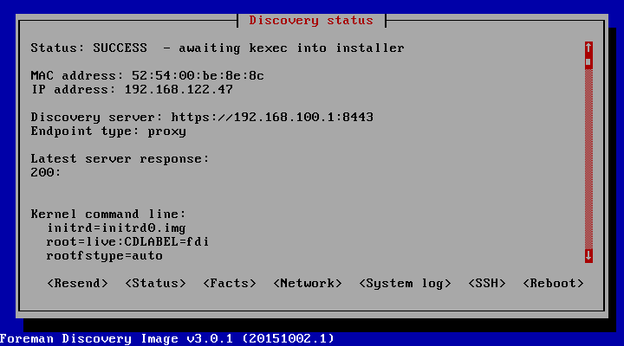
Discovery plugin
Metal as a Service – PXE installation
Notes:
Talk slower

Slide 31
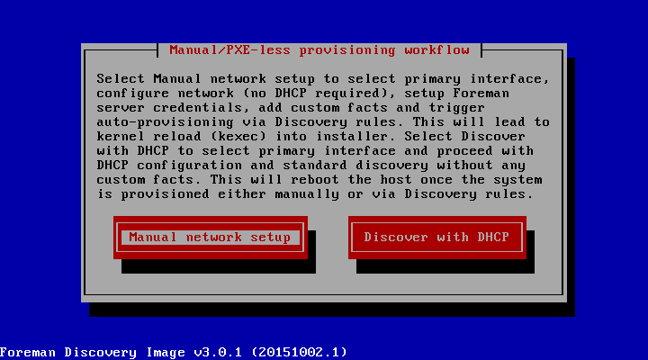
Discovery plugin
PXE-less (un)attended workflow
Notes:
Talk slower

Slide 32
Docker plugin
Start or stop containers
Monitor status
View console
Multiple registry support
Integration with Katello
Notes:
Talk slower

Slide 33
Hooks plugin
Hooks
  Execute arbitrary shell scripts on actions
    host create/update/delete, build complete, etc.
  Good for missing integration
    Add host to external monitoring system
    Perform an extra step after provisioning is done
Notes:
Talk slower

Slide 34
Ansible plugin
Bootstrapping nodes
Facts and reports
Dynamic inventory
Role importing
Running playbooks
API & CLI
Notes:
Talk slower

Slide 35
Salt plugin
Bootstrapping nodes
Full interface to keys/autosign
Define states and pillars
Import reports and grains
API & CLI
Notes:
Talk slower

Slide 36
Chef plugin
Automatic bootstrapping of clients
Import reports and attributes into Foreman
Decomission nodes from Chef server
Same interface and workflow
CLI & API
Notes:
Talk slower

Slide 37
Remote execution plugin
Arbitrary commands on hosts
Job Templates
  Based on Foreman Templating engine
  Input parameters
Collected data available (facts)
Multiple providers architecture:
  SSH (via Smart Proxies)
Notes:
Talk slower

Slide 38
Writing Foreman Plugins
Foreman:
  Rails Engine
  Extra Foreman API (plugin registration)
  Distributed as a Ruby GEM
  Template and HOWTO available
Smart Proxy:
  Sinatra app (REST API)
  Small plugin registration API
  Distributed as a Ruby GEM
Notes:
Talk slower.

Slide 39
What Next?
Visit us http://theforeman.org/
If you do something cool with Foreman, let us know!
Find us:
  IRC: irc.freenode.net
    #theforeman
    #theforeman-dev
  Mailing Lists on Google groups
    foreman-users
    foreman-dev
Notes:
Let us know!

Slide 40
Credits:
https://commons.wikimedia.org/wiki/File:Oktoberfest_bierzelt.JPG
https://commons.wikimedia.org/wiki/File:K%C5%ABrm%C4%81sana_-_Tortoise_Pose_with_Hands_Facing_Back.jpg
Notes:
Talk slower

Slide 41
DEMO

