Slide 1

Foreman
The standard talk
Lukáš Zapletal
@lzap
Notes:
Talk slower

Slide 2
Agenda
Introduction
  Provisioning
  Configuration
  Monitoring
History and Technology
Architecture and Installation
Customizing foreman
  Automating with CLI + API
  Plugins (Bootdisk, Discovery, Docker, Katello, Chef, Salt, Hooks, Remote Execution)
Demo (optional)
Notes:
Introductory talk – first half basic introduction,
second half – customizing to fit your own needs in your data center
How many people use Foreman today?
Puppet?
Chef?
Salt?
Anyone using non-puppet in foreman?
TALK SLOWER

Slide 3
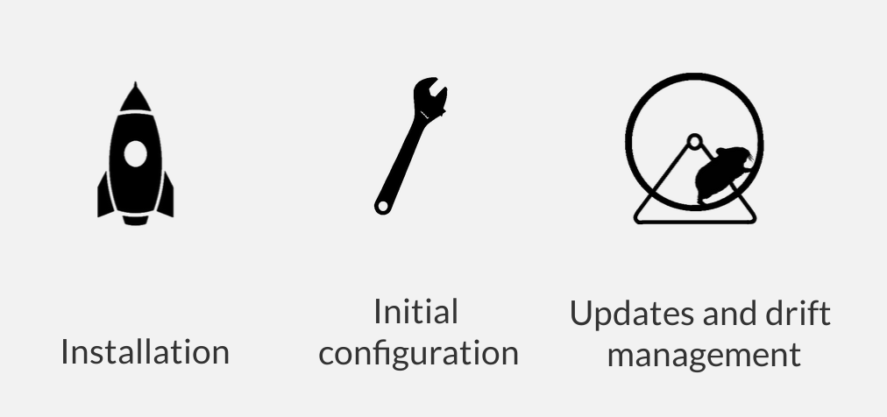
Foreman's Realm
Managing the Lifecycle of your Systems
Notes:
Talk slower

Slide 4

Foreman
Notes:
Talk slower

Slide 5


Provision new machines or containers to (almost) anything
  Bare metal, oVirt, libvirt, VMware, Docker, EC2, Azure, Rackspace, Digital Ocean, OpenStack, etc.
If we don't support it today, we can via new plugins
Notes:
Talk slower

Slide 6
Provisioning types:
  PXE (PXELinux, Grub2, kickstart, preseed, AutoYAST...)
  Semi-attended (PXE-less, Bootdisk, “recipe” on USB drive)
  Image-based (cloning, configured over SSH or user data - cloudinit)
For virtualization provider, we create the VM
For everything we orchestrate related services through Smart Proxies
  DNS - DHCP / TFTP
  FreeIPA Realm - Configuration Management
Notes:
Talk slower

Slide 7
Puppet
Via plugins:
  Ansible
  Chef
  Salt
Automatic registration & setup of clients, including autosigning certs/keys
Defining:
  Classes / states
  Parameters / pillars
Inventory data:
  Facts / Grains
  results of configuration runs
Notes:
Talk slower

Slide 8

Generic Report API with graphs/trends:
  System Inventories
  Reports from runs (Puppet, Ansible...)
  Generic reports: OpenSCAP, ABRT
Context sensitive search:
  Not full-text (SQL level)
  Keyword completion
  Works across whole application
Notes:
Talk slower

Slide 9
Distributed Architecture
Smart Proxies located locally on Foreman itself or independent – (orchestration)
Large organizations and/or multi-tenancy:
  Organizations (Divisions)
  Locations
Strong RBAC model
  Users / Groups
  Permissions / Filters
LDAP / MS-AD integration
Notes:
Install a basic foreman – smart-proxy runs on the localhost with foreman

Slide 10
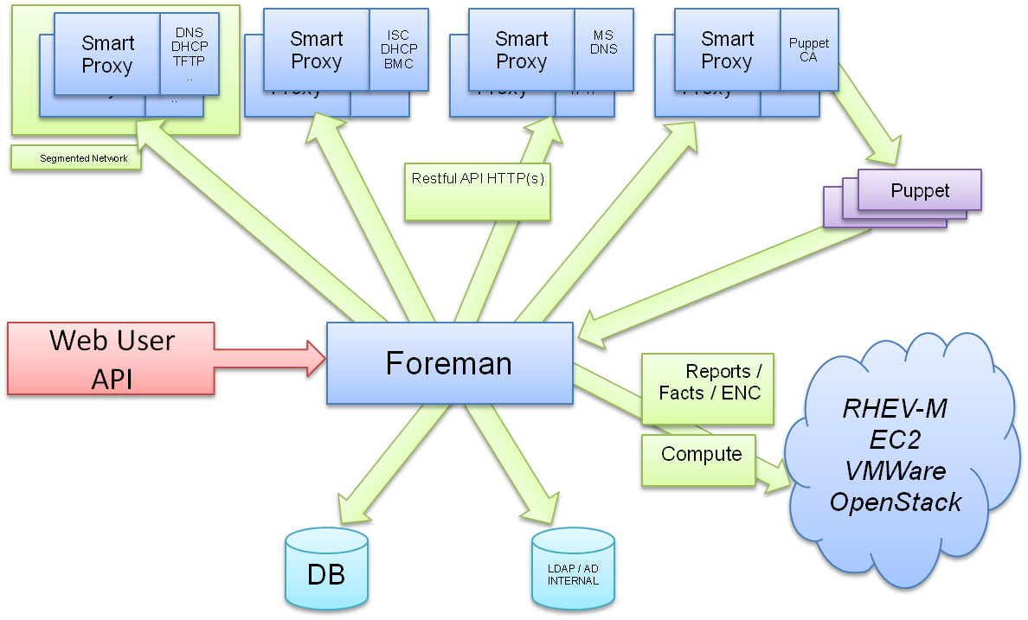
Notes:
Talk slower

Slide 11
History
Project started in July 2009
Initial set of features: Puppet + PXE provisioning
213 unique contributors (winter 2015)
Core team sponsored by Red Hat (GMT +10 -8)
Translated to 13 languages
Healthy and friendly community
Reported usage: Red Hat, CERN, EMC, Citrix, DHL, BBC, Digg, Good Data, Mozilla, eBay/Paypal (100,000 nodes)
Notes:
Install a basic foreman – smart-proxy runs on the localhost with foreman

Slide 12
Technology
Foreman itself
  Ruby on Rails application
  Targeted on UNIX platforms, Ruby 1.9+
  Steep learning curve (git clone, bundle install)
Smart Proxy
  Ruby / Sinatra application
  Minimum dependencies
  Quick start (git clone, bundle install)
  On all Ruby 1.8+ platforms (incl. MS Windows)
Notes:
Install a basic foreman – smart-proxy runs on the localhost with foreman

Slide 13
Installation
Repositories for RHEL/Fedora, Debian/Ubuntu
Puppet-based installer
Sane defaults for POC deployments
Able to install, configure and manage:
  Foreman app
  Smart-proxies
  Services: DNS, DHCP, TFTP, Puppet
  Selected plugins
  # foreman-installer -h | wc -l
  460
Notes:
Install a basic foreman – smart-proxy runs on the localhost with foreman

Slide 14
Customization
Customize Foreman to support your workflows!
  Configuration options in UI: Adminster → Settings
  Smart proxy configuration values (features)
  Automation with API + CLI
  Foreman Plugins
  Smart Proxy Plugins
  Foreman Hooks Plugin
Notes:
Talk slower

Slide 15
API & CLI
Full UI coverage
All of our API is documented
Documentation DSL generates dynamic Ruby bindings
Full RESTful API
  Docs at /apidoc on your Foreman server
  Also available at http://www.theforeman.org/api/1.9/index.html
Emerging GraphQL API
Notes:
Talk slower

Slide 16
Hammer CLI
On par with UI
Username/Password authentication
Easy to use, great for working in shell
hammer salt-key list --smart-proxy=smartproxy.example.com
Notes:
Talk slower

Slide 17
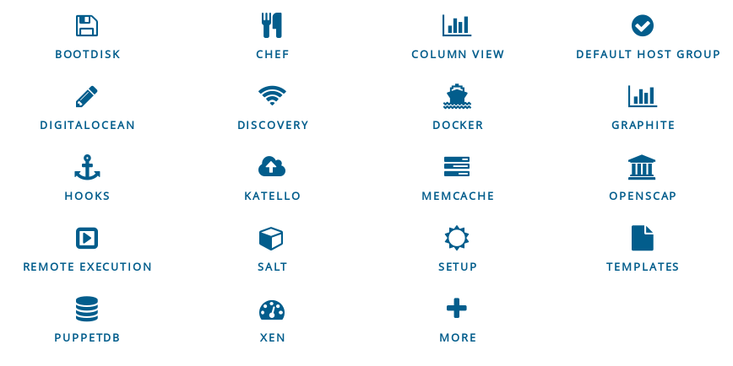
Plugins
Rich ecosystem of existing plugins
More Info: http://projects.theforeman.org/projects/foreman/wiki/List_of_Plugins
Notes:
Talk slower

Slide 18
Bootdisk plugin
Small hybrid ISO downloaded from Host UI page
Unknown or pre-registred hosts boot chainloads from Foreman without PXE/TFTP
Generic image
  iPXE-based, DHCP required
Host image
  iPXE-based, DHCP not required
Full host image
  SYSLINUX-based, DHCP required, OS specific
Notes:
Talk slower

Slide 19
Discovery plugin
Unknown host boots via DHCP/PXE
  Becomes available in Foreman as a “Discovered Host”
  Workflow remains the same
  Discovery image is RHEL7/CentOS7-based
Provision with as few as NO clicks
  Automatic provisioning via rules on arbitrary facts:
    cpu_count < 8 → web server host group
    cpu_count >= 8 → db box host group
Notes:
Talk slower

Slide 20
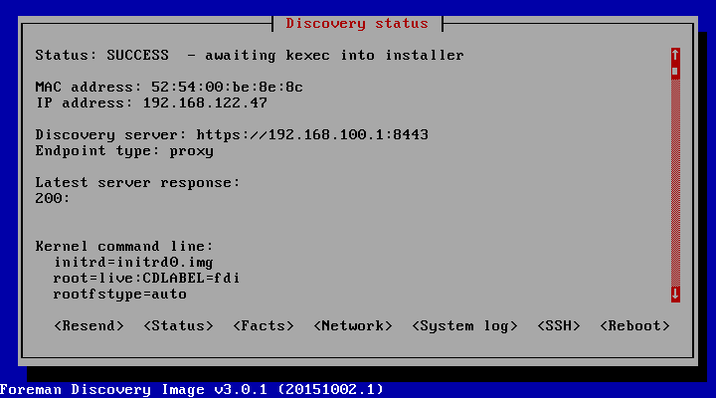
Discovery plugin
Metal as a Service – PXE installation
Notes:
Talk slower

Slide 21
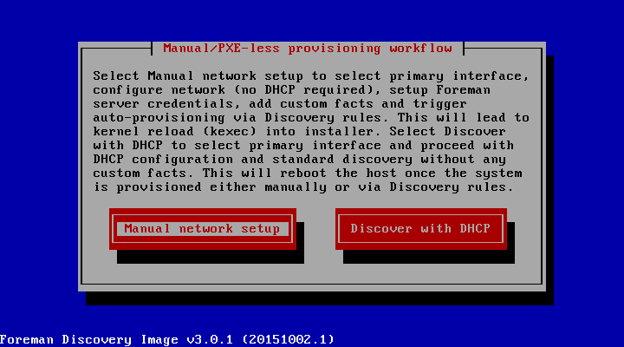
Discovery plugin
PXE-less (un)attended workflow (supports EFI)
Notes:
Talk slower

Slide 22
Katello plugin
Manage through a lifecycle
  Dev → QA → Production (Environments)
Patch Management
  Emergency Patches
  Errata Reports
And much more!
Notes:
Talk slower

Slide 23





Katello plugin
Content Lifecycle Management
  http://www.katello.org/
Sync RPM, Docker, and Puppet content
Spin repositories with filters using Content Views
Notes:
Talk slower

Slide 24
Remote execution plugin
Arbitrary commands on hosts
Job Templates
  Based on Foreman Templating engine
  Input parameters
Collected data available (Facts)
Multiple providers architecture:
  SSH (via Smart Proxies)
Notes:
Talk slower

Slide 25
Hooks plugin
Hooks
  Triggered on actions: on action, do X
    host create/update/delete, build complete, etc.
    X could be anything
      add to nagios
      send an email
    Can be shell, python, ruby, etc.
  More info: https://github.com/theforeman/foreman_hooks
Notes:
Talk slower

Slide 26
Salt plugin
Bootstrapping nodes
Full interface to keys/autosign
Define states, pillars via ext_node and ext_pillar
Import reports (state.highstate results) and grains into Foreman
API & CLI
Notes:
Talk slower

Slide 27
Chef plugin
Automatic bootstrapping of clients
Import reports and attributes into Foreman
Decomission nodes from Chef server when deleted in Foreman
Notes:
Talk slower

Slide 28
Writing Foreman Plugins
Foreman:
  Rails Engine
  Extra Foreman API (plugin registration)
  Distributed as a Ruby GEM
  Template and HOWTO available
Smart Proxy:
  Sinatra app (REST API)
  Small plugin registration API
  Distributed as a Ruby GEM
Notes:
Talk slower.

Slide 29
What Next?
Visit us http://theforeman.org/
If you do something cool with Foreman, let us know!
Find us:
  IRC: irc.freenode.net
    #theforeman
    #theforeman-dev
  Mailing Lists on Google groups
    foreman-users
    foreman-dev
Notes:
Let us know!

Slide 30
DEMO
Notes:
Talk slower

