Slide 1

Foreman & Katello
Sean O’Keeffe
sokeeffe@redhat.com / @sean797

Slide 2
Agenda
Foreman
  Provisioning
  Configuration
  Plugins
Katello
  Content
  Errata
  Tracer
  Notifications

Slide 3
Provisioning
Bare-metal
Virtualization
Cloud
Containers

Slide 4




Configuration

Slide 5
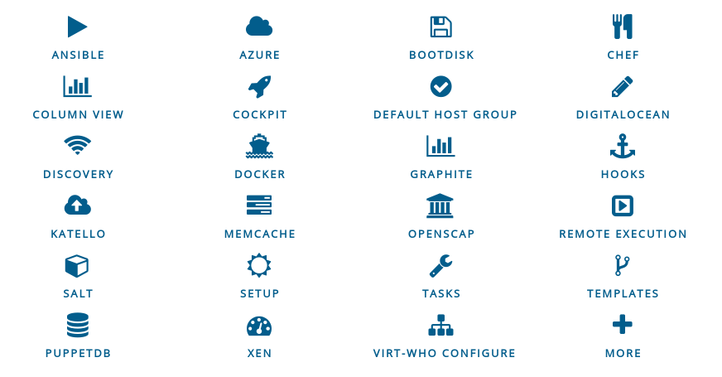
Plugins
Rich ecosystem of existing plugins
More Info: http://projects.theforeman.org/projects/foreman/wiki/List_of_Plugins

Slide 6



Katello

Slide 7
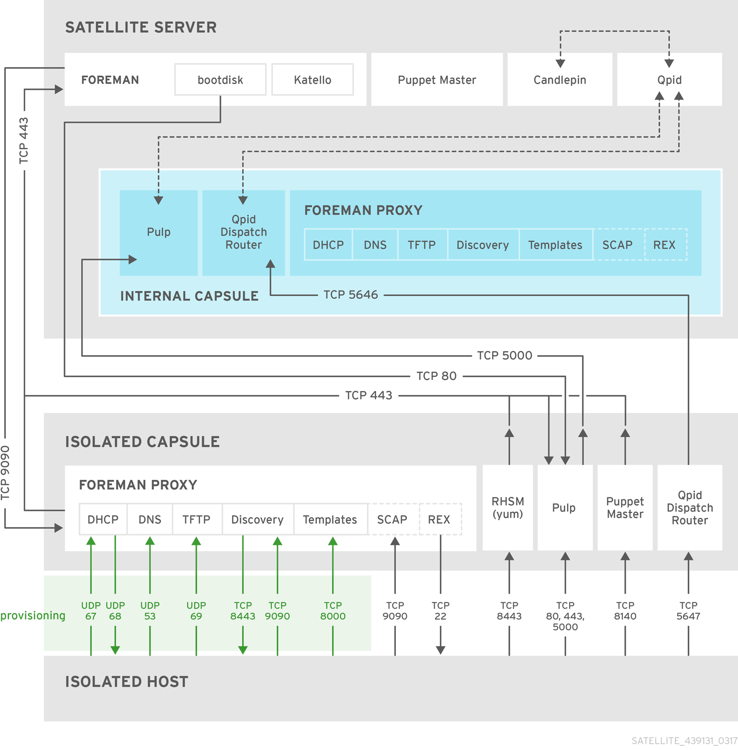
Katello Architecture

Slide 8





Content

Slide 9
Content Sources
External Sync
  Yum repositories
  Debain repositories
  Puppet Forge
  Docker registries
  File repositories (sync requires File manifest)
Direct Upload

Slide 10
Content Views
A snapshot of multiple types of Content

Slide 11
Default Organization View
Simplest View
– Available by default
– Everything you've synced is visible

Slide 12
Custom Content Views
OS repos
App repos
Puppet modules
Filters
Version 1.0
Dev
Prod
Publish
Promote
Promote
Add repositories
Add filters
Publish a version (snapshot) of the Content View and it becomes available in the Library
Promote a version through your Lifecycle Environments

Slide 13
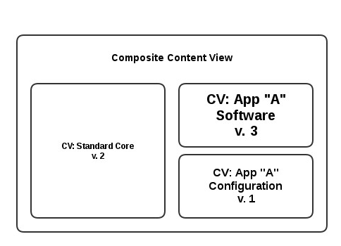
Composite Content View
Contains mutliple Content Views
Manage OS, App, and Configuration layers independently

Slide 14
Errata
EPEL & Fedora updates are publish via errata advisories.
Categories:
  New Package (Fedora only)
  Bugfix
  Enhancement
  Security (and severity – high/medium/low)

Slide 15
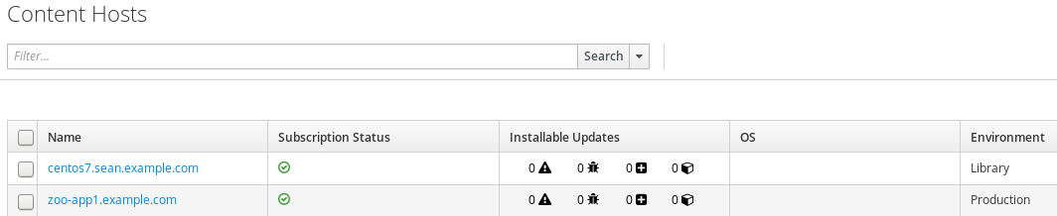
Errata in Katello
Content Hosts page

Slide 16
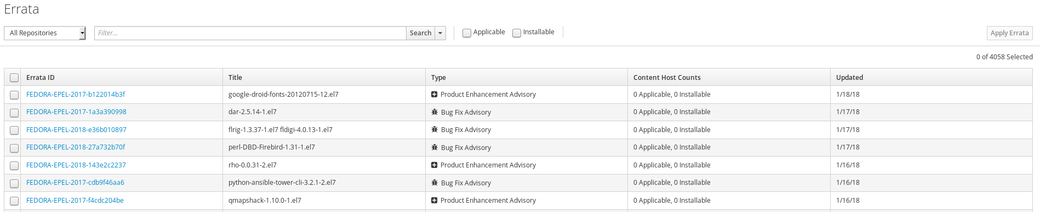
Errata in Katello
Errata page

Slide 17
Critical Update
I want to add just one package/errata to an existing Content View Version.
  Skip the lifecycle
  Designed for emergency patches
  hammer content-view version incremental-update --content-view-version "xxx" --errata-ids yyy
  OR
  hammer content-view version incremental-update --content-view-version "xxx" --packages yyy

Slide 18
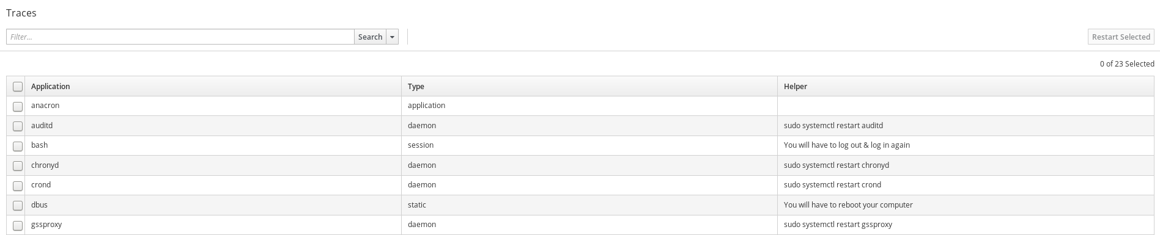
Tracer
“Tracer finds outdated running applications in your system”
Helpers for custom applications can be defined in /etc/tracer/applications.xml & ~/.config/tracer/applications.xml

Slide 19
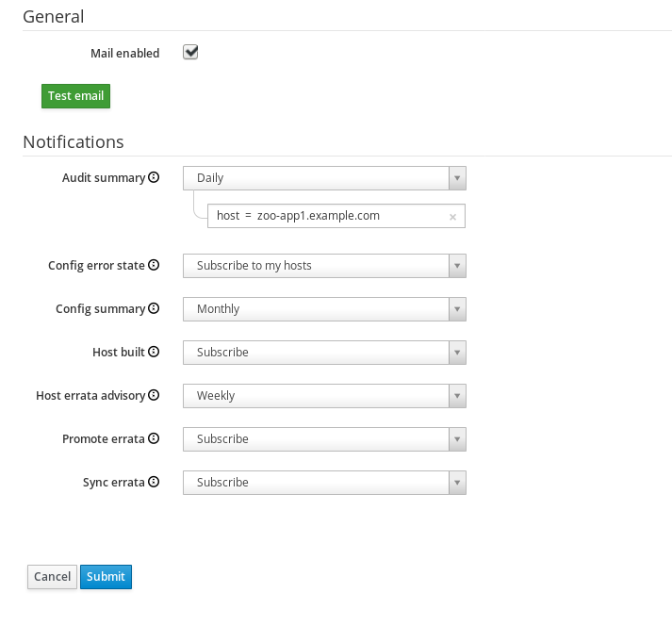
Email Notifications

Slide 20
Foreman Hooks
Hooks into standard Rails callbacks for any Foreman object.
Trigger scripts and commands at any point in an object's lifecycle in Foreman.
Run scripts when a host is created, finishes provisioning, user logs in, sync packages, etc..

Slide 21
Restful API
Everything has an API
JSON
https://HOSTNAME/apiddoc
OR
https://theforeman.org/plugins/katello/3.4/api/index.html

Slide 22
Questions?
Find us:
  https://www.theforeman.org
  Freenode:
    #theforeman
    #theforeman-dev
  Forum:
    https://community.theforeman.org/

