Slide 1
CAI2840C · Introduction to Computer Vision · Research Presentation
Parking Space Detection Using Computer Vision and Deep Learning
How reliably can deep learning detect parking-space occupancy across diverse real-world environments?
Joaquin Gimeno · Fernando Jauregui · Eliot Rudes
Datasets: PKLot & CNRPark-EXT · Models: Baseline CNN, MobileNetV3, VGG16, ResNet50
Notes:
Open with the research question. Parking waste matters for traffic, energy, and city space. One camera can watch many spots—but only if models stay accurate under rain, glare, and shadows. Preview: we compare three transfer-learning CNNs plus a baseline on two public datasets.

Slide 2
Research question
Why accuracy alone is not enough for smart parking
• Cameras can monitor many spaces at once
• CNNs classify cropped spots; detectors locate vehicles in full scenes
• Benchmark scores often ignore rain, glare, shadows, occlusion
• Smart-city routing needs accuracy and speed together
Central question
How reliably can deep learning–based computer vision detect parking-space occupancy across diverse real-world environments—and what do failures imply for future system design?
Sub-questions
• Condition robustness · Cross-dataset generalization • Failure patterns → sensor fusion · Accuracy–speed trade-off
CAI2840C · Parking Occupancy Detection · 2/11
Gimeno · Jauregui · Rudes
Notes:
Spend about two minutes here. Emphasize that high lab accuracy is not the same as reliability in rain, shadows, and odd camera angles. Tie to research questions RQ1–RQ4.

Slide 3
Contribution to the literature
Three gaps we address with one comparative experiment
1 Environmental reliability
Few studies systematically stress-test models under rain, glare, shadows, and low light.
2 Cross-dataset generalization
Models trained on one parking layout often fail on another (PKLot ↔ CNRPark-EXT).
3 Limits of vision-only systems
Failure analysis reveals when cameras need radar / ultrasonic / IoT fusion.
CAI2840C · Parking Occupancy Detection · 3/11
Gimeno · Jauregui · Rudes
Notes:
Keep literature brief. Our contribution is a reproducible comparison under shared splits, metrics, and condition breakdowns—not a new architecture.

Slide 4
Data
Two public datasets chosen for weather and scene diversity
PKLot
CNRPark-EXT
• Segmented parking-space patches
• Multiple lots: PUC, UFPR04, UFPR05
• Labeled weather: Sunny, Cloudy, Rainy
• Supports condition-level evaluation
• Real camera scenes → free / busy patches
• Different viewpoint and lot design
• Tests cross-dataset generalization (H2)
• Inventory records scene, camera, weather
CAI2840C · Parking Occupancy Detection · 4/11
Gimeno · Jauregui · Rudes
Notes:
PKLot gives weather labels; CNRPark-EXT gives a second parking environment. Splits are scene/camera-aware when possible (seed 42) to reduce near-duplicate leakage.

Slide 5
Methods
Same split, same metrics — fair comparison
Baseline CNN
MobileNetV3
VGG16
ResNet50
Simple 3-layer CNN from scratch
Transfer learning ImageNet backbone
Transfer learning ImageNet backbone
Transfer learning ImageNet backbone
• Train-only augmentation: brightness, small rotation, shifts, horizontal flip
• Resize 224×224 · Adam · early stopping · best validation checkpoint
• Metrics: accuracy, precision, recall, F1, macro-F1, confusion matrix, model size, ms/image & FPS
• Optional track: YOLOv8s / YOLO11n for full-scene detection (off until labels exist)
CAI2840C · Parking Occupancy Detection · 5/11
Gimeno · Jauregui · Rudes
Notes:
Transfer learning freezes ImageNet features and trains a small head. Identical protocol so differences reflect architecture. YOLO is an optional secondary task.

Slide 6
Experimental pipeline
Reproducible end-to-end workflow
01
02
03
04
05
Inventory
Split
Train
Evaluate
Review
Scan PKLot & CNRPark-EXT labels
→
Scene-aware 70 / 15 / 15
→
Baseline + 3 TL models
→
Test metrics & condition tables
→
Failure cases for H3
Code & config archived: configs/default.yaml · notebooks/01_parking_occupancy_experiment.ipynb · outputs/metrics/
CAI2840C · Parking Occupancy Detection · 6/11
Gimeno · Jauregui · Rudes
Notes:
Walk the pipeline quickly. Stress reproducibility: fixed seed, shared config, archived split manifest and metrics JSON.

Slide 7
Results — classification comparison
Preliminary demo run on the reproducible pipeline (synthetic patches for pipeline validation)
Model
Accuracy
F1
Size (MB)
ms / image
FPS
Baseline CNN
0.50
0.00
1.1
1.7
583
MobileNetV3
0.83
0.85
4.1
3.7
268
VGG16*
0.00
0.00
56.2
38.7
26
ResNet50
0.81
0.76
90.6
22.4
45
Takeaway: MobileNetV3 offers the best accuracy–speed–size balance in this run (supports H4). *VGG16 collapsed on synthetic demo data—full PKLot/CNRPark-EXT training is required for research claims.
CAI2840C · Parking Occupancy Detection · 7/11
Gimeno · Jauregui · Rudes
Notes:
Do not just read the table. Interpret: MobileNetV3 wins the practical trade-off. ResNet50 is competitive but heavier. Flag that these numbers validate the pipeline; full-dataset results are the research claims.

Slide 8
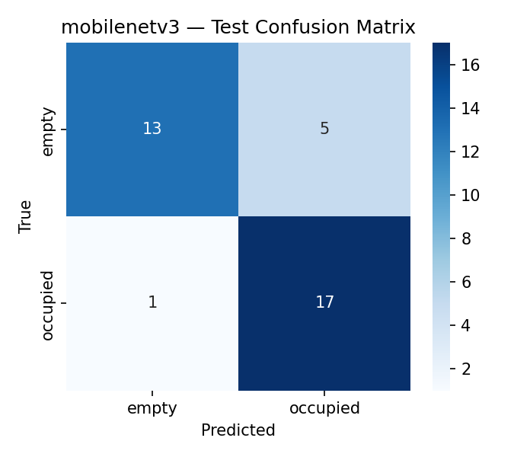
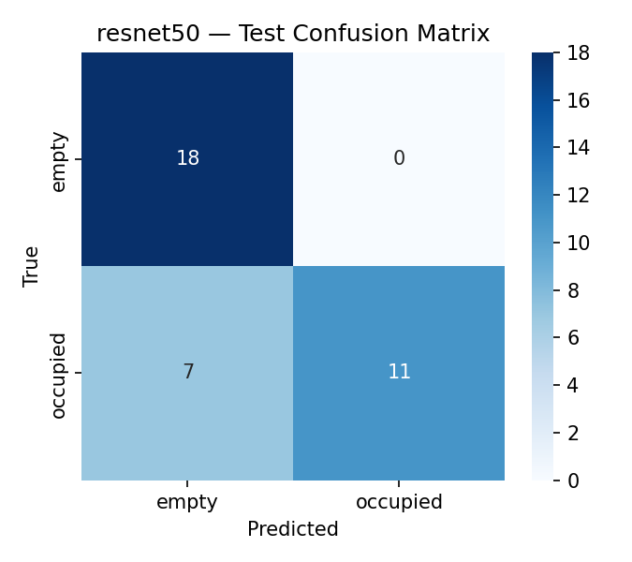
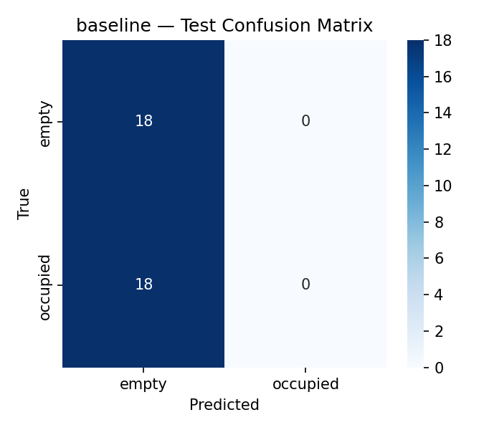
Results — confusion matrices
Where each model is right and wrong on the held-out test set
MobileNetV3
ResNet50
Baseline
CAI2840C · Parking Occupancy Detection · 8/11
Gimeno · Jauregui · Rudes
Notes:
Walk through one matrix: true empty vs occupied. MobileNetV3 recovers both classes; baseline collapses toward one class.

Slide 9
Conditions & failure patterns
Connecting results to H1–H3
MobileNetV3 by weather (demo)
What failures suggest
Rainy
100%
• Vision-only models still struggle at the edges of lighting and layout
• Cross-dataset gaps support the need for diverse training scenes
• Exported failure CSVs support qualitative review (shadows, glare, occlusion)
• Points toward future sensor-fusion—not replacing cameras, complementing them
Cloudy
89%
Sunny
75%
Also tracked: dataset, camera, and scene accuracy when n ≥ 5.
CAI2840C · Parking Occupancy Detection · 9/11
Gimeno · Jauregui · Rudes
Notes:
Link to hypotheses: H1 condition drops, H2 dataset differences, H3 failure cases justify fusion research. Be honest that demo weather labels are synthetic.

Slide 10
What the answer means
Implications for real-time smart parking
Best practical balance
MobileNetV3 combines strong F1 with small size and high FPS—best fit for edge/real-time deployment among the four.
Reliability ≠ one number
Condition and dataset breakdowns matter as much as overall accuracy for city systems.
Vision has limits
Failure patterns under hard conditions motivate camera + ultrasonic / radar / IoT fusion research.
Reproducible framework
Shared splits, configs, and metrics let others extend the study to full PKLot/CNRPark-EXT and optional YOLO.
CAI2840C · Parking Occupancy Detection · 10/11
Gimeno · Jauregui · Rudes
Notes:
Conclude—do not just summarize. Prefer lightweight models for cameras; report condition metrics; plan fusion where vision fails.

Slide 11
Thank you
Questions? Repo: github.com/thefreemannet/Parking
Next steps: full PKLot + CNRPark-EXT training · deeper fine-tuning · optional YOLOv8s/YOLO11n full-scene track
Joaquin Gimeno · Fernando Jauregui · Eliot Rudes · CAI2840C
Notes:
Invite questions. Have failure CSV and confusion matrices ready. Mention GitHub for reproducibility.

