Slide 1
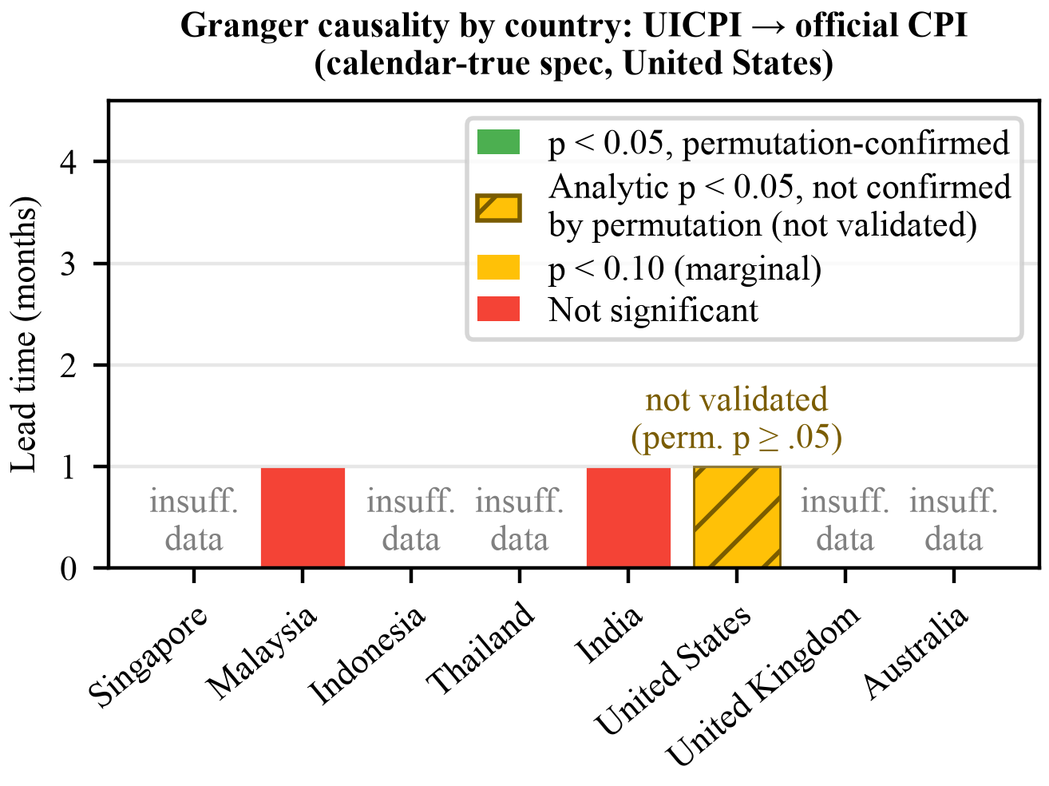
Figure 1. Granger causality by country — UICPI leading official CPI (calendar-true specification for the United States). The US bar is hatched: the analytic p-value clears 0.05 but neither permutation check does.

