Slide 1
KICKOFF MEETING
BUILDING OUR ANTWEIGHT COMBAT ROBOT
One pound of pure attitude, driven from your phone
WEIGHT CLASS
CONTROL
Antweight · 1 lb
Wi-Fi + Browser
Notes:
Welcome everyone, set energy high. Introduce the club and today's agenda.

Slide 2
TODAY'S SESSION
AGENDA
01
04
What is antweight combat robotics
How we'll build it, step by step
02
05
Meet our robot, AntBot-S3
Driving and safety basics
03
06
What we'll need to build it
Getting started together
Notes:
Walk through what we'll cover today at a high level.

Slide 3
THE SPORT
WHAT IS ANTWEIGHT COMBAT ROBOTICS
Two remote-controlled robots, one arena, three minutes. Builders design and drive machines armed with spinners, wedges, and hammers — and the last one still moving wins.
PHOTO: antweight bots battling in a combat arena
1 lb
3 min
Antweight class limit
Typical match length
Notes:
Give a quick, energetic taste of the sport before diving into our build.

Slide 4
THE SPORT
HOW A MATCH IS WON
Knockout
Judges' Decision
Weapon Styles Vary
Immobilize the other bot completely and the match ends early — the clearest win in the sport.
If time runs out, judges score on damage dealt, control, and aggression to pick a winner.
Spinners, flippers, wedges, and hammers are all common — our build uses a spinning weapon.
Notes:
Cover format simply: how you win, why it's approachable for our club to enter.

Slide 5
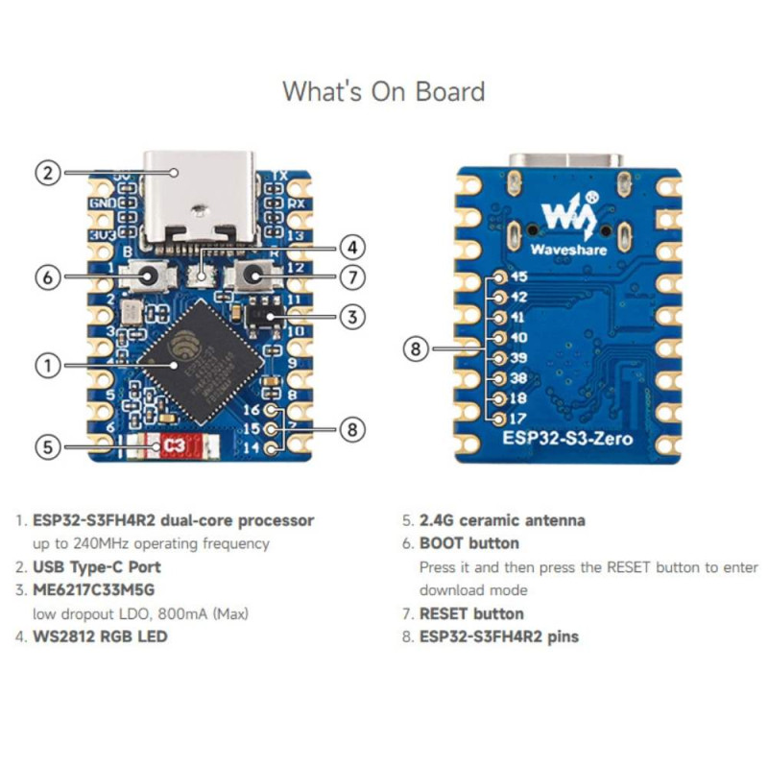
OUR ROBOT
MEET ANTBOT-S3
A microcontroller board is the entire brain — it makes its own Wi-Fi network, so a phone or laptop can drive it straight from a browser. No transmitter, no receiver, no radio gear.
ESP32-S3 DevKit
BRAIN
Hosts Wi-Fi, turns joystick input into motor commands.
DRV8833 + 2× N20
DRIVE
Tank steering, two gear motors, brakes to a stop.
WEAPON
Brushless ESC + Motor
Throttle only, no reverse.
Notes:
Introduce the robot's three functional systems: brain, drive, weapon.

Slide 6
OUR ROBOT
DRIVEN BY WI-FI, NOT RADIO
1
The robot creates its own Wi-Fi network on power-up.
2
Your phone or laptop joins that network and opens a browser.
3
A joystick and weapon slider load right on the page — no app to install.
on-screen joystick, phone browser
Notes:
Explain the phone-as-controller approach and why it's simpler than RC gear.

Slide 7
THE BUILD
WHAT WE'LL NEED
PART
SPEC
QTY
2S LiPo Battery
7.4V nominal, high discharge
1
ESP32-S3 DevKit
Board with onboard RGB status LED
1
DRV8833 Motor Driver
2-channel H-bridge breakout
1
N20 Gear Motors
~500 RPM class @ 6V
2
Brushless Weapon ESC
Slim profile, 15A, 2S, throttle-only
1
Weapon Motor
Brushless, sized to the ESC
1
Connectors & Wire
JST-XH, XT30, silicone wire, heat-shrink
—
Notes:
Show the core parts we'll each need to source before building.

Slide 8
THE BUILD
HOW WE'LL BUILD IT
01
02
03
04
05
Set Up Software
Plan The Layout
Wire The Harness
Flash Firmware
Test & Drive
Install the Arduino IDE and get the robot's code onto your computer.
Dry-fit battery, driver, brain, and ESC before cutting wire.
Build power, signal, and motor connections per the pinout.
Set the pin numbers and Wi-Fi name, then upload it.
Run the checklist, then drive it lifted off the ground.
Notes:
Walk through the five stages of the build in order.

Slide 9
THE BUILD
WIRING IT UP
Every signal on the board comes straight from its own GPIO pins — five wires tell the robot how to move and fire.
SIGNAL
GPIO
GOES TO
WEAPON_PIN
6
Weapon ESC signal
KEEP IT SIMPLE
One shared power bus, short direct signal runs, and keyed connectors — nothing can plug in backward.
L_IN1 / L_IN2
7 / 8
Left motor driver
R_IN2 / R_IN1
9 / 10
Right motor driver
ONLY TWO PLUGS
Everything else solders direct — the battery connector and the weapon signal pigtail are the only joints you'll unplug.
Notes:
Show the pin reference at a moderate level of detail, not the full wiring diagram.

Slide 10
DRIVING & SAFETY
EVERY BOOT STARTS STOPPED
Boot
Ready
Armed
Failsafe
Motors braked, weapon held at zero throttle for 3 seconds while the ESC arms.
LED turns solid — Wi-Fi is up, waiting for a browser to connect.
Tap ACTIVATE in the browser — bot is now live at zero throttle.
Lose the link or hit STOP ALL for 1.2 seconds and it re-latches instantly.
Notes:
This is the key safety concept: the robot always boots stopped and needs an explicit activate.

Slide 11
DRIVING & SAFETY
DRIVING THE BOT
1
2
3
4
Join the robot's Wi-Fi network from your phone or laptop.
Open a browser to the robot's address — the joystick page loads automatically.
Tap ACTIVATE, then drag the pad to drive and the slider to spin the weapon.
Tap STOP ALL — or hit Escape — any time to hard-stop instantly.
Notes:
Walk through actually connecting and driving once at the club table.

Slide 12
PRE-FLIGHT CHECKLIST
BEFORE EVERY RUN
Battery voltage checked before connecting.
No exposed wiring, all heat-shrink intact.
Weapon area clear of fingers and tools.
Status LED confirmed solid before activating.
First test drive done with wheels off the ground.
Weapon tested briefly at low throttle first.
Failsafe confirmed by closing the browser tab.
STOP ALL tested and re-latch confirmed.
Notes:
Emphasize this is run every single time, not just once.

Slide 13
DRIVING & SAFETY
RULES WE NEVER SKIP
Disconnect the main battery whenever the bot isn't actively being driven.
Keep hands, tools, and loose clothing clear of the weapon any time the battery is connected.
Wear eye protection and restrain the robot during weapon testing.
Re-run the full pre-flight checklist after any rewiring or firmware change.
Notes:
This is a non-negotiable slide — read through calmly and clearly.

Slide 14
LET'S GET STARTED
FROM PARTS LIST TO ARENA READY
One board, one battery, and a browser — everything else is just following the steps together.
See you at the build table.
Notes:
Close with energy — recap what we covered and get everyone excited to start.

Slide 15
KICKOFF MEETING
BUILDING OUR ANTWEIGHT COMBAT ROBOT
One pound of pure attitude, driven from your phone
WEIGHT CLASS
CONTROL
Antweight · 1 lb
Wi-Fi + Browser
Notes:
Welcome everyone, set energy high. Introduce the club and today's agenda.

Slide 16
TODAY'S SESSION
AGENDA
01
04
What is antweight combat robotics
How we'll build it, step by step
02
05
Meet our robot, AntBot-S3
Driving and safety basics
03
06
What we'll need to build it
Getting started together
Notes:
Walk through what we'll cover today at a high level.

Slide 17
THE SPORT
WHAT IS ANTWEIGHT COMBAT ROBOTICS
Two remote-controlled robots, one arena, three minutes. Builders design and drive machines armed with spinners, wedges, and hammers — and the last one still moving wins.
PHOTO: antweight bots battling in a combat arena
1 lb
3 min
Antweight class limit
Typical match length
Notes:
Give a quick, energetic taste of the sport before diving into our build.

Slide 18
THE SPORT
HOW A MATCH IS WON
Knockout
Judges' Decision
Weapon Styles Vary
Immobilize the other bot completely and the match ends early — the clearest win in the sport.
If time runs out, judges score on damage dealt, control, and aggression to pick a winner.
Spinners, flippers, wedges, and hammers are all common — our build uses a spinning weapon.
Notes:
Cover format simply: how you win, why it's approachable for our club to enter.

Slide 19
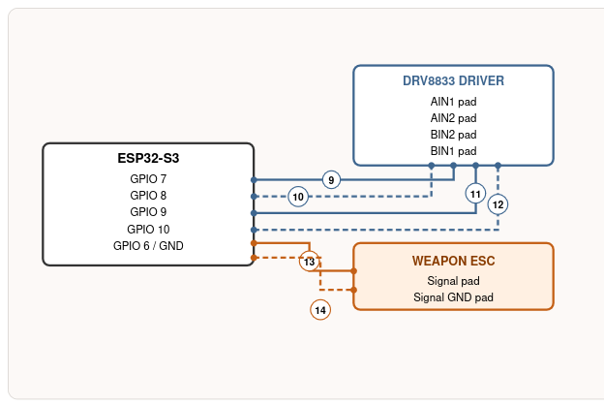
OUR ROBOT
MEET ANTBOT-S3
A microcontroller board is the entire brain — it makes its own Wi-Fi network, so a phone or laptop can drive it straight from a browser. No transmitter, no receiver, no radio gear.
ESP32-S3 DevKit
BRAIN
Hosts Wi-Fi, turns joystick input into motor commands.
DRV8833 + 2× N20
DRIVE
Tank steering, two gear motors, brakes to a stop.
WEAPON
Brushless ESC + Motor
Throttle only, no reverse.
Notes:
Introduce the robot's three functional systems: brain, drive, weapon.

Slide 20
OUR ROBOT
DRIVEN BY WI-FI, NOT RADIO
1
The robot creates its own Wi-Fi network on power-up.
2
Your phone or laptop joins that network and opens a browser.
3
A joystick and weapon slider load right on the page — no app to install.
on-screen joystick, phone browser
Notes:
Explain the phone-as-controller approach and why it's simpler than RC gear.

Slide 21
THE BUILD
WHAT WE'LL NEED
PART
SPEC
QTY
2S LiPo Battery
7.4V nominal, high discharge
1
ESP32-S3 DevKit
Board with onboard RGB status LED
1
DRV8833 Motor Driver
2-channel H-bridge breakout
1
N20 Gear Motors
~500 RPM class @ 6V
2
Brushless Weapon ESC
Slim profile, 15A, 2S, throttle-only
1
Weapon Motor
Brushless, sized to the ESC
1
Connectors & Wire
JST-XH, XT30, silicone wire, heat-shrink
—
Notes:
Show the core parts we'll each need to source before building.

Slide 22
THE BUILD
HOW WE'LL BUILD IT
01
02
03
04
05
Set Up Software
Plan The Layout
Wire The Harness
Flash Firmware
Test & Drive
Install the Arduino IDE and get the robot's code onto your computer.
Dry-fit battery, driver, brain, and ESC before cutting wire.
Build power, signal, and motor connections per the pinout.
Set the pin numbers and Wi-Fi name, then upload it.
Run the checklist, then drive it lifted off the ground.
Notes:
Walk through the five stages of the build in order.

Slide 23
THE BUILD
WIRING IT UP
Every signal on the board comes straight from its own GPIO pins — five wires tell the robot how to move and fire.
SIGNAL
GPIO
GOES TO
WEAPON_PIN
6
Weapon ESC signal
KEEP IT SIMPLE
One shared power bus, short direct signal runs, and keyed connectors — nothing can plug in backward.
L_IN1 / L_IN2
7 / 8
Left motor driver
R_IN2 / R_IN1
9 / 10
Right motor driver
ONLY TWO PLUGS
Everything else solders direct — the battery connector and the weapon signal pigtail are the only joints you'll unplug.
Notes:
Show the pin reference at a moderate level of detail, not the full wiring diagram.

Slide 24
DRIVING & SAFETY
EVERY BOOT STARTS STOPPED
Boot
Ready
Armed
Failsafe
Motors braked, weapon held at zero throttle for 3 seconds while the ESC arms.
LED turns solid — Wi-Fi is up, waiting for a browser to connect.
Tap ACTIVATE in the browser — bot is now live at zero throttle.
Lose the link or hit STOP ALL for 1.2 seconds and it re-latches instantly.
Notes:
This is the key safety concept: the robot always boots stopped and needs an explicit activate.

Slide 25
DRIVING & SAFETY
DRIVING THE BOT
1
2
3
4
Join the robot's Wi-Fi network from your phone or laptop.
Open a browser to the robot's address — the joystick page loads automatically.
Tap ACTIVATE, then drag the pad to drive and the slider to spin the weapon.
Tap STOP ALL — or hit Escape — any time to hard-stop instantly.
Notes:
Walk through actually connecting and driving once at the club table.

Slide 26
PRE-FLIGHT CHECKLIST
BEFORE EVERY RUN
Battery voltage checked before connecting.
No exposed wiring, all heat-shrink intact.
Weapon area clear of fingers and tools.
Status LED confirmed solid before activating.
First test drive done with wheels off the ground.
Weapon tested briefly at low throttle first.
Failsafe confirmed by closing the browser tab.
STOP ALL tested and re-latch confirmed.
Notes:
Emphasize this is run every single time, not just once.

Slide 27
DRIVING & SAFETY
RULES WE NEVER SKIP
Disconnect the main battery whenever the bot isn't actively being driven.
Keep hands, tools, and loose clothing clear of the weapon any time the battery is connected.
Wear eye protection and restrain the robot during weapon testing.
Re-run the full pre-flight checklist after any rewiring or firmware change.
Notes:
This is a non-negotiable slide — read through calmly and clearly.

Slide 28
LET'S GET STARTED
FROM PARTS LIST TO ARENA READY
One board, one battery, and a browser — everything else is just following the steps together.
See you at the build table.
Notes:
Close with energy — recap what we covered and get everyone excited to start.

