Slide 1

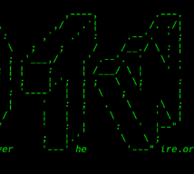
OverTheWire: Bandits

Slide 2
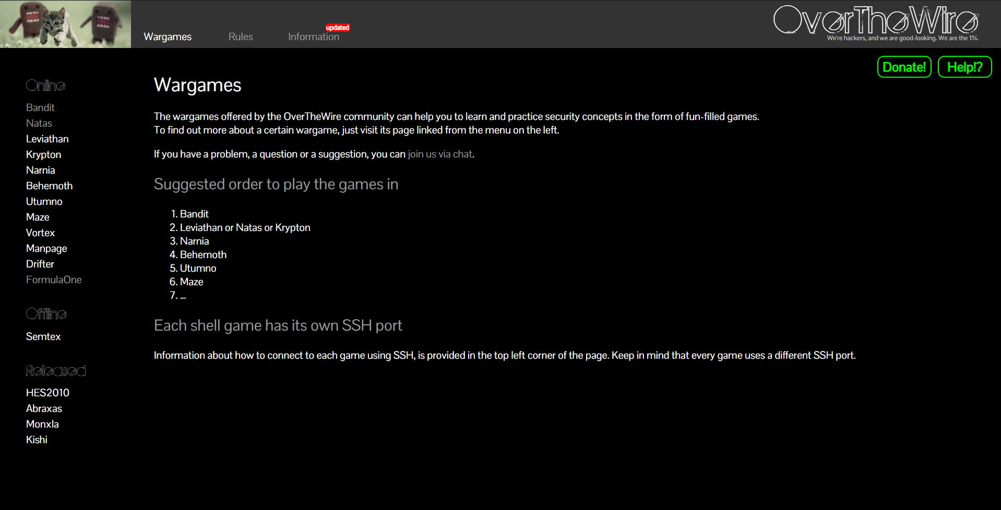

Slide 3

Bandits:
series of levels where you solve challenges to progress.
Linux Command Line Usage
System navigation
Using SSH for remote access

Slide 4
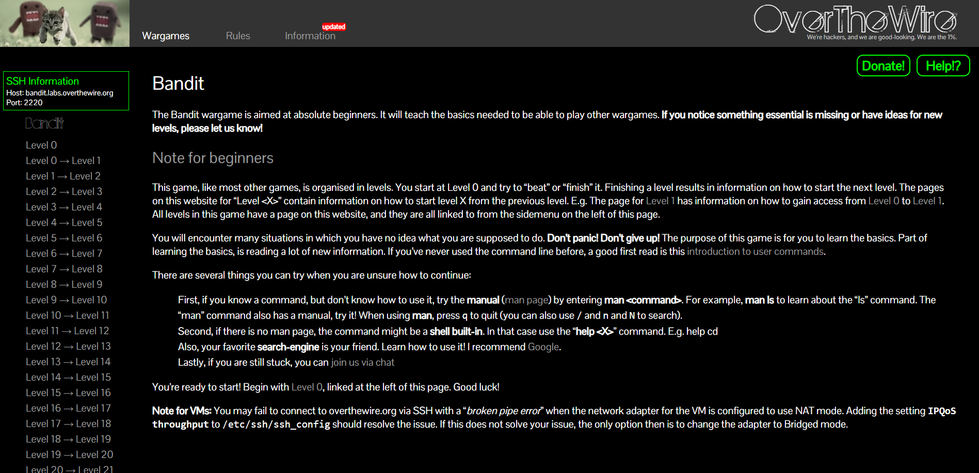

Slide 5
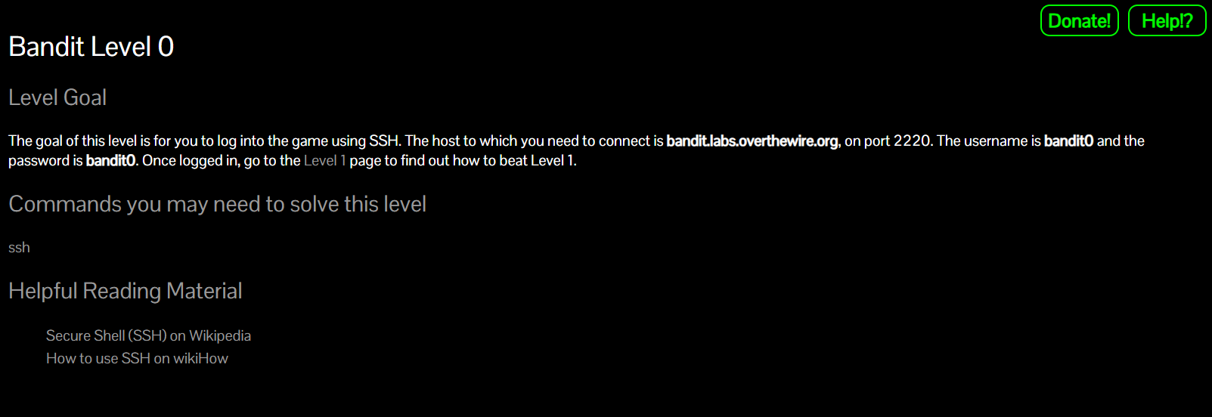

Slide 6
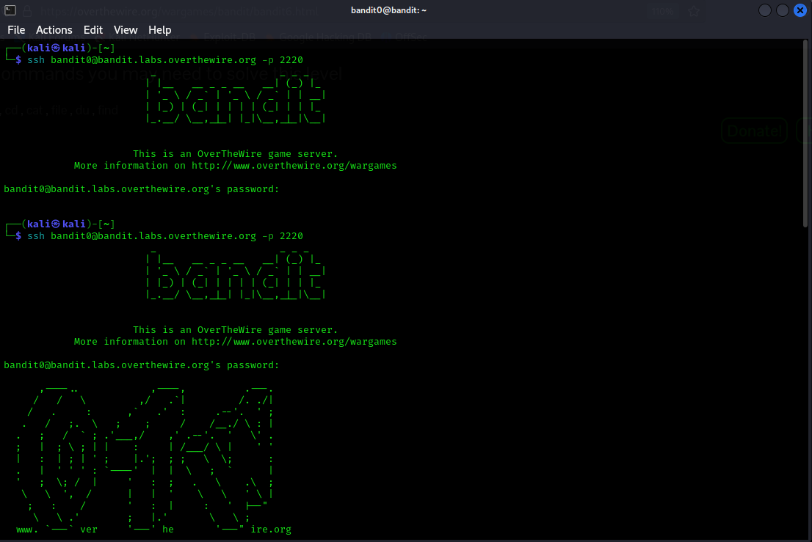

Slide 7


Slide 8
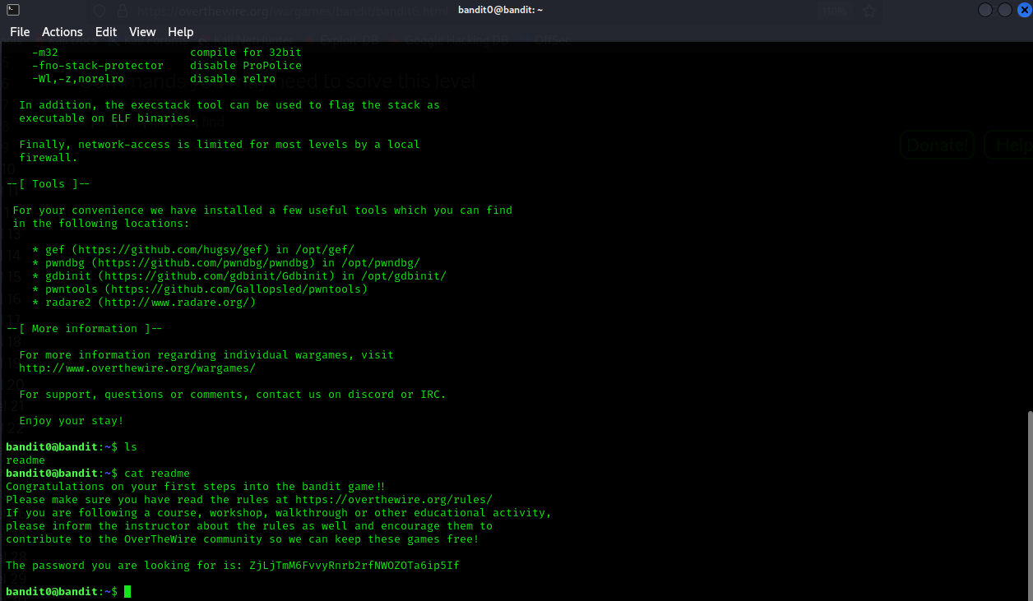

Slide 9


Slide 10
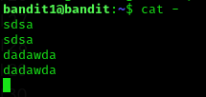

Slide 11


Slide 12


Slide 13
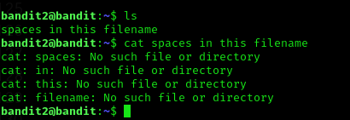

Slide 14


Slide 15


Slide 16
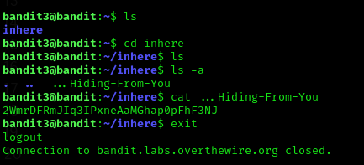

Slide 17


Slide 18


Slide 19
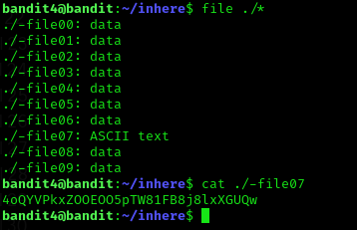

Slide 20
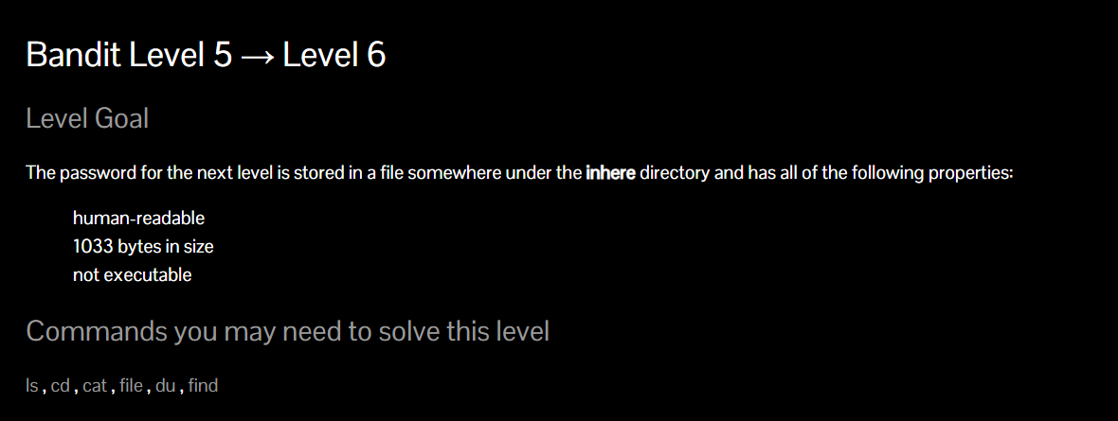

Slide 21


Slide 22
REFERENCES FOR WRITEUPS:
https://blog.certcube.com/overthewire-bandit-1-to-15-full-writeup/

