Slide 1
Neural networks capable of finding medication complaints in social networks
Gajan Nagaraj
CS35L Fall
11/12/18

Slide 2




“I am a little giddy”
“I Cannot get asleep all night”

Slide 3
Introduction
Researchers from Kazan Federal University and Moscow Institute of Physics and Technology found designed an artificial neural network capable of finding medication complaints in social networks
Social media provides huge datasets of people’s opinions complete with demographic information and often much more detailed data regarding a specific user
Harnessing this data, we can train a computer to make informed predictions about the user

Slide 4
High Level Implementation
Social Media Data
Medical Concept Normalization
Diagnosis

Slide 5
Medical Concept Normalization
Social Media Language
Formal Medical Language
“I am a little giddy”
insomnia
“I Cannot get asleep all night”
dizziness
Bridging the gap between the language of the lay public and medical professionals

Slide 6
Problem
Social network data usually contains a lot of noise:
Misspelled words
Incorrect grammar
Abnormal characters or phrases (e.g. hashtags)
Abbreviations
Different variations of the same word
How can we process social media data despite all this noise?

Slide 7
Recurrent Neural Networks

Slide 8
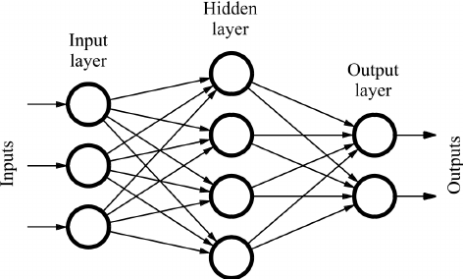
Neural Network
A computational graph
Simplest kind of NNs are Feed-Forward Networks
One layer in a FFN is a transformation of an input vector to a output vector by multiplying it by some weight matrix and applying some non-linear function afterward

Slide 9
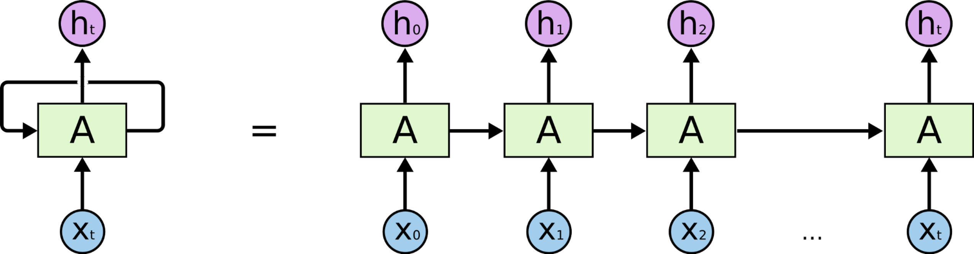
Recurrent Neural Networks
Class of artificial neural network where connections between units form a directed graph along a sequence
Exhibit dynamic temporal behavior
RNNs can use their internal state to process sequences of inputs

Slide 10
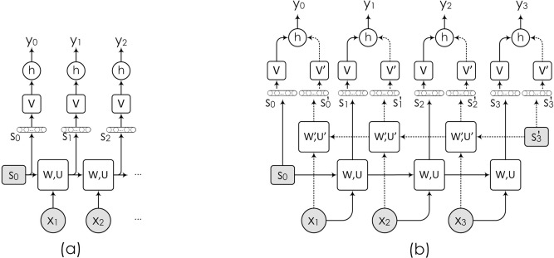

Slide 11
Utilizing the RNN
Medical texts were uploaded to the model, and a special vocabulary was created
Model used vocabulary to assign a vector for each input word
Upload social media texts to model
Compares them to the medical vocabulary
The outputs are word vectors
Words and terms often encountered in a similar context are assigned similar meaning
Essentially, the neural network “compares” user texts and official medical terms

Slide 12
Another Look
Social Media Data
Medical Concept Normalization
Diagnosis
Recurrent neural networks work well with serialized data because they can find links between elements while taking consideration of the context.

Slide 13
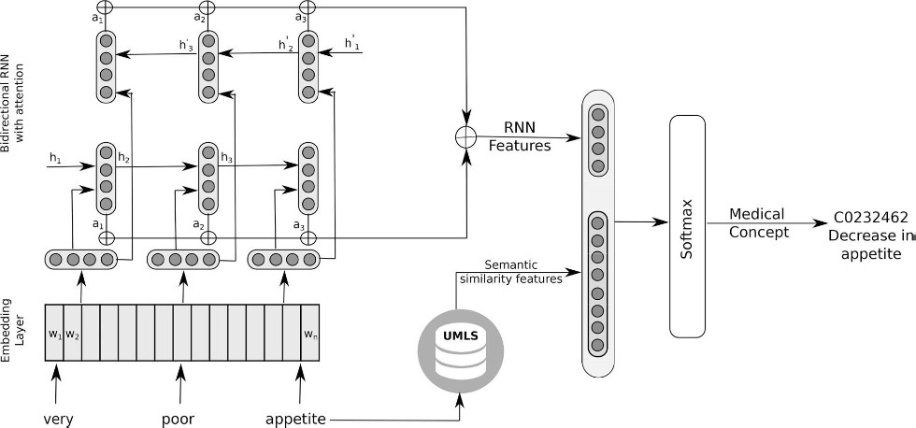
Current Learning Model

Slide 14
Conclusion
The following text analytics method of diagnosing a patient can also be used to directly rather than a separate medium
We can return full circle and use this data to understand how a symptom effects the user
This study shows that we can potentially train computers to understand and interpret other human behaviors
Find meaning from other social media posts
Overall better understanding of human slang

Slide 15
Citation
“Artificial Neural Network Now Capable of Finding Medication Complaints in Social Networks.” Artificial Neural Network Now Capable of Finding Medication Complaints in Social Networks, Kazan Federal University, 17 Sept. 2018, kpfu.ru/eng/news-eng/artificial-neural-network-medication-text-analysis.html.
Shekhar, Amit. “Understanding The Recurrent Neural Network – MindOrks – Medium.” Medium, Medium, 14 Apr. 2018, medium.com/mindorks/understanding-the-recurrent-neural-network-44d593f112a2.
Tutubalina, Elena. “Medical Concept Normalization in Social Media Posts with Recurrent Neural Networks.” NeuroImage, Academic Press, 12 June 2018, www.sciencedirect.com/science/article/pii/S1532046418301126.

