Slide 1
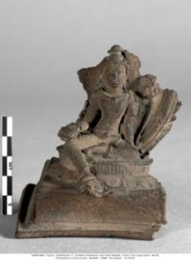
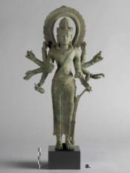
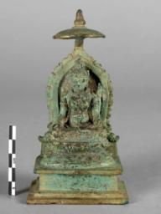
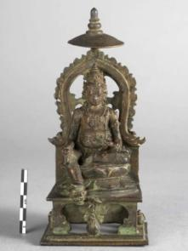
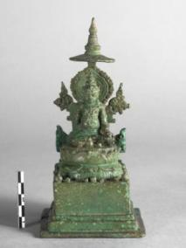
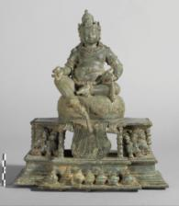
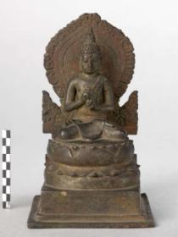
Case Study 4 – The technical investigation of 8th-10th c statuettes from Indonesia
8th-early 9th c
(Category 1)
1st half 9th c
(Category 2)
2nd half 9th c
(Category 2)
Late 9th c
(Category 2)
1st half 10th c
(category 3)
MG 3816
FIG 434
FIG 963
MG 2255
FIG 964
MG 3619
FIG 161
MG 3625
FIG 423
MA 507
MG 3814 (Bangladesh)
FIG 166
MG 18290
FIG 437
Home
Main Questions
Fabrication technique
Cold working
Consecration deposit
Metal composition
Summary of findings
Synopsis of technical parameters
Further Questions
Further Resources

Slide 2
Main questions
8th-early 9th c
(Category 1)
1st half 9th c
(Category 2)
2nd half 9th c
(Category 2)
Late 9th c
(Category 2)
1st half 10th c
(category 3)
MG 3816
FIG 434
FIG 963
MG 2255
FIG 964
MG 3619
FIG 161
MG 3625
FIG 423
MA 507
MG 3814 (Bangladesh)
FIG 166
MG 18290
FIG 437
Home
Main Questions
Fabrication technique
Cold working
Consecration deposit
Metal composition
Summary of findings
Synopsis of technical parameters
Further Questions
Further Resources

Slide 3
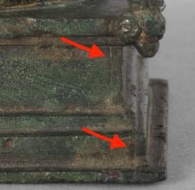
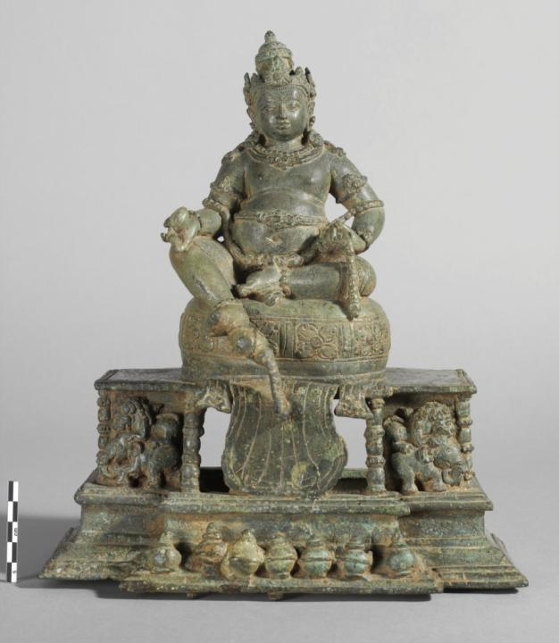
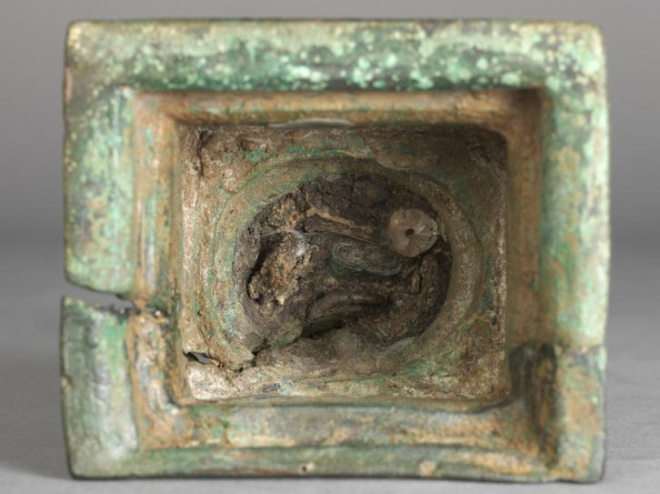
Casting technique: lost- wax casts with numerous wax assemblies
MG 18290
MG 3625
FIG 423
FIG 166
FIG 430
MG 3814
Main questions
Fabrication technique
Cold working
Consecration deposit
Metal composition
Summary of findings
Synopsis of technical parameters
Further Questions
Further Resources
Home

Slide 4
Casting technique: solid-cast figures
FIG 448
FIG 447
Main questions
Fabrication technique
Cold working
Consecration deposit
Metal composition
Summary of findings
Synopsis of technical parameters
Further Questions
Further Resources
Home

Slide 5

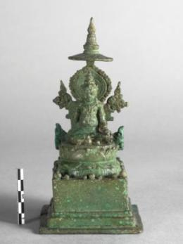
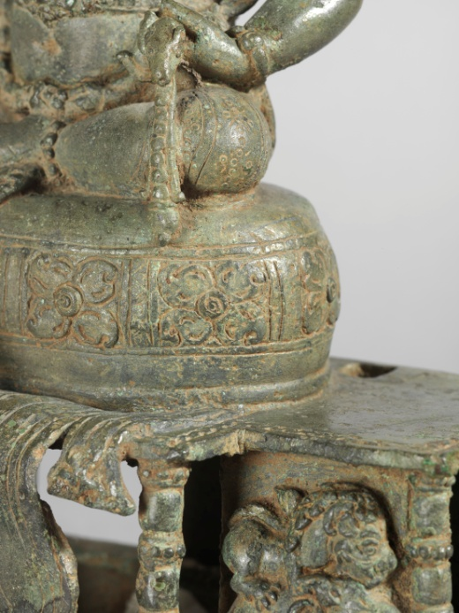
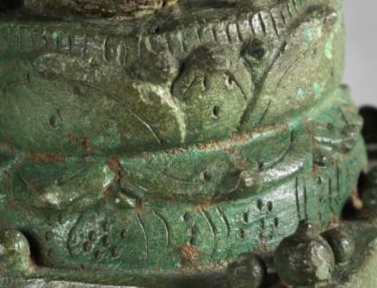
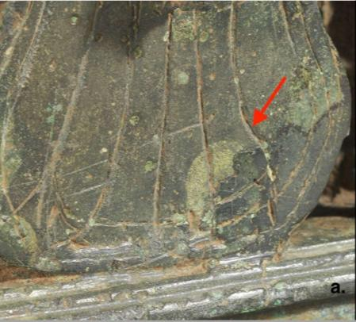
Visual evidence of extensive cold work
FIG 166
FIG 423
FIG 167
FIG 425
FIG 166 zoom in
Main questions
Fabrication technique
Cold working
Consecration deposit
Metal composition
Summary of findings
Synopsis of technical parameters
Further Questions
Further Resources
Home

Slide 6
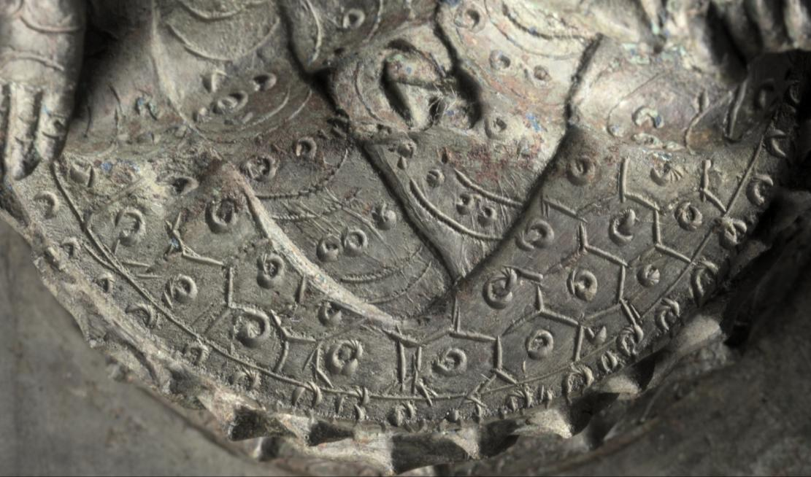
Engraving, as suggested by Reflectance Transformation Imaging (RTI)
FIG 191
MG 3822
Main questions
Fabrication technique
Cold working
Consecration deposit
Metal composition
Summary of findings
Synopsis of technical parameters
Further Questions
Further Resources
Home

Slide 7
Metal punching confirmed by digital microscopy
Fig. 235
Fig. 236
Main questions
Fabrication technique
Cold working
Consecration deposit
Metal composition
Summary of findings
Synopsis of technical parameters
Further Questions
Further Resources
Home

Slide 8
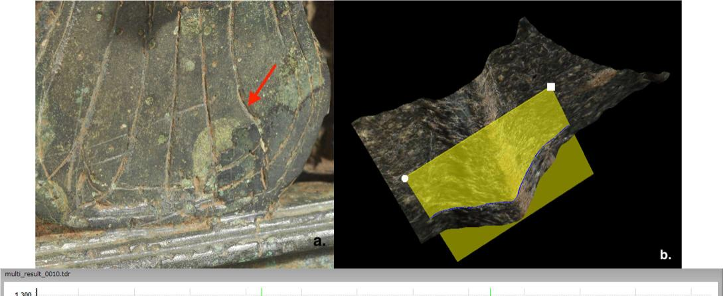
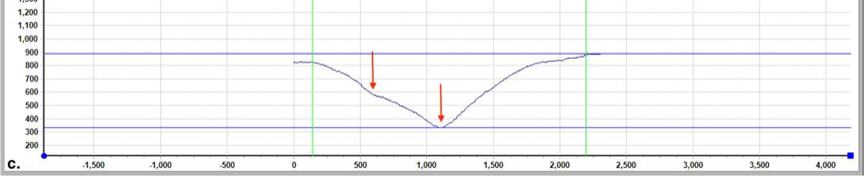
Metal engraving over wax preparatory drawing confirmed by digital microscopy
FIG 166 zoom in
FIG 169
Main questions
Fabrication technique
Cold working
Consecration deposit
Metal composition
Summary of findings
Synopsis of technical parameters
Further Questions
Further Resources
Home

Slide 9
Cavities filled with dense material
FIG 445
Main questions
Fabrication technique
Cold working
Consecration deposit
Metal composition
Summary of findings
Synopsis of technical parameters
Further Questions
Further Resources
Home

Slide 10
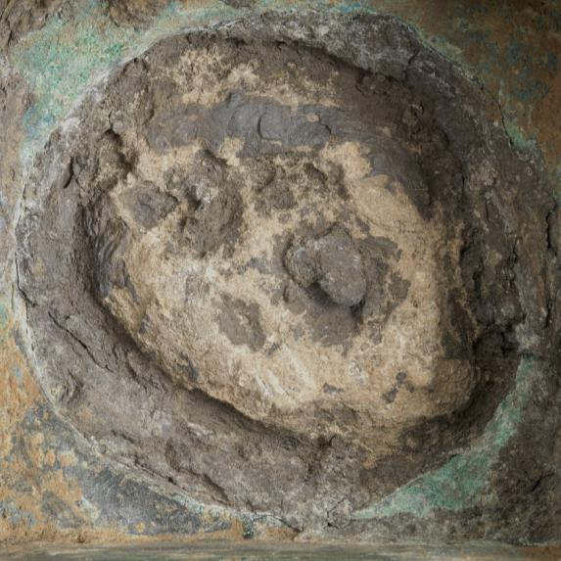
Consecration deposits revealed from below
FIG 423
FIG 437
FIG 442
FIG 430
MG 3625
MG 18290
Main questions
Fabrication technique
Cold working
Consecration deposit
Metal composition
Summary of findings
Synopsis of technical parameters
Further Questions
Further Resources
Home

Slide 11
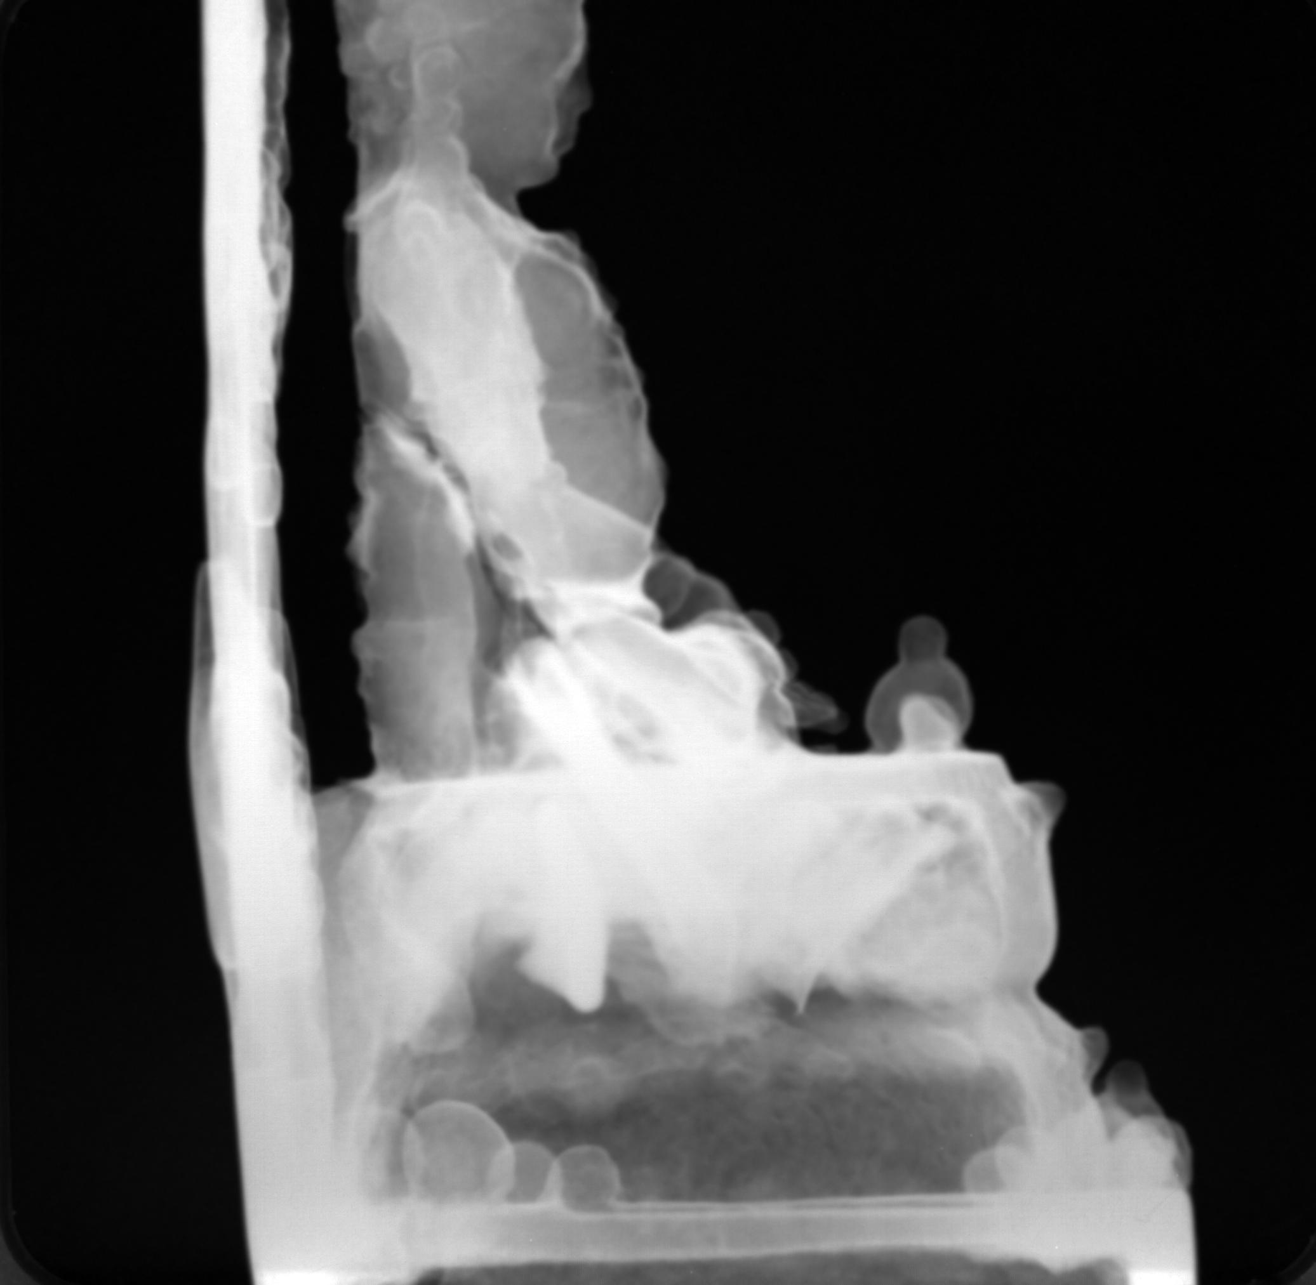
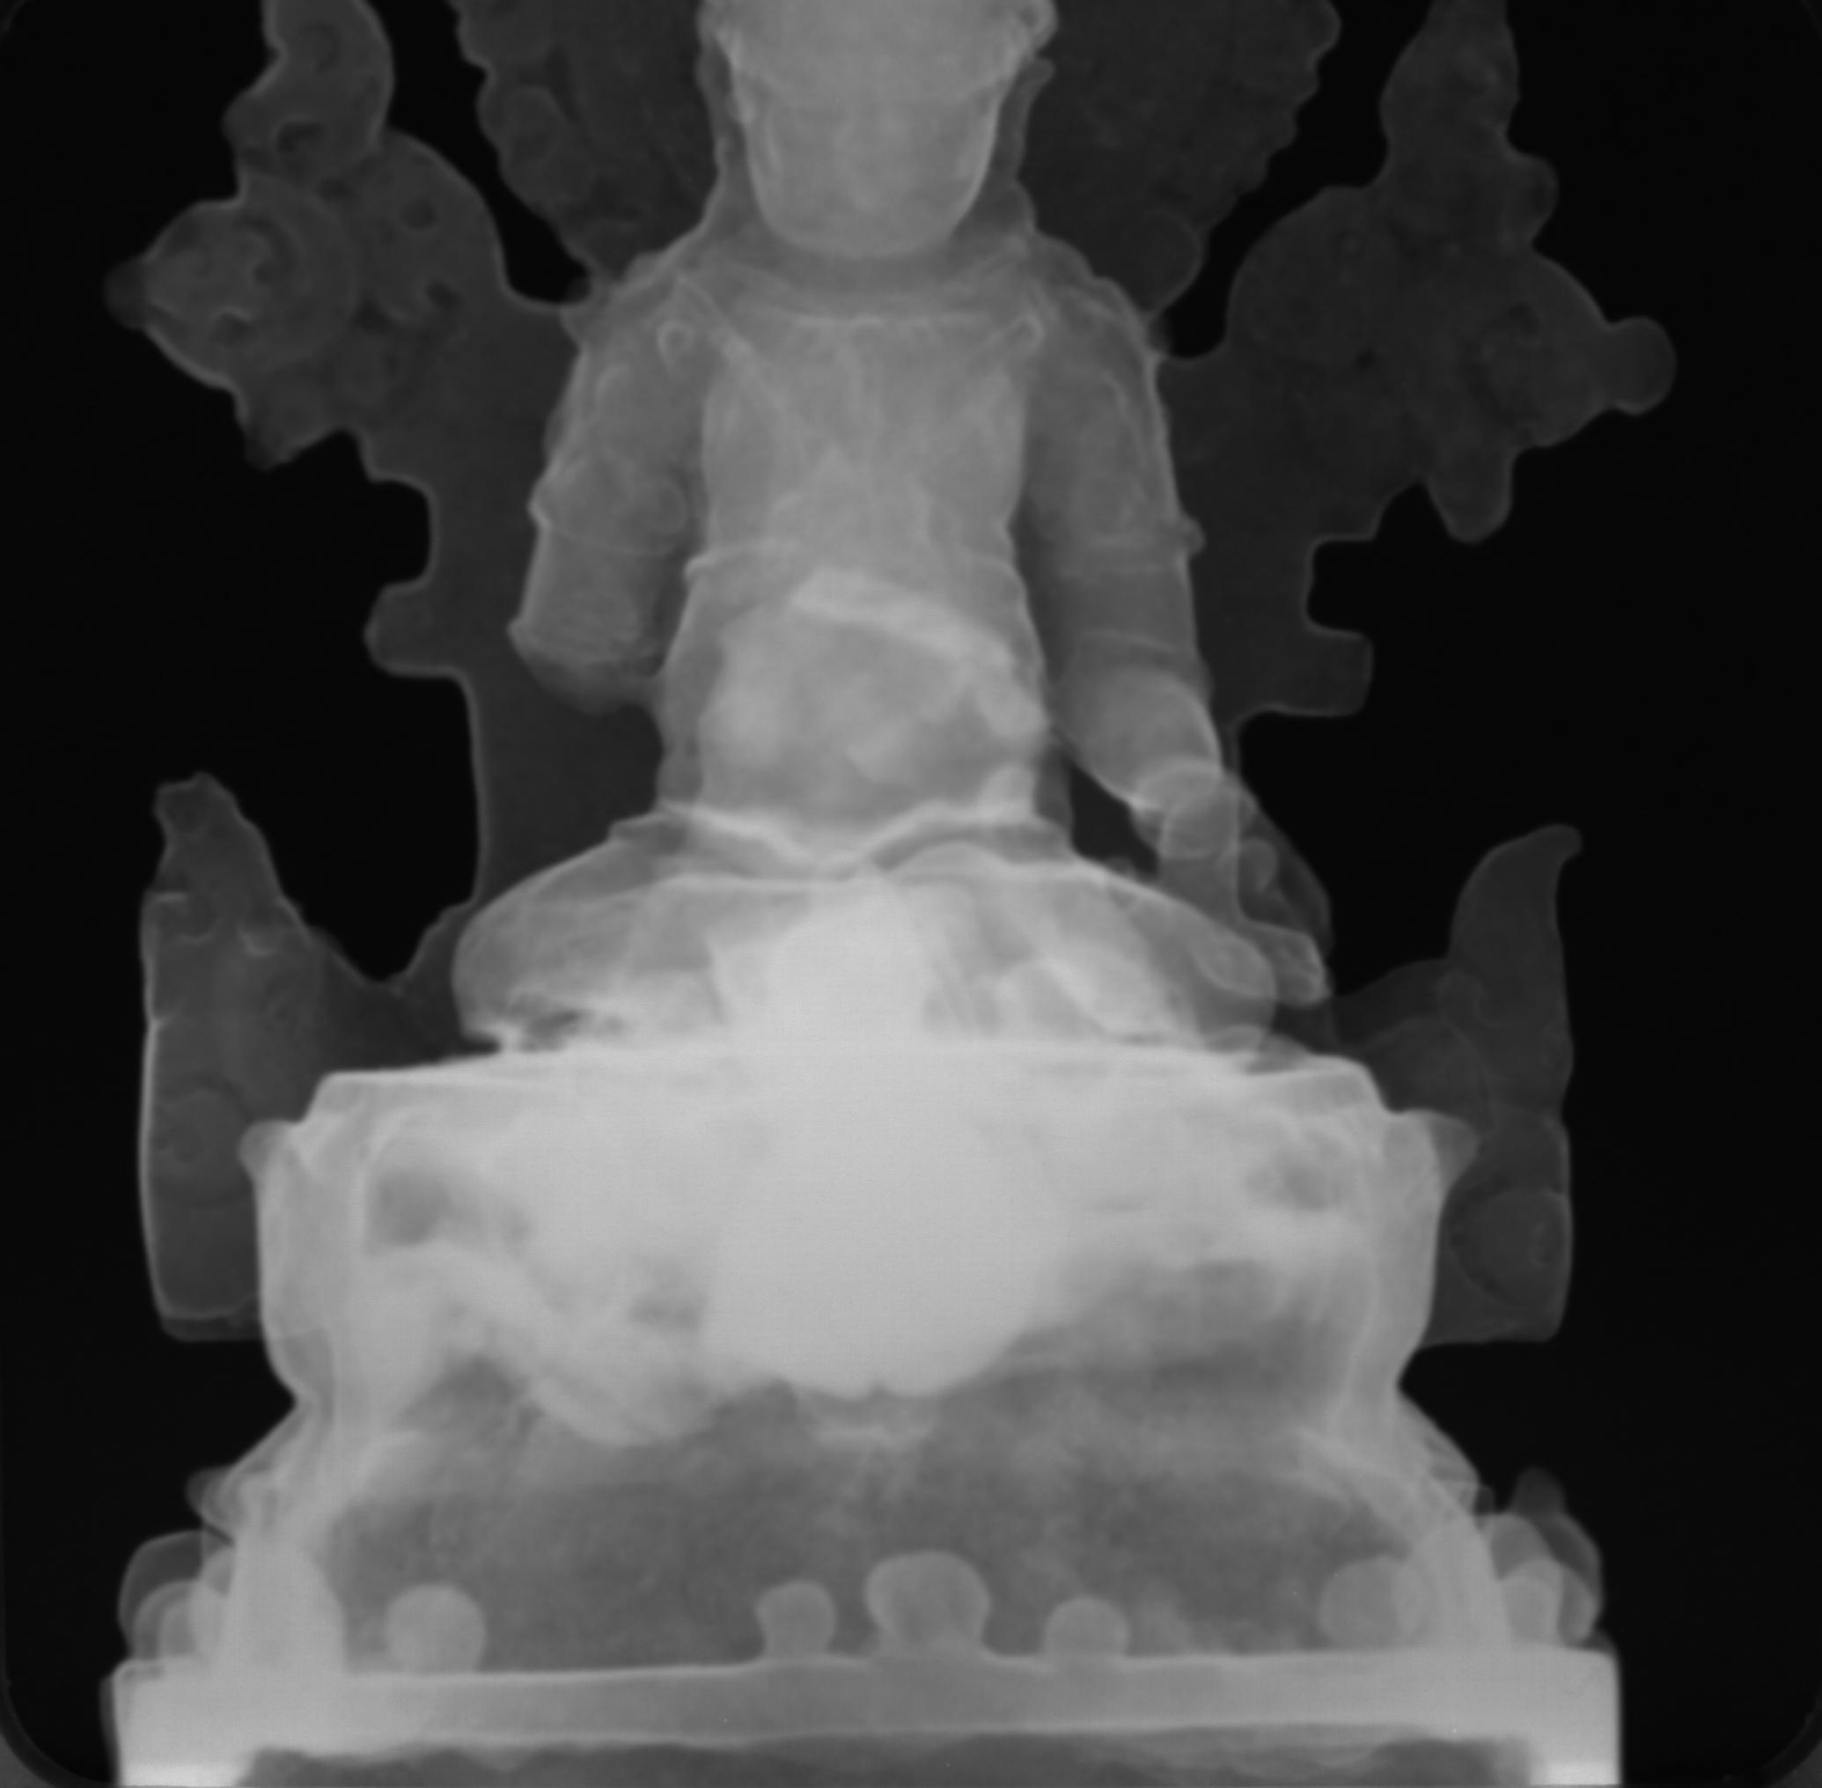
Consecration deposits revealed by neutron radiography and tomography
FIG 444
FIG 443
X-radiographs
MG 3625
Nuetron radiographs
Main questions
Fabrication technique
Cold working
Consecration deposit
Metal composition
Summary of findings
Synopsis of technical parameters
Further Questions
Further Resources
Home
Home

Slide 12
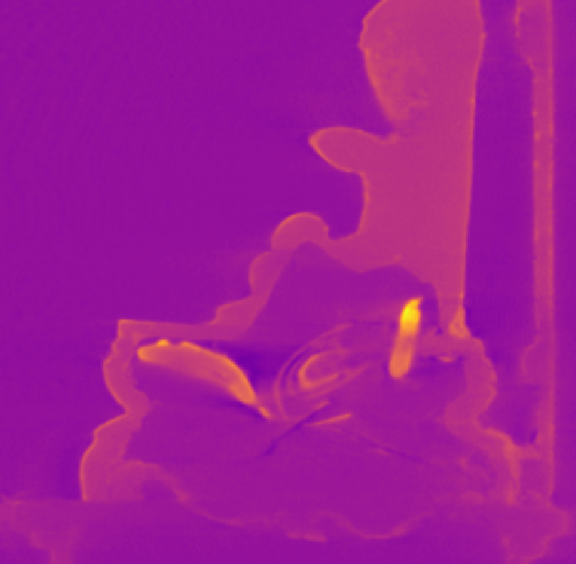
Consecration deposits revealed by neutron radiography and tomography
FIG 449
Spinning of the raw neutron radiographies
Slicing the statue
MG 18290
Main questions
Fabrication technique
Cold working
Consecration deposit
Metal composition
Summary of findings
Synopsis of technical parameters
Further Questions
Further Resources
Home
Home

Slide 13
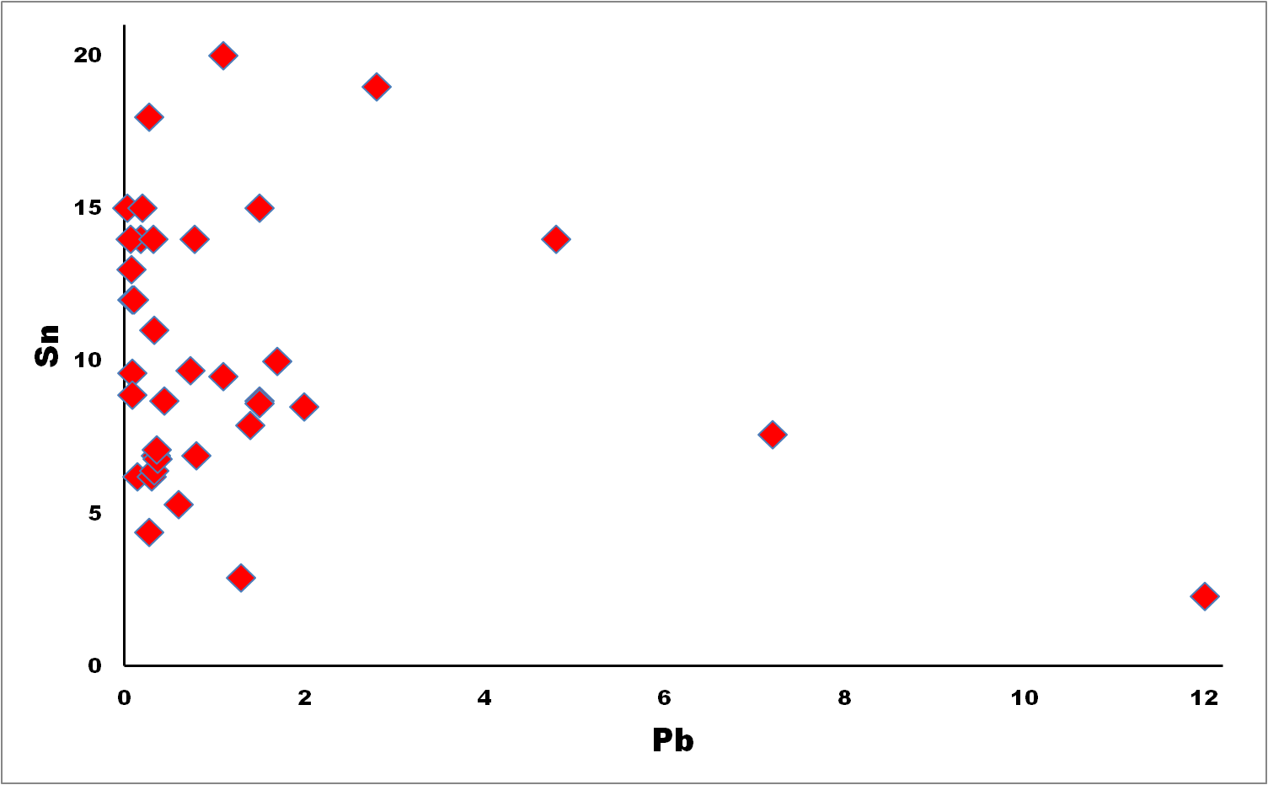
Alloy composition
Main questions
Fabrication technique
Cold working
Consecration deposit
Metal composition
Summary of findings
Synopsis of technical parameters
Further Questions
Further Resources
Home
Home

Slide 14
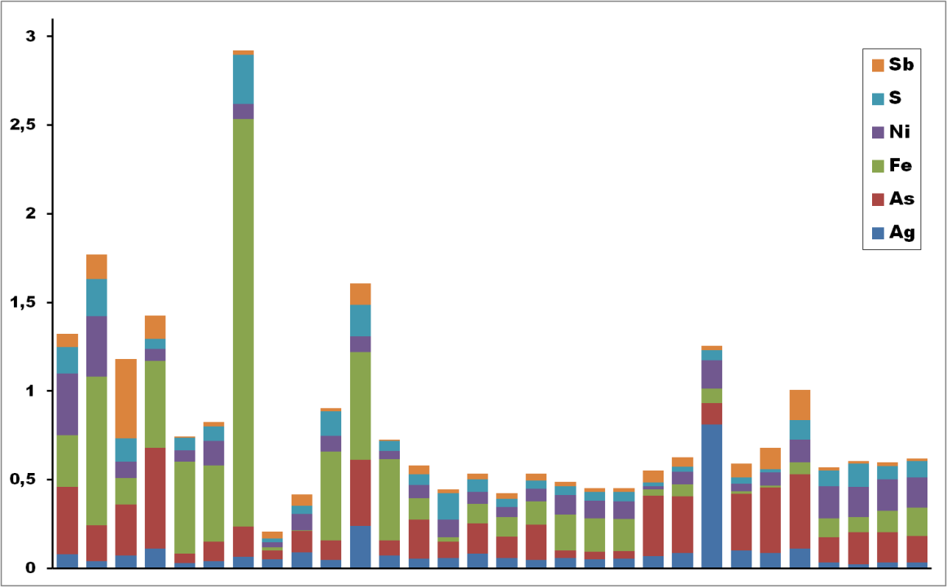
Impurities in the metal
Main questions
Fabrication technique
Cold working
Consecration deposit
Metal composition
Summary of findings
Synopsis of technical parameters
Further Questions
Further Resources
Home
Home

Slide 15
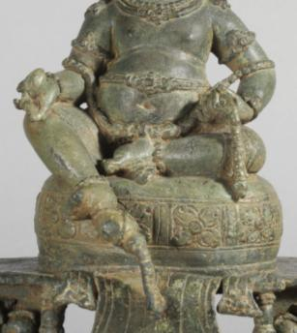
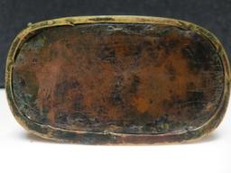
Summary of findings – Consistent features of Indonesian production
FIG 448
FIG 447
FIG 166
Cavities sealed with liquid metal instead of hammered sheets
Solid cast
Extensive wax working
Unleaded tin bronzes with high levels of tin
Main questions
Fabrication technique
Cold working
Consecration deposit
Metal composition
Summary of findings
Synopsis of technical parameters
Further Questions
Further Resources
Home

Slide 16

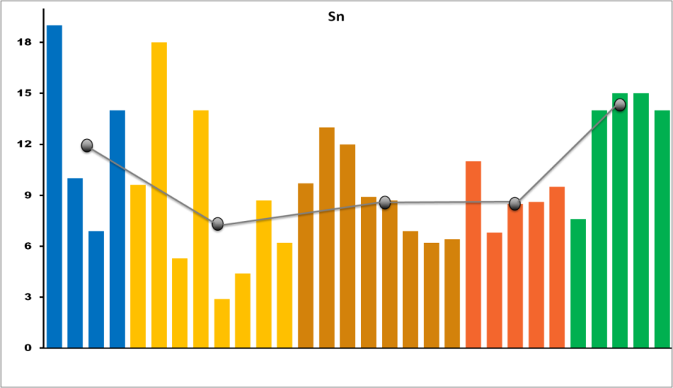





Summary of findings -Towards a chronological and stylistic serialization supported by metal composition
Median content of tin for each period
8th-early 9th
1st half 9th
2nd half 9th
Late 9th
1st half 10th
Main questions
Fabrication technique
Cold working
Consecration deposit
Metal composition
Summary of findings
Synopsis of technical parameters
Further Questions
Further Resources

Slide 17
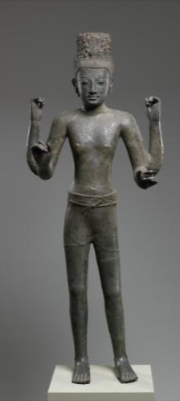
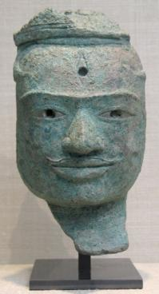
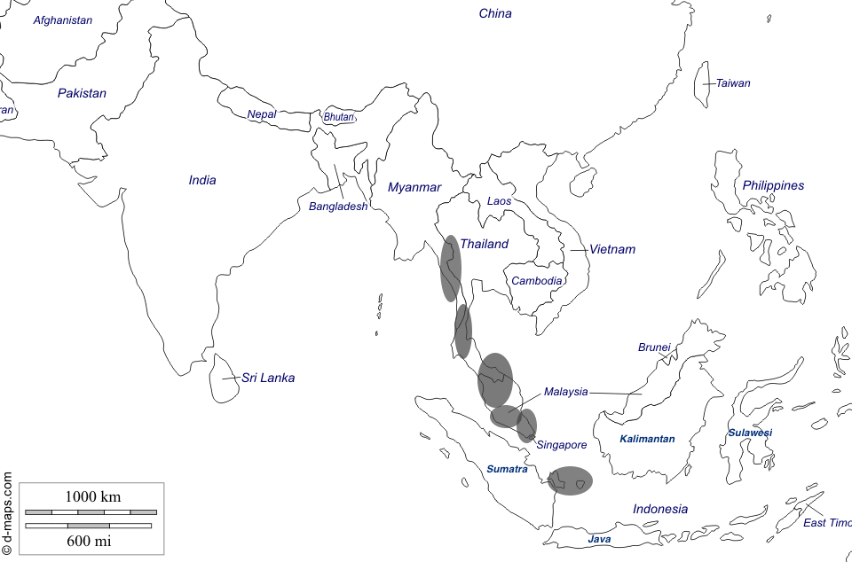
Summary of findings –Tin bronzes: Technical connections with South East Asia mainland
Main questions
Fabrication technique
Cold working
Consecration deposit
Metal composition
Summary of findings
Synopsis of technical parameters
Further Questions
Further Resources

Slide 18
Summary of findings –Characterization of ritual offerings thanks to neutron tomography
Main questions
Fabrication technique
Cold working
Consecration deposit
Metal composition
Summary of findings
Synopsis of technical parameters
Further Questions
Further Resources
Home

Slide 19
Synopsis of technical parameters:
The Case Study is based on a technical study carried out by Mathilde Mechling in collaboration with David Bourgarit and Brice Vincent as part of her ongoing Ph.D. project on Indonesian bronze sculpture.
The examination and analyses were integrally carried out for free at the C2RMF as a service provided to French Museums, namely the Musée National des Arts Asiatiques - Guimet. Neutron tomography was also carried out for free at Reactor Orphée-Laboratoire Léon Brillouin, CEA-CNRS, France as a service for public research.r Main operating conditions are reported in Mechling et al 2019.
The approximate time required to carry out the whole study excluding publication may be estimated at more than 60 persons-day):
Day light & UV photography: Anne Maigret (C2RMF),
Digital microscopy Mathilde Mechling (PhD)& D Bourgarit + D Robcis (C2RMF)
X-ray radiography Elsa lambert (C2RMF)Neutron tomography Frédéric Ott (CNRS-CEA)
Bulk metal analysis by ICP-AES. Nathalie Gandolfo & D Bourgarit (C2RMF)
XRF : D Bourgarit (C2RMF)
Main questions
Fabrication technique
Cold working
Consecration deposit
Metal composition
Summary of findings
Synopsis of technical parameters
Further Questions
Further Resources
Home

Slide 20
Further questions
If comparative data from either similar objects or copper and tin deposits is evolved, will it be possible to investigate the provenance of the metal?
Is there physical evidence pointing conclusively to the use of either the direct or the indirect process to form the wax model?
Can the fabrication of the hosting cavity be further elucidated?
Can it be determined whether the statuettes were cast horizontally or vertically? Since horizontal casting is attested in South India, Sri Lanka and Tibet, is it a feature that might help to determine intercultural exchanges?
Can a comprehensive quantification of tool marks (depth and angle of the grooves) by digital microscopy yield interesting clues regarding know-hows and workshops?
Can the identification of ritualistic items serve as a means of tracing the regional exchange of materials and, if so, can it be done non-destructively avoiding the desecration of the religious image?
Main questions
Fabrication technique
Cold working
Consecration deposit
Metal composition
Summary of findings
Synopsis of technical parameters
Further Questions
Further Resources
Home

Slide 21
Further Resources
Fontein J., Soekmono R. and Sedyawati E. 1971. Ancient Indonesian art of the Central and Eastern Javanese Periods. New York: Asia Society.
Fontein J., Soekmono R. and Sedyawati E. 1990. The sculpture of Indonesia. Washington, D.C.: The National Gallery of Art.
Le Bonheur, A. 1971. La sculpture indonésienne au Musée Guimet. Paris: Presses universitaires de France.
van Lohuizen-de Leeuw, J. 1984. Indo-Javanese metalwork. Stuttgart: Linden-Museum.
Lunsingh Scheurleer, P. and Klokke, M.J. (eds.) 1988. Divine bronze: Ancient Indonesian bronzes from AD 600 to 1600. Leiden: Brill.
Mechling, M., Vincent, B., Baptiste, P., and Bourgarit, D. Forthcoming (2019). « Indonesian bronze-casting tradition: Technical investigations on thirty-nine Indonesian bronze statues (7th-11th c.) from the Musée national des arts asiatiques—Guimet, Paris », Bulletin de l’Ecole Française d’Extrême Orient 104.
Main questions
Fabrication technique
Cold working
Consecration deposit
Metal composition
Summary of findings
Synopsis of technical parameters
Further Questions
Further Resources
Home

