Slide 1
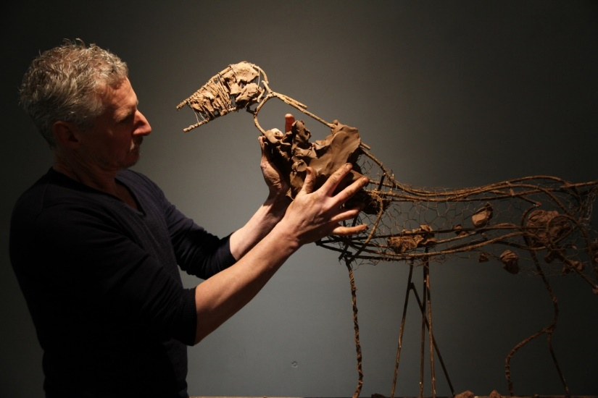
Case Study 7 - Interview – A contemporary artist-founder on a horse: choices of materials and processes
Andrew Lacey, interviewed by David Bourgarit
Fig. 01 image 687
Andrew Lacey beginning the modelling process over a metal armature.

Slide 2
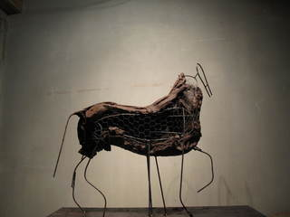
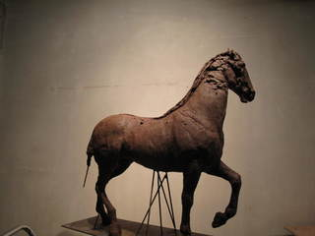
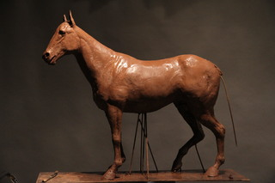
Case Study 7 - Interview – A contemporary artist-founder on a horse: choices of materials and processes
Andrew Lacey, interviewed by David Bourgarit
Fig. 02 image 688 Fig. 03 image 689 Fig. 04 image 691
Clay model partially formed over armature.
Build-up of clay model with front leg raised.
Finished clay model, altered with both front legs on the ground.

Slide 3
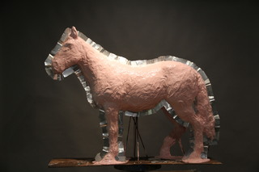
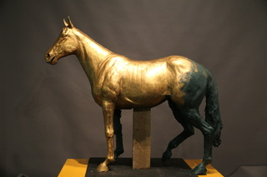
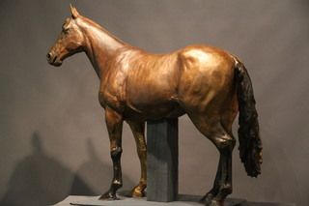
Case Study 7 - Interview – A contemporary artist-founder on a horse: choices of materials and processes
Andrew Lacey, interviewed by David Bourgarit
Fig. 05 image 695 Fig. 06 image 696 Fig. 07 image 698
Silicone rubber mould being taken from the model. Metal shims form the dividing line of the mold.
Wax cast of the horse with gilding wax.
Wax model undergoing final adjustments.

Slide 4
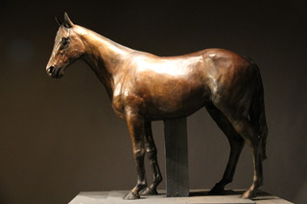
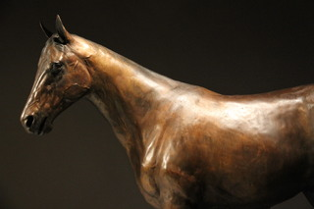
Case Study 7 - Interview – A contemporary artist-founder on a horse: choices of materials and processes
Andrew Lacey, interviewed by David Bourgarit
Fig. 08 image 699. Fig. 09 image 700
Final model of the horse in wax and coloured pigments
Detail of the model showing surface texture and colour.

Slide 5
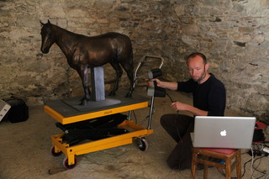
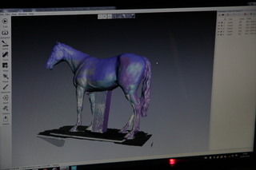
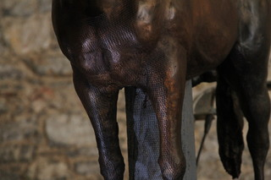
Case Study 7 - Interview – A contemporary artist-founder on a horse: choices of materials and processes
Andrew Lacey, interviewed by David Bourgarit
Fig. 10 image 701 Fig. 11 image 702 Fig. 12 image 703
Adam Stringer of Falmouth University taking a 3-D scan of the wax model.
Digital scan appearing on the computer screen.
Surface of the model during 3-D scanning

Slide 6
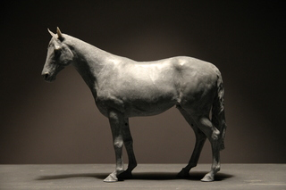
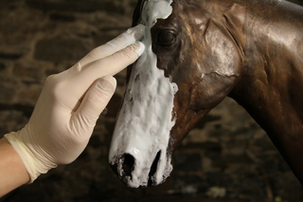
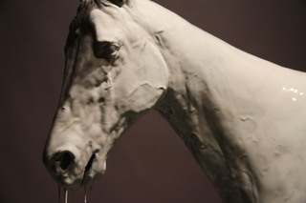
Case Study 7 - Interview – A contemporary artist-founder on a horse: choices of materials and processes
Andrew Lacey, interviewed by David Bourgarit
Fig. 13 image 705 Fig. 14 image 706 Fig. 15 image 707
Reduced-scale, 3-D resin print of the model.
Beginning of careful application of a new silicon rubber to the head of the wax model.
Detail showing more extended application of the initial layer of silicone rubber and how it captures the details of the model.

Slide 7
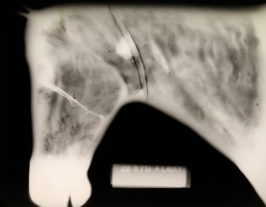
Case Study 7 - Interview – A contemporary artist-founder on a horse: choices of materials and processes
Andrew Lacey, interviewed by David Bourgarit
Fig. 16 image 930
Radiograph of the head showing the weld line (the thin dark line around the neck). The white line half way up the horse’s head is the juncture between the plaster/clay core and the ceramic shell core, clearly a thin line of flashing where the plaster core just slightly shrinks away from the ceramic core. See also the iron wire used to connect both core sections (thin white line that runs up the jaw line of the horse which crosses the core juncture). The larger white patches located on the weld line are the ends of the feeds that were arranged on the inside of the waxes. Two sprue ends overlap at the same place on the x-ray but are opposed sides of the bronze cast. One triangular white patch at the bottom of the weld line is another sprue stub that can be seen tapering off.

Slide 8
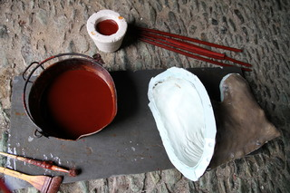
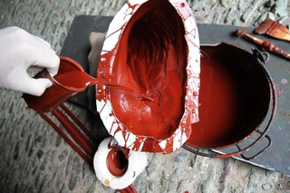
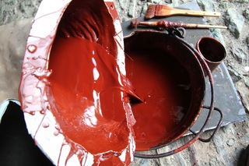
Case Study 7 - Interview – A contemporary artist-founder on a horse: choices of materials and processes
Andrew Lacey, interviewed by David Bourgarit
Fig. 17 image 708 Fig. 18 image 709 Fig. 19 image 710
Assembled silicone rubber mold of the head and neck of the horse awaiting wax application along with bucket of red casting wax, wax sprues, a casting cup freshly formed in its mold, and brushes for wax application.
Slush casting wax in process. Additional wax is poured into the mold that has already been lined with a first layer of wax.
After the mold has been rotated to evenly coat the inner surface with molten wax, the excess wax is decanted.

Slide 9
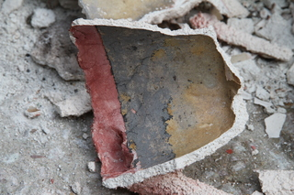
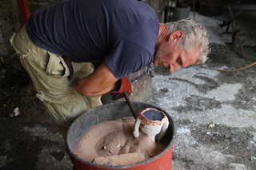
Case Study 7 - Interview – A contemporary artist-founder on a horse: choices of materials and processes
Andrew Lacey, interviewed by David Bourgarit
Fig. 20 image 730 Fig. 21 image 726
Inside of the casting cup coloured in red pigment from the wax and charring from the hot metal.
Andrew lifting the hot mold out of the casting pit after casting.

Slide 10
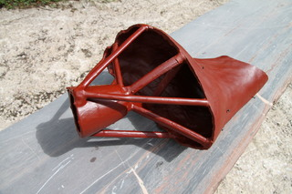
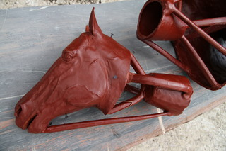
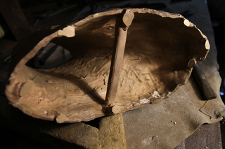
Case Study 7 - Interview – A contemporary artist-founder on a horse: choices of materials and processes
Andrew Lacey, interviewed by David Bourgarit
Fig. 22 image 717 Fig. 23 image 718 Fig. 24 image 742
Cast wax model of the neck section with its sprue system attached.
Cast wax model of the head with its sprue system.
Tide lines from the flow of the liquid wax are captured on the inner surface of the bronze.

Slide 11
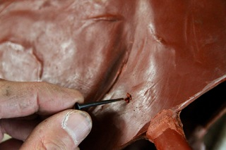
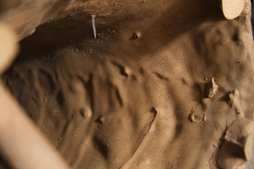
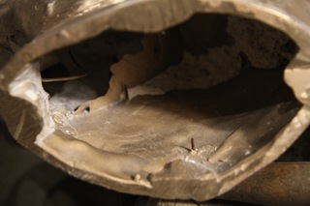
Case Study 7 - Interview – A contemporary artist-founder on a horse: choices of materials and processes
Andrew Lacey, interviewed by David Bourgarit
Fig. 25 image 715 Fig. 26 image 743 Fig. 27 image 741
Core pin being pierced through the wax cast.
Point of the core pin protruding on the inside of the casting.
Inside of the head revealing the flashing at the juncture between the clay/plaster and ceramic cores, and remains of the core material.

Slide 12
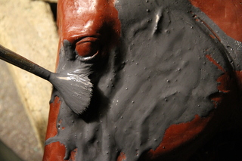
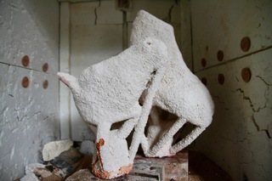
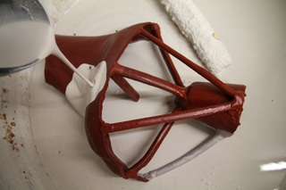
Case Study 7 - Interview – A contemporary artist-founder on a horse: choices of materials and processes
Andrew Lacey, interviewed by David Bourgarit
Fig. 28 image 719 Fig. 29 image 720 Fig. 30 image 790
Careful application to the surface of the wax of the fine, first layer of clay-based investment.
The head and neck segments sprued and invested in clay/ceramic shell molds in the kiln awaiting firing.
Dipping of the sprued wax of the horse’s neck into ceramic shell slurry.

Slide 13
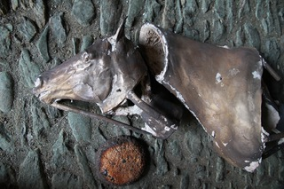
Case Study 7 - Interview – A contemporary artist-founder on a horse: choices of materials and processes
Andrew Lacey, interviewed by David Bourgarit
Fig. 31 image 732
Head, neck and ingot cast from a single pour.

Slide 14
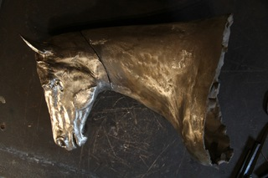
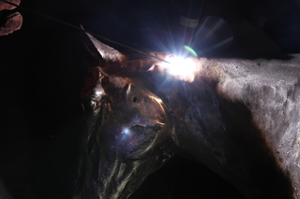
Case Study 7 - Interview – A contemporary artist-founder on a horse: choices of materials and processes
Andrew Lacey, interviewed by David Bourgarit
Fig. 32 image 744 Fig. 33 image 745
Bronze sections of the head and neck positioned for welding.
Bright arc of the Tig welder during joining of the two sections of bronze.

Slide 15
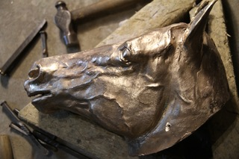
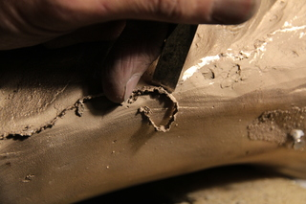
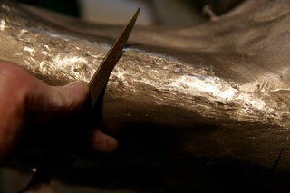
Case Study 7 - Interview – A contemporary artist-founder on a horse: choices of materials and processes
Andrew Lacey, interviewed by David Bourgarit
Fig. 34 image 736 . Fig. 35 image 737 Fig. 36 image 738
First stages of the chasing after the sprues and most core pins have been removed during fettling
Removal of flashing on the neck using a fine chisel (and hammer).
Remaining surface of flashing is taken down with a file.

Slide 16
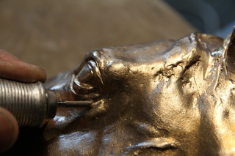
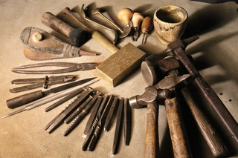
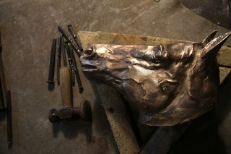
Case Study 7 - Interview – A contemporary artist-founder on a horse: choices of materials and processes
Andrew Lacey, interviewed by David Bourgarit
Fig. 37 image 747 Fig. 38 image 734 Fig. 39 image 735
A tungsten burr on an electric pendent drill is used to hollow out the eye.
Andrew’s collection of tools for chasing the bronze.
Punches used for refining the surface of the casting.

Slide 17
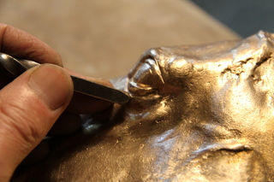
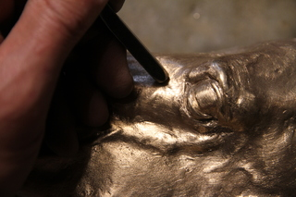
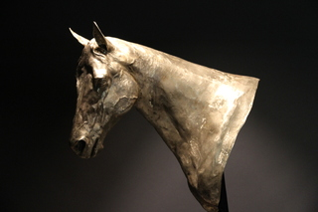
Case Study 7 - Interview – A contemporary artist-founder on a horse: choices of materials and processes
Andrew Lacey, interviewed by David Bourgarit
Fig. 40 image 746 Fig. 41 image 748 Fig. 42 image 749
Refining the shape of the eye using a fine punch.
Hollowing a section around the eye using a fine punch.
Bronze head and neck upon completion of chasing.

Slide 18
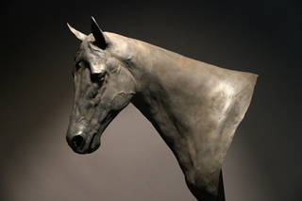
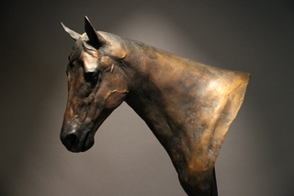
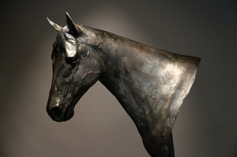
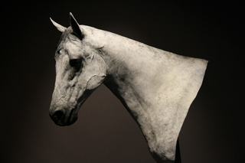
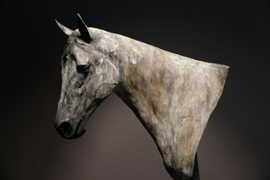
Case Study 7 - Interview – A contemporary artist-founder on a horse: choices of materials and processes
Andrew Lacey, interviewed by David Bourgarit
Fig. 43 image 750 Fig. 44 image 751 Fig. 45 image 752 Fig. 46 image 753 Fig. 47 image 754
Head and neck after first phase of patination process using potassium polysulphide.
After second phase of patination using ferric nitrate.
After third phase using olive oil.
After fourth phase using titanium dioxide and potassium polysulphide.
After fifth phase using ash.

Slide 19
Case Study 7 - Interview – A contemporary artist-founder on a horse: choices of materials and processes
Andrew Lacey, interviewed by David Bourgarit
Fig.

Slide 20
Case Study 7 - Interview – A contemporary artist-founder on a horse: choices of materials and processes
Andrew Lacey, interviewed by David Bourgarit
Fig.

Slide 21
Case Study 7 - Interview – A contemporary artist-founder on a horse: choices of materials and processes
Andrew Lacey, interviewed by David Bourgarit
Fig.

Slide 22
Case Study 7 - Interview – A contemporary artist-founder on a horse: choices of materials and processes
Andrew Lacey, interviewed by David Bourgarit
Fig.

Slide 23
Case Study 7 - Interview – A contemporary artist-founder on a horse: choices of materials and processes
Andrew Lacey, interviewed by David Bourgarit
Fig.

Slide 24
Case Study 7 - Interview – A contemporary artist-founder on a horse: choices of materials and processes
Andrew Lacey, interviewed by David Bourgarit
Fig.

Slide 25
Case Study 7 - Interview – A contemporary artist-founder on a horse: choices of materials and processes
Andrew Lacey, interviewed by David Bourgarit
Fig.

