Slide 1


AI Powered Multimodal Research and Study Analysis for Engineering Students
SIMATS ENGINEERING
SAVEETHA INSTITUTE OF MEDICAL AND TECHNICAL SCIENCES
Faculty,
Dr. Nithisha J
Presented by,
J Karthik - 192472136
M.Chaitanya - 192472047
Joanathan - 192472229
V Rohan - 192472227
Course : CSA6502 - Generative AI and Large Scale Model

Slide 2


ABSTRACT
An AI-powered platform that helps engineering students understand and analyze academic and research materials.
Accepts multiple formats such as PDFs, research papers, images, notes, and documents.
Uses AI to retrieve relevant information and analyze content from multiple sources.
Generates summaries, explanations, comparisons, quizzes, and research insights.
Helps students reduce research time and improve their learning process.

Slide 3

INTRODUCTION
Engineering students work with large amounts of academic and research material.
Information is often spread across different documents and formats.
Traditional methods make it difficult to quickly find and connect relevant information.
Our system uses multimodal AI to understand, retrieve, and analyze this information.
It provides personalized study and research support in one platform.

Slide 4
OBJECTIVES
Objective | Explanation
Multimodal Content Processing | Process academic materials from different formats such as text, images, and documents.
Intelligent Knowledge Retrieval | Retrieve relevant information from the collected study and research materials.
AI-Based Analysis | Summarize, compare, explain, and identify important research insights.
Personalized Learning Support | Generate notes, quizzes, explanations, and topic recommendations.
Improve Research Efficiency | Reduce the time required to study and analyze large amounts of information.

Slide 5
LITERATURE SURVEY
S.No | Author (Year) | Title | Methodology | Limitations
1 | Z. Li et al. (2025) | Retrieval-Augmented Generation for Educational Application: A Systematic Survey | Reviewed RAG methods for educational applications | Hallucination, retrieval quality, limited multimodality
2 | S. Guizani et al. (2025) | A Systematic Literature Review to Implement Large Language Model in Higher Education | Reviewed LLM applications, issues, and solutions in higher education | Privacy, reliability, ethics, implementation challenges
3 | Y. Qian (2025) | Pedagogical Applications of Generative AI in Higher Education: A Systematic Review of the Field | Reviewed GenAI applications in higher education | Need for better evaluation and responsible use
4 | L. Fan et al. (2025) | Educational Impacts of Generative Artificial Intelligence on Learning and Performance of Engineering Students in China | Surveyed 148 engineering students on GenAI use and learning impact | Limited sample and regional focus
5 | Z. Li et al. (2026) | Large Language Models in Education: A Systematic Review of Empirical Applications, Benefits, and Challenges | Reviewed 88 empirical LLM studies in education | Over-reliance, privacy, fairness, and technical reliability

Slide 6

PROBLEM STATEMENT
Engineering students handle large amounts of study and research material.
Important information is scattered across different formats and documents.
Finding, comparing, and understanding relevant information is time-consuming.
Existing tools often focus on a single format or provide only basic summarization.
Students need one system that can analyze multiple sources and provide useful study and research support.

Slide 7
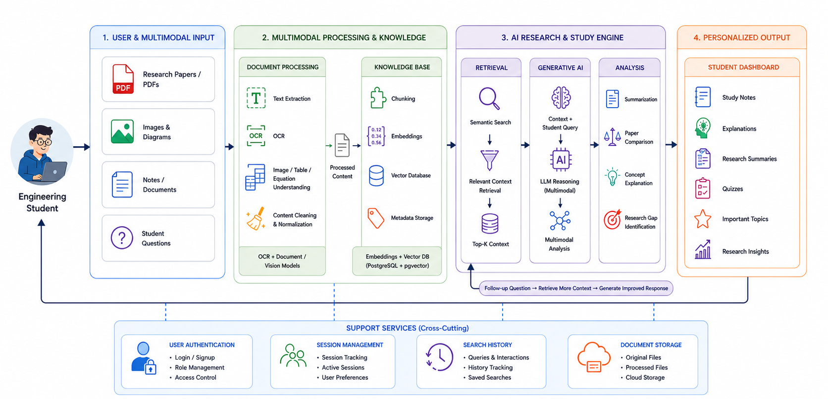
SYSTEM ARCHITECTURE

Slide 8
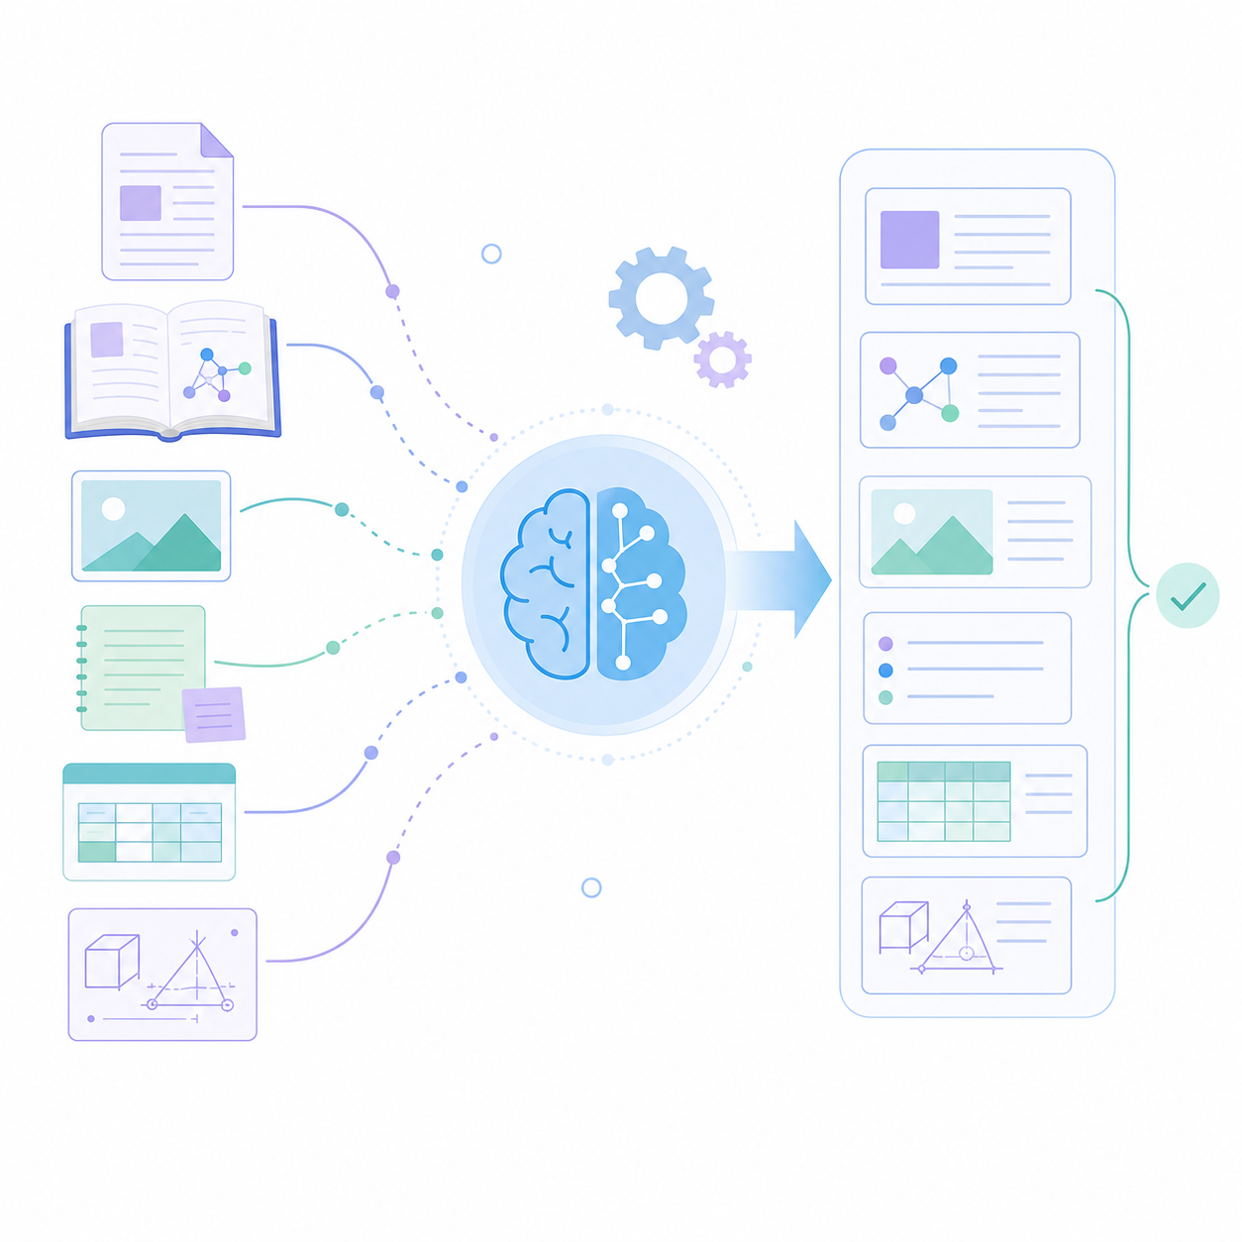
MODULE – 1 Multimodal Input & Document Processing
Purpose: To collect and process academic and research materials from different formats.
Key Points:
Accepts PDFs, papers, images, notes, and documents.
Extracts text, tables, figures, and equations.
Cleans and organizes the extracted information.
Stores processed content for further analysis.
Outcome: A structured collection of multimodal academic content ready for retrieval and analysis.

Slide 9

MODULE – 2 Multimodal Knowledge & Retrieval
Purpose: To create a searchable knowledge base from the processed materials.
Key Points:
Creates representations of the collected content.
Retrieves relevant information based on user queries.
Connects related information across multiple sources.
Provides relevant context to the AI.
Outcome: Relevant and contextual information is retrieved for accurate AI analysis.

Slide 10
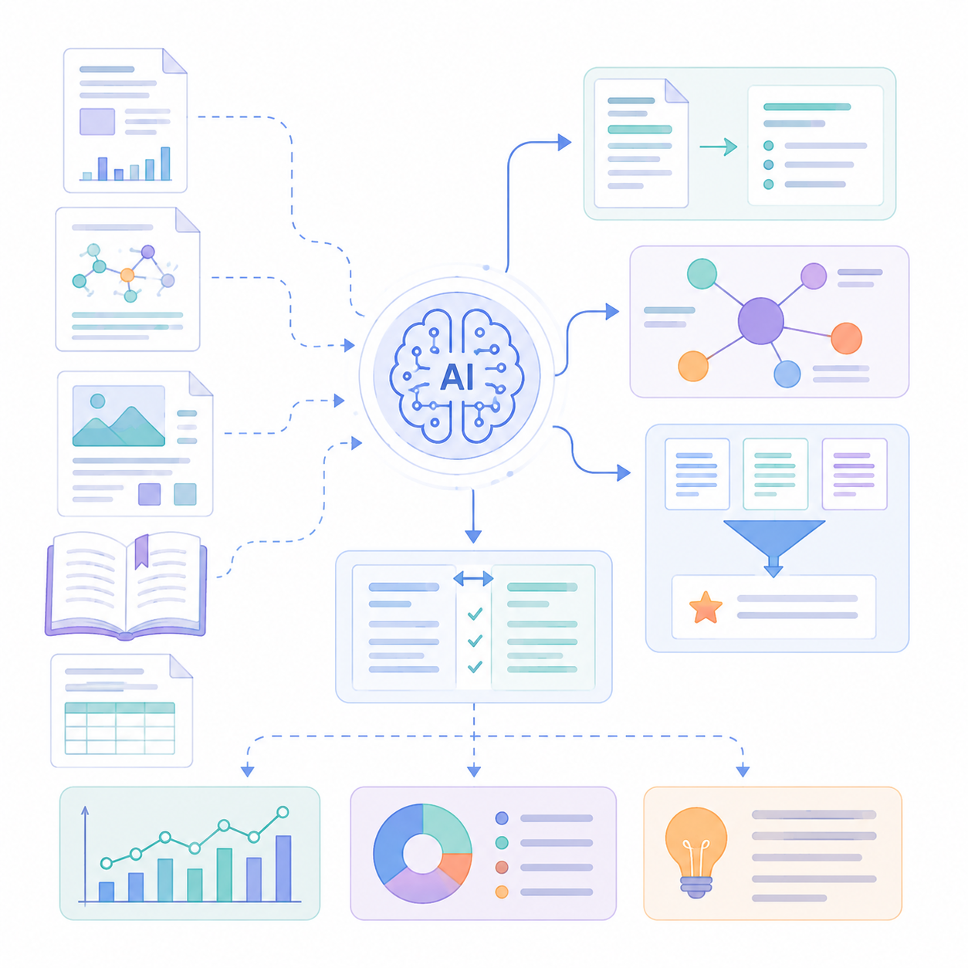
MODULE – 3 Research & Study Analysis
Purpose: To analyze retrieved information and generate meaningful academic insights.
Key Points:
Summarizes research papers and study materials.
Compares concepts and multiple research papers.
Identifies findings, methodologies, and research gaps.
Answers questions using the retrieved sources.
Outcome: Students receive clear, source-based analysis of their study and research materials.

Slide 11

MODULE – 4 Personalized Learning & Research Support
Purpose: To convert AI analysis into useful learning and research outputs.
Key Points:
Generates concise study notes and explanations.
Creates quizzes and practice questions.
Recommends important topics for revision.
Generates structured research summaries and reports.
Outcome: Students receive personalized resources that support both learning and research.

Slide 12
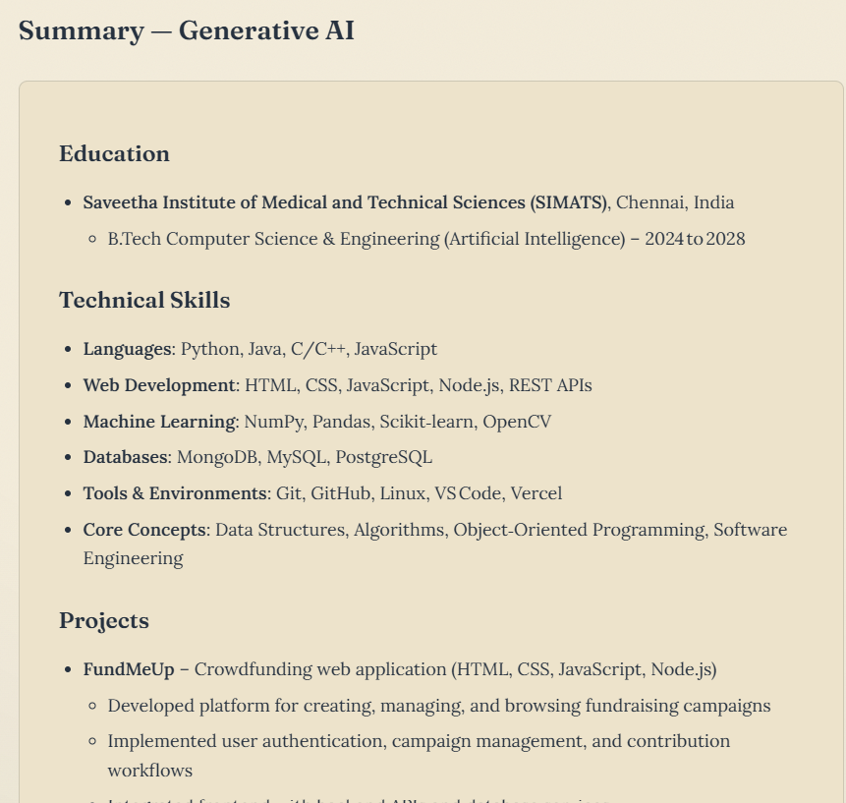
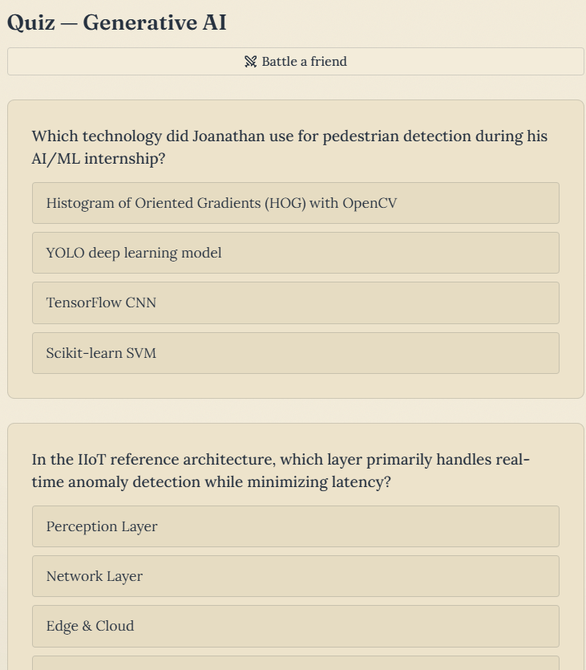
DASHBOARD

Slide 13
RESULT & DISCUSSION
Successfully combines PDFs, research papers, images, notes, and documents into one analysis workflow.
Retrieves relevant information and provides context-aware AI responses using multimodal processing and RAG.
Generates useful outputs including summaries, explanations, paper comparisons, and research gap insights.
Supports personalized learning through study notes, quizzes, important topics, and research summaries.
Provides a unified platform that can reduce research time and improve the overall study experience for engineering students.

Slide 14
CONCLUSION
Developed an AI-powered multimodal platform to support engineering students in study and research activities.
Integrates documents, research papers, images, notes, and other academic content in one workflow.
Uses multimodal processing, knowledge retrieval, RAG, and LLM analysis to generate meaningful insights.
Provides personalized notes, explanations, quizzes, research summaries, and research gap insights.
The system can help reduce research effort, improve learning efficiency, and provide a unified academic research assistant.

Slide 15
REFERENCES
□
Z. Li et al., “Retrieval-Augmented Generation for Educational Application: A Systematic Survey,” Comput. Educ. Artif. Intell., vol. 8, 2025.
S. Guizani et al., “A Systematic Literature Review to Implement Large Language Model in Higher Education,” Discover Education, vol. 4, 2025.
Y. Qian, “Pedagogical Applications of Generative AI in Higher Education: A Systematic Review of the Field,” TechTrends, vol. 69, pp. 1105–1120, 2025.
L. Fan, K. Deng, and F. Liu, “Educational Impacts of Generative Artificial Intelligence on Learning and Performance of Engineering Students in China,” Sci. Rep., vol. 15, 2025.
Z. Li et al., “Large Language Models in Education: A Systematic Review of Empirical Applications, Benefits, and Challenges,” Comput. Educ. Artif. Intell., vol. 10, 2026.

Slide 16
THANK YOU!

