Slide 1
Minor Project: Image Processing
Image Enhancement

Slide 2
Aim/Objective
The main objective of Image Enhancement is to improve the perception of the image by humans and automated image processing techniques. The module developed here aims to improve image contrast.

Slide 3
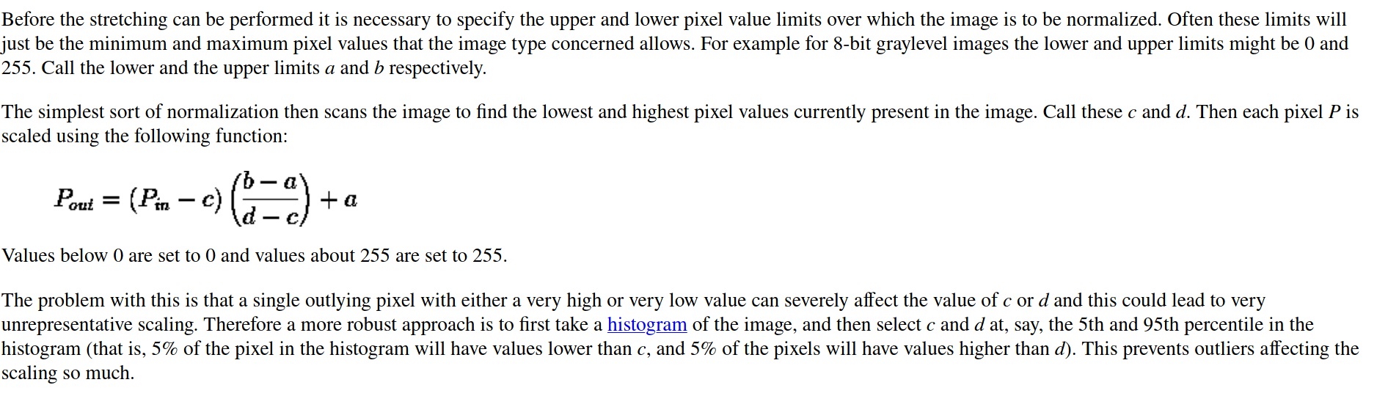
Methodology
In this project I have applied contrast stretching as described in https://homepages.inf.ed.ac.uk/rbf/HIPR2/stretch.htm

Slide 4
Methodology
The module is written in Python3 and uses the following libraries:-
Numpy
Matplotlib
Open-CV
Argparse
PythonImagingLibrary

Slide 5
Methodology
The module consists of 3 classes
colImg - handles all functions related to 3 channel BGR colored images
greyImg - handles all functions related to 1 channel grayscale images
lumImg - handles all functions related to 3 channel YCrCb images
Each module performs 2 major functions on each of these types of Images:-
conStretch() - stretch contrast using transform function shown earlier
genHists() - generate histograms for an image (1 if grayscale or YCrCb, 3 if BGR)

Slide 6
Features
The tool has the following functions:-
Read images and save from command line
Set intensity range for pixels based in percentile
Uses histogram to calculate min and max pixel values
Outputs 3 channel and single channel histogram as output
Configurable using command line options (n1, n2, --color, --histogram)

Slide 7
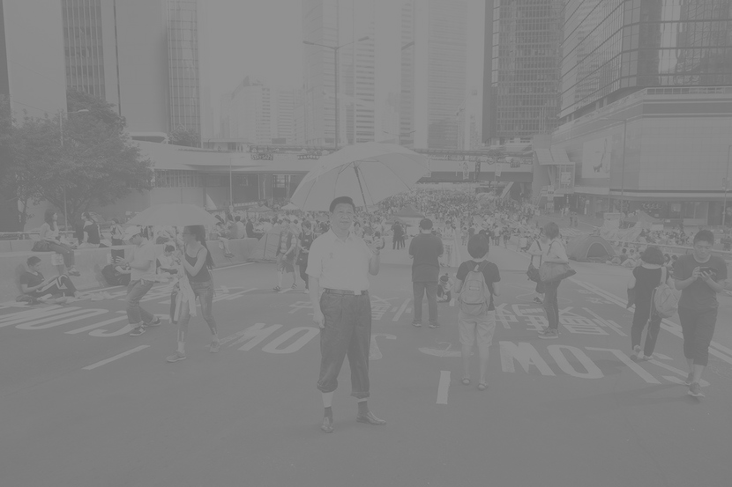
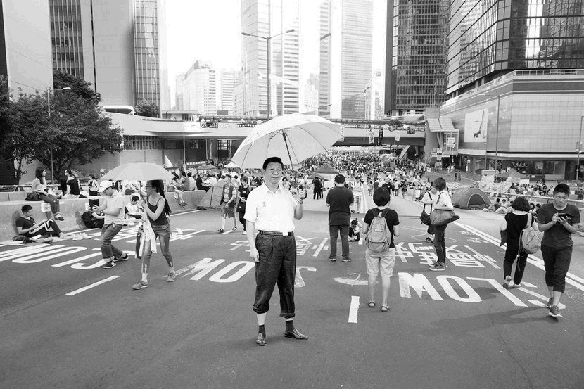
Results
Case 1: Grayscale Image (low contrast) single band stretching applied

Slide 8
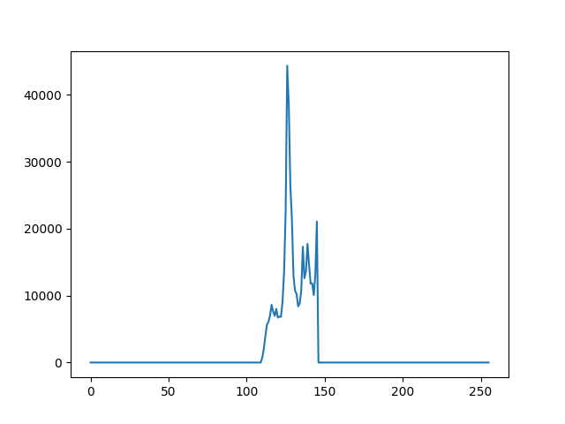
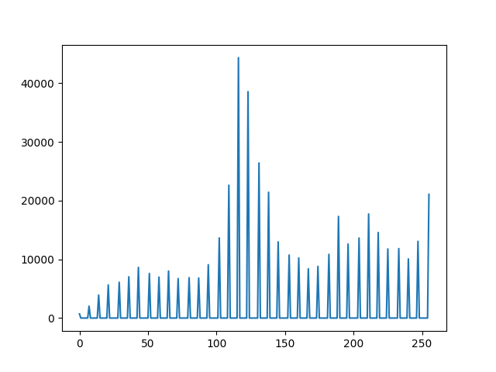
Results

Slide 9
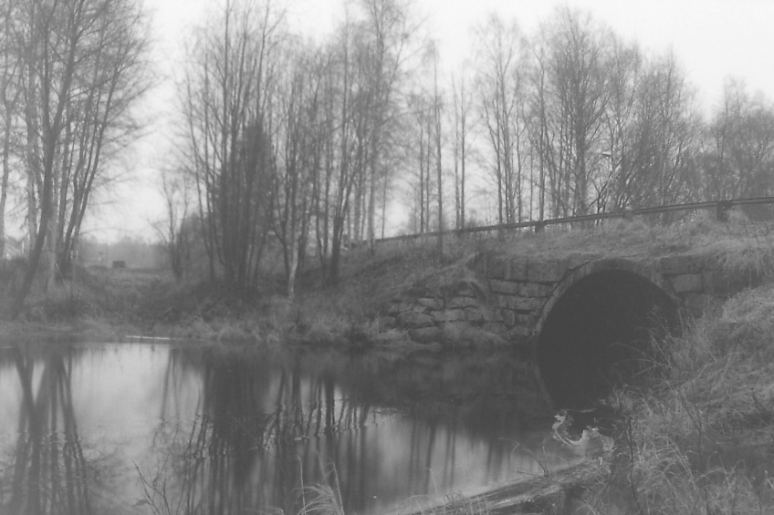
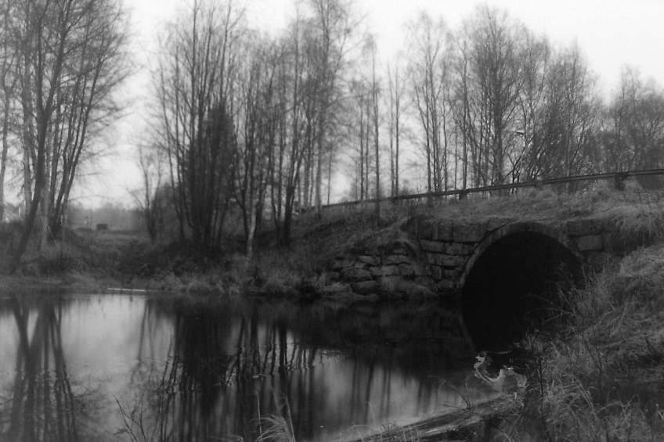
Results
Another Grayscale Image with single band stretching applied

Slide 10
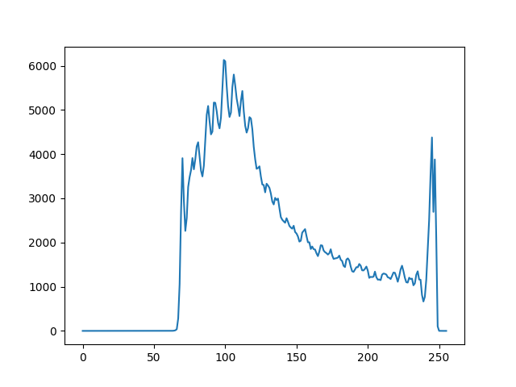
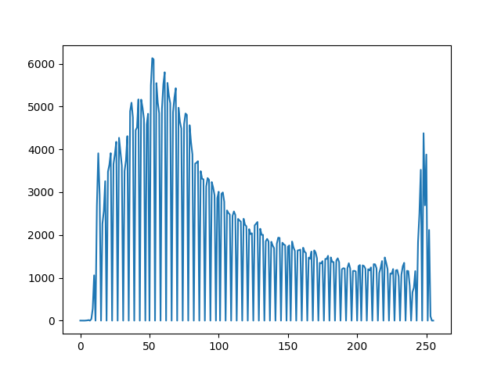
Results

Slide 11
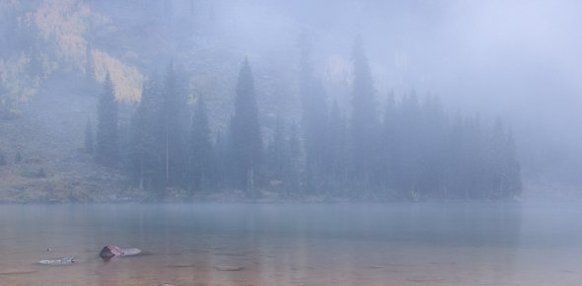
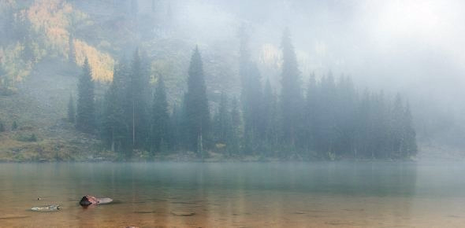
Results
Case 2: Colored Image with 3 band stretching applied

Slide 12
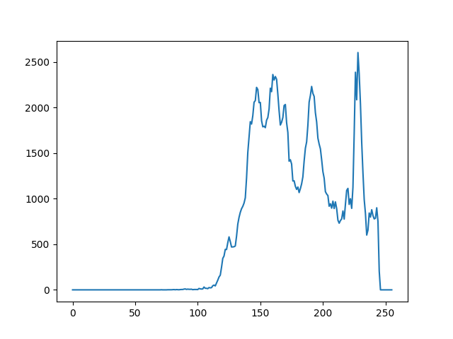
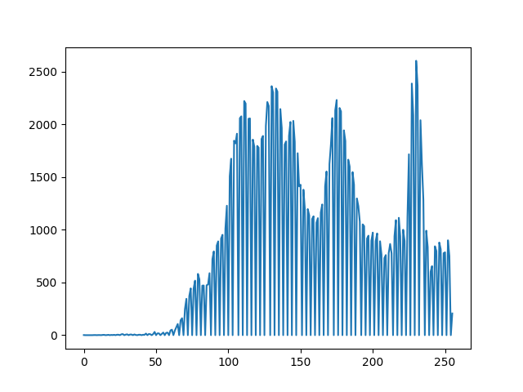
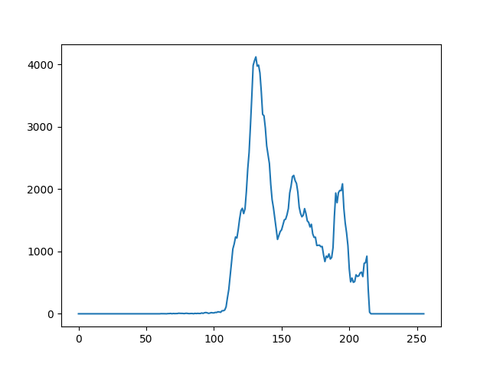
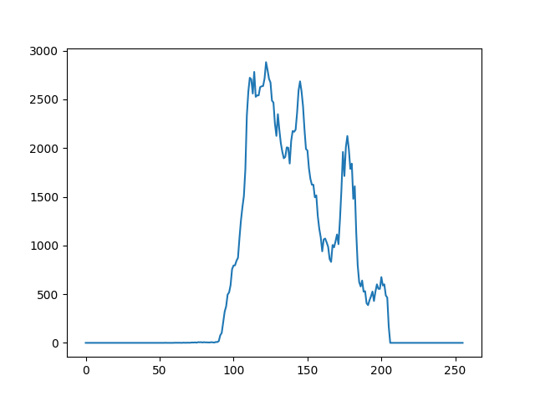
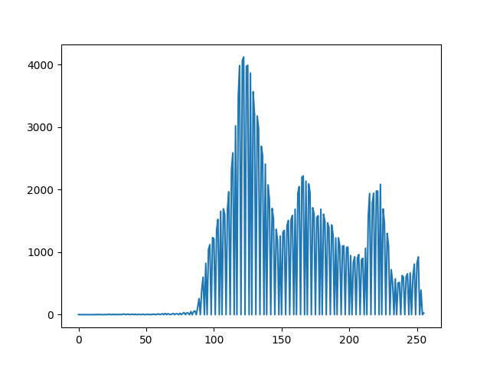
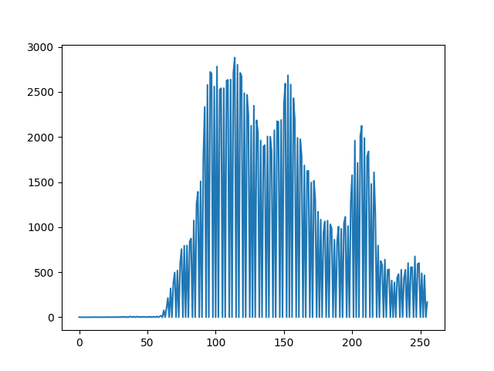
Results

Slide 13
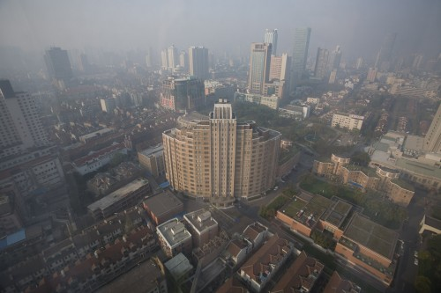

Results
Another colored image with 3 band stretching applied:-

Slide 14
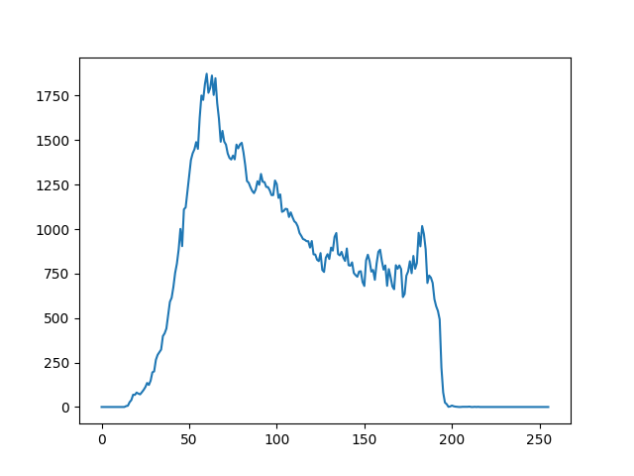
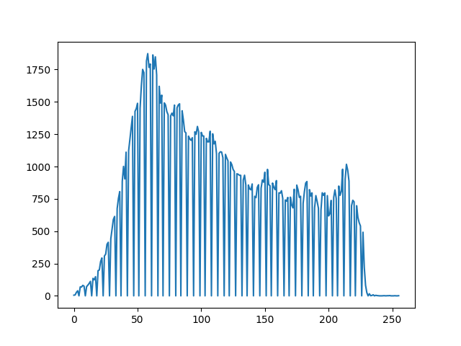
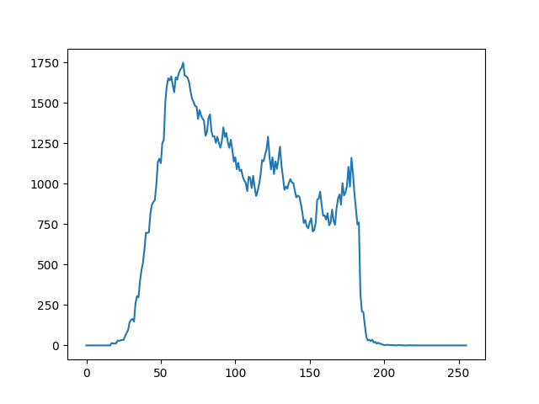
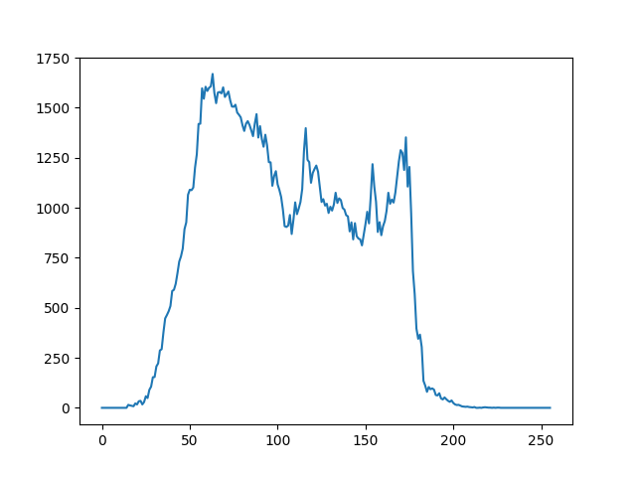
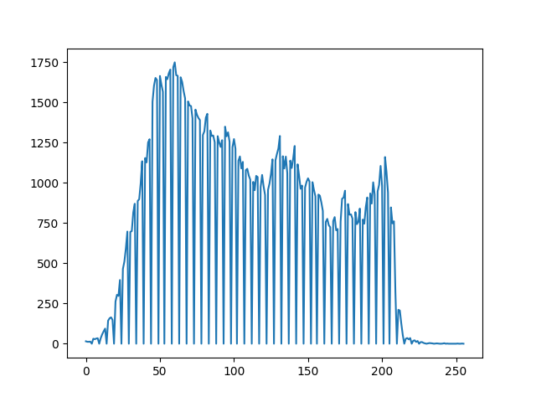
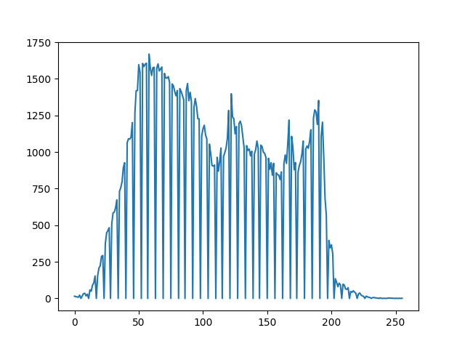
Results

Slide 15
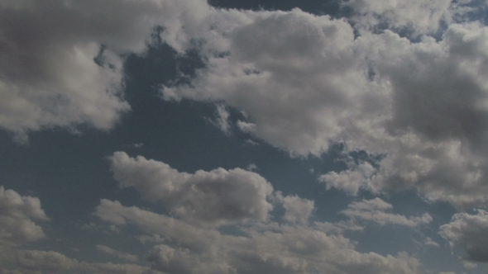
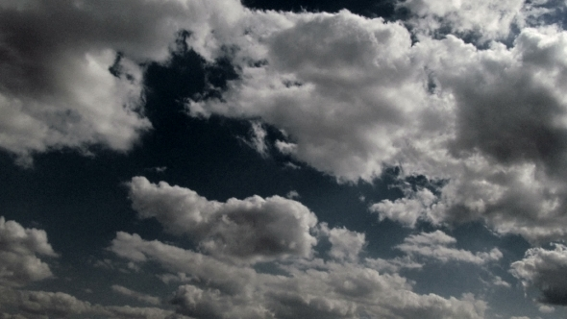
Results
Case 3: Colored Image with single band luminance stretching applied

Slide 16
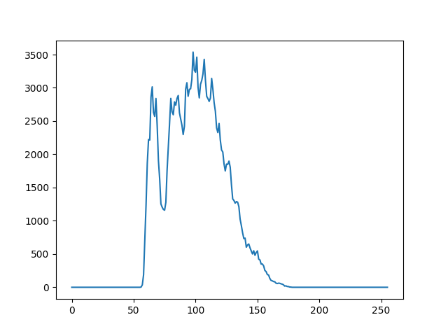
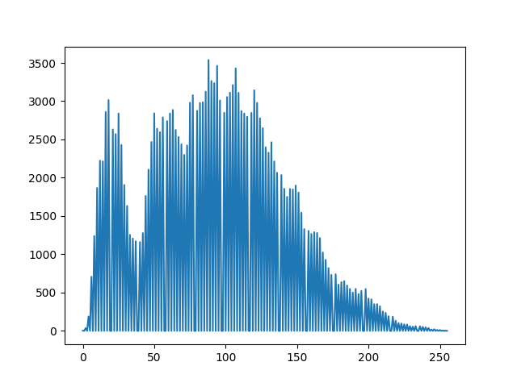
Results

Slide 17
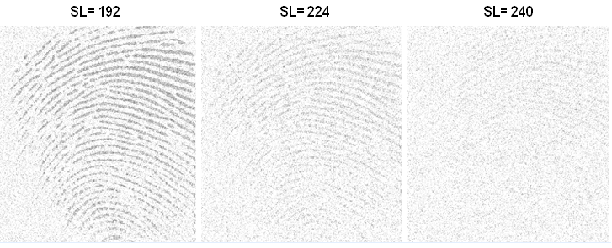
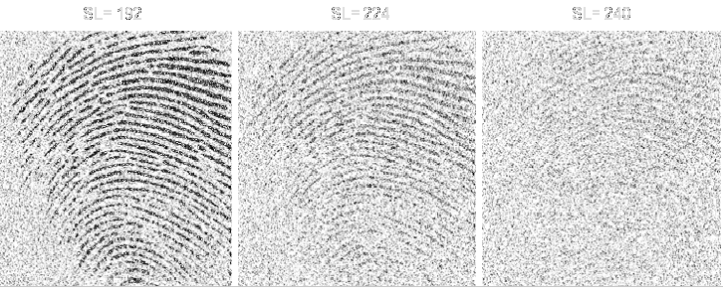
Results
Case 4: Fingerprints

Slide 18
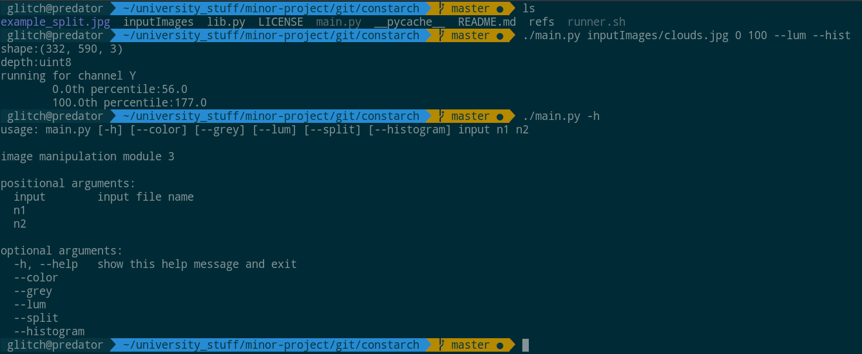
Code/Output

Slide 19
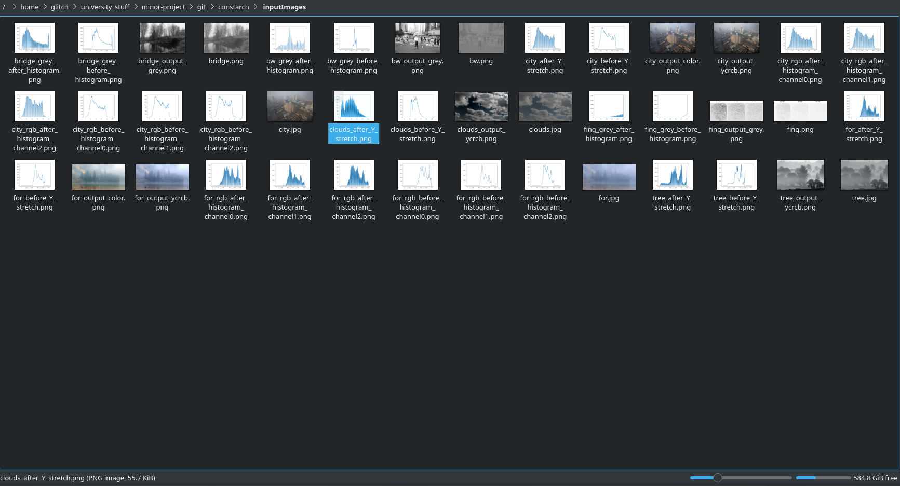
Code/Output

Slide 20
Conclusion
The contrast stretching algorithm works especially well for grayscale single channel images with low initial contrast.
The algorithm gives imprecise colors for colored images using 3 band contrast stretching.
The single band Y stretching improves contrast of colored images while providing better color accuracy than 3 band RGB stretching.

