Slide 1
ISG - Cannon
Arnav Sachdev
(6290013)

Slide 2
Cannon is a game played by 2 players on a 10x10 board with 15 pieces each.
Each player has a piece called a town, which if lost results in a victory to the opponent.
Pieces have the following moves:-
Move
Capture
Retreat
Slide
Shoot

Slide 3
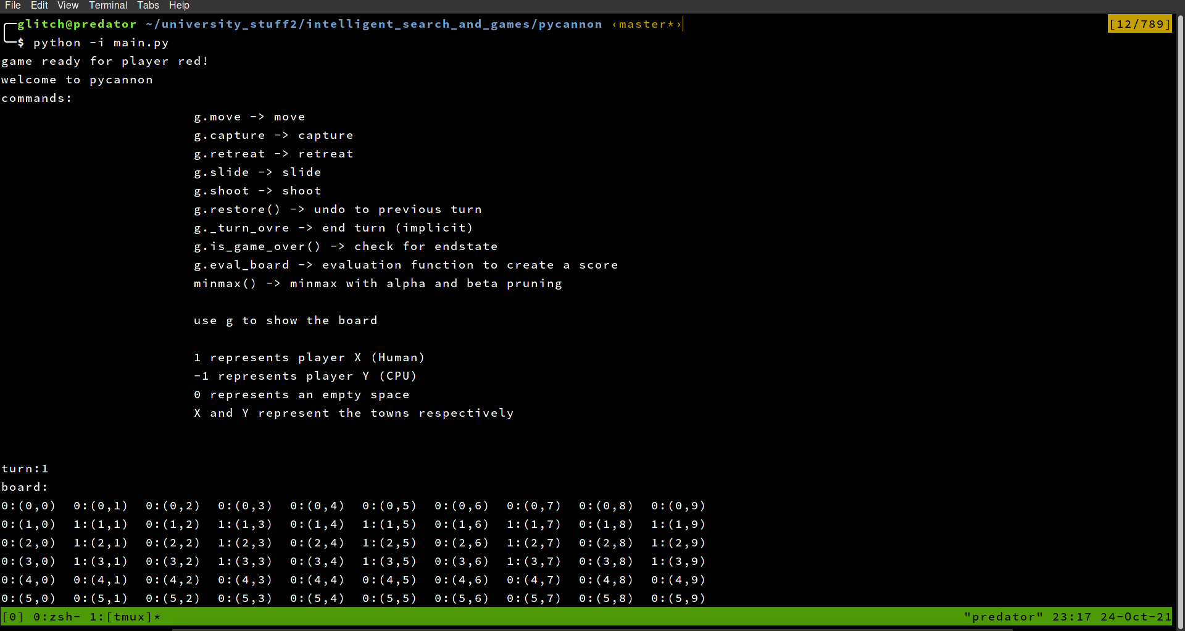
How does the program work?
The program uses a minmax recursive algorithm with alpha/beta pruning to reduce game tree traversal.
The key functions are:-
minmax()
eval_board()
gen_move_list()

Slide 4
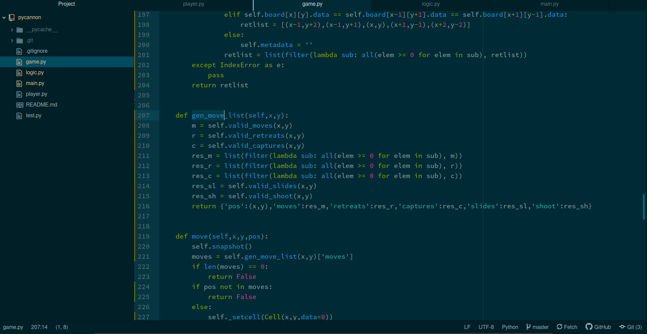
gen_move_list()
For any position on the board (x,y), it generates a list of all possibles squares the piece on (x,y) can legally move to

Slide 5
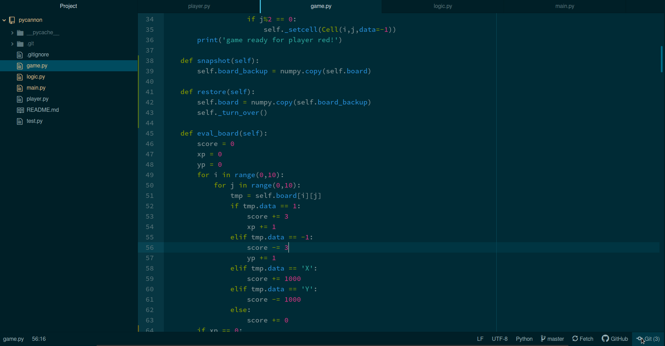
eval_board()
This function known as the evaluation function gives each state of the board a score.
The evaluation function rewards captures with 3 points, rewards slides and shoot actions with 5 points and town captures with 1000 points.

Slide 6
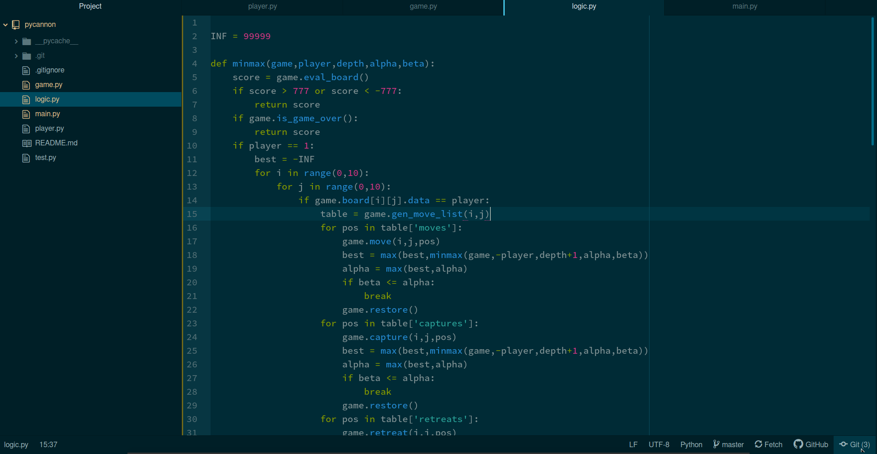
minmax
This function is the heart of the problem. It recursively traverses all states of the game tree (with alpha beta pruning to reduce branches) and returns the optimum move given the current state of the board.

Slide 7
Thanks, please watch the video demonstration to see the program in action.

