Slide 1

Python Operators

Slide 2
“An investment in knowledge pays the best interest“
- BENJAMIN FRANKLIN

Slide 3
Today’s Agenda
Operators In Python

Slide 4
Types Of Operators In Python
Arithmetic operators
Comparison operators or Relational operators
Logical operators
Assignment operators
Identity operators
Membership operators

Slide 5
Operator in python
Operators are special symbols in Python or in any other language which can manipulate the value of operands.
The value that the operator operates on is called the operand.
For example: here 2+3=5. Here, + is the operator that performs addition and 2 and 3 represent the operands.

Slide 6
Arithmetic Operator
Arithmetic operators are used with numeric values to perform common mathematical operations:
Operator | Name | Example
+ | Addition | x + y
- | Subtraction | x - y
* | Multiplication | x * y
/ | Division | x / y
% | Modulus | x % y
** | Exponentiation | x ** y
// | Floor division | x // y

Slide 7
Arithmetic Operator
x = 5
y = 3
print(x + y)
print(x - y)
print(x * y)
print(x / y)
Print(x % y) #It's used to get the remainder of a division problem.
print(x ** y)
print(x // y) #the floor division // rounds the result down to the nearest whole number

Slide 8
Relational Operators In Python
Relational Operators
Relational Operators With Strings
Chaining Of Relational Operators
Special Behavior Of == and !=

Slide 9
Relational Operators In Python
Relational operators are used to compare values.
They either return True or False according to the condition.
These operators are:
Operator | Meaning
> | Greater Than
< | Less Than
>= | Greater Than Equal To
<= | Less Than Equal To
== | Equal To
!= | Not Equal To

Slide 10
The 6 Basic Relational Operators
a=10
b=4
print("a=", a, "b=", b)
print("a > b", a>b)
print("a < b", a<b)
print("a==b", a==b)
print("a!=b", a!=b)
print("a>=b", a>=b)
print("a<=b", a<=b)

Slide 11
Relational Operators With Strings
Relational Operators can also work with strings .
When applied on string operands , they compare the unicode of corresponding characters and return True or False based on that comparison.
As discussed previuosly , this type of comparison is called lexicographical comparison

Slide 12
Relational Operators With Strings
a="Ramesh"
b="Rajesh"
print("a=", a, "b=", b)
print("a > b", a>b)
print("a < b", a<b)
print("a==b", a==b)
print("a!=b", a!=b)
print("a>=b", a>=b)
print("a<=b", a<=b)

Slide 13
Relational Operators With Strings
If we want to check the UNICODE value for a particular letter , then we can call the function ord().
It is a built in function which accepts only one character as argument and it returns the UNICODE number of the argument passed
Example:
ord(‘A’)
ord(‘m’)
ord(‘j’)

Slide 14
Relational Operators With Strings
a= "BHOPAL"
b= "bhopal"
print("a=", a, "b=", b)
print("a > b", a>b)
print("a < b", a<b)
print("a==b", a==b)
print("a!=b", a!=b)
print("a>=b", a>=b)
print("a<=b", a<=b)

Slide 15
Will This Code Run ?
a=True
b=False
print("a=", a, "b=", b)
print("a > b", a>b)
print("a < b", a<b)
print("a==b", a==b)
print("a!=b", a!=b)
print("a>=b", a>=b)
print("a<=b", a<=b)
Yes , the code will successfully
Run because True is 1 and False is 0

Slide 16
What about this code?
a=‘True’
b=‘False’
print("a=", a, "b=", b)
print("a > b", a>b)
print("a < b", a<b)
print("a==b", a==b)
print("a!=b", a!=b)
print("a>=b", a>=b)
print("a<=b", a<=b)
Yes , this code will also successfully
Run but ‘True’ and ‘False’ will be handled as strings

Slide 17
Special Behavior Of Relational Operators
Python allows us to chain multiple relational operators in one single statement.
For example the expression 1<2<3 is perfectly valid in Python
However when Python evaluates the expression , it returns True if all individual conditions are true , otherwise it returns False

Slide 18
Cascading Of Relational Operators
Example:
print(7>6>5)
Example:
print(5<6>7)
Example:
print(5>6>7)
Example:
print(5<6<7)

Slide 19
Special Behavior Of == And !=
== compares its operands for equality and if they are of compatible types and have same value then it returns True otherwise it returns False
Similarly != compares it’s operands for inequality and if they are of incompatible types or have different value then it returns True otherwise it returns False

Slide 20
Special Behavior Of == And !=
Example:
print(10==10)
Example:
print(10==20)
Example:
print(10==“10”)
Example:
print(10==True)
Example:
print(1==True)
Example:
print(“A”==“A”)
Example:
print(“A”==“65”)
Example:
print(“A”==65)

Slide 21
Special Behavior Of == And !=
Example:
print(15==15.0)
Example:
print(15==15.01)
Example:
print(15!=“15”)
Example:
print(0 != False)
Example:
print(False!=True)
Example:
print(False != 0.0)
Example:
print(2+5j==2+5j)
Example:
print(2+5j!= 2)

Slide 22
Logical Operators In Python
Logical operators are used to combine two or more conditions and perform the logical operations using Logical and, Logical or and Logical not.
Operator | Meaning
and | It will return true when both conditions are true
or | It will returns true when at-least one of the condition is true
not | If the condition is true, logical NOT operator makes it false

Slide 23
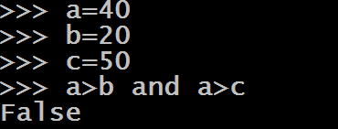
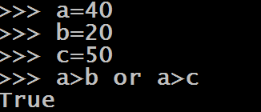
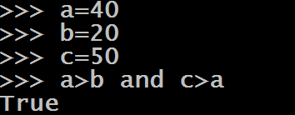
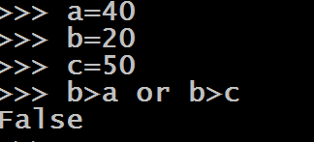
Behavior Of Logical and Operator

Slide 24
Behavior Of Logical Operators With Non Boolean
Python allows us to apply logical operators with non boolean types also
But before we understand how these operators work with non boolean types, we must understand some very important points

Slide 25
Behavior Of Logical Operators With Non Boolean
None, 0 , 0.0 ,”” are all False values
The return value of Logical and & Logical or operators is never True or False when they are applied on non boolean types.

Slide 26
Behavior Of Logical Operators With Non Boolean
If the first value is False , then Logical and returns first value , otherwise it returns the second value
If the first value is True , then Logical or returns first value , otherwise it returns the second value
When we use not operator on non boolean types , it returns True if it’s operand is False( in any form) and False if it’s operand is True ( in any form)

Slide 27
Logical Operators On Non Boolean Types
Example:
‘Sachin’ and 10
Example:
‘Sachin’ and 0
Example:
‘Indore’ and ‘Bhopal’
Example:
‘Bhopal’ and ‘Indore’
Example:
5 and 6
Example:
5 and 0
Example:
0 and 10
Example:
6 and 0

Slide 28
Logical Operators On Non Boolean Types
Example:
0 and 10/0
Example:
10/0 and 0
Example:
5 or 6
Example:
5 or 0
Example:
0 or 10
Example:
6 or 0
Example:
‘Sunny’ or 10
Example:
‘Sunny’ or 0
Example:
‘Indore’ or ‘Bhopal’

Slide 29
Logical Operators On Non Boolean Types
Example:
0 or 10/0
Example:
10/0 or 0
Example:
not 5
Example:
not 0
Example:
not ‘Sunny’
Example:
not ‘’

Slide 30
Assignment Operators In Python
The Python Assignment Operators are used to assign the values to the declared variables.
Equals (=) operator is the most commonly used assignment operator in Python.
For example:
a=10

Slide 31
Assignment Operators In Python
Shortcut for assigning same value to all the variables
x=y=z=10
Shortcut for assigning different value to all the variables
x,y,z=10,20,30

Slide 32
Guess The Output
a,b,c=10,20
print(a,b,c)
Output:
ValueError : Not enough values to unpack
a,b,c=10,20,30,40
print(a,b,c)
Output:
ValueError : Too many values to unpack

Slide 33
Compound Assignment Operators
Python allows us to combine arithmetic operators as well as bitwise operators with assignment operator.
For example: The statement
x=x+5
Can also be written as
x+=5

Slide 34
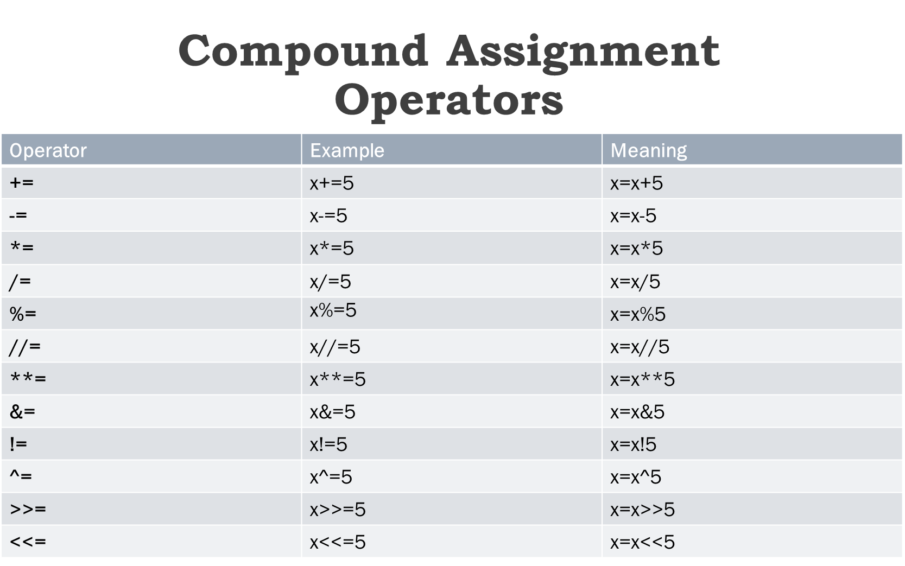

Slide 35
Guess The Output
a=10
print(++a)
Output: 10
a=10
print(a++)
Output:
SyntaxError : Invalid Syntax
Conclusion:
Python does not has any
increment operator like ++.
Rather it is solved as
+(+x) i.e +(+10) which is 10
However the expression a++
is an error as it doesn’t make
any sense

Slide 36
Guess The Output
a=10
print(--a)
Output: 10
a=10
print(a--)
Output: SyntaxError : Invalid Syntax
Conclusion:
Python does not has any
decrement operator like --.
Rather it is solved as
-(-x) i.e -(-10) which is 10
However the expression a--
is an error as it doesn’t make
any sense

Slide 37
Guess The Output
a=10
print(+++++a)
Output: 10
a=10
print(-----a)
Output: -10

Slide 38
Identity Operators
Identity operators in Python are is and is not
They serve 2 purposes:
To verify if two references point to the same memory location or not
AND
To determine whether a value is of a certain class or type

Slide 39
Behavior Of is and is not
The operator is returns True if the operands are identical , otherwise it returns False.
The operator is not returns True if the operands are not identical , otherwise it returns False.

Slide 40
Guess The Output
a=2
b=3
c=a is b
print(c)
Explanation:
Since a and b are pointing
to 2 different objects, so
the operator is returns False
a=2
b=2
c=a is b
print(c)
Explanation:
Since a and b are pointing
to same objects, so
the operator is returns True

Slide 41
Examples Of is Operator
a=2
b=type(a) is int
print(b)
Output:
True
Explanation:
type(a) is int evaluates to True because
2 is indeed an integer number.
a=2
b=type(a) is float
print(b)
Output:
False
Explanation:
type(a) is float evaluates to False
because 2 is not a float number.

Slide 42
Examples Of is not Operator
a=“Delhi”
b=“delhi”
c=a is not b
print(c)
Output:
True
Explanation:
Since a and b are pointing
to 2 differentobjects, so
the operator is not returns True
a=“Delhi”
b=“Delhi”
c=a is not b
print(c)
Output:
False
Explanation:
Since a and b are pointing
to the same object, so
the operator is not returns False

Slide 43
Membership Operators
Membership operators are used to test whether a value or variable is found in a sequence (string, list, tuple, set and dictionary).
There are 2 Membership operators
in
not in

Slide 44
Behavior Of in and not in
in: The ‘in’ operator is used to check if a value exists in a sequence or not
not in : The ‘not in’ operator is the opposite of ‘in’ operator. So, if a value does not exists in the sequence then it will return a True else it will return a False.

Slide 45
Examples Of in Operator
a=“Welcome”
b=“om”
print(b in a)
Output:
True
a=“Welcome”
b=“mom”
print(b in a)
Output:
False

Slide 46
Examples Of not in Operator
primes=[2,3,5,7,11]
x=4
print(x not in primes)
Output:
True
primes=[2,3,5,7,11]
x=5
print(x not in primes)
Output:
False

Slide 47
Precedence Of Operators
There can be more than one operator in an expression.
To evaluate these type of expressions there is a rule called precedence in all programming languages .
It guides the order in which operation are carried out.

Slide 48
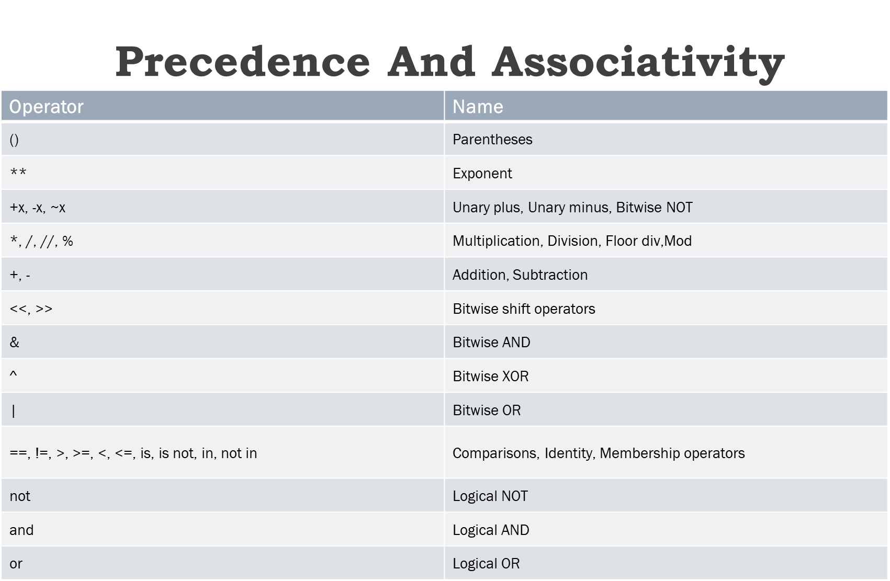

Slide 49
Guess The Output
a=25/(2+3)**2
print(a)
Output:
1.0
a=6/2+3**4
print(a)
Output:
84.0
a=20-12//3**2
print(a)
Output:
19

Slide 50
Associativity Of Operators
When two operators have the same precedence, Python follows associativity
Associativity is the order in which an expression is evaluated and almost all the operators have left-to-right associativity.
For example, multiplication and division have the same precedence. Hence, if both of them are present in an expression, left one is evaluates first.

Slide 51
Guess The Output
a=5*2//3
print(a)
Output: 3
a=5*(2//3)
print(a)
Output: 0

Slide 52
Guess The Output
Remember , ** has Right to left assoiativity
a=2**3**2
print(a)
Output: 512
a=(2**3)**2
print(a)
Output: 64

Slide 53
Exercise
WAP to accept two numbers from the user and display their sum
Code:
a=int(input("Enter first num:"))
b=int(input("Enter second num:"))
c=a+b
print("Nos are", a, "and", b)
print("Their sum is", c)

Slide 54
Exercise
WAP to accept radius of a Circle from the user and calculate area and circumference
Code:
radius=float(input("Enter radius:"))
area=3.14*radius**2
circum=2*3.14*radius
print("Area is“, area)
print("Circumference is", circum)

Slide 55
Accepting Different Values
WAP to accept roll number , grade and percentage as input from the user and display it back
Code
roll=int(input("Enter roll no:"))
name=input("Enter name:");
per=float(input("Enter per:"))
print("Roll no is", roll)
print("Name is", name)
print("Per is", per)

Slide 56
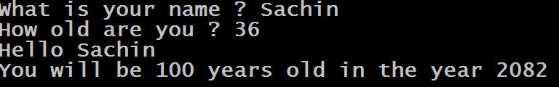
Exercise
Write a program that asks the user to enter his/her name and age. Print out a message , displaying the user’s name along with the year in which they will turn 100 years old.

Slide 57
Accepting Multiple Values In One Line
In Python , the input( ) function can read and return a complete line of input as a string.
However , we can split this input string into individual values by using the function split( ) available in the class str
The function split( ) , breaks a string into multiple strings by using space as a separator

Slide 58
Accepting Multiple Values In One Line
To understand , working of split( ) , consider the following example:
text=“I Love Python”
word1,word2,word3=text.split()
print(word1)
print(word2)
print(word3)

Slide 59
Accepting Multiple Values In One Line
text=input(“Type a 3 word message”)
word1,word2,word3=text.split()
print(“First word”,word1)
print(“Second word”,word2)
print(“Third word”,word3)

Slide 60
An Important Point!
The number of variables on left of assignment operator and number of values generated by split() must be the same

Slide 61
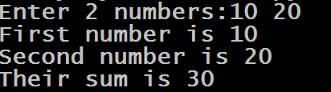
Exercise
Write a program that asks the user to input 2 integers and adds them . Accept both the numbers in a single line only

Slide 62
Solution
Code:
s=input("Enter 2 numbers:")
a,b=s.split()
print("First number is", a);
print("Second number is", b)
c=int(a)+int(b)
print("Their sum is", c)

Slide 63
Accepting Multiple Values Separated With ,
By default split( ) function considers , space as a separator
However , we can use any other symbol also as a separator if we pass that symbol as argument to split( ) function
For example , if we use comma , as a separator then we can provide comma separated input

Slide 64
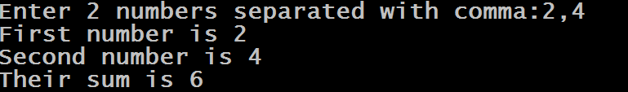
Example
Code:
s=input("Enter 2 numbers separated with comma:")
a,b=s.split(",")
print("First number is",a);
print("Second number is",b)
c=int(a)+int(b)
print("Their sum is",c)

Slide 65
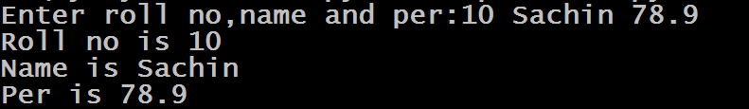
Accepting Different Values In One Line
Code:
s=input("Enter roll no,name and per:")
roll,name,per=s.split()
print("Roll no is",roll)
print("Name is",name)
print("Per is",per)

Slide 66
Thank you

